Slide 1
視覺辨識課程
謝坤達
jumbokh@gmail.com
0953313123

Slide 2
大綱
1. 視覺辨識介紹
2. 影像標示
3. 在Jetson Nano上實作深度學習物件辨識模型
4. YOLO 系統辨識

Slide 3
在雲端上實作深度學習物件辨識模型
何謂物件辨識
物件辨識演算法
訓練資料準備
實作

Slide 4
電腦視覺（Computer vision）
電腦視覺（Computer vision）是一門研究如何使機器「看」的科學，更進一步的說，就是指用攝影機和電腦代替人眼對目標進行辨識、跟蹤和測量等機器視覺，並進一步做圖像處理，用電腦處理成為更適合人眼觀察或傳送給儀器檢測的圖像

Slide 5
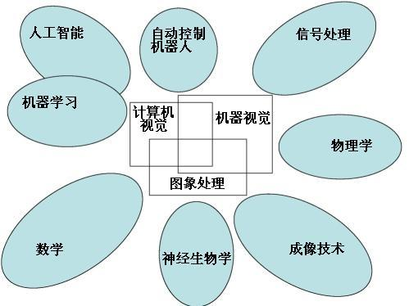
電腦視覺與其他領域的關係(維基百科)

Slide 6
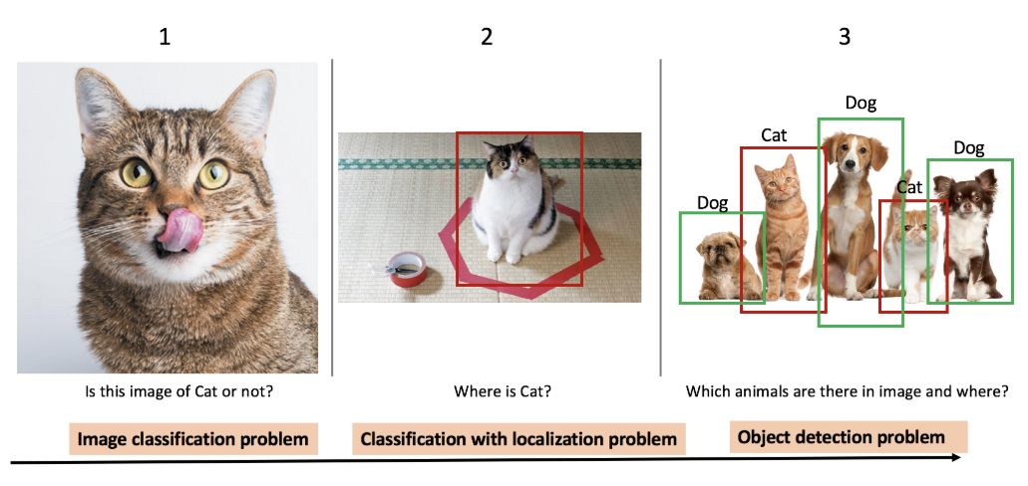
What is object detection?
Object dection compares the image classification and localizations
https://towardsdatascience.com/evolution-of-object-detection-and-localization-algorithms-e241021d8bad

Slide 7
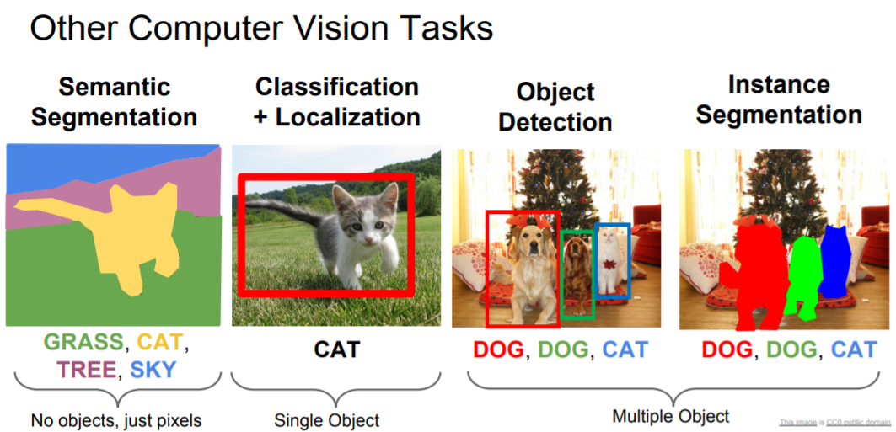
What is object dection?
http://cs231n.stanford.edu/slides/2018/cs231n_2018_lecture11.pdf

Slide 8
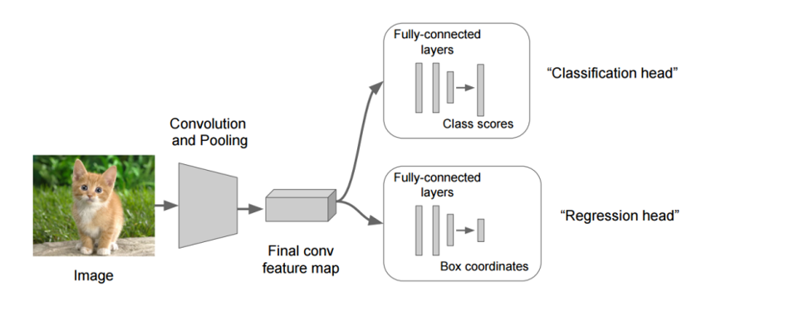
Object dection algorithms

Slide 9
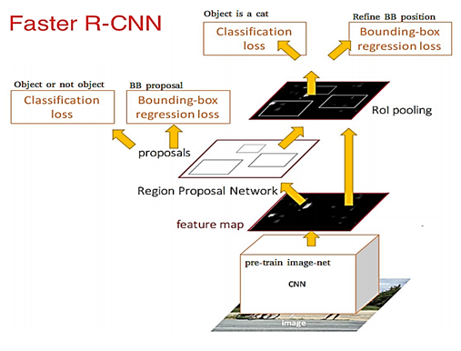
Object dection algorithms(cont.)
R-CNN(Region with CNN) (See: https://arxiv.org/abs/1311.2524)
Fast RCNN(See:https://arxiv.org/abs/1504.08083)
Faster RCNN(See: https://arxiv.org/abs/1506.01497)
R-FCN()
SSD
YOLOv1 to YOLOv3
ReinaNet
FPN

Slide 10

Object dection algorithms(cont.)
(參考: a. 關於影像辨識，所有你應該知道的深度學習模型’
b. R-CNN, Fast R-CNN, Faster R-CNN, YOLO — Object Detection Algorithms)
Deep Learning for Object Detection: A Comprehensive Review https://towardsdatascience.com/deep-learning-for-object-detection-a-comprehensive-review-73930816d8d9

Slide 11
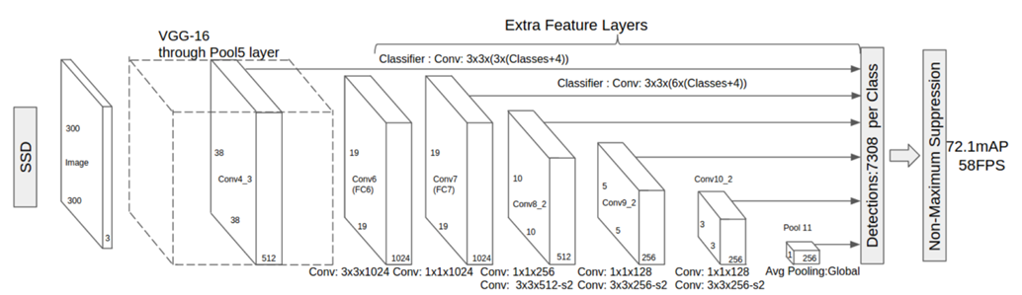
Object dection algorithms(cont.)

Slide 12
Object dection algorithms(cont.)
one stage and two stages
(深度學習-什麼是one stage，什麼是two stage 物件偵測
Optimizing the Trade-off between Single-Stage and Two-Stage Deep Object Detectors using Image Difficulty Prediction PDF)
Comparison
YOLOv3 is good as mAP and time
What’s new in YOLO v3?
https://towardsdatascience.com/deep-learning-for-object-detection-a-comprehensive-review-73930816d8d9 (https://pjreddie.com/media/files/papers/YOLOv3.pdf

Slide 13
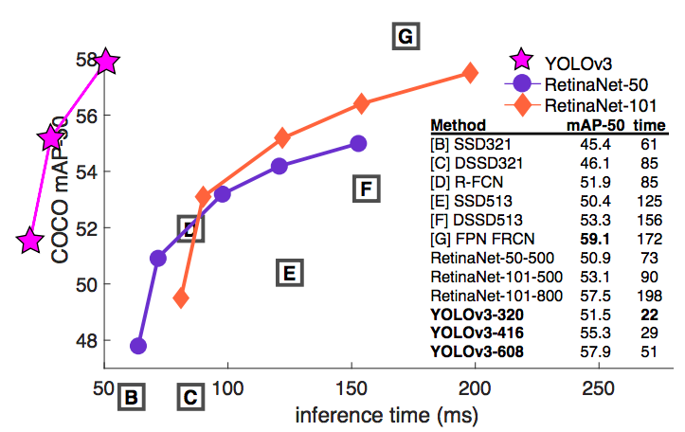
YOLO vs RetinaNet performance on COCO 50 Benchmark

Slide 14
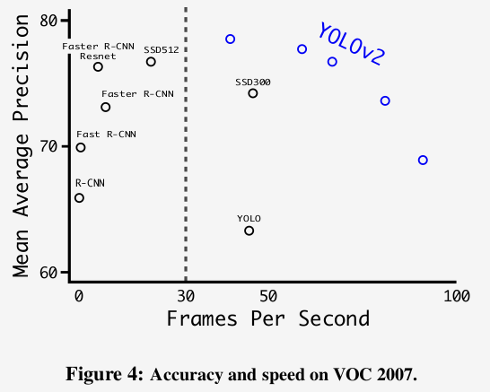
Accuracy and speed tradeoff on VOC 2007 (Source: YOLOv2 paper)
YOLO3: A Huge Improvement
https://mc.ai/yolo3-a-huge-improvement/

Slide 15
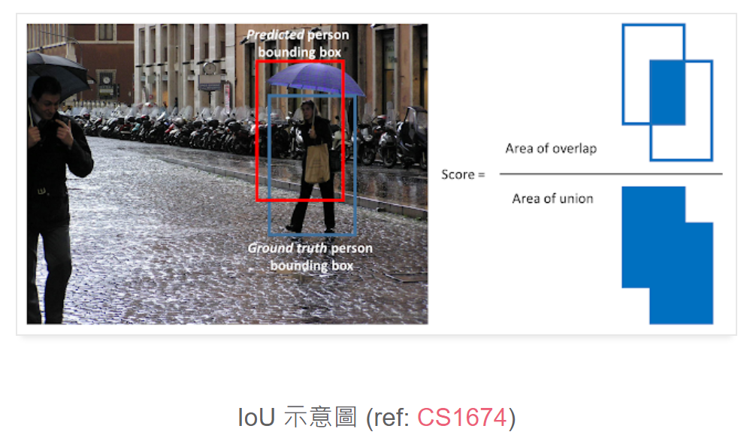
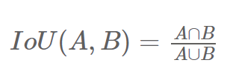
模型評估
1. IoU (Intersection over Union)
預測結果與 ground truth 的聯集分之交集 (如下式)。
一般預測任務最常用的指標是 .5 IoU， 表示在一次 bounding box 預測中，該 bounding box 算出的 IoU > 0.5 時為預測成功。

Slide 16
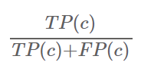
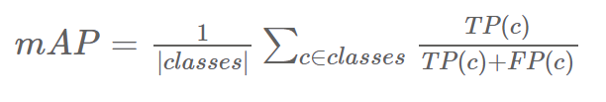
2. mAP (Mean Average Precision)
計算各個種類的精確度並平均，這裡的精確度即是使用 IoU 作為判別準則，通常為 .5 IoU。
TP(c): True Positive in class c，預測的 proposal 和 ground true 吻合 (種類正確且重疊部份夠高)。
FP(c): False Positive in class c，預測的 proposal 和 ground true 不吻合 (種類錯誤或重疊部份不夠高)。
因此由以上步驟可知在 class c 中的準確率為：
因此每個 class 平均的準確率為：

Slide 17
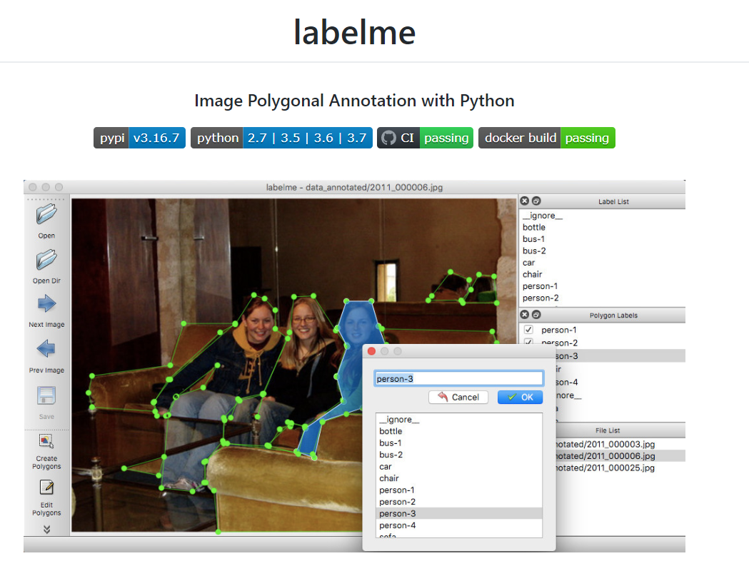
影像標示
https://github.com/wkentaro/labelme
https://tzutalin.github.io/labelImg/

Slide 18
實作程式碼
Colab example:
IMAGEAI_ObjectDetectionTrain_HoloLens
Make a copy and test!

Slide 19
系統安裝及設置

Slide 20
Virtualenv安裝及設定
sudo apt-get install virtualenv -y
mkdir envs; cd envs
virtualenv –p python3 ai
source ~/envs/ai/bin/activate
echo ' source ~/envs/ai/bin/activate ' >> ~/.bashrc

Slide 21
開啟SWAP
sudo swapon –show
理想的SWAP size應是RAM的二倍，但由於SD空間不是很充裕，先設定4G SWAP。
sudo fallocate -l 4G /swapfile
sudo chmod 600 /swapfile
ls -lh /swapfile
sudo mkswap /swapfile
sudo swapon /swapfile
sudo swapon –show

Slide 22
把SWAP加到fstab設定檔中
free –h
sudo cp /etc/fstab /etc/fstab.bak
echo '/swapfile none swap sw 0 0' | sudo tee -a /etc/fstab

Slide 23
設定OpenCV
dpkg -l | grep libopencv
sudo apt-get install python3-numpy
git clone https://github.com/jetsonhacksnano/buildopencv
cd buildopencv
./buildopencv.sh |& tee opencv_build.log
sudo ldconfig -v

Slide 24
安裝DLIB
sudo apt-get update && sudo apt-get install python3-dev
mkdir temp; cd temp
wget http://dlib.net/files/dlib-19.17.tar.bz2
tar xvf dlib-19.17.tar.bz2
cd dlib-19.17/
mkdir build
cd build
cmake ..
cmake --build . --config Release
sudo make install sudo ldconfig
cd .. && python setup.py install

Slide 25
安裝Darknet
將下列兩行加到 ~/.bashrc後方
export PATH=${PATH}:/usr/local/cuda/bin
export LD_LIBRARY_PATH=${LD_LIBRARY_PATH}:/usr/local/cuda/lib64
下載 darknet
git clone https://github.com/pjreddie/darknet
cd darknet/
nano Makefile
將Makefile中的下列參數內容更改為1
GPU=1
CUDNN=1
OPENCV=1
make

Slide 26
安裝YOLO3-4-Py
讓Jetson Nano可透過Python在GPU推論YOLO model
pip install yolo34py-gpu

Slide 27
安裝Jetson stats
針對NVIDIA Jetson系列所開發的資源監控工具
git clone https://github.com/rbonghi/jetson_stats.git
cd jetson_stats/
執行ntop，可看到CPU、GPU、memory、Disk的耗用情況、以及電量、溫度等資訊。
執行jetson_release可顯示本環境中所安裝的NVIDIA Jetson各項版本資訊。

Slide 28
YOLO: Real-Time Object Detection
https://pjreddie.com/darknet/yolo/

Slide 29
Darknet 常用指令
./darknet detector test cfg/coco.data cfg/yolov3.cfg yolov3.weights data/dog.jpg
./darknet detector demo cfg/coco.data cfg/yolov3.cfg yolov3.weights
./darknet detector demo cfg/coco.data cfg/yolov3.cfg yolov3.weights <video file>
./darknet detector train cfg/coco.data cfg/yolov3.cfg darknet53.conv.74
./darknet detector train cfg/coco.data cfg/yolov3.cfg darknet53.conv.74 -gpus 0,1,2,3
./darknet detector train cfg/coco.data cfg/yolov3.cfg backup/yolov3.backup -gpus 0,1,2,3

Slide 30
Extras
Run SSD, Faster RCNN and FCN
https://medium.com/swlh/how-to-train-an-object-detection-model-easy-for-free-f388ff3663e
(Or https://www.dlology.com/blog/how-to-train-an-object-detection-model-easy-for-free/ )

Slide 31
結論
The impact of the object detection
YOLO is agreat framework so far
Implementation is quite easy now
Labeling job is quite laborious, we are working on some tricks

Slide 32
Reference
Reference:
ImageAI (v2.1.4)
https://github.com/OlafenwaMoses/ImageAI
Train Object Detection AI with 6 lines of code (Part_I) https://medium.com/deepquestai/train-object-detection-ai-with-6-lines-of-code-6d087063f6ff
Object Detection with 10 lines of code (Part_II)
https://towardsdatascience.com/object-detection-with-10-lines-of-code-d6cb4d86f606
Evolution of Object Detection and Localization Algorithms https://towardsdatascience.com/evolution-of-object-detection-and-localization-algorithms-e241021d8bad
Object Localization and Detection https://leonardoaraujosantos.gitbooks.io/artificial-inteligence/content/object_localization_and_detection.html https://medium.com/%E8%B3%87%E6%96%99%E9%9A%A8%E7%AD%86/machine-learning-103-d81ef2ad3597

Slide 33
Reference(Cont.)
系統安裝
Jetson Nano 安裝及測試
NVIDIA® Jetson Nano 初體驗（一）安裝與測試
Yolo：基於深度學習的物件偵測 (含YoloV3)
NVIDIA Jetson Nano 如何執行深度學習範例？分類模型辨識北極熊與即時影像人臉辨識

