Slide 1
Sparse Tables
A sparse table refers to a table that is populated sparsely by data and most of its cells are empty
With a sparse table, the table can be replaced by a system of linked lists

Slide 2
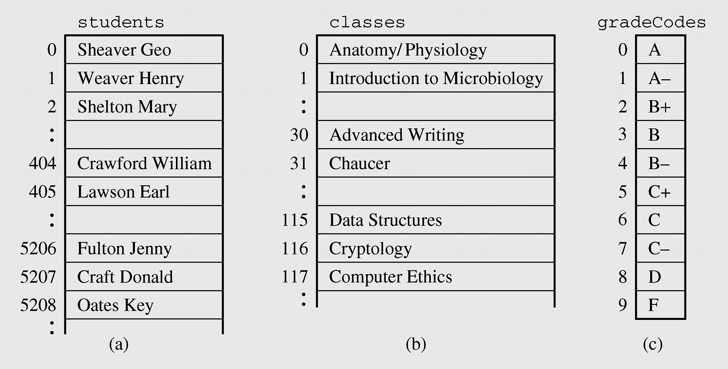
Sparse Tables (continued)
Figure 3-22 Arrays and sparse table used for storing student grades

Slide 3
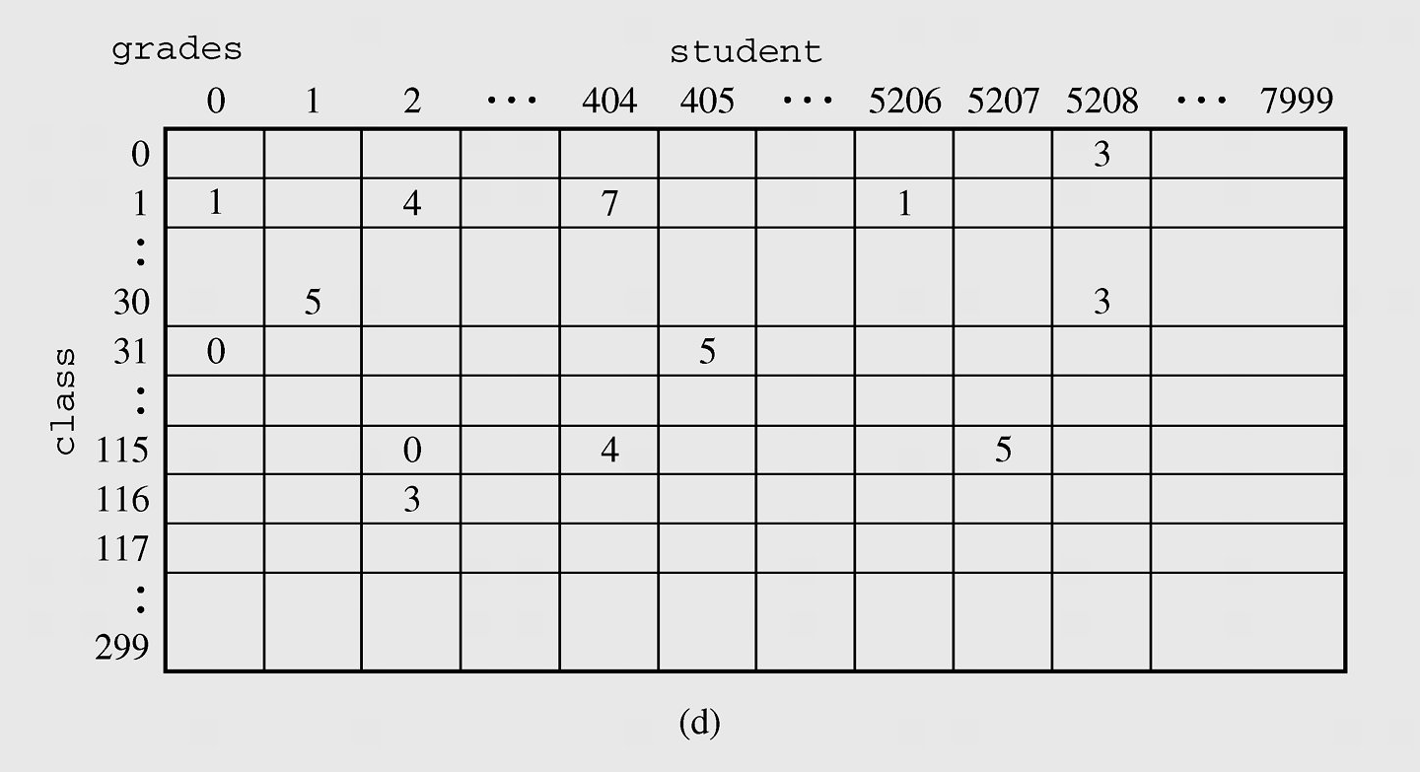
Sparse Tables (continued)
Figure 3-22 Arrays and sparse table used for storing student grades
(continued)

Slide 4
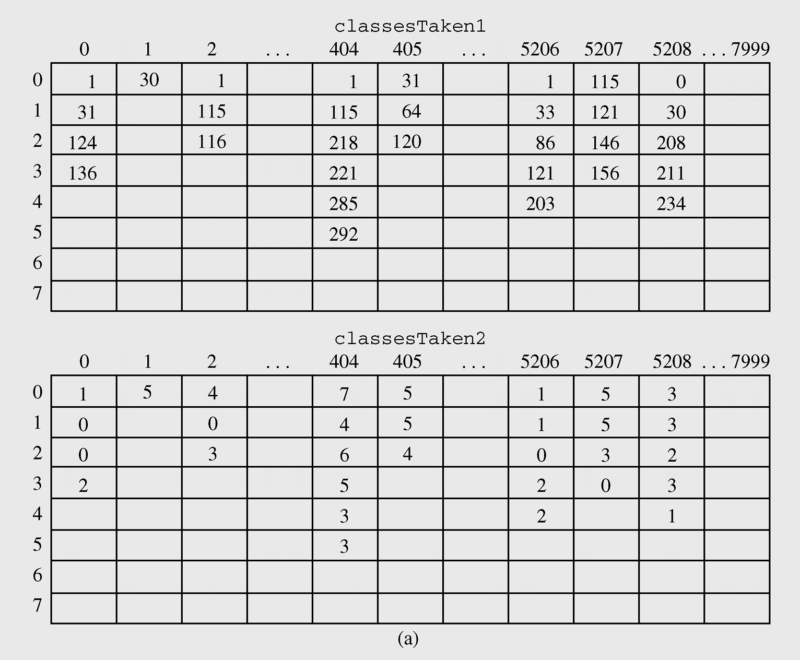
Sparse Tables (continued)
Figure 3-23 Two-dimensional arrays for storing student grades

Slide 5
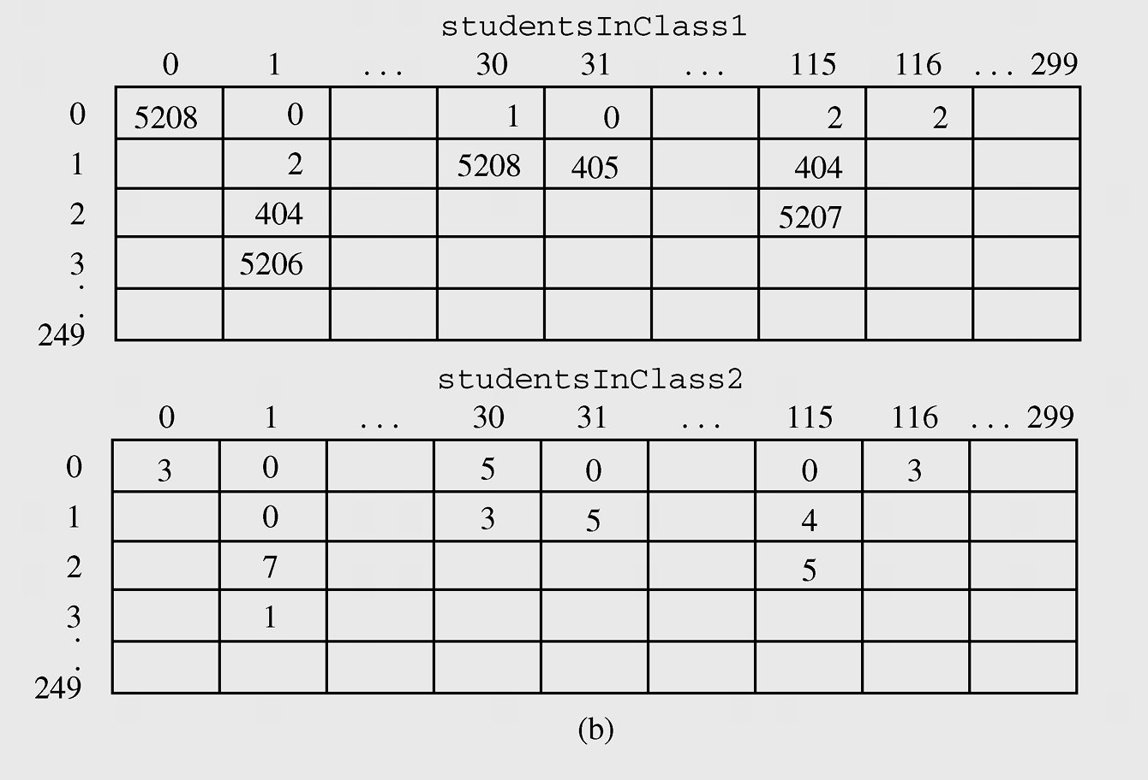
Sparse Tables (continued)
Figure 3-23 Two-dimensional arrays for storing student grades
(continued)

Slide 6
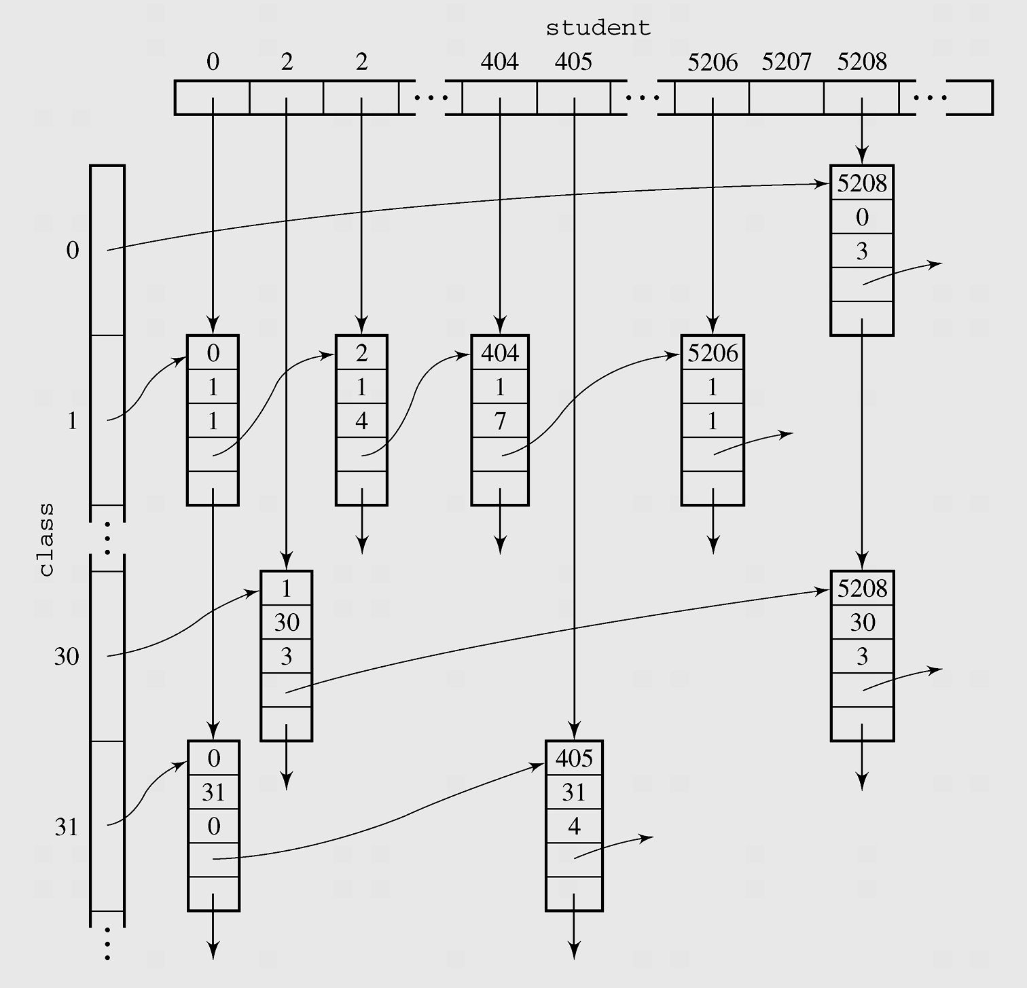
Lists in java.util
Figure 3-24 Student grades implemented using linked lists

Slide 7
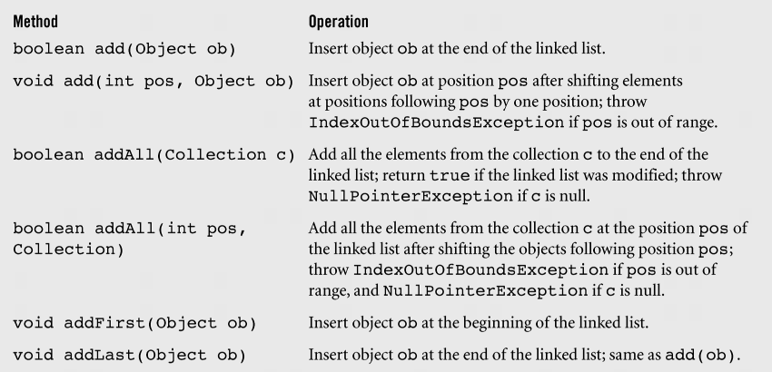
Lists in java.util (continued)
Figure 3-25 An alphabetical list of methods in the class LinkedList
including some inherited methods

Slide 8
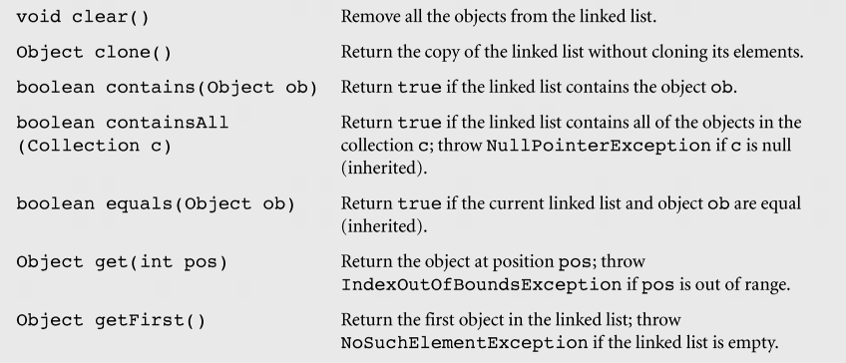
Lists in java.util (continued)
Figure 3-25 An alphabetical list of methods in the class LinkedList
including some inherited methods (continued)

Slide 9
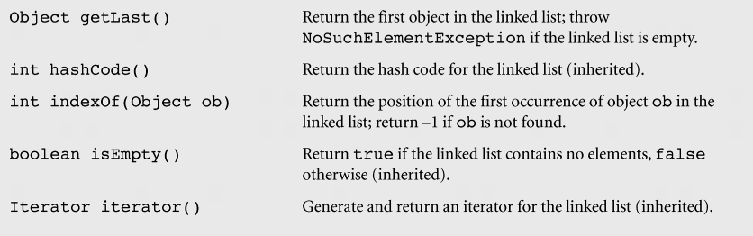
Lists in java.util (continued)
Figure 3-25 An alphabetical list of methods in the class LinkedList
including some inherited methods (continued)

Slide 10
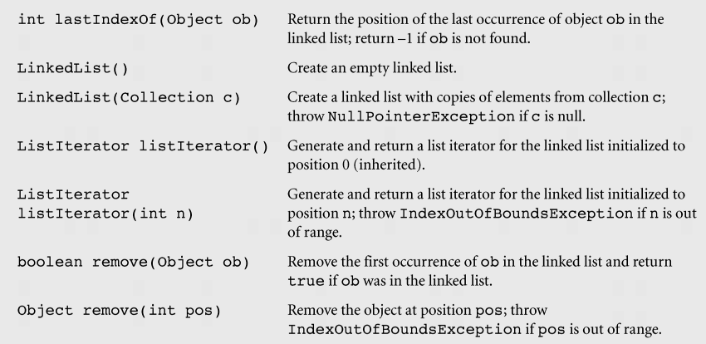
Lists in java.util (continued)
Figure 3-25 An alphabetical list of methods in the class LinkedList
including some inherited methods (continued)

Slide 11
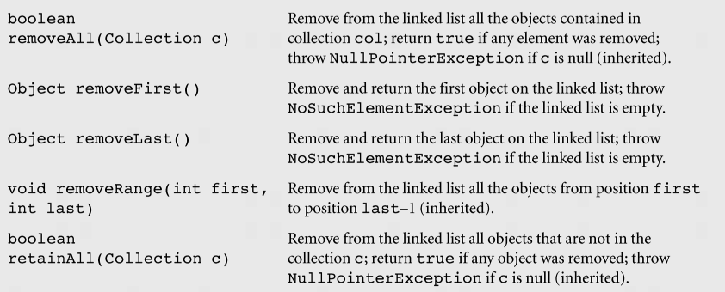
Lists in java.util (continued)
Figure 3-25 An alphabetical list of methods in the class LinkedList
including some inherited methods (continued)

Slide 12
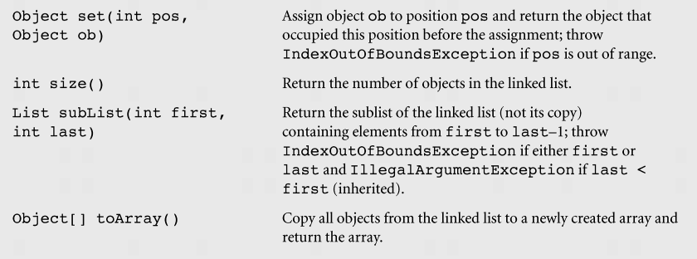
Lists in java.util (continued)
Figure 3-25 An alphabetical list of methods in the class LinkedList
including some inherited methods (continued)

Slide 13
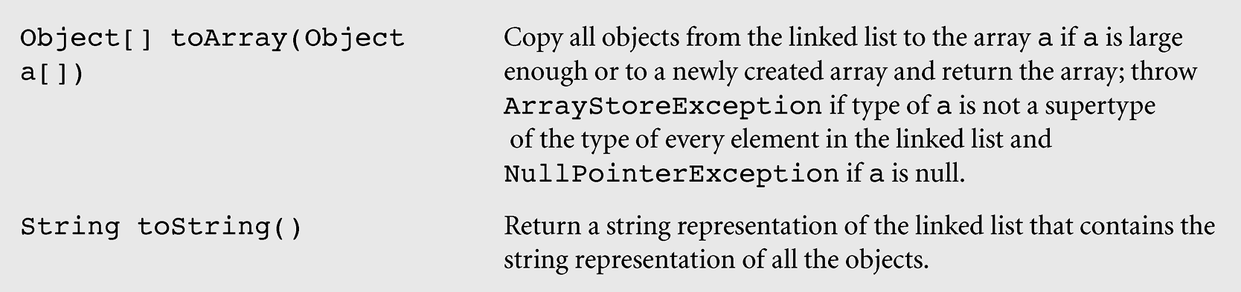
Lists in java.util (continued)
Figure 3-25 An alphabetical list of methods in the class LinkedList
including some inherited methods (continued)

Slide 14
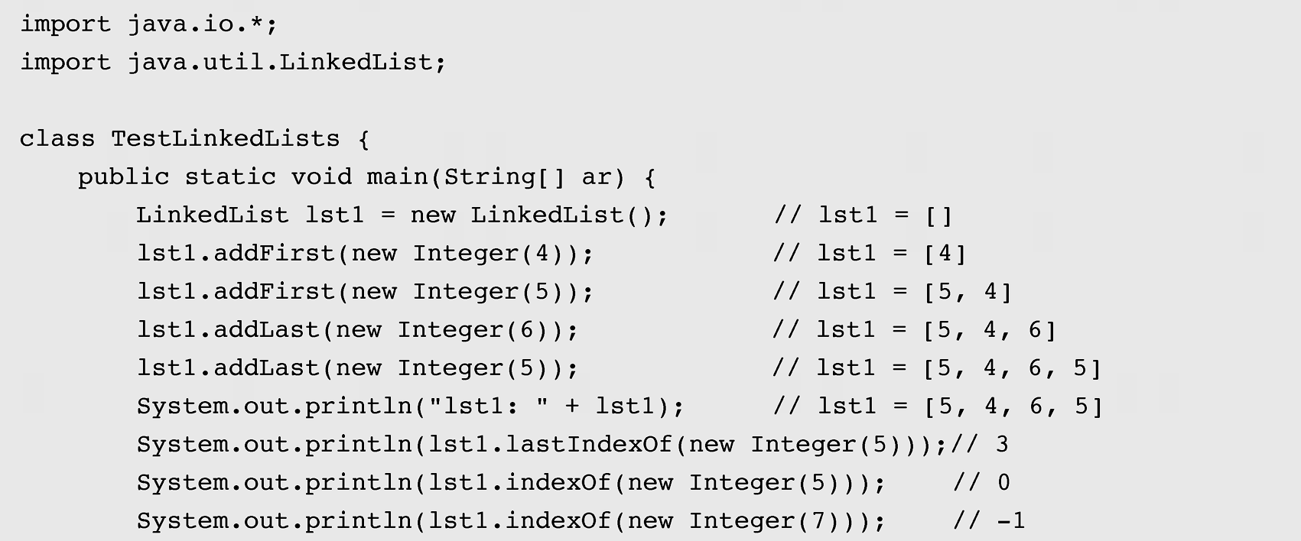
Lists in java.util (continued)
Figure 3-26 A program demonstrating the operation of
LinkedList methods

Slide 15
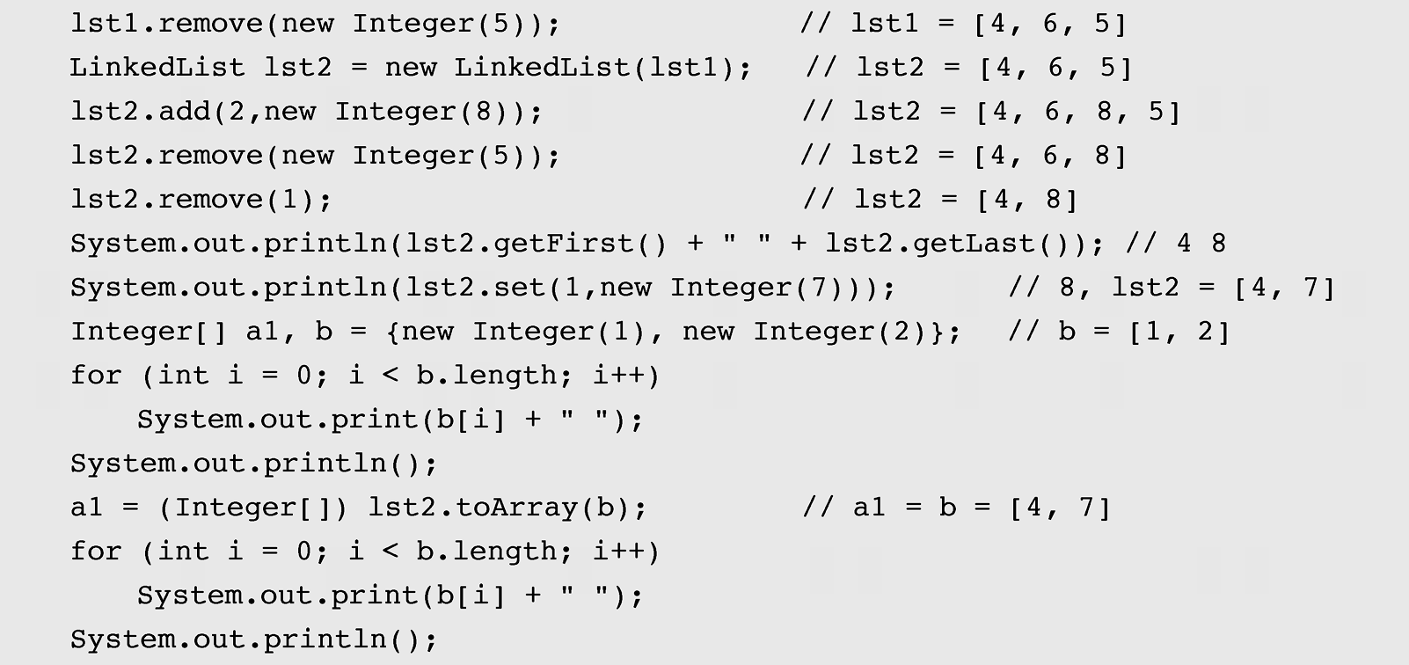
Lists in java.util (continued)
Figure 3-26 A program demonstrating the operation of
LinkedList methods (continued)

Slide 16
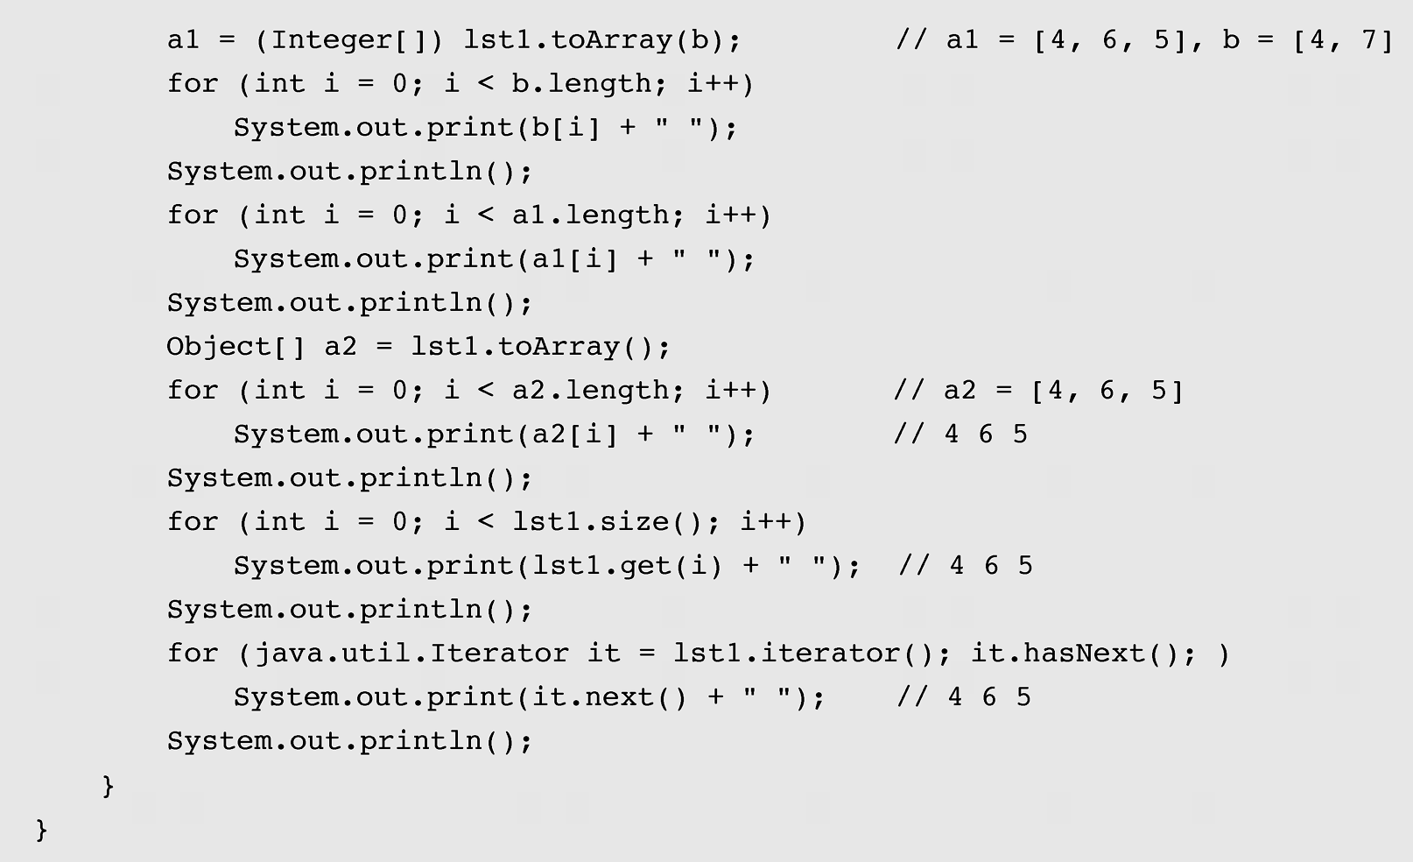
Lists in java.util (continued)
Figure 3-26 A program demonstrating the operation of
LinkedList methods (continued)

Slide 17
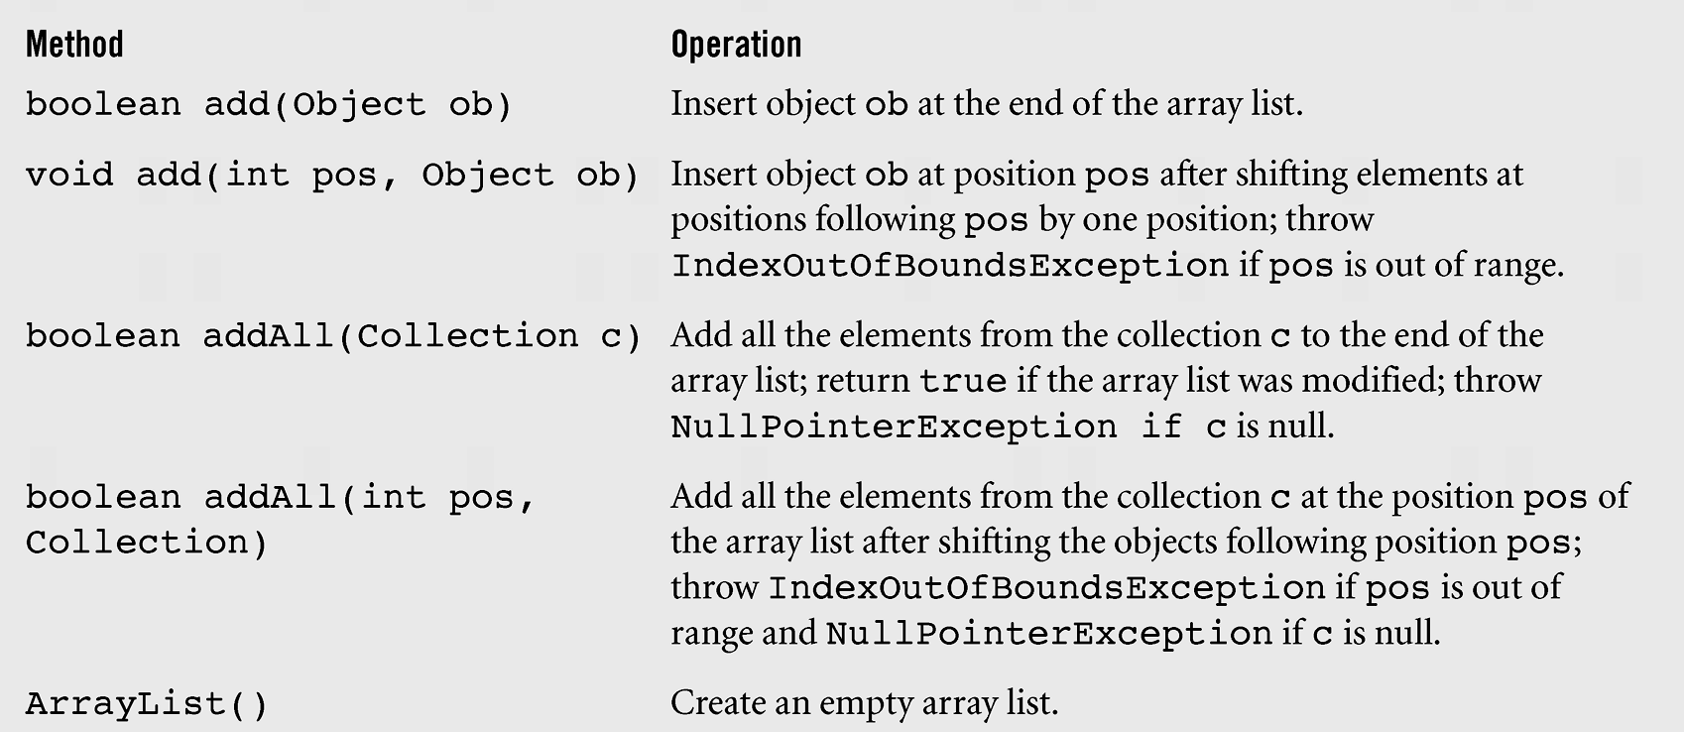
Lists in java.util (continued)
Figure 3-27 An alphabetical list of methods in the class ArrayList

Slide 18
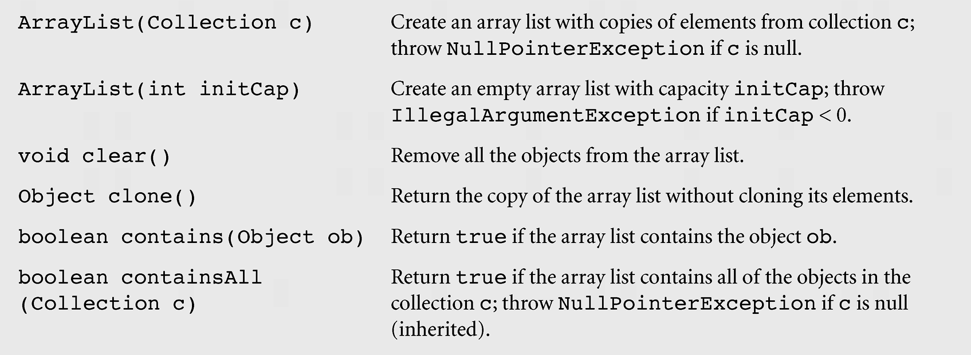
Lists in java.util (continued)
Figure 3-27 An alphabetical list of methods in the class ArrayList
(continued)

Slide 19
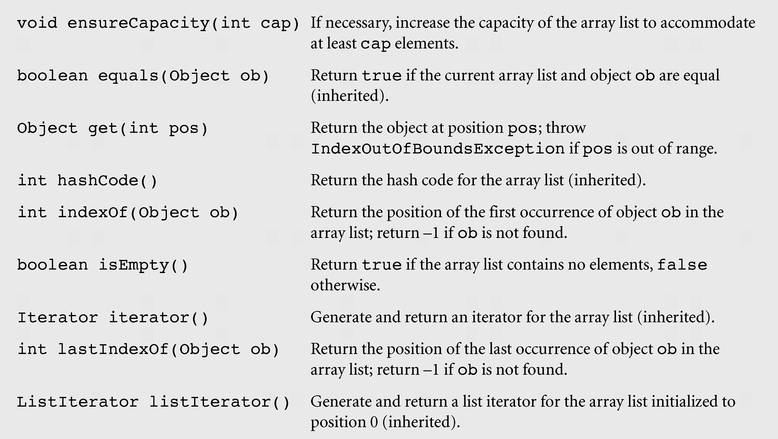
Lists in java.util (continued)
Figure 3-27 An alphabetical list of methods in the class ArrayList
(continued)

Slide 20
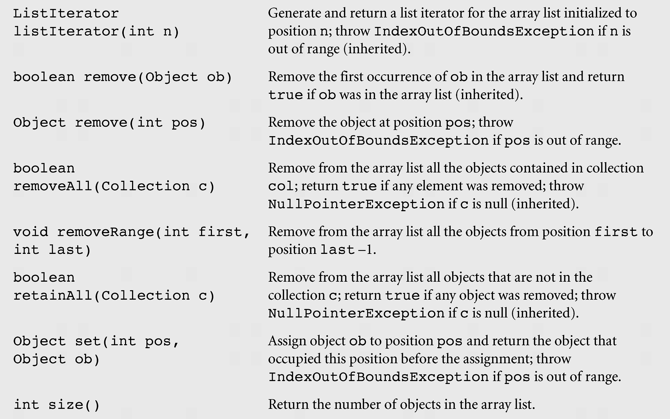
Lists in java.util (continued)
Figure 3-27 An alphabetical list of methods in the class ArrayList
(continued)

Slide 21
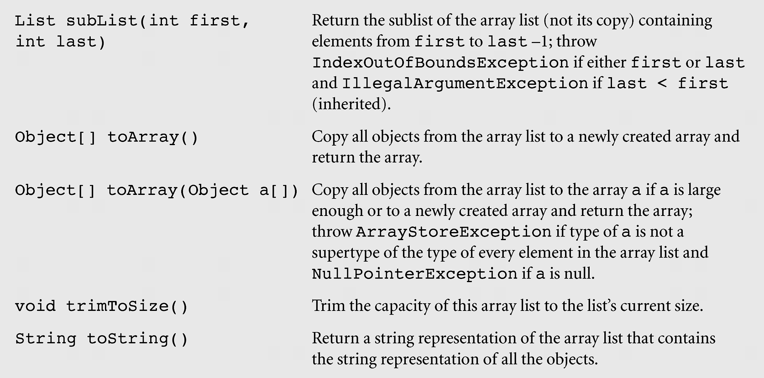
Lists in java.util (continued)
Figure 3-27 An alphabetical list of methods in the class ArrayList
(continued)

Slide 22
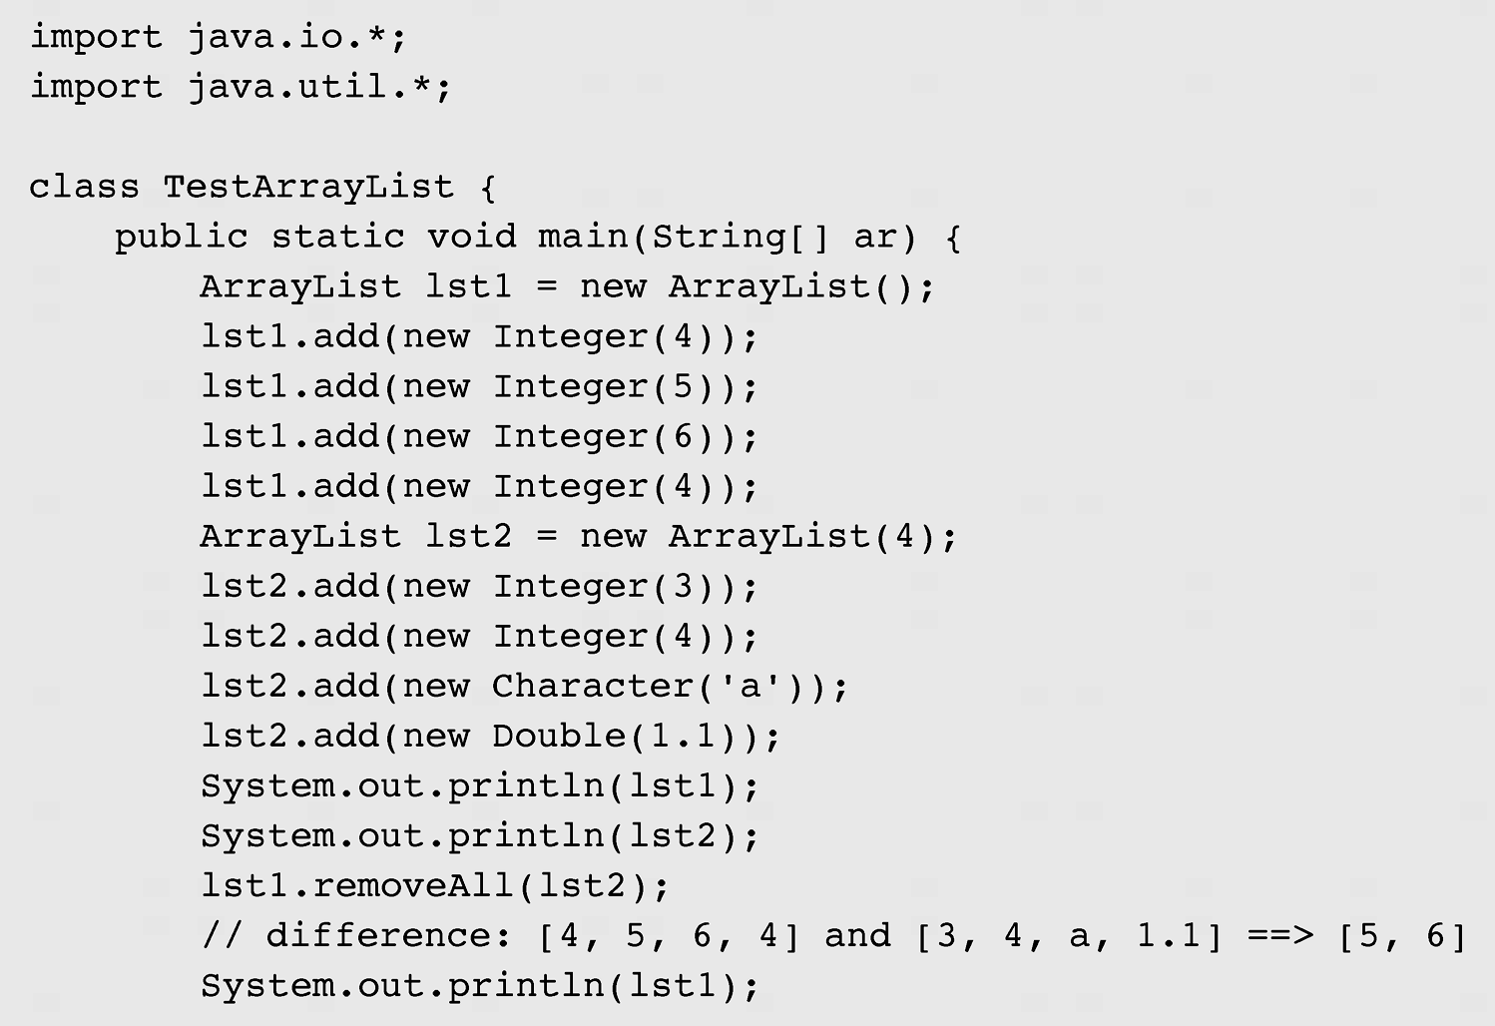
Lists in java.util (continued)
Figure 3-28 A program demonstrating the operation of ArrayList methods

Slide 23
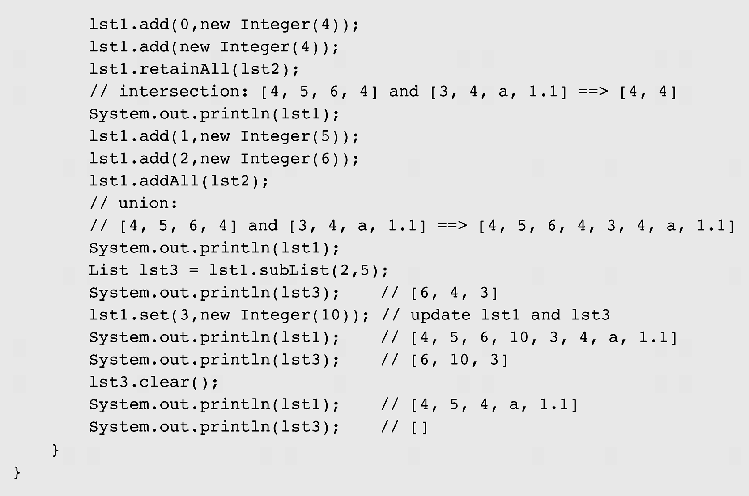
Lists in java.util (continued)
Figure 3-28 A program demonstrating the operation of ArrayList methods
(continued)

Slide 24
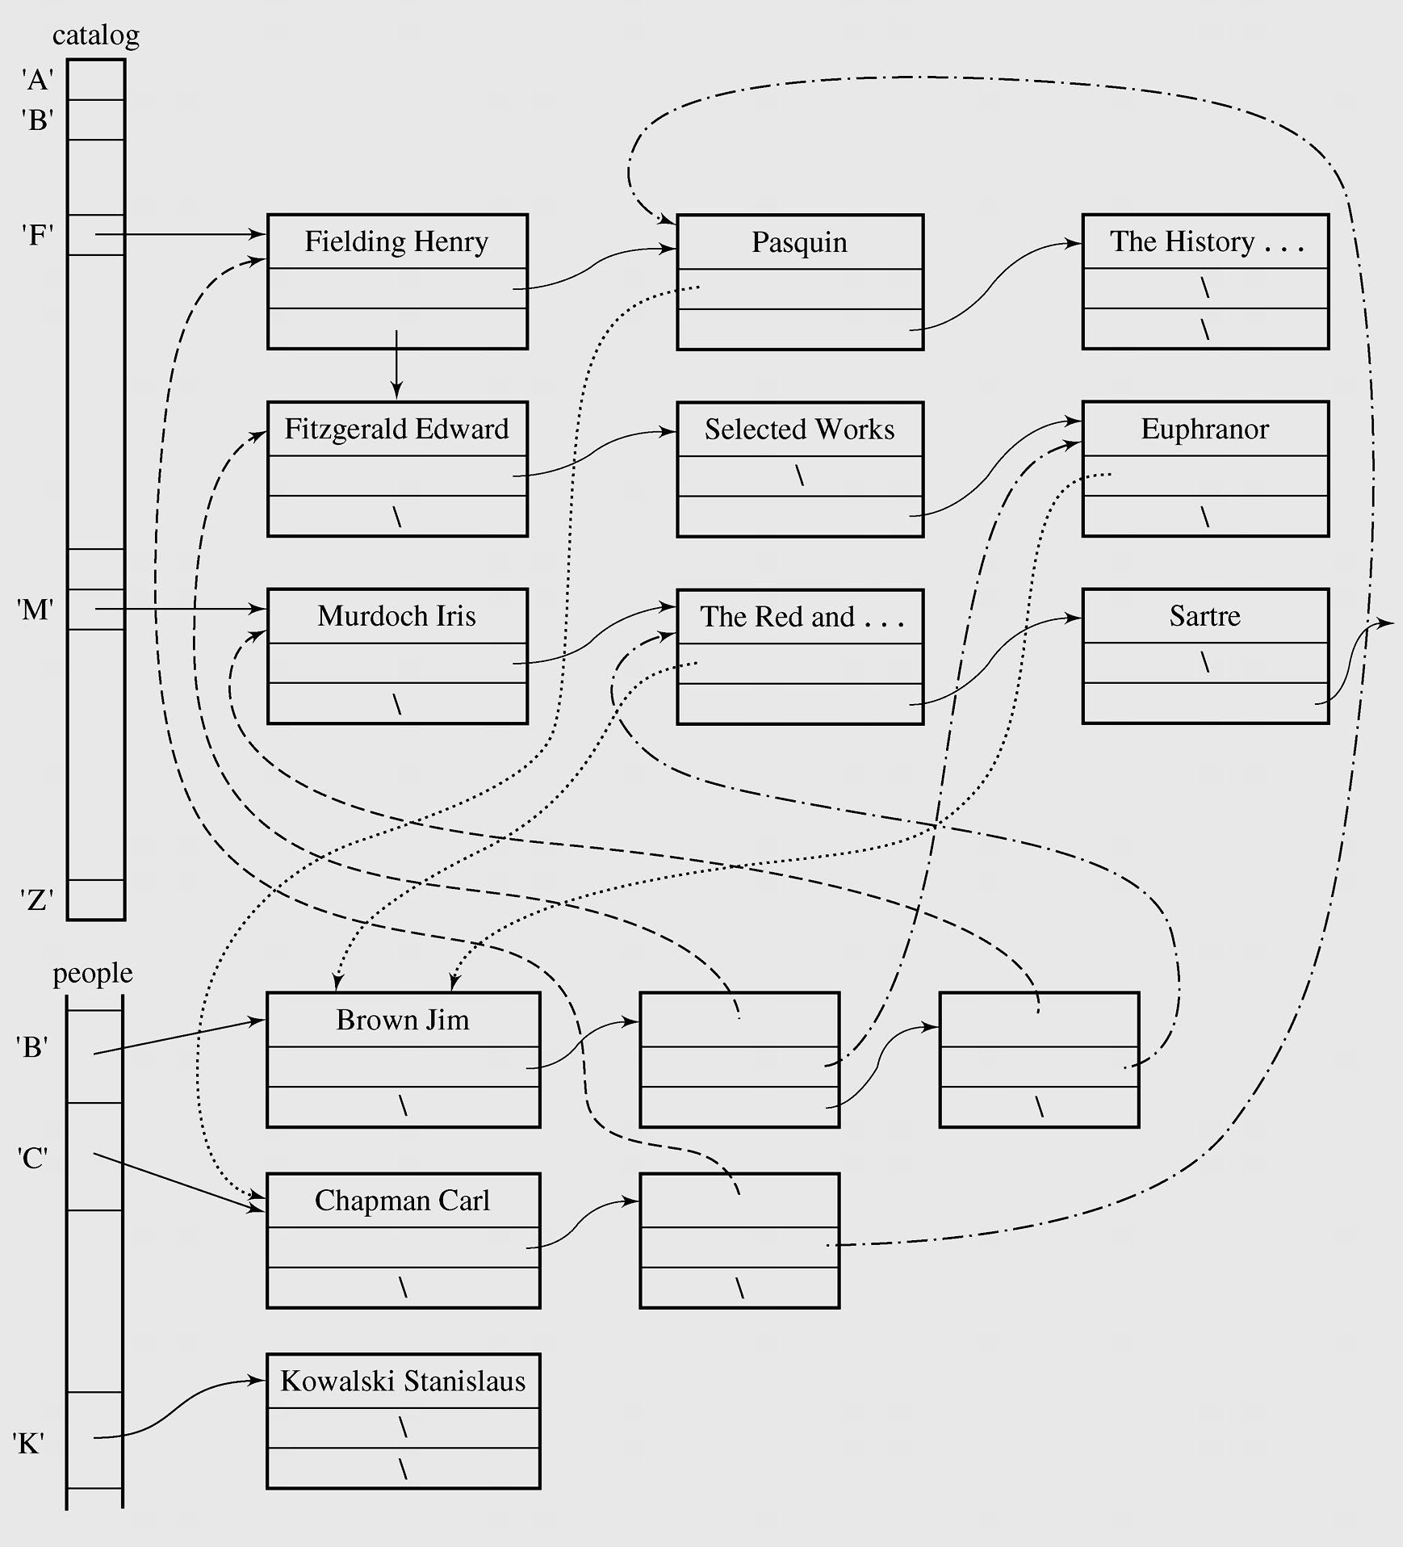
Case Study: A Library
Figure 3-29 Linked lists indicating library status

Slide 25
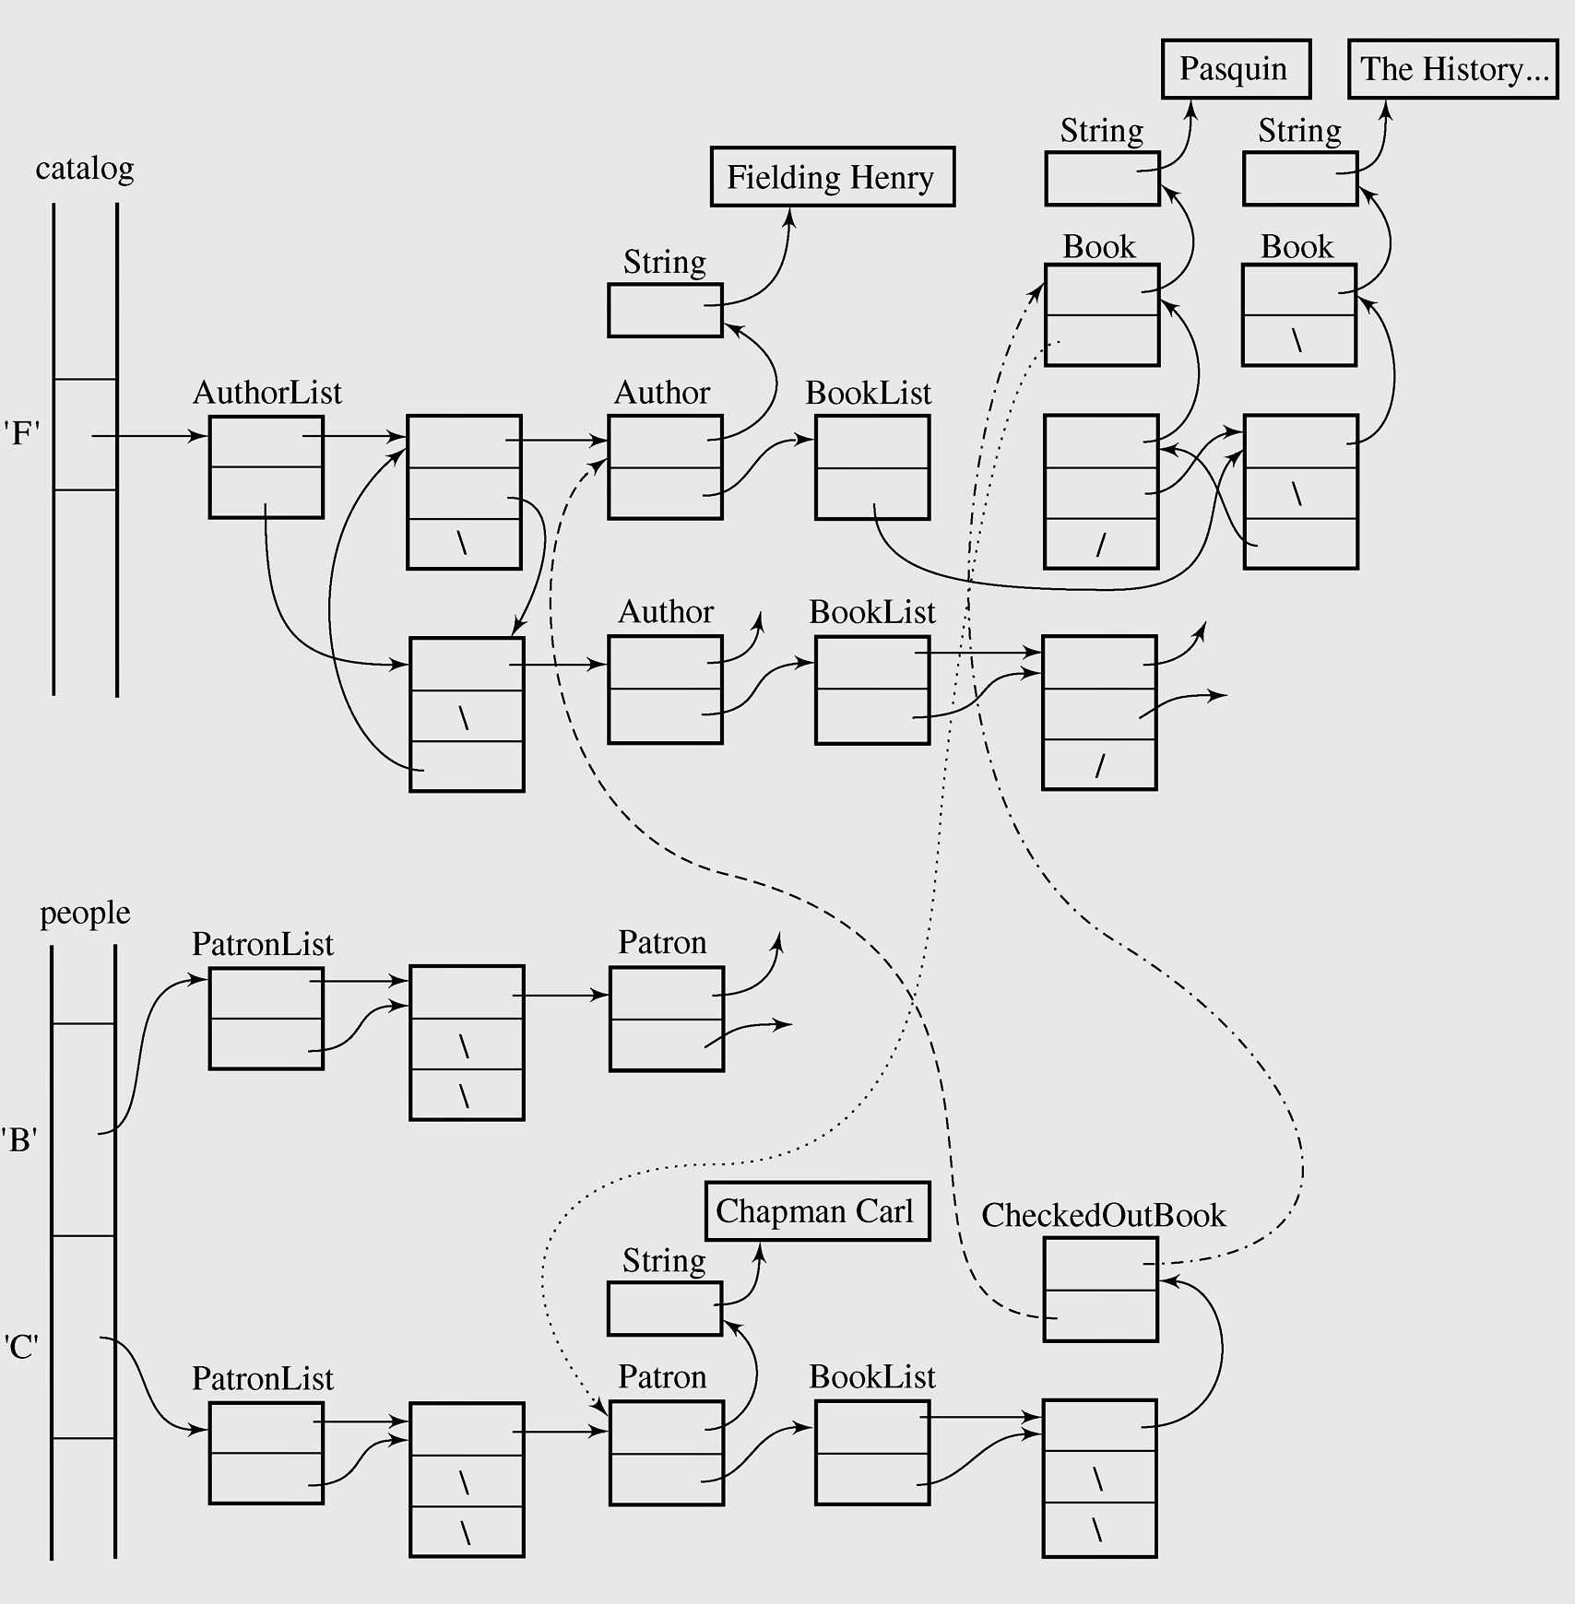
Case Study: A Library (continued)
Figure 3-30 Fragment of structure from Figure 3-29 with all the
objects used in the implementation

Slide 26
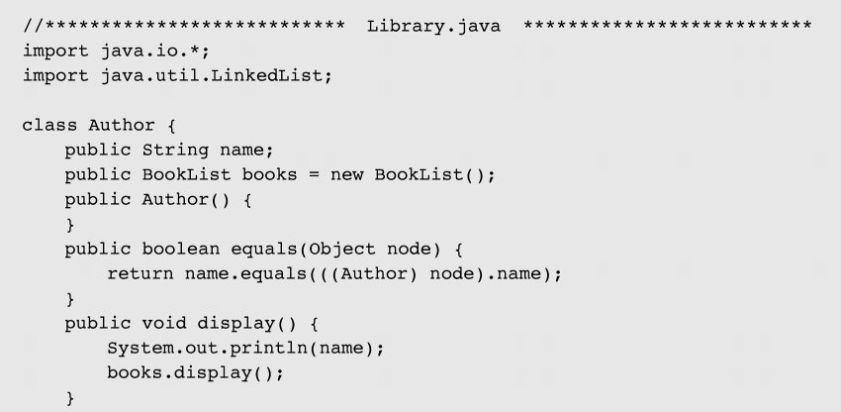
Case Study: A Library (continued)
Figure 3-31 The library program (continued)

Slide 27
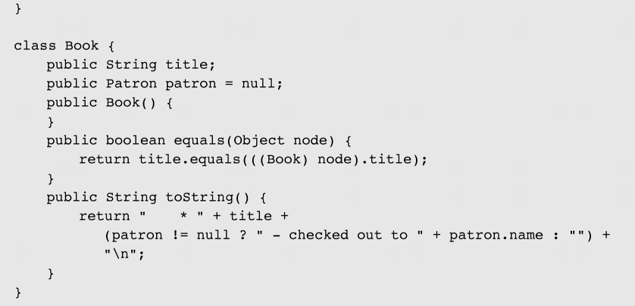
Case Study: A Library (continued)
Figure 3-31 The library program (continued)

Slide 28
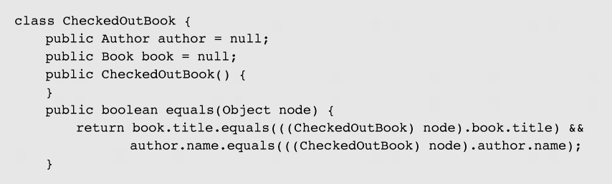
Case Study: A Library (continued)
Figure 3-31 The library program (continued)

Slide 29
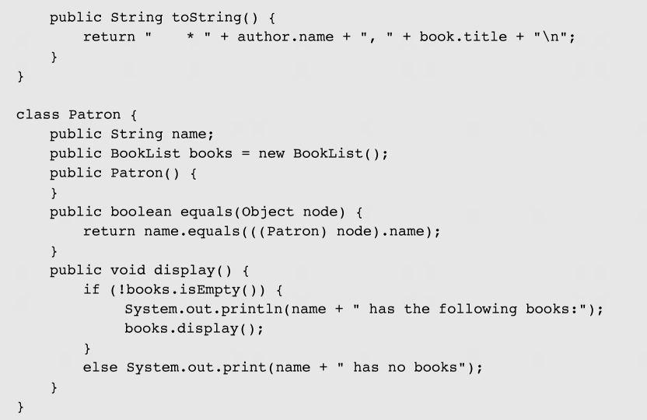
Case Study: A Library (continued)
Figure 3-31 The library program (continued)

Slide 30
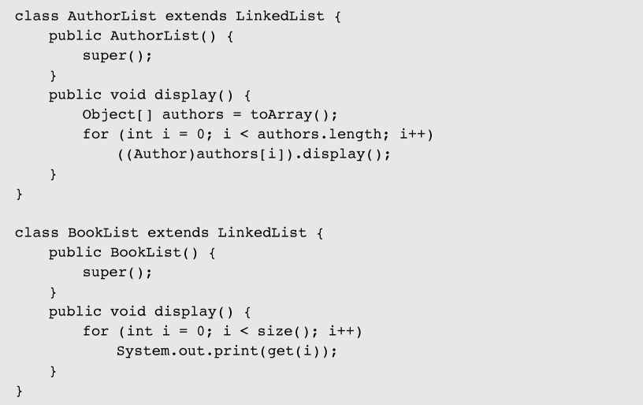
Case Study: A Library (continued)
Figure 3-31 The library program (continued)

Slide 31
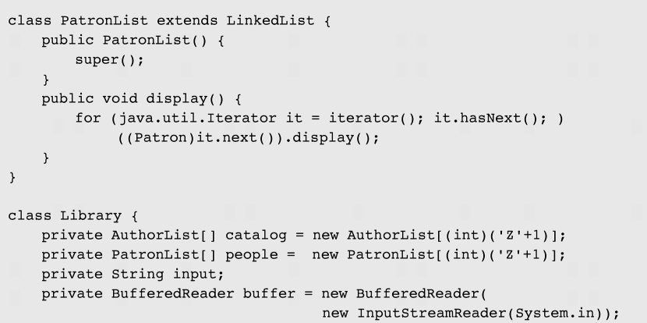
Case Study: A Library (continued)
Figure 3-31 The library program (continued)

Slide 32
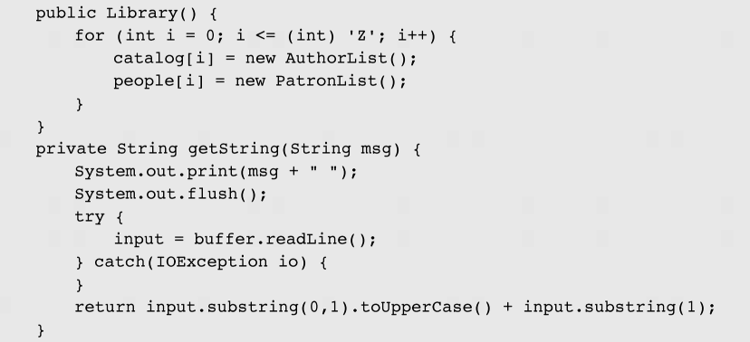
Case Study: A Library (continued)
Figure 3-31 The library program (continued)

Slide 33
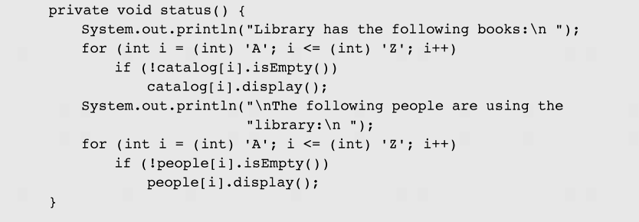
Case Study: A Library (continued)
Figure 3-31 The library program (continued)

Slide 34
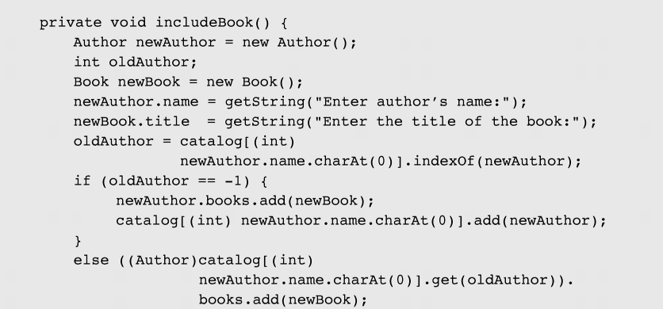
Case Study: A Library (continued)
Figure 3-31 The library program (continued)

Slide 35
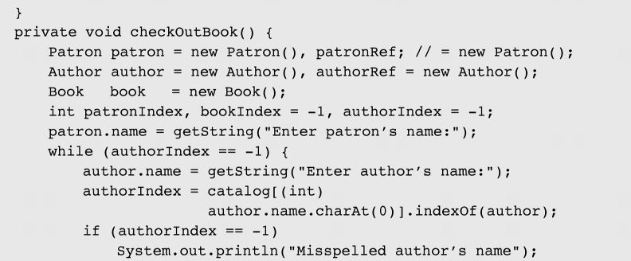
Case Study: A Library (continued)
Figure 3-31 The library program (continued)

Slide 36
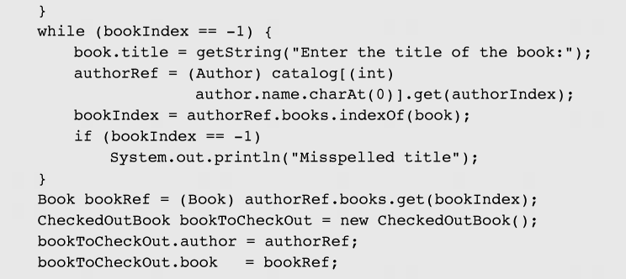
Case Study: A Library (continued)
Figure 3-31 The library program (continued)

Slide 37
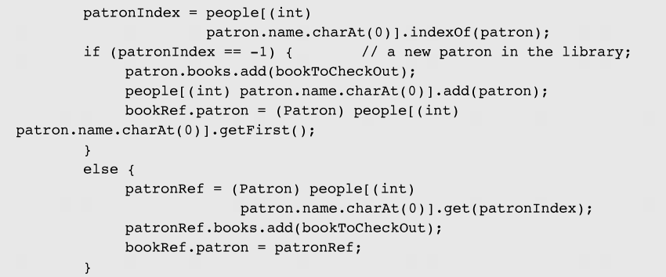
Case Study: A Library (continued)
Figure 3-31 The library program (continued)

Slide 38
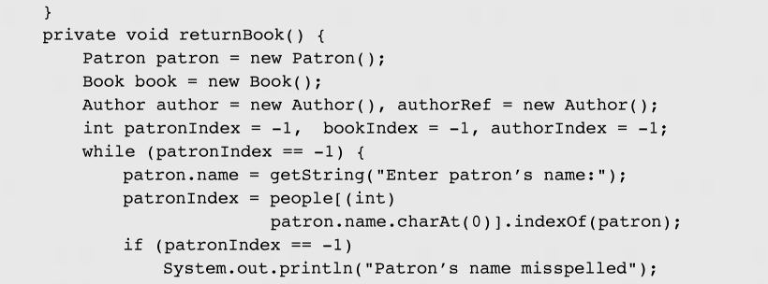
Case Study: A Library (continued)
Figure 3-31 The library program (continued)

Slide 39
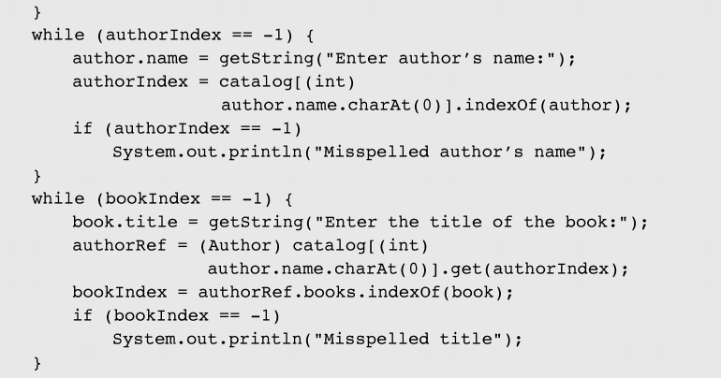
Case Study: A Library (continued)
Figure 3-31 The library program (continued)

Slide 40
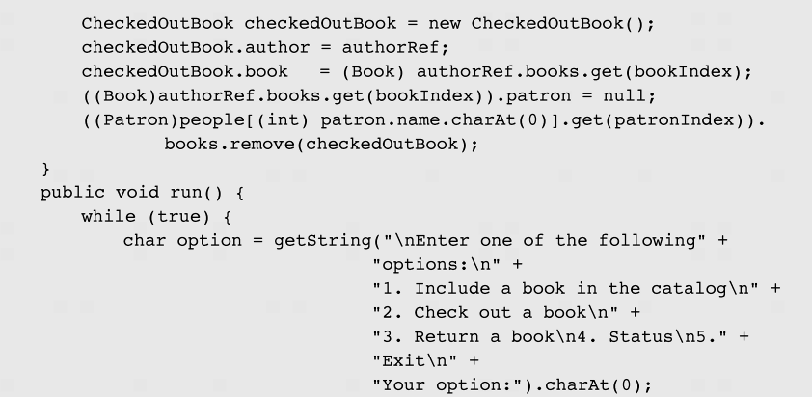
Case Study: A Library (continued)
Figure 3-31 The library program (continued)

Slide 41
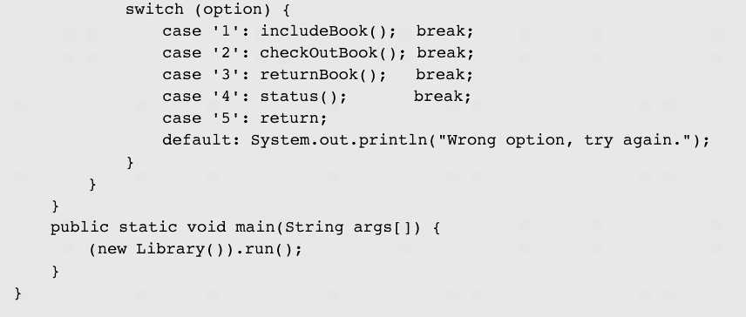
Case Study: A Library (continued)
Figure 3-31 The library program (continued)

Slide 42
Summary
A linked structure is a collection of nodes storing data and links to other nodes.
A linked list is a data structure composed of nodes, each node holding some information and a reference to another node in the list.
A singly linked list is a node that has a link only to its successor in this sequence.
A circular list is when nodes form a ring: The list is finite and each node has a successor.

Slide 43
Summary (continued)
A skip list is a variant of the ordered linked list that makes a nonsequential search possible.
There are four methods for organizing lists: move-to-front method, transpose method, count method, and ordering method.
Optimal static ordering - all the data are already ordered by the frequency of their occurrence in the body of data so that the list is used only for searching, not for inserting new items.

Slide 44
Summary (continued)
A sparse table refers to a table that is populated sparsely by data and most of its cells are empty.
Linked lists allow easy insertion and deletion of information because such operations have a local impact on the list.
The advantage of arrays over linked lists is that they allow random accessing.

