Slide 1
Chapter 4
Stacks and Queues

Slide 2
How to check delimiters matching in a program?
How to add very large numbers?
How to undo, redo in Word application?
How to implement method calling in a program?
The problem of a trapped mouse that tries to find its way to an exit in a maze.

Slide 3
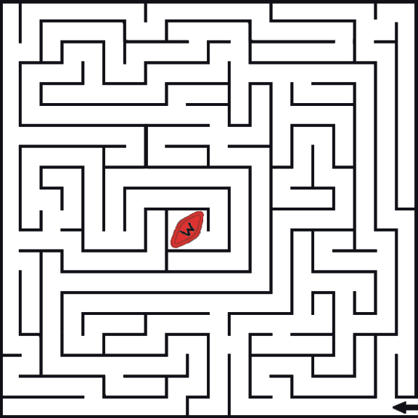

Slide 4
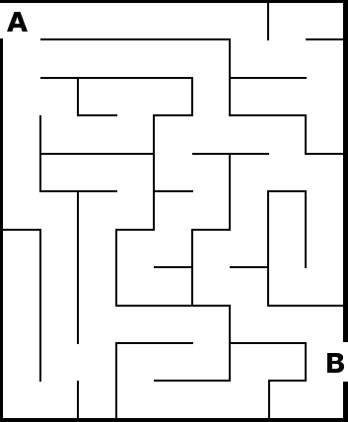

Slide 5
Objectives
Discuss the following topics:
Stacks
Queues
Priority Queues
Case Study: Exiting a Maze

Slide 6
Stacks
A stack is a linear data structure that can be accessed only at one of its ends for storing and retrieving data
A stack is called an LIFO structure: last in/first out

Slide 7
Stacks (continued)
The following operations are needed to properly manage a stack:
  clear() — Clear the stack
  isEmpty() — Check to see if the stack is empty
  push(el) — Put the element el on the top of the stack
  pop() — Take the topmost element from the stack
  topEl() — Return the topmost element in the stack without removing it

Slide 8

Stacks (continued)
Figure 4-1 A series of operations executed on a stack

Slide 9
Stacks (continued)
a = b + (c – d ) * (e – f);
g[10] = h[i[9]] + (j + k) * l;
while (m < (n[8] + o)) { p = 7; /* initialize p */ r = 6; }
These examples are statements in which mismatching occurs:
a = b + (c – d) * (e – f));
g[10] = h[i[9]] + j + k) * l;
while (m < (n[8] + o]) { p = 7; /* initialize p */ r = 6; }
while (m < (n[8] + o))

Slide 10
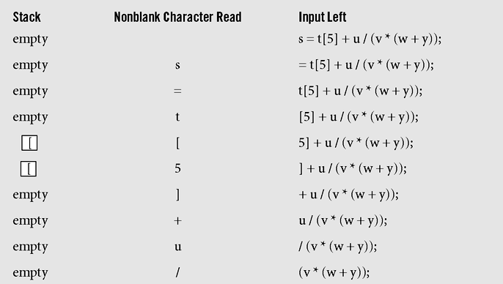
Stacks (continued)
Figure 4-2 Processing the statement s=t[5]+u/(v*(w+y)); with
the algorithm delimiterMatching()

Slide 11
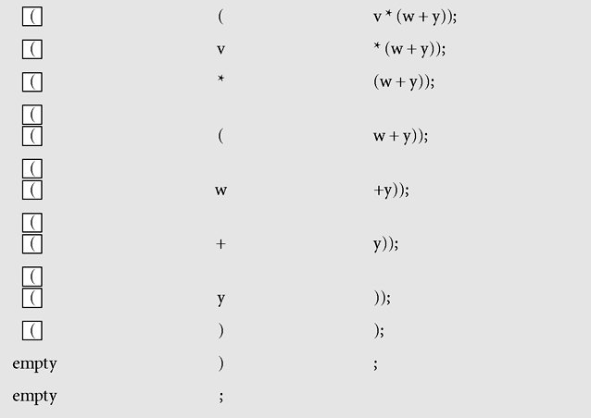
Stacks (continued)
Figure 4-2 Processing the statement s=t[5]+u/(v*(w+y)); with
the algorithm delimiterMatching() (continued)

Slide 12
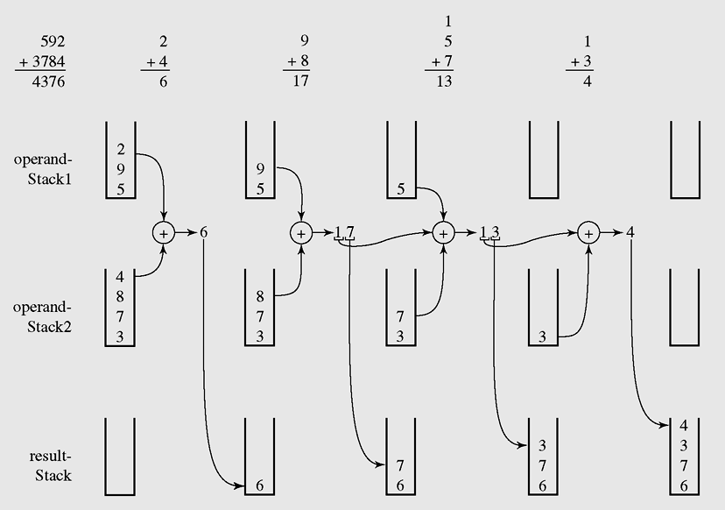
Stacks (continued)
Figure 4-3 An example of adding numbers 592 and 3,784 using stacks

Slide 13
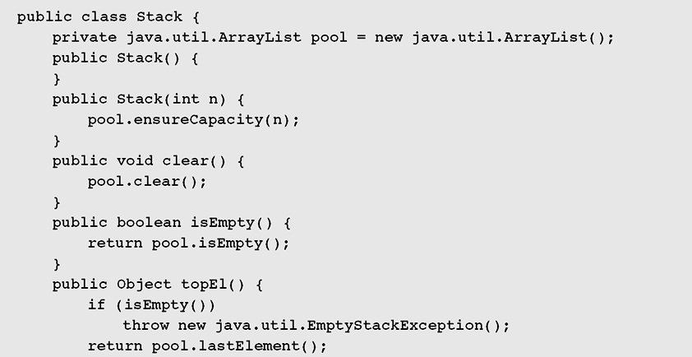
Stacks (continued)
Figure 4-4 Array list implementation of a stack

Slide 14
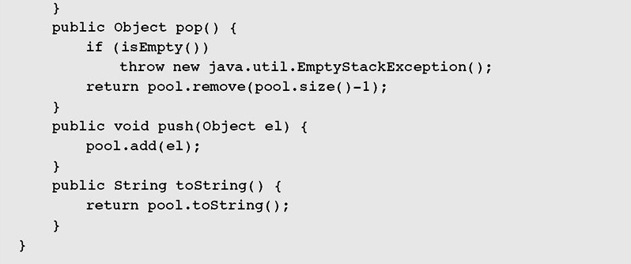
Stacks (continued)
Figure 4-4 Array list implementation of a stack (continued)

Slide 15
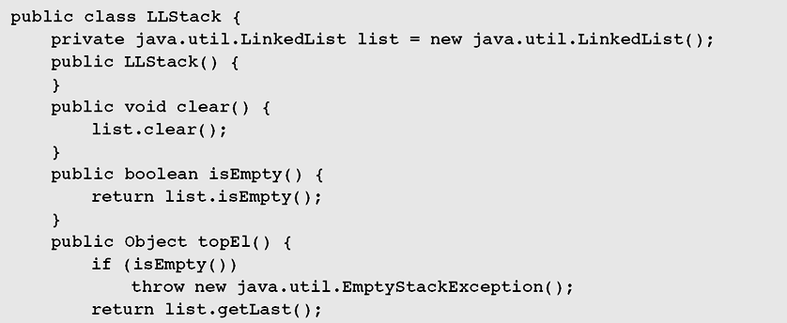
Stacks (continued)
Figure 4-5 Implementing a stack as a linked list

Slide 16
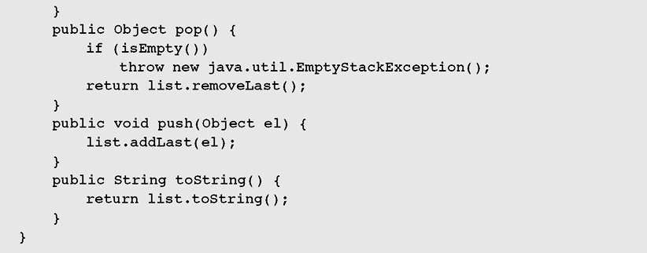
Stacks (continued)
Figure 4-5 Implementing a stack as a linked list (continued)

Slide 17
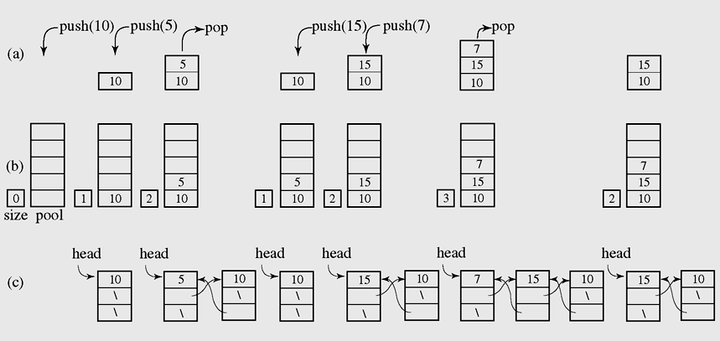
Stacks (continued)
Figure 4-6 A series of operations executed on an abstract stack (a) and the
stack implemented with an array (b) and with a linked list (c)

Slide 18

Stacks in java.util
Figure 4-7 A list of methods in java.util.Stack; all methods from
Vector are inherited

Slide 19
Queues
A queue is a waiting line that grows by adding elements to its end and shrinks by taking elements from its front
A queue is a structure in which both ends are used:
  One for adding new elements
  One for removing them
A queue is an FIFO structure: first in/first out

Slide 20
Queues (continued)
The following operations are needed to properly manage a queue:
  clear() — Clear the queue
  isEmpty() — Check to see if the queue is empty
  enqueue(el) — Put the element el at the end of the queue
  dequeue() — Take the first element from the queue
  firstEl() — Return the first element in the queue without removing it

Slide 21
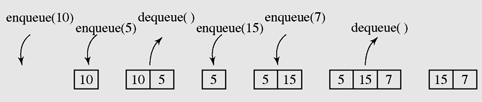
Queues (continued)
Figure 4-8 A series of operations executed on a queue

Slide 22

Queues (continued)
Figure 4-9 Two possible configurations in an array implementation
of a queue when the queue is full

Slide 23
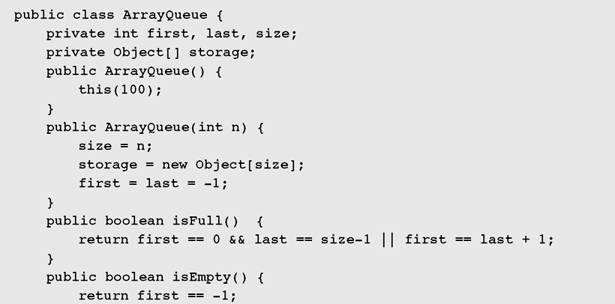
Queues (continued)
Figure 4-10 Array implementation of a queue

Slide 24
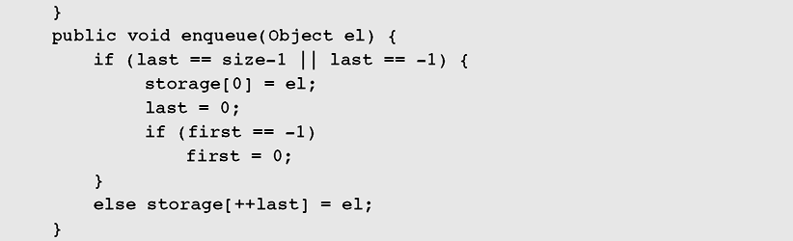
Queues (continued)
Figure 4-10 Array implementation of a queue (continued)

Slide 25
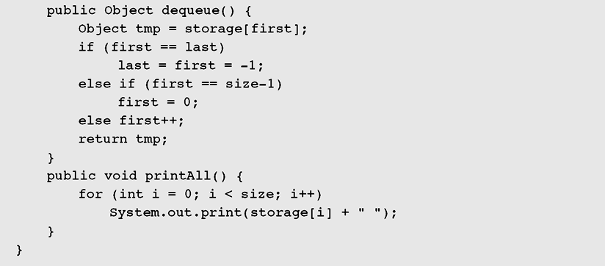
Queues (continued)
Figure 4-10 Array implementation of a queue (continued)

Slide 26
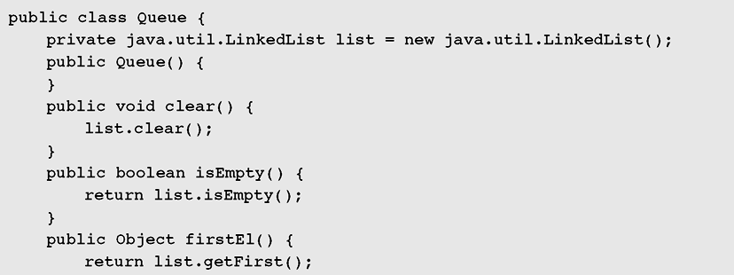
Queues (continued)
Figure 4-11 Linked list implementation of a queue

Slide 27
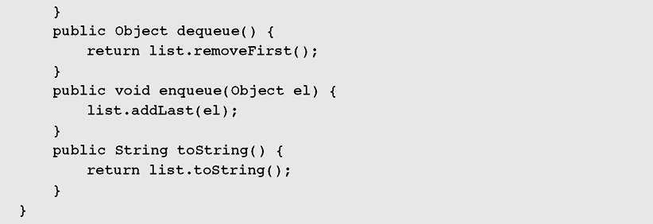
Queues (continued)
Figure 4-11 Linked list implementation of a queue (continued)

Slide 28
Queues (continued)
In queuing theory, various scenarios are analyzed and models are built that use queues for processing requests or other information in a predetermined sequence (order)

Slide 29
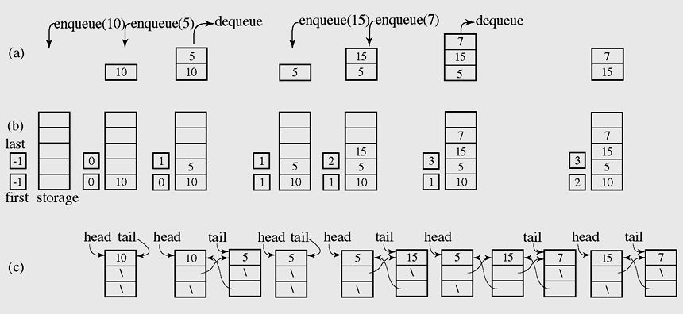
Queues (continued)
Queuing theory is when various scenarios are analyzed and models are built that use queues
Figure 4-12 A series of operations executed on an abstract queue (a) and the
stack implemented with an array (b) and with a linked list (c)

Slide 30
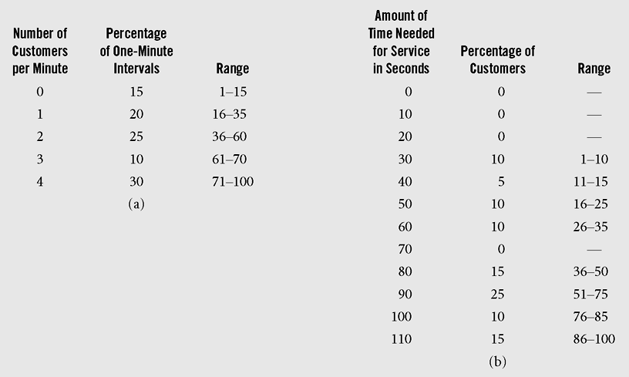
Queues (continued)
Figure 4-13 Bank One example: (a) data for number of arrived customers per
one-minute interval and (b) transaction time in seconds per customer

Slide 31
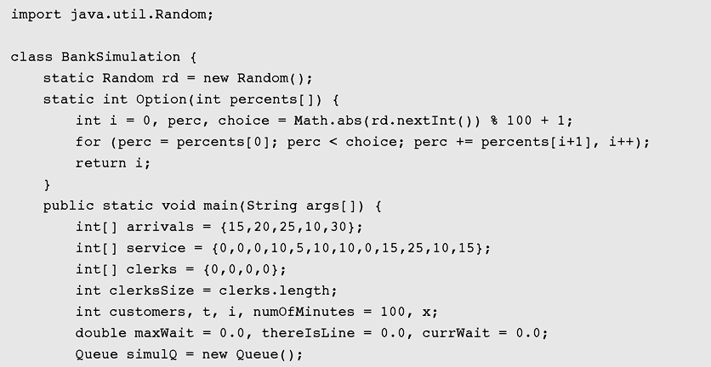
Queues (continued)
Figure 4-14 Bank One example: implementation code

Slide 32
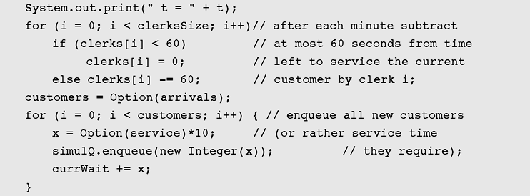
Queues (continued)
Figure 4-14 Bank One example: implementation code (continued)

Slide 33
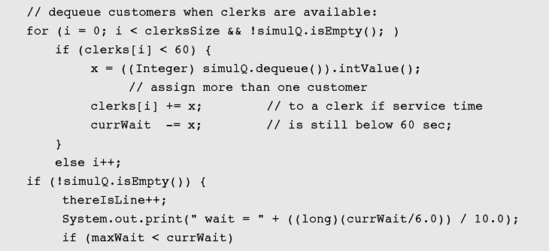
Queues (continued)
Figure 4-14 Bank One example: implementation code (continued)

Slide 34
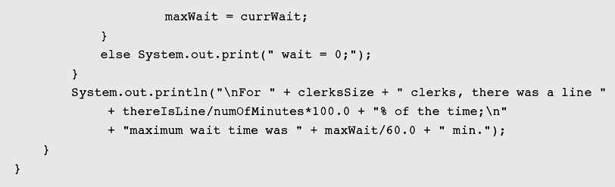
Queues (continued)
Figure 4-14 Bank One example: implementation code (continued)

Slide 35
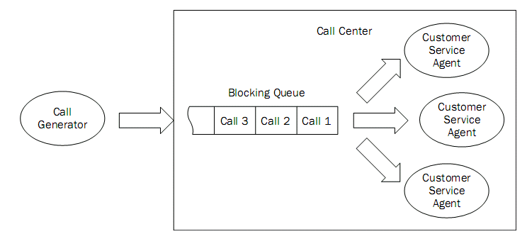
A call center simulation

Slide 36
Priority Queues
A priority queue can be assigned to enable a particular process, or event, to be executed out of sequence without affecting overall system operation
In priority queues, elements are dequeued according to their priority and their current queue position

Slide 37
Priority Queues (continued)
Priority queues can be represented by two variations of linked lists:
  All elements are entry ordered
  Order is maintained by putting a new element
  in its proper position according to its priority

Slide 38
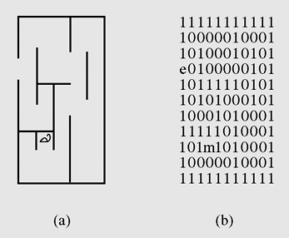
Case Study: Exiting a Maze
Figure 4-15 (a) A mouse in a maze; (b) two-dimensional character
array representing this situation

Slide 39
Case Study: Exiting a Maze (continued)
exitMaze()
initialize stack, exitCell, entryCell, currentCell = entryCell;
while currentCell is not exitCell
mark currentCell as visited;
push onto the stack the unvisited neighbors of currentCell;
if stack is empty
failure;
else pop off a cell from the stack and make it currentCell;
success;

Slide 40
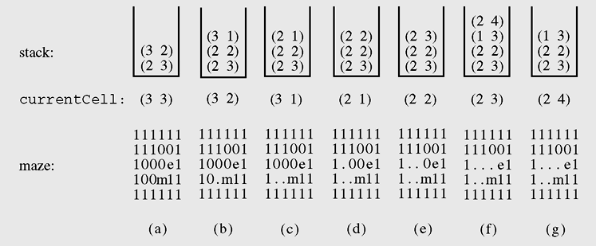
Case Study: Exiting a Maze (continued)
Figure 4-16 An example of processing a maze

Slide 41
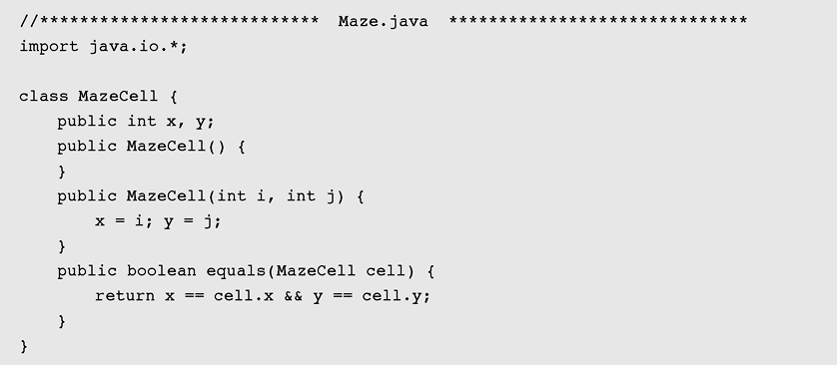
Case Study: Exiting a Maze (continued)
Figure 4-17 Listing of the program for maze processing

Slide 42
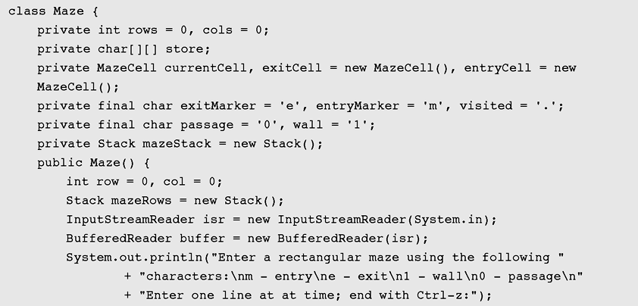
Case Study: Exiting a Maze (continued)
Figure 4-17 Listing of the program for maze processing (continued)

Slide 43
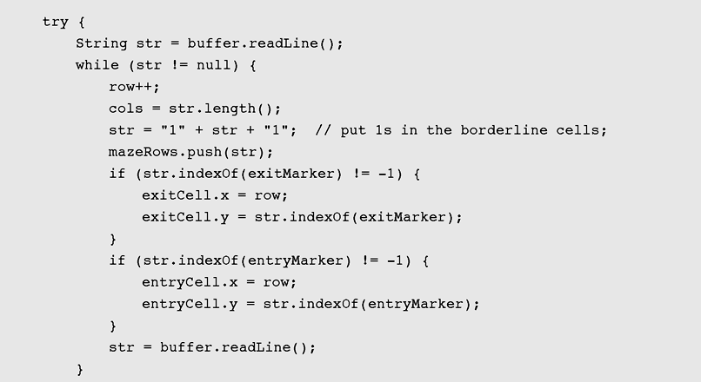
Case Study: Exiting a Maze (continued)
Figure 4-17 Listing of the program for maze processing (continued)

Slide 44
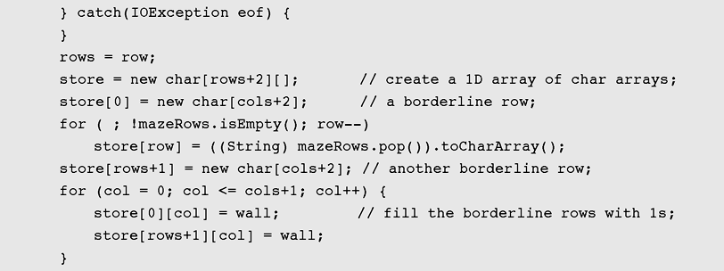
Case Study: Exiting a Maze (continued)
Figure 4-17 Listing of the program for maze processing (continued)

Slide 45
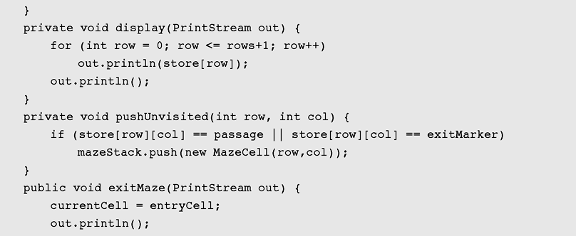
Case Study: Exiting a Maze (continued)
Figure 4-17 Listing of the program for maze processing (continued)

Slide 46
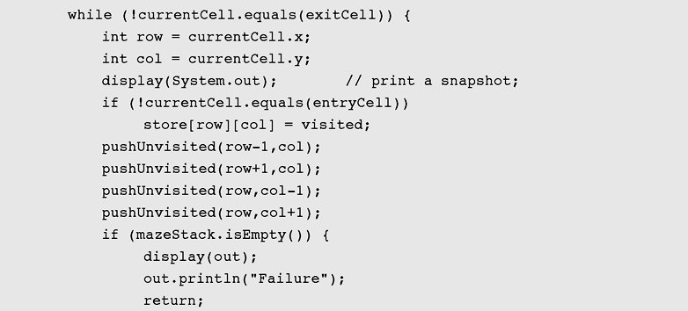
Case Study: Exiting a Maze (continued)
Figure 4-17 Listing of the program for maze processing (continued)

Slide 47
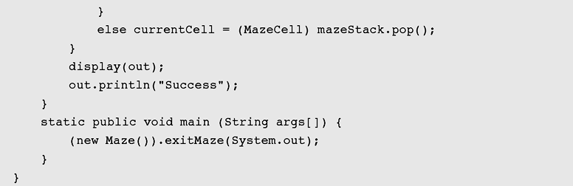
Case Study: Exiting a Maze (continued)
Figure 4-17 Listing of the program for maze processing (continued)

Slide 48
Summary
A stack is a linear data structure that can be accessed at only one of its ends for storing and retrieving data.
A stack is called an LIFO structure: last in/first out.
A queue is a waiting line that grows by adding elements to its end and shrinks by taking elements from its front.
A queue is an FIFO structure: first in/first out.

Slide 49
Summary (continued)
In queuing theory, various scenarios are analyzed and models are built that use queues for processing requests or other information in a predetermined sequence (order).
A priority queue can be assigned to enable a particular process, or event, to be executed out of sequence without affecting overall system operation.

Slide 50
Summary (continued)
In priority queues, elements are dequeued according to their priority and their current
queue position.

