Slide 1
Chapter 5
Recursion

Slide 2
Objectives
Discuss the following topics:
Recursive Definitions
Method Calls and Recursion Implementation
Anatomy of a Recursive Call
Tail Recursion
Nontail Recursion
Indirect Recursion

Slide 3
Objectives (continued)
Discuss the following topics:
Nested Recursion
Excessive Recursion
Backtracking
Case Study: A Recursive Descent Interpreter

Slide 4
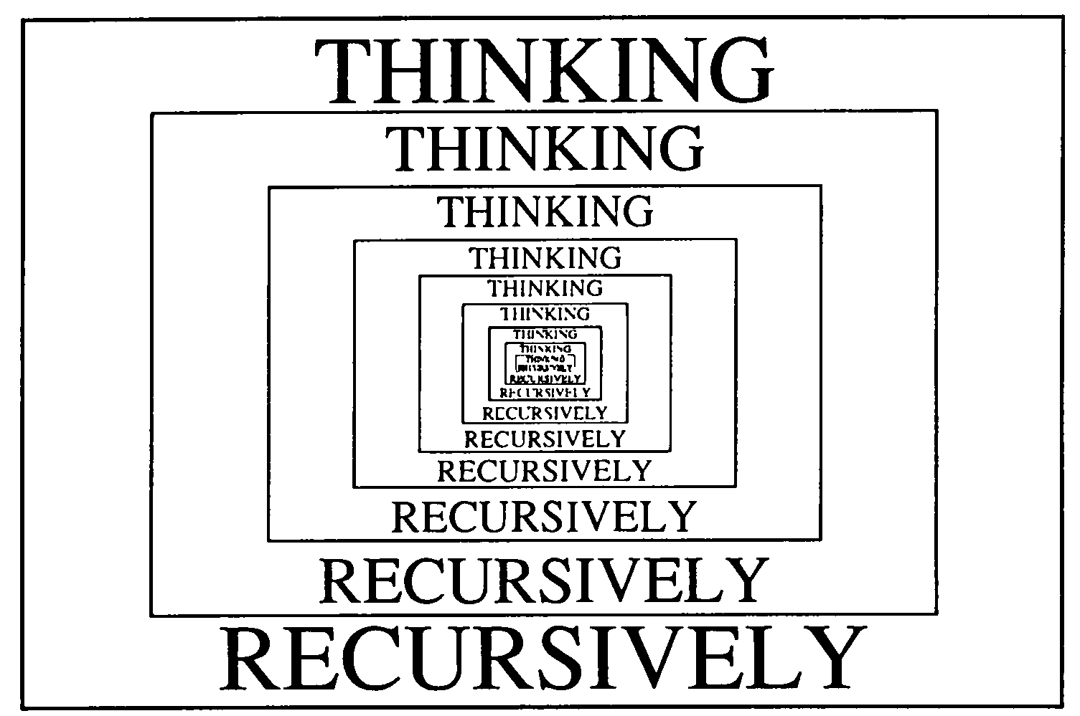

Slide 5
Recursive Definitions
Recursive definitions are programming concepts that define themselves
A recursive definition consists of two parts:
  The anchor or ground case, the basic elements that are the building blocks of all other elements of the set
  Rules that allow for the construction of new objects out of basic elements or objects that have already been constructed

Slide 6
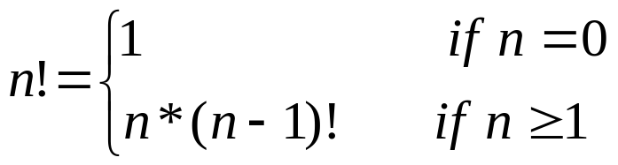
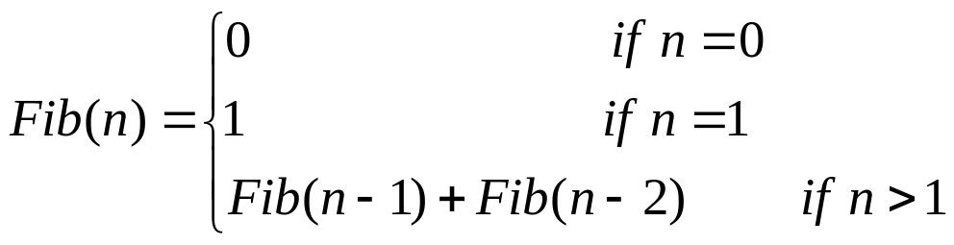
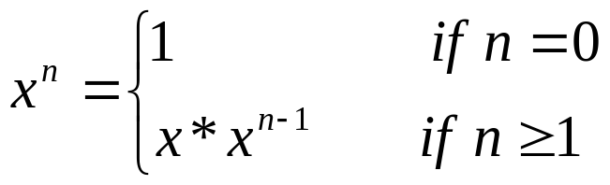
Recursive Definitions
Examples:

Slide 7
Recursive Definitions (continued)
Recursive definitions serve two purposes:
  Generating new elements
  Testing whether an element belongs to a set
Recursive definitions are frequently used to define functions and sequences of numbers

Slide 8
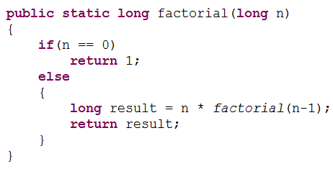
Recursive Definitions (continued)

Slide 9
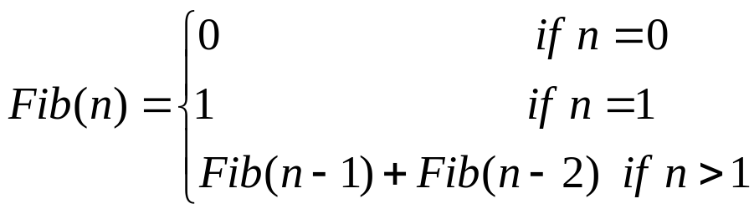
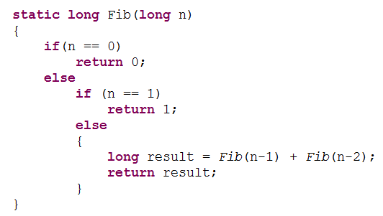
Recursive Definitions (continued)

Slide 10
Recursive Definitions (continued)
Exercises:
  1.
  2. Write a recursive method that for a positive integer n calculate sum of numbers from 1 to n.
  3. Write a recursive method that for a positive integer n prints numbers
  a. between 1 and n
  b. between n and 1

Slide 11
Method Calls and Recursion Implementation
Activation records contain the following:
  Values for all parameters to the method, location of the first cell if an array is passed or a variable is passed by reference, and copies of all other data items
  Local (automatic) variables that can be stored elsewhere
  The return address to resume control by the caller, the address of the caller’s instruction immediately following the call

Slide 12
Method Calls and Recursion Implementation (continued)
  A dynamic link, which is a pointer to the caller’s activation record
  The returned value for a method not declared as void

Slide 13
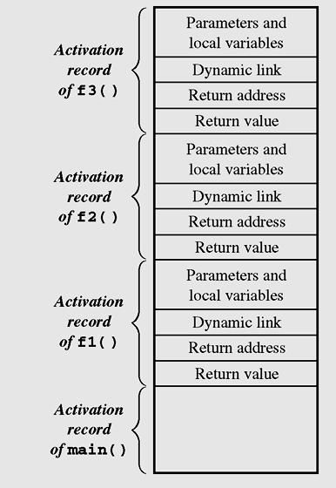
Method Calls and Recursion Implementation (continued)
Figure 5-1 Contents of the run-time stack when main() calls
method f1(), f1() calls f2(), and f2() calls f3()

Slide 14

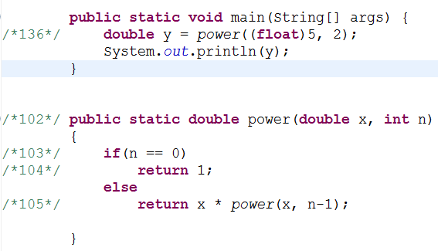
Anatomy of a Recursive Call

Slide 15

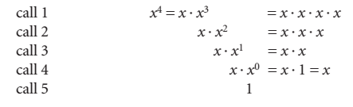
Anatomy of a Recursive Call

Slide 16
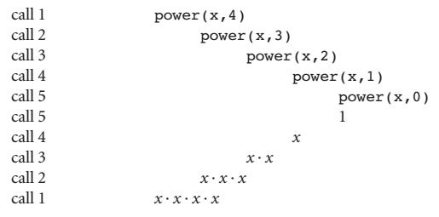
Anatomy of a Recursive Call

Slide 17
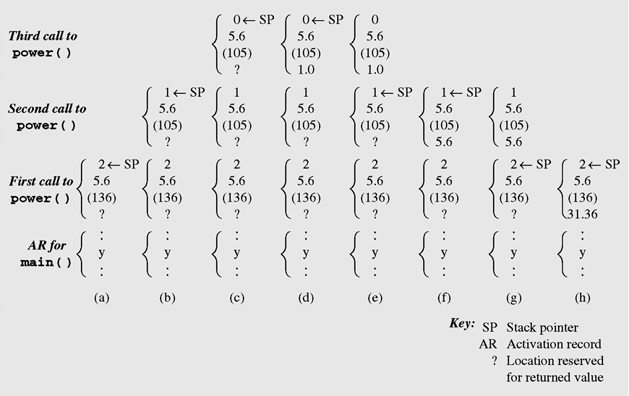
Anatomy of a Recursive Call
Figure 5-2 Changes to the run-time stack during execution
of power(5.6,2)

Slide 18
Tail Recursion
Tail recursion is characterized by the use of only one recursive call at the very end of a method implementation
    void tail (int i) {
    if (i > 0) {
    System.out.print (i + "");
    tail(i-1);
    }
    }

Slide 19
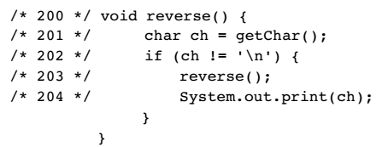
Nontail Recursion

Slide 20
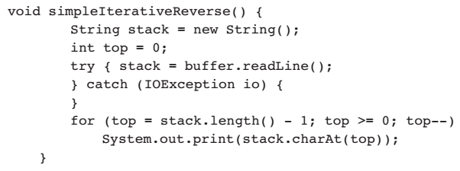
Nontail Recursion
The method is quite short and, perhaps, a bit more cryptic than its recursive counterpart.

Slide 21
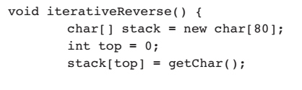
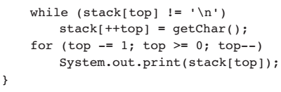
Tail Recursion

Slide 22
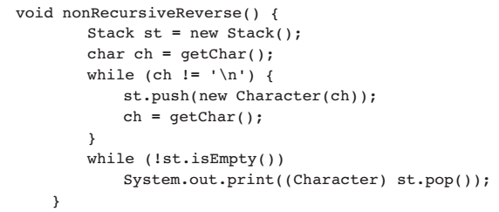
Nontail Recursion

Slide 23
Nontail Recursion
  Example of nontail recursion:
    void nonTail (int i) {
    if (i > 0) {
    nonTail(i-1);
    System.out.print (i + "");
    nonTail(i-1);
    }
    }

Slide 24
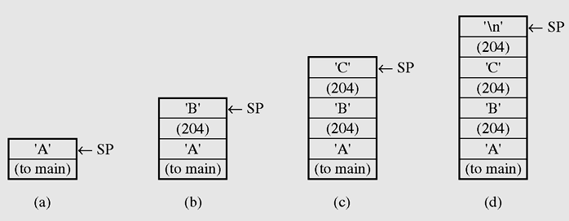
Nontail Recursion (continued)
Figure 5-3 Changes on the run-time stack during the execution
of reverse()

Slide 25

Nontail Recursion (continued)
Divide an interval side into three even parts
Move one-third of side in the direction specified by angle
Figure 5-4 Examples of von Koch snowflakes

Slide 26
Nontail Recursion (continued)
Turn to the right 60° (i.e., turn –60°) and go forward one-third of side
Turn to the left 120° and proceed forward
one-third of side
Turn right 60° and again draw a line one-third of side long

Slide 27
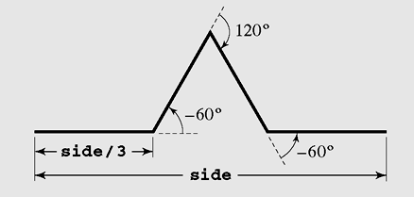
Nontail Recursion (continued)
Figure 5-5 The process of drawing four sides of one segment of
the von Koch snowflake

Slide 28
Nontail Recursion (continued)
  drawFourLines (side, level)
  if (level = 0)
  draw a line;
  else
  drawFourLines(side/3, level-1);
  turn left 60°;
  drawFourLines(side/3, level-1);
  turn right 120°;
  drawFourLines(side/3, level-1);
  turn left 60°;
  drawFourLines(side/3, level-1);

Slide 29
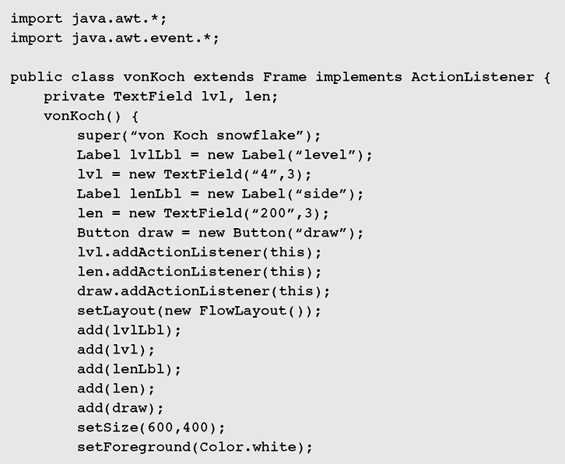
Nontail Recursion (continued)
Figure 5-6 Recursive implementation of the von Koch snowflake

Slide 30
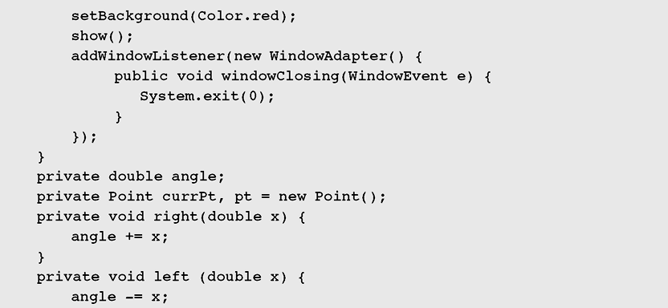
Nontail Recursion (continued)
Figure 5-6 Recursive implementation of the von Koch snowflake
(continued)

Slide 31
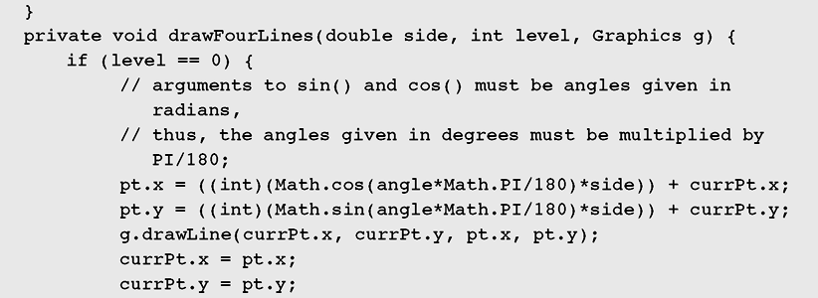
Nontail Recursion (continued)
Figure 5-6 Recursive implementation of the von Koch snowflake
(continued)

Slide 32
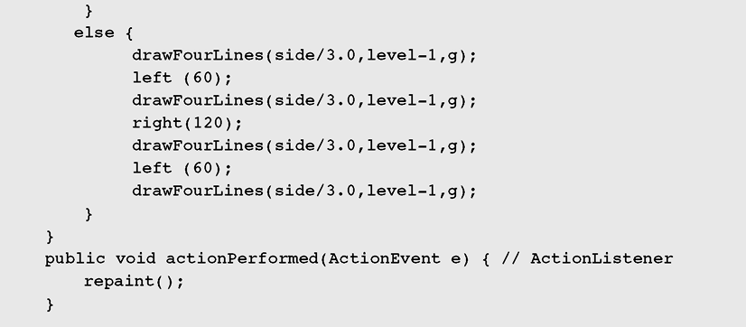
Nontail Recursion (continued)
Figure 5-6 Recursive implementation of the von Koch snowflake
(continued)

Slide 33
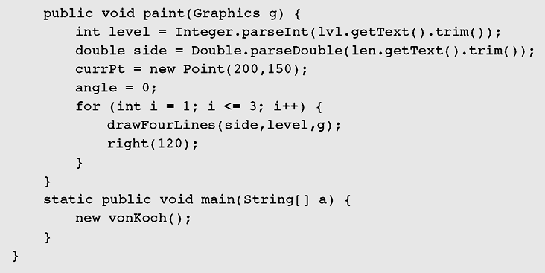
Nontail Recursion (continued)
Figure 5-6 Recursive implementation of the von Koch snowflake
(continued)

Slide 34
Indirect Recursion
  receive(buffer)
  while buffer is not filled up
  if information is still incoming
  get a character and store it in buffer;
  else exit();
  decode(buffer);
  decode(buffer)
  decode information in buffer;
  store(buffer);
  store(buffer)
  transfer information from buffer to file;
  receive(buffer);

Slide 35
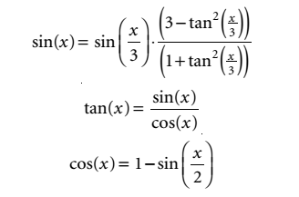

Indirect Recursion (continued)

Slide 36
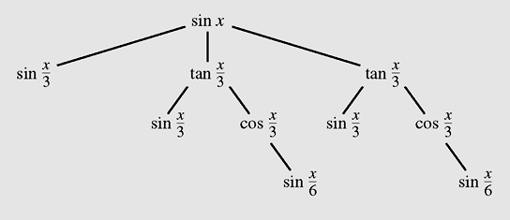
Indirect Recursion (continued)
Figure 5-7 A tree of recursive calls for sin (x)

Slide 37
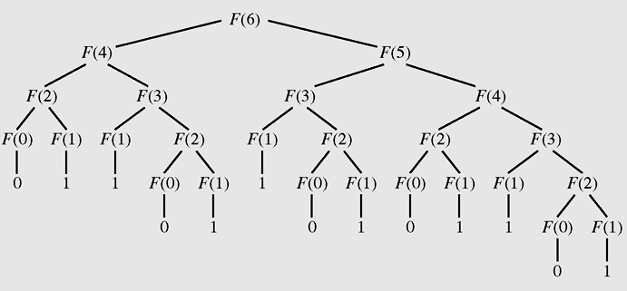
Excessive Recursion
Figure 5-8 The tree of calls for Fib(6)

Slide 38
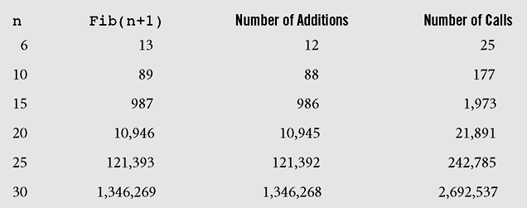
Excessive Recursion (continued)
Figure 5-9 Number of addition operations and number of recursive
calls to calculate Fibonacci numbers

Slide 39
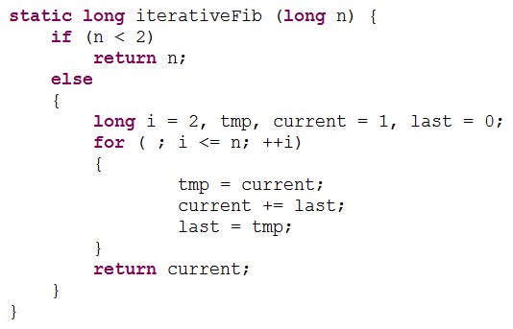
Excessive Recursion (continued)

Slide 40
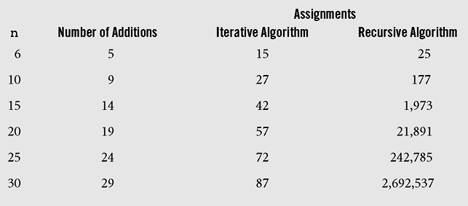
Excessive Recursion (continued)
Figure 5-10 Comparison of iterative and recursive algorithms
for calculating Fibonacci numbers

Slide 41
Backtracking
Backtracking is a technique for returning to a given position (e.g., entry point) after trying other avenues that are unsuccessful in solving a particular problem

Slide 42
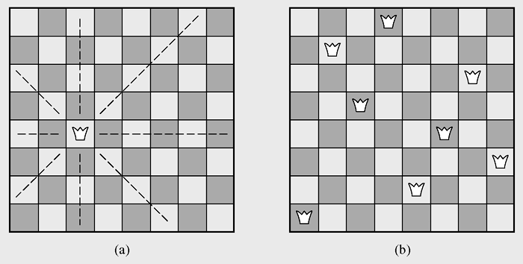
Backtracking (continued)
Figure 5-11 The eight queens problem

Slide 43
Backtracking (continued)
  putQueen(row)
  for every position col on the same row
  if position col is available
  place the next queen in position col;
  if (row < 8)
  putQueen(row+1);
  else success;
  remove the queen from position col;

Slide 44
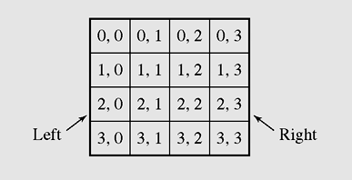
Backtracking (continued)
Figure 5-12 A 4 x 4 chessboard

Slide 45
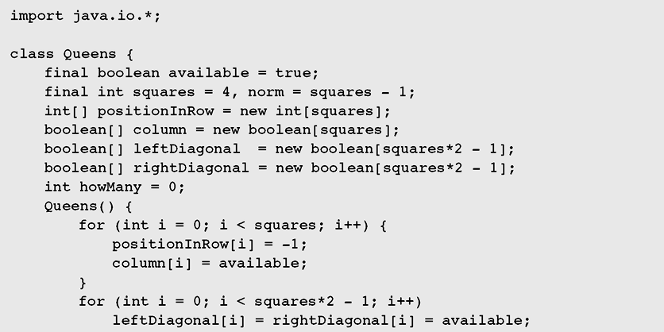
Backtracking (continued)
Figure 5-13 Eight queens problem implementation

Slide 46
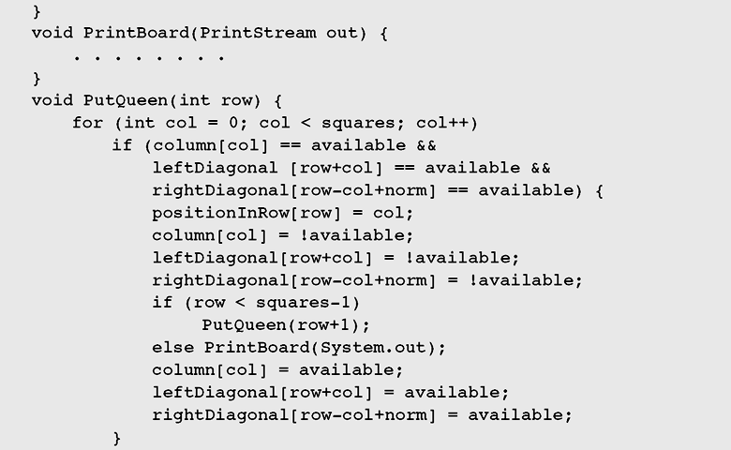
Backtracking (continued)
Figure 5-13 Eight queens problem implementation (continued)

Slide 47
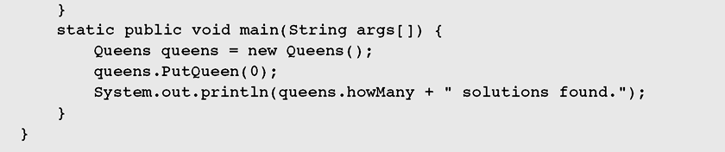
Backtracking (continued)
Figure 5-13 Eight queens problem implementation (continued)

Slide 48
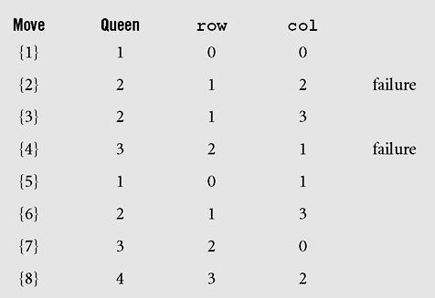
Backtracking (continued)
Figure 5-14 Steps leading to the first successful configuration of
four queens as found by the method putQueen()

Slide 49
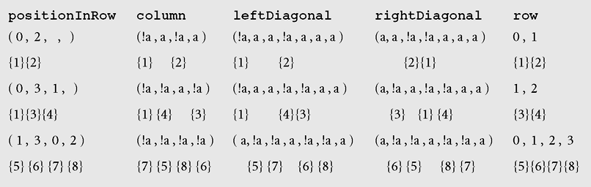
Backtracking (continued)
Figure 5-15 Changes in the four arrays used by method putQueen()

Slide 50
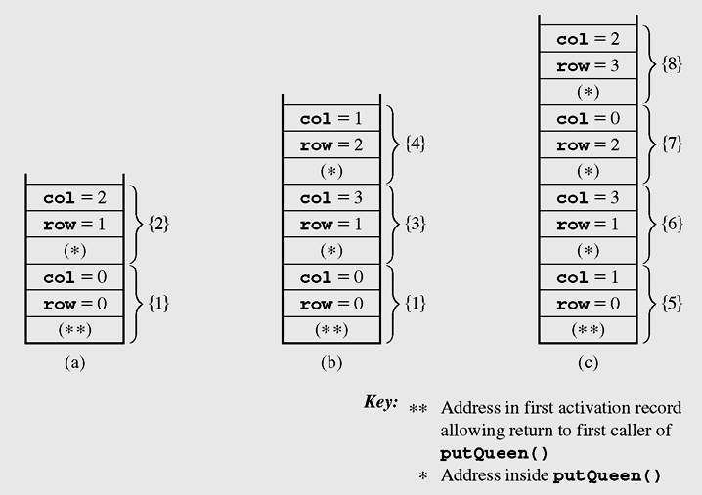
Backtracking (continued)
Figure 5-16 Changes on the run-time stack for the first
successful completion of putQueen()

Slide 51
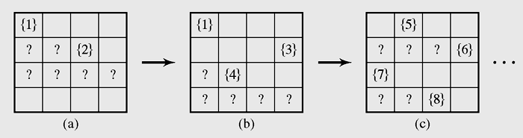
Backtracking (continued)
Figure 5-17 Changes to the chessboard leading to the first
successful configuration

Slide 52
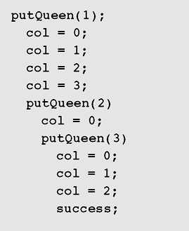
Backtracking (continued)
Figure 5-18 Trace of calls to putQueen() to place four queens
(continued)

Slide 53
Case Study: A Recursive
Descent Interpreter
The process of translating one executable statement at a time and immediately executing it is called interpretation
Translating the entire program first and then executing it is called compilation

Slide 54
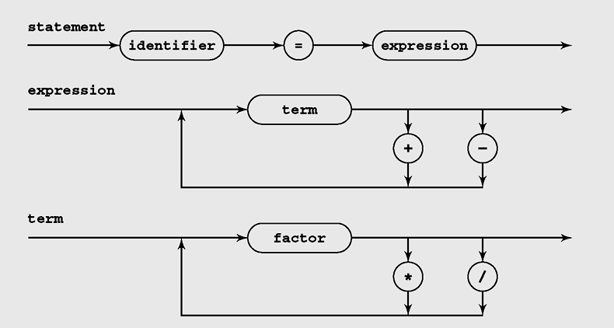
Case Study: A Recursive
Descent Interpreter (continued)
Figure 5-19 Diagrams of methods used by the recursive
descent interpreter

Slide 55
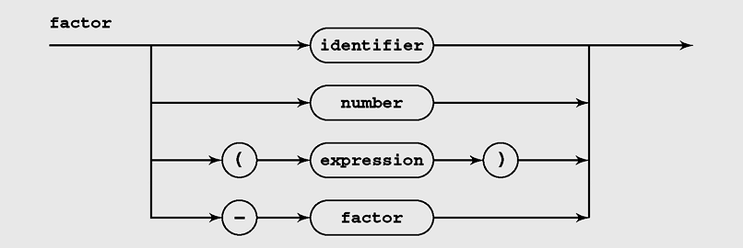
Case Study: A Recursive
Descent Interpreter (continued)
Figure 5-19 Diagrams of methods used by the recursive
descent interpreter (continued)

Slide 56
Case Study: A Recursive
Descent Interpreter (continued)
term()
f1 = factor();
while current token is either / or *
f2 = factor();
f1 = f1 * f2 or f1 / f2;
return f1;
factor()
process all +s and – s preceding a factor;
if current token is an identifier
return value assigned to the identifier;
else if current token is a number
return the number;
else if current token is (
e = expression();
if current token is )
return e;

Slide 57
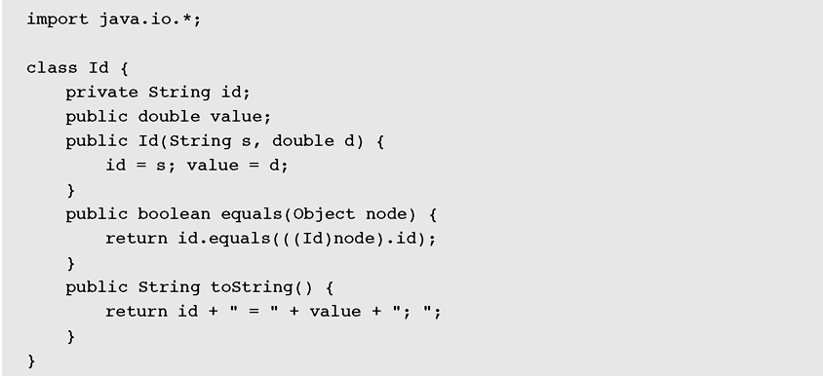
Case Study: A Recursive
Descent Interpreter (continued)
Figure 5-20 Implementation of a simple language interpreter

Slide 58
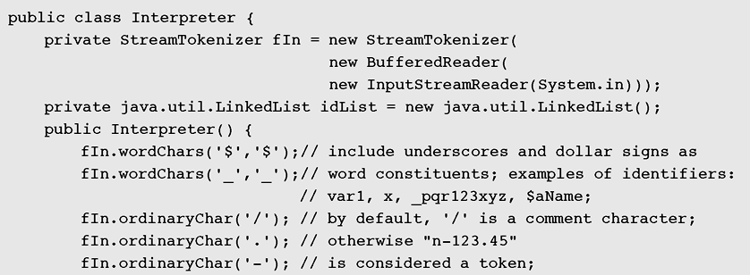
Case Study: A Recursive
Descent Interpreter (continued)
Figure 5-20 Implementation of a simple language interpreter (continued)

Slide 59
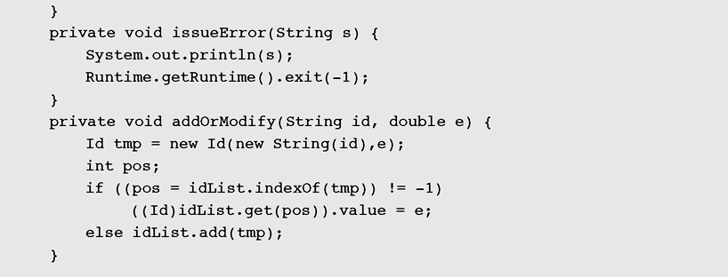
Case Study: A Recursive
Descent Interpreter (continued)
Figure 5-20 Implementation of a simple language interpreter (continued)

Slide 60
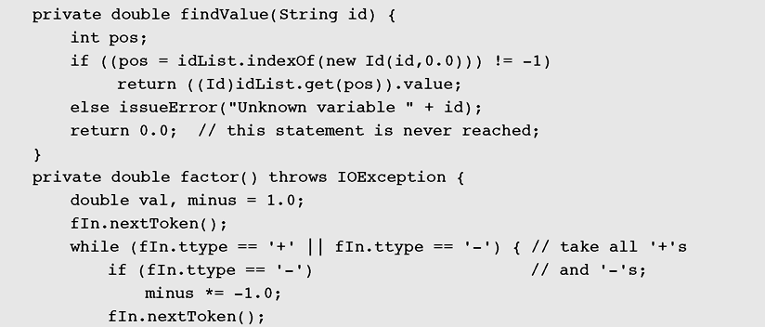
Case Study: A Recursive
Descent Interpreter (continued)
Figure 5-20 Implementation of a simple language interpreter (continued)

Slide 61
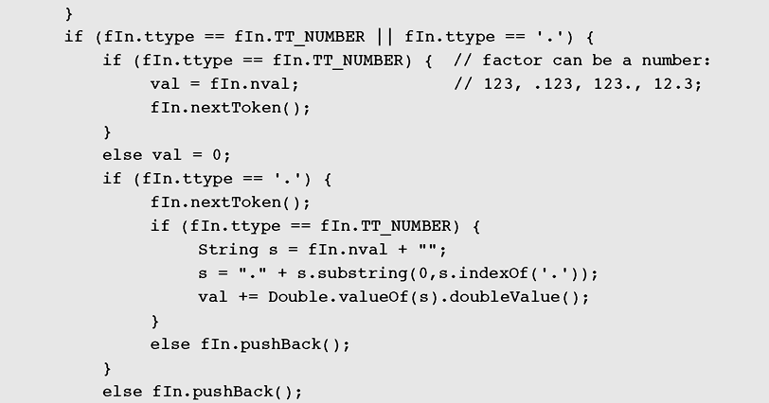
Case Study: A Recursive
Descent Interpreter (continued)
Figure 5-20 Implementation of a simple language interpreter (continued)

Slide 62
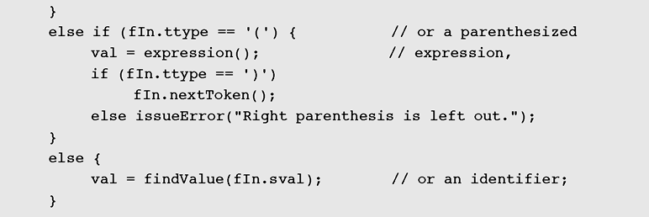
Case Study: A Recursive
Descent Interpreter (continued)
Figure 5-20 Implementation of a simple language interpreter (continued)

Slide 63
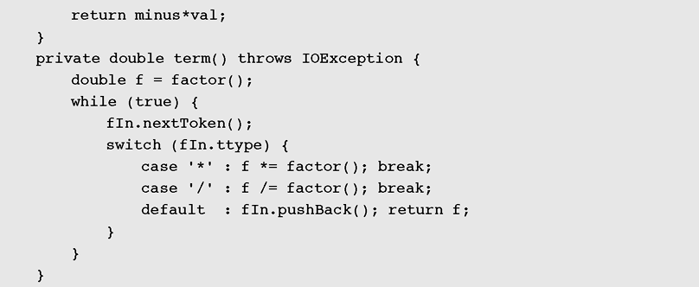
Case Study: A Recursive
Descent Interpreter (continued)
Figure 5-20 Implementation of a simple language interpreter (continued)

Slide 64
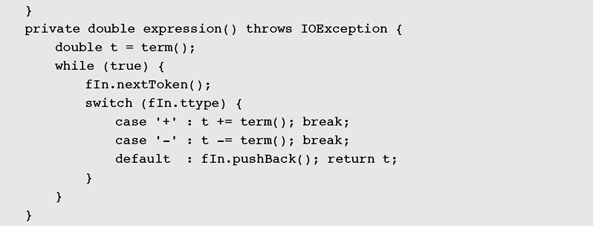
Case Study: A Recursive
Descent Interpreter (continued)
Figure 5-20 Implementation of a simple language interpreter (continued)

Slide 65

Case Study: A Recursive
Descent Interpreter (continued)
Figure 5-20 Implementation of a simple language interpreter (continued)

Slide 66

Case Study: A Recursive
Descent Interpreter (continued)
Figure 5-20 Implementation of a simple language interpreter (continued)

Slide 67

Case Study: A Recursive
Descent Interpreter (continued)
Figure 5-20 Implementation of a simple language interpreter (continued)

Slide 68
Summary
Recursive definitions are programming concepts that define themselves
Recursive definitions serve two purposes:
  Generating new elements
  Testing whether an element belongs to a set
Recursive definitions are frequently used to define functions and sequences of numbers

Slide 69
Summary (continued)
Tail recursion is characterized by the use of only one recursive call at the very end of a method implementation.
Backtracking is a technique for returning to a given position (e.g., entry point) after trying other avenues that are unsuccessful in solving a particular problem.
The process of translating one executable statement at a time and immediately executing it is called interpretation.

