Slide 1
Chapter 6
Binary Trees

Slide 2
Objectives
Discuss the following topics:
Trees, Binary Trees, and Binary Search Trees
Implementing Binary Trees
Searching a Binary Search Tree
Tree Traversal
Insertion
Deletion

Slide 3
Objectives (continued)
Discuss the following topics:
Balancing a Tree
Self-Adjusting Trees
Heaps
Polish Notation and Expression Trees
Case Study: Computing Word Frequencies

Slide 4
Trees, Binary Trees, and Binary Search Trees
A tree is a data type that consists of nodes and arcs
These trees are depicted upside down with the root at the top and the leaves (terminal nodes) at the bottom
The root is a node that has no parent; it can have only child nodes
Leaves have no children (their children are null)

Slide 5
Trees, Binary Trees, and Binary Search Trees (continued)
Each node has to be reachable from the root through a unique sequence of arcs, called a path
The number of arcs in a path is called the length of the path
The level of a node is the length of the path from the root to the node plus 1, which is the number of nodes in the path
The height of a nonempty tree is the maximum level of a node in the tree

Slide 6
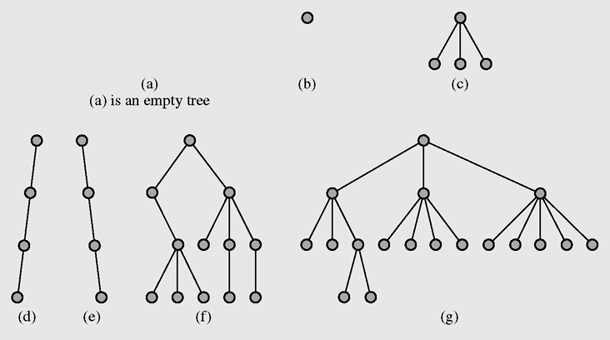
Trees, Binary Trees, and Binary Search Trees (continued)
Figure 6-1 Examples of trees

Slide 7
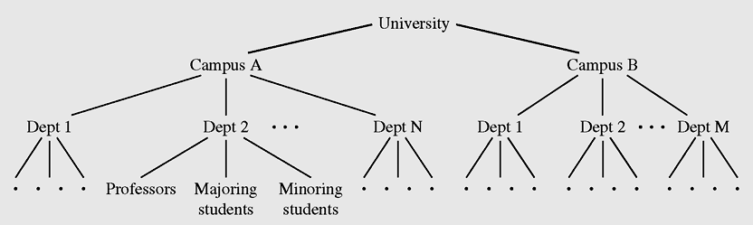
Trees, Binary Trees, and Binary Search Trees (continued)
Figure 6-2 Hierarchical structure of a university shown as a tree

Slide 8
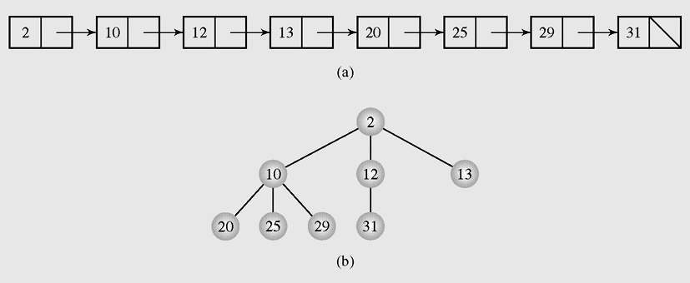
Trees, Binary Trees, and Binary Search Trees (continued)
An orderly tree is where all elements are stored according to some predetermined criterion of ordering
Figure 6-3 Transforming (a) a linked list into (b) a tree

Slide 9
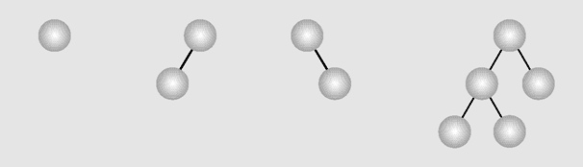
Trees, Binary Trees, and Binary Search Trees (continued)
A binary tree is a tree whose nodes have two children (possibly empty), and each child is designated as either a left child or a right child
Figure 6-4 Examples of binary trees

Slide 10
Trees, Binary Trees, and Binary Search Trees (continued)
In a complete binary tree, all nonterminal nodes have both their children, and all leaves are at the same level
A decision tree is a binary tree in which all nodes have either zero or two nonempty children

Slide 11
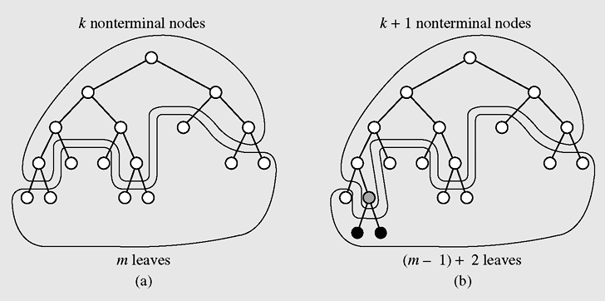
Trees, Binary Trees, and Binary Search Trees (continued)
Figure 6-5 Adding a leaf to tree (a), preserving the relation of the
number of leaves to the number of nonterminal nodes (b)

Slide 12
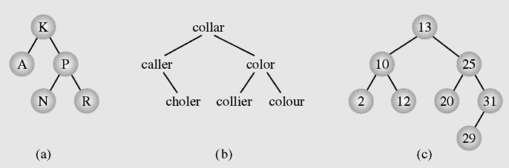
Trees, Binary Trees, and Binary Search Trees (continued)
Figure 6-6 Examples of binary search trees

Slide 13
Implementing Binary Trees
Binary trees can be implemented in at least two ways:
  As arrays
  As linked structures
To implement a tree as an array, a node is declared as an object with an information field and two “reference” fields

Slide 14
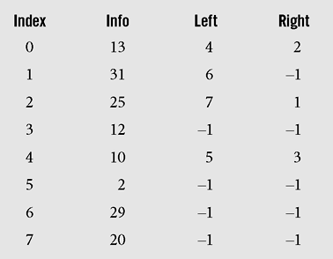
Implementing Binary Trees (continued)
Figure 6-7 Array representation of the tree in Figure 6.6c

Slide 15
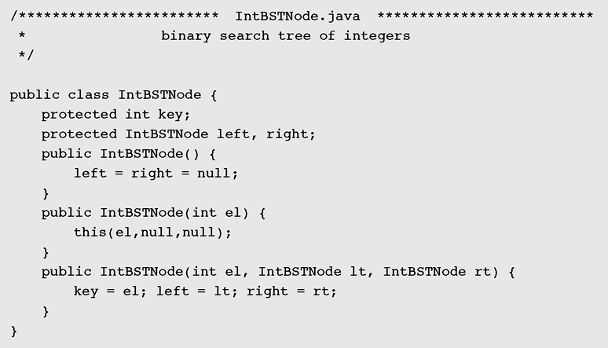
Implementing Binary Trees (continued)
Figure 6-8 Implementation of a generic binary search tree

Slide 16
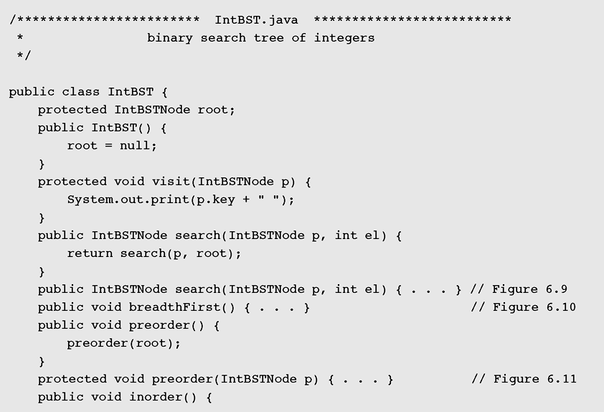
Implementing Binary Trees (continued)
Figure 6-8 Implementation of a binary search tree
(continued)

Slide 17
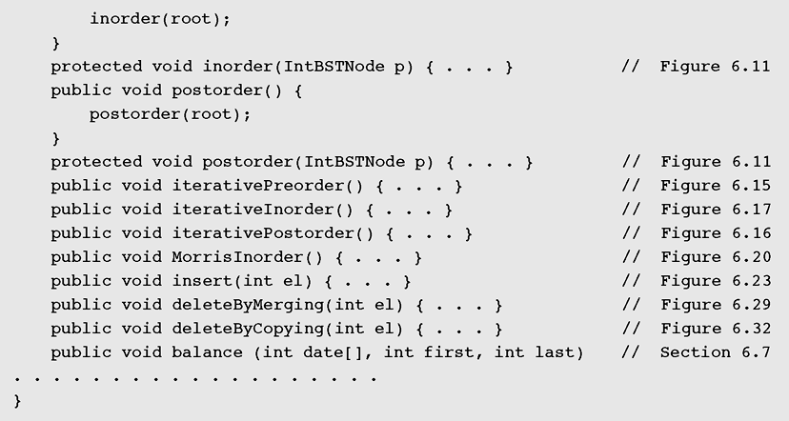
Implementing Binary Trees (continued)
Figure 6-8 Implementation of a generic binary search tree
(continued)

Slide 18
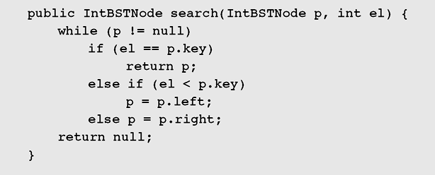
Searching a Binary Search Tree
Figure 6-9 A function for searching a binary search tree

Slide 19
Searching a Binary Search Tree (continued)
The internal path length (IPL) is the sum of all path lengths of all nodes
It is calculated by summing Σ(i – 1)l_{i} over all levels i, where l_{i} is the number of nodes on
level I
A depth of a node in the tree is determined by the path length
An average depth, called an average path length, is given by the formula IPL/n, which depends on the shape of the tree

Slide 20
Tree Traversal
Tree traversal is the process of visiting each node in the tree exactly one time
Breadth-first traversal is visiting each node starting from the lowest (or highest) level and moving down (or up) level by level, visiting nodes on each level from left to right (or from right to left)

Slide 21
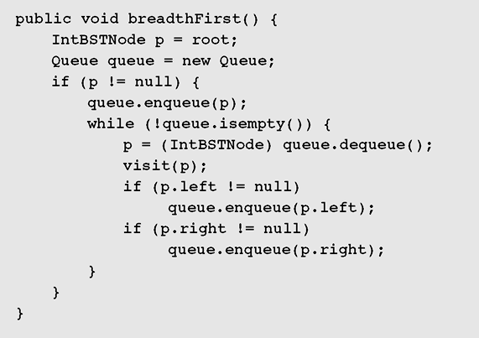
Breadth-First Traversal
Figure 6-10 Top-down, left-to-right, breadth-first traversal
implementation

Slide 22
Depth-First Traversal
Depth-first traversal proceeds as far as possible to the left (or right), then backs up until the first crossroad, goes one step to the right (or left), and again as far as possible to the left (or right)
  V — Visiting a node
  L — Traversing the left subtree
  R — Traversing the right subtree

Slide 23
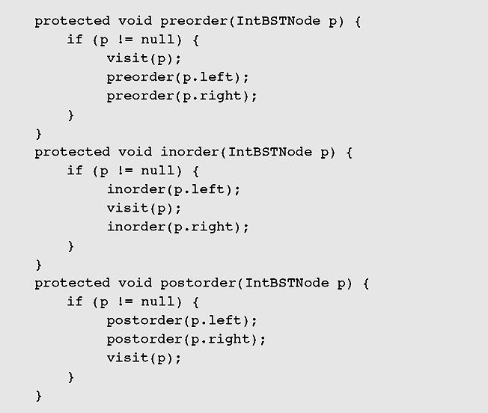
Depth-First Traversal (continued)
Figure 6-11 Depth-first traversal implementation

Slide 24
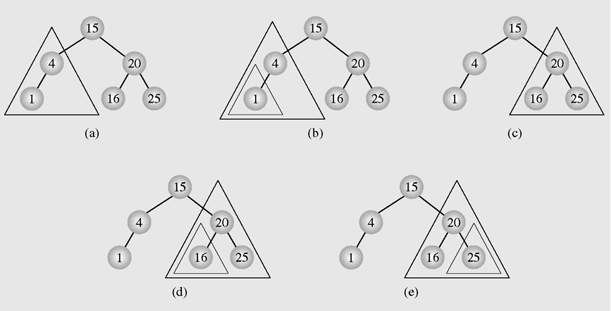
Depth-First Traversal (continued)
Figure 6-12 Inorder tree traversal

Slide 25
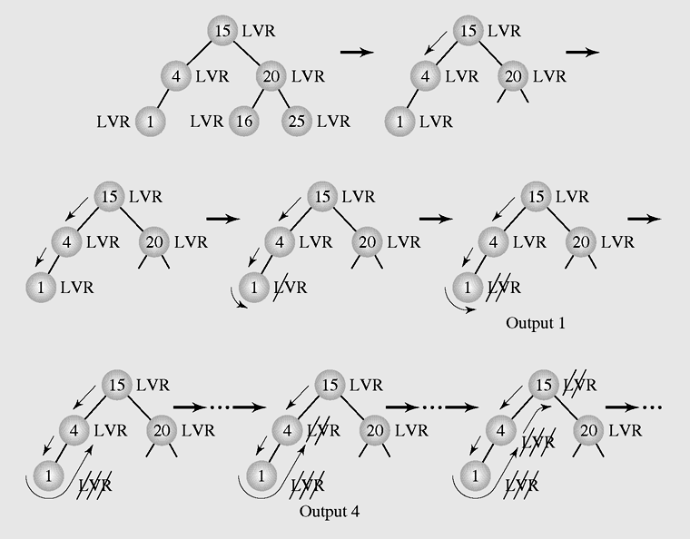
Depth-First Traversal (continued)
Figure 6-13 Details of several of the first steps of inorder traversal

Slide 26
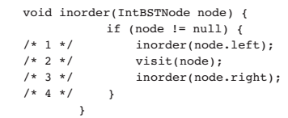
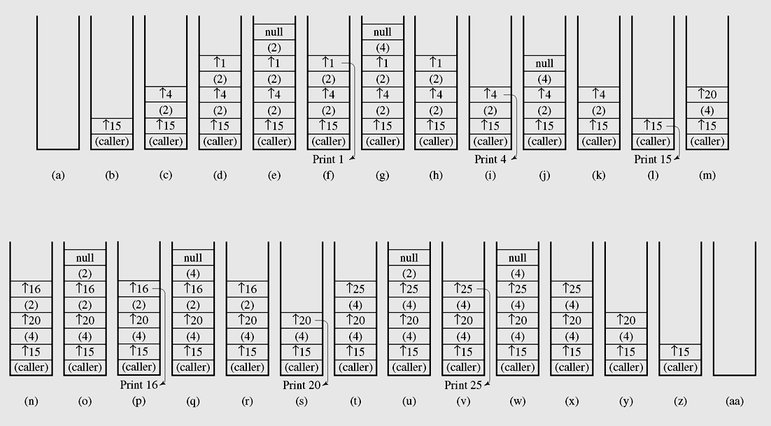
Figure 6-14 Changes in the run-time stack during inorder traversal

Slide 27
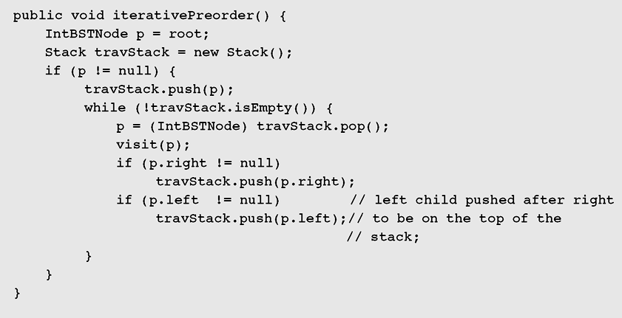
Depth-First Traversal (continued)
Figure 6-15 A nonrecursive implementation of preorder tree traversal

Slide 28
Stackless Depth-First Traversal
Threads are references to the predecessor and successor of the node according to an inorder traversal
Trees whose nodes use threads are called threaded trees
The left reference is either a reference to the left child or to the predecessor. Analogously, the right reference refers either to the right subtree or to the successor.
Threaded trees can used for preorder, inorder and post order traversal.

Slide 29
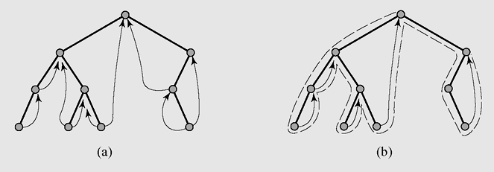
Stackless Depth-First Traversal (continued)
Figure 6-18 (a) A threaded tree and (b) an inorder traversal’s path in
a threaded tree with right successors only

Slide 30
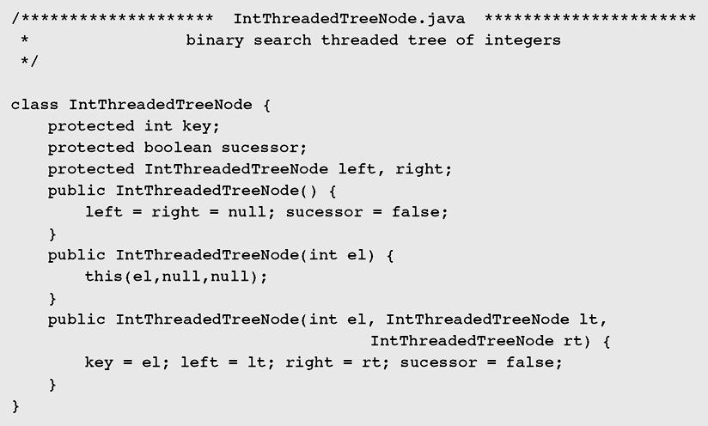
Stackless Depth-First Traversal (continued)
Figure 6-19 Implementation of the threaded tree and the
inorder traversal of a threaded tree

Slide 31
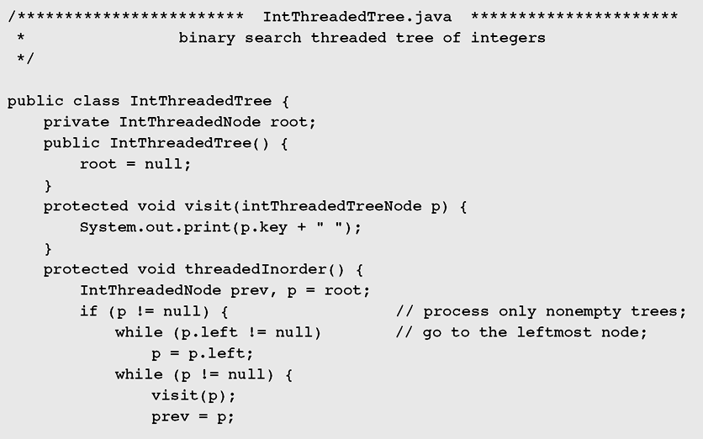
Stackless Depth-First Traversal (continued)
Figure 6-19 Implementation of the threaded tree and the
inorder traversal of a threaded tree (continued)

Slide 32
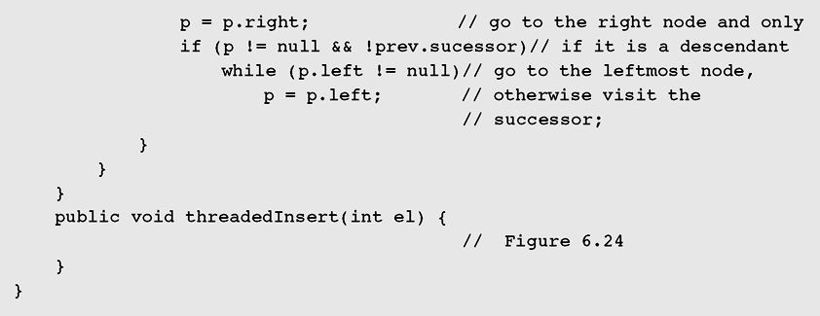
Stackless Depth-First Traversal (continued)
Figure 6-19 Implementation of the threaded tree and the
inorder traversal of a threaded tree (continued)

Slide 33
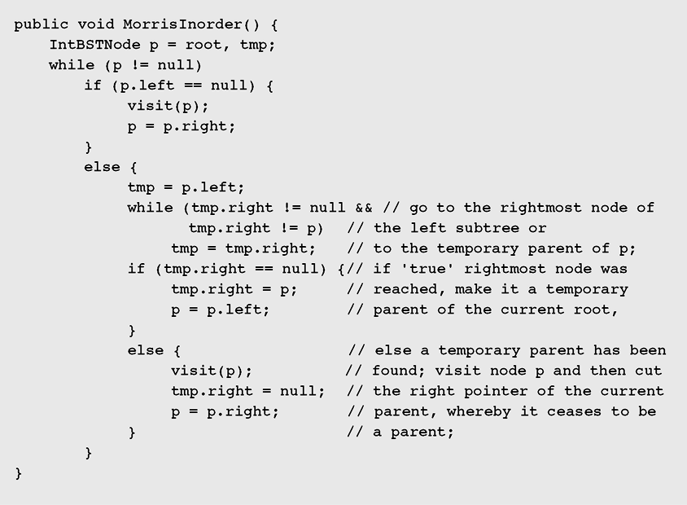
Traversal Through Tree Transformation
Figure 6-20 Implementation of the Morris algorithm for inorder traversal

Slide 34
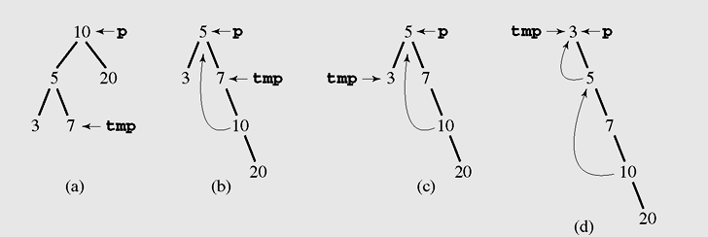
Traversal Through Tree Transformation (continued)
Figure 6-21 Tree traversal with the Morris method

Slide 35
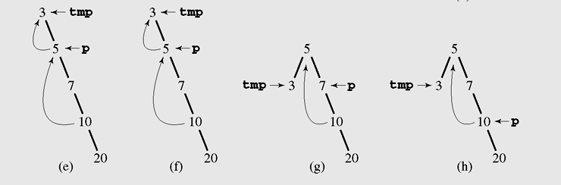
Traversal Through Tree Transformation (continued)
Figure 6-21 Tree traversal with the Morris method (continued)

Slide 36
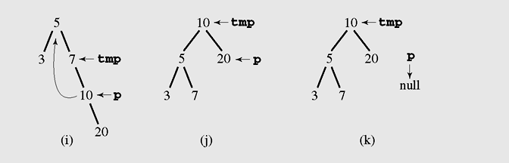
Traversal Through Tree Transformation (continued)
Figure 6-21 Tree traversal with the Morris method (continued)

Slide 37
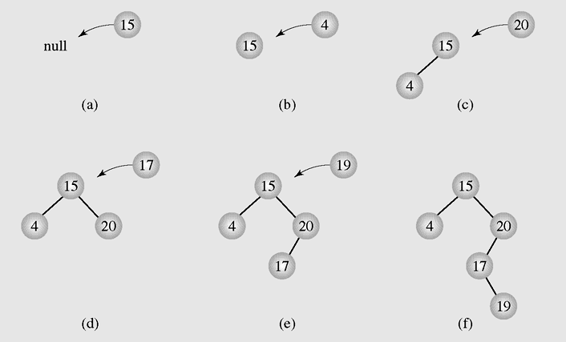
Insertion
Figure 6-22 Inserting nodes into binary search trees

Slide 38
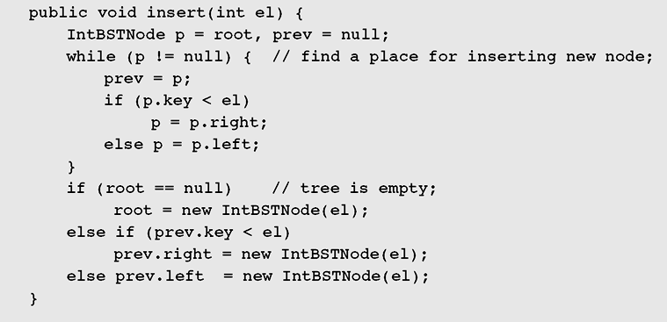
Insertion (continued)
Figure 6-23 Implementation of the insertion algorithm

Slide 39
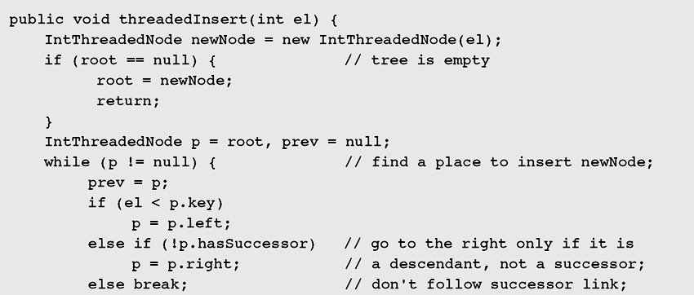
Insertion (continued)
Figure 6-24 Implementation of the algorithm to insert nodes
into a threaded tree

Slide 40
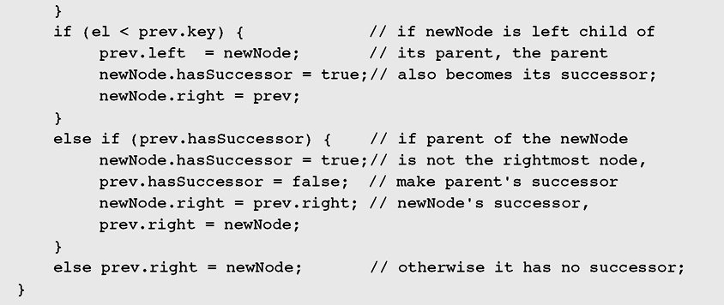
Insertion (continued)
Figure 6-24 Implementation of the algorithm to insert nodes
into a threaded tree (continued)

Slide 41
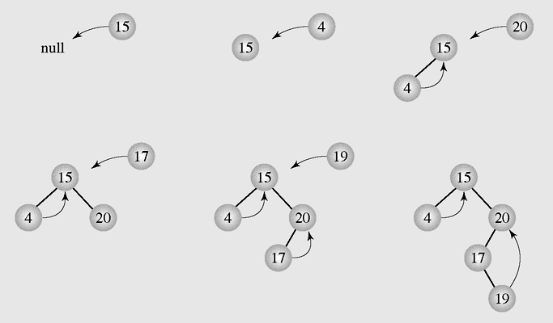
Insertion (continued)
Figure 6-25 Inserting nodes into a threaded tree

Slide 42
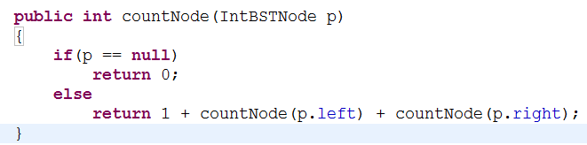

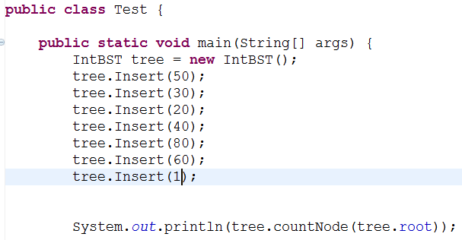

Slide 43
Deletion
There are three cases of deleting a node from the binary search tree:
  The node is a leaf; it has no children
  The node has one child
  The node has two children

Slide 44
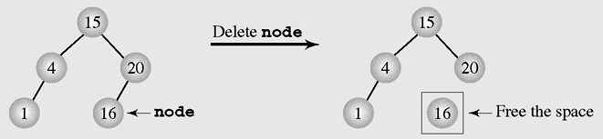
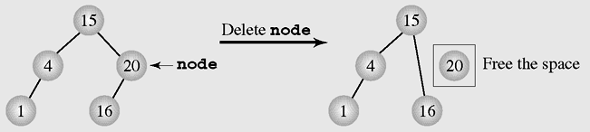
Deletion (continued)
Figure 6-26 Deleting a leaf
Figure 6-27 Deleting a node with one child

Slide 45
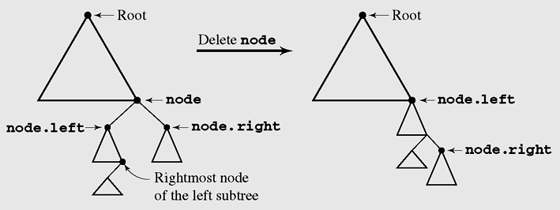
Deletion by Merging
Making one tree out of the two subtrees of the node and then attaching it to the node’s parent is called deleting by merging
Figure 6-28 Summary of deleting by merging

Slide 46
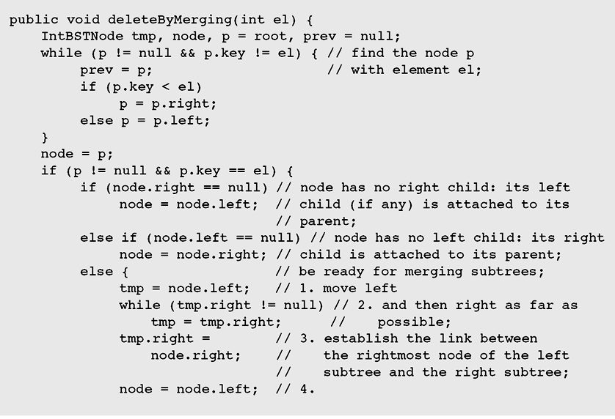
Deletion by Merging (continued)
Figure 6-29 Implementation of algorithm for deleting by merging

Slide 47
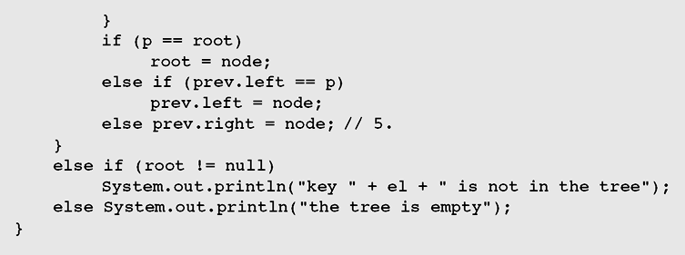
Deletion by Merging (continued)
Figure 6-29 Implementation of algorithm for deleting by merging
(continued)

Slide 48
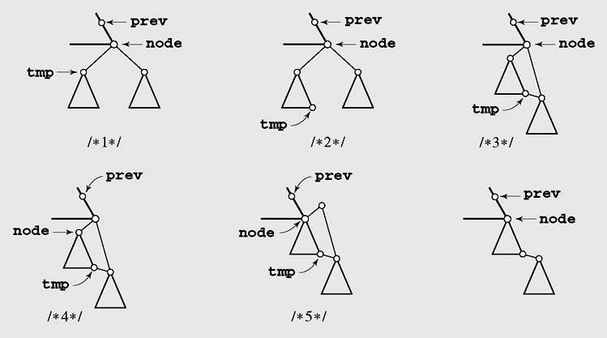
Deletion by Merging (continued)
Figure 6-30 Details of deleting by merging

Slide 49
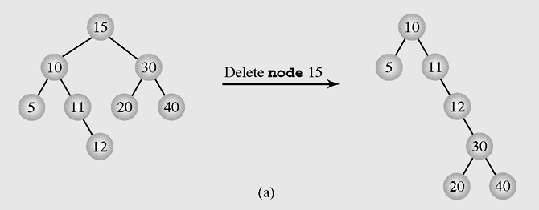
Deletion by Merging (continued)
Figure 6-31 The height of a tree can be (a) extended or
(b) reduced after deleting by merging

Slide 50
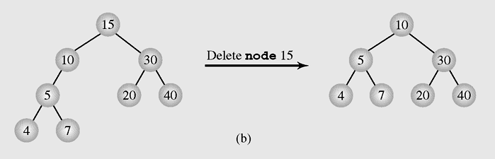
Deletion by Merging (continued)
Figure 6-31 The height of a tree can be (a) extended or
(b) reduced after deleting by merging (continued)

Slide 51
Deletion by Copying
If the node has two children, the problem can be reduced to:
  The node is a leaf
  The node has only one nonempty child
Solution: replace the key being deleted with its immediate predecessor (or successor)
A key’s predecessor is the key in the rightmost node in the left subtree

Slide 52
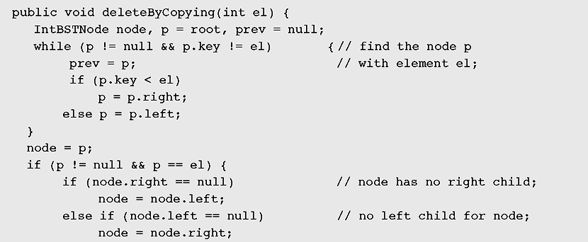
Deletion by Copying (continued)
Figure 6-32 Implementation of an algorithm for deleting by copying

Slide 53
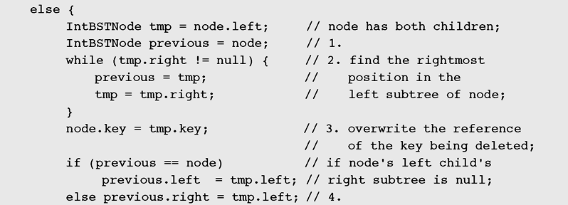
Deletion by Copying
Figure 6-32 Implementation of an algorithm for deleting by copying
(continued)

Slide 54
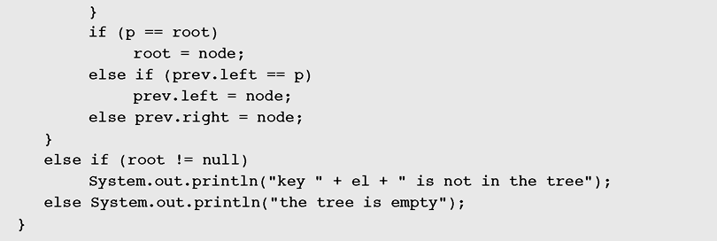
Deletion by Copying
Figure 6-32 Implementation of an algorithm for deleting by copying
(continued)

Slide 55
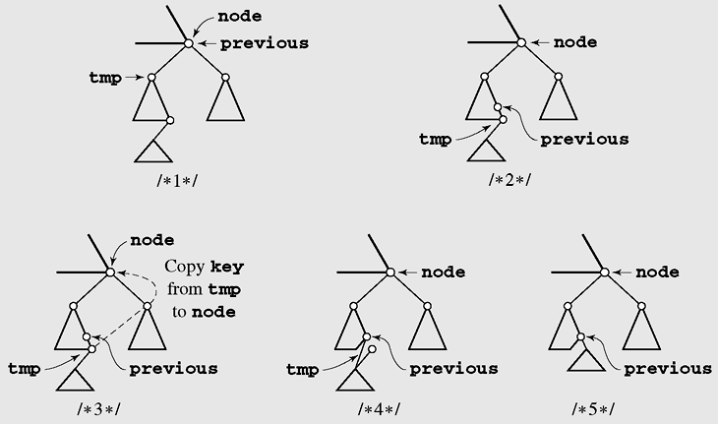
Deletion by Copying (continued)
Figure 6-33 Deleting by copying

Slide 56
Balancing a Tree
A binary tree is height-balanced or balanced if the difference in height of both subtrees of any node in the tree is either zero or one
A tree is considered perfectly balanced if it is balanced and all leaves are to be found on one level or two levels

Slide 57
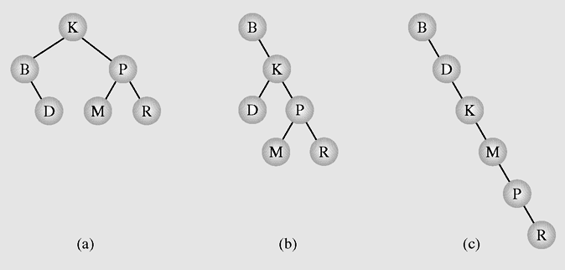
Balancing a Tree (continued)
Figure 6-34 Different binary search trees with the same information

Slide 58
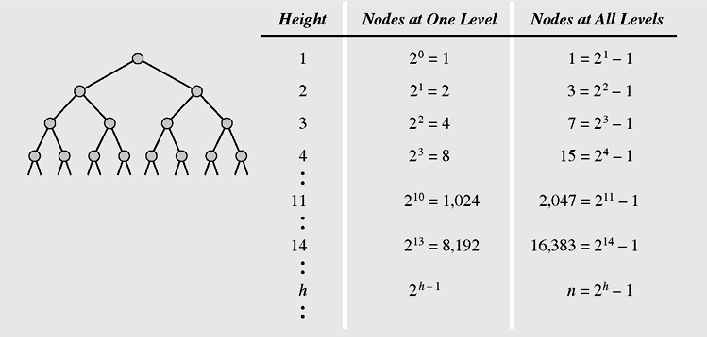
Balancing a Tree (continued)
Figure 6-35 Maximum number of nodes in binary trees of
different heights

Slide 59
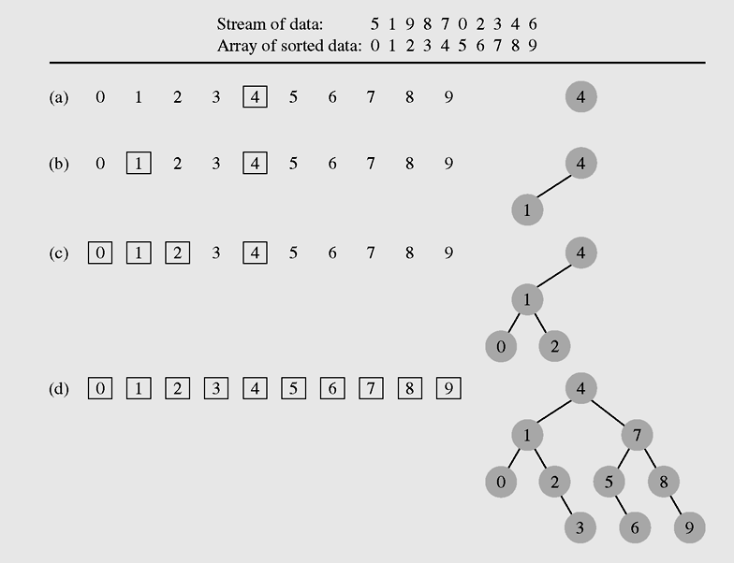
Balancing a Tree (continued)
Figure 6-36 Creating a binary search tree from an ordered array

