Slide 1
Chapter 3
Linked Lists

Slide 2

Please close your laptop!

Slide 3
Objectives
Discuss the following topics:
Singly Linked Lists
Doubly Linked Lists
Circular Lists
Lists in java.util

Slide 4
Review Array
Array is the most common data storage structure
Arrays can be used in programs where a list of objects with the same data type is needed.
Arrays have great use in all kinds of applications, especially games (Lines 98, Bejeweled) and simulations.
Examples: an array of character models, an array of textures, an array of sounds.

Slide 5
Review Array
Advantages:
  Simple usage
  Fast access
Disadvantages:
  Must specify size at construction time => fixed size
  Inefficient space usage
  Insert and Remove operations is expensive

Slide 6
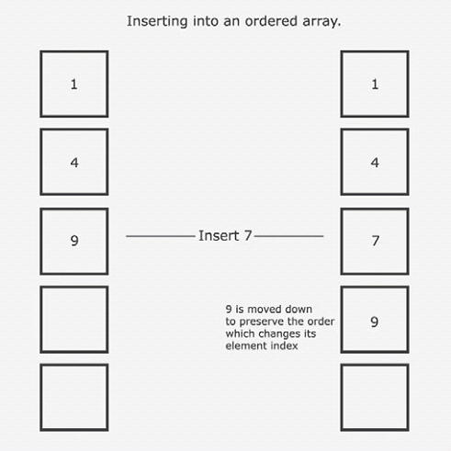
Review Array
Insert into an
ordered array

Slide 7
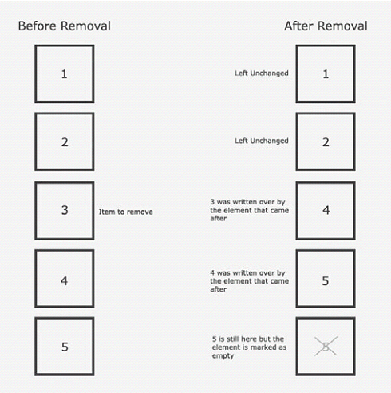
Review Array
Removing an item
from an array by
copying over it

Slide 8
Linked Lists
“linked” term
  A linked structure is a collection of nodes storing data and links to other nodes
  A linked list is a data structure composed of nodes, each node holding some information and a reference to another node in the list
  A singly linked list is a node that has a link only to its successor in this sequence

Slide 9
Singly Linked Lists
Flexible space use
  Dynamically allocate space for each element (node) as needed
  Include a reference (pointer) to the next element
Singly Linked List
  Each node of the list contains
    the information item (an object pointer)
    a pointer to the next node
Info
Next

Slide 10
Singly Linked Lists (continued)
The Collection has a reference (pointer) to the list head
  Initially NULL
Collection
Head

Slide 11
Singly Linked Lists (continued)
Collection structure has a pointer to the list head
  Initially NULL
Add first item
  Allocate space for node
  Set its info to refer to object
  Set Next to NULL
  Set Head to refer to new node
Collection
node
Head
Info
Next

Slide 12
Singly Linked Lists (continued)
Add second item
  Allocate space for node
  Set its info to refer to object
  Set Next to current Head
  Set Head to refer to new node
Collection
Head
node
node
Info
Next
Info
Next

Slide 13

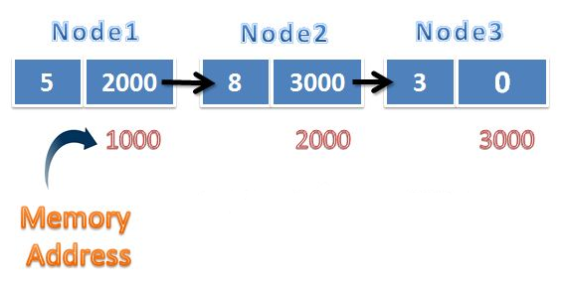
Singly Linked Lists (continued)

Slide 14
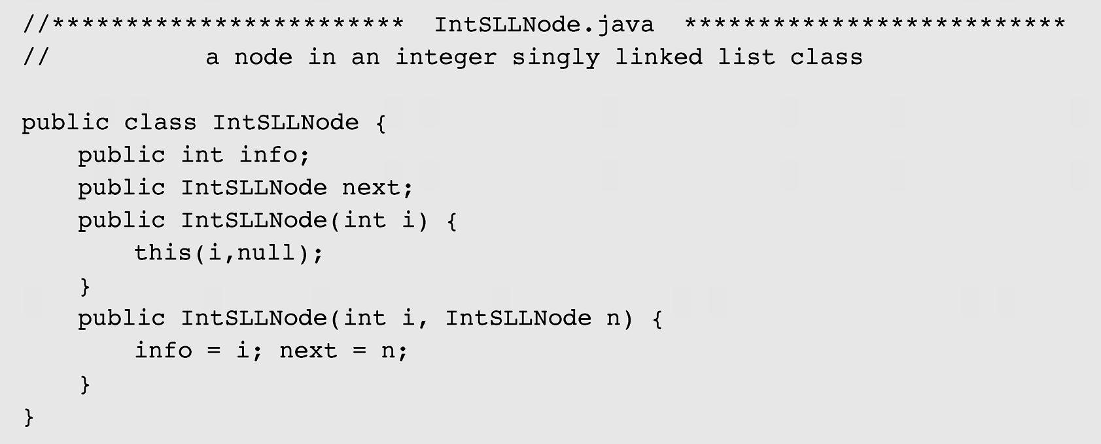
Singly Linked Lists (continued)
Figure 3-2 An implementation of a singly linked list of integers

Slide 15

Singly Linked Lists (continued)
Figure 3-2 An implementation of a singly linked list of integers
(continued)

Slide 16

Singly Linked Lists (continued)
Figure 3-3 A singly linked list of integers

Slide 17

Singly Linked Lists (continued)
Figure 3-4 Inserting a new node at the beginning of a singly linked list

Slide 18
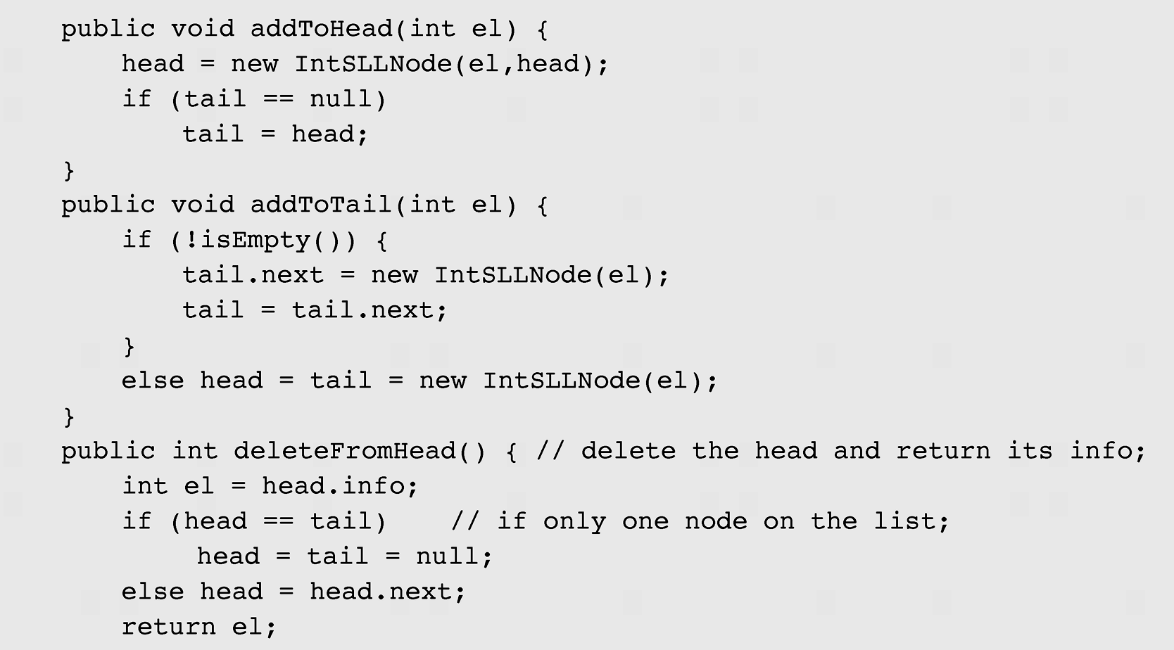
Singly Linked Lists (continued)
Figure 3-2 An implementation of a singly linked list of integers (continued)

Slide 19

Singly Linked Lists (continued)
Figure 3-5 Inserting a new node at the end of a singly linked list

Slide 20
Singly Linked Lists (continued)
Figure 3-2 An implementation of a singly linked list of integers (continued)

Slide 21

Singly Linked Lists (continued)
Figure 3-6 Deleting a node from the beginning of a singly linked list

Slide 22
Singly Linked Lists (continued)
Figure 3-2 An implementation of a singly linked list of integers (continued)

Slide 23

Singly Linked Lists (continued)
Figure 3-7 Deleting a node from the end of a singly linked list

Slide 24
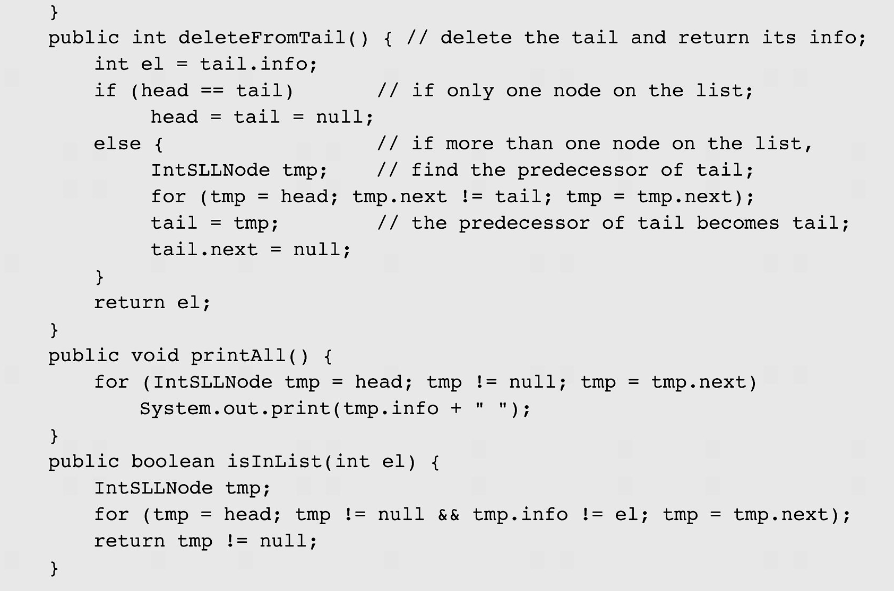
Singly Linked Lists (continued)
Figure 3-2 An implementation of a singly linked list of integers (continued)

Slide 25
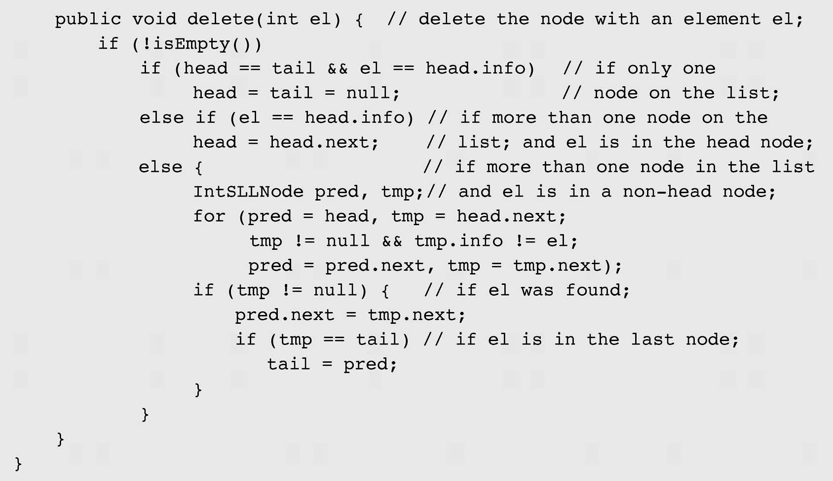
Singly Linked Lists (continued)
Figure 3-2 An implementation of a singly linked list of integers (continued)

Slide 26
Singly Linked List
public static void main(String[] args) {
  IntSLL l = new IntSLL();
  l.AddtoHead(5);
  l.AddtoHead(4);
  l.printAll(); // 4, 5
    l.AddtoTail(6);
    l.AddtoTail(7);
    l.printAll(); // 4, 5, 6, 7
    l.DeleteFromHead();
    l.printAll(); // 5, 6, 7
    l.DeleteFromTail();
    l.printAll(); // 5, 6
  }

Slide 27
Exercises
Write the following methods:
  Count nodes in a SLL.
  Insert a node into any position
  Remove a node at any position
  Search a node by info

Slide 28
Singly Linked List
How to store data which is not integer (double, Student,…)?
  Implement SLL for specific data.
  Implement generic SLL.

Slide 29
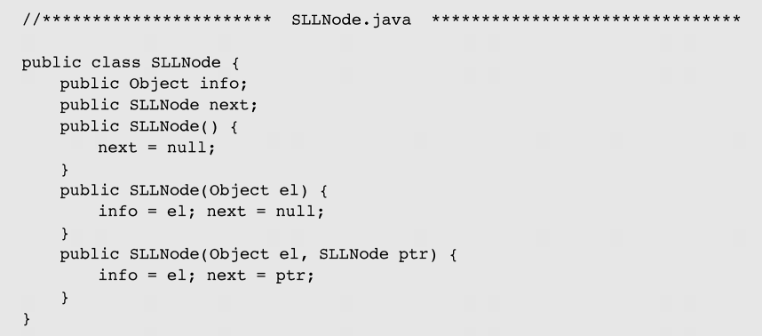
Singly Linked Lists (continued)
Figure 3-9 Implementation of a generic singly linked list

Slide 30

Singly Linked Lists (continued)
Figure 3-9 Implementation of a generic singly linked list (continued)

Slide 31
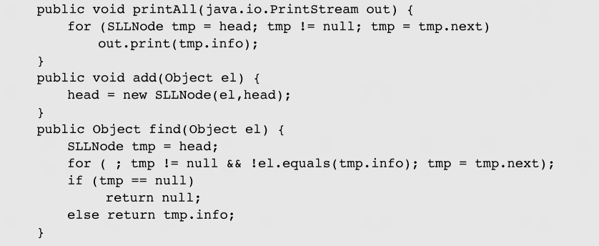
Singly Linked Lists (continued)
Figure 3-9 Implementation of a generic singly linked list (continued)

Slide 32
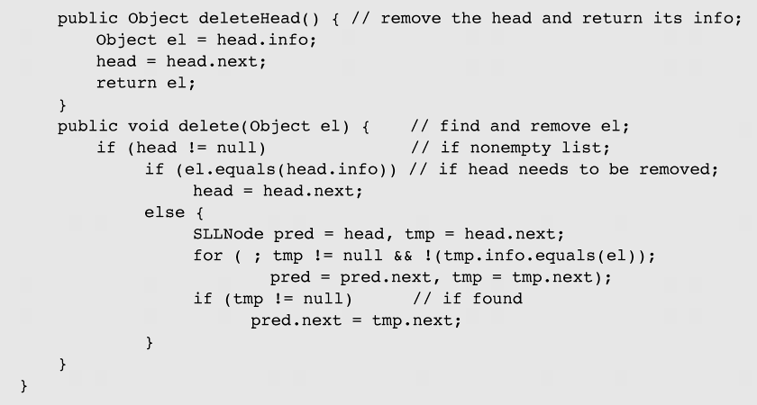
Singly Linked Lists (continued)
Figure 3-9 Implementation of a generic singly linked list (continued)

Slide 33
Singly Linked Lists (continued)
  Case1:
  SLL l = new SLL();
  l.Add(5);// Boxing
  l.Add(4);// Boxing
  int el = (int)l.first(); // Unboxing
  Case2:
  SLL l = new SLL();
  l.Add(new Student());
  Student el = (Student)l.first(); // casting
  => Use generic SLL<T> ( source code in Text book)

Slide 34

Doubly Linked Lists
A doubly linked list is when each node in a linked list has two reference fields, one to the successor and one to the predecessor
Figure 3-10 A doubly linked list

Slide 35
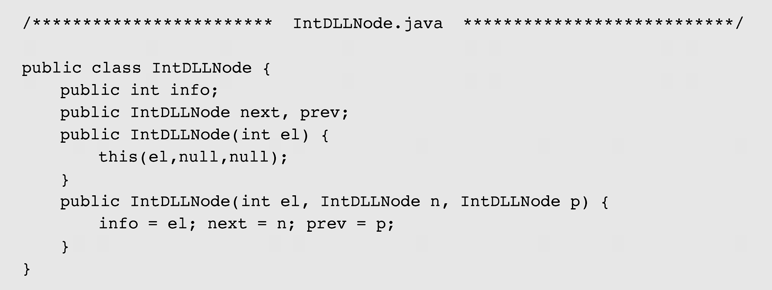
Doubly Linked Lists (continued)
Figure 3-11 An implementation of a doubly linked list

Slide 36
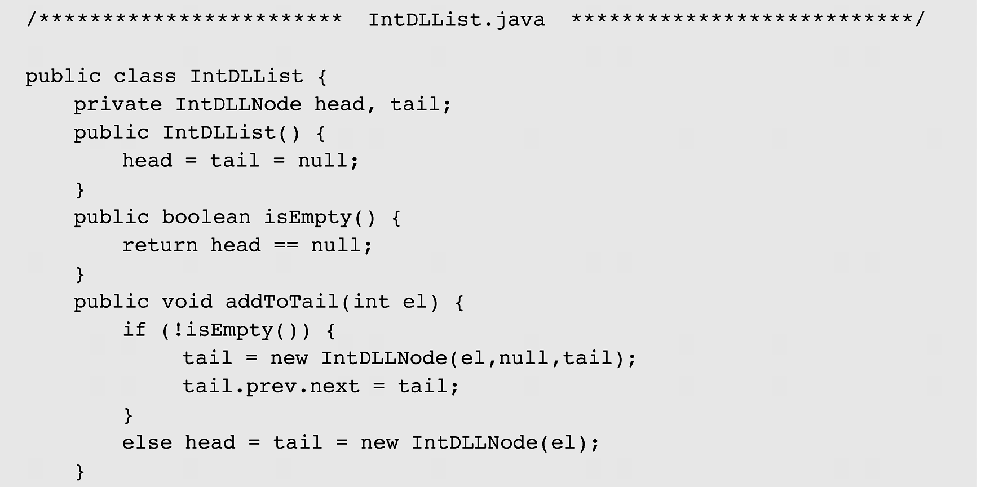
Doubly Linked Lists (continued)
Figure 3-11 An implementation of a doubly linked list (continued)

Slide 37
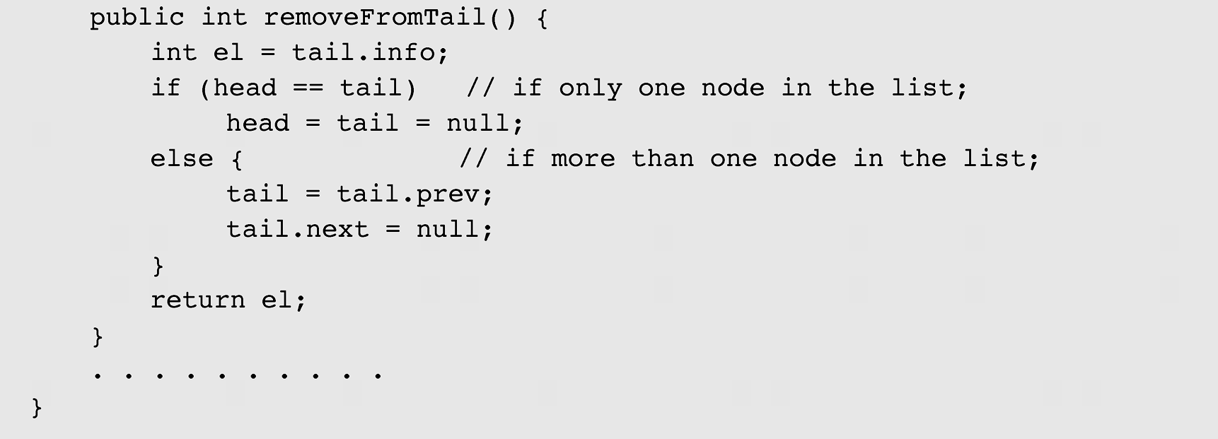
Doubly Linked Lists (continued)
Figure 3-11 An implementation of a doubly linked list (continued)

Slide 38

Doubly Linked Lists (continued)
Figure 3-12 Adding a new node at the end of a doubly linked list

Slide 39

Doubly Linked Lists (continued)
Figure 3-12 Adding a new node at the end of a doubly linked list
(continued)

Slide 40

Doubly Linked Lists (continued)
Figure 3-13 Deleting a node from the end of a doubly linked list

Slide 41

Circular Lists
A circular list is when nodes form a ring: The list is finite and each node has a successor
Figure 3-14 A circular singly linked list

Slide 42

Circular Lists (continued)
Figure 3-15 Inserting nodes at the front of a circular singly linked
list (a) and at its end (b)

Slide 43
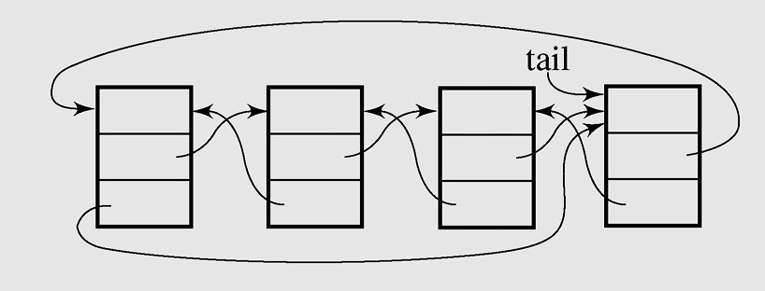
Circular Lists (continued)
Figure 3-16 A circular doubly linked list

Slide 44
Vector & ArrayList
API: the two classes are very similar.
Synchronization:
  Vectors are synchronized -> thread safe & make them executing slow.
  ArrayLists are unsynchronized -> not thread safe & faster than Vectors.
Data growth:
  Both hold onto their contents using an Array.
  Different to doubling the size of its array.

