Slide 1
The DSW Algorithm
The building block for tree transformations in this algorithm is the rotation
There are two types of rotation, left and right, which are symmetrical to one another
rotateRight (Gr, Par, Ch)
if Par is not the root of the tree // i.e., if Gr is not null
grandparent Gr of child Ch becomes Ch’s parent;
right subtree of Ch becomes left subtree of Ch’s parent Par;
node Ch acquires Par as its right child;

Slide 2
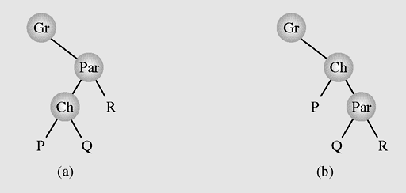
The DSW Algorithm (continued)
Figure 6-37 Right rotation of child Ch about parent Par

Slide 3
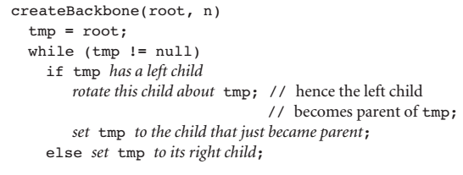
The DSW Algorithm (continued)
Step 1: Transforming a binary search tree into a backbone

Slide 4
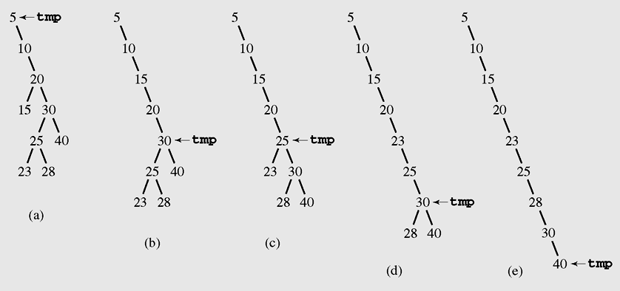
The DSW Algorithm (continued)
Figure 6-38 Transforming a binary search tree into a backbone

Slide 5
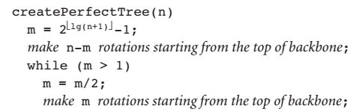
The DSW Algorithm (continued)
Step 2: Transforming a backbone into a perfectly balanced tree

Slide 6
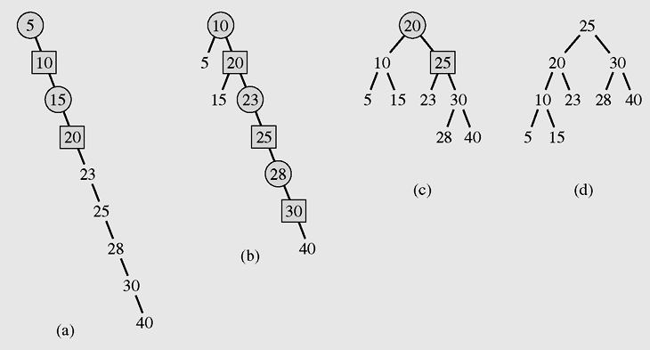
The DSW Algorithm (continued)
Figure 6-39 Transforming a backbone into a perfectly balanced tree

Slide 7
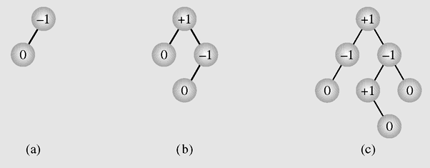
AVL Trees
An AVL tree is one in which the height of the left and right subtrees of every node differ by at most one
A balance factor is the height of the right subtree minus the height of the left subtree.
Figure 6-40 Examples of AVL trees

Slide 8
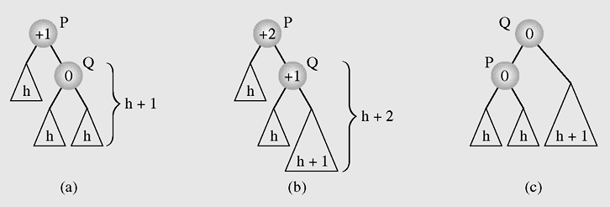
AVL Trees (continued)
Figure 6-41 Balancing a tree after insertion of a node in the right
subtree of node Q

Slide 9
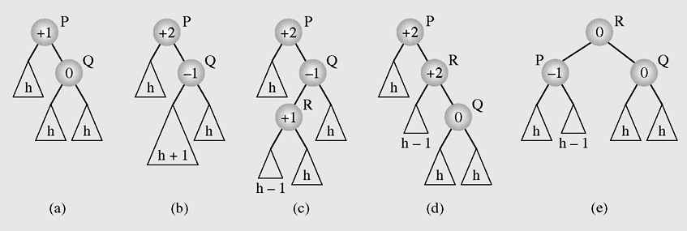
AVL Trees (continued)
Figure 6-42 Balancing a tree after insertion of a node in the left
subtree of node Q

Slide 10
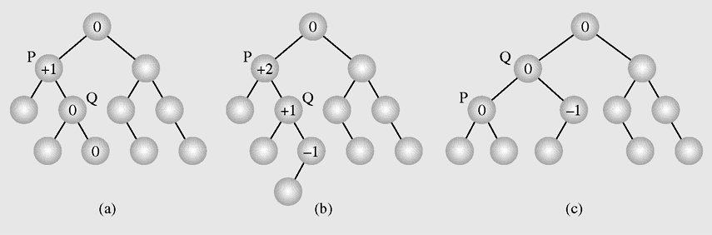
AVL Trees (continued)
Figure 6-43 An example of inserting a new node (b) in an AVL tree (a),
which requires one rotation (c) to restore the height
balance

Slide 11
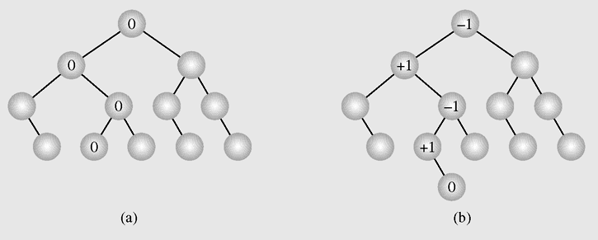
AVL Trees (continued)
Figure 6-44 In an AVL tree (a) a new node is inserted
(b) requiring no height adjustments

Slide 12
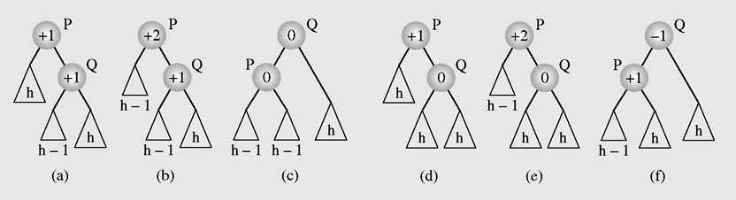
AVL Trees (continued)
Figure 6-45 Rebalancing an AVL tree after deleting a node

Slide 13
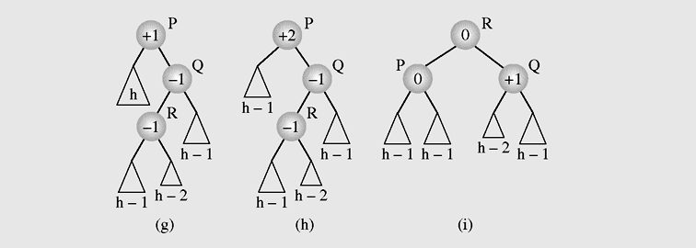
AVL Trees (continued)
Figure 6-45 Rebalancing an AVL tree after deleting a node
(continued)

Slide 14
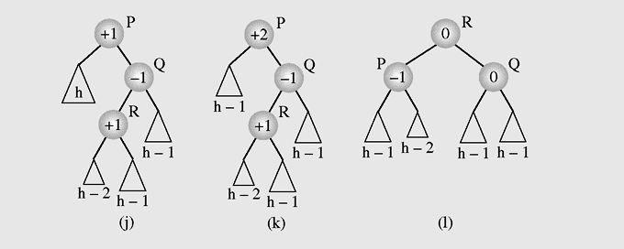
AVL Trees (continued)
Figure 6-45 Rebalancing an AVL tree after deleting a node
(continued)

Slide 15
Self-Adjusting Trees
The strategy in self-adjusting trees is to restructure trees by moving up the tree with only those elements that are used more often, and creating a priority tree

Slide 16
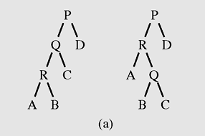
Self-Restructuring Trees
Single rotation – Rotate a child about its parent if an element in a child is accessed, unless it is the root
Figure 6-46 Restructuring a tree by using (a) a single rotation or
(b) moving to the root when accessing node R

Slide 17
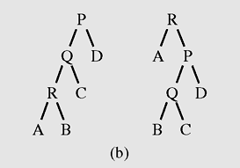
Self-Restructuring Trees (continued)
Moving to the root – Repeat the child–parent rotation until the element being accessed is in the root
Figure 6-46 Restructuring a tree by using (a) a single rotation or
(b) moving to the root when accessing node R (continued)

Slide 18
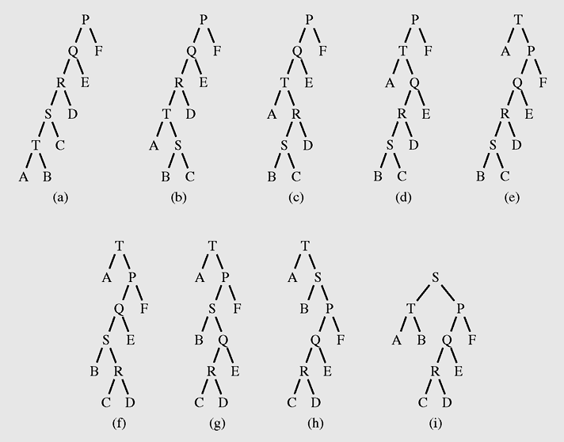
Self-Restructuring Trees (continued)
Figure 6-47 (a–e) Moving element T to the root and then (e–i)
moving element S to the root

Slide 19
Splaying
A modification of the move-to-the-root strategy is called splaying
Splaying applies single rotations in pairs in an order depending on the links between the child, parent, and grandparent
Semisplaying requires only one rotation for a homogeneous splay and continues splaying with the parent of the accessed node, not with the node itself

Slide 20
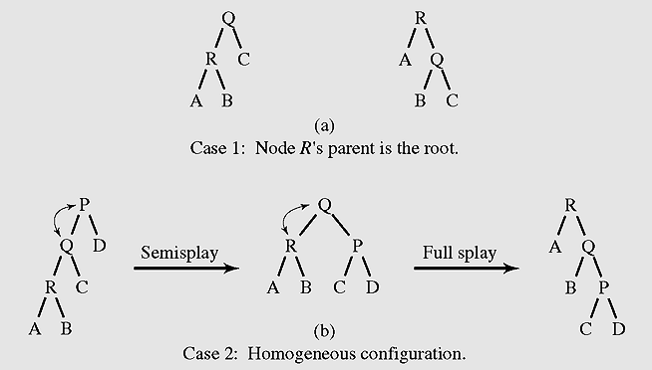
Splaying (continued)
Figure 6-48 Examples of splaying

Slide 21
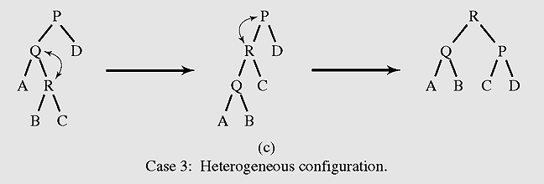
Splaying (continued)
Figure 6-48 Examples of splaying (continued)

Slide 22
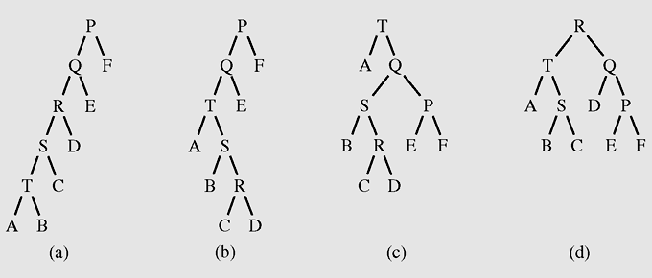
Splaying (continued)
Figure 6-49 Restructuring a tree with splaying (a–c) after
accessing T and (c–d) then R

Slide 23
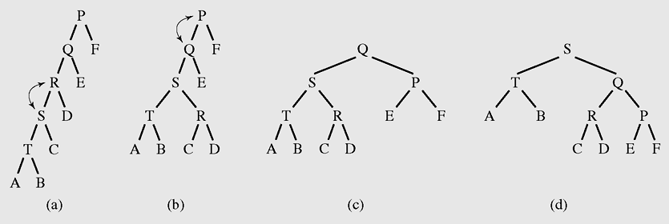
Splaying (continued)
Figure 6-50 (a–c) Accessing T and restructuring the tree with
semisplaying; (c–d) accessing T again

Slide 24
Heaps
A particular kind of binary tree, called a heap, has two properties:
  The value of each node is greater than or
  equal to the values stored in each of its children
  The tree is perfectly balanced, and the leaves in the last level are all in the leftmost positions
These two properties define a max heap
If “greater” in the first property is replaced with “less,” then the definition specifies a min heap

Slide 25
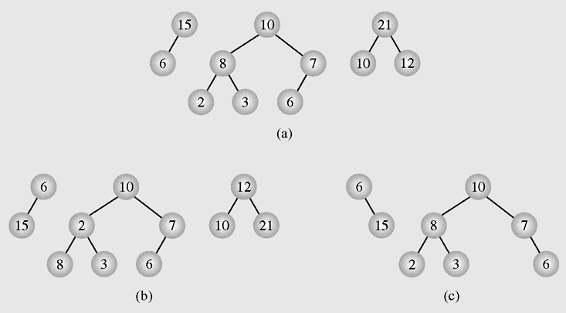
Heaps (continued)
Figure 6-51 Examples of (a) heaps and (b–c) nonheaps

Slide 26
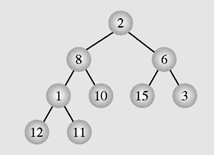
Heaps (continued)
Figure 6-52 The array [2 8 6 1 10 15 3 12 11] seen as a tree

Slide 27
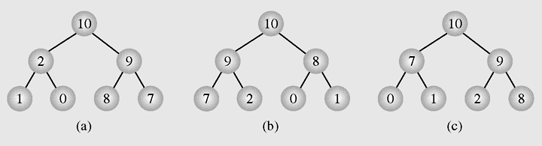
Heaps (continued)
Figure 6-53 Different heaps constructed with the same elements

Slide 28
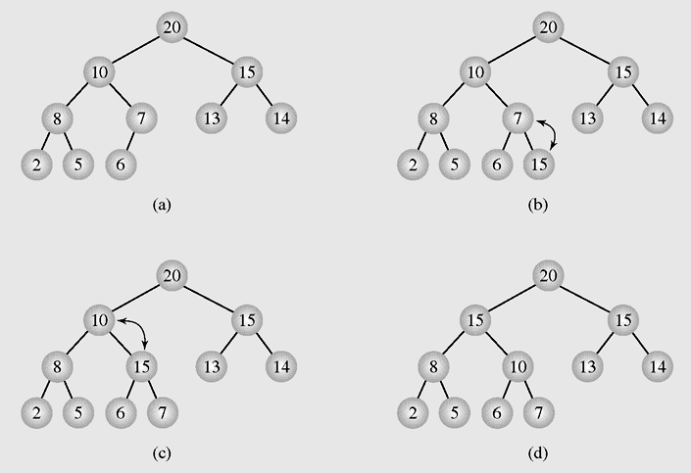
Heaps as Priority Queues
Figure 6-54 Enqueuing an element to a heap

Slide 29
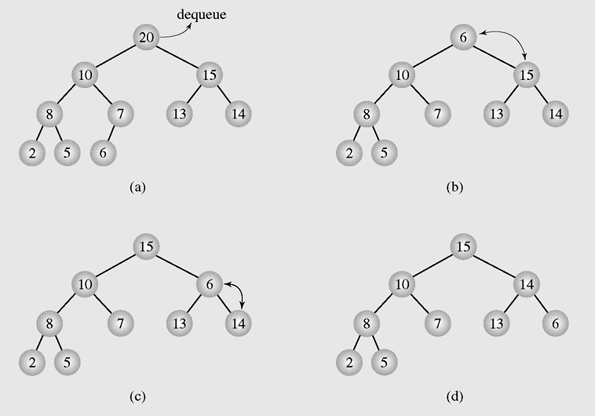
Heaps as Priority Queues (continued)
Figure 6-55 Dequeuing an element from a heap

Slide 30
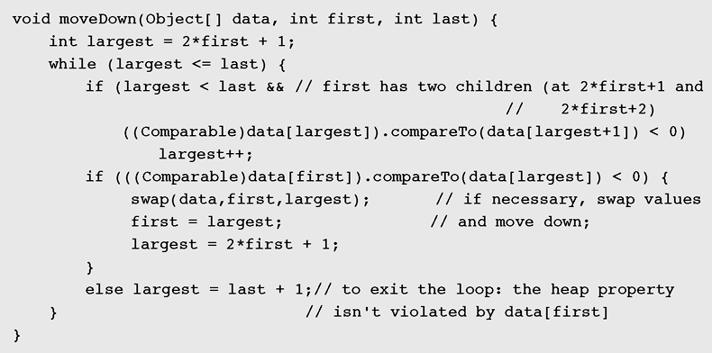
Heaps as Priority Queues (continued)
Figure 6-56 Implementation of an algorithm to move the root
element down a tree

Slide 31
Organizing Arrays as Heaps
Top down:
  Start with an empty heap and sequentially include elements into a growing heap

Slide 32
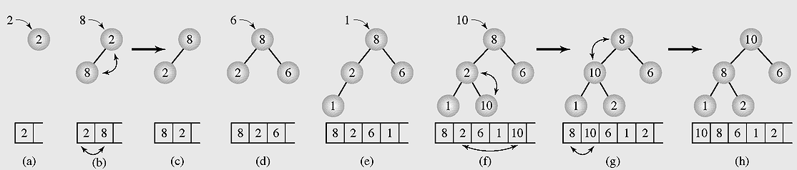
Organizing Arrays as Heaps
[2 8 6 1 10 15 3 12 11]
N
2n+1
2n+2

Slide 33
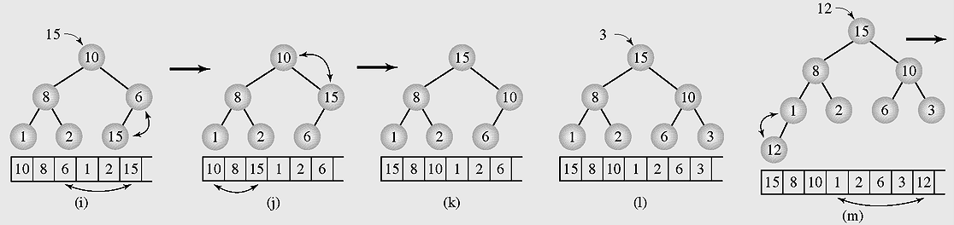
Organizing Arrays as Heaps
Figure 6-57 Organizing an array as a heap with a top-down method
(continued)

Slide 34
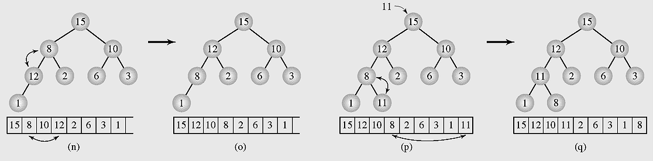
Organizing Arrays as Heaps
Figure 6-57 Organizing an array as a heap with a top-down method
(continued)

Slide 35
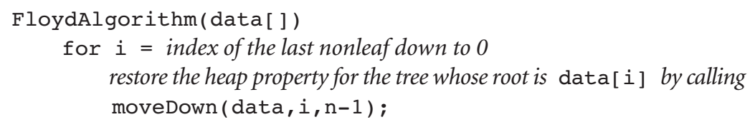
Organizing Arrays as Heaps
Bottom up:

Slide 36
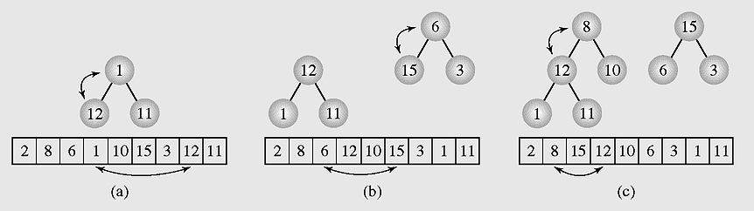
Organizing Arrays as Heaps (continued)
Figure 6-58 Transforming the array [2 8 6 1 10 15 3 12 11] into
a heap with a bottom-up method

Slide 37
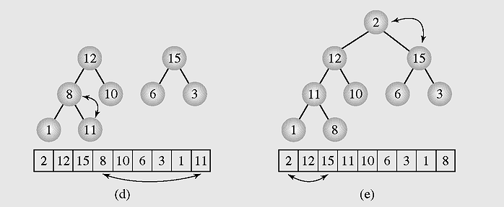
Organizing Arrays as Heaps (continued)
Figure 6-58 Transforming the array [2 8 6 1 10 15 3 12 11] into
a heap with a bottom-up method (continued)

Slide 38
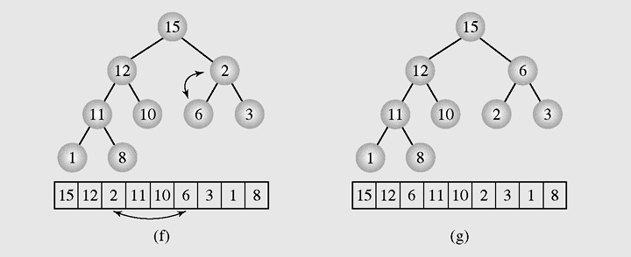
Organizing Arrays as Heaps (continued)
Figure 6-58 Transforming the array [2 8 6 1 10 15 3 12 11] into
a heap with a bottom-up method (continued)

Slide 39
Polish Notation and
Expression Trees
Polish notation is a special notation for propositional logic that eliminates all parentheses from formulas
The compiler rejects everything that is not essential to retrieve the proper meaning of formulas rejecting it as “syntactic sugar”

Slide 40
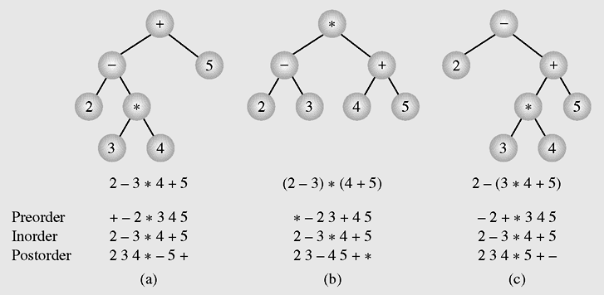
Polish Notation and
Expression Trees (continued)
Figure 6-59 Examples of three expression trees and results
of their traversals

Slide 41
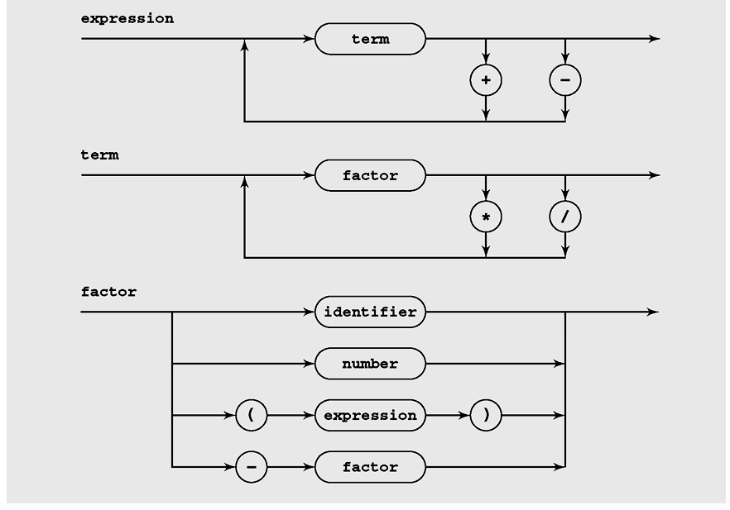
Diagram

Slide 42
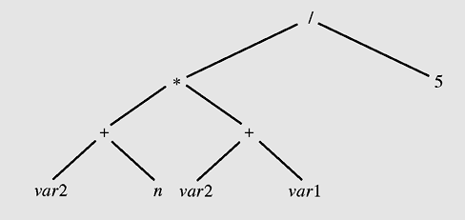
Operations on Expression Trees
Figure 6-60 An expression tree

Slide 43
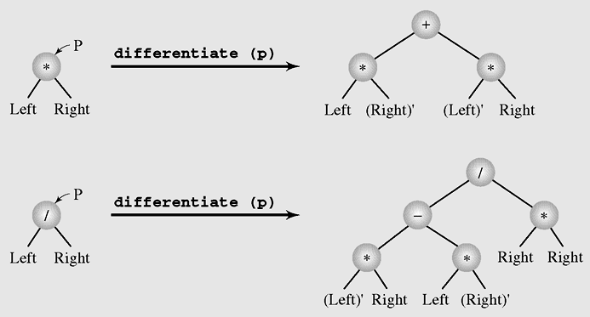
Operations on Expression Trees (continued)
Figure 6-61 Tree transformations for differentiation of
multiplication and division

Slide 44
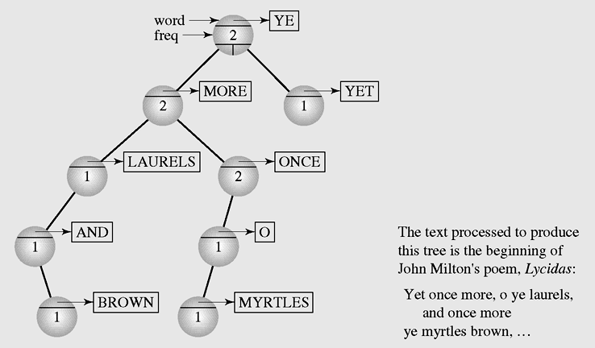
Case Study: Computing Word Frequencies
Figure 6-62 Semisplay tree used for computing word frequencies

Slide 45
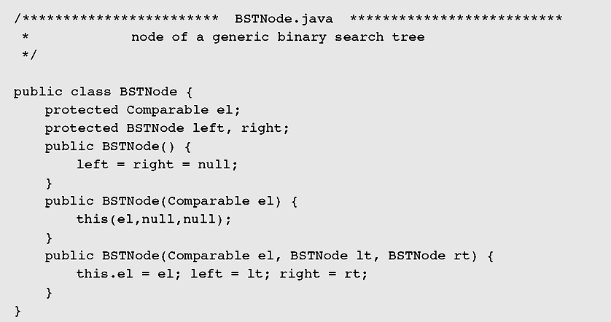
Case Study: Computing Word Frequencies (continued)
Figure 6-63 Implementation of word frequency computation

Slide 46
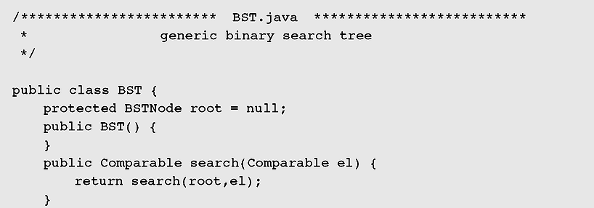
Case Study: Computing Word Frequencies (continued)
Figure 6-63 Implementation of word frequency computation
(continued)

Slide 47
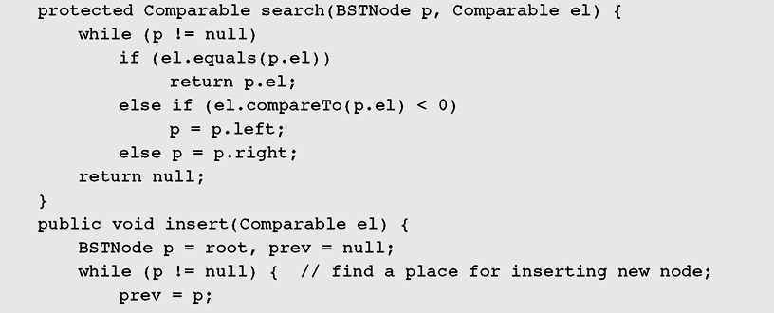
Case Study: Computing Word Frequencies (continued)
Figure 6-63 Implementation of word frequency computation
(continued)

Slide 48
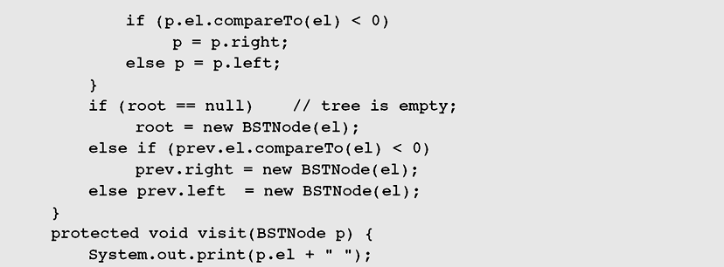
Case Study: Computing Word Frequencies (continued)
Figure 6-63 Implementation of word frequency computation
(continued)

Slide 49
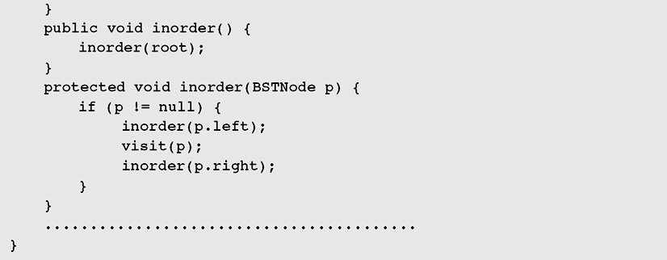
Case Study: Computing Word Frequencies (continued)
Figure 6-63 Implementation of word frequency computation
(continued)

Slide 50
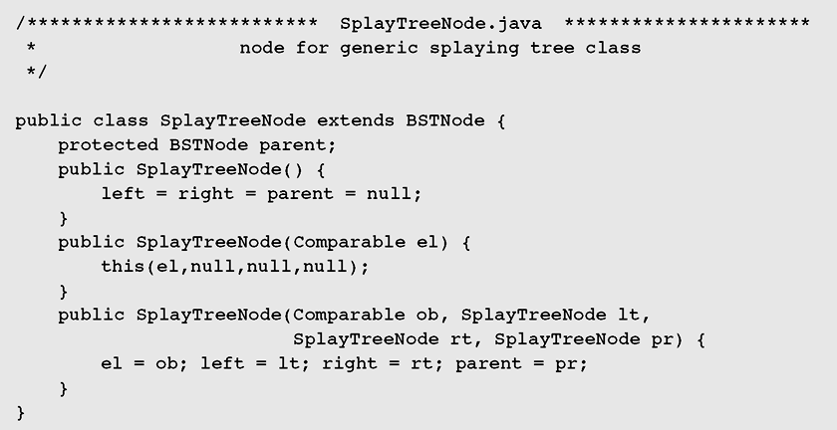
Case Study: Computing Word Frequencies (continued)
Figure 6-63 Implementation of word frequency computation
(continued)

Slide 51
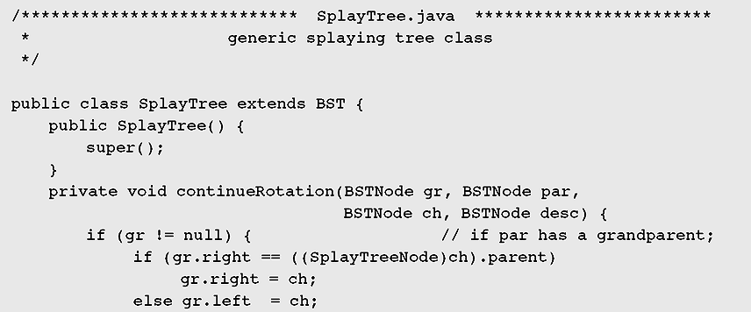
Case Study: Computing Word Frequencies (continued)
Figure 6-63 Implementation of word frequency computation
(continued)

Slide 52
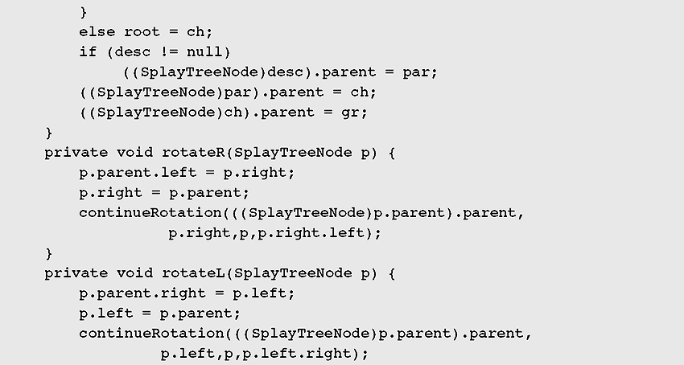
Case Study: Computing Word Frequencies (continued)
Figure 6-63 Implementation of word frequency computation
(continued)

Slide 53
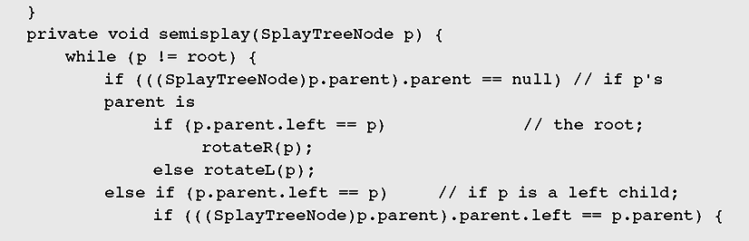
Case Study: Computing Word Frequencies (continued)
Figure 6-63 Implementation of word frequency computation
(continued)

Slide 54
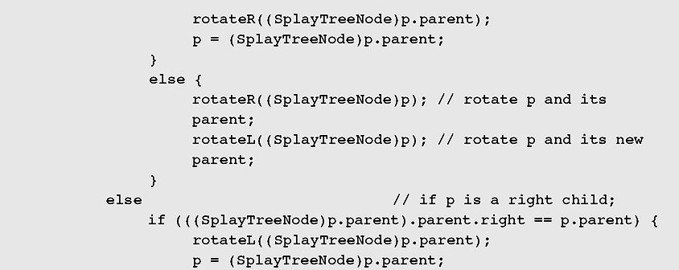
Case Study: Computing Word Frequencies (continued)
Figure 6-63 Implementation of word frequency computation
(continued)

Slide 55
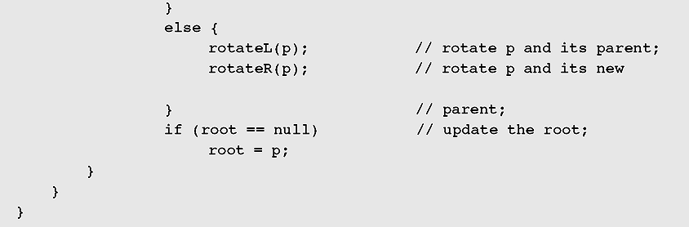
Case Study: Computing Word Frequencies (continued)
Figure 6-63 Implementation of word frequency computation
(continued)

Slide 56
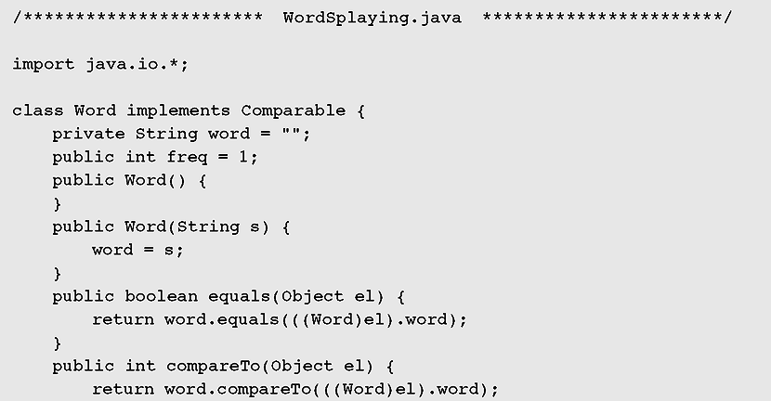
Case Study: Computing Word Frequencies (continued)
Figure 6-63 Implementation of word frequency computation
(continued)

Slide 57

Case Study: Computing Word Frequencies (continued)
Figure 6-63 Implementation of word frequency computation
(continued)

Slide 58

Case Study: Computing Word Frequencies (continued)
Figure 6-63 Implementation of word frequency computation
(continued)

Slide 59

Case Study: Computing Word Frequencies (continued)
Figure 6-63 Implementation of word frequency computation
(continued)

Slide 60

Case Study: Computing Word Frequencies (continued)
Figure 6-63 Implementation of word frequency computation
(continued)

Slide 61

Case Study: Computing Word Frequencies (continued)
Figure 6-63 Implementation of word frequency computation
(continued)

Slide 62
Summary
A tree is a data type that consists of nodes and arcs.
The root is a node that has no parent; it can have only child nodes.
Each node has to be reachable from the root through a unique sequence of arcs, called a path.
An orderly tree is where all elements are stored according to some predetermined criterion of ordering.

Slide 63
Summary (continued)
A binary tree is a tree whose nodes have two children (possibly empty), and each child is designated as either a left child or a right child.
A decision tree is a binary tree in which all nodes have either zero or two nonempty children.
Tree traversal is the process of visiting each node in the tree exactly one time.
Threads are references to the predecessor and successor of the node according to an inorder traversal.

Slide 64
Summary (continued)
An AVL tree is one in which the height of the left and right subtrees of every node differ by at most one.
A modification of the move-to-the-root strategy
is called splaying.
Polish notation is a special notation for propositional logic that eliminates all parentheses from formulas.

