Slide 1
Chapter 8
Graphs

Slide 2
Objectives
Discuss the following topics:
Graphs
Graph Representation
Graph Traversals
Shortest Paths
Cycle Detection

Slide 3
Objectives (continued)
Discuss the following topics:
Spanning Trees
Connectivity
Eulerian and Hamiltonian Graphs
Graph Coloring

Slide 4
Graphs
A graph is a collection of vertices (or nodes) and the connections between them
A simple graph G = (V, E) consists of a nonempty set V of vertices and a possibly empty set E of edges, each edge being a set of two vertices from V
A directed graph, or a digraph, G = (V, E) consists of a nonempty set V of vertices and a set E of edges (also called arcs), where each edge is a pair of vertices from V

Slide 5
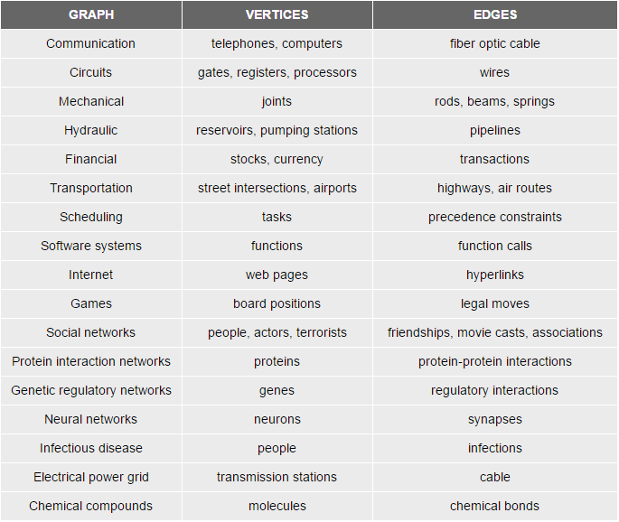


Slide 6
Graphs (continued)
A multigraph is a graph in which two vertices can be joined by multiple edges
A pseudograph is a multigraph with the condition v_{i} ≠ v_{j} removed, which allows for
loops to occur
If all vertices in a circuit are different, then it is called a cycle
A graph is called a weighted graph if each edge has an assigned number

Slide 7
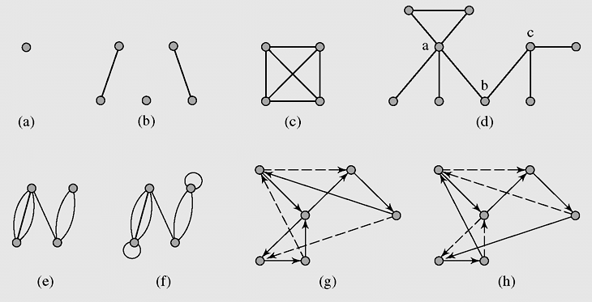
Graphs (continued)
Figure 8-1 Examples of graphs: (a–d) simple graphs; (c) a complete graph K₄;
(e) a multigraph; (f) a pseudograph; (g) a circuit in a digraph; (h) a cycle in the
digraph

Slide 8
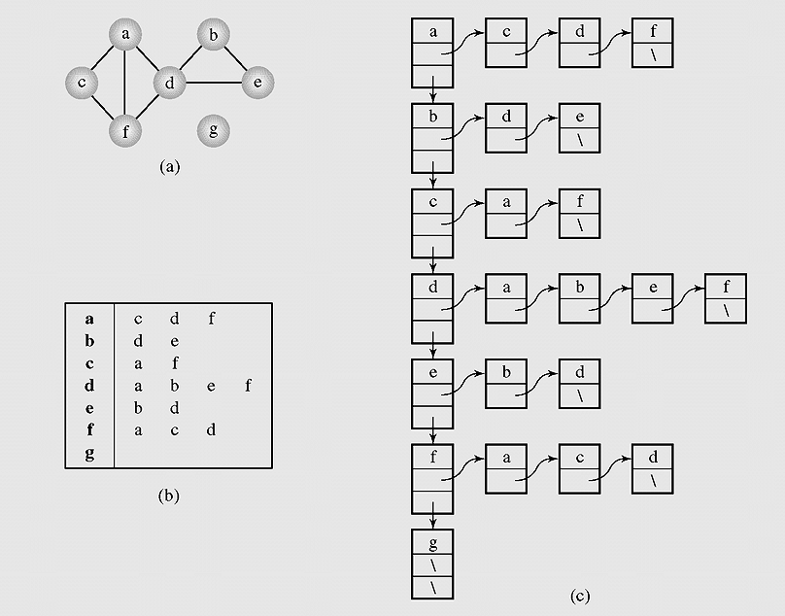
Graph Representation
Figure 8-2 Graph representations (a) A graph represented
as (b–c) an adjacency list

Slide 9
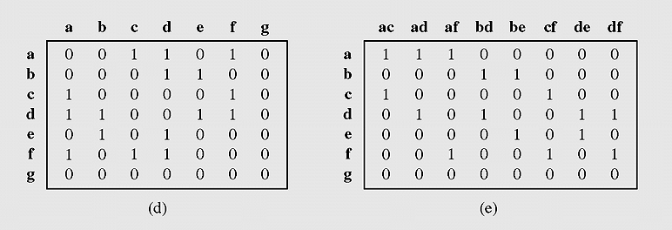
Graph Representation (continued)
Figure 8-2 Graph representations (d) an adjacency matrix, and
(e) an incidence matrix (continued)

Slide 10
Graph Traversals
In the depth-first search algorithm, each vertex v is visited and then each unvisited vertex adjacent to v is visited

Slide 11
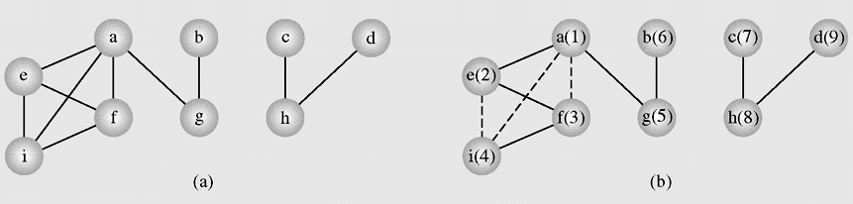
Graph Traversals
Figure 8-3 An example of application of the depthFirstSearch()
algorithm to a graph

Slide 12
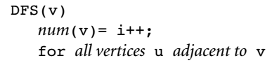
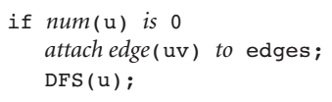
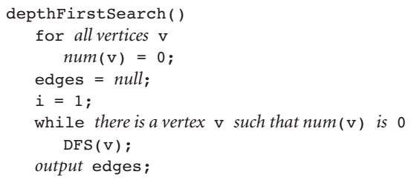
Graph Traversals (continued)

Slide 13
Graph Traversals (continued)
A spanning tree is an algorithm that guarantees generating a tree (or a forest, a set of trees) that includes or spans over all vertices of the original graph

Slide 14
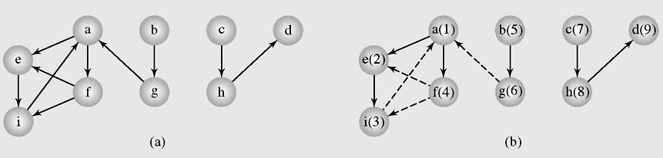
Graph Traversals (continued)
Figure 8-4 The depthFirstSearch() algorithm applied to a digraph

Slide 15
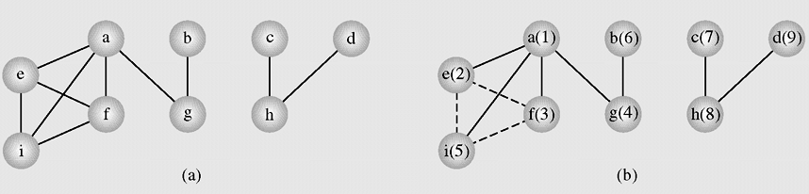
Graph Traversals (continued)
Figure 8-5 An example of application of the breadthFirstSearch()
algorithm to a graph

Slide 16
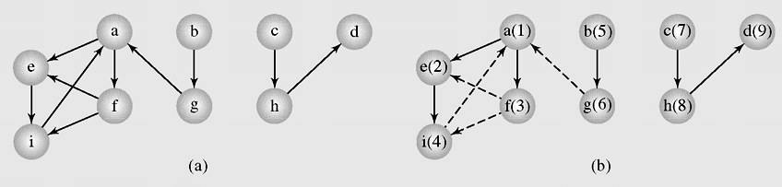
Graph Traversals (continued)
Figure 8-6 The breadthFirstSearch() algorithm applied to a digraph

Slide 17
Shortest Paths
The methods solving the shortest path problem are divided in two classes:
  Label-setting methods
    In each pass through the vertices still to be processed, one vertex is set to a value that remains unchanged to the end of the execution
  Label-correcting methods
    Allow for the changing of any label during application of the method
Negative cycle is a cycle composed of edges with weights adding up to a negative number

Slide 18
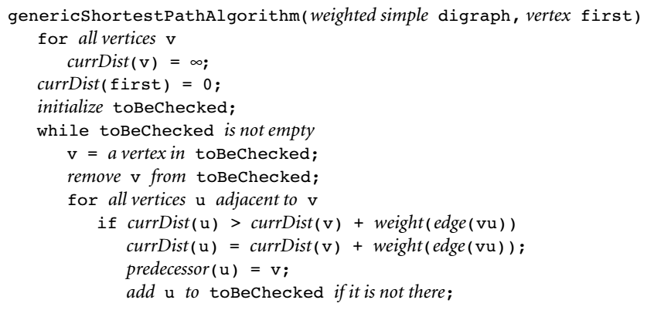
Shortest Paths (continued)

Slide 19
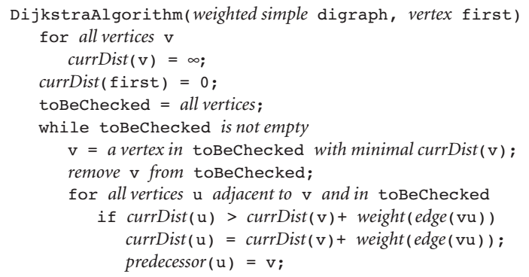
Shortest Paths (continued)

Slide 20
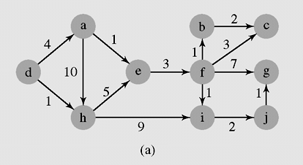
Shortest Paths (continued)
Figure 8-7 An execution of DijkstraAlgorithm()

Slide 21
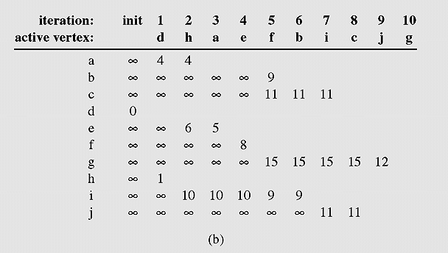
Shortest Paths (continued)
Figure 8-7 An execution of DijkstraAlgorithm() (continued)

Slide 22
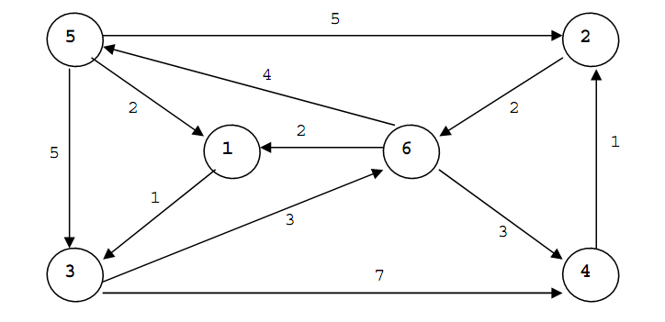

Slide 23
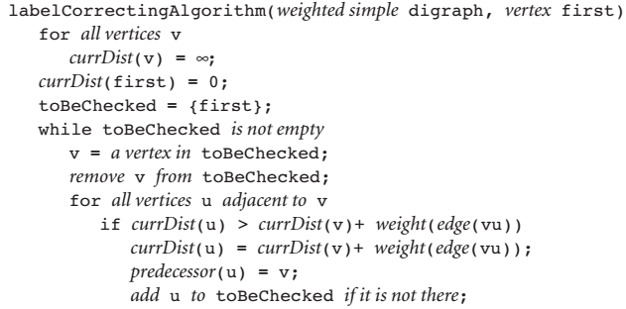
Shortest Paths (continued)

Slide 24
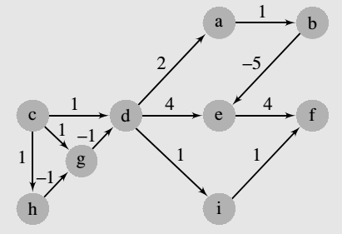
Shortest Paths (continued)

Slide 25
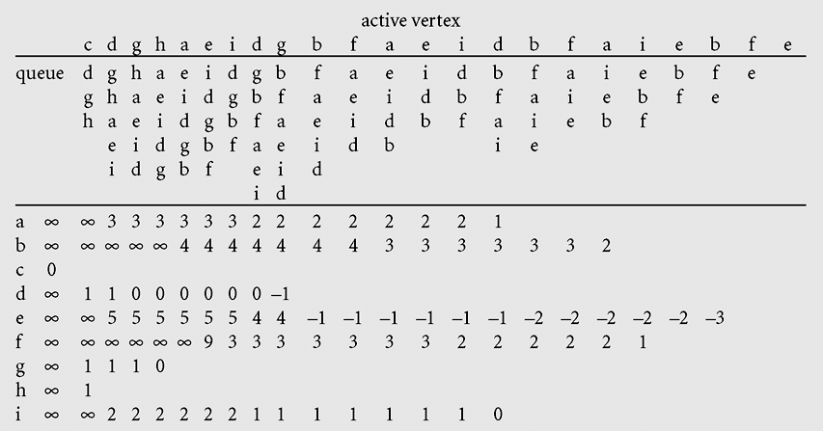
Shortest Paths (continued)
Figure 8-9 An execution of labelCorrectingAlgorithm(),
which uses a queue

Slide 26
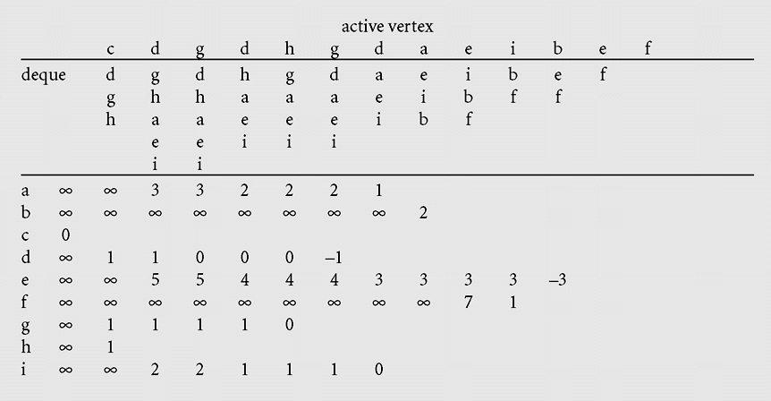
Shortest Paths (continued)
Figure 8-10 An execution of labelCorrectingAlgorithm(),
which applies a deque

Slide 27
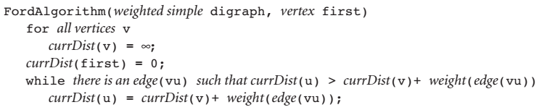
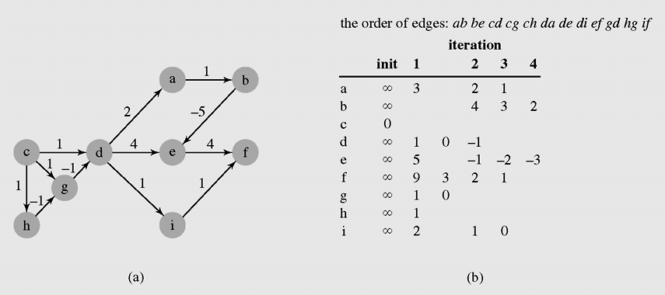
Shortest Paths (continued)

Slide 28
All-to-All Shortest Path Problem Algorithm
WFIalgorithm(matrix weight)
for i = 1 to |V|
for j = 1 to |V|
for k = 1 to |V|
if weight[j][k] > weight[j][i] + weight[i][k]
weight[j][k] = weight[j][i] + weight[i][k];

Slide 29
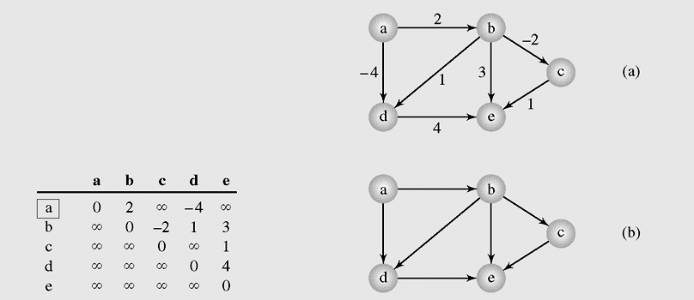
All-to-All Shortest Path Problem
Figure 8-11 An execution of WFIalgorithm()

Slide 30
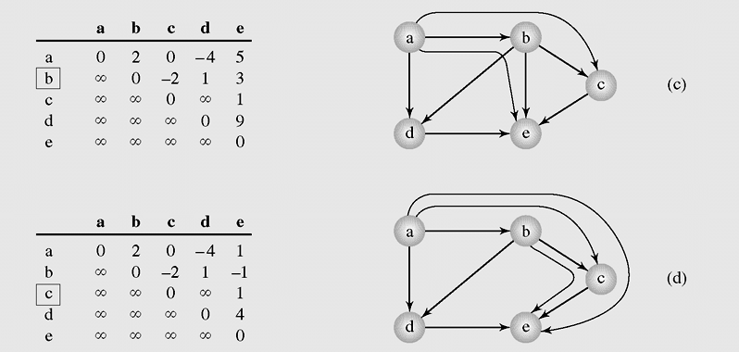
All-to-All Shortest Path Problem (continued)
Figure 8-11 An execution of WFIalgorithm() (continued)

Slide 31
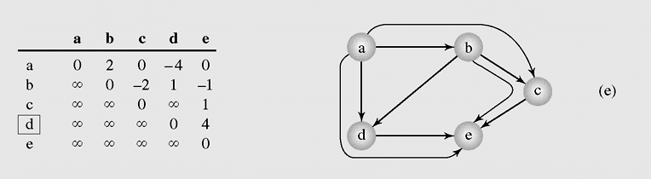
All-to-All Shortest Path Problem (continued)
Figure 8-11 An execution of WFIalgorithm() (continued)

Slide 32
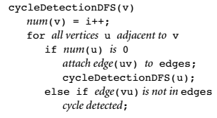
Cycle Detection
Some algorithms used to detect cycle in graph:
  WFI all-to-all shortest path
  Extension Depth First Search

Slide 33
Cycle Detection
Some algorithms used to detect cycle in graph:
  WFI all-to-all shortest path:
    Complexity: O(|V|³)
  Extension Depth First Search:
    Complexity: O(|E|(|E| + |V|)), ,which could turn into O(|V|⁴) for dense graphs.
  => A better method needs to be found: Union-Find problem.

Slide 34
Union-Find Problem
The task is to determine if two vertices are in the same set by:
  Finding the set to which a vertex v belongs
  Uniting the two sets into one if vertex v belongs
  to one of them and w to another
The sets used to solve the union-find problem are implemented with circular linked lists
Each list is identified by a vertex that is the root of the tree to which the vertices in the list belong.

Slide 35
Union-Find Problem
All vertices are numbered with integers 0, . . ., |V| – 1,which are used as indexes in three arrays:
  root[]to store a vertex index identifying a set of vertices.
  next[]to indicate the next vertex on a list.
  length[]to indicate the number of vertices in a list.

Slide 36
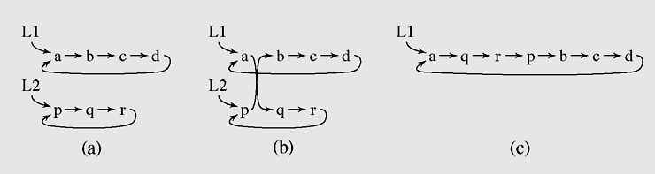
Union-Find Problem (continued)
Figure 8-12 Concatenating two circular linked lists

Slide 37
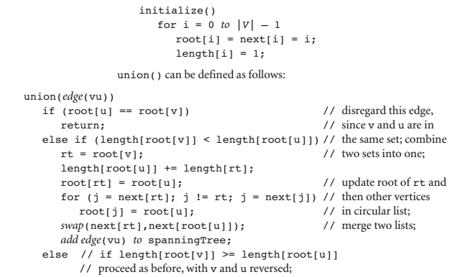
Union-Find Problem (continued)

Slide 38
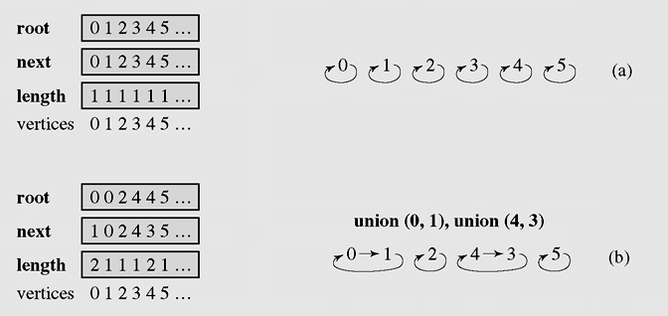
Union-Find Problem (continued)
Figure 8-13 An example of application of union() to merge lists

Slide 39
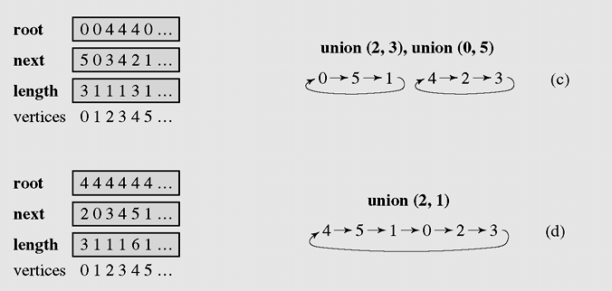
Union-Find Problem (continued)
Figure 8-13 An example of application of union() to merge lists
(continued)

Slide 40
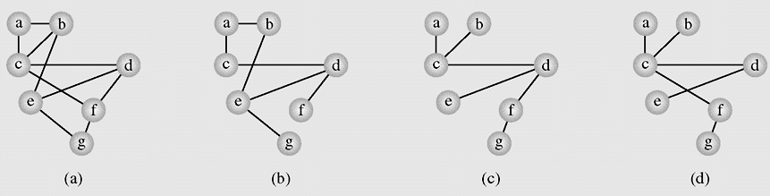
Spanning Trees
Figure 8-14 A graph representing (a) the airline connections between
seven cities and (b–d) three possible sets of connections

Slide 41
Spanning Trees (continued)

Slide 42
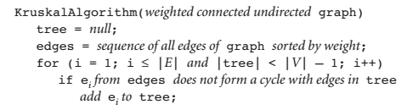
Spanning Trees (continued)

Slide 43
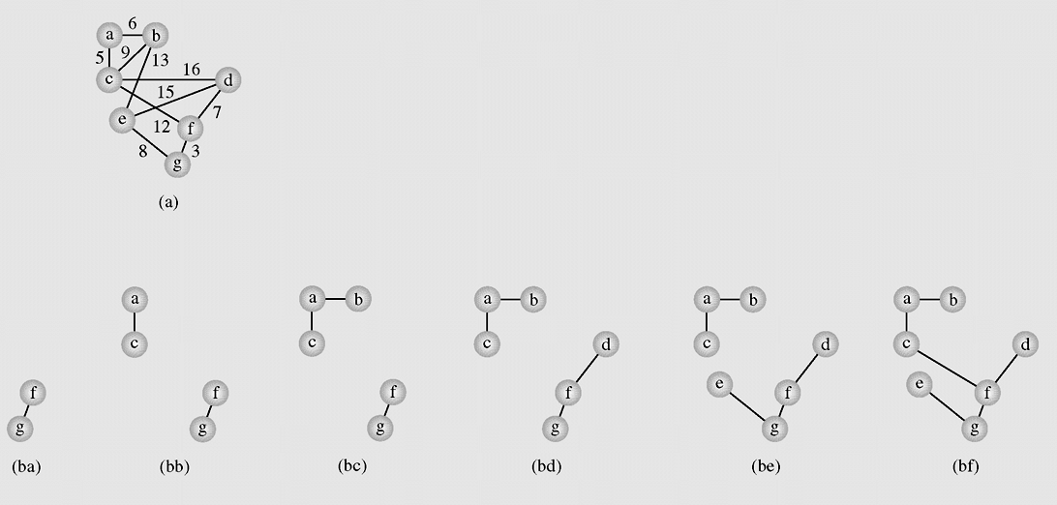
Spanning Trees (continued)
Figure 8-15 A spanning tree of graph (a) found, (ba–bf) with Kruskal’s
algorithm, (ca–cl) and with Dijkstra’s method

Slide 44
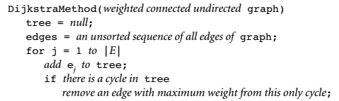
Spanning Trees (continued)

Slide 45
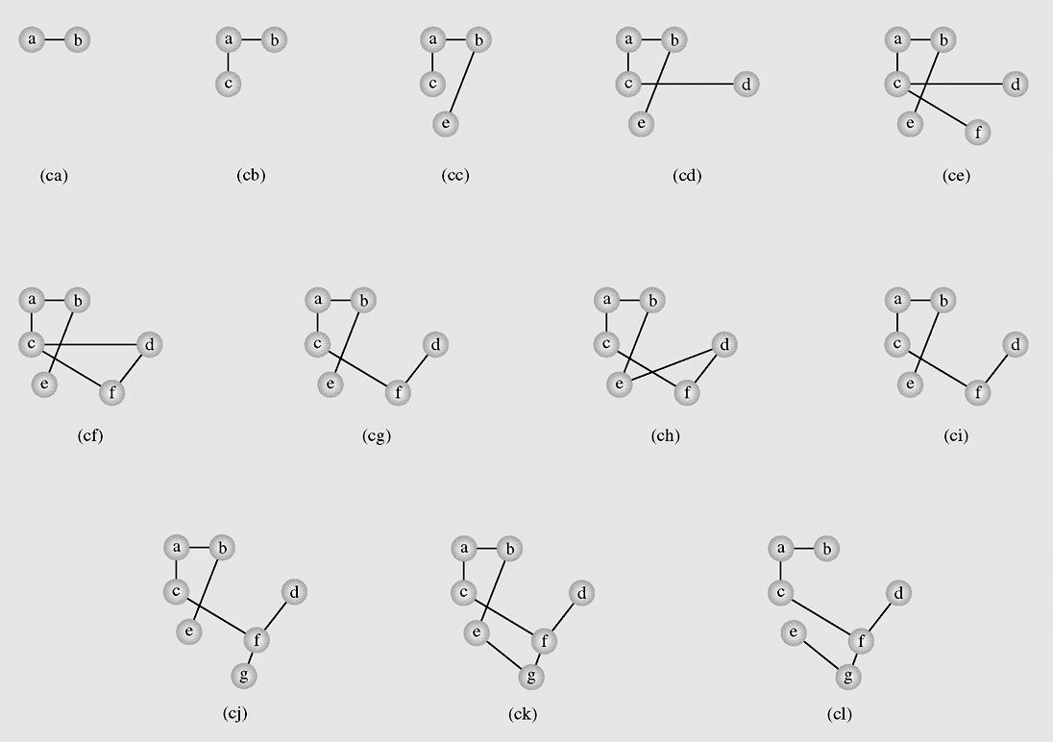
Spanning Trees (continued)
Figure 8-15 A spanning tree of graph (a) found, (ba–bf) with Kruskal’s
algorithm, (ca–cl) and with Dijkstra’s method (continued)

Slide 46
Spanning Trees (continued)
Compare two algorithms?

Slide 47
Connectivity
An undirected graph is called connected when there is a path between any two vertices of the graph
A graph is called n-connected if there are at least n different paths between any two vertices; that is, there are n paths between any two vertices that have no vertices in common
A 2-connected or biconnected graph is when there are at least two nonoverlapping paths between any two vertices

Slide 48
Connectivity (continued)
If the vertex is removed from a graph (along with incident edges) and there is no way to find a path from a to b, then the graph is split into two separate subgraphs called articulation points, or cut-vertices
If an edge causes a graph to be split into two subgraphs, it is called a bridge or cut-edge
Connected subgraphs with no articulation points or bridges are called blocks

Slide 49
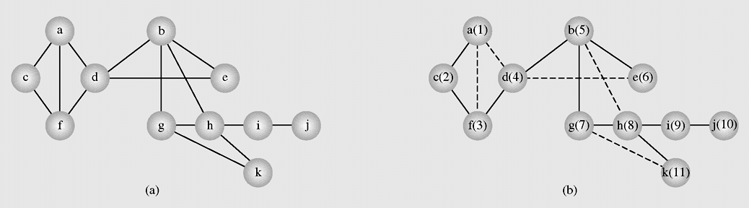
Connectivity in Undirected Graphs
Figure 8-16 Finding blocks and articulation points using
the blockDFS() algorithm

Slide 50
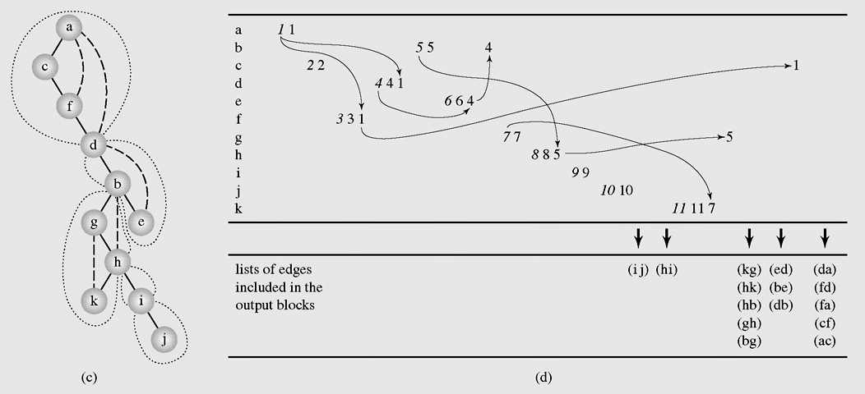
Connectivity in Undirected Graphs (continued)
Figure 8-16 Finding blocks and articulation points using
the blockDFS() algorithm (continued)

Slide 51
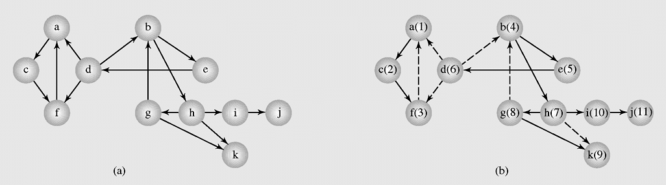
Connectivity in Directed Graphs
Figure 8-17 Finding strongly connected components with
the strongDFS() algorithm

Slide 52
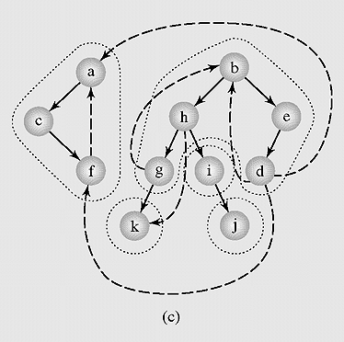
Connectivity in Directed Graphs (continued)
Figure 8-17 Finding strongly connected components with the
strongDFS() algorithm (continued)

Slide 53
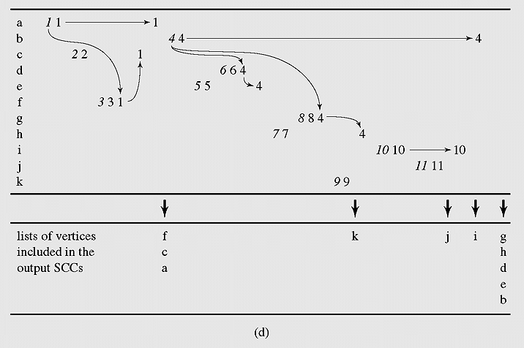
Connectivity in Directed Graphs (continued)
Figure 8-17 Finding strongly connected components with the
strongDFS() algorithm (continued)

Slide 54
Topological Sort
A topological sort linearizes a digraph
It labels all its vertices with numbers 1, . . . , |V| so that i < j only if there is a path from vertex v_{i} to vertex v_{j}
The digraph must not include a cycle; otherwise, a topological sort is impossible
topologicalSort(digraph)
for i = 1 to |V|
find a minimal vertex v;
num(v) = i;
remove from digraph vertex v and all edges incident with v;

Slide 55
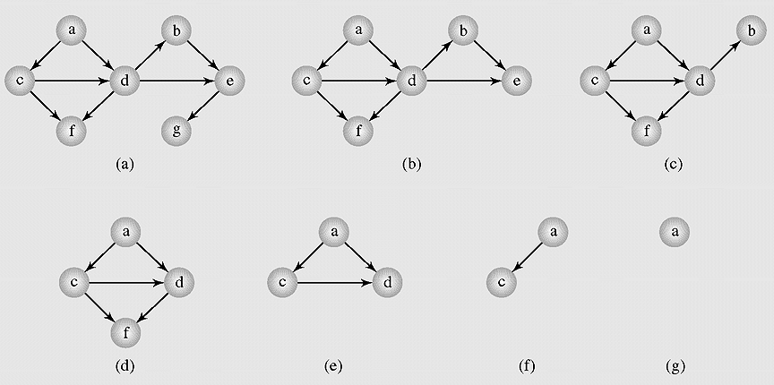
Topological Sort (continued)
Figure 8-18 Executing a topological sort

Slide 56
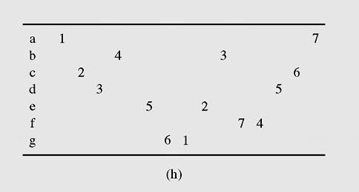
Topological Sort (continued)
Figure 8-18 Executing a topological sort (continued)

Slide 57
Networks
A network is a digraph with one vertex s, called the source, with no incoming edges, and one vertex t, called the sink, with no outgoing edges

Slide 58
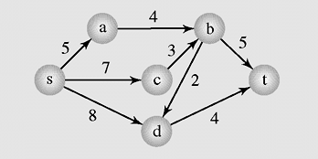
Networks
Figure 8-19 A pipeline with eight pipes and six pumping stations

Slide 59
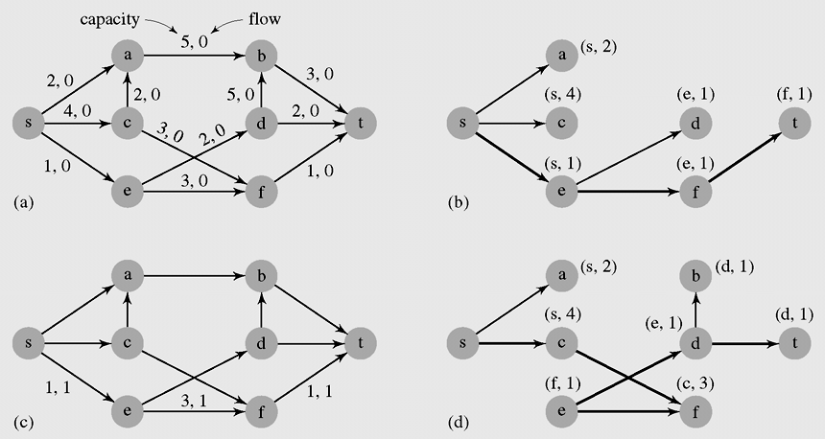
Maximum Flows
Figure 8-20 An execution of FordFulkersonAlgorithm() using
depth-first search

Slide 60
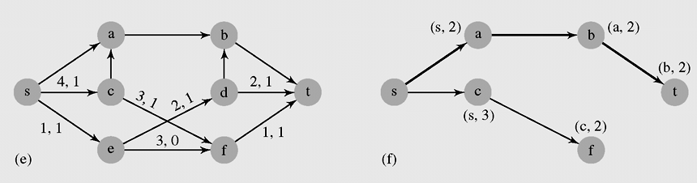
Maximum Flows (continued)
Figure 8-20 An execution of FordFulkersonAlgorithm() using
depth-first search (continued)

Slide 61
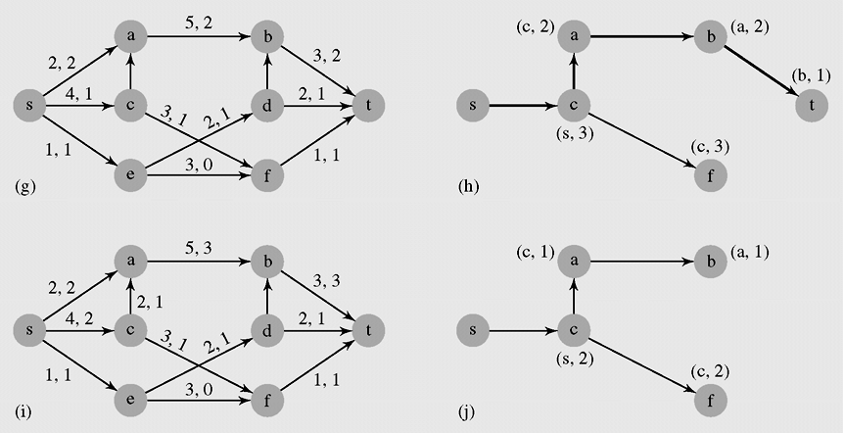
Maximum Flows (continued)
Figure 8-20 An execution of FordFulkersonAlgorithm() using
depth-first search (continued)

Slide 62
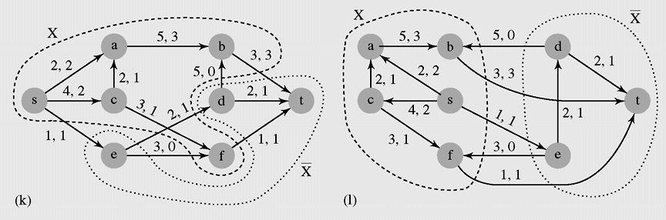
Maximum Flows (continued)
Figure 8-20 An execution of FordFulkersonAlgorithm() using
depth-first search (continued)

Slide 63
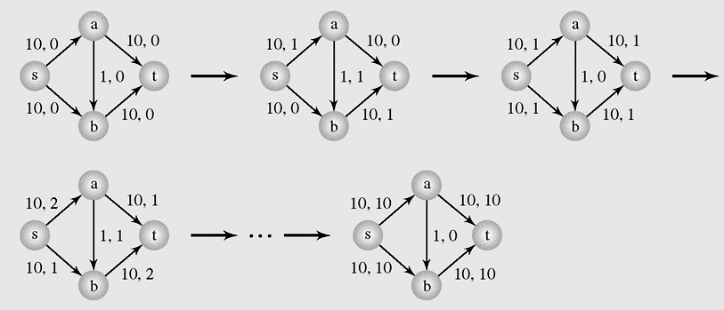
Maximum Flows (continued)
Figure 8-21 An example of an inefficiency of FordFulkersonAlgorithm()

Slide 64
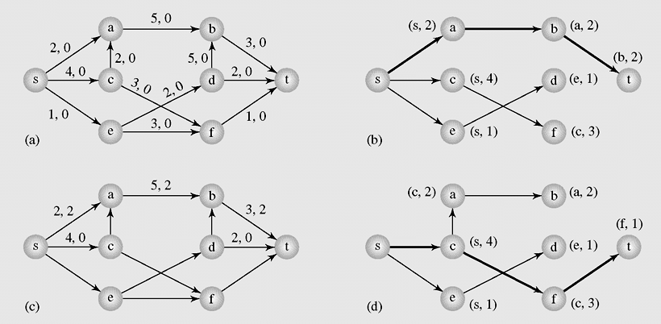
Maximum Flows (continued)
Figure 8-22 An execution of FordFulkersonAlgorithm() using
breadth-first search

Slide 65
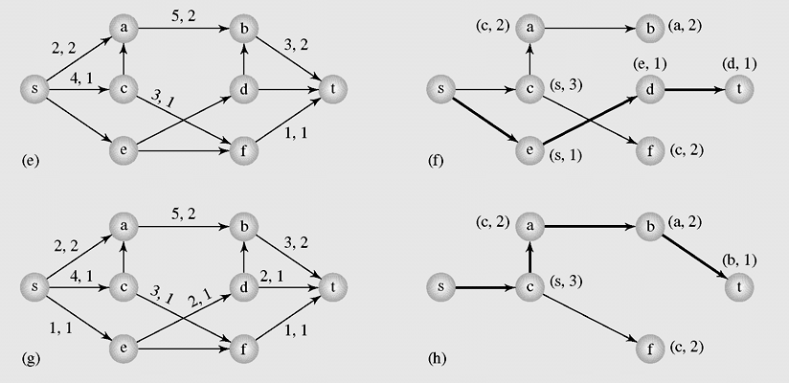
Maximum Flows (continued)
Figure 8-22 An execution of FordFulkersonAlgorithm() using
breadth-first search (continued)

Slide 66

Maximum Flows (continued)
Figure 8-22 An execution of FordFulkersonAlgorithm() using
breadth-first search (continued)

Slide 67

Maximum Flows (continued)
Figure 8-23 An execution of DinicAlgorithm()

Slide 68

Maximum Flows (continued)
Figure 8-23 An execution of DinicAlgorithm()(continued)

Slide 69

Maximum Flows (continued)
Figure 8-23 An execution of DinicAlgorithm()(continued)

