Slide 1
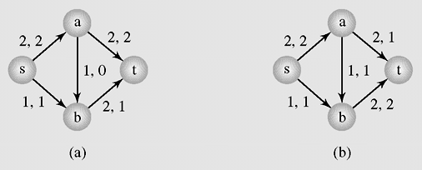
Maximum Flows of Minimum Cost
Figure 8-24 Two possible maximum flows for the same network

Slide 2
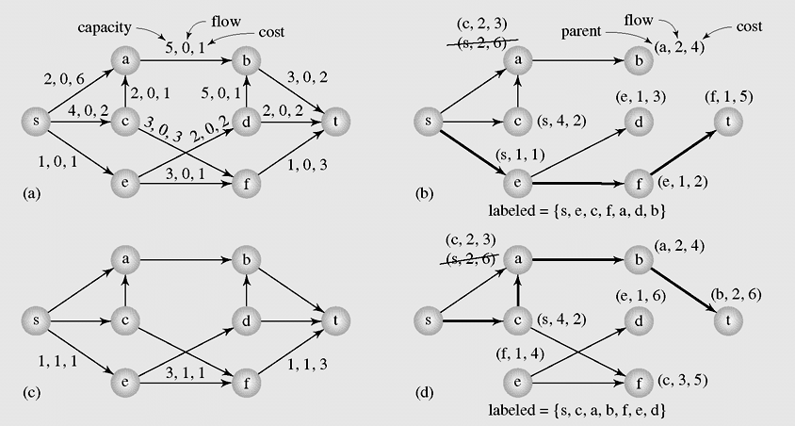
Maximum Flows of Minimum Cost (continued)
Figure 8-25 Finding a maximum flow of minimum cost

Slide 3
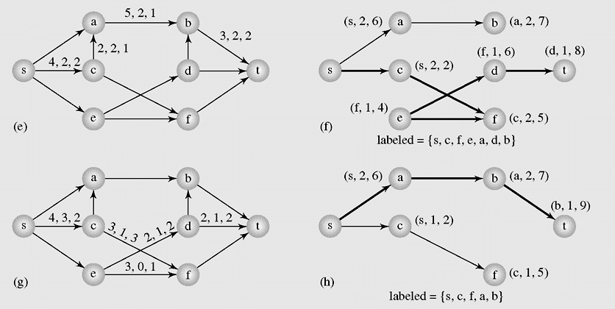
Maximum Flows of Minimum Cost (continued)
Figure 8-25 Finding a maximum flow of minimum cost (continued)

Slide 4
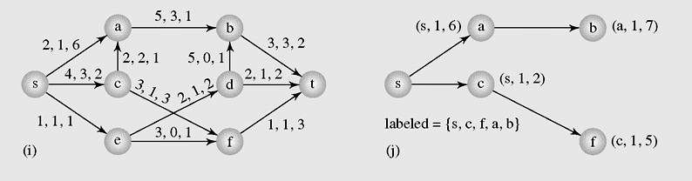
Maximum Flows of Minimum Cost (continued)
Figure 8-25 Finding a maximum flow of minimum cost (continued)

Slide 5
Matching
Maximum matching is a matching that contains a maximum number of edges so that the number of unmatched vertices (that is, vertices not incident with edges in M) is minimal
A matching problem consists in finding a maximum matching for a certain graph G
The problem of finding a perfect matching is also called the marriage problem

Slide 6
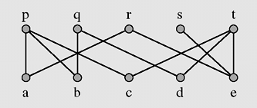
Matching (continued)
Figure 8-26 Matching five applicants with five jobs

Slide 7
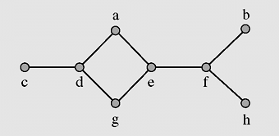
Matching (continued)
Figure 8-27 A graph with matchings M₁ = {edge(ab), edge(ef)} and
M₂ = {edge(ab), edge(de), edge(fh)}

Slide 8
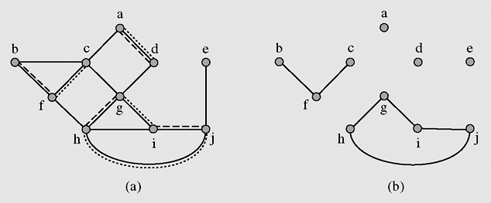
Matching (continued)
Figure 8-28 (a) Two matchings M and N in a graph G = (V,E) and
(b) the graph G′ = (V, M N)

Slide 9
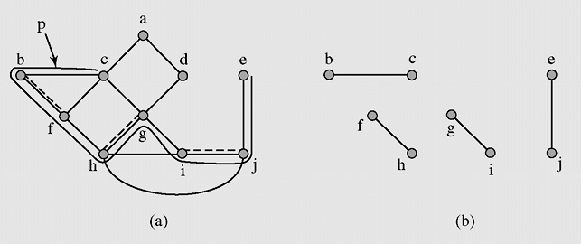
Matching (continued)
Figure 8-29 (a) Augmenting path P and a matching M and
(b) the matching M P

Slide 10
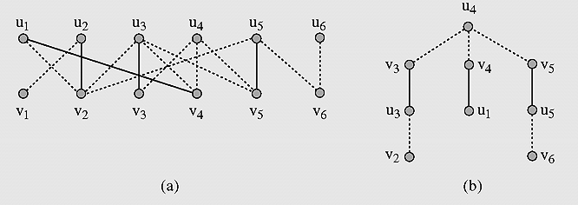
Matching (continued)
Figure 8-30 Application of the findMaximumMatching() algorithm.
Matched vertices are connected with solid lines.

Slide 11
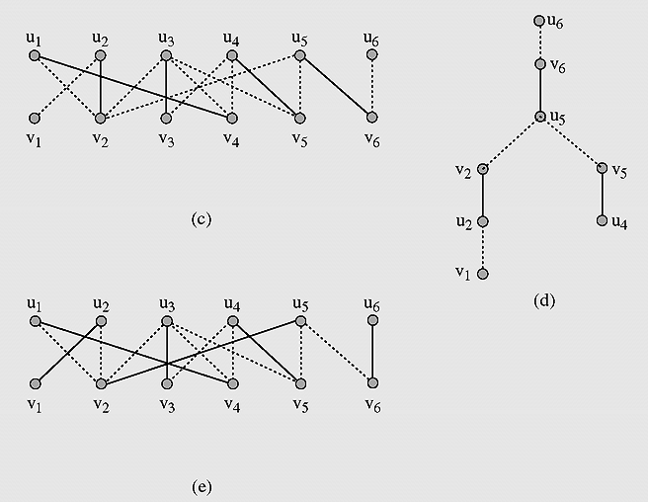
Matching (continued)
Figure 8-30 Application of the findMaximumMatching() algorithm.
Matched vertices are connected with solid lines (continued).

Slide 12
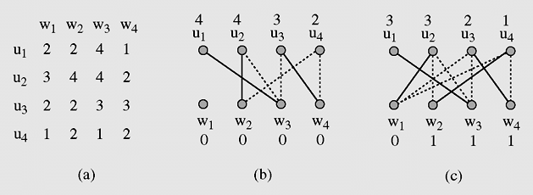
Assignment Problem
Figure 8-31 An example of application of the optimalAssignment()
algorithm

Slide 13
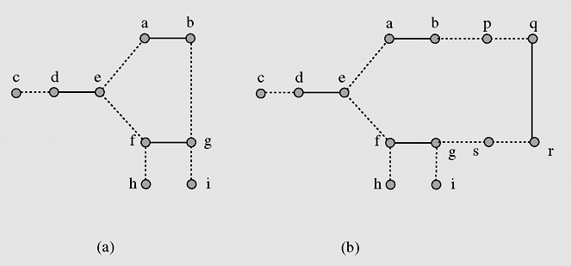
Matching in Nonbipartite Graphs
Figure 8-32 Application of the findMaximumMatching() algorithm
to a nonbipartite graph

Slide 14
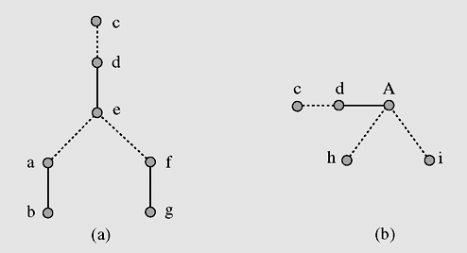
Matching in Nonbipartite Graphs (continued)
Figure 8-33 Processing a graph with a blossom

Slide 15
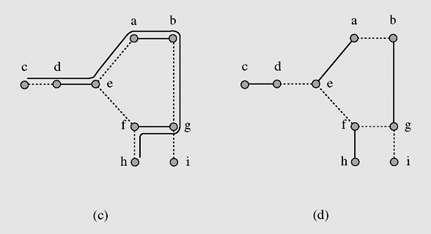
Matching in Nonbipartite Graphs (continued)
Figure 8-33 Processing a graph with a blossom (continued)

Slide 16
Eulerian Graphs
An Eulerian trail in a graph is a path that includes all edges of the graph only once
An Eulerian cycle is a cycle that is also an Eulerian trail
A graph that has an Eulerian cycle is called an Eulerian graph

Slide 17
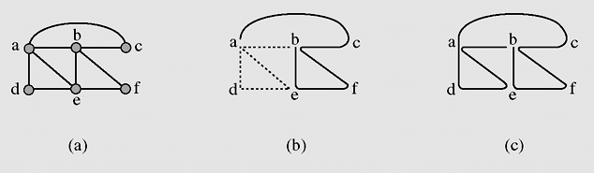
Eulerian Graphs (continued)
Figure 8-34 Finding an Eulerian cycle

Slide 18
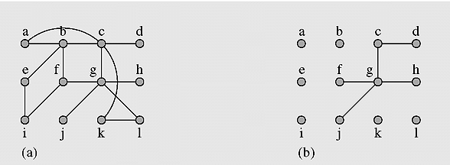
The Chinese Postman Problem
Figure 8-35 Solving the Chinese postman problem

Slide 19
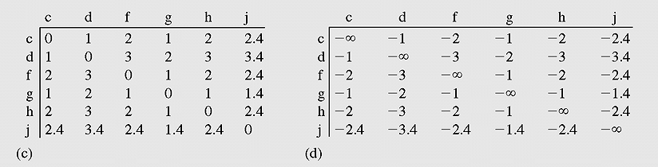
The Chinese Postman Problem
Figure 8-35 Solving the Chinese postman problem (continued)

Slide 20
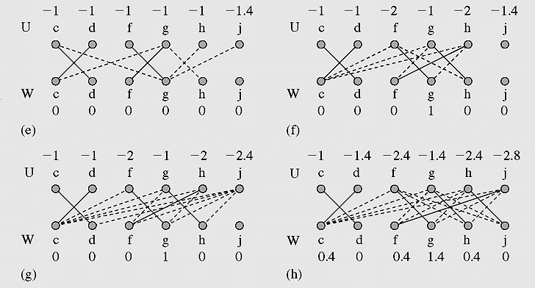
The Chinese Postman Problem
Figure 8-35 Solving the Chinese postman problem (continued)

Slide 21
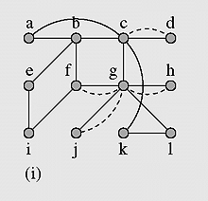
The Chinese Postman Problem
Figure 8-35 Solving the Chinese postman problem (continued)

Slide 22
Hamiltonian Graphs
A Hamiltonian cycle in a graph is a cycle that passes through all the vertices of the graph
A graph is called a Hamiltonian graph if it includes at least one Hamiltonian cycle

Slide 23
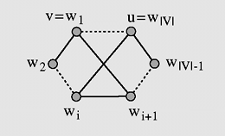
Hamiltonian Graphs (continued)
Figure 8-36 Crossover edges

Slide 24
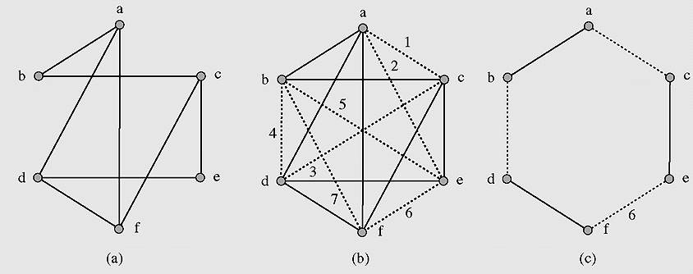
Hamiltonian Graphs (continued)
Figure 8-37 Finding a Hamiltonian cycle

Slide 25
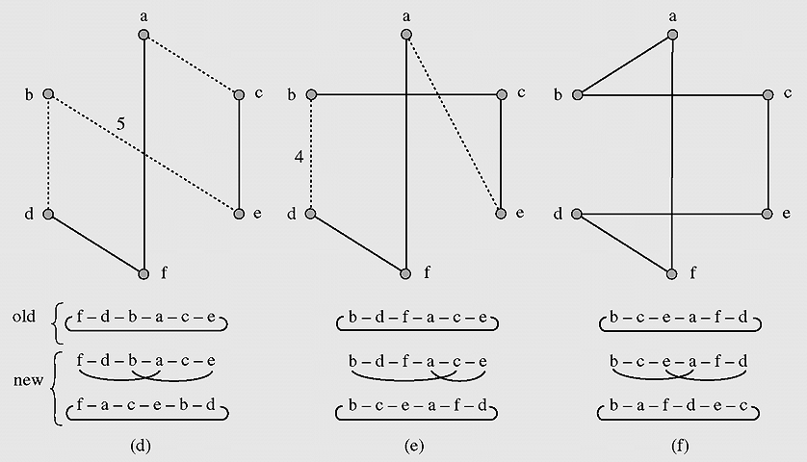
Hamiltonian Graphs (continued)
Figure 8-37 Finding a Hamiltonian cycle (continued)

Slide 26
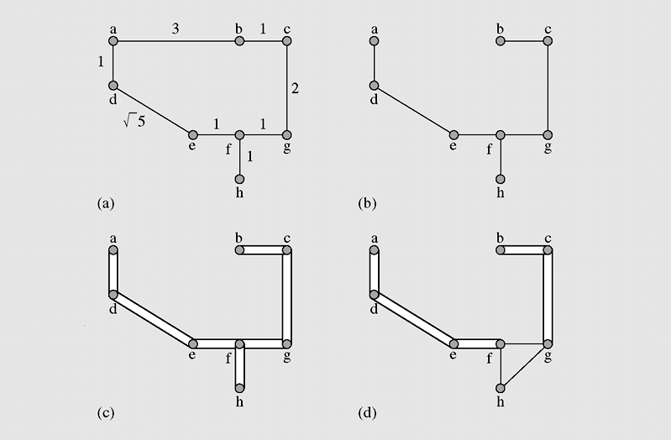
The Traveling Salesman Problem
Figure 8-38 Using a minimum spanning tree to find a minimum
salesman tour

Slide 27
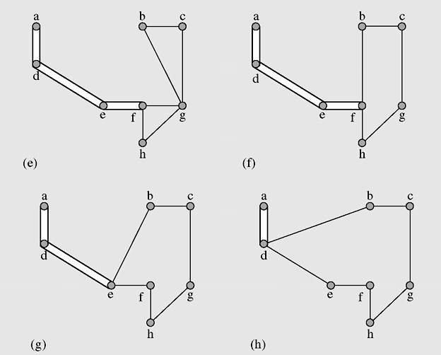
The Traveling Salesman Problem (continued)
Figure 8-38 Using a minimum spanning tree to find a minimum
salesman tour (continued)

Slide 28
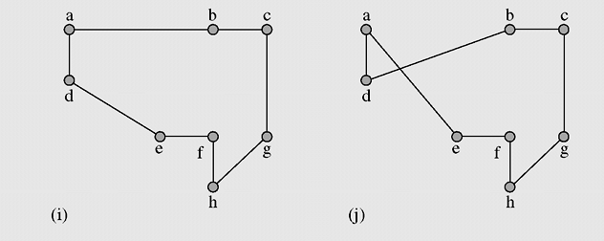
The Traveling Salesman Problem (continued)
Figure 8-38 Using a minimum spanning tree to find a minimum
salesman tour (continued)

Slide 29
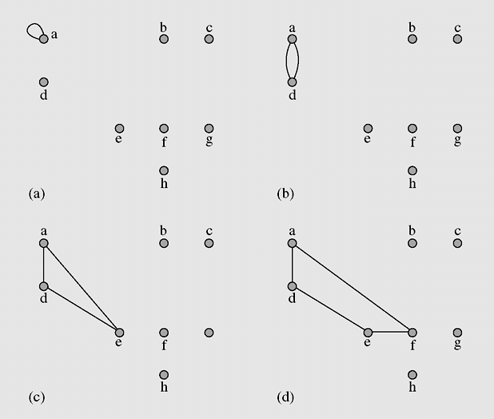
The Traveling Salesman Problem (continued)
Figure 8-39 Applying the nearest insertion algorithm to the cities
in Figure 8.38a

Slide 30
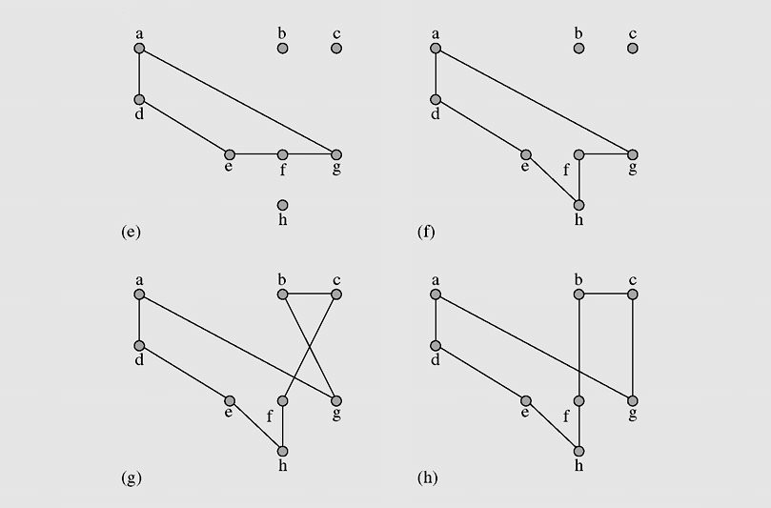
The Traveling Salesman Problem (continued)
Figure 8-39 Applying the nearest insertion algorithm to the cities
in Figure 8.38a (continued)

Slide 31
Graph Coloring
Sequential coloring establishes the sequence of vertices and a sequence of colors before coloring them, and then color the next vertex with the lowest number possible
sequentialColoringAlgorithm(graph = (V, E))
put vertices in a certain order v_{P1}, v_{P2}, . . . , v_{Pv} ;
put colors in a certain order c_{P1}, c₂, . . . , c_{k};
for i = 1 to |V|
j = the smallest index of color that does not appear in any neighbor of v_{Pi};
color(v_{Pi}) = c_{j};

Slide 32
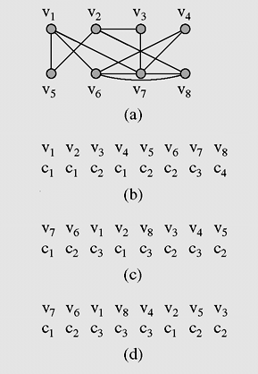
Graph Coloring (continued)
Figure 8-40 (a) A graph used for coloring; (b) colors assigned to vertices with
the sequential coloring algorithm that orders vertices by index number;
(c) vertices are put in the largest first sequence; (d) graph coloring obtained
with the Brélaz algorithm

Slide 33
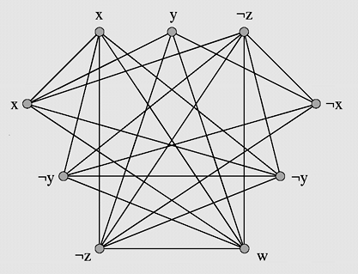
The Clique Problem
Figure 8-41 A graph corresponding to Boolean expression

Slide 34
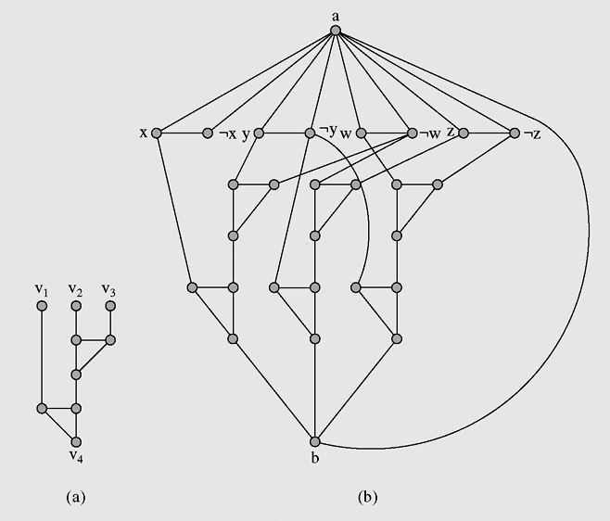
The 3-Colorability Problem
Figure 8-42 (a) A 9-subgraph; (b) a graph corresponding to
Boolean expression

Slide 35
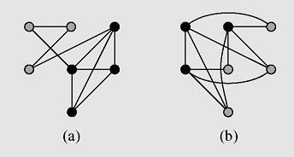
The Vertex Cover Problem
Figure 8-43 (a) A graph with a clique; (b) a complement graph

Slide 36
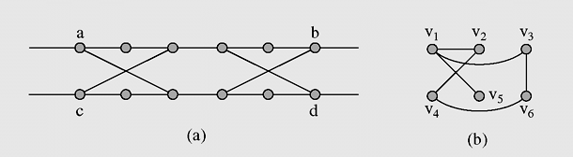
The Hamiltonian Cycle Problem
Figure 8-44 (a) A 12-subgraph; (b) a graph G and (c) its
transformation, graph G_{H}

Slide 37
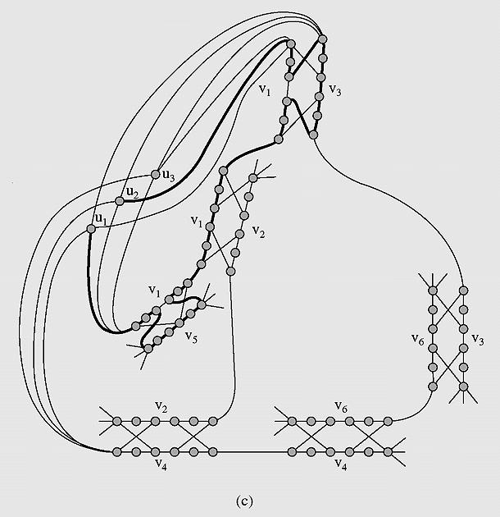
The Hamiltonian Cycle Problem
Figure 8-44 (a) A 12-subgraph; (b) a graph G and (c) its
transformation, graph G_{H} (continued)

Slide 38
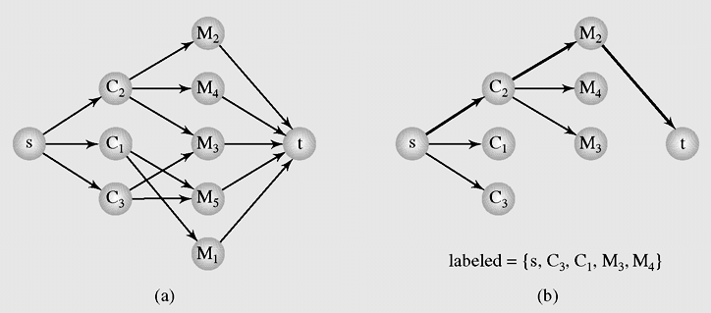
Case Study: Distinct Representatives
Figure 8-45 (a) A network representing membership of three
committees, C₁, C₂, and C₃, and (b) the first
augmenting path found in this network

Slide 39
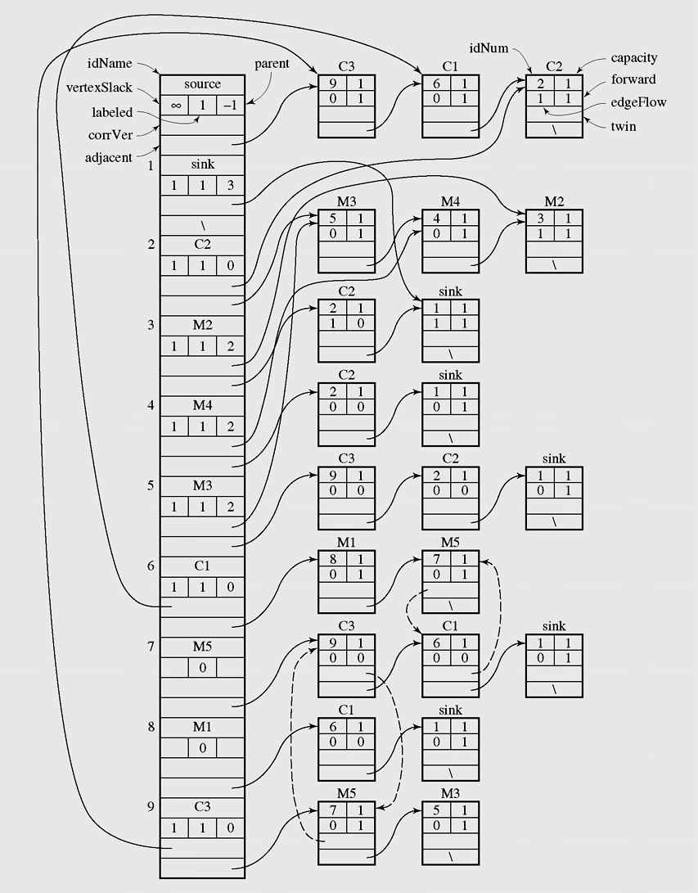
Case Study: Distinct Representatives (continued)
Figure 8-46 The network representation created by
FordFulkersonMaxFlow()

Slide 40

Case Study: Distinct Representatives (continued)
Figure 8-47 An implementation of the distinct representatives problem

Slide 41
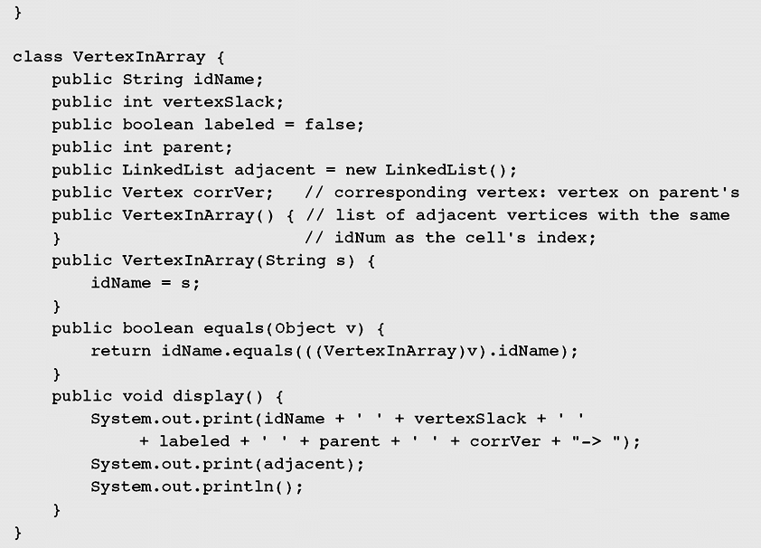
Case Study: Distinct Representatives (continued)
Figure 8-47 An implementation of the distinct representatives problem
(continued)

Slide 42

Case Study: Distinct Representatives (continued)
Figure 8-47 An implementation of the distinct representatives problem
(continued)

Slide 43

Case Study: Distinct Representatives (continued)
Figure 8-47 An implementation of the distinct representatives problem
(continued)

Slide 44

Case Study: Distinct Representatives (continued)
Figure 8-47 An implementation of the distinct representatives problem
(continued)

Slide 45
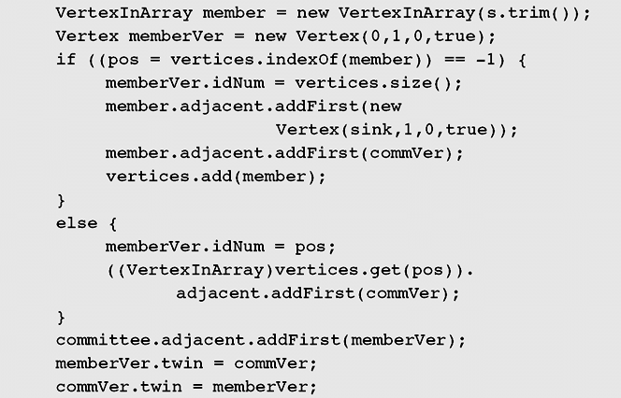
Case Study: Distinct Representatives (continued)
Figure 8-47 An implementation of the distinct representatives problem
(continued)

Slide 46

Case Study: Distinct Representatives (continued)
Figure 8-47 An implementation of the distinct representatives problem
(continued)

Slide 47
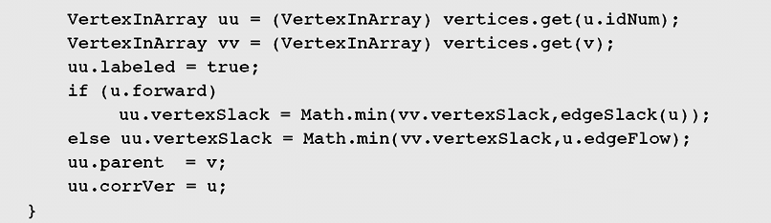
Case Study: Distinct Representatives (continued)
Figure 8-47 An implementation of the distinct representatives problem
(continued)

Slide 48

Case Study: Distinct Representatives (continued)
Figure 8-47 An implementation of the distinct representatives problem
(continued)

Slide 49
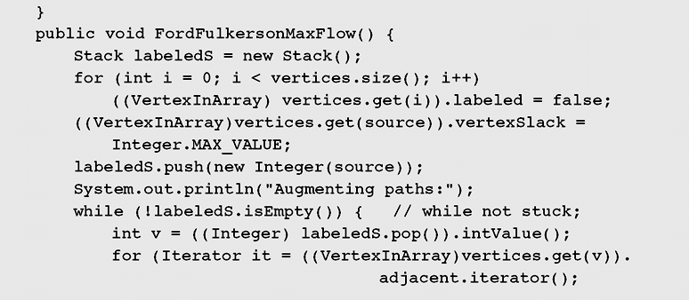
Case Study: Distinct Representatives (continued)
Figure 8-47 An implementation of the distinct representatives problem
(continued)

Slide 50

Case Study: Distinct Representatives (continued)
Figure 8-47 An implementation of the distinct representatives problem
(continued)

Slide 51

Case Study: Distinct Representatives (continued)
Figure 8-47 An implementation of the distinct representatives problem
(continued)

Slide 52

Case Study: Distinct Representatives (continued)
Figure 8-47 An implementation of the distinct representatives problem
(continued)

Slide 53
Summary
A graph is a collection of vertices (or nodes) and the connections between them
A multigraph is a graph in which two vertices can be joined by multiple edges
A pseudograph is a multigraph with the condition v_{i} ≠ v_{j} removed, which allows for loops to occur
The sets used to solve the union-find problem are implemented with circular linked lists

Slide 54
Summary (continued)
A spanning tree is an algorithm that guarantees generating a tree (or a forest, a set of trees) that includes or spans over all vertices of the original graph
An undirected graph is called connected when there is a path between any two vertices of the graph
A network is a digraph with one vertex s, called the source, with no incoming edges, and one vertex t, called the sink, with no outgoing edges

Slide 55
Summary (continued)
Maximum matching is a matching that contains a maximum number of edges so that the number of unmatched vertices (that is, vertices not incident with edges in M) is minimal
A Hamiltonian cycle in a graph is a cycle that passes through all the vertices of the graph
Sequential coloring establishes the sequence of vertices and a sequence of colors before coloring them, and then color the next vertex with the lowest number possible

