Slide 1
Chapter 9
Sorting

Slide 2
Objectives
Discuss the following topics:
Elementary Sorting Algorithms
Efficient Sorting Algorithms
Sorting in java.util
Case Study: Adding Polynomials

Slide 3

Elementary Sorting Algorithms

Slide 4
Insertion sort
An insertion sort starts by considering the two first elements of the array data, which are
data[0] and data[1]
Next, the third element, data[2], is considered
and inserted into its proper place
insertionsort(data[]) {
  for i = 1 to data.length–1
  tmp = data[i];
  move all elements data[j] greater than tmp by one position;
  place tmp in its proper position;

Slide 5
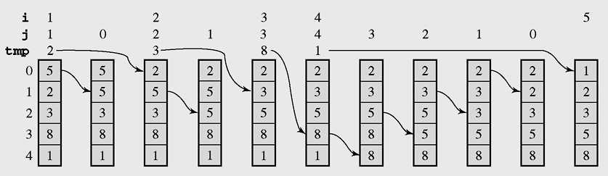
Insertion sort (continued)
Figure 9-1 The array [5 2 3 8 1] sorted by insertion sort

Slide 6
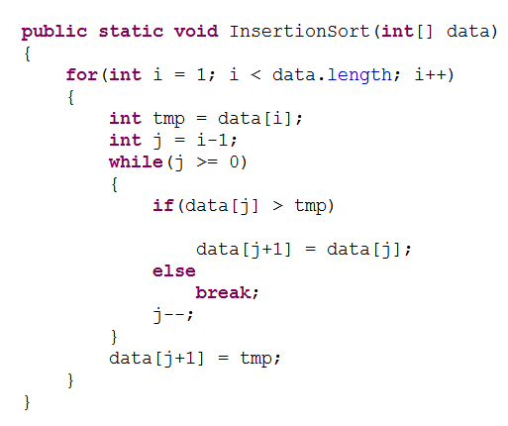
Insertion sort (continued)

Slide 7


Insertion sort (continued)
The best case: n– 1 comparisons and 2(n– 1) moves => O(n)
The worst case:
  Total number of comparisons:
  Total number of moves:

Slide 8


Insertion sort (continued)
Is the number of movements and comparisons for a randomly ordered array closer to the best or to the worst case?
The average number of comparisons of data[i] with other elements during the iteration i:
The average number of all comparisons (for all iterations of the outer for loop):

Slide 9


Insertion sort (continued)
In iteration i, data[i] can be moved either 0, 1,...,or i– 1 times => The average number of moves:
The average number of all moves (for all iterations of the outer for loop):
=> O(n²)

Slide 10
Selection Sort
Selection sort is an attempt to localize the exchanges of array elements by finding a misplaced element first and putting it in its final place
selectionsort(data[])
for i = 0 to data.length-2
select the smallest element among data[i], . . . , data[data.length-1];
swap it with data[i];

Slide 11
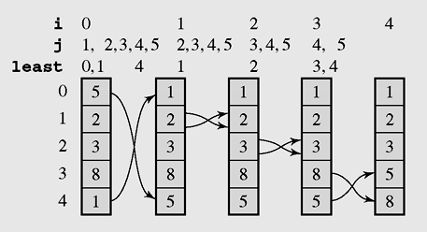
Selection Sort (continued)
Figure 9-2 The array [5 2 3 8 1] sorted by selection sort

Slide 12
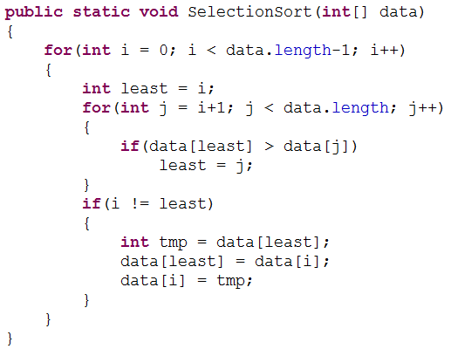
Selection Sort (continued)

Slide 13

Selection Sort (continued)
Number of comparisons of keys in the inner loop:
In the best case, no array elements are swapped.
In the worst case, when the largest element is in the first position and the remaining elements are ordered, number of swaps are 3(n– 1).

Slide 14
Bubble Sort
public void bubblesort(int[] data) {
for (int i = 0; i < data.length-1; i++)
for (int j = data.length-1; j > i; --j)
if (data[j] < data[j-1])
swap(data,j,j-1);
}

Slide 15
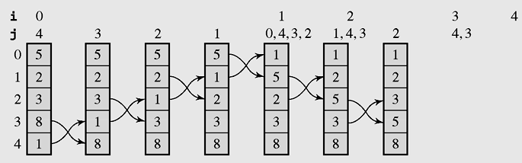
Bubble Sort
Figure 9-3 The array [5 2 3 8 1] sorted by bubble sort

Slide 16


Bubble Sort
The number of comparisons is the same in each case (best, average, and worst) and equals the total number of iterations of the inner for loop:
The number of swaps in the worst case is 3:

Slide 17

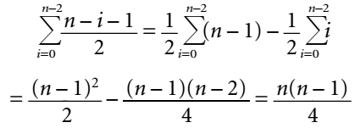
Bubble Sort
The average number of swaps during iteration i:
The average number of all moves (for all iterations of the outer for loop):

Slide 18
Decision Trees
Every sorting algorithm can be expressed in terms of a binary tree in which the arcs carry the labels Y(es) or N(o)
A decision tree is when nonterminal nodes of the tree contain conditions or queries for labels, and the leaves have all possible orderings of the array to which the algorithm is applied

Slide 19
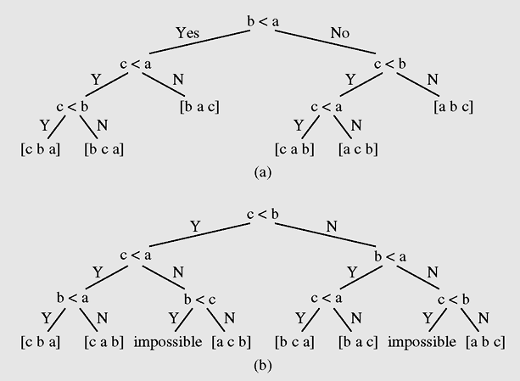
Decision Trees (continued)
Figure 9-4 Decision trees for (a) insertion sort and (b) bubble sort
as applied to the array [a b c]

Slide 20
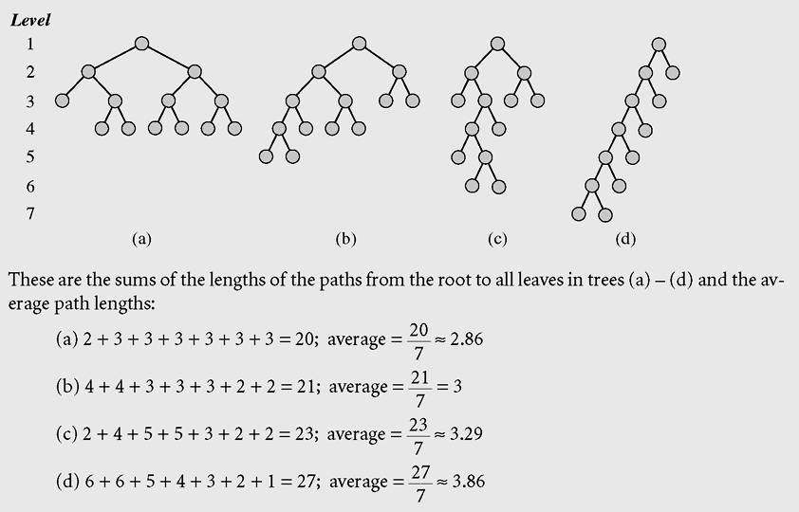
Decision Trees (continued)
Figure 9-5 Examples of decision trees for an array of three elements

Slide 21
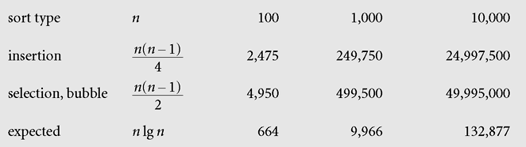
Decision Trees (continued)
Figure 9-6 Number of comparisons performed by the simple
sorting method and by an algorithm whose
efficiency is estimated by the function n lg n

Slide 22
Shell Sort
Shell sort divides the original array into subarrays, sorting them separately, and then dividing them again to sort the new subarrays until the whole array is sorted

Slide 23
Shell Sort (continued)
divide data into h subarrays;
for i = 1 to h
sort subarray data_{i};
sort array data;
determine numbers h_{t} . . . h₁ of ways of dividing array data into subarrays;
for (h=h_{t}; t > 1; t- -, h=h_{t})
divide data into h subarrays;
for i = 1 to h
sort subarray data_{i};
sort array data

Slide 24
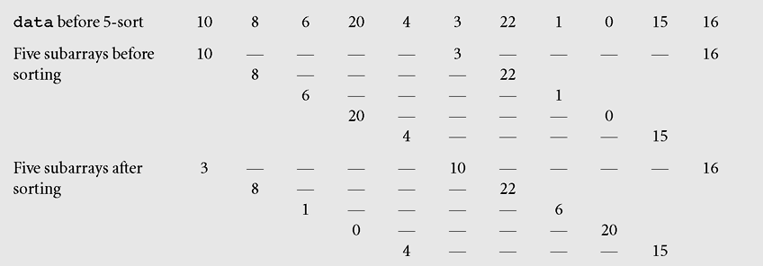
Shell Sort (continued)
Figure 9-7 The array [10 8 6 20 4 3 22 1 0 15 16] sorted by Shell sort

Slide 25
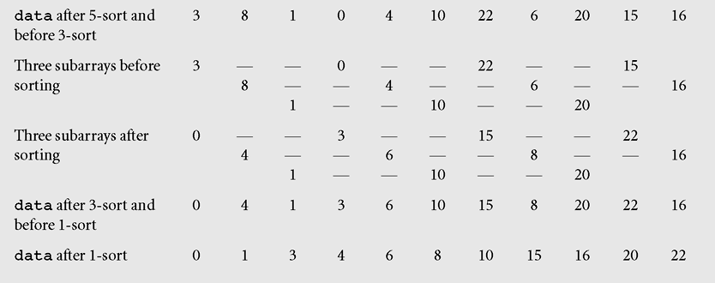
Shell Sort (continued)
Figure 9-7 The array [10 8 6 20 4 3 22 1 0 15 16] sorted by Shell sort
(continued)

Slide 26
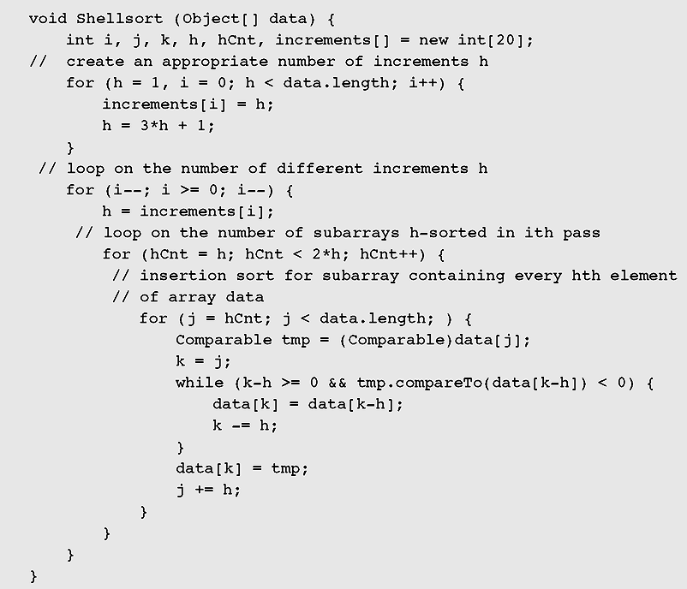
Shell Sort (continued)
Figure 9-8 Implementation of Shell sort

Slide 27
Shell Sort (continued)
The sequence of increments
A simple sorting algorithm applied in all passes except the last
A simple sorting algorithm applied only in the last pass, for 1-sort

Slide 28
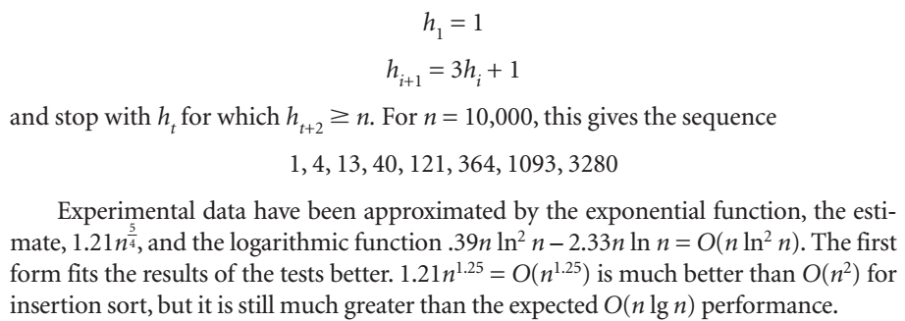
Shell Sort (continued)

Slide 29
Heap Sort
A heap is a binary tree with the following two properties:
  The value of each node is not less than the values stored in each of its children.
  The tree is perfectly balanced and the leaves in the last level are all in the leftmost positions.
Elements in a heap are not perfectly ordered

Slide 30
Heap Sort (continued)
The largest element is in the root node and that, for each other node, all its descendants are not greater than the element in this node
heapsort(data[])
transform data into a heap;
for i = data.length-1 downto 2
swap the root with the element in position i;
restore the heap property for the tree data[0], . . . , data[i-1];

Slide 31
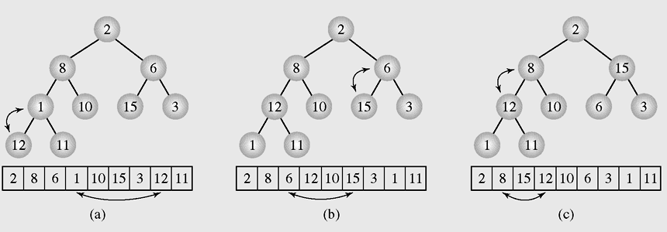
Heap Sort (continued)
Figure 9-9 Transforming the array [2 8 6 1 10 15 3 12 11] into a heap

Slide 32
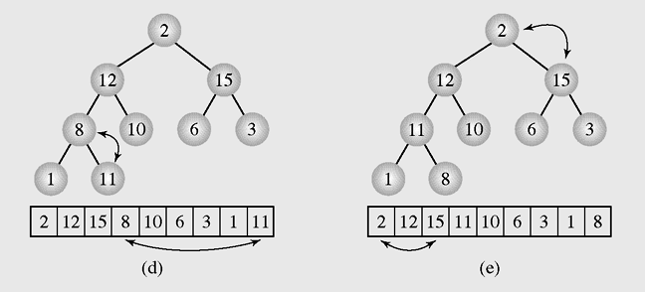
Heap Sort (continued)
Figure 9-9 Transforming the array [2 8 6 1 10 15 3 12 11] into a heap
(continued)

Slide 33
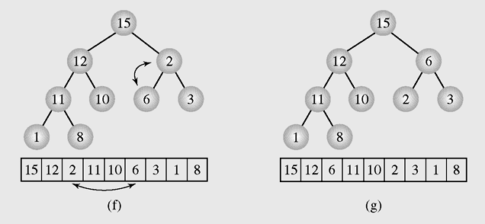
Heap Sort (continued)
Figure 9-9 Transforming the array [2 8 6 1 10 15 3 12 11] into a heap
(continued)

Slide 34
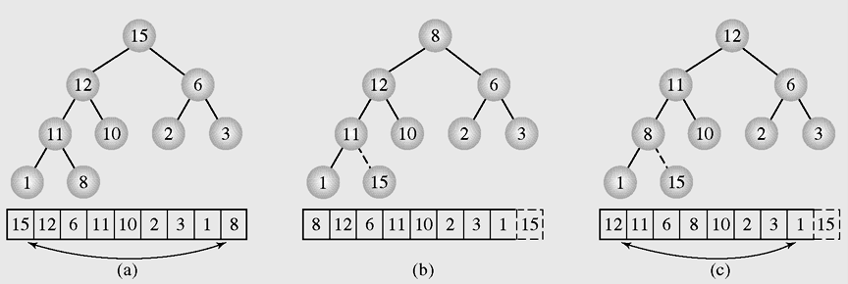
Heap Sort (continued)
Figure 9-10 Execution of heap sort on the array [15 12 6 11 10 2 3 1 8],
which is the heap constructed in Figure 9.9

Slide 35
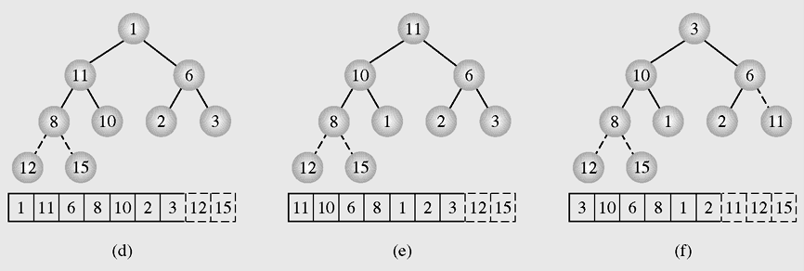
Heap Sort (continued)
Figure 9-10 Execution of heap sort on the array [15 12 6 11 10 2 3 1 8],
which is the heap constructed in Figure 9.9 (continued)

Slide 36
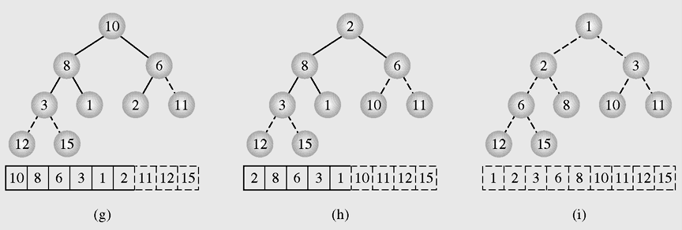
Heap Sort (continued)
Figure 9-10 Execution of heap sort on the array [15 12 6 11 10 2 3 1 8],
which is the heap constructed in Figure 9.9 (continued)

Slide 37

Heap Sort (continued)
In the first phase, to create the heap, heapsort() uses moveDown(), which performs O(n) steps (see Section 6.9.2).
In the second phase, heapsort() exchanges n– 1 times the root with the element in position i and also restores the heap n– 1 times, which in the worst case causes moveDown()to iterate lgi times to bring the root down to the level of the leaves,the total number of moves in all executions of moveDown() in the second phase of heapsort() is:

Slide 38
Heap Sort (continued)
The worst case:
  In the first phase, heapsort() requires O(n) steps.
  In the second phase, n – 1 swaps and O(nlgn) operations to restore the heap property => O(n) + O(nlg n) + (n – 1) = O(nlg n) exchanges.
The best case (when the array contains identical elements):
  In the first phase, moveDown() is called n / 2 times (but no moves are performed) and n comparisons are made.
  In the second phase, heapsort() makes n–1 moves and 2(n-1) comparisons
  => The complexity is O(n)

Slide 39
Heap Sort (continued)
The best case (when the array contains distinct elements):
  number of comparisons equals nlg n– O(n)

Slide 40
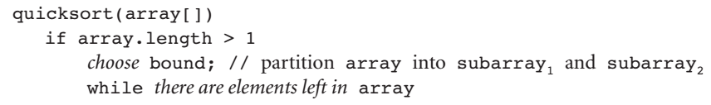
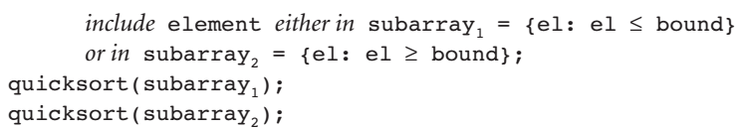
Quicksort

Slide 41
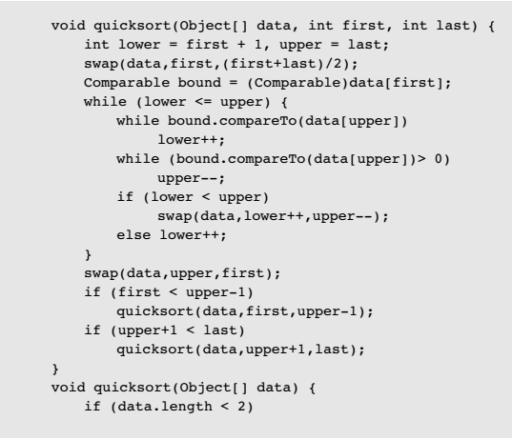
Quicksort
Figure 9-11 Implementation of quicksort

Slide 42
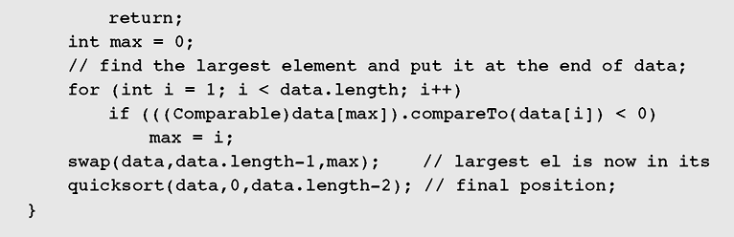
Quicksort (continued)
Figure 9-11 Implementation of quicksort (continued)

Slide 43
Quicksort (continued)
In this implementation, quicksort(data[]) preprocesses the array to be sorted by locating the largest element in the array and exchanging it with the last element of the array. Having the largest element at the end of the array prevents the index lower from running off the end of the array.
To ensure that the bound is not moved around, it is stashed in the first position, and after partitioning is done, it is moved to its proper position, which is the rightmost position of the first subarray.

Slide 44
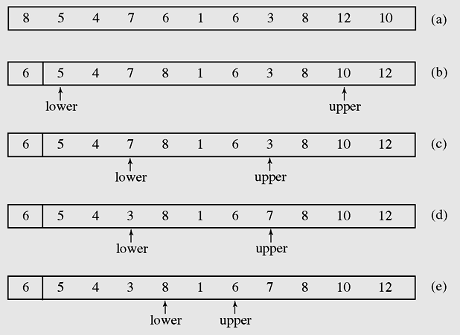
Quicksort (continued)
Figure 9-12 Partitioning the array [8 5 4 7 6 1 6 3 8 12 10] with quicksort()

Slide 45
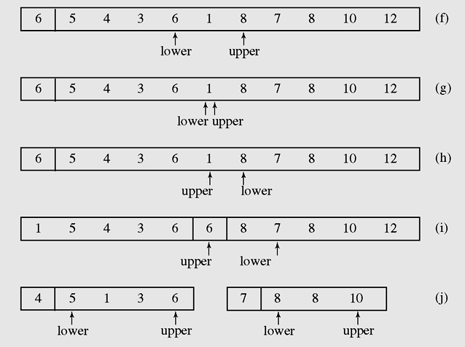
Quicksort (continued)
Figure 9-12 Partitioning the array [8 5 4 7 6 1 6 3 8 12 10] with quicksort()
(continued)

Slide 46
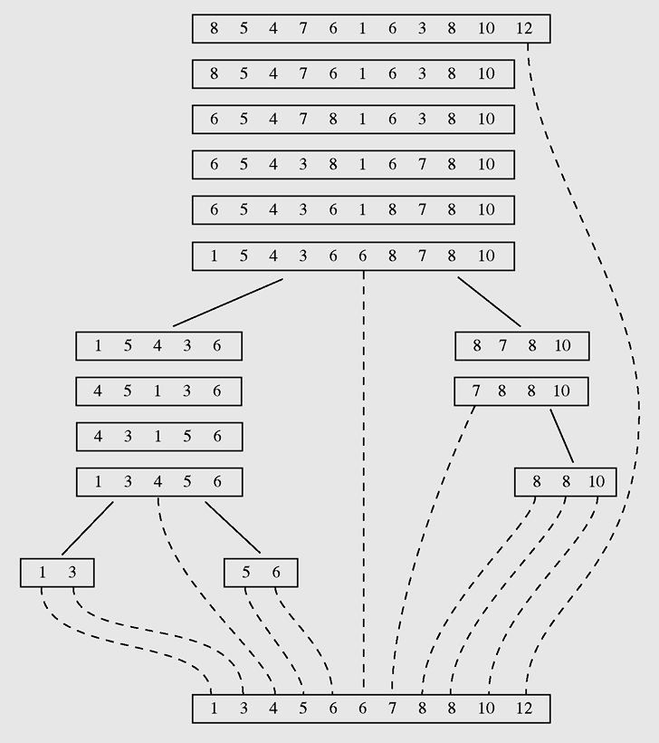
Quicksort (continued)
Figure 9-13 Sorting the array [8 5 4 7 6 1 6 3 8 12 10] with quicksort()

Slide 47

Quicksort (continued)
The worst case: The algorithm thus operates on arrays of size n– 1,n– 2, . . . , 2. The partitions require n– 2 + n– 3 + · · · + 1 comparisons, and for each partition, only the bound is placed in the proper position => O(n²).
The best case:
=> O(nlgn)

Slide 48
Mergesort
Mergesort makes partitioning as simple as possible and concentrates on merging sorted halves of an array into one sorted array
It was one of the first sorting algorithms used on a computer and was developed by John von Neumann
mergesort(data)
if data have at least two elements
mergesort(left half of data);
mergesort(right half of data);
merge(both halves into a sorted list);

Slide 49
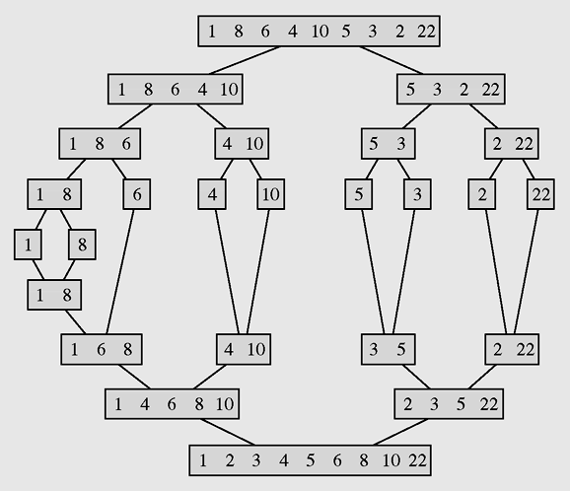
Mergesort (continued)
Figure 9-14 The array [1 8 6 4 10 5 3 2 22] sorted by mergesort

Slide 50

Mergesort (continued)
For an n-element array, the number of movements is computed by the following recurrence relation:

Slide 51
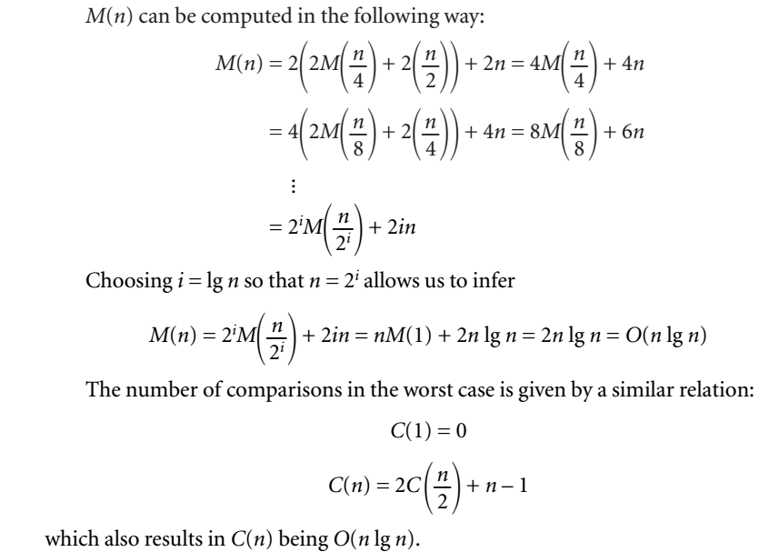

Slide 52
Mergesort (continued)
Mergesort can be made more efficient by replacing recursion with iteration or by applying insertion sort to small portions of an array.
However, mergesort has one serious drawback: the need for additional storage for merging arrays, which for large amounts of data could be an insurmountable obstacle.

Slide 53
Radix Sort
Radix sort is a popular way of sorting used in everyday life. To sort library cards, we may create as many piles of cards as letters in the alphabet, each pile containing authors whose names start with the same letter.
Then, each pile is sorted separately using the same method; namely, piles are created according to the second letter of the authors’ names.

Slide 54
Radix Sort (continued)
This process continues until the number of times the piles are divided into smaller piles equals the number of letters of the longest name.
Used when sorting mail in the post office, and to sort 80-column cards of coding information in the early days of computers.

Slide 55
Radix Sort (continued)
A technique to sort integers by proceeding
right to left
A technique that looks at each number as a string of bits so that all integers are of equal length
radixsort()
for d = 1 to the position of the leftmost digit of longest number
distribute all numbers among piles 0 through 9 according to the dth digit;
put all integers on one list;

Slide 56
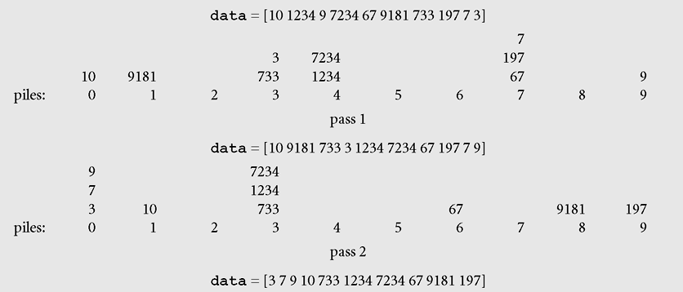
Radix Sort (continued)
Figure 9-15 Sorting the list 10, 1234, 9, 7234, 67, 9181, 733, 197, 7, 3
with radix sort

Slide 57
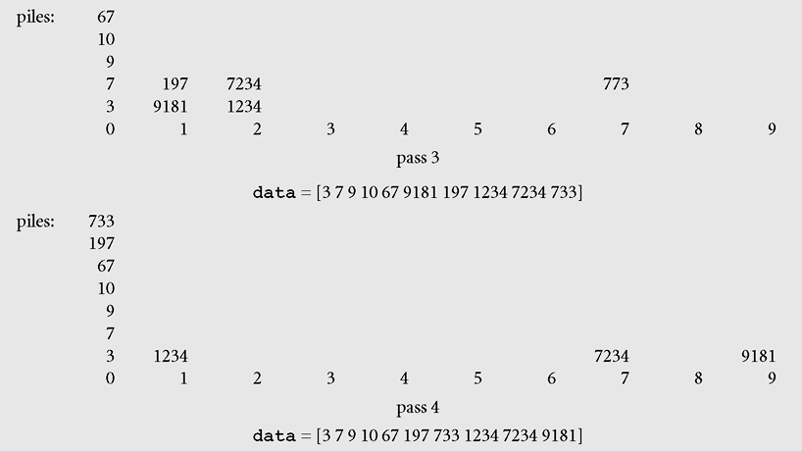
Radix Sort (continued)
Figure 9-15 Sorting the list 10, 1234, 9, 7234, 67, 9181, 733, 197, 7, 3
with radix sort (continued)

Slide 58
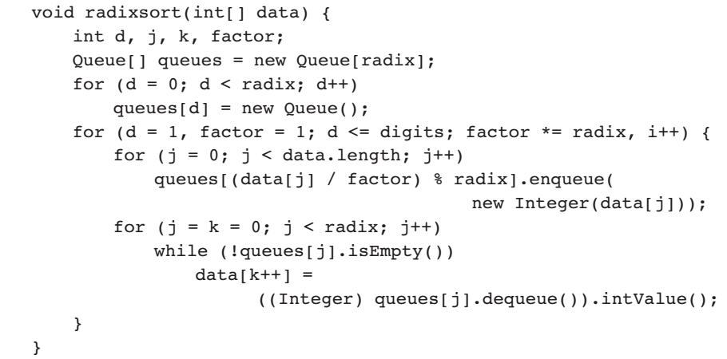
Radix Sort (continued)

Slide 59
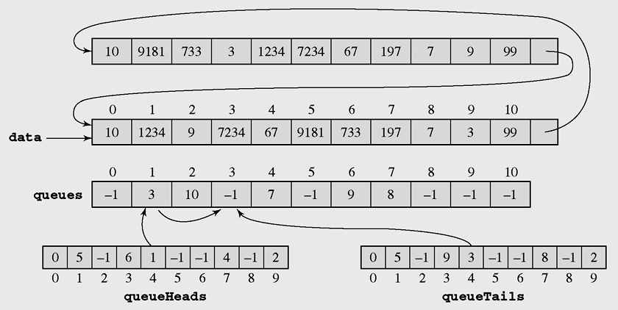
Radix Sort (continued)
Figure 9-16 An implementation of radix sort

Slide 60
Radix Sort (continued)
This algorithm does not rely on data comparison.
Two operations are performed:
  division by a factor to disregard digits following digit i being processed in the current pass
  division modulo radix(equal to 10) to disregard all digits preceding i
  => total: 2ndigits = O(n) operations.
In each pass, all integers are moved to piles and then back to data => total: 2ndigits = O(n) moves

Slide 61
Radix Sort (continued)
The algorithm requires additional space for piles
If implemented as linked lists then require 4n bytes for reference fields.

Slide 62
Sorting in java.util
Java provides two sets of versions of sorting methods: one for arrays and one for lists
The utility class Arrays includes a method for:
  Searching arrays for elements with binary search
  Filling arrays with a particular value
  Converting an array into a list, and sorting methods
The sorting methods are provided for arrays with elements of all elementary types except Boolean

Slide 63
Sorting in java.util (continued)
For each type of sorting method there are two versions:
  One for sorting an entire array
  One for sorting a subarray
public static void sort(int[] a);
public static void sort(int[] a, int first, int last);

Slide 64
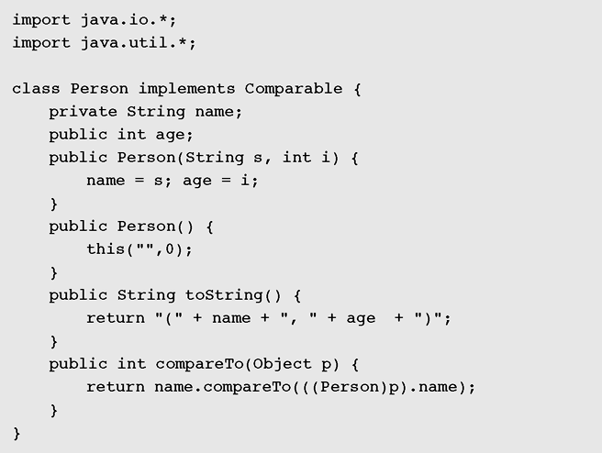
Sorting in java.util (continued)
Figure 9-17 Demonstration of sorting functions

Slide 65
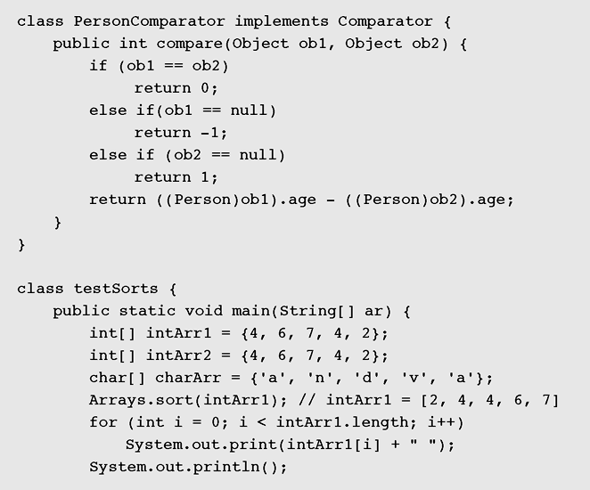
Sorting in java.util (continued)
Figure 9-17 Demonstration of sorting functions (continued)

Slide 66
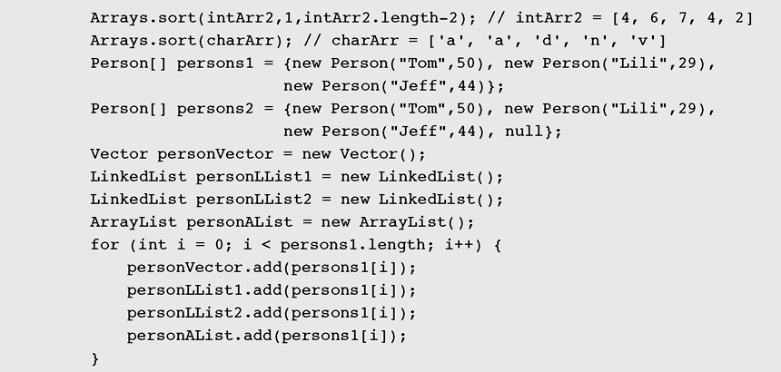
Sorting in java.util (continued)
Figure 9-17 Demonstration of sorting functions (continued)

Slide 67
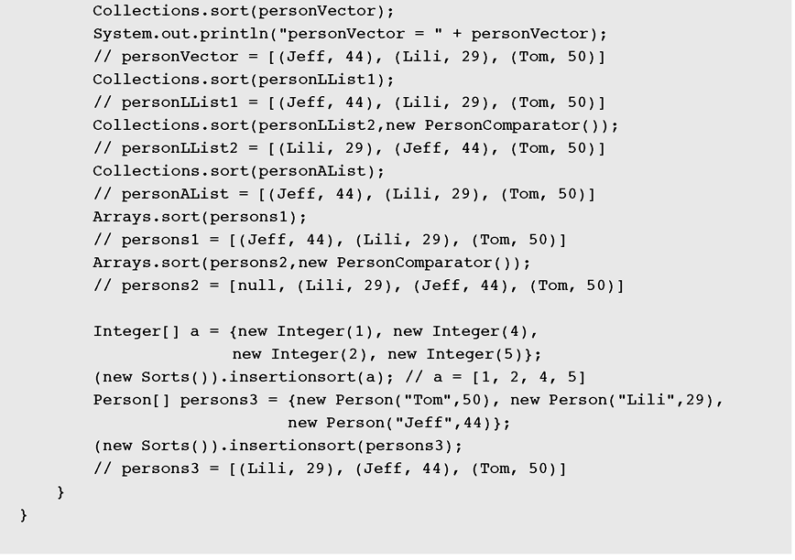
Sorting in java.util (continued)
Figure 9-17 Demonstration of sorting functions (continued)

Slide 68
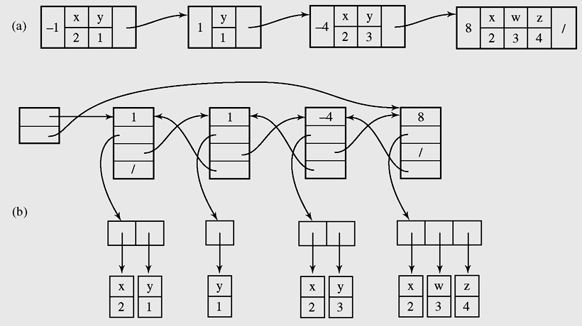
Case Study: Adding Polynomials
Figure 9-19 A linked list representation of the expression
–x²y + y – 4x²y³ + 8x²w³z⁴

Slide 69
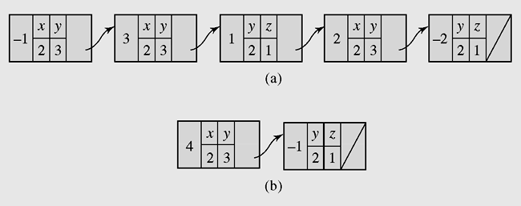
Case Study: Adding Polynomials (continued)
Figure 9-20 Transforming (a) a list representing the expression
–x²y³ + 3x²y³ + y²z + 2x²y³ – 2y²z into
(b) a list representing a simplified version of this
expression, 4x²y³ – y²z

Slide 70
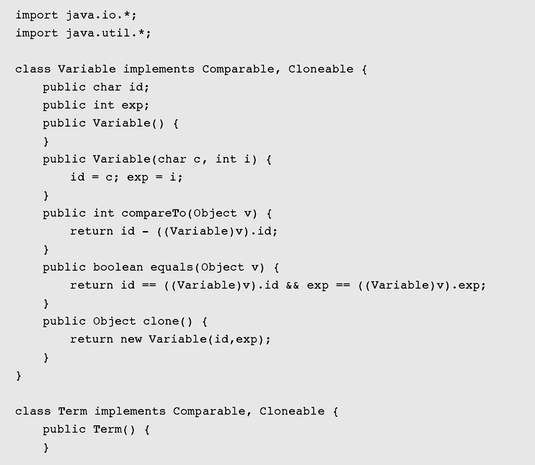
Case Study: Adding Polynomials (continued)
Figure 9-21 Implementation of the program to add polynomials

Slide 71
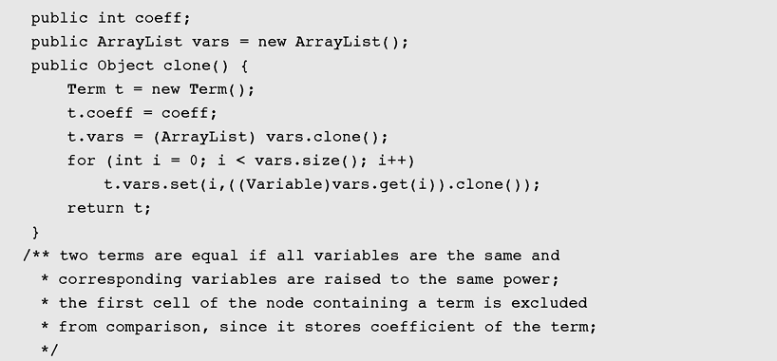
Case Study: Adding Polynomials (continued)
Figure 9-21 Implementation of the program to add polynomials
(continued)

Slide 72
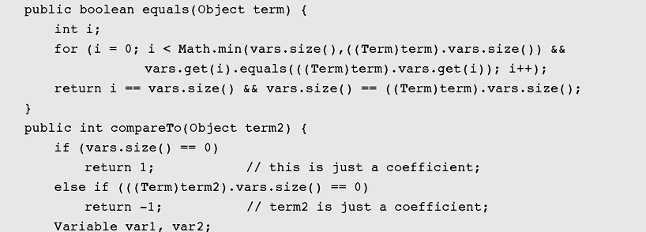
Case Study: Adding Polynomials (continued)
Figure 9-21 Implementation of the program to add polynomials
(continued)

Slide 73
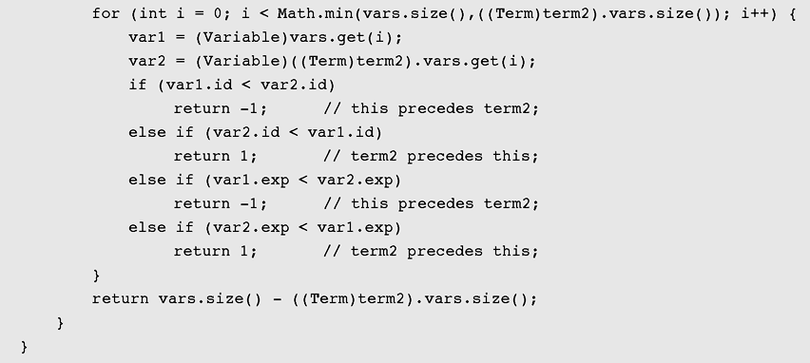
Case Study: Adding Polynomials (continued)
Figure 9-21 Implementation of the program to add polynomials
(continued)

Slide 74
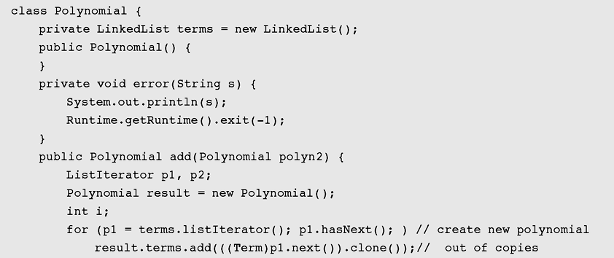
Case Study: Adding Polynomials (continued)
Figure 9-21 Implementation of the program to add polynomials
(continued)

Slide 75
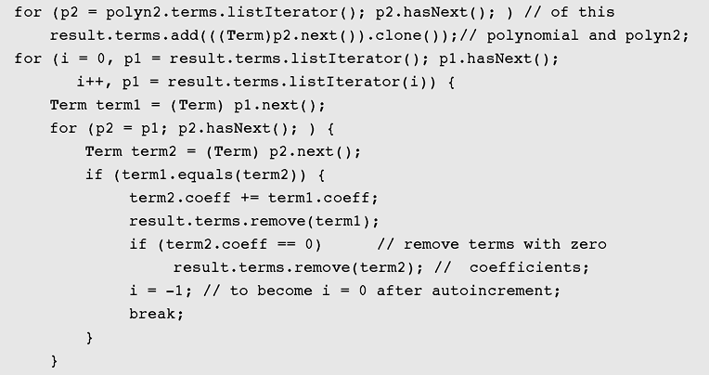
Case Study: Adding Polynomials (continued)
Figure 9-21 Implementation of the program to add polynomials
(continued)

Slide 76
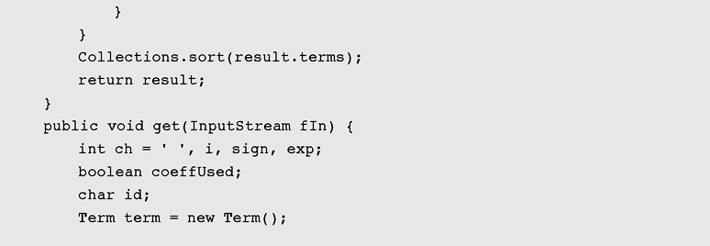
Case Study: Adding Polynomials (continued)
Figure 9-21 Implementation of the program to add polynomials
(continued)

Slide 77
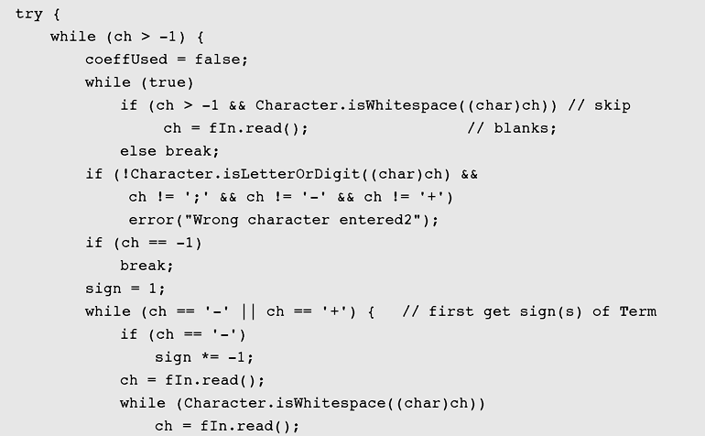
Case Study: Adding Polynomials (continued)
Figure 9-21 Implementation of the program to add polynomials
(continued)

Slide 78
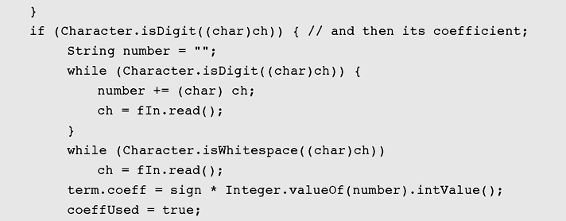
Case Study: Adding Polynomials (continued)
Figure 9-21 Implementation of the program to add polynomials
(continued)

Slide 79
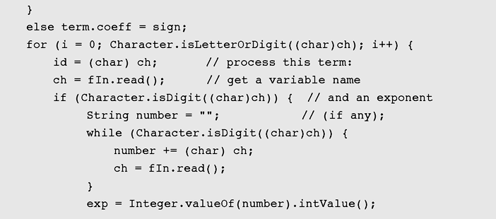
Case Study: Adding Polynomials (continued)
Figure 9-21 Implementation of the program to add polynomials
(continued)

Slide 80
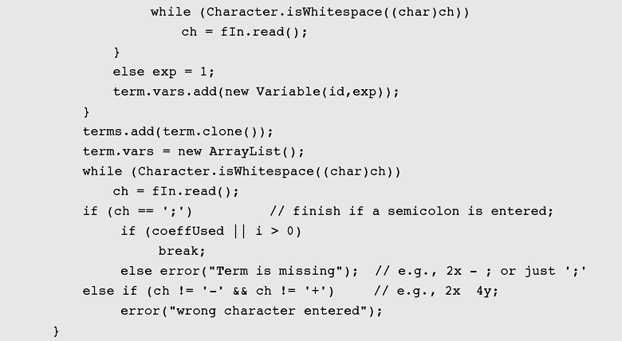
Case Study: Adding Polynomials (continued)
Figure 9-21 Implementation of the program to add polynomials
(continued)

Slide 81
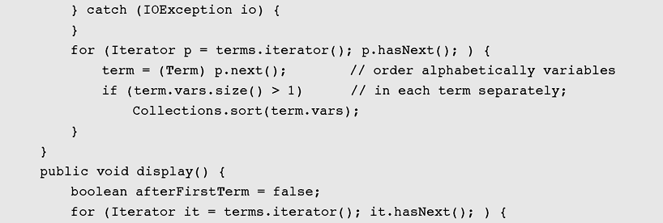
Case Study: Adding Polynomials (continued)
Figure 9-21 Implementation of the program to add polynomials
(continued)

Slide 82

Case Study: Adding Polynomials (continued)
Figure 9-21 Implementation of the program to add polynomials
(continued)

Slide 83

Case Study: Adding Polynomials (continued)
Figure 9-21 Implementation of the program to add polynomials
(continued)

Slide 84

Case Study: Adding Polynomials (continued)
Figure 9-21 Implementation of the program to add polynomials
(continued)

Slide 85
Summary
Sorting is a two step process: Choose the criteria that will be used to order data and determine how to put a set of data in order using that criterion
An insertion sort starts by considering the two first elements of the array data, which are
data[0] and data[1]
Selection sort is an attempt to localize the exchanges of array elements by finding a misplaced element first and putting it in its final place

Slide 86
Summary (continued)
A decision tree is when nonterminal nodes of the tree contain conditions or queries for labels, and the leaves have all possible orderings of the array to which the algorithm is applied
Shell sort divides the original array into subarrays, sorting them separately, and then dividing them again to sort the new subarrays until the whole array is sorted

Slide 87
Summary (continued)
Mergesort makes partitioning as simple as possible and concentrates on merging sorted halves of an array into one sorted array
Radix sort is a a technique to sort integers by proceeding right to left
Java provides two sets of versions of sorting methods: one for arrays and one for lists

