Slide 1
Chapter 10
Hashing

Slide 2
Objectives
Discuss the following topics:
Hashing
Hash Functions
Collision Resolution
Deletion
Perfect Hash Functions (*)
Hash Functions for Extendable files (*)
Hashing in java.util

Slide 3
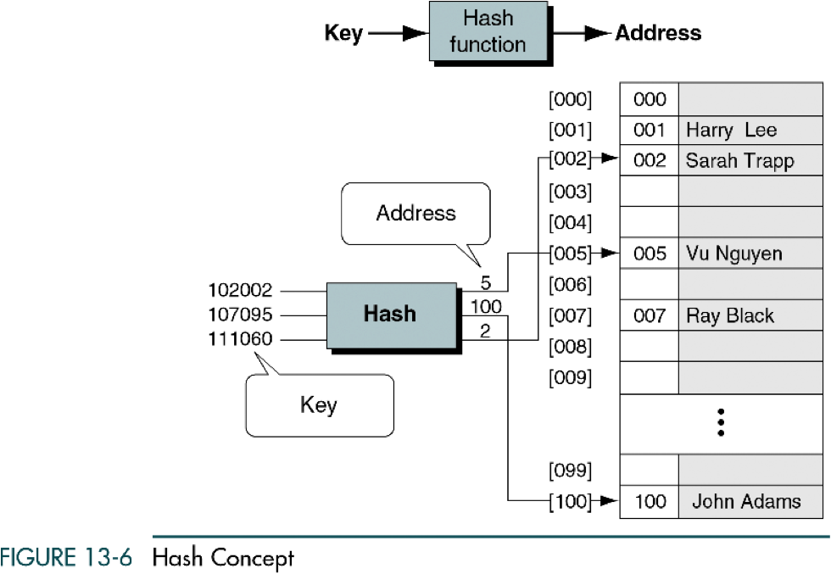
Hashing

Slide 4
Hashing
Hash tables are one of the most efficient means of searching for data. A hash table establishes a mapping between all of the possible keys and the position where the data associated with those keys is stored. The expected complexity of searching using a hash table is O(1).
Hash function h(x) is a function which transforms a particular key x, be it a string, number, record, or the like, into an index i = h(x) in the table T, where T[i] is used for storing an item having key x or its address.
.

Slide 5
Hashing
If h(x) transforms different keys into diffenrent values (most of case are integral numbers), it is called a perfect hash function. (In this case the hash table contains at least the same number of positions as the number of elements being hashed).
The situation, that h(x) = h(y) for some x # y, is called the collision of the hash function h(x)

Slide 6
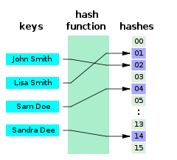
Hashing

Slide 7

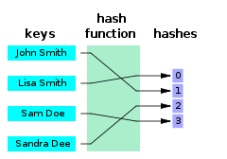
Hashing

Slide 8
How to select Hash functions?
We want a hash function that is easy to compute and that minimizes the number of collisions.
Hashing functions should be unbiased.
  That is, if we randomly choose a key, x, from the key space, the probability that f(x) = i is 1/M, where M is the size of the hash table.
  We call a hash function that satisfies unbiased property a uniform hash function.

Slide 9
Hash Functions
Division h_{D}(x) = x % M :
  Using the modulus (%) operator.
  We divide the key x by some number M and use the remainder as the hash index for x.
    This gives indexes that range from 0 to M - 1,
    where M = that table size (hash table).
The choice of M is critical.
  If M is divisible by 2, then odd keys to odd indexes and even keys to even ones. (biased!!)
  A good choice for M would be : M a prime number such that M does not divide r^{k}±a for small k and a.

Slide 10
Hash Functions (continued)
Folding
  Partition key x into several parts.
  All parts except for the last one have the same length.
  Add the parts together to obtain the value y, the hash index then is h(x) = y % M.
Two possibilities (divide x into several parts)
  Shift folding:
  Shift all parts except for the last one, so that the least significant bit of each part lines up with corresponding bit of the last part. Suppose x = 72320354121324
    x₁=723, x₂=203, x₃=541, x₄=213, x₅=24, index=1704%1000 = 704
  Boundary folding (folding at the boundaries):
  reverses every other partition before adding
    x₁=723, x₂=302, x₃=541, x₄=312, x₅=24, index=1902%1000 = 902

Slide 11
Hash Functions (continued)
In the mid-square method, the key is squared and the middle or mid part of the result is used as the address.
  Exp: key = 3121² = 9 740 641 ->index = 406 mod Tsize
Since the middle bits of the square usually depend upon all the characters in a key, there is high probability that different keys will produce different hash indexes.

Slide 12
Hash Functions (continued)
In the extraction method, only a part of the key is used to compute the address
  Exp: 123-45-6789->1234-5-6789 -> index = 1289 mod TSize
Using the radix transformation, the key K is transformed into another number base; K is expressed in a numerical system using a different radix.
  Exp: 345₁₀ = 423₉ -> index = 423 mod TSize

Slide 13
Collision Resolution
In the open addressing method, when a key collides with another key, the collision is resolved by finding an available table entry other than the position (address) to which the colliding key is originally hashed
The simplest method is linear probing, for which p(i) = i, and for the ith probe, the position to be tried is (h(K) + i) mod TSize

Slide 14
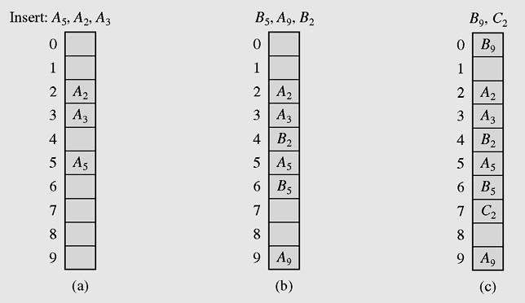
Collision Resolution (continued)
Figure 10-1 Resolving collisions with the linear probing method.
Subscripts indicate the home positions of the keys
being hashed.

Slide 15
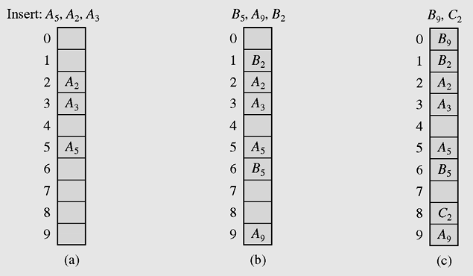
Collision Resolution (continued)
Figure 10-2 Using quadratic probing for collision resolution

Slide 16
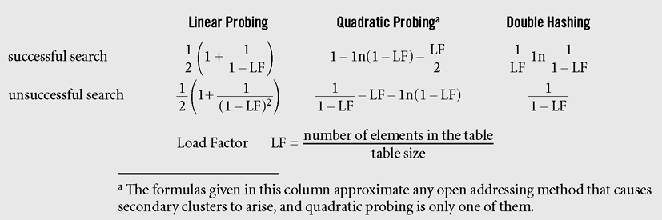
Collision Resolution (continued)
Figure 10-3 Formulas approximating, for different hashing methods,
the average numbers of trials for successful and
unsuccessful searches (Knuth, 1998)

Slide 17
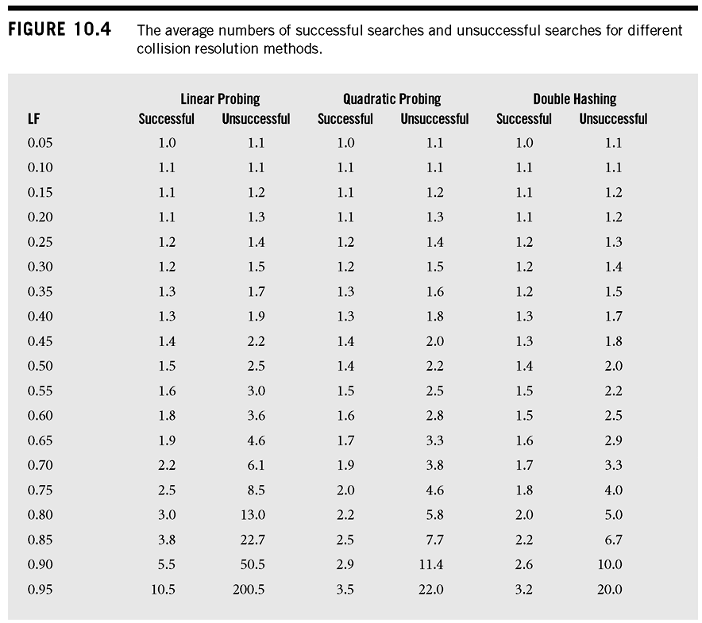
Collision Resolution (continued)

Slide 18
Chaining
In chaining, each position of the table is associated with a linked list or chain of structures whose info fields store keys or references to keys
This method is called separate chaining, and a table of references (pointers) is called a scatter table

Slide 19
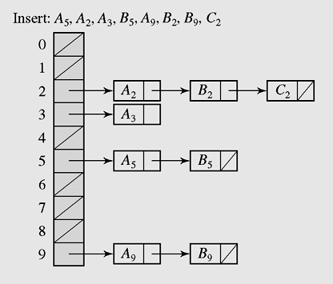
Chaining (continued)
Figure 10-5 In chaining, colliding keys are put on
the same linked list

Slide 20
Chaining (continued)
A version of chaining called coalesced hashing (or coalesced chaining) combines linear probing with chaining
An overflow area known as a cellar can be allocated to store keys for which there is no room in the table

Slide 21
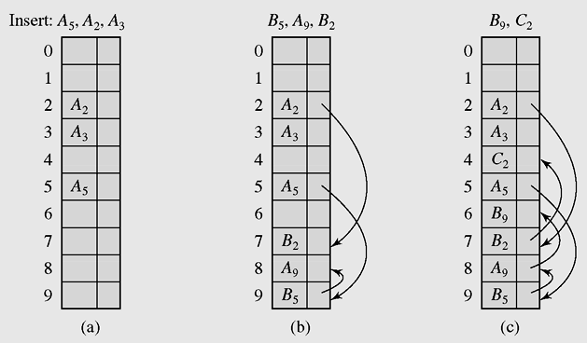
Chaining (continued)
Figure 10-6 Coalesced hashing puts a colliding key in the last
available position of the table

Slide 22
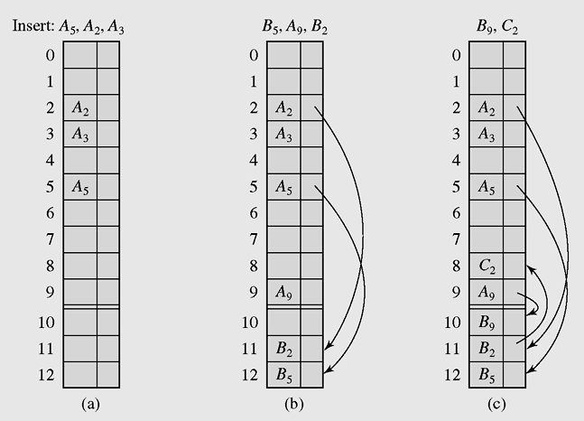
Chaining (continued)
Figure 10-7 Coalesced hashing that uses a cellar

Slide 23
Bucket Addressing
To store colliding elements in the same position in the table can be achieved by associating a bucket with each address
A bucket is a block of space large enough to store multiple items

Slide 24
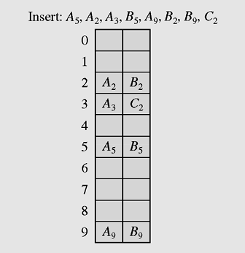
Bucket Addressing (continued)
Figure 10-8 Collision resolution with buckets and
linear probing method

Slide 25
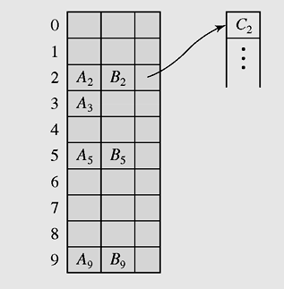
Bucket Addressing (continued)
Figure 10-9 Collision resolution with buckets and overflow area

Slide 26
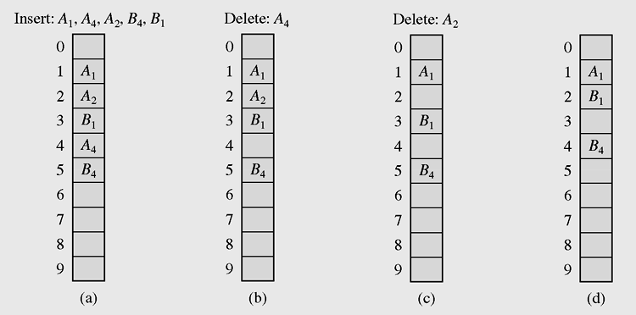
Deletion
Figure 10-10 Linear search in the situation where both insertion
and deletion of keys are permitted

Slide 27
Perfect Hash Functions
If a function requires only as many cells in the table as the number of data so that no empty cell remains after hashing is completed, it is called a minimal perfect hash function
Cichelli’s method is an algorithm to construct a minimal perfect hash function
It is used to hash a relatively small number of reserved words

Slide 28
Cichelli’s Method
Where g is the function to be constructed
h(word) = (length(word) + g(firstletter(word)) + g(lastletter(word))) mod TSize
The algorithm has three parts:
  Computation of the letter occurrences
  Ordering the words
  Searching

Slide 29
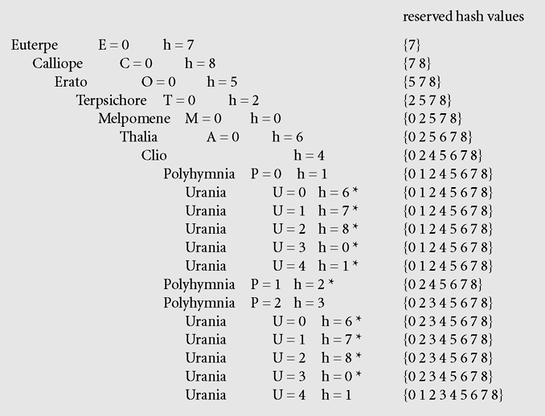
Cichelli’s Method (continued)
Figure 10-11 Subsequent invocations of the searching procedure with Max = 4
in Cichelli’s algorithm assign the indicated values to letters and to the list of
reserved hash values. The asterisks indicate failures.

Slide 30
The FHCD Algorithm
The FHCD algorithm searches for a minimal perfect hash function of the form (modulo TSize), where g is the function to be
determined by the algorithm
  h(word) = h₀(word) + g(h₁(word)) + g(h₂(word))

Slide 31
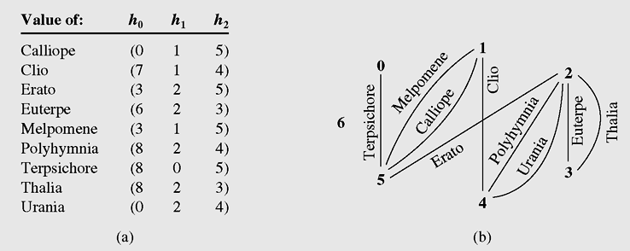
The FHCD Algorithm (continued)
Figure 10-12 Applying the FHCD algorithm to the names of
the nine Muses

Slide 32
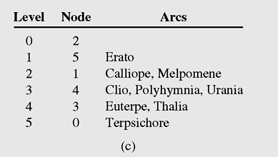
The FHCD Algorithm (continued)
Figure 10-12 Applying the FHCD algorithm to the names of
the nine Muses (continued)

Slide 33
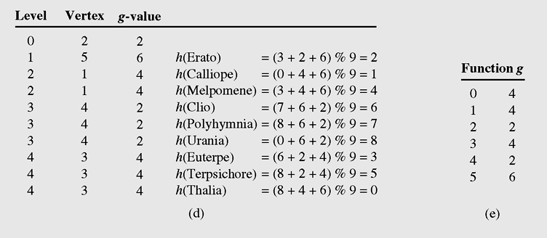
The FHCD Algorithm (continued)
Figure 10-12 Applying the FHCD algorithm to the names of the
nine Muses (continued)

Slide 34
Hash Functions for Extendible Files
Expandable hashing, dynamic hashing, and extendible hashing methods distribute keys among buckets in a similar fashion
The main difference is the structure of the index (directory)
In expandable hashing and dynamic hashing, a binary tree is used as an index of buckets
In extendible hashing, a directory of records is kept in a table

Slide 35
Extendible Hashing
Extendible hashing accesses the data stored in buckets indirectly through an index that is dynamically adjusted to reflect changes in the file
Extendible hashing allows the file to expand without reorganizing it, but requires storage space for an index
Values returned by such a hash function are called pseudokeys

Slide 36
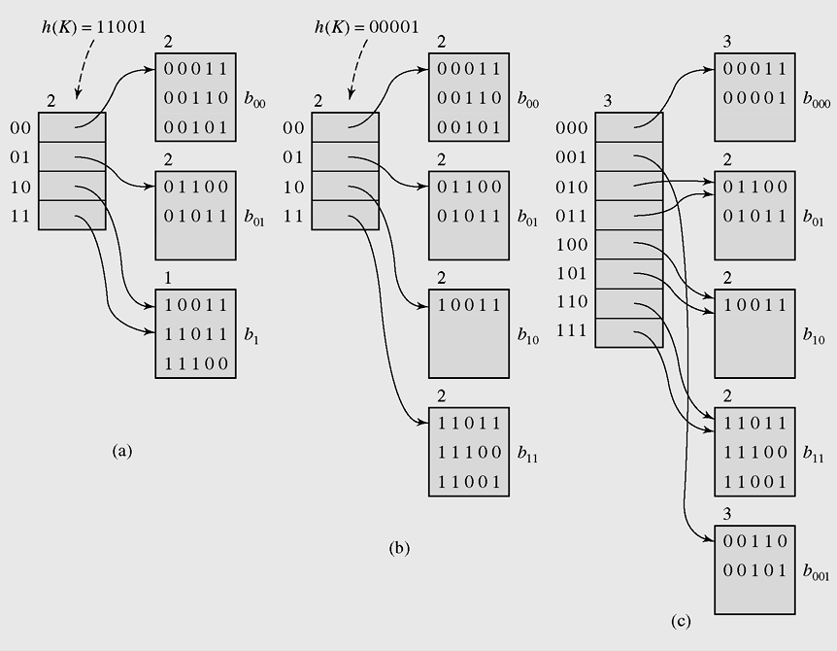
Extendible Hashing (continued)
Figure 10-13 An example of extendible hashing

Slide 37
Linear Hashing
With this method, no index is necessary because new buckets generated by splitting existing buckets are always added in the same linear way, so there is no need to retain indexes
A reference split indicates which bucket is to be split next
After the bucket is divided, the keys in this bucket are distributed between this bucket and the newly created bucket, which is added to the end of the table

Slide 38
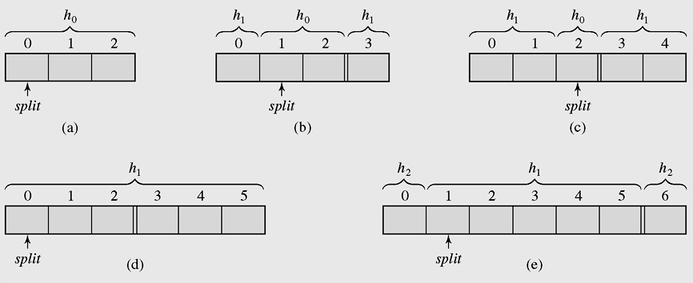
Linear Hashing (continued)
Figure 10-14 Splitting buckets in the linear hashing technique

Slide 39
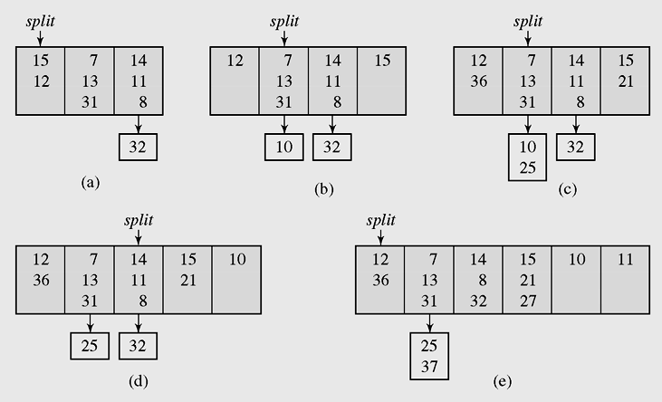
Linear Hashing (continued)
Figure 10-15 Inserting keys to buckets and overflow areas with
the linear hashing technique

Slide 40
HashMap
HashMap is an implementation of the interface Map
A map is a collection that holds pairs (key, value) or entries
A hash map is a collection of singly linked lists (buckets); that is, chaining is used as a collision resolution technique
In a hash map, both null values and null keys are permitted

Slide 41
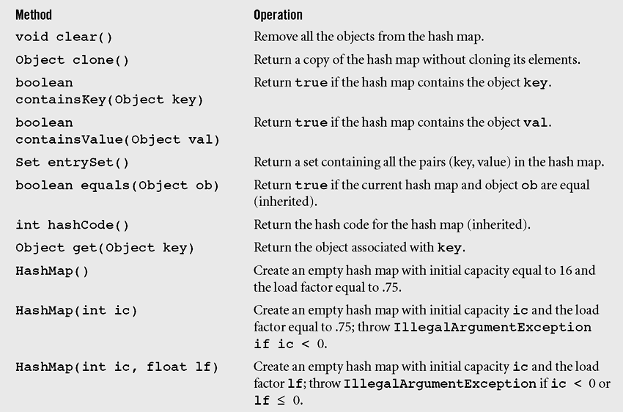
HashMap (continued)
Figure 10-16 Methods in class HashMap including three inherited methods

Slide 42
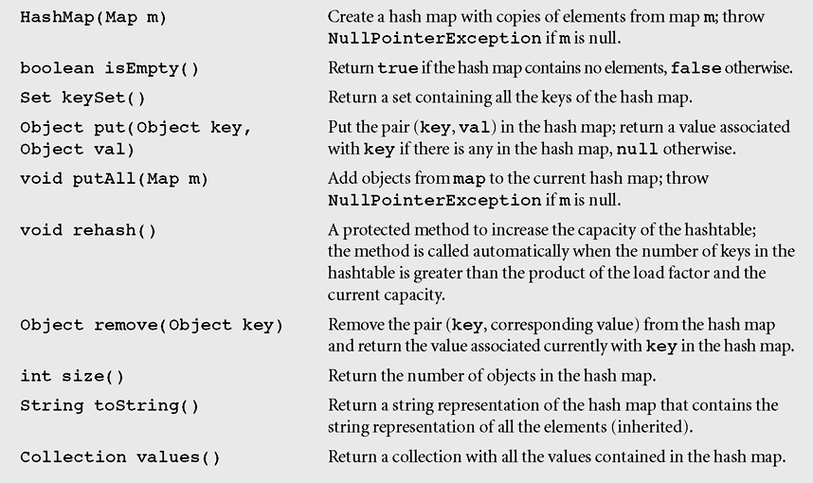
HashMap (continued)
Figure 10-16 Methods in class HashMap including three inherited methods
(continued)

Slide 43
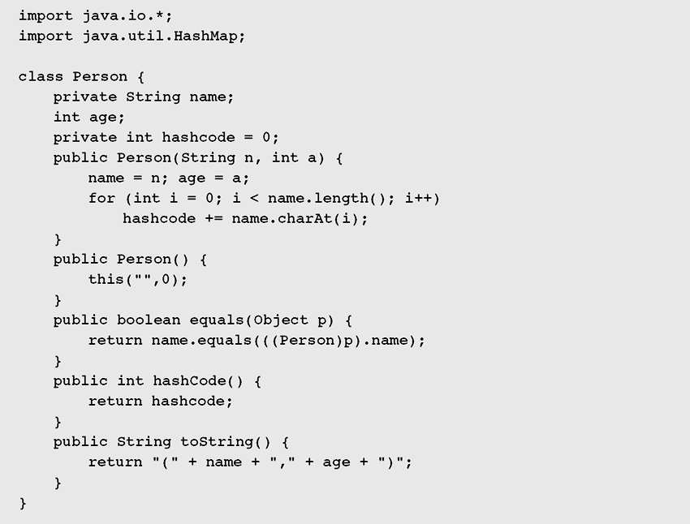
HashMap (continued)
Figure 10-17 Demonstrating the operation of the methods in class HashMap

Slide 44
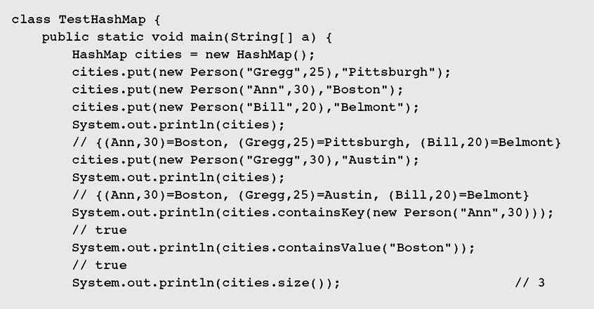
HashMap (continued)
Figure 10-17 Demonstrating the operation of the methods in class HashMap
(continued)

Slide 45
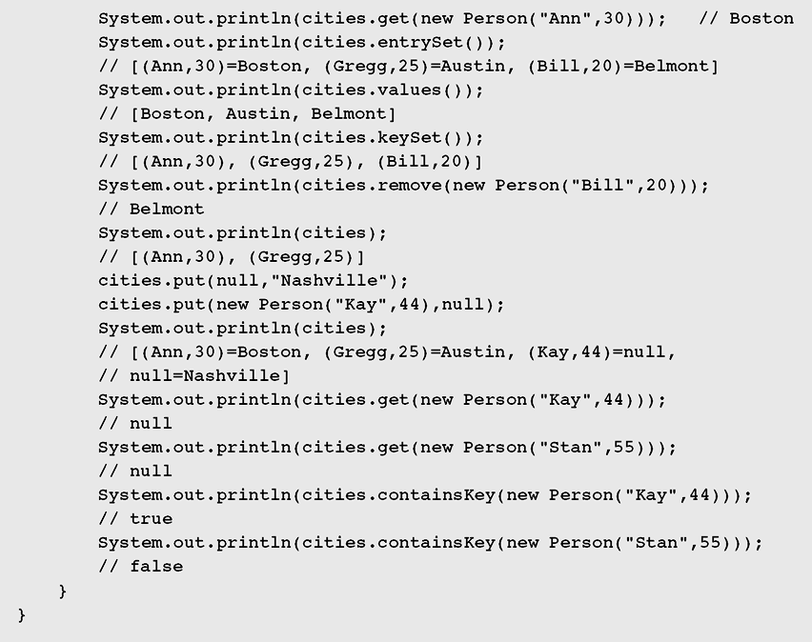
HashMap (continued)
Figure 10-17 Demonstrating the operation of the methods in class HashMap
(continued)

Slide 46
HashSet
HashSet is another implementation of a set
(an object that stores unique elements)
Class hierarchy in java.util for HashSet is:
Object →AbstractCollection → AbstractSet → HashSet
HashSet is implemented in terms of HashMap
    public HashSet() {
    map = new HashMap();
    }

Slide 47
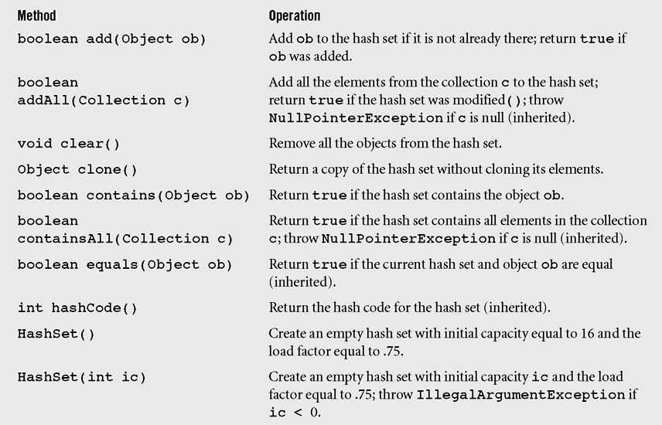
HashSet (continued)
Figure 10-18 Methods in class HashSet including some inherited methods

Slide 48
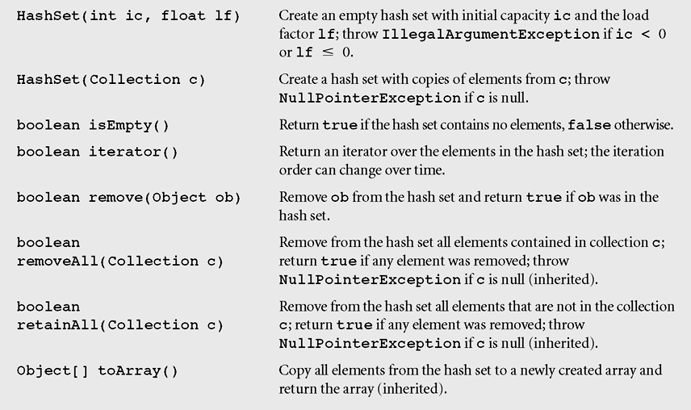
HashSet (continued)
Figure 10-18 Methods in class HashSet including some inherited methods
(continued)

Slide 49
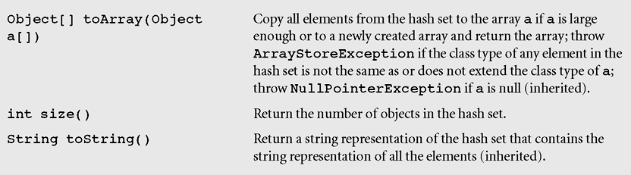
HashSet (continued)
Figure 10-18 Methods in class HashSet including some inherited methods
(continued)

Slide 50
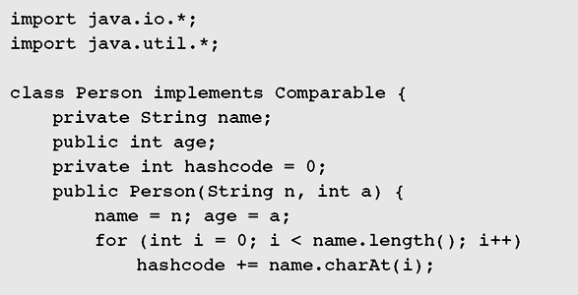
HashSet (continued)
Figure 10-19 Demonstrating the operation of the methods
in class HashSet

Slide 51
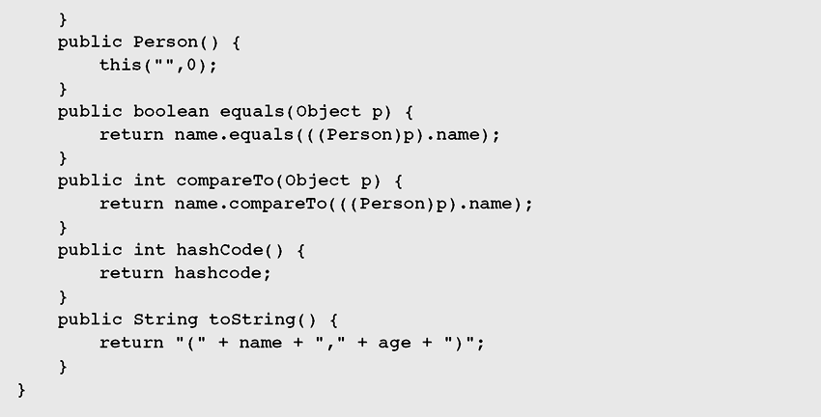
HashSet (continued)
Figure 10-19 Demonstrating the operation of the methods
in class HashSet (continued)

Slide 52
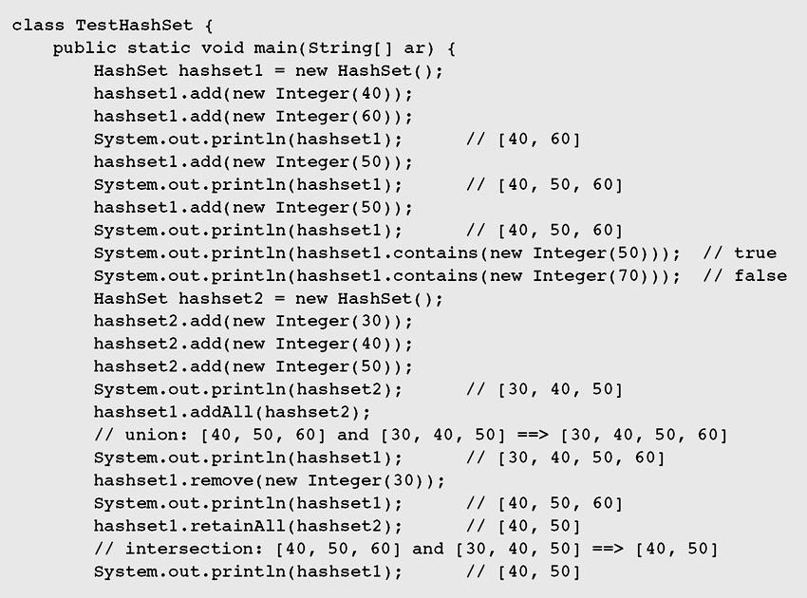
HashSet (continued)
Figure 10-19 Demonstrating the operation of the methods
in class HashSet (continued)

Slide 53
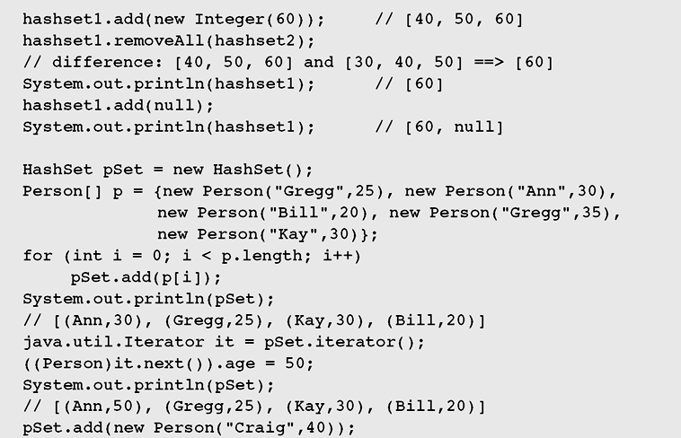
HashSet (continued)
Figure 10-19 Demonstrating the operation of the methods
in class HashSet (continued)

Slide 54
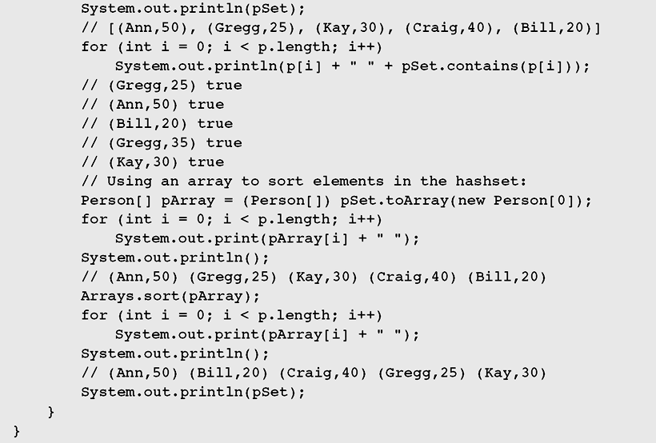
HashSet (continued)
Figure 10-19 Demonstrating the operation of the methods
in class HashSet (continued)

Slide 55
Hashtable
A Hashtable is roughly equivalent to a HashMap except that it is synchronized and does not permit null values with methods to operate on hash tables
The class Hashtable is considered a legacy class, just like the class Vector
Class hierarchy in java.util is:
Object → Dictionary → Hashtable

Slide 56
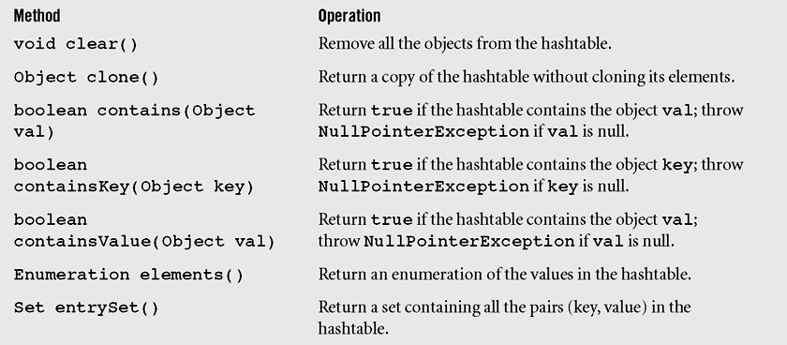
Hashtable (continued)
Figure 10-20 Methods of the class Hashtable including three
inherited methods

Slide 57
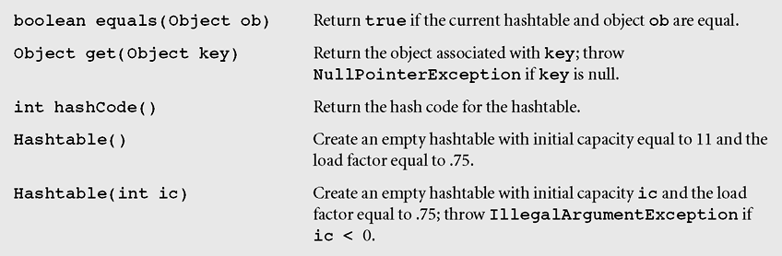
Hashtable (continued)
Figure 10-20 Methods of the class Hashtable including three
inherited methods (continued)

Slide 58
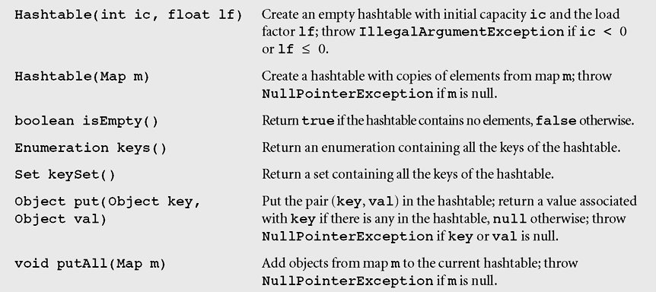
Hashtable (continued)
Figure 10-20 Methods of the class Hashtable including three
inherited methods (continued)

Slide 59
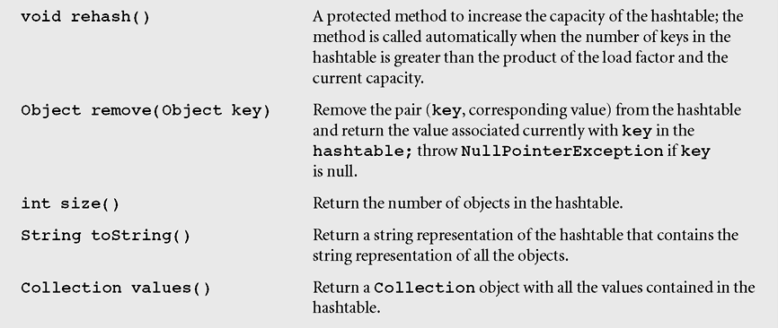
Hashtable (continued)
Figure 10-20 Methods of the class Hashtable including three
inherited methods (continued)

Slide 60
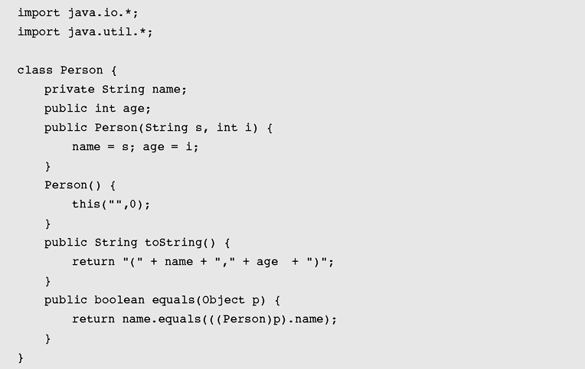
Hashtable (continued)
Figure 10-21 A program demonstrating operations of the Hashtable methods

Slide 61
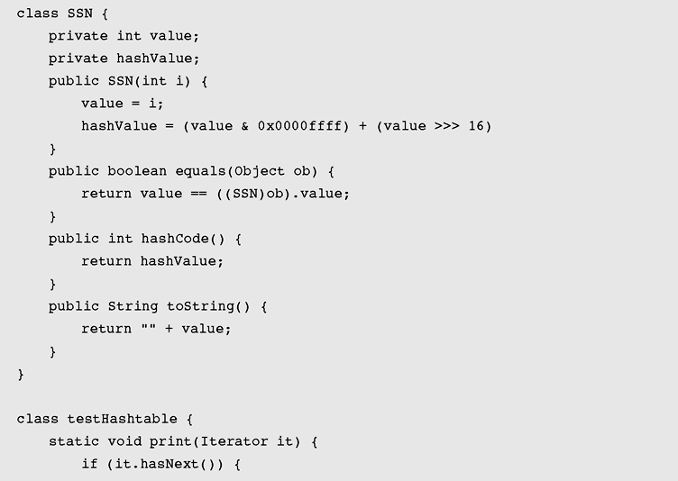
Hashtable (continued)
Figure 10-21 A program demonstrating operations of the Hashtable
methods (continued)

Slide 62
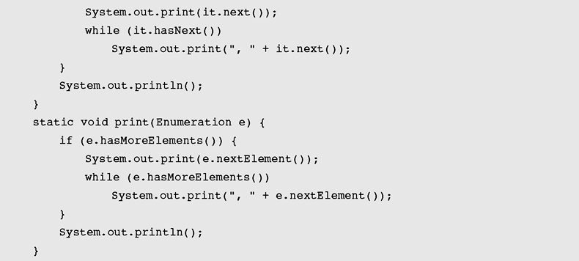
Hashtable (continued)
Figure 10-21 A program demonstrating operations of the Hashtable
methods (continued)

Slide 63
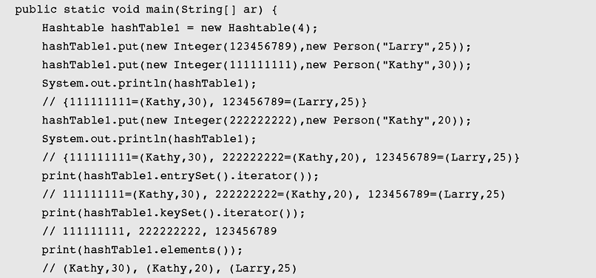
Hashtable (continued)
Figure 10-21 A program demonstrating operations of the Hashtable
methods (continued)

Slide 64
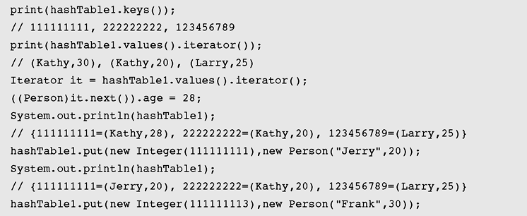
Hashtable (continued)
Figure 10-21 A program demonstrating operations of the Hashtable
methods (continued)

Slide 65
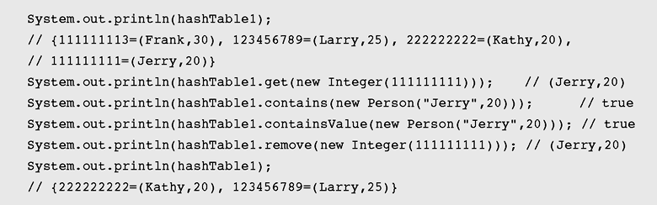
Hashtable (continued)
Figure 10-21 A program demonstrating operations of the Hashtable
methods (continued)

Slide 66
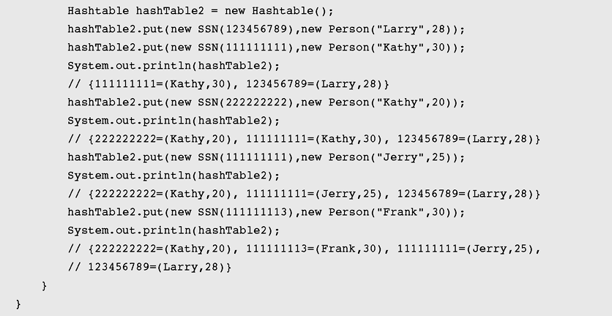
Hashtable (continued)
Figure 10-21 A program demonstrating operations of the Hashtable
methods (continued)

Slide 67
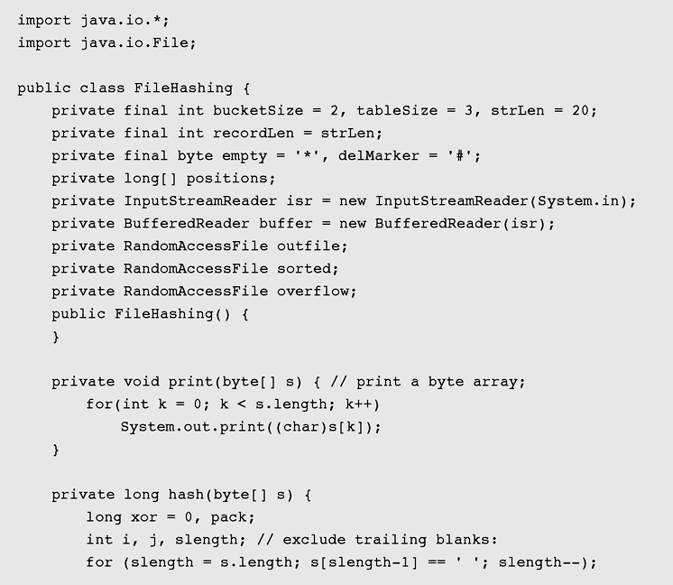
Case Study: Hashing with Buckets
Figure 10-22 Implementation of hashing using buckets

Slide 68
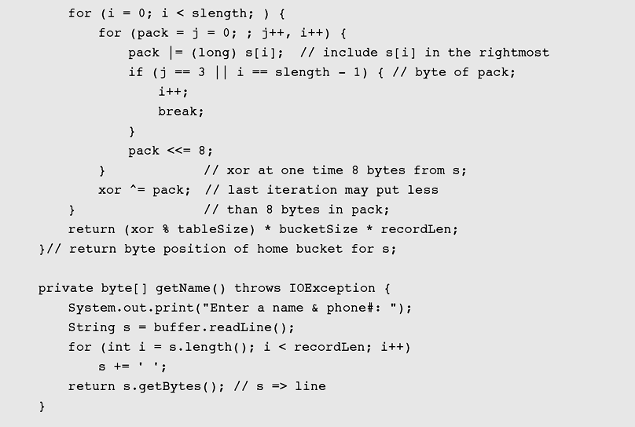
Case Study: Hashing with Buckets (continued)
Figure 10-22 Implementation of hashing using buckets (continued)

Slide 69
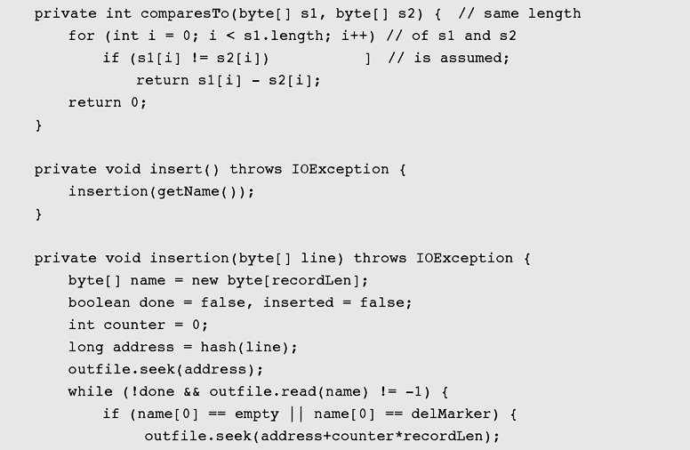
Case Study: Hashing with Buckets (continued)
Figure 10-22 Implementation of hashing using buckets (continued)

Slide 70
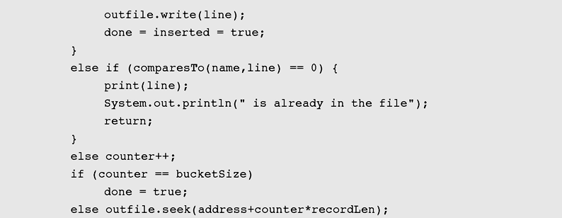
Case Study: Hashing with Buckets (continued)
Figure 10-22 Implementation of hashing using buckets (continued)

Slide 71
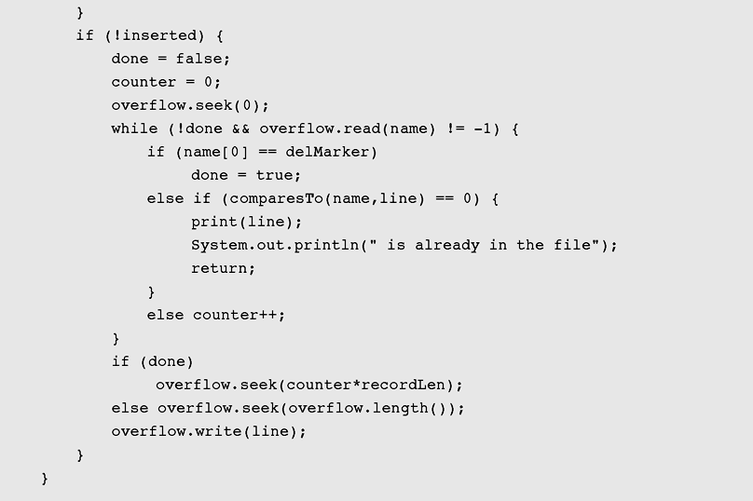
Case Study: Hashing with Buckets (continued)
Figure 10-22 Implementation of hashing using buckets (continued)

Slide 72

Case Study: Hashing with Buckets (continued)
Figure 10-22 Implementation of hashing using buckets (continued)

Slide 73
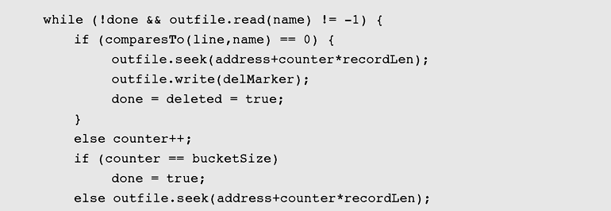
Case Study: Hashing with Buckets (continued)
Figure 10-22 Implementation of hashing using buckets (continued)

Slide 74

Case Study: Hashing with Buckets (continued)
Figure 10-22 Implementation of hashing using buckets (continued)

Slide 75

Case Study: Hashing with Buckets (continued)
Figure 10-22 Implementation of hashing using buckets (continued)

Slide 76

Case Study: Hashing with Buckets (continued)
Figure 10-22 Implementation of hashing using buckets (continued)

Slide 77

Case Study: Hashing with Buckets (continued)
Figure 10-22 Implementation of hashing using buckets (continued)

Slide 78

Case Study: Hashing with Buckets (continued)
Figure 10-22 Implementation of hashing using buckets (continued)

Slide 79

Case Study: Hashing with Buckets (continued)
Figure 10-22 Implementation of hashing using buckets (continued)

Slide 80

Case Study: Hashing with Buckets (continued)
Figure 10-22 Implementation of hashing using buckets (continued)

Slide 81

Case Study: Hashing with Buckets (continued)
Figure 10-22 Implementation of hashing using buckets (continued)

Slide 82

Case Study: Hashing with Buckets (continued)
Figure 10-22 Implementation of hashing using buckets (continued)

Slide 83

Case Study: Hashing with Buckets (continued)
Figure 10-22 Implementation of hashing using buckets (continued)

Slide 84
Summary
Hash functions include the division, folding,
mid-square, extraction and radix
transformation methods
Collision resolution includes the open addressing, chaining, and bucket addressing methods
Cichelli’s method is an algorithm to construct a minimal perfect hash function

Slide 85
Summary (continued)
The FHCD algorithm searches for a minimal perfect hash function of the form (modulo TSize), where g is the function to be determined by the algorithm
In expandable hashing and dynamic hashing, a binary tree is used as an index of buckets
In extendible hashing, a directory of records is kept in a table

Slide 86
Summary (continued)
A hash map is a collection of singly linked lists (buckets); that is, chaining is used as a collision resolution technique
HashSet is another implementation of a set
(an object that stores unique elements)
A Hashtable is roughly equivalent to a HashMap except that it is synchronized and does not permit null values with methods to operate on hash tables

