Slide 1
Chapter 11
Data Compression

Slide 2
Data Compression
Compression reduces the size of a file:
  To save space when storing it.
  To save time when transmitting it.
  Most files have lots of redundancy.
Text, images, sound, video, …

Slide 3
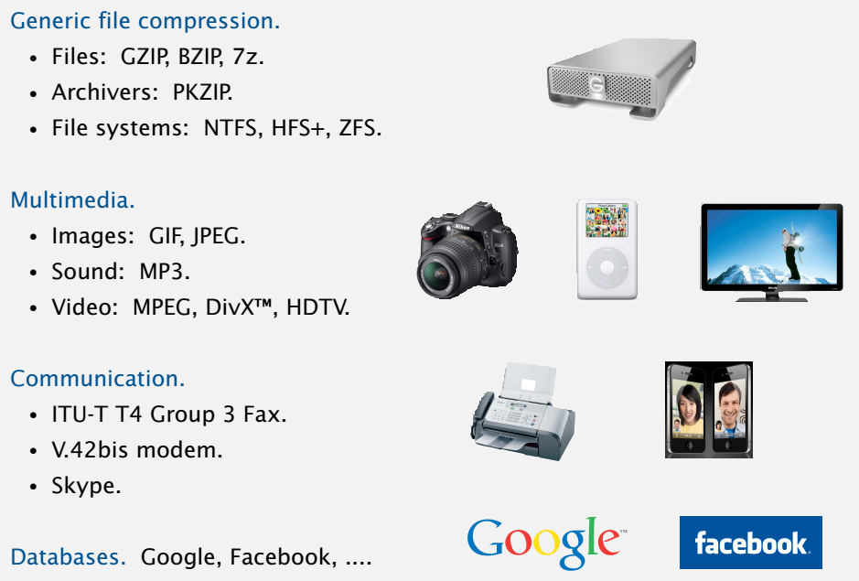


Slide 4
Objectives
Discuss the following topics:
Conditions for Data Compression
Huffman Coding
Run-Length Encoding
Ziv-Lempel Code
Case Study: Huffman Method with Run-Length Encoding

Slide 5
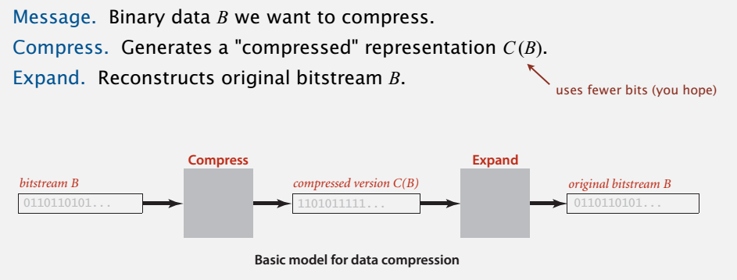
Lossless compression and expansion

Slide 6
Conditions for Data Compression
The information content of the set M, called the entropy of the source M, is defined by:
  L_{ave} = P(m₁)L(m₁) + · · · + P(m_{n})L(m_{n})
  Where P(m_{i}) is probabilities of occurrence of symbol m_{i} , and L(m_{i}) = –lg(P(m_{i}))
No data compression algorithm can be better than L_{ave}, and the closer it is to this number, the better is its compression rate.

Slide 7
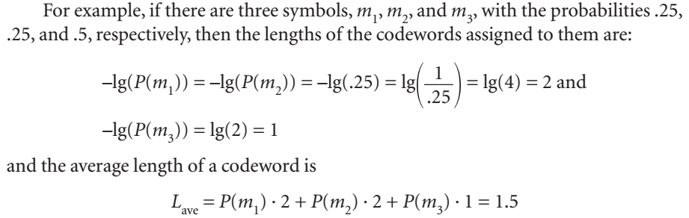
Conditions for Data Compression

Slide 8
Conditions for Data Compression
To compare the efficiency of different data compression methods when applied to the same data, the same measure is used; this measure is the compression rate
  length(input) – length (output)
  length(input)

Slide 9
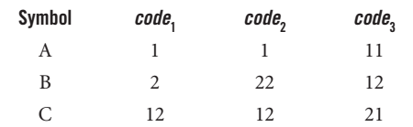
Conditions for Data Compression
1.Each codeword corresponds to exactly one symbol.
2. Decoding should not require any look ahead.

Slide 10
Conditions for Data Compression
3. The length of the codeword for a given symbol m_{j}
should not exceed the length of the codeword of a less probable symbol m_{i}; that is,
If P(m_{i}) ≤ P(m_{j}) then L(m_{i}) ≥ L(m_{j}) for 1 ≤i, j≤n.
4. In an optimal encoding system, there should not be any unused short codewords either as stand-alone encodings or as prefixes for longer codewords
codewords 01, 000, 001, 100, 101 is not optimal
codewords 01, 10, 11, 000, 001 is optimal

Slide 11
Huffman Coding
The construction of an optimal code was developed by David Huffman, who utilized a
tree structure in this construction: a binary tree for a binary code
To assess the compression efficiency of the Huffman algorithm, a definition of the weighted path length is used

Slide 12
Huffman Coding (continued)
Huffman()
for each symbol create a tree with a single root node and order all trees
according to the probability of symbol occurrence;
while more than one tree is left
take the two trees t₁, t₂ with the lowest probabilities p₁, p₂ (p₁ ≤ p₂)
and create a tree with t₁ and t₂ as its children and with
the probability in the new root equal to p₁ + p₂;
associate 0 with each left branch and 1 with each right branch;
create a unique codeword for each symbol by traversing the tree from the root
to the leaf containing the probability corresponding to this
symbol and by putting all encountered 0s and 1s together;

Slide 13
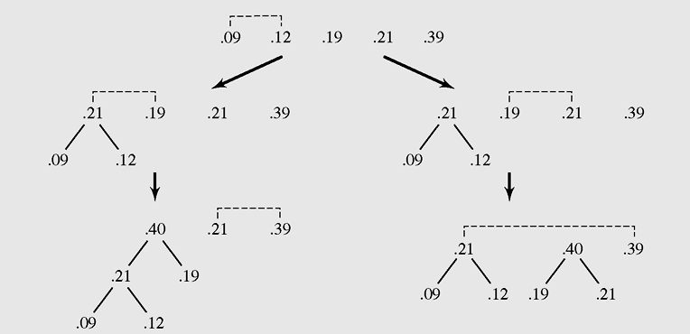
Huffman Coding (continued)
Figure 11-1 Two Huffman trees created for five letters A, B, C, D, and E
with probabilities .39, .21, .19, .12, and .09

Slide 14
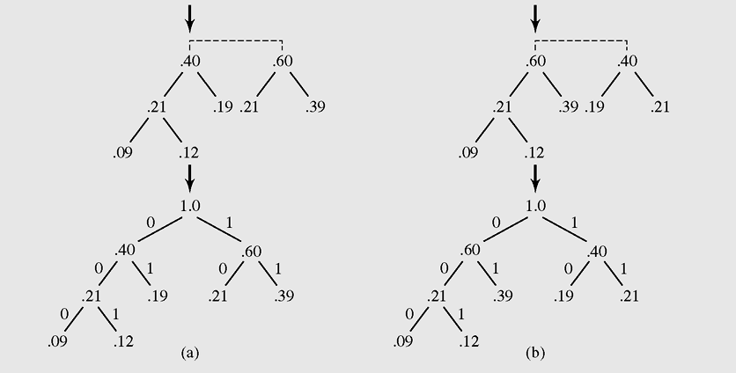
Huffman Coding (continued)
Figure 11-1 Two Huffman trees created for five letters A, B, C, D, and E
with probabilities .39, .21, .19, .12, and .09 (continued)

Slide 15
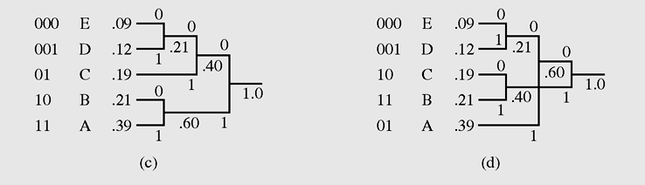
Huffman Coding (continued)
Figure 11-1 Two Huffman trees created for five letters A, B, C, D, and E
with probabilities .39, .21, .19, .12, and .09 (continued)

Slide 16
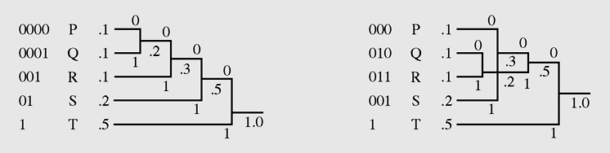
Huffman Coding (continued)
Figure 11-2 Two Huffman trees generated for letters P, Q, R, S,
and T with probabilities .1, .1, .1, .2, and .5

Slide 17
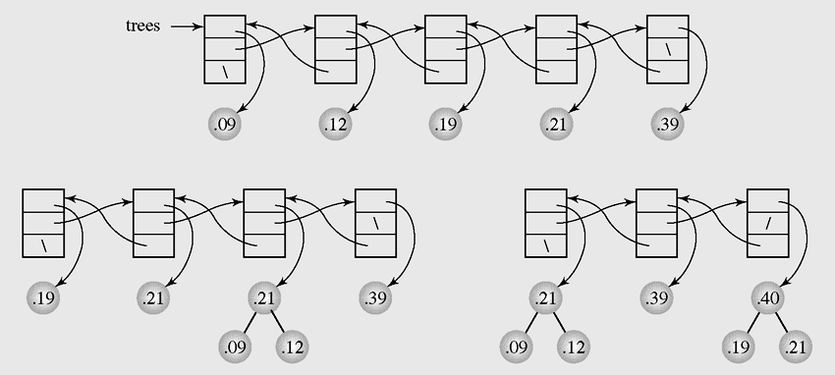
Huffman Coding (continued)
Figure 11-3 Using a doubly linked list to create the Huffman tree
for the letters from Figure 11-1

Slide 18
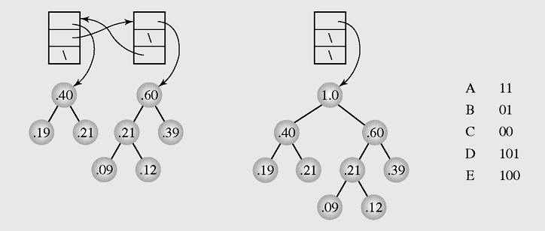
Huffman Coding (continued)
Figure 11-3 Using a doubly linked list to create the Huffman tree
for the letters from Figure 11-1 (continued)

Slide 19
Huffman Coding (continued)
createHuffmanTree(prob)
declare the probabilities p1, p₂, and the Huffman tree Htree;
if only two probabilities are left in prob
return a tree with p₁, p₂ in the leaves and p₁ + p₂ in the root;
else remove the two smallest probabilities from prob and assign them to p₁ and p₂;
insert p₁ + p₂ to prob;
Htree = createHuffmanTree(prob);
in Htree make the leaf with p₁ + p₂ the parent of two leaves with p₁ and p₂;
return Htree;

Slide 20
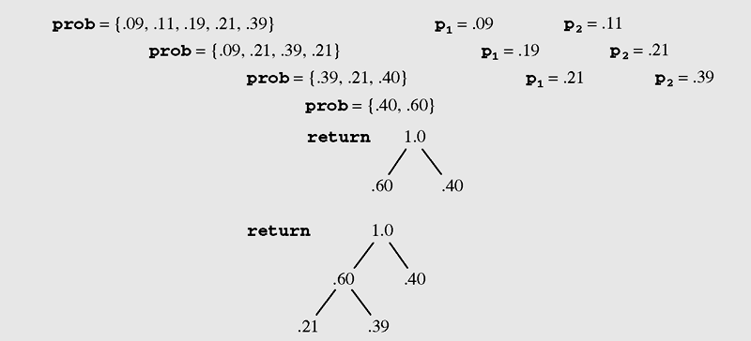
Huffman Coding (continued)
Figure 11-4 Top-down construction of a Huffman tree using
recursive implementation

Slide 21
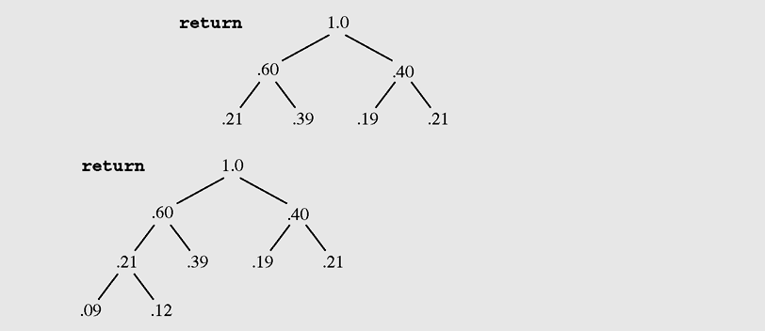
Huffman Coding (continued)
Figure 11-4 Top-down construction of a Huffman tree using
recursive implementation (continued)

Slide 22
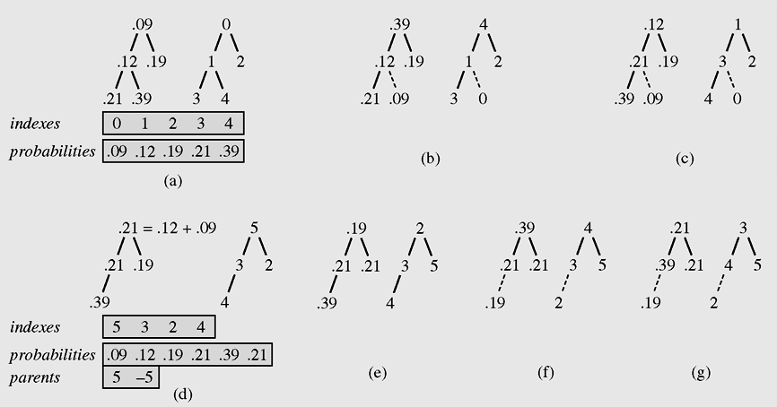
Huffman Coding (continued)
Figure 11-5 Huffman algorithm implemented with a heap

Slide 23
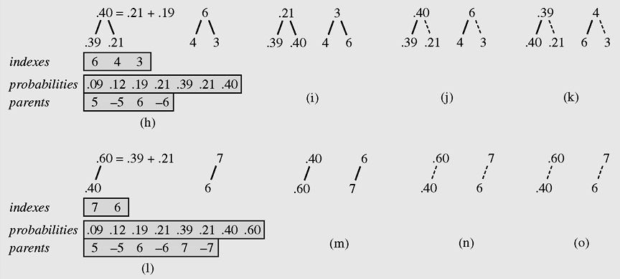
Huffman Coding (continued)
Figure 11-5 Huffman algorithm implemented with a heap (continued)

Slide 24
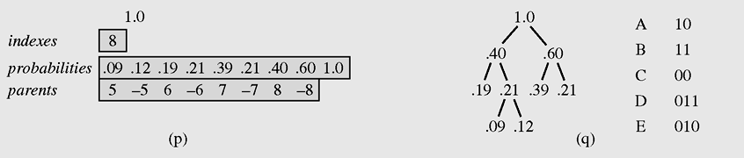
Huffman Coding (continued)
Figure 11-5 Huffman algorithm implemented with a heap (continued)

Slide 25
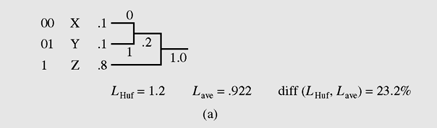
Huffman Coding (continued)
Figure 11-6 Improving the average length of the codeword by applying
the Huffman algorithm to (b) pairs of letters instead of
(a) single letters

Slide 26
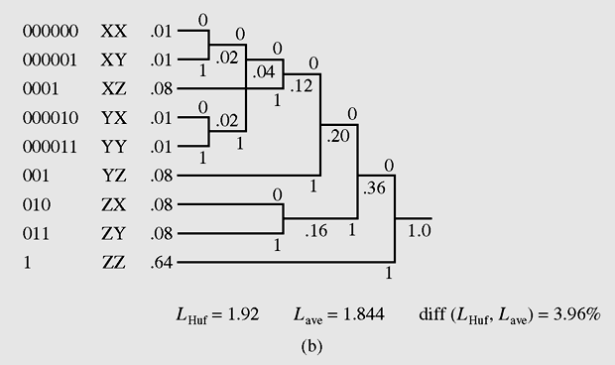
Huffman Coding (continued)
Figure 11-6 Improving the average length of the codeword by applying
the Huffman algorithm to (b) pairs of letters instead of
(a) single letters (continued)

Slide 27

Huffman Coding (continued)
Applications:

Slide 28
Adaptive Huffman Coding
An adaptive Huffman encoding technique was devised first by Robert G. Gallager and then improved by Donald Knuth
The algorithm is based on the sibling property: If each node has a sibling (except for the root) and the breadth-first right-to-left tree traversal generates a list of nodes with nonincreasing frequency counters, it can be proven that a tree with the sibling property is a Huffman tree.

Slide 29
Adaptive Huffman Coding (continued)
In adaptive Huffman coding, the Huffman tree includes a counter for each symbol, and the counter is updated every time a corresponding input symbol is being coded

Slide 30
Adaptive Huffman Coding (continued)
Adaptive Huffman coding surpasses simple Huffman coding in two respects:
  It requires only one pass through the input
  It adds only an alphabet to the output
Both versions are relatively fast and can be applied to any kind of file, not only to text files
They can compress object or executable files

Slide 31
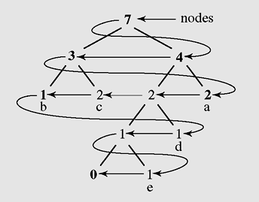
Adaptive Huffman Coding (continued)
Figure 11-7 Doubly linked list nodes formed by
breadth-first right-to-left tree traversal

Slide 32
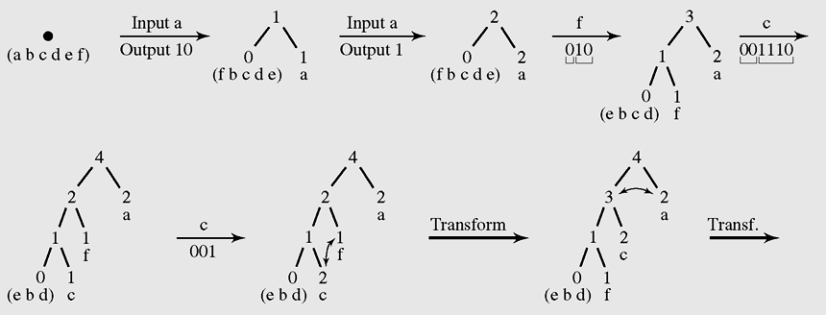
Adaptive Huffman Coding (continued)
Figure 11-8 Transmitting the message “aafcccbd” using an
adaptive Huffman algorithm

Slide 33
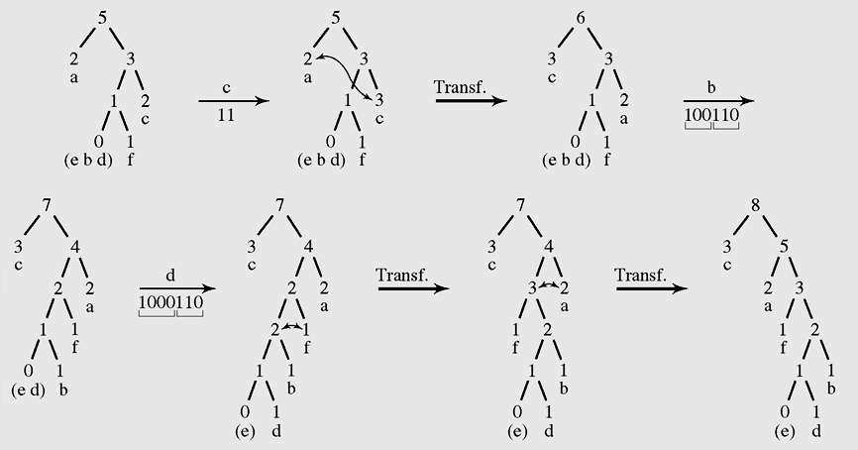
Adaptive Huffman Coding (continued)
Figure 11-8 Transmitting the message “aafcccbd” using an
adaptive Huffman algorithm (continued)

Slide 34
Run-Length Encoding
A run is defined as a sequence of identical characters
Run-length encoding is efficient only for text files in which only the blank character has a tendency to be repeated
Null suppression compresses only runs of blanks and eliminates the need to identify the character being compressed

Slide 35
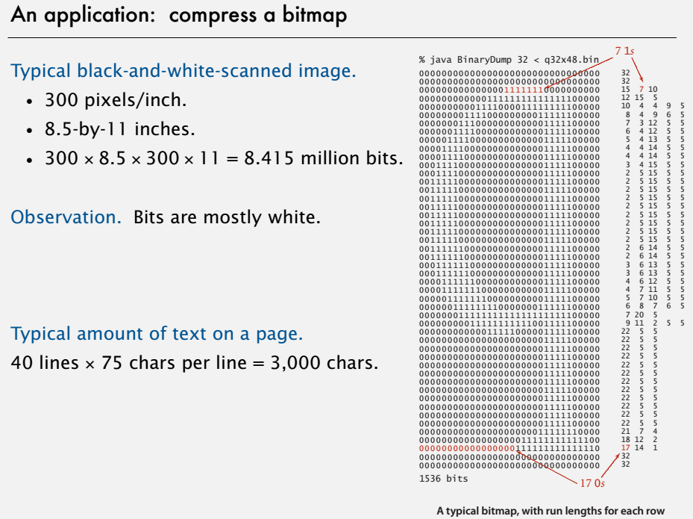

Slide 36
Run-Length Encoding (continued)
Run-length encoding is useful when applied to files that are almost guaranteed to have many runs of at least four characters, such as relational databases
A serious drawback of run-length encoding is that it relies entirely on the occurrences of runs.
Applications: JPEG, ITU-T T4 Group 3 Fax, ...

Slide 37
Ziv-Lempel Code
With a universal coding scheme, knowledge about input data prior to encoding can be built up during data transmission rather than relying on previous knowledge of the source characteristics
The Ziv-Lempel code is an example of a universal data compression code

Slide 38
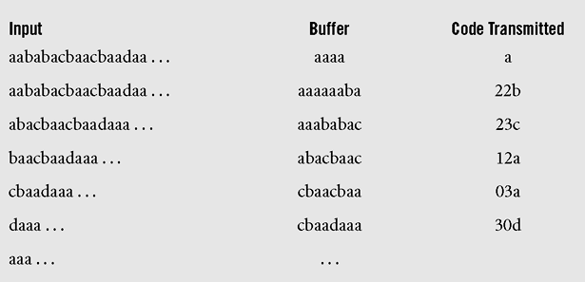
Ziv-Lempel Code (continued)
Figure 11-9 Encoding the string “aababacbaacbaadaaa . . .”
with LZ77

Slide 39
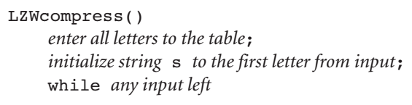
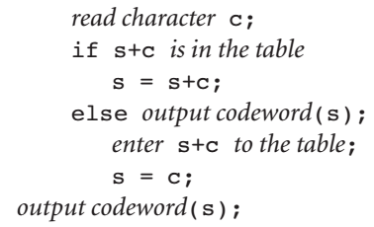

Slide 40
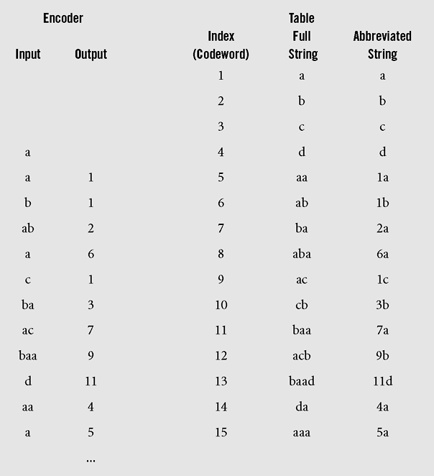
Ziv-Lempel Code (continued)
Figure 11-10 LZW applied to the string “aababacbaacbaadaaa . . . .”

Slide 41
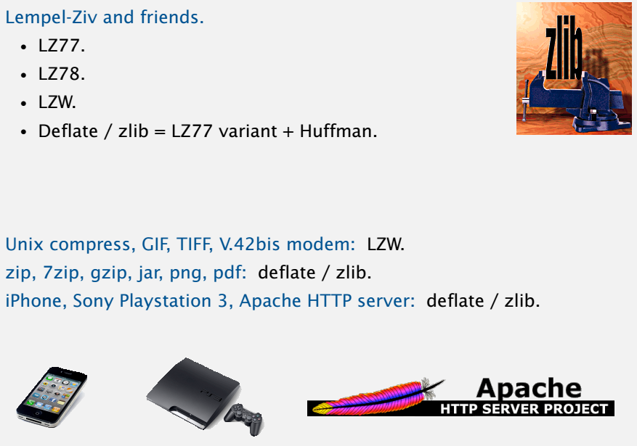

Slide 42
UNIX has three compression programs: pack uses the Huffman algorithm, compact is based on the adaptive Huffman method, and compress uses LZW coding.
Pack compresses text files by 25–40 percent
Compact by 40 percent
Compress by 40–50 percent.
=> The rate of compression is better for Ziv-Lempel coding.
And also faster.

Slide 43
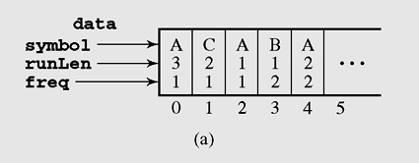
Case Study: Huffman Method with Run-Length Encoding
Figure 11-11 (a) Contents of the array data after the message
AAABAACCAABA has been processed

Slide 44
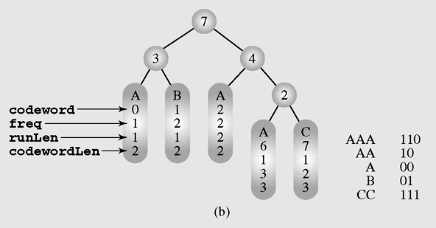
Case Study: Huffman Method with Run-Length Encoding (continued)
Figure 11-11 (b) Huffman tree generated from these data (continued)

Slide 45
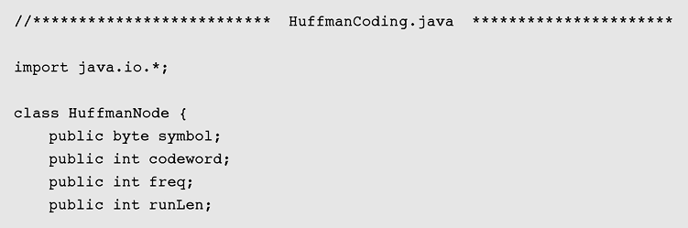
Case Study: Huffman Method with Run-Length Encoding (continued)
Figure 11-12 Implementation of Huffman method with run-length
encoding

Slide 46
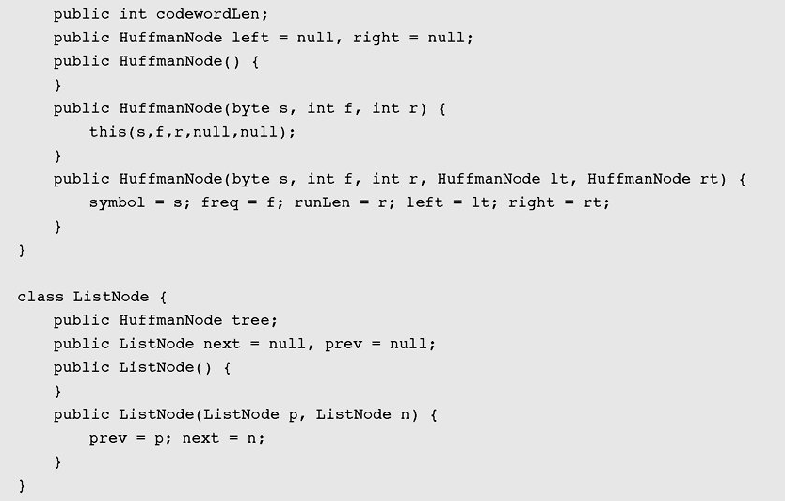
Case Study: Huffman Method with Run-Length Encoding (continued)
Figure 11-12 Implementation of Huffman method with run-length
encoding (continued)

Slide 47
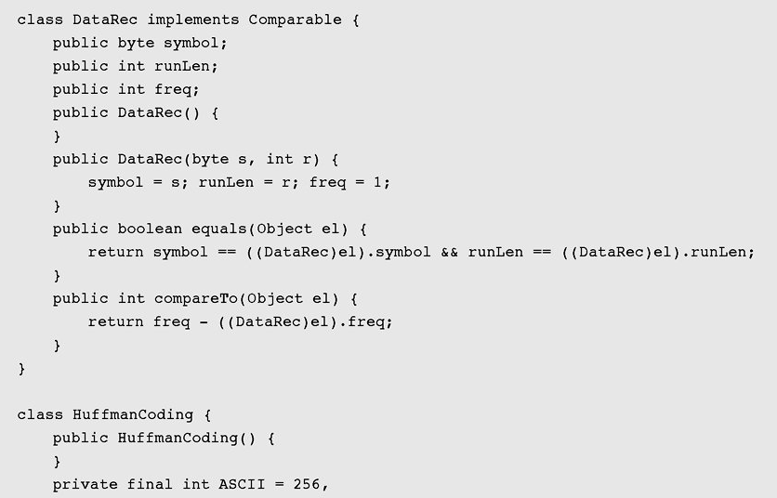
Case Study: Huffman Method with Run-Length Encoding (continued)
Figure 11-12 Implementation of Huffman method with run-length
encoding (continued)

Slide 48
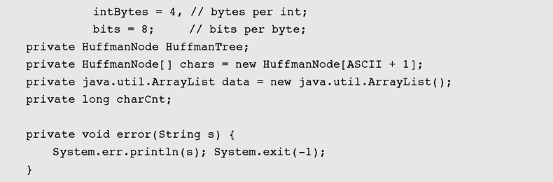
Case Study: Huffman Method with Run-Length Encoding (continued)
Figure 11-12 Implementation of Huffman method with run-length
encoding (continued)

Slide 49
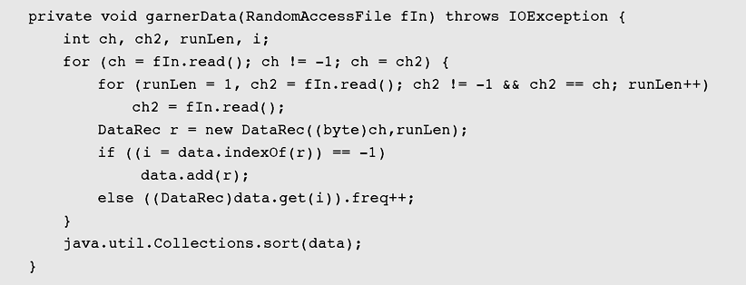
Case Study: Huffman Method with Run-Length Encoding (continued)
Figure 11-12 Implementation of Huffman method with run-length
encoding (continued)

Slide 50
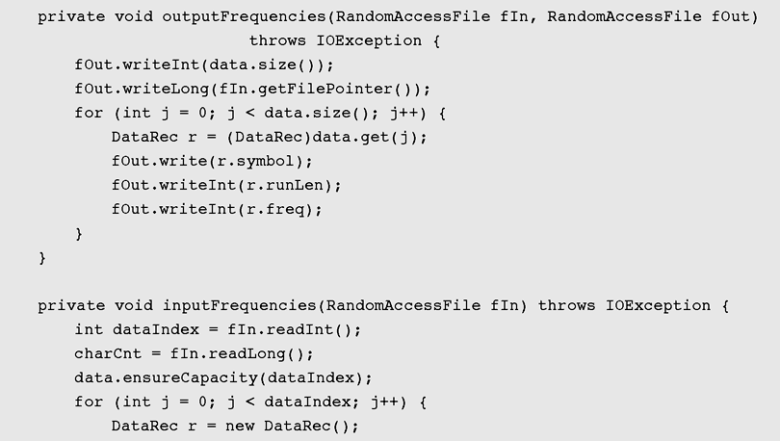
Case Study: Huffman Method with Run-Length Encoding (continued)
Figure 11-12 Implementation of Huffman method with run-length
encoding (continued)

Slide 51
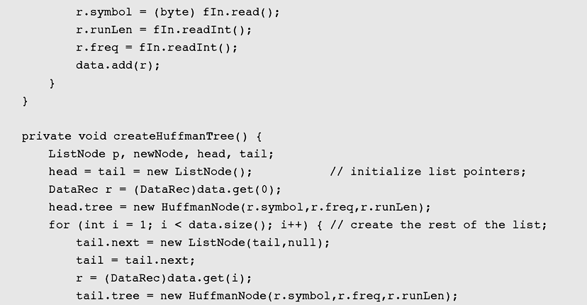
Case Study: Huffman Method with Run-Length Encoding (continued)
Figure 11-12 Implementation of Huffman method with run-length
encoding (continued)

Slide 52
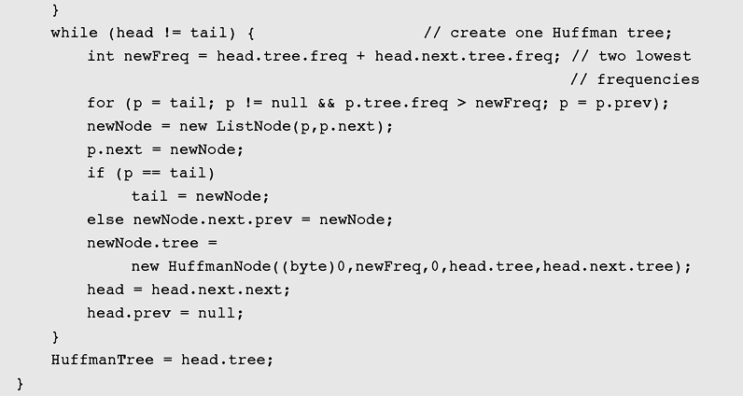
Case Study: Huffman Method with Run-Length Encoding (continued)
Figure 11-12 Implementation of Huffman method with run-length
encoding (continued)

Slide 53
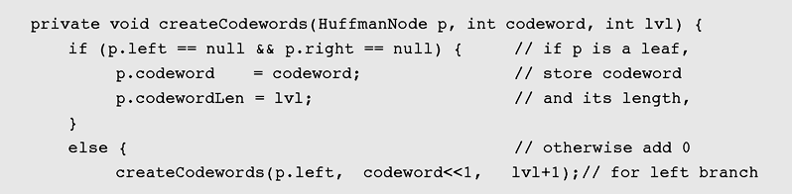
Case Study: Huffman Method with Run-Length Encoding (continued)
Figure 11-12 Implementation of Huffman method with run-length
encoding (continued)

Slide 54
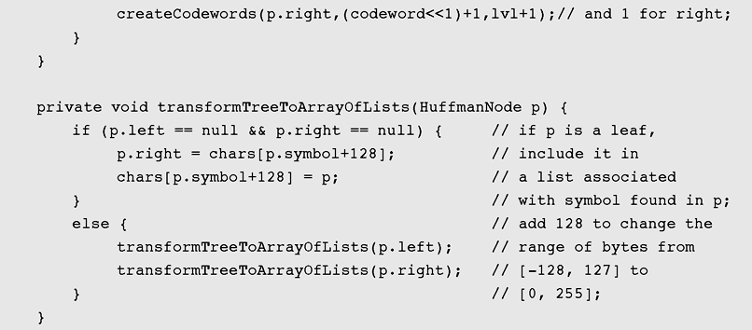
Case Study: Huffman Method with Run-Length Encoding (continued)
Figure 11-12 Implementation of Huffman method with run-length
encoding (continued)

Slide 55
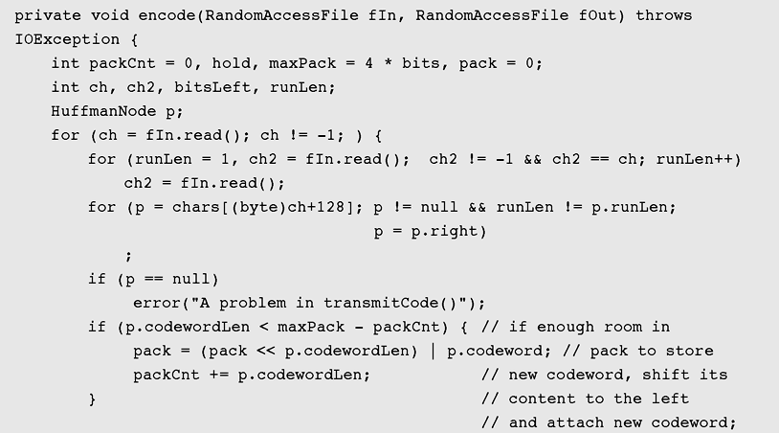
Case Study: Huffman Method with Run-Length Encoding (continued)
Figure 11-12 Implementation of Huffman method with run-length
encoding (continued)

Slide 56
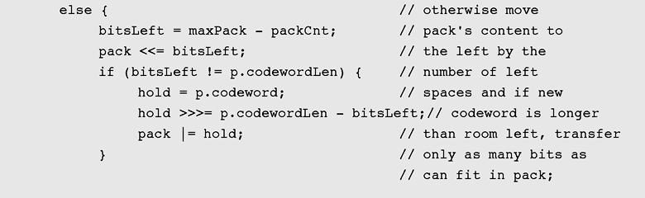
Case Study: Huffman Method with Run-Length Encoding (continued)
Figure 11-12 Implementation of Huffman method with run-length
encoding (continued)

Slide 57
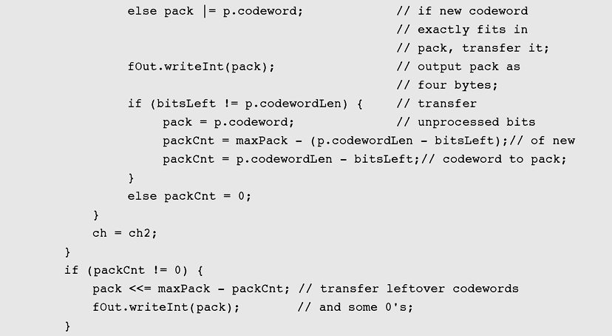
Case Study: Huffman Method with Run-Length Encoding (continued)
Figure 11-12 Implementation of Huffman method with run-length
encoding (continued)

Slide 58
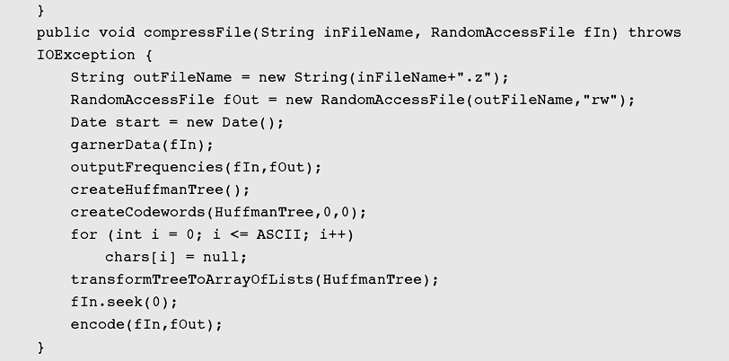
Case Study: Huffman Method with Run-Length Encoding (continued)
Figure 11-12 Implementation of Huffman method with run-length
encoding (continued)

Slide 59
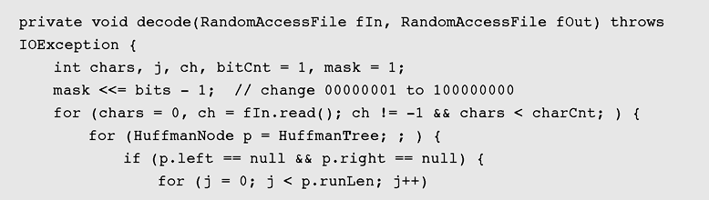
Case Study: Huffman Method with Run-Length Encoding (continued)
Figure 11-12 Implementation of Huffman method with run-length
encoding (continued)

Slide 60
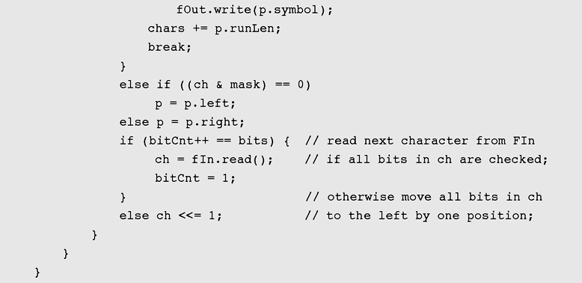
Case Study: Huffman Method with Run-Length Encoding (continued)
Figure 11-12 Implementation of Huffman method with run-length
encoding (continued)

Slide 61
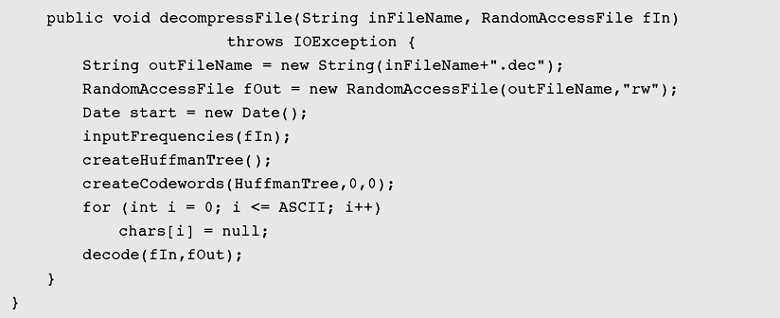
Case Study: Huffman Method with Run-Length Encoding (continued)
Figure 11-12 Implementation of Huffman method with run-length
encoding (continued)

Slide 62
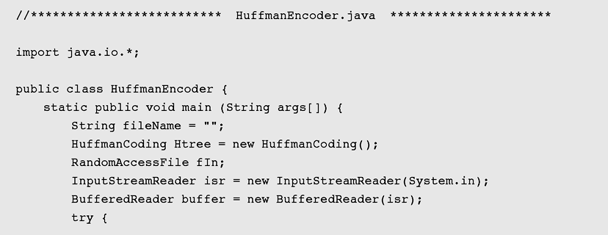
Case Study: Huffman Method with Run-Length Encoding (continued)
Figure 11-12 Implementation of Huffman method with run-length
encoding (continued)

Slide 63
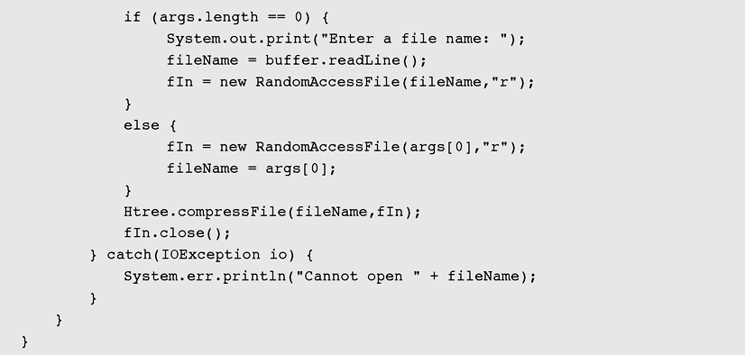
Case Study: Huffman Method with Run-Length Encoding (continued)
Figure 11-12 Implementation of Huffman method with run-length
encoding (continued)

Slide 64
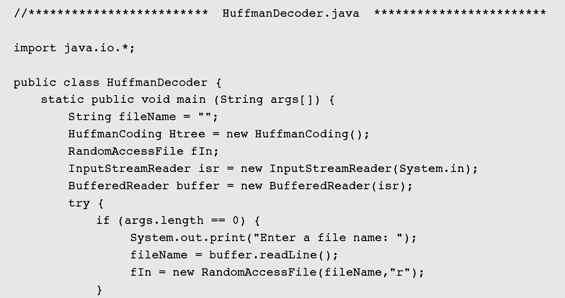
Case Study: Huffman Method with Run-Length Encoding (continued)
Figure 11-12 Implementation of Huffman method with run-length
encoding (continued)

Slide 65
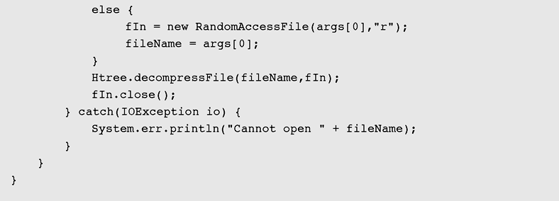
Case Study: Huffman Method with Run-Length Encoding (continued)
Figure 11-12 Implementation of Huffman method with run-length
encoding (continued)

Slide 66
Summary
To compare the efficiency of different data compression methods when applied to the same data, the same measure is used; this measure is the compression rate
The construction of an optimal code was developed by David Huffman, who utilized a
tree structure in this construction: a binary tree for a binary code

Slide 67
Summary (continued)
In adaptive Huffman coding, the Huffman tree includes a counter for each symbol, and the counter is updated every time a corresponding input symbol is being coded
A run is defined as a sequence of identical characters
Run-length encoding is useful when applied to files that are almost guaranteed to have many runs of at least four characters, such as relational databases

Slide 68
Summary (continued)
Null suppression compresses only runs of blanks and eliminates the need to identify the character being compressed
The Ziv-Lempel code is an example of a universal data compression code

