Slide 1
THE DATABASE LANGUAGE SQL

Slide 2
SQL Language Overview
SQL (sequel) is a database language designed for managing data in relational database management systems, and originally based upon relational algebra.
There are many different dialects of SQL
Ansi SQL (or SQL-86), SQL-92, SQL-99
SQL:2003, SQL:2006, SQL:2008, SQL:2009
Transact-SQL (T-SQL) is Microsoft's and Sybase's proprietary extension to SQL.
PL/SQL (Procedural Language/Structured Query Language) is Oracle Corporation's procedural extension for SQL and the Oracle relational database.
Today, SQL is accepted as the standard RDBMS language

Slide 3
6.1 SIMPLE QUERIES IN SQL

Slide 4
Example Database Schema

Slide 5
SQL Queries and Relational Algebra
Syntax
SELECT L
FROM R
WHERE C
π_{L}(σ_{C}(R))

Slide 6
T-SQL : Basic Syntax for a simple SELECT queries
SELECT [ ALL | DISTINCT ] [ TOP n [ PERCENT ] ]
* | {column_name | expression [alias],…}
[FROM table]
[WHERE conditions]
SELECT identifies what columns
ALL: Specifies that duplicate rows can appear in the result set. ALL is the default
DISTINCT: Specifies that only unique rows can appear in the result set. Null values are considered equal for the purposes of the DISTINCT keyword
TOP n [ PERCENT ]:Specifies that only the first n rows are to be output from the query result set. n is an integer between 0 and 4294967295. If PERCENT is also specified, only the first n percent of the rows are output from the result set. When specified with PERCENT, n must be an integer between 0 and 100
FROM identifies which table
The WHERE clause follows the FROM clause. Condition: is composed of column names, expressions, constants, and a comparison operator

Slide 7
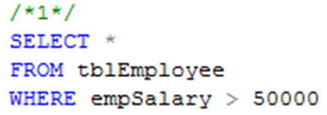
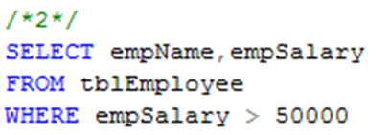
Common Query in SQL
Example 1: Listing all employees whose salary exceed at 50000
Example 2: Listing name and salary of all employees whose income exceed 50000

Slide 8
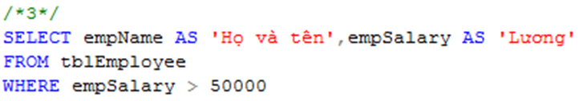
Projection in SQL
Using alias name in select clause
Example 3:
Listing full name and salary of all employees whose income exceed 50000

Slide 9
Selection in SQL
Condition expression in where clause may use
Constants and attributes
Arithmetic operators
+, -, *, /
Comparison operators
=, <>, <, >, ≤, ≥
Logical operators
and, or, not
The result of condition must be True or False

Slide 10
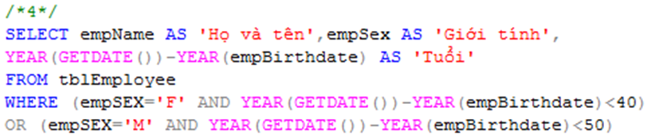
Selection in SQL
Example 4
List all under 40 year-old female or under 50 year-old male employees

Slide 11
Comparison of Strings
Two strings are equal (=) if they are the same sequence of characters
Other comparisons: <, >, ≤, ≤, ≠
Suppose a=a₁a₂…a_{n} and b=b₁b₂…b_{m} are two strings, the first is less than the second if ∃ k≤min(n,m):
∀i, 1≤i≤k: a_{i} = b_{i}, and
a_{k+1}<b_{k+1}
Example
fodder < foo
bar < bargain

Slide 12
Pattern Matching in SQL
Like or Not Like
Two special characters
% means any sequence of 0 or more characters
_ means any one character
SELECT
FROM
WHERE s LIKE p;
SELECT
FROM
WHERE s NOT LIKE p;

Slide 13


Pattern Matching in SQL
Example 5.1:
Find all employees named as ‘Võ Việt Anh’
Example 5.2
Find all employees whose name is ended at ‘Anh’

Slide 14
Pattern Matching in SQL
USING ESCAPE keyword
SQL allows us to specify any one character we like as the escape character for a single pattern
Example
WHERE s LIKE ‘%20!%%’ ESCAPE !
Or WHERE s LIKE ‘%20@%%’ ESCAPE @
➔ Matching any s string contains the 20% string
WHERE s LIKE ‘x%%x%’ ESCAPE x
➔ Matching any s string that begins and ends with the character %

Slide 15
Dates and Times
Dates and times are special data types in SQL
A date constant’s presentation
DATE ‘1948-05-14’
A time constant’s presentation
TIME ‘15:00:02.5’
A combination of dates and times
TIMESTAMP ‘1948-05-14 12:00:00’
Operations on date and time
Arithmetic operations
Comparison operations

Slide 16
Null Values
Null value: special value in SQL
Some interpretations
Value unknown: there is, but I don’t know what it is
Value inapplicable: there is no value that makes sense here
Value withheld: we are not entitled to know the value that belongs here
Null is not a constant
Two rules for operating upon a NULL value in WHERE clause
Arithmetic operators on NULL values will return a NULL value
Comparisons with NULL values will return UNKNOWN

Slide 17
The Truth-Value UNKNOWN
Truth table for True, False, and Unknown
We can think of TRUE=1; FALSE=0; UNKNOWN=1/2, so
x AND y = MIN(x,y); x OR y = MAX(x, y); NOT x = 1-x
x | y | x AND y | x OR y | NOT x
TRUE | TRUE | TRUE | TRUE | FALSE
TRUE | UNKNOWN | UNKNOWN | TRUE | FALSE
TRUE | FALSE | FALSE | TRUE | FALSE
UNKNOWN | TRUE | UNKNOWN | TRUE | UNKNOWN
UNKNOWN | UNKNOWN | UNKNOWN | UNKNOWN | UNKNOWN
UNKNOWN | FALSE | FALSE | UNKNOWN | UNKNOWN
FALSE | TRUE | FALSE | TRUE | TRUE
FALSE | UNKNOWN | FALSE | UNKNOWN | TRUE
FALSE | FALSE | FALSE | FALSE | TRUE

Slide 18
The Truth-Value Unknown
SQL conditions in Where clause produce three truth values: True, False, and Unknown
Those tuples which condition has the value True become part of the answer
Those tuples which condition has the value False or Unknown are excluded from the answer

Slide 19
Ordering the Output
Presenting the tuples produced by a query in sorted order
The order may be based on the value of any attribute
Syntax
Order by clause follows Where and any other clauses. The ordering is performed on the result of the From, Where, and other clauses, just before Select clause
Using keyword ASC for ascending order and DESC for descending order
SELECT <list of attributes>
FROM <list of tables>
WHERE <conditions>
ORDER BY <list of attributes>

Slide 20

Ordering the Output
Example 6:
Listing all employee by department number ascreasingly, then by salary descreasingly

Slide 21
6.2 QUERIES INVOLVING MORE THAN ONE RELATION

Slide 22
Queries Involving More Than One Relation
SQL allows we combine two or more relations through joins, products, unions, intersections, and differences

Slide 23
Products and Joins in SQL
When data from more than one table in the database is required, a join condition is used.
Simple way to couple relations: list each relation in the From clause
Other clauses in query can refer to the attributes of any of the relations in the From clause

Slide 24

Products and Joins in SQL
Example 7:
List all employees who work on ‘Phòng Phần mềm trong nước’ department

Slide 25
What we do if …
… a query involves several relations, and there are two or more attributes with the same name?

Slide 26
Tuple Variables
We may list a relation R as many times as we need
We use tuple variables to refer to each occurrence of R

Slide 27

Disambiguating Attributes
Example 8:
Find all cities in which our company is

Slide 28

What we do if …
… a query involves two or more tuples from the same relation?
Example 9:
Find all those project numbers which have more than two members

Slide 29
Union, Intersection, Difference of Queries
We combine relations using the set operations of relational algebra: union, intersection, and difference
SQL provides corresponding operators with UNION, INTERSECT, and EXCEPT for ∪, ∩, and -, respectively

Slide 30

Union, Intersection, Difference of Queries
Example 10.1
Find all those employees whose name is begun by ‘H’ or salary exceed 80000

Slide 31

Union, Intersection, Difference of Queries
Example 10.2
Find all those normal employees, that is who do not supervise any other employees

Slide 32
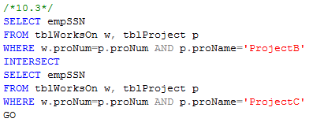
Union, Intersection, Difference of Queries
Example 10.3
Find all employees who work on projectB and projectC

Slide 33
6.3 SUB QUERIES

Slide 34
Sub-queries
One query can be used to help in the evaluation of another
A query that is part of another is called a sub-query
Sub-queries return a single constant, this constant can be compared with another value in a WHERE clause
Sub-queries return relations, that can be used in WHERE clause
Sub-queries can appear in FROM clauses, followed by a tuple variable

Slide 35
Sub-queries that Produce Scalar Values
An atomic value that can appear as one component of a tuple is referred to as a scalar
Let’s compare two queries for the same request

Slide 36
Sub-queries that Produce Scalar Values
Example 7: Find the employees of Phòng Phần mềm trong nước department

Slide 37
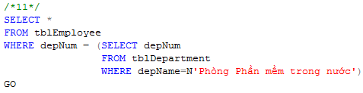
Sub-queries that Produce Scalar Values
Example 11:
Find the employees of Phòng Phần mềm trong nước department

Slide 38
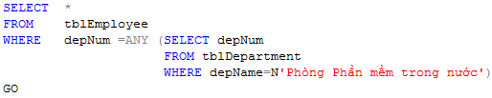
Sub-queries that Produce Scalar Values
Example 11:
Find the employees of Phòng Phần mềm trong nước department

Slide 39
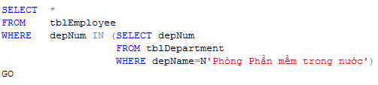
Sub-queries that Produce Scalar Values
Example 11:
Find the employees of Phòng Phần mềm trong nước department

Slide 40
Conditions Involving Relations
Some SQL operators can be applied to a relation R and produce a bool result
(EXISTS R = True) ⇔ R is not empty
(s IN R = True) ⇔ s is equal to one of the values of R
(s > ALL R = True) ⇔ s is greater than every values in unary R
(s > ANY R = True) ⇔ s is greater than at least one value in unary R

Slide 41
Conditions Involving Tuples
A tuple in SQL is represented by a list of scalar values between ()
If a tuple t has the same number of components as a relation R, then we may compare t and R with IN, ANY, ALL

Slide 42
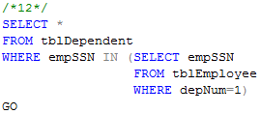
Sub-queries that Produce Scalar Values
Example 12:
Find the dependents of all employees of department number 1

Slide 43
Correlated Sub-queries
To now, sub-queries can be evaluated once and for all, the result used in a higher-level query
But, some sub-queries are required to be evaluated many times
That kind of sub-queries is called correlated sub-query
Note: Scoping rules for names

Slide 44
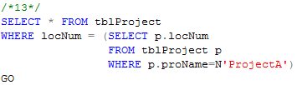
Correlated Sub-queries
Example 13:
Find all those projects have the same location with projectA

Slide 45
Correlated Sub-queries
Another example:
Find the titles that have been used for two or movies
SELECT title
FROM Movies Old
WHERE year < ANY
(SELECT year
FROM Movies
WHERE title =Old.title)

Slide 46
Sub-queries in FROM Clauses
In a FROM list we can use a parenthesized sub-query
We must give it a tuple-variable alias
Example: Find the employees of Phòng Phần mềm trong nước
SELECT *
FROM tblEmployee e, (SELECT depNum
FROM tblDepartment
WHERE depName=N'Phòng phần mềm trong nước') d
WHERE e.depNum=d.depNum

Slide 47
SQL Join Expressions
SQL Join Expressions can be stand as a query itself or can be used as sub-queries in FROM clauses
Cross Join in SQL= Cartesian Product
Syntax: R CROSS JOIN S;
Meaning: Each tuple of R connects to each tuple of S
Theta Join with ON keyword
Systax: R JOIN S ON R.A=S.A;
Meaning: Each tuple of R connects to those tuples of S, which satisfy the condition after ON keyword

Slide 48

SQL Join Expression
Example 15.1
Product two relations Department and Employee
Example 15.2
Find departments and employees who work in those departments, respectively

Slide 49
SQL Join Expression
More Example

Slide 50
Natural Joins
A natural join differs from a theta-join in that:
The join condition: all pairs of attributes from the two relations having a common name are equated, and there are no other condition
One of each pair of equated attributes is projected out
Syntax : Table1 NATURAL JOIN Table2
Microsoft SQL SERVER DONOT SUPPORT NATURAL JOINS AT ALL

Slide 51
Outer Joins
The outer join is a way to augment the result of join by the dangling tuples, padded with null values
When padding dangling tuples from both of its arguments, we use full outer join
When padding from left/right side, we use left outer join/right outer join

Slide 52

Outer joins
Example 17.1:
For each location, listing the projects that are processed in it

Slide 53

Outer joins
Example 17.2:
For each department, listing the projects that it controls

Slide 54
6.4 Full-Relation Operations
Study some operations that acts on relations as whole, rather than on tuples individually

Slide 55
Eliminating Duplicates
A relation, being a set, cannot have more than one copy of any given tuple
But, the SQL response to a query may list the same tuple several times, that is, SELECT preserves duplicates as a default
So, by DISTINCT we can eliminate a duplicates from SQL relations

Slide 56
Eliminating Duplicates
Example 17.3: List all location in which the projects are processed.
Location name is repeated many times
SELECT DISTINCT l.locNum, l.locName
FROM tblLocation l JOIN tblProject p ON l.locNum=p.locNum
SELECT DISTINCT l.locNum, l.locName
FROM tblLocation l JOIN tblProject p ON l.locNum=p.locNum

Slide 57
Duplicates in Unions, Intersections, and Differences
Set operations on relations will eliminate duplicates automatically
Use ALL keyword after Union, Intersect, and Except to prevent elimination of duplicates
Syntax:
R UNION ALL S;
R INTERSECT ALL S;
R EXCEPT ALL S;

Slide 58
Grouping and Aggregation in SQL
Grouping operator partitions the tuples of relation into groups, based on the values of tuples in one or more attributes
After grouping the tuples of relation, we are able to aggregate certain other columns of relation
We use GROUP BY clause in SELECT statement

Slide 59
Aggregation Operators
Five aggregation operators
SUM acts on single numeric column
AVG acts on single numeric column
MIN acts on single numeric column
MAX acts on single numeric column
COUNT act on one or more columns or all of columns
Eliminating duplicates from the column before applying the aggregation by DISTINCT keyword

Slide 60


Aggregation Operators
Example 18.1
Find average salary of all employees
Example 18.2
Find number of employees

Slide 61
Grouping
To partition the tuples of relation into groups
Syntax
SELECT <list of attributes>
FROM <list of tables>
WHERE <condition>
GROUP BY <list of attributes>

Slide 62

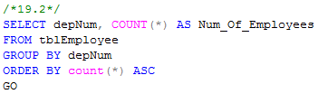
Grouping
Example 19.1:
Group employees by department number
Example 19.2
List number of employees for each department number

Slide 63
Grouping
There are two kinds of terms in SELECT clause
Aggregations, that applied to an attribute or expression involving attributes
Grouping Attributes, that appear in GROUP BY clause
A query with GROUP BY is interpreted as follow:
Evaluate the relation R expressed by the FROM and WHERE clauses
Group the tuples of R according to the attributes in GROUP BY clause
Produce as a result the attributes and aggregation of the SELECT clause

Slide 64

Grouping
Example 20
Compute the number of employees for each project

Slide 65
Grouping, Aggregation, and Nulls
When tuples have nulls, there are some rules:
The value NULL is ignored in any aggregation
Count(*): a number of tuples in a relation
Count(A): a number of tuples with non-NULL values for A attribute
NULL is treated as an ordinary value when forming groups
The count of empty bag is 0, other aggregation of empty bag is NULL

Slide 66
Grouping, Aggregation, and Nulls
Example: Suppose R(A,B) as followed
A | B
NULL | NULL
The result of query
SELECT A, count(B)
FROM R
GROUP BY A;
is one tuple (NULL,0)
The result of query
SELECT A, sum(B)
FROM R
GROUP BY A;
is one tuple (NULL,NULL)

Slide 67
Considerations …
If we want to apply conditions to tuples of relations, we put those conditions in WHERE clause
If we want to apply conditions to groups of tuples after grouping, those conditions are based on some aggregations, how can we do?
In that case, we follow the GROUP BY clause with a HAVING clause

Slide 68
HAVING clause
Syntax:
SELECT <list of attributes>
FROM <list of tables>
WHERE <conditions on tuples>
GROUP BY <list of attributes>
HAVING <conditions on groups>

Slide 69
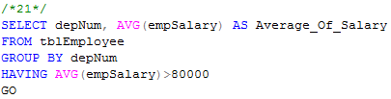
HAVING clause
Example 21:
Print the number of employees for each those department, whose average salary exceeds 80000

Slide 70
HAVING clause
Some rules about HAVING clause
An aggregation in a HAVING clause applies only to the tuples of the group being tested
Any attribute of relations in the FROM clause may be aggregated in the HAVING clause, but only those attributes that are in the GROUP BY list may appear un-aggregated in the HAVING clause (the same rule as for the SELECT clause)

Slide 71
HAVING clause
Example:
SELECT proNum, COUNT(empSSN) AS Number_Of_Employees,
FROM tblWorksOn
GROUP BY proNum
HAVING AVG(workHours)>20
SELECT proNum, COUNT(empSSN) AS Number_Of_Employees,
FROM tblWorksOn
GROUP BY proNum
HAVING proNum=4

Slide 72
Exercises
Page 257, Exercise 6.1.3
Page 267, Exercise 6.2.2
Page 279, Exercise 6.3.1
Page 289, Exercise 6.4.6

Slide 73
6.5 DATABASE MODIFICATIONS

Slide 74
Database Modifications
Three types of statements that allow us to
Insert tuples into relation
Delete certain tuples from a relation
Update values of certain components of certain existing tuples

Slide 75
Insertion
Basic form of insertion statement
A tuple is created using the values v₁ for attribute A_{i}
If the list of attributes does not include all attributes of the relation R, then the tuple created has default values for all missing attributes
The basic form allows to insert only one tuple at once
The extended form allows to insert a set of tuples as result of a sub query:
INSERT INTO R(A₁, ..., A_{n})
SELECT A₁, …, A_{n} FROM … WHERE …
INSERT INTO R(A1,…,An) VALUES (v₁ ,…,v_{n} );

Slide 76
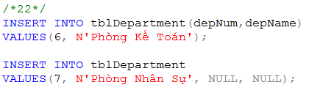
Insertion
Example: add new a department

Slide 77
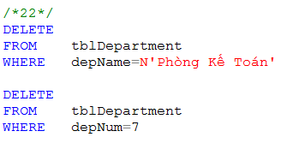
Deletion
The form of a deletion
DELETE FROM R WHERE <condition>;
Example:
remove a department named ‘Phòng Kế Toán’
remove a department which depNum is 7
If no WHERE clause, all the department will be deleted. Be carefully !

Slide 78

Updates
The form of an update statement
UPDATE R SET <new-value assignments> WHERE <condition>;
Example: Update new salary and depNum for the employee named ‘Mai Duy An’

Slide 79
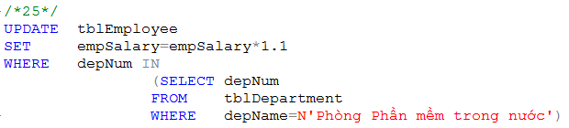
Updates
Example: increase salary to 10% for all employees who belongs to ' Phòng Phần mềm trong nước ' department

Slide 80
6.6 TRANSACTION IN SQL

Slide 81
Introduction
DB User operates on database by querying or modifying the database
Operations on database are executed one at a time
Output of one operation is input of the next operation
So, how the DBMS treats simultaneous operations?

Slide 82
Serializability
In applications, many operations per second may be performed on database
These may operate on the same data
We’ll get unexpected results

Slide 83
Serializability
Example: Two users book the same seat of the flight
time | User 1 finds a seat empty
 |  | User2 finds a seat empty
 | User1 sets seat 22A occupied
 |  | User2 sets seat 22A occupied

Slide 84
Serializability
Transaction is a group of operations that need to be performed together
A certain transaction must be serializable with respect to other transactions, that is, the transactions run serially – one at a time, no overlap

Slide 85
Atomicity
A certain combinations of database operations need to be done atomically, that is, either they are all done or neither is done

Slide 86
Atomicity
Example: Transfer $500 from the account number 3209 to account number 3208 by two steps
(1) Subtract $500 from account number 3209
(2) Add $500 to account number 3208
What happen if there is a failure after step (1) but before step (2)?

Slide 87
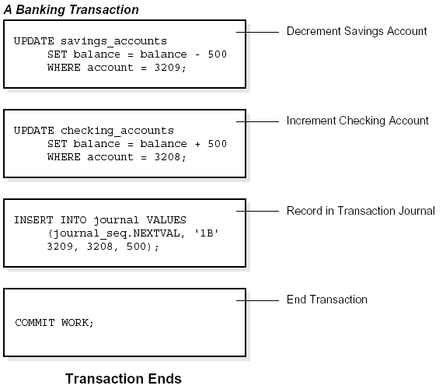
Atomicity
$500
ACC: 3209
$500
ACC: 3208

Slide 88
Transactions
Transaction is a collection of one or more operations on the database that must be executed atomically
That is, either all operations are performed or none are
In SQL, each statement is a transaction by itself
SQL allows to group several statements into a single transaction

Slide 89
Transactions
Transaction begins by SQL command START TRANSACTION
Two ways to end a transaction
The SQL statement COMMIT causes the transaction to end successfully
The SQL statement ROLLBACK causes the transaction to abort, or terminate unsuccessfully

Slide 90
ACID properties of Transaction (review)
Transactions should possess several properties, often called the ACID properties; they should be enforced by the concurrency control and recovery methods of the DBMS. The following are the ACID properties:
Atomicity
Consistency
Isolation
Durability

Slide 91
ACID properties of Transaction
Atomicity: a transaction is an atomic unit of processing; it should either be performed in its entirety or not performed at all.
At the end of the transaction, either all statements of the transaction is successful or all statements of the transaction fail.
If a partial transaction is written to the disk then the Atomic property is violated
Consistency: a transaction should be consistency preserving, meaning that if it is completely executed from beginning to end without interference from other transactions, it should take the database from one consistent state to another.

Slide 92
ACID properties of Transaction
Isolation: a transaction should appear as though it is being executed in isolation from other transactions, even though many transactions are executing concurrently. That is the execution of a transaction should not be interfered with by any other transactions executing concurrently.
Durability : the changes applied to the database by a committed transaction must persist in the database. These changes must not be lost because of any failure..

Slide 93
Read-Only Transactions
A transaction can read or write some data into the database
When a transaction only reads data and does not write data, the transaction may execute in parallel with other transactions
Many read-only transactions access the same data to run in parallel, while they would not be allowed to run in parallel with a transaction that wrote the same data

Slide 94
Transactions
SQL statement set read-only to the next transaction
SET TRANSACTION READ ONLY;
SQL statement set read/write to the next transaction
SET TRANSACTION READ WRITE;

Slide 95
Dirty Reads
Dirty data: data written by a transaction that has not yet committed
Dirty read: read of dirty data written by another transaction
Problem: the transaction that wrote it may eventually abort, and the dirty data will be removed
Sometimes the dirty read matters, sometimes it doesn’t

Slide 96
Dirty Reads
Transaction 1 | Transaction 2 | Logical value | Uncommitted value | What transaction 2 show
START T1 |  | 3
UPDATE A=5 | START T2 | 3 | 5
. . . | SELECT @v=A | 3 | 5 | 5
ROLLBACK | UPDATE B=@v | 3 |  | 5

Slide 97
Dirty Reads
We can specify that dirty reads are acceptable for a given transaction
SET TRANSACTION READ WRITE
ISOLATION LEVEL READ UNCOMMITTED;

Slide 98
Other Isolation Levels
SET TRANSACTION ISOLATION LEVEL READ UNCOMMITED;
SET TRANSACTION ISOLATION LEVEL READ COMMITTED;
SET TRANSACTION ISOLATION LEVEL REPEATABLE READ;
SET TRANSACTION ISOLATION LEVEL SERIALIZABLE;
Notes:
4 mức tách biệt giao tác trong SQL
READ UNCOMMITED : cho phép đọc dữ liệu chưa xác nhận hoàn tất (dirty read)
READ COMMITED: chỉ cho đọc dữ liệu đã xác nhận hoàn tất
REAPEATABLE READ: bảo đảm rằng sẽ nhận được cùng một (số) bộ khi thực hiện cùng truy vấn đó nhiều lần
SERIALIZABLE: bảo đảm các giao tác được thực hiện tuần tự

Slide 100
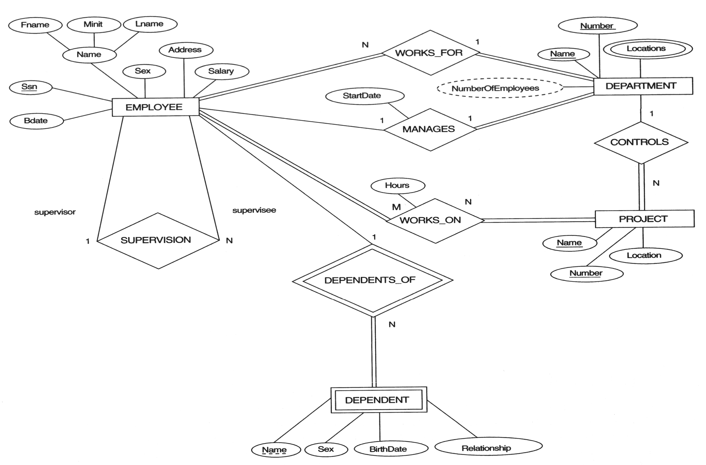
Example COMPANY Database

