Slide 1
SQL IN A SERVER ENVIRONMENT

Slide 2
Objectives
The typical server environment
SQL terminology for client – server computing and connecting to a database
Embedding SQL within programming language
The SQL standard library called SQL/CLI
Persistent, Stored Modules (SQL/PSM)

Slide 3
The three – tier Architecture
A very common architecture for large database installation
Three different, interacting functions
Web servers
Application servers
Database servers
The processes can run on the same processor or on a large number of processors

Slide 4
The three – tier Architecture
Database
Database Server
Database Server
Application Server
Application Server
Application Server
Web Server
Web Server
Web Server
Web Server
Internet
Client
Client

Slide 5
The Webserver Tier
The webserver processes manage the interactions with the user
When a user makes contact, a webserver response to the request, and the user becomes a client of this webserver process

Slide 6
The Application Tier
Turning data from the database into a response to the request that it receives from the webserver
One webserver process invoke many application-tier processes, which can be on one or many different machines
The application-tier processes execute the business logic of the organization operating the database

Slide 7
The Database Tier
There can be many processes in the database tier
The processes can be in one or many machines
The database tier executes queries that are requested from the application tier

Slide 8
STORED PROCEDURES

Slide 9
Introduction
Persistent, Stored Modules (SQL/PSM)
Help to write procedures in a simple, general-purpose language and to store them in the database
We can use these procedures in SQL queries and other statements to perform computations
Each commercial DBMS offers its own extension of PSM

Slide 10
Creating PSM Functions and Procedures
Procedure declaration
Function declaration
CREATE PROCEDURE <name> (<parameters>)
<local declarations>
<procedure body>;
CREATE FUNCTION <name> (<parameters>) RETURN <type>
<local declarations>
<function body>;

Slide 11
Some Simple Statement Forms in PSM
The call-statement
The form of a procedure call is
CALL <procedure name>(<argument list>);
This call can be made from a variety of places
From a host-language program
EXEC SQL CALL Foo(:x, 3);
As a statement of another PSM function or procedure
In generic SQL interface
CALL Foo(1,3);
The return-statement
RETURN <expression>;

Slide 12
Some Simple Statement Forms in PSM
Declarations of local variables
DECLARE <name> <type>;
Assignment Statements
SET <variable> = <expression>;
Statement groups
BEGIN … END;
Statement label
LABEL:

Slide 13
Branching Statements
If statement
Ends with keyword END IF
If-statement nested within the else-clause are introduced with the single word ELSEIF
IF <condition> THEN
<statement list>
ELSEIF <condition> THEN
<statement list>
ELSEIF
…
ELSE
<statement list>
END IF;

Slide 14
Queries in PSM
Several ways that select-from-where queries are used in PSM
Subqueries can be used in conditions, or in general, any place a subquery is legal in SQL
Queries that return a single value can be used as the right sides of assignment statements
A single-row select statement is a legal statement in PSM
We can declare and use a cursor for embedded SQL

Slide 15
Loops in PSM
The basic loop construct in PSM is
It is possible to break out of the loop
Example
loop1: LOOP
. . .
LEAVE loop1;
. . .
END LOOP;
LOOP
<statement list>
END LOOP;
LEAVE <loop label>;

Slide 16
Other Loop Constructs
WHILE <condition> DO
<statement list>
END WHILE;
REPEAT <statement list>
UNTIL <condition>
END REPEAT;

Slide 17
Exceptions in PSM
The form of a handler declaration is
The choices for where to go next
CONTINUE
EXIT
UNDO
DECLARE <where to go next> HANDLER FOR
<condition list> <statement list>;

Slide 18
Using PSM Functions and Procedures
We can call a PSM procedure anywhere SQL statements can appear
In addition, a PSM function can be used as part of an expression

Slide 19
Creating Stored Procedure under MS SQL Server
Create stored procedure:
CREATE PROCEDURE procedure_name
[ {@parameter1 data_type} [= default] [OUTPUT] ] [ {@parameter2 data_type} [= default] [OUTPUT] ] ...
AS
sql_statement1 sql_statement2
Calling stored procedure
EXEC procedure_name [argument1, argument2, …]

Slide 20
Creating PSM Functions and Procedures
Example 1:
Create stored procedure to list all projects
Create stored procedure to change the project’s name
Create stored function to return the name of project

Slide 21
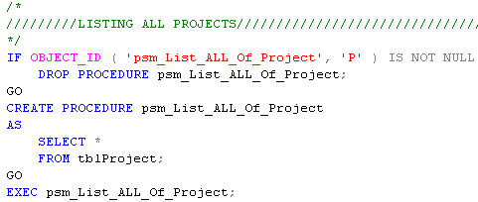
Example

Slide 22
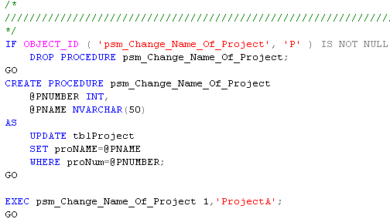
Example

Slide 23
Using Cursor in MS SQL Server
Declare cursor
DECLARE cursor_name CURSOR FOR SELECT Statement
Open cursor
OPEN cursor_name
Loop and get values of each tuple in cursor with FETCH statement
FETCH NEXT | PRIOR | FIRST | LAST FROM cursor_name INTO @var1, @var2
Using @@FETCH_STATUS to check fetch status. The 0 value mean FETCH statement was successful.
CLOSE cursor_name
DEALLOCATE cursor_name

Slide 24
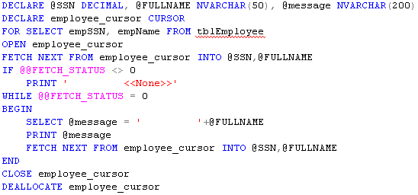
Example

Slide 25
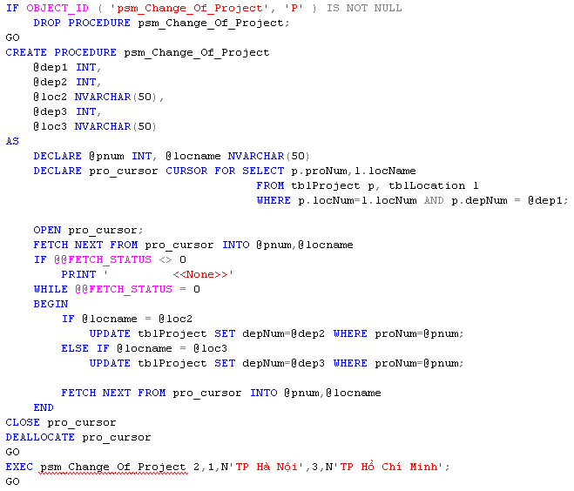
Example

Slide 26
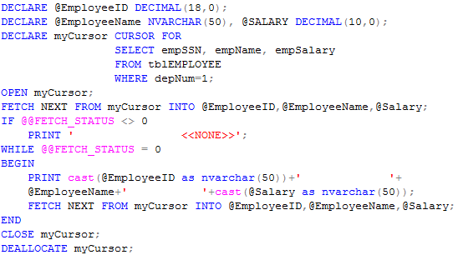
Example

Slide 27
Advantages of using Stored Procedure
Using stored procedures offer numerous advantages over using SQL statements. These are:
Reuse of Code
Maintainability
Reduced Client/Server Traffic
Precompiled Execution
Improved Security

