Slide 1
VIEW AND INDEX

Slide 2
VIRTUAL VIEWS

Slide 3
Relations vs. Views
Relations
Actually exist in database in some physical organization
Defined with a CREATE TABLE statement
Exist indefinitely and not to change unless explicit request
Virtual views
Do not exist physically
Defined by an expression like a query
Can be queried and can even be modified

Slide 4
Virtual Views
The simplest form of view definition is
The <view-definition> is a SQL query
CREATE VIEW <view-name> AS <view-definition>;

Slide 5
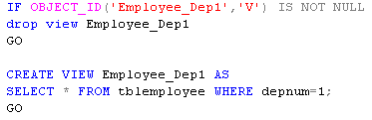
Virtual Views
Example 1:
Create a view to list all employees who are in Department number 1

Slide 6

Querying Views
Example 2
Find all employees who work in department 1

Slide 7
Querying Views
Find all dependents of the employees who work in department 1
SELECT *
FROM Employee_Dep1 ed1, tblDependent d
WHERE ed1.empSSN=d.empSSN
SELECT *
FROM (SELECT *
FROM tblEmployee
WHERE depNum=1
) ed1, tblDependent d
WHERE ed1.empSSN=d.empSSN

Slide 8
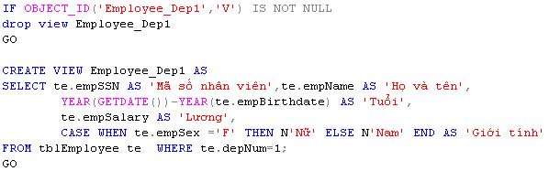
Renaming Attributes
Example 3:
Create view for all employees of Department number 1, including: SSN, Fullname, Age, Salary, Sex

Slide 9
Modifying Views
With updatable views, the modification is translated into an equivalent modification on a base table
The modification can be done to the base table

Slide 10
View Removal
As we know, Employee_Dep1 is associated to tplEmployee relation
DROP VIEW Employee_Dep1;
Delete the definition of the view
Does not effect on tplEmployee relation
DROP TABLE tplEmployee;
Delete tplEmployee relation
Make the view Employee_Dep1 unusable

Slide 11
Updatable Views
We can modify views that are defined by selecting some attributes from one relation R, and
Sub query started by SELECT, not SELECT DISTINCT
The WHERE clause must not involve R in a sub query
The FROM clause can only consist of one occurrence of R and no other relation
The list in the SELECT clause must include enough attributes that for every tuple inserted into the view, we can fill the other attributes out with NULL values or the proper default

Slide 12
Updatable Views
Example 4:
Create view from table Employee
Do changes on Employee and review created view
Do changes on created view and review Employee

Slide 13
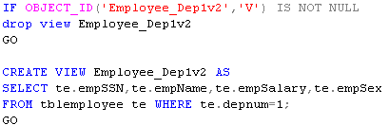
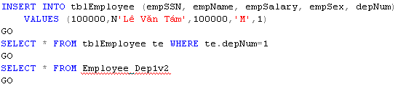
Update on table effects on view

Slide 14
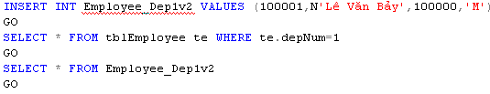
Update on view effects on table with unexpected result

Slide 15
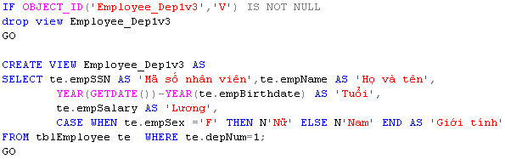
Update on view raises error on table

Slide 16
Instead-Of Triggers on Views
When a trigger is defined on a view, we can use INSTEAD OF in place of BEFORE or AFTER
When an event awakens the trigger, the action of the trigger is done instead of the event itself

Slide 17
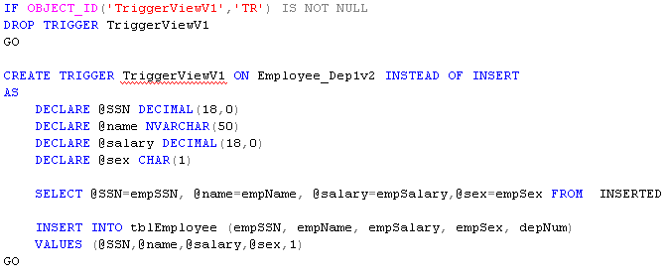
Instead-of triggers on views

Slide 18
Indexes in SQL
An index is a data structure used to speed access to tuples of a relation, given values of one or more attributes
An index is as a binary search tree of (key, locations) pairs, in which a key a is associated with a locations in relation, whose value is a

Slide 19
Motivation for Indexes
When relations are very large, it become expensive to scan all the tuples of a relation to find some tuples
Example
SELECT *
FROM Employee
WHERE Bplace LIKE N‘TP Hồ Chí Minh’;
How we solve this problem?

Slide 20
Declaring Indexes
Example 6:
Suppose we want to have an index on attribute Bplace for the relation Employee
CREATE INDEX IX_BPlace ON Employee(BPlace);

Slide 21
Declaring Indexes
Example: Delete IX_BPlace index from database
DELETE INDEX IX_BPlace;

Slide 22
Selection of Indexes
The existence of an index on an attribute may speed up the execution of certain queries
An index makes update operations on relation becomes more complex

Slide 23
A Simple Cost Model
The tuples of a relation are normally distributed among many pages of a disk
When one tuple is required, the whole page is brought into main memory
So, it’s better that all required tuples on a page than only one and a required page is already in main memory

Slide 24
Some Useful Indexes
The most useful index on a relation is an index on its keys with two reasons
Queries with a value for the key are common in used. Thus, an index on the key will get used frequently
Since index is on key, the index will return either nothing or one location for a tuple

Slide 25
Some Useful Indexes
When the index is not a key, there are two situations
If the attribute is almost a key; that is, relatively few tuples have a given for that attribute
If the tuples are clustered on that attribute; that is, a relation is clustered on attribute by grouping the tuples with a common value

Slide 26
How do we …
… choose the best index among many indexes on attributes of a relation?

Slide 27
Why do we …
… choose the best index?
Index is useful for querying
Each change on relation forces to change any relatively index
Thus, be very conservative about creating indexes

