Slide 1

Lecture 02: Concurrency (Part 2)
(20 slides)

Slide 2
Review
In the previous session:
Definitions: Program, Process, Thread
Multi-processing system
Multi-threading programming in Java
Thread Fundamentals in Java
Thread states

Slide 3
Objectives
How to develop a non-race multi-thread applications
How to develop a multi-thread applications in which some threads accessing common resources?
Contents:
Demonstrations
Monitors, Waiting and Notifying
Deadlocks

Slide 4
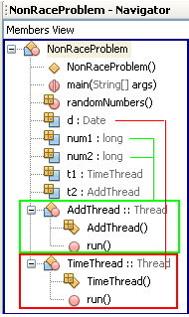
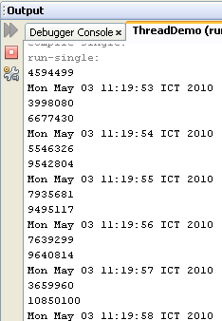
Non-race Demonstration
This program contains 2 threads:
The first thread that will print out the system time for every second.
The second will print out the sum of two random integers for every half of a second.

Slide 5
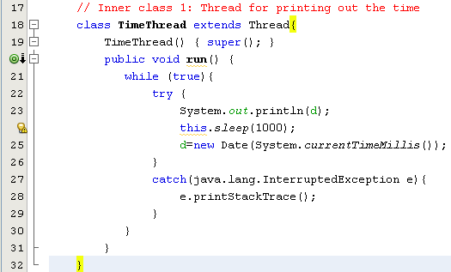
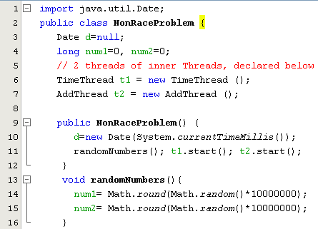
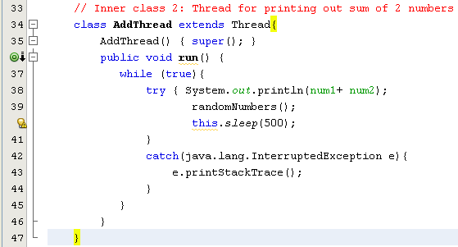

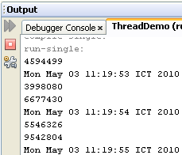
Non-race Demonstration…

Slide 6
4- Monitors, Waiting and Notifying
Some threads can access common resources concurrently. We must synchronize accessing common resources ➔ Every object has a lock
Lock: an extra variable is added by the compiler for monitoring the state of common resource. Before a thread accesses the common resource, the lock is tested.
After a thread has the lock (it is permitted to access the common resource), it can access common resource. When it did, it needs notifying to others thread ( wait-notify mechanism).
Running
Enter synchronized code
wait()
Seeking Lock
notify(), notifyAll(), time out, or interrupt
waiting
Scheduler
Ready
Lock obtained

Slide 7
Monitors, Waiting and Notifying…
Two ways to mark code as synchronize
Synchronize an entire method: Let the synchronized modifier in the method’s declaration.
synchronized Type Method(args){
<code>
}
Synchronize some method of an object
Type Method ( args){
……
synchronized ( object_var){
object_var.method1(args);
object_var.method2(args);
}
}
A class contains synchronized code is called monitor.
Monitor: A technique to encapsulate common resources to a class. When a thread wants to access common resources, it must call a public synchronized method. As a result, common resources are accessed in successive manner.

Slide 8
Demo: The Producer-Consumer Problem
Producer makes a product then puts it to a store.
Consumer buys a product from a store.
Selling Procedure: First In First Out
product
Store
product
Producer
Consumer
Put to the tail
Get from the head
Attention!:
Store is common resource of 2 threads: producer and consumer.
➔ Store is a monitor and it’s activities needs synchronization
Synchronizing:
* After a thread accessed common resource, it should sleep a moment or it must notify to the next thread ( or all thread) in the thread-pool to awake and execute.
* Use the synchronized keyword to declare a method that will access common resource.

Slide 9
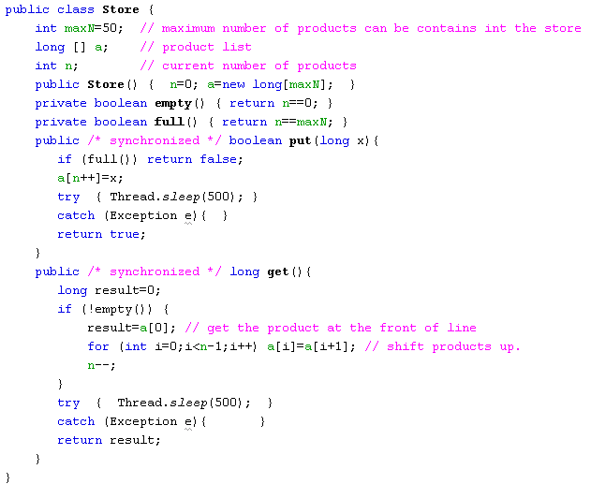
The Producer-Consumer Problem
A product is simulated as a number.
/* synchronized */
No synchronization

Slide 10
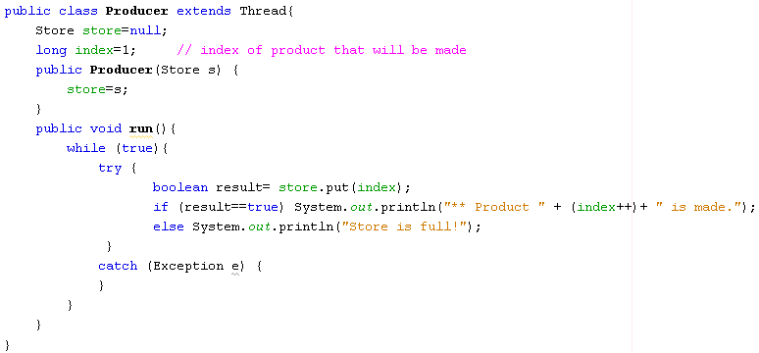
The Producer-Consumer Problem

Slide 11
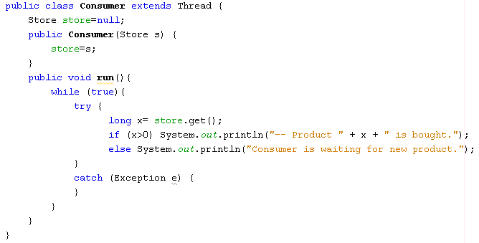
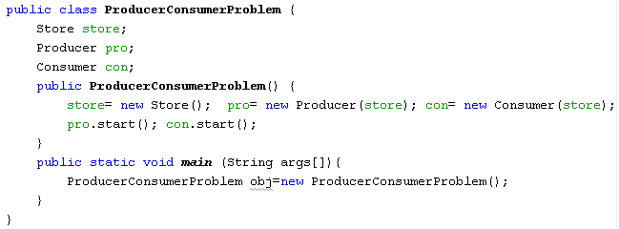
The Producer-Consumer Problem

Slide 12
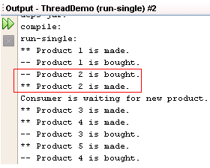
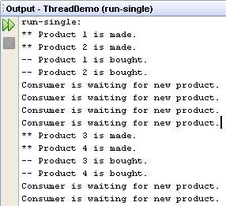
The Producer-Consumer Problem
Synchronization is not used
Synchronization is used:
Consumer được chạy trước (do Scheduler) quyết định nên Product 2 is bought. Sau đó Prodcut 2 is made chạy sau cũng do
Schdeuler.

Slide 13
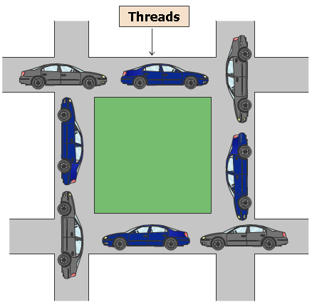
5 - Deadlock
What is deadlock?
Deadlock describes a situation where two or more threads are blocked forever, waiting for each other → All threads in a group halt.
When does deadlock occur?
There exists a circular wait the lock that is held by other thread.
Nothing can ensure that DEADLOCK do not occur.

Slide 14
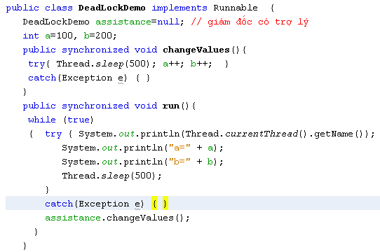
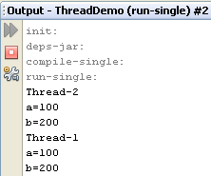
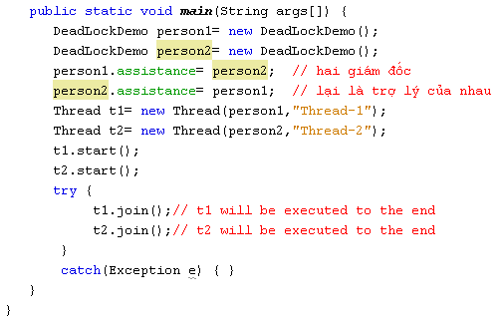
Deadlock Demo.

Slide 15

The Philosophers Problem
Wait-Notify
Mechanism, a way helps preventing deadlocks
Deadlock!
3 classes

Slide 16
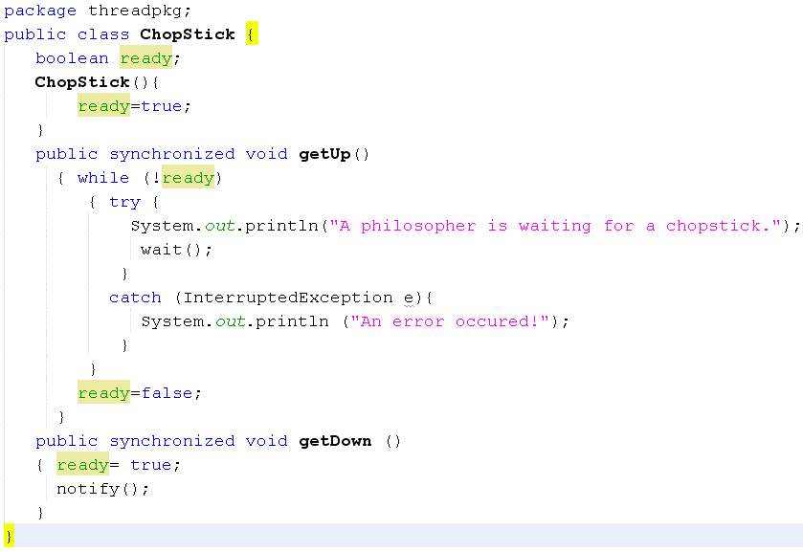
The Philosophers Problem
Thread table
Thread | Code Addr | Duration (mili sec) | CPU | State
Thread 1 | 10320 | 15 | 1 | Suspended →Ready
Thread 2 | 40154 | 17 | 2 | Suspended
Thread 3 | 80166 | 22 | 1 | Suspended
… | … | … | … | ….

Slide 17
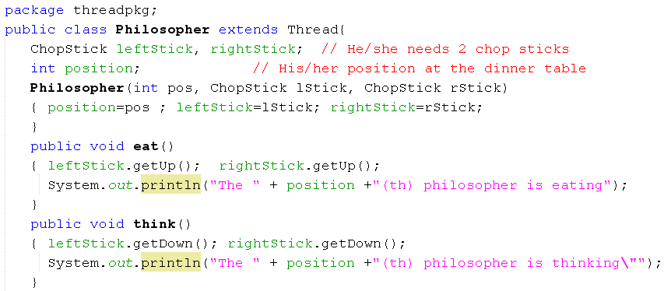
The Philosophers Problem

Slide 18
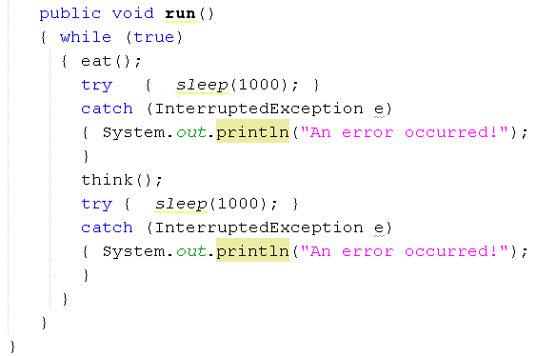
The Philosophers Problem

Slide 19
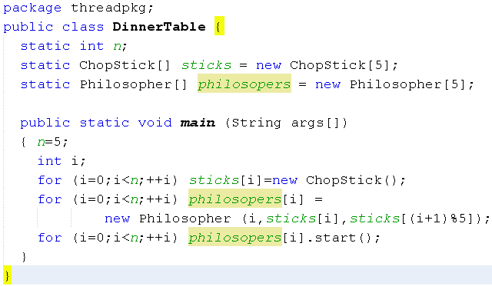
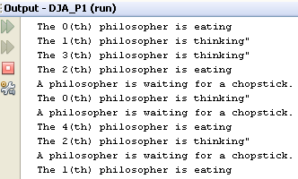
The Philosophers Problem

Slide 20
Summary
Concepts were introduced:
Definitions: Program, Process, Thread
Multi-processing system
Multi-threading programming in Java
Thread Fundamentals in Java
Synchronizing access to common resource.
Monitoring thread states: Wait-notify mechanism.
If you want some tasks executing concurrently, multi-threading is a solution.

Slide 21
Exercises
Workshop 1 (with report): The producer-consumer problem and
Workshop 2 (with report): the philosophers problem.

Slide 22
Thank You

