Slide 1
DATAFLOW WITH USING N8N
TOOL BASED KNOWLEDGE

Slide 2
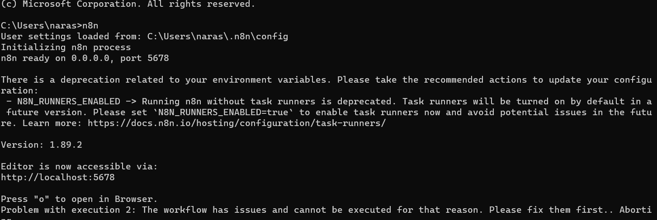
INSTALLATION

Slide 3
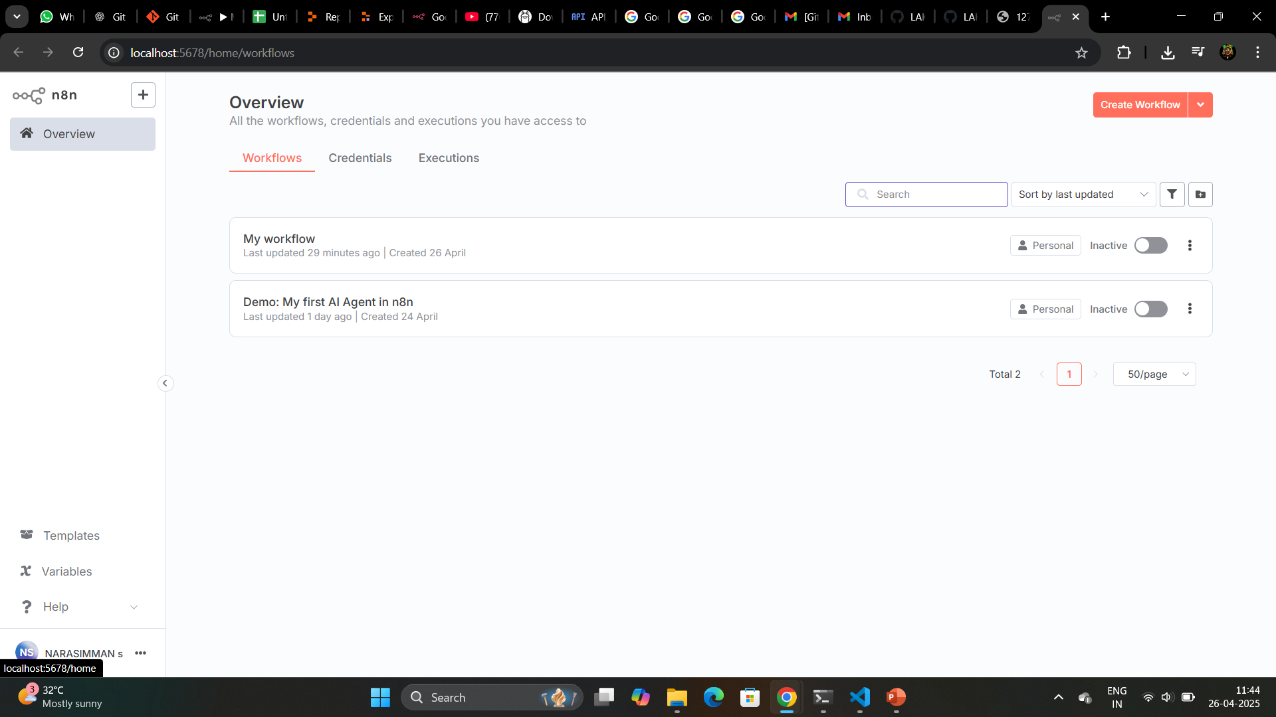
LOGIN TO N8N (OR CREATE NEW)

Slide 4
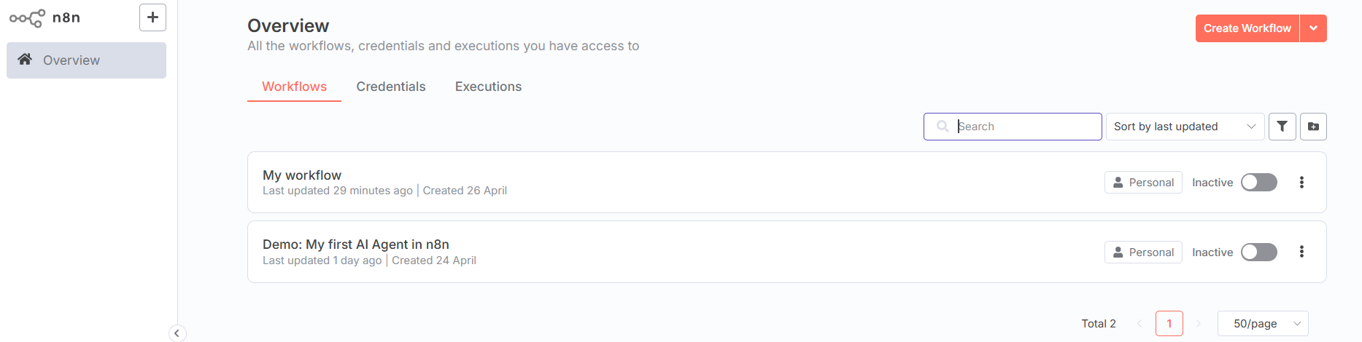
CREATE NEW PROJECT
CLICK “CREATE WORKFLOW”

Slide 5
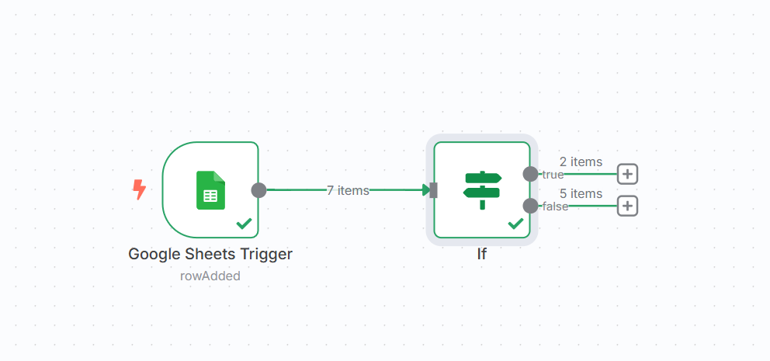
INITIALIZE PROJECT

Slide 6
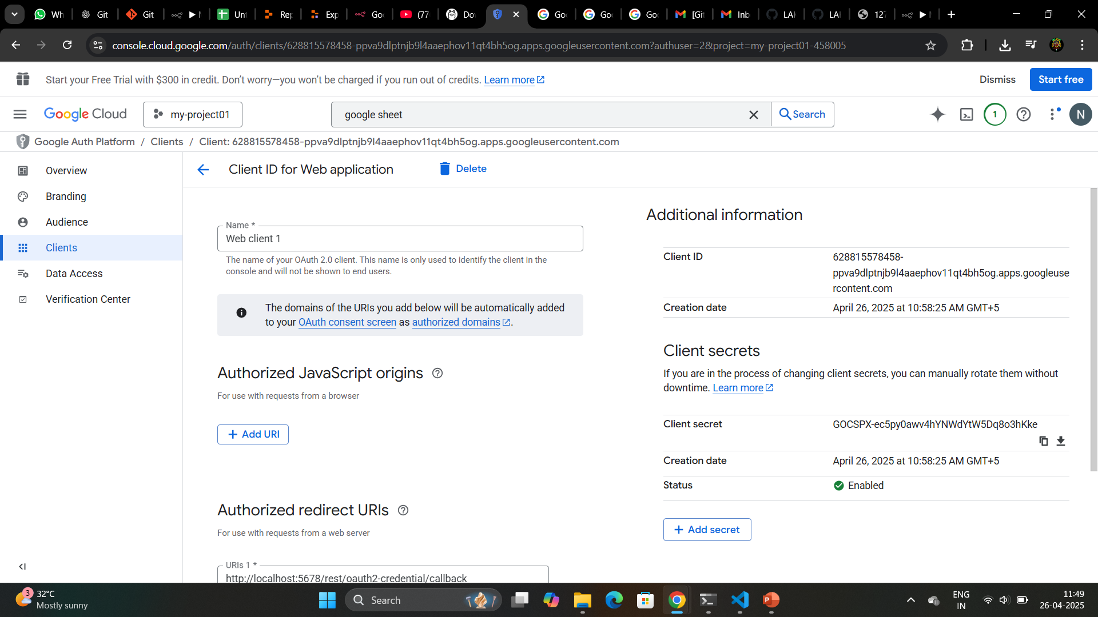
MAKE CREDENTIAL

Slide 7
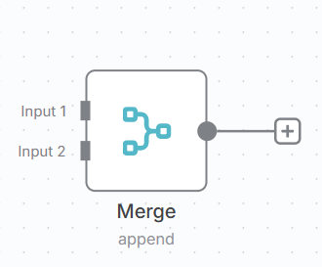
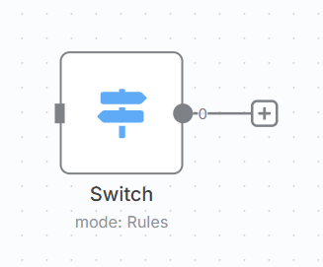
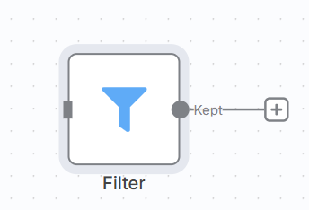
EXPLORE ALL DATA FLOWS

Slide 8
THANK YOU

