Slide 1

Image Color Detection
by
Lakshmi Sree R
Roll No:224G1A3341
Department of Computer Science and Engineering (AI&ML)
Srinivasa Ramanujan Institute of Technology
Autonomous
Rotarypuram Village, B K Samudram Mandal, Ananthapuramu – 515701.
2024-2025

Slide 2

Contents
Introduction
Problem Defination
Objectives
Design
331

Slide 3
Introduction
The Image and Color Detection application streamlines the process of analyzing and detecting colors in images. It offers a user-friendly interface for uploading images and real-time color detection through both uploaded images and live camera feed. Users can view detected colors and their RGB values instantly.
Key features include image uploading, real-time detection, and integrated display of images and detected colors. This automation improves the efficiency and accuracy of color analysis, promoting creativity and efficiency in fields like graphic design and digital art.
By implementing this system, we aim to create an organized and engaging environment for color analysis.
3341
3341
3341
3341

Slide 4
Problem Definition
Problem Statement: The need for an efficient tool to analyze and detect colors
in images.
Context: Color detection is essential in fields like graphic design, digital art, and computer vision.
Scope: Use Tkinter for GUI, OpenCV for image processing, and CSV for data
for decting the colors of the image.
This structured approach helps in clearly defining the issue, making it easier to develop solutions. Want to explore more examples or details?

Slide 5
Objectives
Easy Interface:
Use Tkinter to make a simple, user-friendly design.
Image Upload:
Let users upload and view images easily.
Real-Time Color Detection:
Detect colors instantly when users double click on the image.
Show detected colors and their RGB values right away.
Combined View:
Display the image and detected colors together in one interface.
Accurate Data Handling:
Use CSV files to store and match color data accurately.
Efficiency:
Automate color detection to save time and reduce errors.
Support Creativity:
Help users in fields like graphic design and digital art with easy color analysis.
These objectives aim to make the process of color analysis simple, efficient, and accessible for everyone.

Slide 6
Design
The Image and Color Detection project is designed using Python’s Tkinter library for the graphical user interface and CSV files for data. The system will facilitate the detection of prominent colors in images and the management of these detected colors efficiently.
Key Features:
User Interface: A simple and intuitive GUI that includes features for uploading images, interacting with the displayed image, and viewing the detected colors along with their RGB values.
Image Upload: Users can upload images from their local system and view these images within the application interface.
Color Detection: Users can interactively detect colors by double-clicking on the uploaded image.The application displays the detected color's name and its RGB values right-away.
Integrated Display: The system seamlessly integrates the display of the uploaded image and the list of detected colors in one interface, providing real-time feedback.
CSV Data Handling: The application reads from a CSV file containing color data and matches detected colors with this data. It ensures easy data management and retrieval.

Slide 7
Continution
Technical Requirements
Programming Language: Python Programming
Libraries: Tkinter , PIL , OpenCV(cv2) , pandas , report lab,
Dataset: CSV file to read the colors of the image

Slide 8
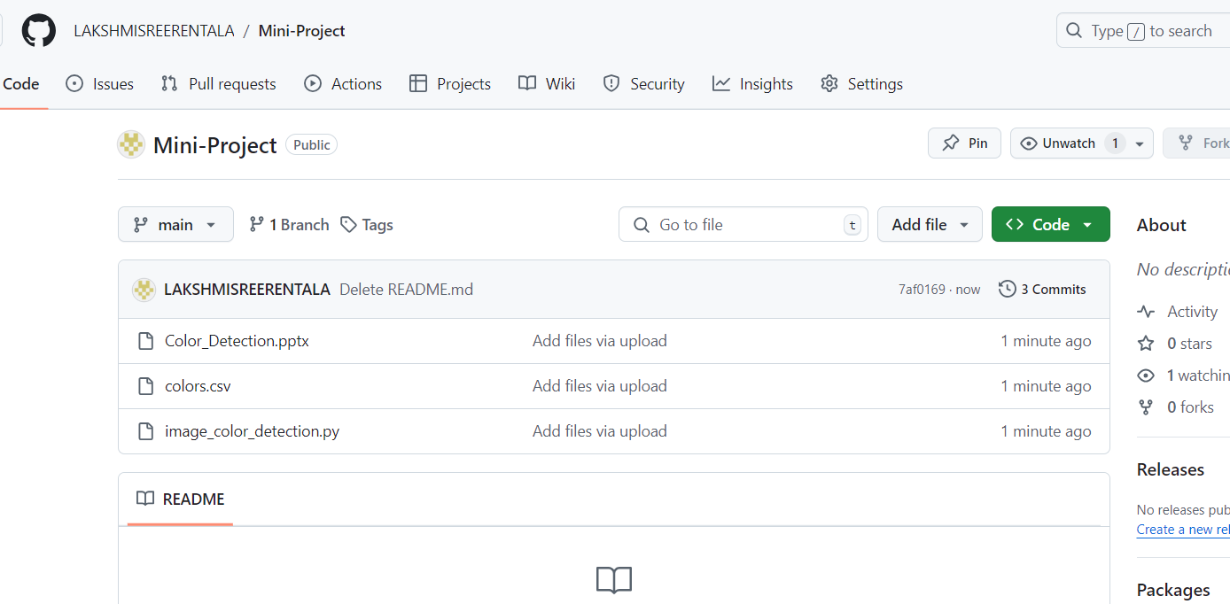
Github Link
Repository Name : Mini-Project
Git Hub Link : https://github.com/LAKSHMISREERENTALA

Slide 9
Any Queries?

Slide 10
Thank You

