Slide 1
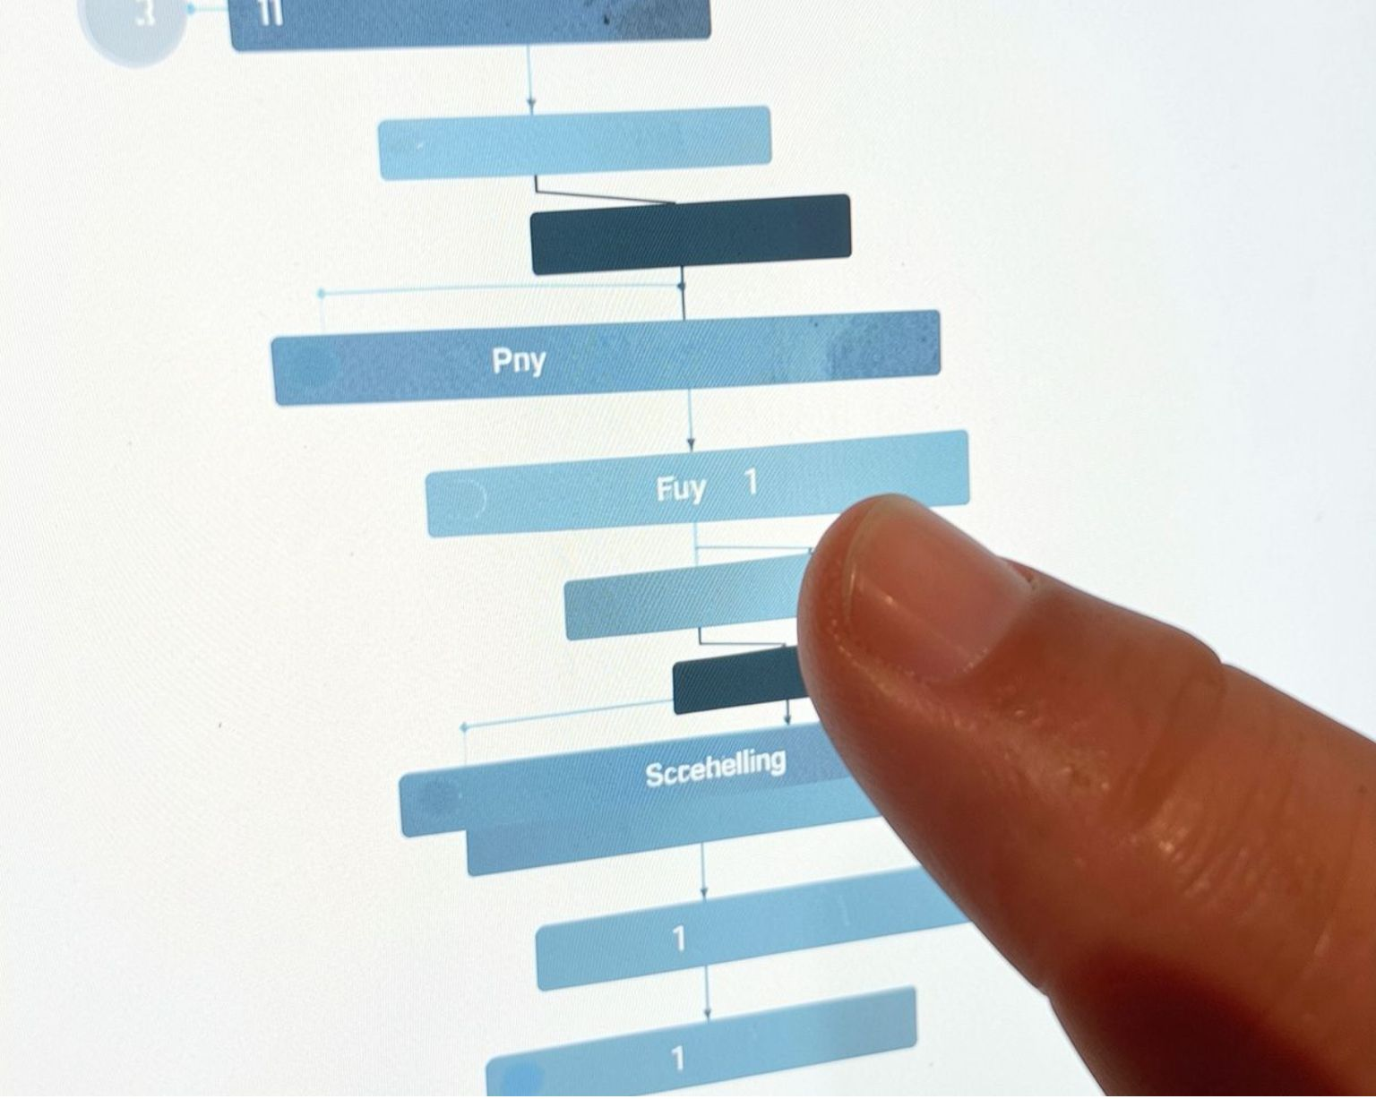
OPERATING SYSTEMS PROJECT
PROCESS MANAGEMENT
AND FORK TREE
VISUALIZER
An Interactive Operating System Process Simulation Tool
Presented by
Bassil H 24BCE0904
Ajitesh Mohan N 24BCE0887
Presented by Bassil H, Ajitesh Mohan N, and Abjieet, this project focuses on the practical understanding of process management in operating systems through an interactive web-based application. Process management is one of the fundamental responsibilities of an operating system, as it involves creating processes, maintaining their states, managing parent–child relationships, and deciding how CPU time is allocated. The Process Management and Fork Tree Visualizer brings these concepts together in a single interface, allowing users to explore process hierarchies, understand process-state transitions, and observe the working of different CPU scheduling algorithms. The main aim of the project is to make operating system concepts easier to understand through visual representation and practical demonstrations rather than relying entirely on theoretical explanations.

Slide 2
ABSTRACT
Process management plays an important role in an operating system because it determines how programs are executed and how system resources are allocated among different processes. Concepts such as process creation, process scheduling, process-state transitions, and parent–child relationships can be challenging for students to understand when they are explained only through textbooks or programming examples. To address this difficulty, the Process Management and Fork Tree Visualizer provides an interactive web-based environment for exploring these concepts visually.
The application brings together a process management interface, a fork-tree visualization module, a process-state flow diagram, and a CPU scheduling module. It demonstrates the working principles of First Come First Served (FCFS), Shortest Job First (SJF), Shortest Remaining Time First (SRTF), and Round Robin scheduling. The project also includes a learning section related to operating system system calls, helping users understand how applications interact with operating system services. React and TypeScript are used to structure the interface and implement the application's logic, while dedicated utility functions support scheduling calculations and fork-tree positioning. Overall, the project aims to connect theoretical operating system concepts with practical visual learning and provide students with a more accessible way to study process management.

Slide 3
PROBLEM STATEMENT
Understanding process management is an important part of learning operating systems, but many students find it difficult to understand how processes are created, how they are related to one another, and how the CPU decides which process should execute next. Traditional explanations often use diagrams, tables, and code examples, which may not clearly demonstrate the relationships and execution order involved in real process-management scenarios.
One major challenge is understanding the fork() system call and the parent–child relationships it creates. When a process creates child processes, the resulting hierarchy can become difficult to follow without a clear visual representation. Similarly, CPU scheduling algorithms follow different selection rules, and comparing their behaviour requires an understanding of arrival times, burst times, execution order, and scheduling metrics. Process-state transitions introduce another layer of complexity because a process may move between states depending on its execution and scheduling conditions.
The problem addressed by this project is the difficulty of learning these operating system concepts through theory alone. The proposed application combines process information, fork-tree structures, process-state diagrams, and CPU scheduling simulations in one interface. This approach helps students connect the underlying concepts with their visual representation and understand how different parts of process management work together.

Slide 4
OBJECTIVES
The primary objective of the Process Management and Fork Tree Visualizer is to develop a practical learning tool that explains important operating system concepts through an interactive visual interface. Instead of presenting process management as a collection of separate theoretical topics, the application brings together the concepts involved in process creation, process relationships, state transitions, and CPU scheduling.
A major objective is to represent processes and their relationships in a clear and understandable format. By using process identifiers and parent-process information, the application can illustrate the hierarchy between parent and child processes through a fork-tree structure.
Another objective is to explain process-state transitions visually so that users can better understand how a process moves through the different stages of execution.
The project also aims to demonstrate the working of commonly studied CPU scheduling algorithms, including FCFS, SJF, SRTF, and Round Robin. Through execution sequences and scheduling-related calculations, students can examine how different algorithms handle processes and how their scheduling decisions affect waiting time, turnaround time, completion time, and response time where these values are calculated. In addition, the project seeks to provide an organised interface for learning about operating system system calls. The overall objective is to make the study of operating systems more practical, understandable, and engaging.

Slide 5

INTRODUCTION AND SYSTEM DESIGN
Common UI
Fork-Tree View
CPU Scheduling
Process Management
Process-State Flow
System Calls
The Process Management and Fork Tree Visualizer is designed as a browser-based educational application that demonstrates several important concepts related to process management. The system follows a modular design in which different components focus on specific operating system topics while working together through a common user interface. This structure helps organise the application and makes its functionality easier to understand and maintain. The process management module focuses on displaying and working with process information. The fork-tree module represents the relationships between parent and child processes, using a hierarchical arrangement of nodes and connecting lines. This visual structure helps users understand how a process hierarchy is formed and how individual processes relate to one another. The process-state flow module presents the movement between process states and provides a visual explanation of the stages involved in process execution. Another important component is the CPU scheduling module, which demonstrates different scheduling strategies and presents their execution sequences through a Gantt-style timeline. This allows users to follow how CPU time is allocated to processes under different algorithms. The system also contains a section for learning about system calls and their purpose in operating systems. The application uses React components to organise the interface and TypeScript modules to manage application logic. Shared process information is handled through React's state-management mechanisms, while separate utility functions support scheduling calculations and fork-tree layout. This separation between interface components and supporting logic provides a structured foundation for the project.

Slide 6




IMPLEMENTATION
Process management
Fork-tree visualization
CPU scheduling
System calls
The implementation of the Process Management and Fork Tree Visualizer is divided into different functional modules to keep the code organised and make each operating system concept easier to demonstrate. The frontend is developed using React and TypeScript, allowing the application to use reusable components, structured data types, and state-based updates. The application logic is separated into supporting utilities wherever appropriate, so that visual elements and calculations can be maintained independently.
The process management functionality handles process-related information and uses the application's state-management logic to keep relevant data available to the interface. The fork-tree visualization uses process identifiers and parent-process relationships to organise process nodes into a hierarchy. The tree-layout utility determines node positions and the connections between them, helping the user understand the structure of parent and child processes.
The CPU scheduling module implements four commonly studied algorithms. FCFS schedules processes according to their arrival order, while SJF selects the available process with the shortest burst time. SRTF selects the process with the shortest remaining execution time and can change the running process when another eligible process has a shorter remaining time. Round Robin allocates CPU time in fixed intervals determined by a time quantum, allowing processes to receive turns in a cyclic order. The scheduling logic produces execution sequences and calculates relevant timing values that can be displayed for comparison.
The application also includes visual learning components for process-state transitions and operating system system calls. These components help explain concepts that would otherwise require separate diagrams or written explanations. By combining these modules in a single application, the project provides an organised environment for demonstrating process-management concepts and exploring the logic behind CPU scheduling.

Slide 7
TECHNOLOGY STACK
Node.js and npm form part of the development environment and are used to manage the project's packages and dependencies. Lucide React supplies icons used throughout the interface to improve visual clarity and navigation.
The project also includes Three.js, React Three Fiber, and Drei among its dependencies for 3D-related rendering capabilities. Their presence in the technology stack does not necessarily mean that every module uses 3D rendering. The main application logic relies on React state management and TypeScript utility functions to handle process-related information, scheduling calculations, and fork-tree positioning. The supplied project is primarily a client-side web application, and its simulations should be understood as educational demonstrations rather than direct control over the operating system kernel.
The project uses modern frontend technologies to create an interactive and visually organised learning environment. React 19 is used to build the user interface through reusable components, making it easier to organise the process manager, fork-tree visualizer, scheduling module, and other learning sections. TypeScript provides static typing for application data and functions, helping maintain consistency and reduce certain programming errors during development.
CSS is used to control the overall appearance of the application, including layouts, spacing, visual effects, and component presentation. Tailwind CSS 4 supports utility-based styling, allowing interface elements to be designed and adjusted efficiently. These technologies work together to provide the visual structure needed to present process information and scheduling results clearly.
Vite 6 is used as the development and build tool, providing a development server and supporting the creation of the production frontend.

Slide 8
RESULTS AND OBSERVATIONS
The Process Management and Fork Tree Visualizer brings several operating system learning concepts together within a single application. The process management interface provides a dedicated place to work with process information, while the fork-tree module presents parent–child relationships through a hierarchical visual structure. This representation makes it easier to understand how processes can be organised into a tree and how each child process relates to its parent.
The process-state flow module provides a visual explanation of the states involved in process execution. It helps users connect theoretical descriptions of process states with a diagram that represents the relationships between them. The CPU scheduling module implements FCFS, SJF, SRTF, and Round Robin, allowing the scheduling rules of these algorithms to be explored through the application's logic.
Execution sequence
01
02
03
04
Arrival
Selection
Execution
Completion
The scheduling functionality can present the execution order through a Gantt-style timeline and calculate scheduling-related values such as completion time, turnaround time, waiting time, and response time where supported by the implementation. These values help explain how the execution of a set of processes can differ depending on the scheduling algorithm selected. The system-call learning section further supports the educational purpose of the application by providing information about operating system services.
The implementation demonstrates how visual representations can support the learning of process management and CPU scheduling. These observations describe the functionality available in the project source code; they do not represent measured performance scores or formal user-study results. The application's educational value can be demonstrated using screenshots and verified examples generated by running the actual project.

Slide 9
APPLICATIONS AND FUTURE SCOPE
The Process Management and Fork Tree Visualizer can be used as a supplementary learning tool in operating systems courses. Students can use it to understand process hierarchies, observe process-state relationships, and study how different CPU scheduling algorithms select processes for execution. It can also support classroom demonstrations, laboratory discussions, and self-learning by presenting concepts in a more visual format than conventional written explanations.
The scheduling module is particularly useful for understanding the differences between scheduling strategies. FCFS follows arrival order, SJF prioritises shorter jobs, SRTF considers the remaining execution time, and Round Robin distributes CPU time using a time quantum. Observing these differences can help students understand why scheduling decisions affect the order of execution and the timing values associated with each process.
There are several opportunities to extend the project in the future. Additional algorithms, such as Priority Scheduling and Multilevel Queue Scheduling, could be introduced to expand the scheduling module. The application could also provide more detailed step-by-step execution, with controls to pause, resume, and advance the simulation one step at a time. Improved handling of larger process trees would make the visualizer more useful for complex examples.
Another possible improvement is to introduce automated test cases for validating scheduling calculations and process-tree relationships. Detailed comparisons of average waiting time, turnaround time, and response time could also be added to help users evaluate the behaviour of different algorithms. These enhancements would expand the application's capabilities and make it a more comprehensive resource for practical operating system learning.

Slide 10




CONCLUSION
The Process Management and Fork Tree Visualizer demonstrates how important operating system concepts can be presented through an interactive web application. The project brings together process management, parent–child relationships, fork-tree visualization, process-state flow, CPU scheduling, and system-call learning in a common environment. By combining these concepts, the application provides a practical way for students to connect theoretical knowledge with visual demonstrations.
The fork-tree module helps explain process hierarchies, while the process-state diagram provides a visual understanding of process transitions. The scheduling module demonstrates the principles behind FCFS, SJF, SRTF, and Round Robin and presents execution sequences and relevant timing calculations. These features help explain how processes are organised and how scheduling algorithms make decisions about CPU allocation.
Process management
Fork-tree visualization
1
2
System-call learning
4
3
CPU scheduling
The use of React and TypeScript provides a modular foundation for the application, while Vite and the supporting frontend libraries help with development and interface presentation. The project also demonstrates how software development techniques can be applied to create an educational tool focused on a core computer science subject.
Overall, the Process Management and Fork Tree Visualizer provides a practical foundation for studying process management and CPU scheduling. Although it is an educational simulation rather than a complete operating system implementation, it helps make complex concepts easier to follow and understand. With further improvements to simulation controls, scheduling options, testing, and visualisation, the application can be developed into a more comprehensive learning platform for operating systems.

Slide 11
CORE IMPLEMENTATION: PCB & FORK() SYSCALL
kernel_pcb_fork.py (Process Table & Syscall Logic)
DATA STRUCTURE
Process Control Block (PCB)
• Encapsulates process ID, parent ID, priority, and memory quota.
• Maintains 5-state lifecycle: NEW, READY, RUNNING, WAITING, TERMINATED.
• Enables dynamic hierarchical traversal across the fork tree visualizer.
# 1. Process Control Block (PCB) Data Structure
@dataclass
class ProcessControlBlock:
pid: int; ppid: int; name: str; state: str = "READY"
priority: int = 5; cpu_burst: int = 10; memory_mb: int = 32
children: List[int] = field(default_factory=list)
# Hardware CPU Registers saved across Context Switches
pc: str = "0x00400000" # Program Counter
sp: str = "0x7ffd0000" # Stack Pointer
rax: str = "0x00000000" # Accumulator Register
# 2. POSIX fork() System Call Simulation
def fork(self, parent_pid: int, name: str, priority=5, burst=8):
"""Replicates context, allocates PID & updates process tree."""
if parent_pid not in self.process_table:
raise ValueError(f"Parent {parent_pid} not found")
child_pid = max(self.process_table.keys()) + 1
child_pcb = ProcessControlBlock(
pid=child_pid, ppid=parent_pid, name=name, state="READY",
priority=priority, cpu_burst=burst, total_burst=burst,
pc=f"0x{0x00400000 + child_pid * 0x100:08x}",
sp=f"0x{0x7ffd0000 + child_pid * 0x20:08x}"
)
self.process_table[child_pid] = child_pcb
self.process_table[parent_pid].children.append(child_pid)
return child_pid
SYSTEM CALL
POSIX fork() Mechanics
• Simulates address space replication and unique PID allocation.
• Links child PID directly into parent PCB children list to preserve lineage.
• Child process is admitted immediately into the READY Queue.
HARDWARE CONTEXT
Register State Preservation
• Simulates PC (Program Counter), SP (Stack Pointer), and RAX registers.
• Preserves execution offsets to support transparent context switching.
• Directly serialized and displayed in the frontend PCB Inspector drawer.

Slide 12
CORE IMPLEMENTATION: SCHEDULING & CONTEXT SWITCHING
scheduler_engine.py (Round-Robin & Preemption)
EXECUTION CYCLE
CPU Clock Tick & PC Advance
• Clock ticks decrement CPU burst for the active core process.
• Program Counter (PC) steps forward 4 bytes per instruction cycle.
• Tasks automatically transition to TERMINATED when burst reaches zero.
# 1. CPU Execution Step & Timer Preemption
def step(self, algorithm: str = "ROUND_ROBIN"):
"""Advances hardware clock & executes running process."""
self.tick += 1
curr = self.process_table.get(self.current_running)
if curr and curr.state == "RUNNING" and curr.pid != 1:
curr.cpu_burst -= 1
curr.pc = f"0x{(int(curr.pc, 16) + 4):08x}" # PC += 4 bytes
curr.rax = f"0x{(self.tick * 2654435761 + curr.pid) & 0xFFFFFFFF:08x}"
if curr.cpu_burst <= 0:
curr.state, curr.memory_mb = "TERMINATED", 0
self.schedule_next(algorithm) # Finished execution
elif algorithm == "ROUND_ROBIN":
self.quantum_rem -= 1
if self.quantum_rem <= 0:
curr.state = "READY" # Quantum timer interrupt
self.schedule_next(algorithm)
else: self.schedule_next(algorithm)
# 2. POSIX waitpid() Zombie Reaping & Orphan Adoption
def reap_zombies(self):
dead = [p for p, obj in self.process_table.items() if obj.state == "TERMINATED"]
for pid in dead:
for c_pid in self.process_table[pid].children:
if c_pid in self.process_table:
self.process_table[c_pid].ppid = 1 # Re-parent to init
self.process_table[1].children.append(c_pid)
del self.process_table[pid] # Free PCB from kernel table
ALGORITHM DISPATCH
Round-Robin & Preemption
• Hardware timer decrements allocated time quantum (q ticks).
• On quantum timeout, running process is preempted back to READY queue.
• Dispatcher selects the next eligible task, resetting the time quantum.
PROCESS ANOMALIES
Zombie Reaping & Orphan Adoption
• Simulates parent waitpid() call to reap zombie PCB records.
• Active orphan children are adopted by PID 1 (systemd/init).
• Frees virtual memory allocation while maintaining fork tree consistency.

Slide 13
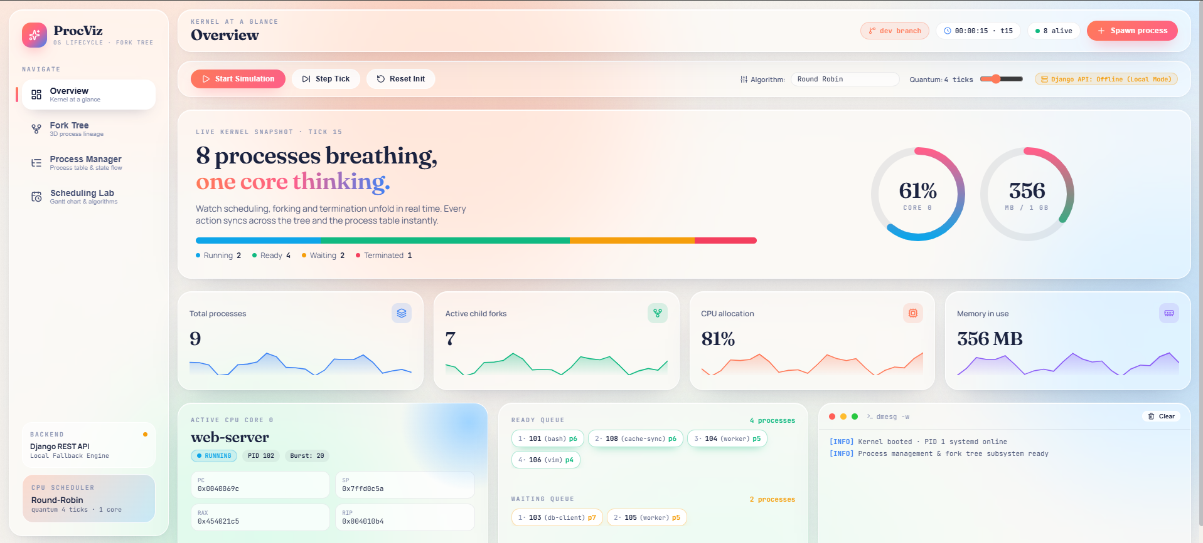

Slide 14
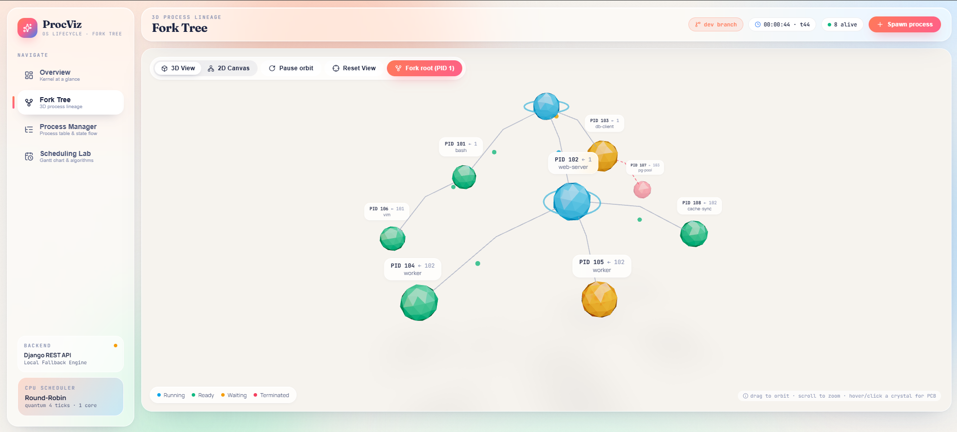

Slide 15
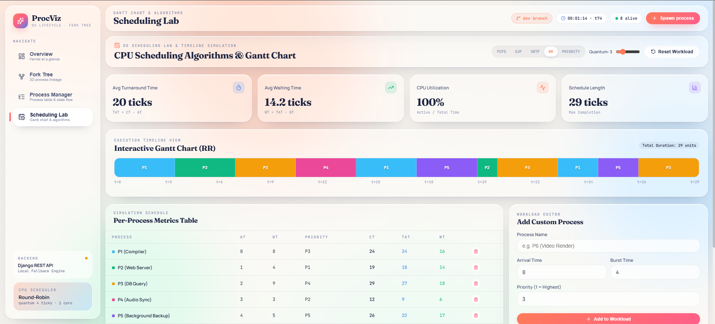

Slide 16
Github Project Repository Link
https://github.com/ajiteshmohan/fork-tree-visualizer.git

