Slide 1
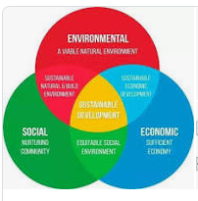
Sustainable Development
By Lakshya Jain
“Sustainable development is an organizing principle for meeting human development goals while also sustaining the ability of natural systems to provide the natural resources and ecosystem services on which the economy and society depend……”

Slide 2
Sustainable Development is the science of balance.
The Balance between advancement and conservation and the now and the future.

Slide 3
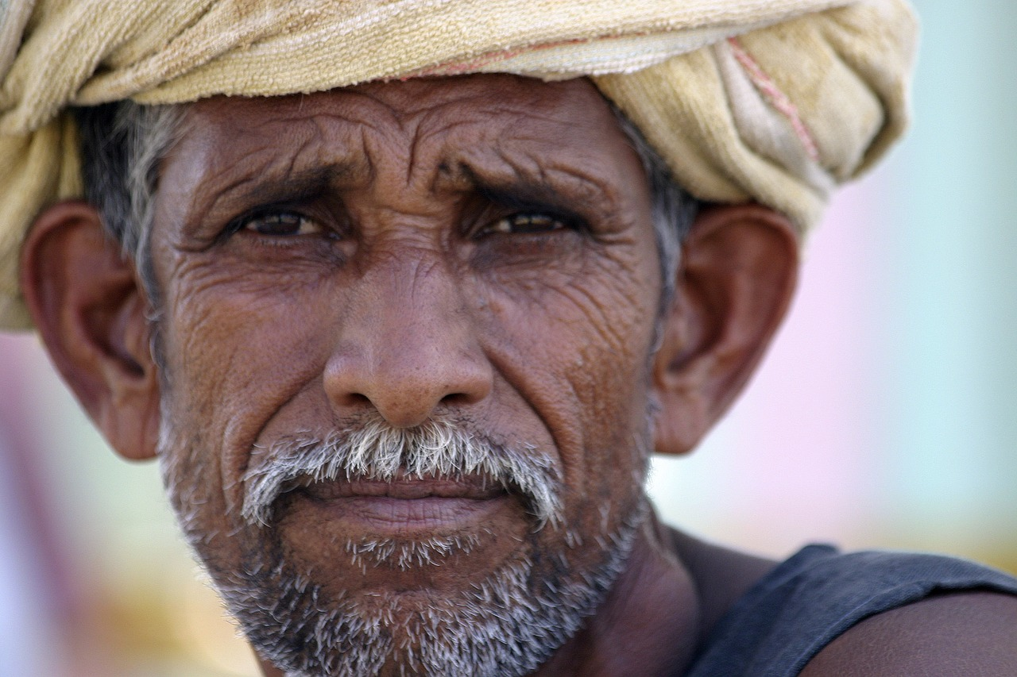
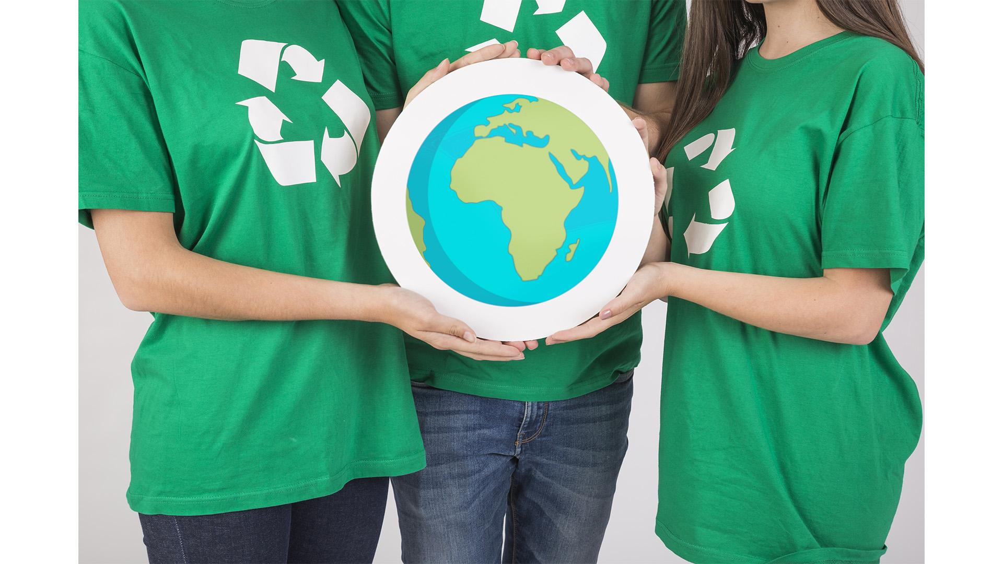
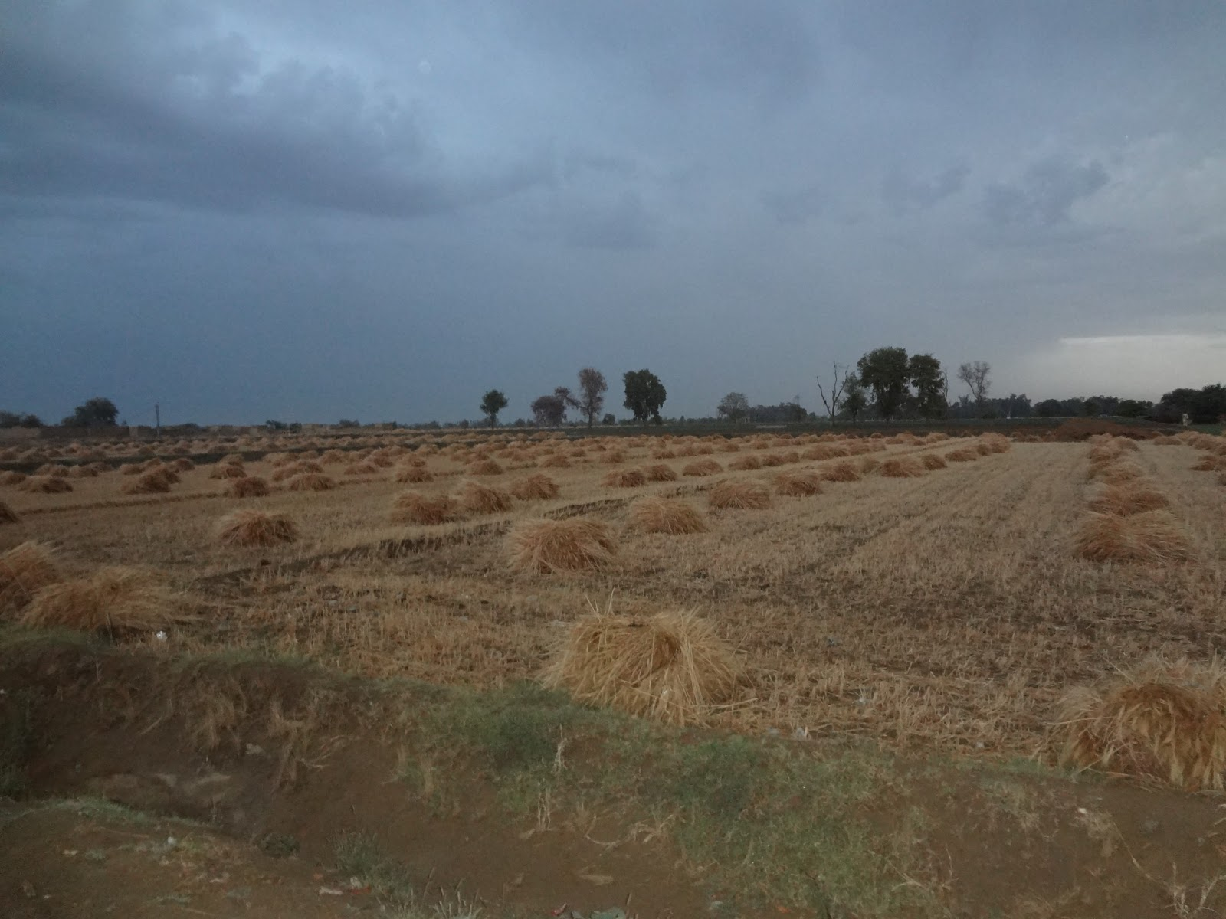
Overuse of Fertilizers and Chemicals
Raju
69 Years Old
Wheat Farmer in Uttar Pradesh
6 Sons
Don’t Worry Farmers, Science is here!
0.5 Hectare
(Average size of a Small Indian Farmer’s plot)

Slide 4
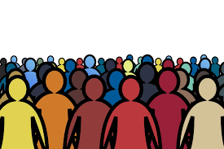
Lakshya’s First Law
Society resists change. Once it gets its hands on a new way of life, it will keep on committing and investing making change harder
Force of Change
New, Better Lifestyle
Current Way of Life

Slide 5
Lakshya’s Third Law
Environmental Viability 𝛼
1
SocioEconomic Viability
Socio-Economic
Sustainbility
Environment Sustainbility

Slide 6
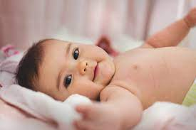
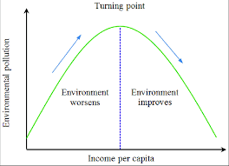
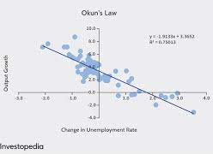
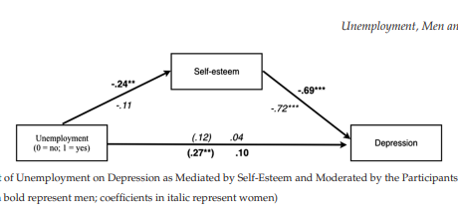
The Baby Bonanza Phenomenon
Environmental Impact
Social Impact
Economic Impact
Kuznets Curve
Alvaro Relation
Okun’s Law
Advancement↑ Conservation ↓
Growing Population, Growing Demand, Same Resources

Slide 7
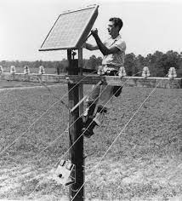
“Innovation keeps on happening, but implementation does not.”
Decrease in Demand
Solar Panels were invented in 1954, but still lack widespread adoption
Potential to Conserve

Slide 8
Thank you

