Slide 1
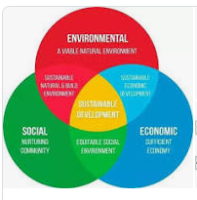
Sustainable Development
By Lakshya Jain
“Sustainable development is an organizing principle for meeting human development goals while also sustaining the ability of natural systems to provide the natural resources and ecosystem services on which the economy and society depend……”

Slide 2
Sustainable Development is the science of balance.
The Balance between advancement and conservation and the now and the future.

Slide 3
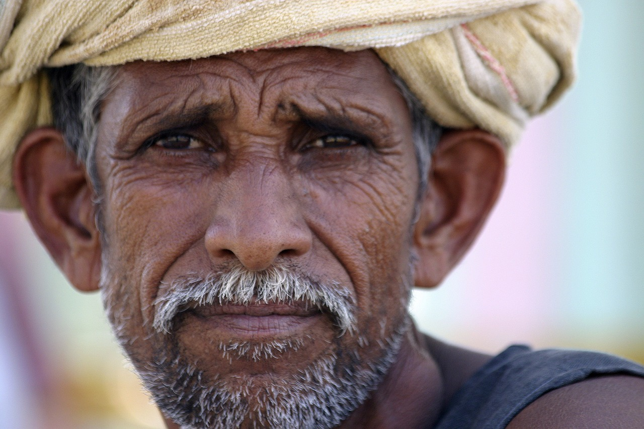
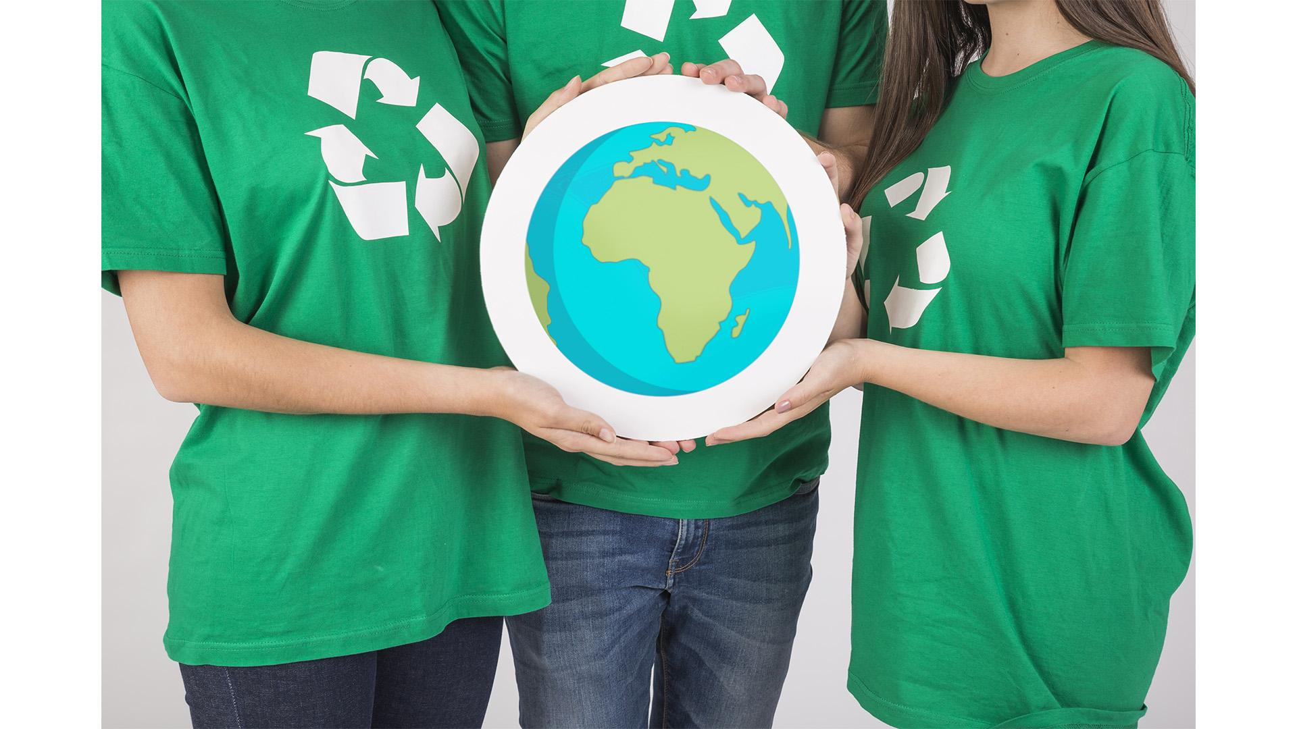
Raju
68 Years Old
Wheat Farmer in Uttar Pradesh
6 Sons
Don’t Worry Farmers, Science is here!
0.5 Hectare
(Average size of a Small Indian Farmer’s plot)

Slide 4
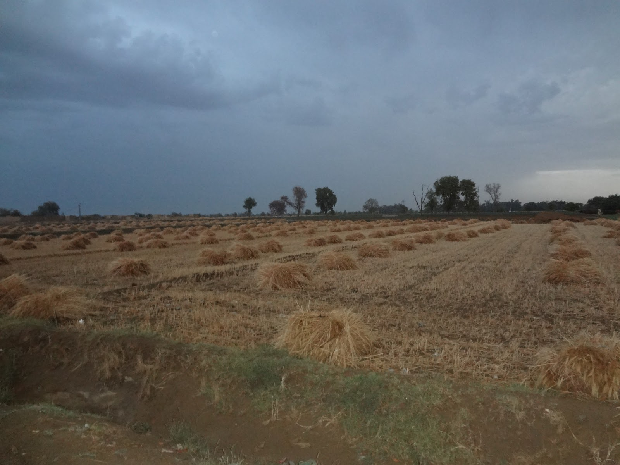
Overuse of Fertilizers and Chemicals
Conservation
Advancement

Slide 5
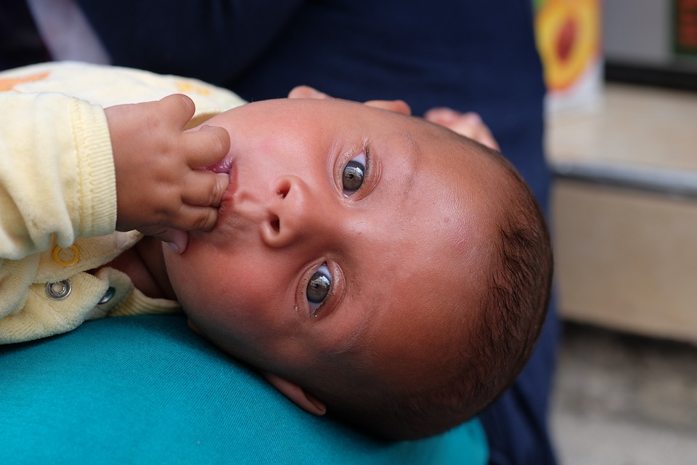
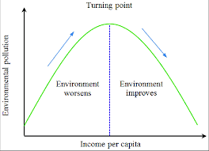
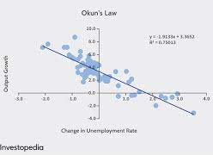
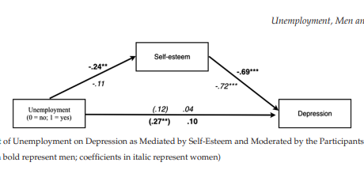
The Baby Bonanza Phenomenon
Environmental Impact
Social Impact
Economic Impact
Kuznets Curve
Álvaro Relation
Okun’s Law
Advancement↑ Conservation ↓
Growing Population, Growing Demand, Same Resources

Slide 6
Lakshya’s Third Law
Conservation 𝛼
1
Advancement
Advancement
Conservation

Slide 7
Deal with Problems Today
or
Spoil our Society for the Future?

Slide 8
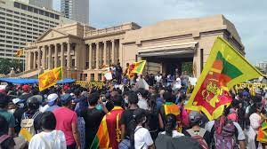
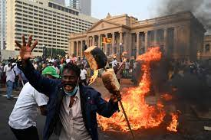
Deal with Shortage Today
Sri Lanka

Slide 9
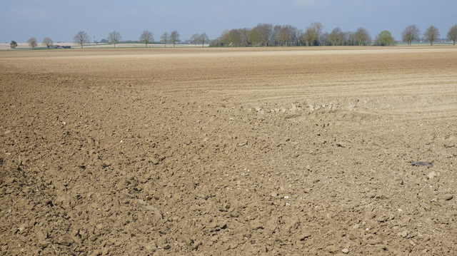
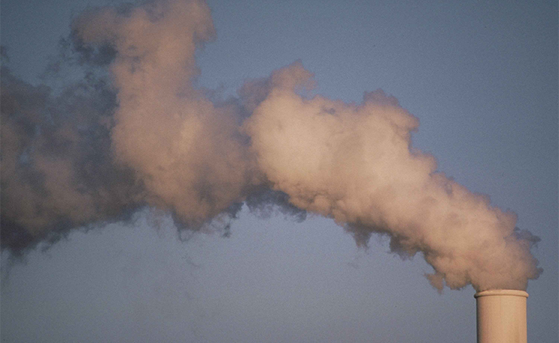
Spoil our Resources for the Future
Venezuela

Slide 10
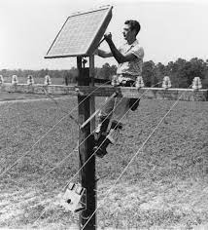
“Innovation keeps on happening, but implementation does not.”
Solar Panel Installation in 1955

Slide 11
Thank you

