Slide 1
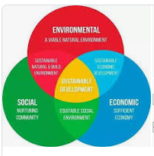
Sustainable Development
By Lakshya Jain
“Sustainable development is an organizing principle for meeting human development goals while also sustaining the ability of natural systems to provide the natural resources and ecosystem services on which the economy and society depend……”

Slide 2
Sustainable Development is the science of balance.
The Balance between advancement and conservation and the now and the future.

Slide 3
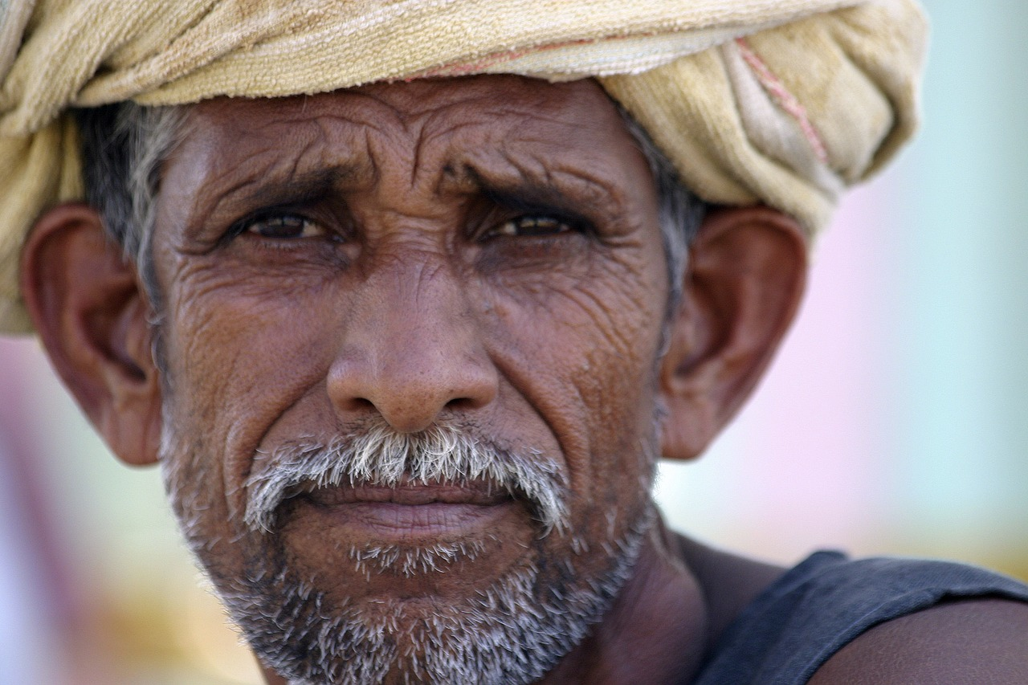
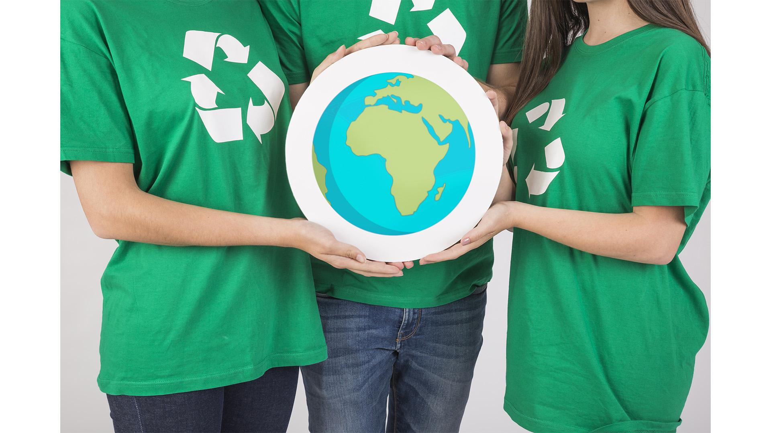
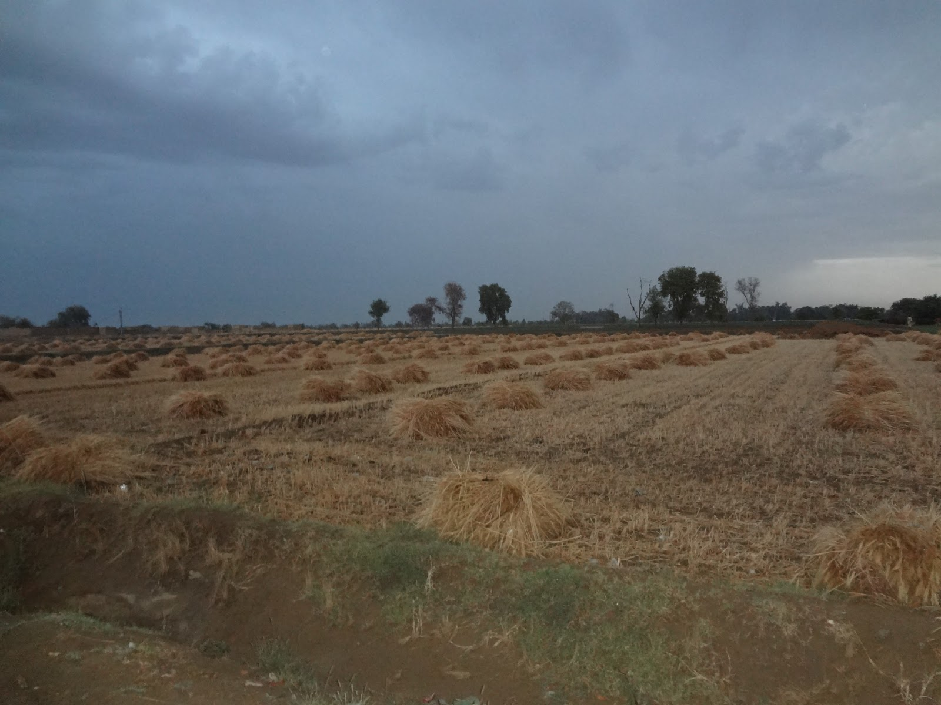
Overuse of Fertilizers and Chemicals
Raju
69 Years Old
Wheat Farmer in Uttar Pradesh
6 Sons
Don’t Worry Farmers, Science is here!
0.5 Hectare
(Average size of a Small Indian Farmer’s plot)

Slide 4
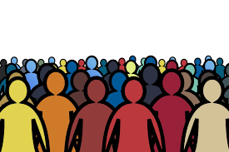
Lakshya’s First Law
Society resists change. Once it gets its hands on a new way of life, it will keep on committing and investing making change harder
Force of Change
New, Better Lifestyle
Current Way of Life

Slide 5
Lakshya’s Third Law
Environmental Viability𝛼
1
Advancement
Socio-Economic
Sustainbility
Environment Sustainbility

Slide 6
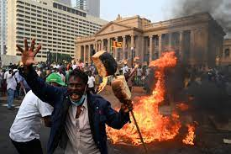
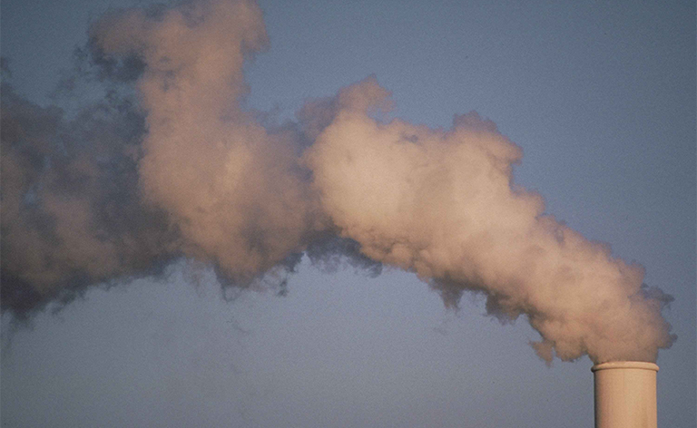

Deal with Problems Today
Spoil Society for the Future
Sri Lanka
Venezuela
Near Perfect Balance
Finland
SDG Score of 86.51 -> World Leader in Clean Energy -> Unemployment rate of 6.7% -> World’s Happiest Country

Slide 7
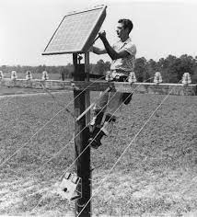
“Innovation keeps on happening, but implementation does not.”
Solar Panel Installation in 1955

Slide 8
Thank you

