Slide 1
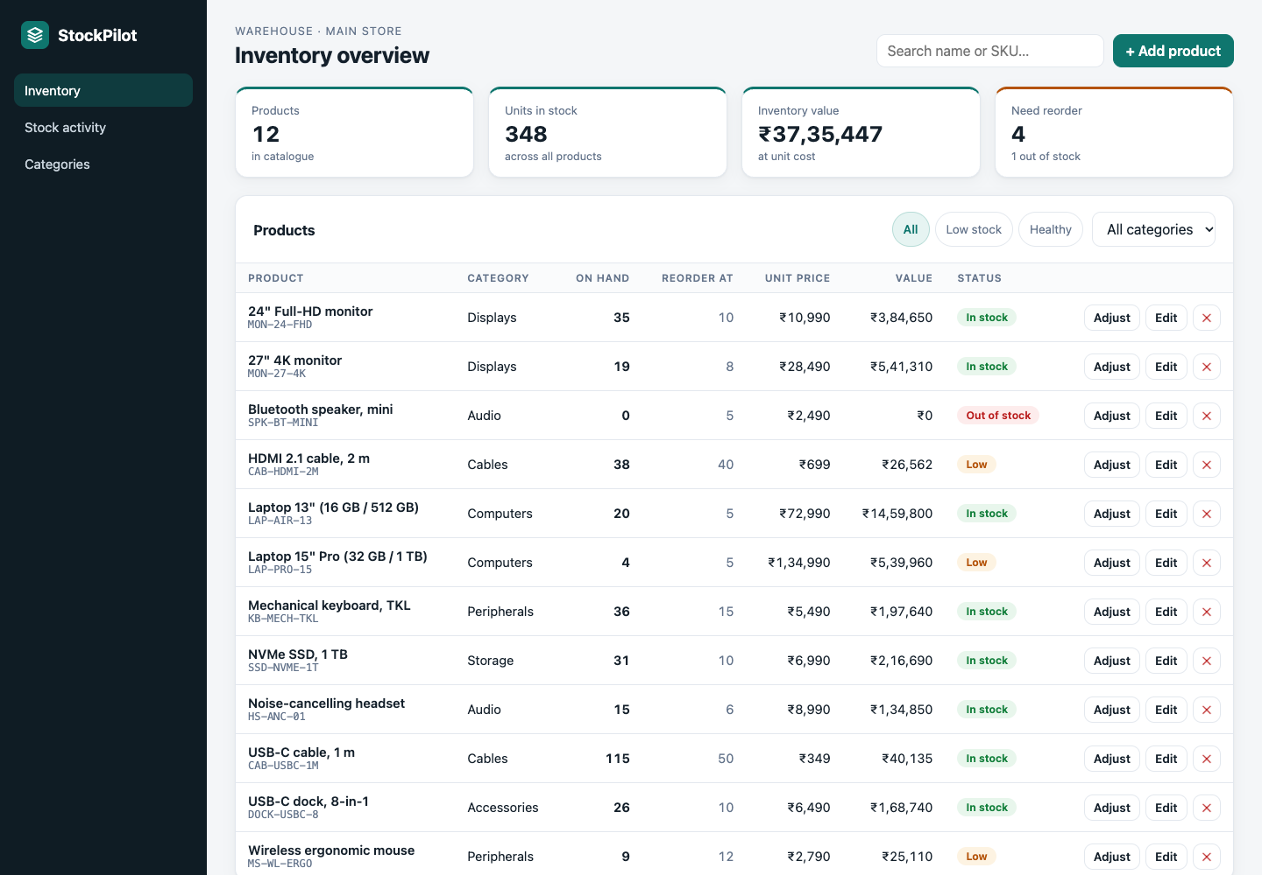
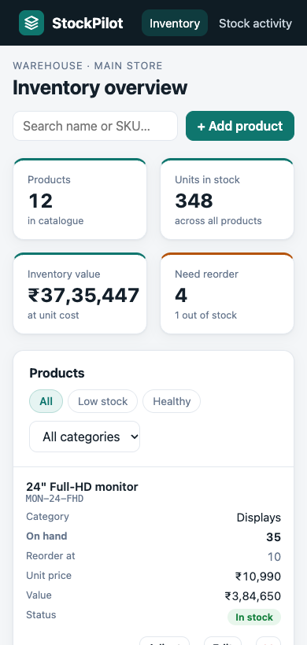
StockPilot
SESSION 21 · DEVOPS FINAL CAPSTONE
Inventory management, from a laptop to a monitored Kubernetes cluster on AWS
Lakshya Mewara
Enrollment 24BCS10290
Notes:
Hi, I'm Lakshya Mewara, enrollment 24BCS10290. This is my Session 21 DevOps capstone: StockPilot, an inventory-management application. I'll show how it goes from code on my laptop through tests, security scanning and a container registry, onto Kubernetes with Helm, autoscaling and monitoring, with the AWS network and EKS cluster defined in Terraform.

Slide 2
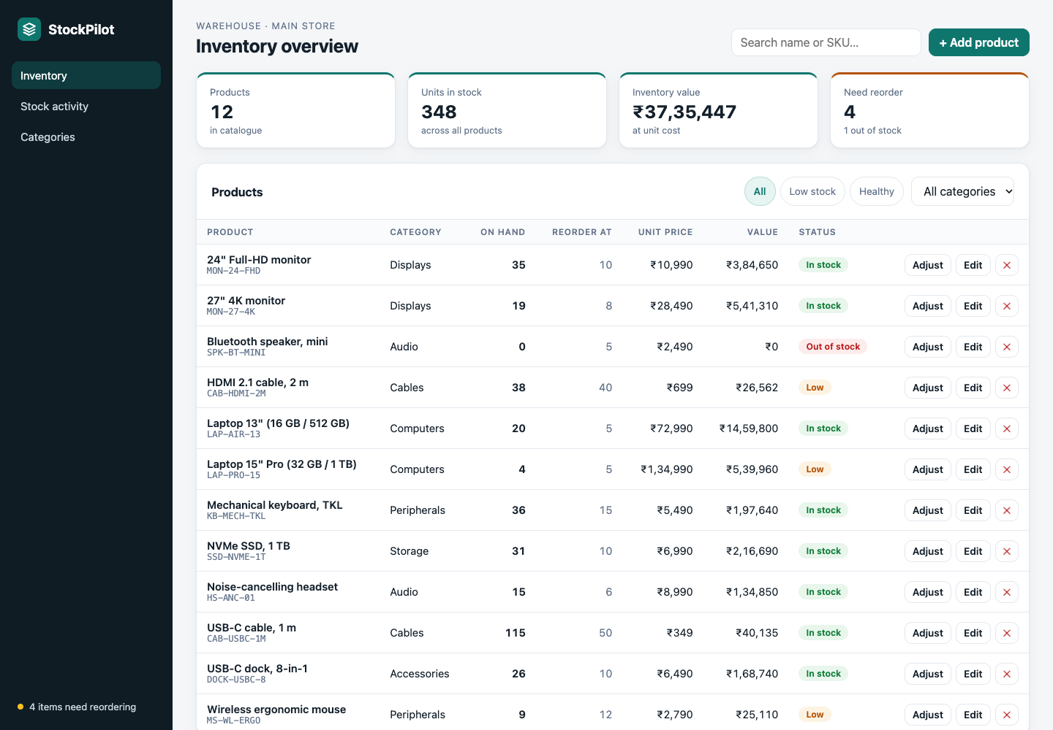




What StockPilot does
Product catalogue
SKU, category, unit price and a reorder level for every product
Audited stock movements
Every stock in and out is recorded; stock can never go negative
Reorder alerts
Low and out-of-stock items flagged in the UI and in Prometheus
Running on Kubernetes, served through the Ingress
Responsive dashboard
KPIs, search, filters and a live activity feed on desktop and phone
Notes:
StockPilot keeps a product catalogue with SKUs, prices and reorder levels. Staff receive and issue stock, and every change is written to an audit trail, so stock can never go negative. Products at or below their reorder level are flagged, both in the dashboard and as a Prometheus alert. The UI is responsive: on a phone the table turns into cards.

Slide 3
Architecture at a glance
BUILD & DELIVER
Developer
git push
GitHub
source of truth
GitHub Actions
tests · scans · Trivy gate · build
GHCR
image tag = commit SHA
RUN ON KUBERNETES (HELM)
Ingress
stockpilot.local
frontend
nginx · 2 pods
/ → frontend
/api, /docs → backend
backend
FastAPI · 2-6 pods (HPA)
PostgreSQL
StatefulSet + PVC
INFRASTRUCTURE & OBSERVABILITY
Terraform
infrastructure as code
AWS ap-south-1
VPC · subnets · NAT · EKS
Prometheus
scrapes /metrics · alerts
Grafana
dashboard as code
Notes:
Three lanes. Delivery: I push to GitHub, GitHub Actions tests, scans and builds two images, and pushes them to GitHub Container Registry tagged with the commit SHA. Run: a Helm chart deploys the frontend, the backend and PostgreSQL on Kubernetes, behind one Ingress hostname. Infrastructure and observability: Terraform builds the AWS network and the EKS cluster, and Prometheus with Grafana watch the application.

Slide 4












Tech stack
React + Vite
FastAPI
PostgreSQL
pytest
Responsive dashboard
REST API, 10 endpoints
Data + Alembic migrations
20 automated tests
Docker
GitHub Actions
Trivy
Terraform
2 images + Compose
9-job CI/CD pipeline
Image security gate
AWS VPC + EKS
Kubernetes
Helm
Prometheus
Grafana
k3s locally, EKS on AWS
One chart, 3 value sets
Metrics and alert rules
Dashboard shipped as code
Notes:
These are the tools, layer by layer: React and Vite for the UI, FastAPI and PostgreSQL with Alembic migrations for the backend, pytest for tests, Docker for both images, GitHub Actions for CI/CD with Trivy as the security gate, Terraform for AWS, Kubernetes and Helm to run it, and Prometheus with Grafana to monitor it.

Slide 5
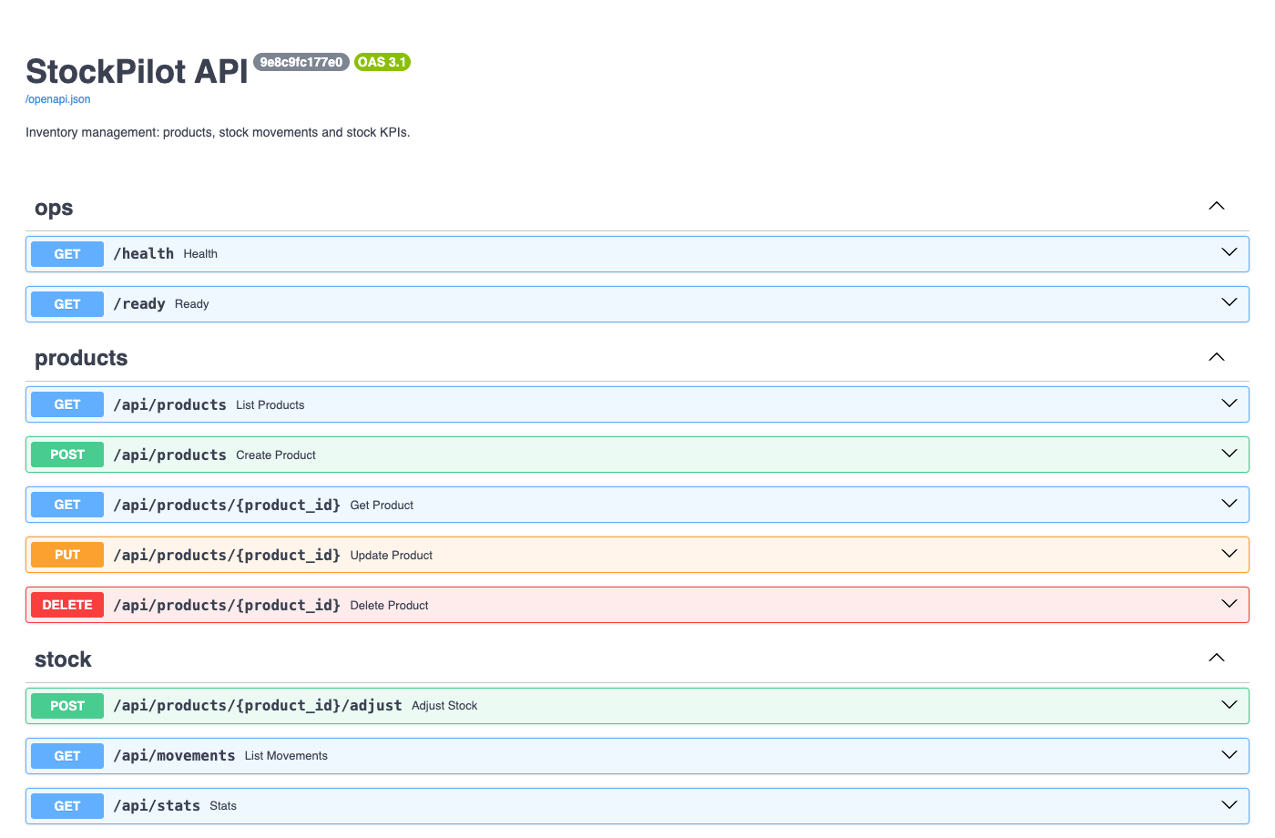
Application: API and data
10
REST endpoints - GET, POST, PUT, DELETE, plus stock adjust
2
Alembic migrations - products and the stock_movements audit trail
1
Postgres advisory lock - replicas run migrations one at a time
Notes:
The backend exposes ten REST endpoints with full create, read, update and delete, plus a stock-adjust endpoint that records every movement. The schema is managed by two Alembic migrations. Every backend pod runs the migrations on start, so a Postgres advisory lock makes concurrent replicas take turns. I tested that with three pods migrating an empty database at the same moment: one migrated, the other two waited and exited cleanly.

Slide 6



Testing: the first quality gate
20
89%
11
pytest tests, all passing
code coverage
routes covered: every endpoint + /metrics
Throwaway test database
Real PostgreSQL in CI
Fail fast
A fresh SQLite DB built by the real Alembic migrations - production is never touched
Migrations go upgrade → downgrade → upgrade on Postgres 18 to prove they reverse
A failing test stops the pipeline before any image is built or pushed
Notes:
Tests are the first gate. Twenty pytest tests cover every endpoint, at 89 percent coverage. They run against a throwaway SQLite database created by the real migrations, so the migration files are tested too and production data is never touched. In CI a second job runs the migrations on a real PostgreSQL 18 container, up, down and up again. If any test fails, the pipeline stops before an image is built.

Slide 7

Docker: two images, one command
docker compose up --build
Backend image
python:3.12-slim, dependencies cached in their own layer. On start: wait for DB → alembic upgrade → uvicorn.
postgres:18
health: pg_isready
Runs as UID 10001
backend
starts when postgres is healthy · health: /ready
Frontend image
Multi-stage: Node 22 builds the React app, then unprivileged nginx serves only the static files.
frontend
starts when the backend is healthy · :3000
Runs as UID 101
3 / 3 services healthy
Notes:
Both parts are containerised. The backend image installs dependencies in their own layer so rebuilds are fast; on start it waits for the database, applies migrations and starts uvicorn. The frontend is a multi-stage build: Node builds the React app and an unprivileged nginx image serves only the static files. Neither runs as root. One command, docker compose up build, starts all three services in the right order using health checks.

Slide 8
CI/CD: nine jobs on every push
4 / 4
pipeline runs green
SHA
every image is tagged with its full commit SHA, never 'latest'
0
rebuilds after scanning: the exact scanned image is pushed
Notes:
Every push to main runs nine jobs. Tests, the Postgres migration check, the frontend build and the secret and code scans run in parallel. Then both images are built and scanned by Trivy, pushed to GitHub Container Registry, and finally deployed with Helm to a throwaway Kubernetes cluster where a smoke test creates a product through the whole stack. All four runs were green. Images are tagged with the commit SHA, and the image that passed the scan is the one pushed, without a rebuild.

Slide 9





DevSecOps: a gate that really blocks
Scan fails
Trivy finds CVE‑2026‑4775 (HIGH) in libtiff inside the nginx base image. A fix exists, so the gate exits 1 and nothing is pushed.
Trivy
Gitleaks
container images
no secrets in Git
Fix
The runtime stage runs apk upgrade, pulling the patched libtiff 4.7.2‑r0.
Bandit
npm audit
Python SAST
frontend dependencies
Pass
0 fixable HIGH or CRITICAL vulnerabilities in either image - the gate passes and the images are pushed.
At runtime: non-root, read-only root filesystem, all Linux capabilities dropped
Notes:
Security scanning is a real gate, not a report. The first frontend build failed it: Trivy found a high-severity vulnerability in libtiff, which comes with the nginx base image, and a fixed package was available, so the job exited with code 1 and nothing was pushed. Adding apk upgrade to the runtime stage pulled the fix, and both images now pass with zero fixable high or critical findings. Gitleaks, Bandit and npm audit cover secrets, Python code and frontend dependencies.

Slide 10
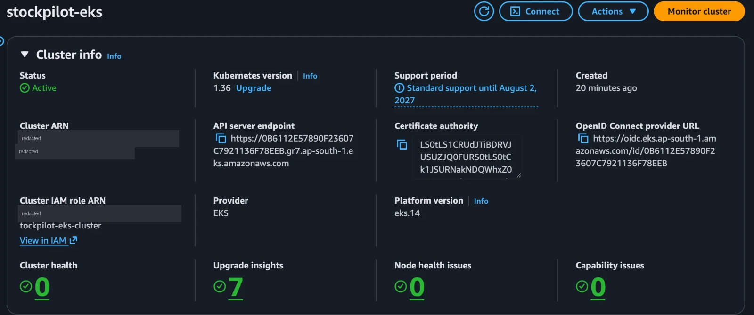
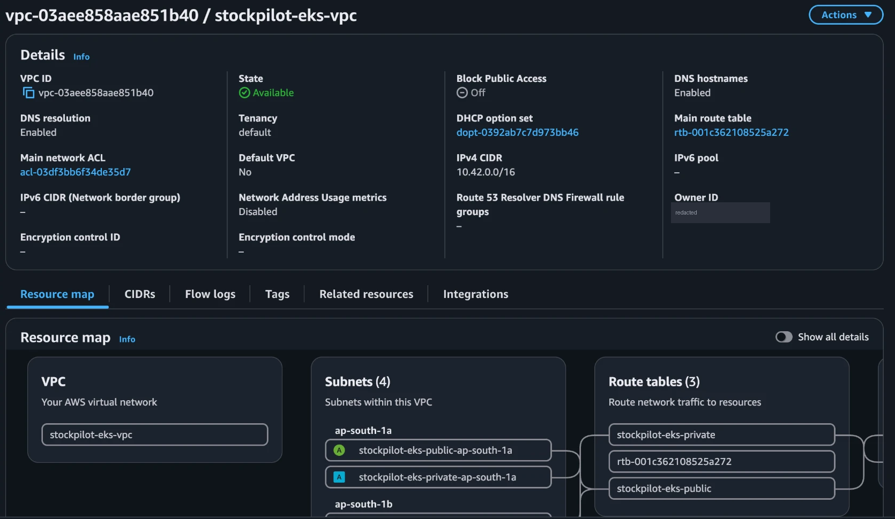
Terraform: AWS VPC + EKS in Mumbai
22
11½ min
0
resources, one plan
terraform apply
left after destroy
VPC 10.42.0.0/16 across 2 availability zones
2 public subnets (load balancers) + 2 private subnets (nodes)
Internet gateway, NAT gateway, route tables
IAM roles for the cluster and the nodes
EKS 1.36 + managed node group: 2 × t3.medium
API endpoint restricted to one IP; no keys in code
AWS Console: the EKS cluster Active on 1.36, and the VPC with its 4 subnets. Account details redacted.
Notes:
Terraform defines the AWS side in the Mumbai region: a VPC across two availability zones with public and private subnets, a NAT gateway, IAM roles, and an EKS cluster with a managed node group of two t3.medium nodes in the private subnets. One plan created twenty-two resources in about eleven and a half minutes. Here is the cluster Active in the AWS console, and the VPC with its four subnets. I then ran terraform destroy and checked through the AWS API that nothing was left running.

Slide 11
Kubernetes + Helm
One Helm chart deploys
frontend Deployment
2 pods · nginx
2 Deployments
3 Services
/
StatefulSet + PVC
Ingress
Ingress
stockpilot.local
Services (ClusterIP)
frontend :80 · backend :8000
HorizontalPodAutoscaler
2 PodDisruptionBudgets
/api
ConfigMap + Secret
ServiceMonitor
backend Deployment
2-6 pods · HPA at 60% CPU
PrometheusRule
Grafana dashboard
helm lint passes with dev, default and prod values
PostgreSQL StatefulSet
1Gi PVC
Notes:
One Helm chart deploys the whole application. The Ingress sends slash to the frontend and slash api to the backend. Both run as Deployments with two replicas and health probes; the backend has a Horizontal Pod Autoscaler. PostgreSQL runs as a StatefulSet with a persistent volume. The chart also ships disruption budgets and the monitoring objects, and it lints cleanly with the dev, default and prod values. Prod points at an external database instead of an in-cluster one.

Slide 12
Autoscaling under real load
580%
of the CPU target when load started
2 → 6
pods, all Ready within 30 s
≈ 75 s
after the load stopped, back to 2 pods
At 6 pods the single node hit 96% CPU: the HPA adds pods, not machines. On EKS a cluster autoscaler adds nodes.
Notes:
Here is the autoscaler under five minutes of real load through the Ingress, sampled every fifteen seconds. CPU jumped to almost six times the target, the HPA scaled the backend from two to six pods, and all six were ready within about thirty seconds. When the load stopped, it scaled back to two about seventy-five seconds later. At six pods my single-node cluster was at 96 percent CPU, which shows the HPA's limit: it adds pods, not machines. On EKS, a cluster autoscaler would add nodes.

Slide 13
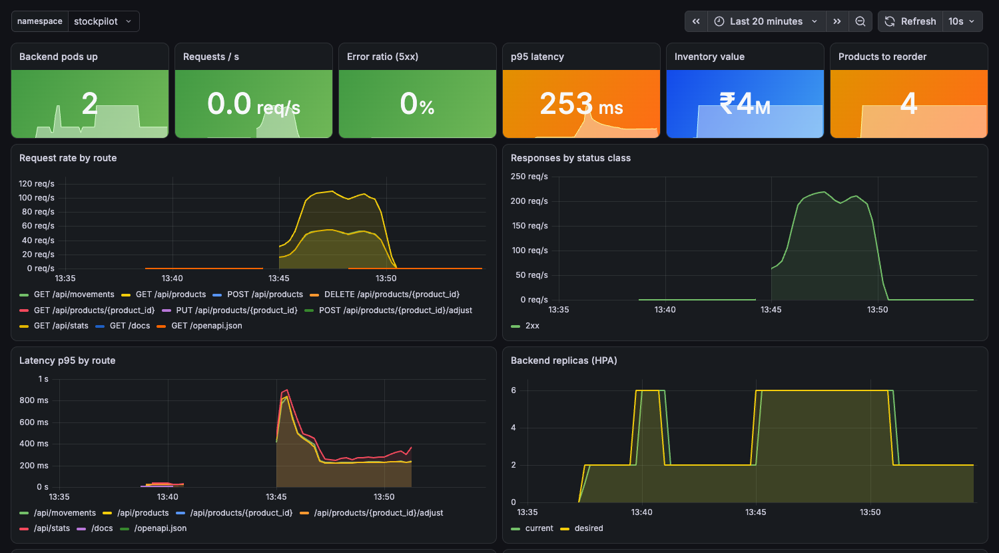
Observability: Prometheus + Grafana
6 / 6 targets UP
a ServiceMonitor scrapes every backend pod's /metrics
5 alert rules
backend down, 5xx ratio, p95 latency, HPA at max, and a business alert for products to reorder
Dashboard as code
ships in the Helm chart; Grafana loads it automatically
StockPilot dashboard after the load test: request rate, status codes, p95 latency, replicas, CPU and stock
Notes:
For monitoring, the backend exposes HTTP metrics and business gauges such as inventory value and products to reorder, read live from the database. A ServiceMonitor tells Prometheus to scrape every backend pod; during the load test all six were up. There are five alert rules, including a business alert for products below their reorder level. The Grafana dashboard ships inside the Helm chart, and this is it after the load test.

Slide 14
Troubleshooting lab
SYMPTOM
INVESTIGATE
ROOT CAUSE
FIX
Pods stuck in ImagePullBackOff
kubectl describe pod: image reference not found
Image tag typo: 1.31‑alpinee
kubectl set image → rollout succeeds
Pods Ready, but requests to the Service fail
EndpointSlice is empty; compare the selector with ‑‑show‑labels
Service selects app=catalog‑wbe, matching no pod
Patch the selector → 2 endpoints, HTTP 200
Notes:
The troubleshooting lab has two deliberately broken deployments. In the first, pods sit in ImagePullBackOff; describing the pod shows the image reference was not found, the root cause is a typo in the tag, and setting the right image fixes the rollout. In the second, every pod is ready but requests to the Service fail; its EndpointSlice is empty, because the selector has a typo and matches no pod. Patching the selector brings back two endpoints and HTTP 200.

Slide 15




What I learned
Deploying finds what tests miss
Migrations could not import the app inside the container - only docker compose caught it
Test the gates too
Trivy really blocked a build on a fixable HIGH CVE until the image was patched
Metrics need care
Default 0.1 s histogram buckets made p95 meaningless; millisecond buckets fixed it
Check limits before apply
A shared account had 5 of 5 Elastic IPs used, so the NAT gateway became optional
Autoscaling has a ceiling
The HPA adds pods, not nodes - at 6 pods the node was at 96% CPU
Notes:
Five things I learned. Deploying finds problems tests miss: my migrations could not import the app inside the container, and only running docker compose showed it. Security gates need testing too: Trivy really blocked a build. Metrics need care: the default histogram buckets made the p95 latency meaningless. Check account limits before terraform apply: one AWS account had no Elastic IPs left, so I made the NAT gateway optional. And autoscaling has a ceiling: the HPA adds pods, not machines.

Slide 16

Thank you
LIVE DEMO
Project repository
github.com/LAKSHYAMEWARA0025/devops‑heros
/tree/main/session21‑capstone
Commit a change → watch the pipeline → new image in GHCR → helm upgrade → refresh the app
README: setup, evidence and the full demo script
Lakshya Mewara
Enrollment 24BCS10290
Notes:
That's StockPilot end to end. For the live demo I'll make a small change, commit and push it, watch the pipeline test, scan and publish a new image tagged with the commit, then roll the cluster to that image with helm upgrade and refresh the app. Everything, including the evidence and the demo steps, is in the README in the repository. Thank you.

