Slide 1


Intro Artificial Intelligence TERM PROJECT PRESENTATION BY NAGASREE RAYALA(00719044) LALITHA PENMETSA(00719012)

Slide 2
TOPIC :
Comparison of Search-based and Reinforcement Learning Agents in Solving the Game of Snake.

Slide 3
Objectives
Design search-based Learning agents and Reinforcement-based Learning agents to solve the game
Design 4 Learning agents (3 – search based and 1- Reinforcement agents)
Play snake game with all these learning agents
Snake game logic depends on
Comparing the difference between search-based Reinforcement Learning agents
2)Snake dies when it hits the wall or if it bites itself.
Comparing the difference between search-based Reinforcement Learning agents
1)Snake grows when it eats food.

Slide 4

Approach
These are the Learning Agents we are choosing: • Search-based Learning agents 1)Breadth First Search 2)Depth First Search 3)A*Search 4)Hamilton Search • Reinforcement-based Learning agents 1)Q-Learning Agents 2)SARSA Agents 3)Advantage Actor-Critic Agents • Technology Stack Python3

Slide 5
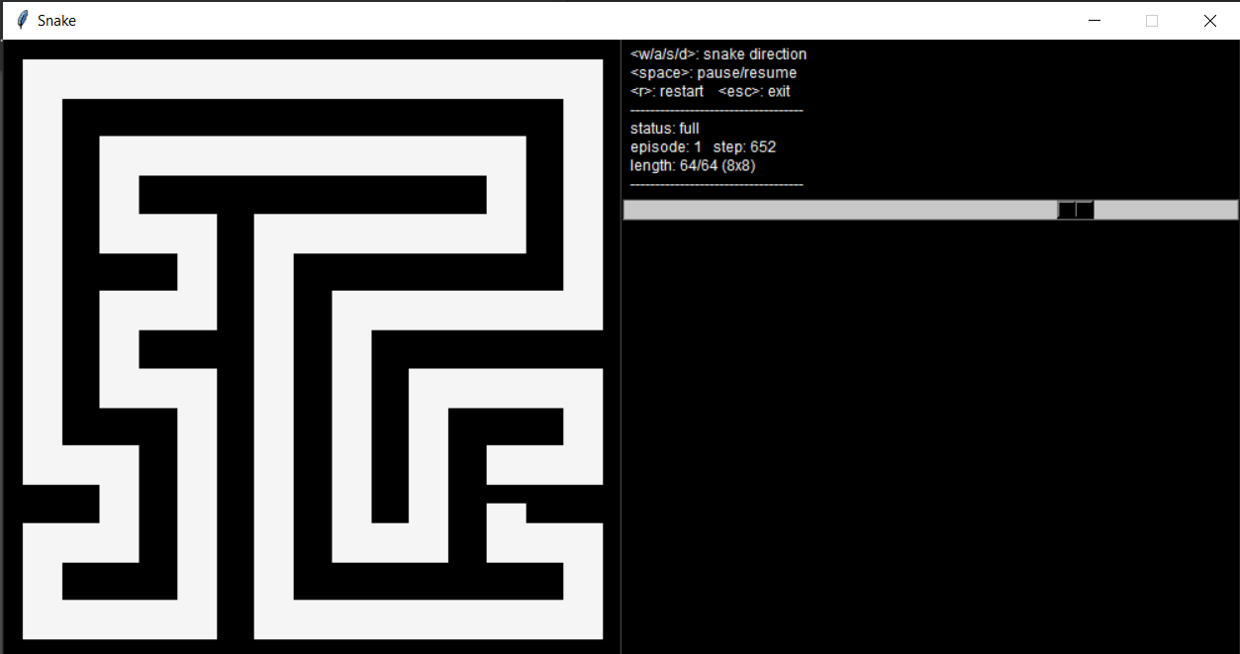
GAME FEATURES

Slide 6
Deliverables
User documentation manual which gives details about the snake game implementation using search-based and reinforcement learning agent.
Algorithms developed for Learning agent using python programming language(.py files)
GitHub repository link for project code and related files.
YouTube video demonstrating project implementation and slides.

Slide 7
BFS
Average length: 56/64
Number of steps: 1000
Time taken : 2 mins

Slide 8
DFS
Average length: 52/64
Number of steps: 1050
Time taken: 2:30 mins

Slide 9
Hamilton
Average length: 63.93/64
Number of steps: 717
Time taken: 1 min

Slide 10
Q- Learning
Average Length: 63/64
Number of steps: 600
Time taken : 50 sec

Slide 11
Performance metrics
As we have seen Q learning has the maximum length of a snake and it took less time than compared to other agents.
BFS | 40 | 60 seconds
DFS | 30 | 60 seconds
Hamilton | 25 | 60 seconds
QLearning | 55 | 60 seconds

Slide 12
Feature scope
Many more Agents like “SARSA AGENTS” and “Advantage actor-critic agents”.
Neural networks can also be effectively used to solve this game.

Slide 13
THANK YOU

