Slide 1
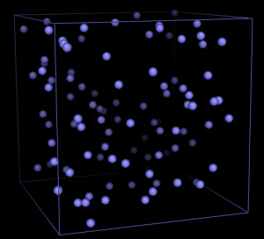
MD Simulation of Argon gas

Slide 2
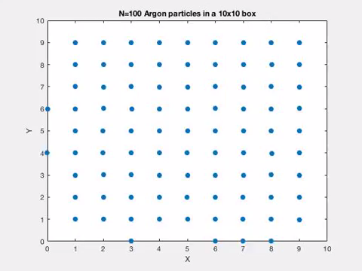

Slide 3
Key steps
Initialize
Solve 3N classical equations simultaneously (Verlet algorithm)
Under equilibrium get results

Slide 4
Initialize
V₀₌={v¹₀,v²₀…..v^{N}₀}
X₀={x¹₀,x²₀…..x^{N}₀}
Y₀={y¹₀,y²₀…..y^{N}₀}

Slide 5
Verlet algorithm (Recap)
X_{n+1}=2x_{n}-x_{n-1}+h²F(x_{n},t_{n})
V_{n}=(X_{n+1}-X_{n-1})/2h
Likewise for Y also………..

Slide 6
Start iteration (Verlet lgorithm)
X₀, V₀
?
X₁₌X₀₊h* V₀+h²F(r_{0,}t₀)/2
?
X_{n+1}=2X_{n}-X_{n-1}+h²F(r_{n},t_{n})
V_{n}=(X_{n+1}-X_{n-1})/2h
Likewise for Y also………..

Slide 7
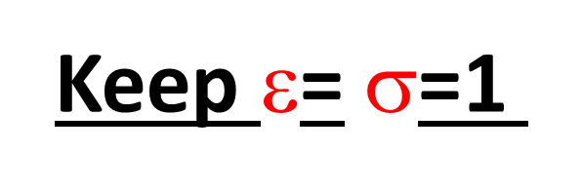
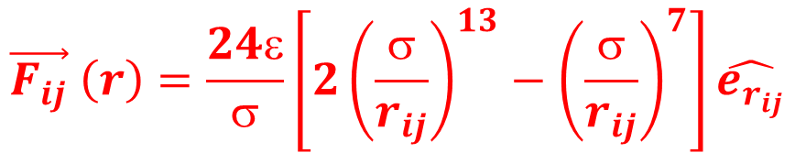
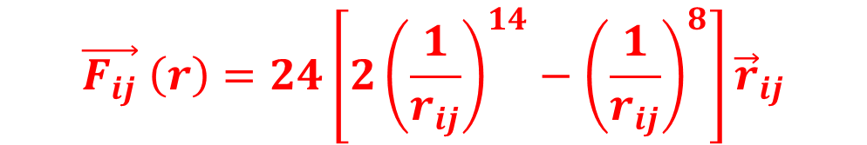
How to get F(r_{n},t_{n})??
r_{ij}
j
i
Force from Lenard Jones Potential
$$\vec{F_{ij}} \left(r\right)=\frac{24ε}{σ}\left[2{\left(\frac{σ}{r_{ij}}\right)}^{13}−{\left(\frac{σ}{r_{ij}}\right)}^{7}\right]\hat{e_{r_{ij}}}$$
Keep $$= $$=1
$$\vec{F_{ij}} \left(r\right)=24\left[2{\left(\frac{1}{r_{ij}}\right)}^{14}−{\left(\frac{1}{r_{ij}}\right)}^{8}\right]{\vec{r}}_{ij}$$

Slide 8
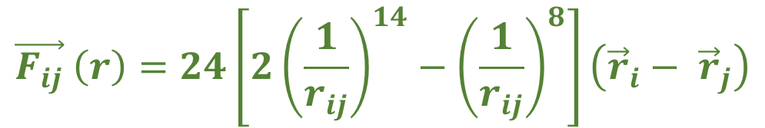



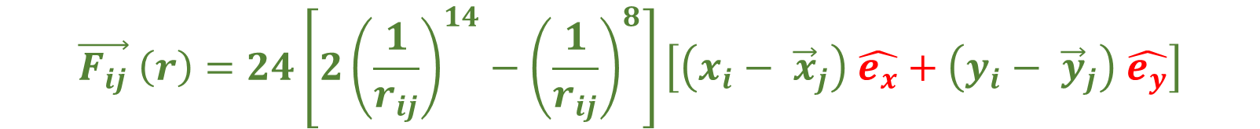
$$\vec{F_{ij}} \left(r\right)=24\left[2{\left(\frac{1}{r_{ij}}\right)}^{14}−{\left(\frac{1}{r_{ij}}\right)}^{8}\right]{\vec{r}}_{ij}$$
$$\vec{F_{ij}} \left(r\right)=24\left[2{\left(\frac{1}{r_{ij}}\right)}^{14}−{\left(\frac{1}{r_{ij}}\right)}^{8}\right]\left({\vec{r}}_{i}− {\vec{r}}_{j}\right)$$
$$\vec{F_{ij}} \left(r\right)=24\left[2{\left(\frac{1}{r_{ij}}\right)}^{14}−{\left(\frac{1}{r_{ij}}\right)}^{8}\right]\left[\left(x_{i}− {\vec{x}}_{j}\right) \hat{e_{x}}+\left(y_{i}− {\vec{y}}_{j}\right) \hat{e_{y}}\right]$$
$${F_{x}}^{ij}=24\left[2{\left(\frac{1}{r_{ij}}\right)}^{14}−{\left(\frac{1}{r_{ij}}\right)}^{8}\right]\left[\left(x_{i}− x_{j}\right)\right]$$
$${F_{y}}^{ij}=24\left[2{\left(\frac{1}{r_{ij}}\right)}^{14}−{\left(\frac{1}{r_{ij}}\right)}^{8}\right]\left[\left(y_{i}− y_{j}\right) \right]$$

Slide 9
X₀={x¹₀,x²₀…..x^{N}₀}
Y₀={y¹₀,y²₀…..y^{N}₀}
V_{x0=}={v_{x}¹₀,v_{x}²₀…..v_{x}^{N}₀}
V_{y0=}={v_{y}¹₀,v_{y}²₀…..v_{y}^{N}₀}
X₁₌X₀+h* V_{x0}+h²F_{x}(r_{0,}t₀)/2
Y₁₌Y₀+h* V_{y0}+h²F_{y}(r_{0,}t₀)/2

Slide 10


X^{i}₁₌X^{i}₀+h* V^{i}_{x0}+h²F^{i}_{x}(r_{0,}t₀)/2
Y^{i}₁₌Y^{i}₀+h* V^{i}_{y0}+h²F^{i}_{y}(r_{0,}t₀)/2
$${F_{x}}^{i}=\sum_{\begin{aligned}j=1 \\ j≠i\end{aligned}}^{N}{24\left[2{\left(\frac{1}{r_{ij}}\right)}^{14}−{\left(\frac{1}{r_{ij}}\right)}^{8}\right]\left[\left(x_{i}− x_{j}\right)\right]}$$
$${F_{y}}^{i}=\sum_{\begin{aligned}j=1 \\ j≠i\end{aligned}}^{N}{24\left[2{\left(\frac{1}{r_{ij}}\right)}^{14}−{\left(\frac{1}{r_{ij}}\right)}^{8}\right]\left[\left(y_{i}− y_{j}\right)\right]}$$

Slide 11
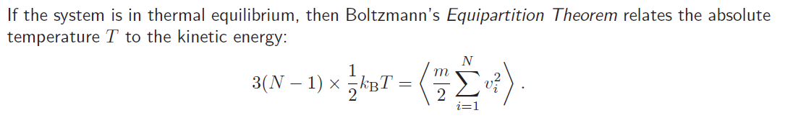
X_{n+1}=2x_{n}-x_{n-1}+h²F(x_{n},t_{n})
V_{n}=(X_{n+1}-X_{n-1})/2h

