Slide 1
Property Investment
Corda App from Corda Code Club
Daniel, Patrick, Lonnie and Deepa

Slide 2

Property Investment
Phase 1and 2 - Design and Tasks

Slide 3

Domain Vocabulary
Property
Property Fund Manager
Two types of Investors
Institutional Investor
Private Investor
Fund
Dividend
Bid For Fund

Slide 4

Phase 1
Fund Manager creates Fund on a set of Properties
Collects Rental Income
Distributes Dividend

Slide 5
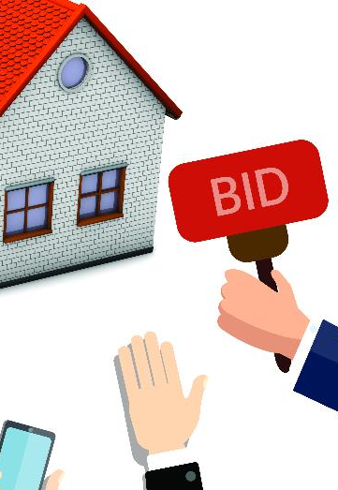
Phase 2
Fund Manager creates Fund on a set of Properties
Fund Manager invites bids from Investors from potential Investors for a particular Sum
Investors Bid for different share values
Fund Manager closes the bids and assigns share
Collects Rental Income
Distributes Dividend to share holders

Slide 6


Phase 1
Create Parties called FundManager, Investors.
Let there be one Fund Manager and 2-3 Investors
Create a Fund State
Create a IssueFund Contract
Create a Flow to Issue a Property Fund with a list of Share holders
Create a Dividend State
Create a IssueDividend Contract
Create a Flow to Issue a Dividend to Shareholders for a Fund
FundState
_{Name}
Properties
Value
ShareHolders
amount > 0
Issue
(issuer)
DividendState
Fund Name
Value
amount > 0
Issue
(issuer)

Slide 7
Phase 2
https://github.com/corda/observer-cordapp

