Slide 1
Analyzing Weather parameters and Their Impact on Human Comfort in Toronto in 2020
ID | Name | Email Address
1211101582 | TEOH KAI LOON | 1211101582@student.mmu.edu.my
1221304973 | WONG KAH CHUN | 1221304973@student.mmu.edu.my
1211101961 | CHAI DI SHENG | 1211101961@student.mmu.edu.my
1221303175 | LAM ZI FOONG | 1221303175@student.mmu.edu.my

Slide 2
Motivation，Problem
Public health & safety: understand risk factors from cold weather (falls) and develop mitigation strategies.
Economy: understand impact on retail, hospitality, and transportation for better business planning.
Urban planning & infrastructure: predict comfort impact to improve building design, public areas, and infrastructure.
Comfort & quality of life: gain insights on weather's influence and improve well-being through informed decisions (clothing, location, activities).

Slide 3




Impact on the proposed problem to society and communities
Farming and crops is guaranteed, and the efforts of farmers are no int vain
Bad weather lead to transportation cannot be travel
Agriculture aspect
Transportation Issue
Converting nature’s energy into resources
Daily activity of people such as student and office will be affected
Energy Source
Daily Inconvenience

Slide 4




Question
Question 1: How do temperature and relative humidity vary on a monthly basis throughout 2020?
Question 2: How does wind speed vary on a monthly basis throughout 2020
Question 3: Is there a discernible relationship between humidity levels and visibility in Toronto City Centre during 2020?
Question 4: What is the relationship between temperature and dew point in 2020

Slide 5
Data Collection
Toronto City Centre Hourly Weather Data 2020 by Jason Ho from Kaggle community.
Data include:
station location information (longitude, latitude and station name)
date and time information (year, month, day, time)
weather elements (temperature, dew point temperature, relative humidity, wind direction, wind speed, visibility, station pressure)
derived weather indexes ( humidex and wind chill)
For each weather element, there is also a flag to indicate unique events.

Slide 6

Data Preprocessing
Data Cleaning
Drop columns with high missing values
Impute missing values in numeric columns (Wind Direction,Temperature, Dew Point Temperature, Relative Humidity, Wind Speed, Visibility, Station Atmospheric Pressure) using monthly mean
Remove irrelevant features
Data Transformation
Encode categorical data (time strings) using label encoding
Data Splitting
Divide data into training and testing sets for model building and evaluation

Slide 7
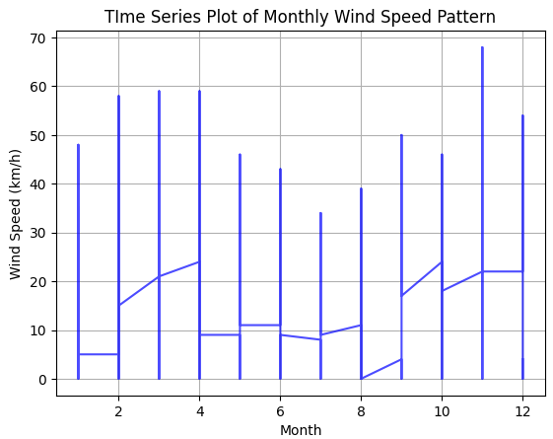
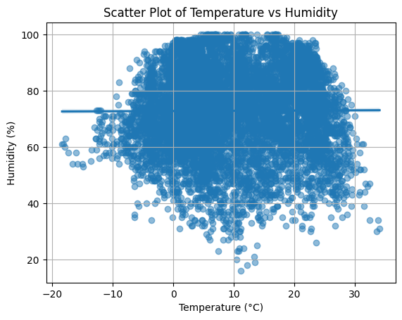
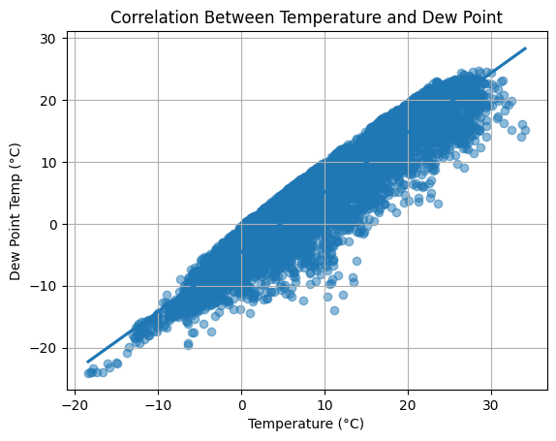
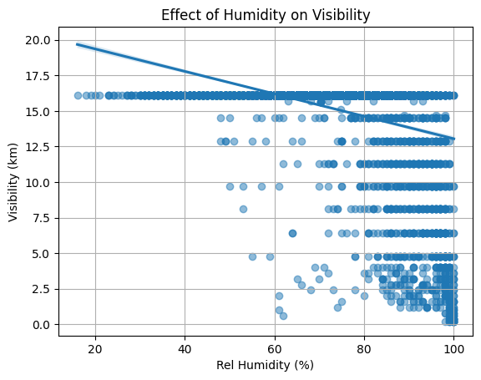
Data Exploration

Slide 8
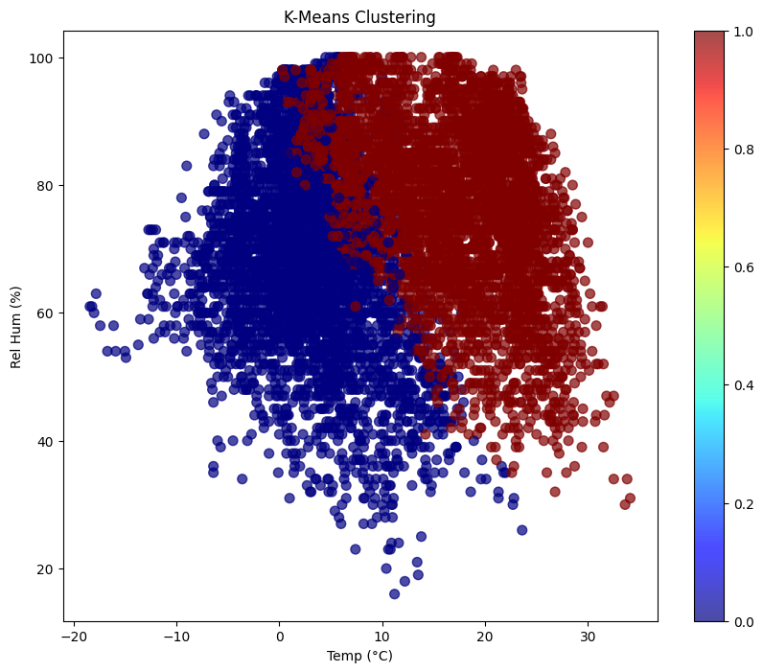
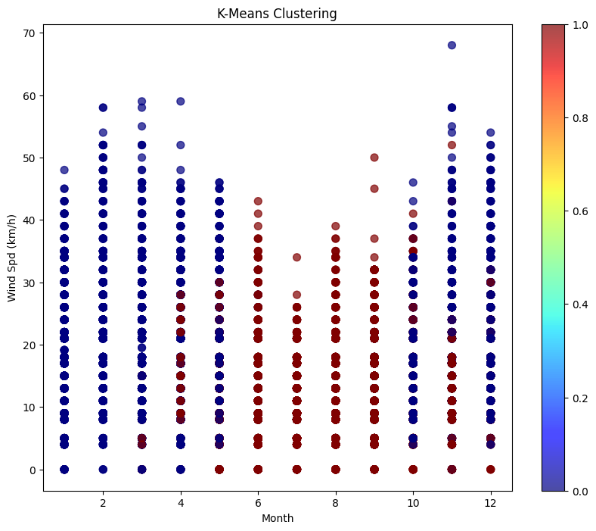
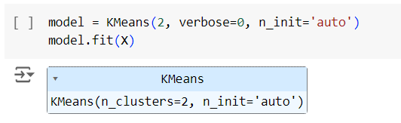
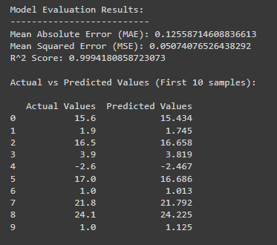
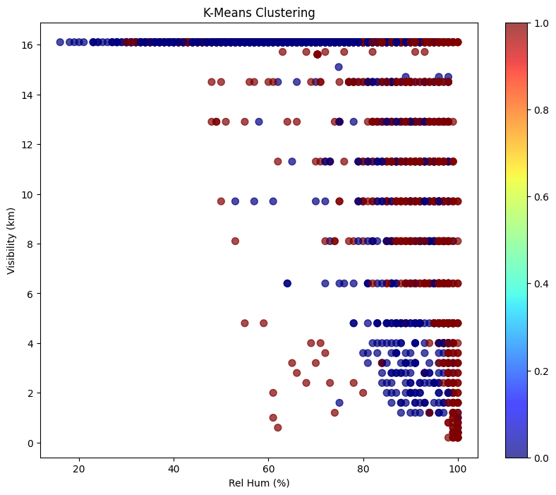
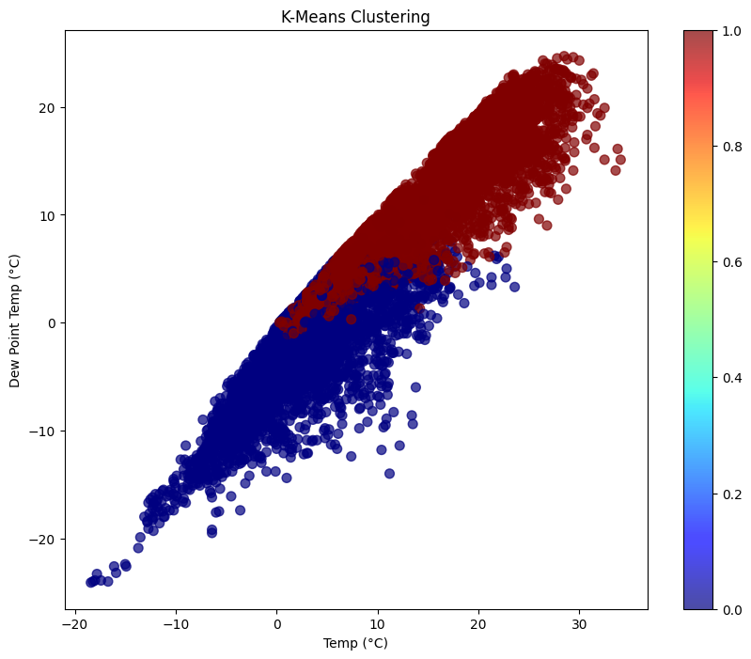
Data Mining

Slide 9



Challenge and Limitation encounter
Massive Data Sources
Choose the appropriate data source in order to ensure the data validity
Integrity of Data Source
The collected data source have a missing value and data issue, which may affect the result of output
External Factor
Environment and climate changing constantly may affect the accuracy of analytical result

