Slide 1
CHAPTER 1
OS definition, functionalities
Classification of computer systems and operating systems:
multiprogramming,
batch systems, time-sharing/interactive systems,
(hard, soft) real time systems,
distributed systems, parallel systems
Parallel vs. Concurrent, degree of multiple programming
当前主流OS？！

Slide 2
CHAPTER 1
interrupt vs. trap (陷阱、内部中断)
Storage structure and hierarchy
caching, Fig.1.4
Dual mode operation and (略：privileged instructions) (1.5)
System call, API

Slide 3
CHAPTER 2
Services provided by OS (2.1)，见下图
Interfaces between OS and Users (2.2)
System calls as API (概念、原理, 2.3)
（略——Types of system calls ，2.4了解)
(2.7) System structure:
simple, layered, microkernel, module,
各自结构特点、每类结构的代表性OS
（略——2.8 the concepts of virtual machine）
(2.9) system booting, bootstrap (概念、过程)

Slide 4
Services: what functions does the OS provide for OS users, or supporting programs executing , viewpoints of OS users components: how to provide these services, viewpoints of OS designers/developers
accounting
protection and
security
User
interfaces
file system
manipulation
services
program
Execution
(dynamic)
resource
allocation
I/O
operations
error
detection
communication
(§2.1)
OS components/functions
Command-interpreter system
networking
file
management
process
management
main memory
management
I/O system
management
Secondary
storage
management
hardware
device controllers
I/O devices
memory controllers
secondary memory
(disk, tape)
CPU
main
memory
(§1.2)
Fig. 2.0.1

Slide 5
Fig. 2.0.2
Persons
Application programs
Users
Other system software,
i.e. DBMS, MS Office2000
Compilers, Assemblers
Loader, linkage, debuger
Text
editors
communication
System software
Command Statements:
process, I/O, memory, file,
protection, networking
(GUI, MMI)
System
libraries
System
Programs(§2.5)
Operating system
Command-interpreter
system( or Shell, §2.2.1 )
system calls (or API, §2.3/2.4 )
OS kernels (parts of OS components
, §2.7)
drivers (chapter13)
Hardware
device controllers
I/O devices
memory controllers
secondary memory
(disk, tape)
CPU
main
memory

Slide 6
！summary
OS | features
DOS | simple/ill-structure
Unix | kernel
Mach | micro-kernel
OS2 | layered
Solaris/Linux | module
Windows NT/XP， Mac OS X | (micro-)kernel + layered

Slide 7
例题
3. When we power up or reset a PC computer, the booting procedure starts, and the CPU will sequentially executes the following codes, including
I. boot block on disk II. bootstrap in BIOS
III. OS kernel
IV. application programs V. system programs
The correct order of code execution is D :
A. I, II, III, IV, V B. II, I, III, IV, V
C. I, II, III, V, VI D. II, I, III, V, VI

Slide 8
CHAPTER 3
(3.1) Process concept
process vs. program
Process states and state transitions!
— 哪些状态转换不可能发生？ e.g. waiting → running
CPU switch, PCB, components of processes
(3.2) Process Scheduling: scheduling queues,
long-term, medium-term, short-term, 各自作用;
Context of the process and context switch
（略：Process creation and termination )

Slide 9
外存交换区
作业提交
就绪
等待
I/O管
理系统
交换调度
主存
完成
状态
提交
状态
后备
状态
就绪
等待
进程或线程
disk 输入井
运行
作业结果
输出
作业运行态
进程/线程调度
作业调度

Slide 10
CHAPTER 3
independent process vs cooperating process
I/O bound process vs CPU bound process
Inter-process Communication :
message-passing system
memory-sharing/shared
（略：pipe, signal，socket）

Slide 11
CHAPTER 4
definition of thread, benefits of thread,
process vs thread
资源分配单位 vs CPU调度单位
TCB，线程执行轨迹
user-level threads (ULT) and kernel-level threads (KLT)
— KLT:
在支持线程的操作系统中，由OS直接管理、调度和分配CPU的对象，来自于OS、系统软件、应用软件程序模块
— ULT：用户编程空间中的编程、管理、调度对象
multithreading models：
one-to-one, many-to-many, many-to-one
实现ULT→KLT，通过编译

Slide 12
用户空间
进程1
进程2
进程3
进程4
进程5
u
u
u
u
u
u
u
u
u
u
u
u
线程库
线程 库
线程库
线程库
线程 库
L
L
L
L
L
L
L
L
L
内核空间
k
k
k
k
k
k
k
k
k
线程调度程序
CPU
CPU
CPU
CPU
CPU
硬
件
例。 Window XP + Java/C++/C#

Slide 13
CHAPTER 5
Concepts on CPU scheduling§5.1:
CPU-I/O bursts, scheduling(select-allocate-enable), scheduler vs dispatcher,
when CPU scheduling occurs——5.1.4节，4种情况!
Scheduling Criteria (§5.2)
计算CPU利用率
Several scheduling algorithms (§5.3，做题)
FIFO, SJFS, priority(抢占/非抢占), RR, HRRF
【preemptive SJFS 最短剩余时间优先】
preemptive: SJFS, priority, RR, HRRF
nonpreemptive: FIFO

Slide 14
CHAPTER 6
synchronization vs mutual exclusion
synchronization in producer-consumer problem (Bounded-Buffer)
(6.2) Critical-Section Problem :
three requirements for solutions to critical-section problem（P194),
general structure of the process (Fig.6.1)
Synchronizing mechanisms on four levels:
OS信号量,
(略:hardware, monitor, application software)

Slide 15
CHAPTER 6
Semaphores: definitions, wait/signal operators,
physical implications for semaphores,
maximum/minimum values
Semaphore implementation：busy-waiting, non-busy-waiting
Concepts of deadlock and starvation
信号量四种应用场合
1. 进程间同步, 二元sync
2. 进程间互斥, 二元mutex
3. 资源信号量, 多元, empty/full
4. 对信号量所代表的资源进行复杂的逻辑判断，
引入用户空间变量对信号量的备份/镜像，e.g. readcount + mutex
睡眠理发师

Slide 16
操作系统概念（英文）——6 - 例题与作业
注意事项
1）应用问题抽象归结为经典问题，特别是生产者-消费者、读写者问题
2）对信号量的操作只能通过系统调用wait/signal，不允许应用程序在用户空间内对信号量直接操作

Slide 17
注意：
不允许用户应用程序直接对信号量操作！
信号量是OS提供的一种内核空间进程同步互斥机制
在用户态下运行的用户应用程序只能通过wait()、signal()等系统调用，间接地操纵修改信号量
不允许用户应用程序直接在用户态下修改信号亮
反例。 Semaphore S
…
S := S – 1
if S > 0 then …
else …

Slide 18
CHAPTER 7
Resource-allocation and Deadlock:
concept of deadlocks, 饿死starvation
resource-allocation model (§7.1); resource-allocation graph
Necessary conditions for deadlock (§7.2);
Three methods for deadlock handling(§7.3, 原理)
prevention, avoidance, detect-and-recovery
Deadlock prevention (§7.4):
no preemption based, circular wait based (有序资源使用法)
主要破坏的条件： hold-and-wait, circular wait

Slide 19
7.2.1 Necessary Conditions (cont.)
Principles of deadlock handling
  if deadlock occurs
then { (mutual exclusion)
and (hold and wait )
and (no preemption)
and (circular wait )
}
  /* 等价逆否命题：
if { not (mutual exclusion)
or not (hold and wait )
or not (no preemption)
or not (circular wait ) }
then deadlock will not occur

Slide 20

CHAPTER 7
Deadlock avoidance (§7.5)
resource-allocation state,
safe state vs nondeadlock state,
safe sequence;

Slide 21
注意点
关于安全状态、安全序列是针对死锁避免、不是针对死锁检测的
死锁检测中无安全状态、安全序列的概念，只有死锁、非死锁状态

Slide 22
第7章 计算题类型
操作系统概念（英文）——7 - 例题与作业
根据资源、进程间的请求关系，画出Resource-Allocation Graph
e.g. 实际问题（道路、汽车）→ 资源模型
Deadlock Avoidance
  当每类资源只有一个资源实例，利用Resource-Allocation Graph Algorithm判断有无死锁/系统是否安全
  当资源可有多个资源实例时，利用Banker Algorithm判断系统是否安全?(无死锁?)
Deadlock Detecting
  当每类资源只有一个资源实例，利用waiting graph判断有无死锁?
  当资源可有多个资源实例时，利用deadlock detecting algorithm 判断有无死锁、哪些进程处于死锁?

Slide 23
例题
某系统有n台互斥使用的同类设备，3个并发进程分别需要使用2、3、4台设备，可确保系统发生死锁的设备数目n最大为多少？
答案：
n = 所有进程的设备总需求数L - 进程总数m*1
= (2+3+4) - 3*1
= 6

Slide 24
n=9，3个进程的设备需求完全满足，进程无等待

Slide 25
n=9-1=6，每个进程占有的设备数缺少1个，形成循环等待

Slide 26
CHAPTER 8
Logical vs Physical Address Space
Address binding (address mapping among three address spaces, 地址变换与重定位)；
compile-assembly-linkage-load-executing过程(Fig.8.3)；
binding时机：编译时、加载时、执行时；
静态 vs 动态bingding
MMU: base register, limit register
address translation and protection
swapping (概念)
逻辑地址：
address generated by CPU,
CPU译码时从指令中取出的地址，
e.g. LOAD A, X

Slide 27
Fig.8.0.0 Address mapping among three address spaces
0
70000
Logical/Relocatable address in object module
,
e.g., 14 bytes from the beginning of this module
Absolute
address in executing codes ,
e.g., 70014# byte in main memory
Symbolic
address in
source programs,
e.g.,
Integer count
compiler
, assembly
linkage
, loader
Symbolic
Address space
符号地址空间
Logical / Relocatable/
Virtual Address space
逻辑地址空间/
虚拟/相对/可重定位地址空间
Absolute/Physical Address space
绝对地址空间/
物理地址空间

Slide 28
CHAPTER 8 实存管理
(8.3) Contiguous memory Allocation:
principle, allocation method (fixed-sized partitions, 可变分区法),
memory protection;

Slide 29
CHAPTER 8
(8.4) Paging :
basic method, page, frame(页框);
address mapping and page tables;
frame table;
internal/external fragmentation;
memory protection (read-write or read-only, valid-invalid bit );

Slide 30
CHAPTER 8
Page table structures:
multi-level/hierarchical, (略：inverted, hash)
多级页表目标：
不是为了提高页表访问速度和基于页表的地址变换，而是解决过长页表对连续存储空间的需求！！！
page sharing (了解)；

Slide 31
CHAPTER 8
做题：
(1) 逻辑-物理地址空间变换
（2）EAT, hit rate, TLB，见Appendix D
（3）逻辑地址空间、物理地址空间、页表结构和组成
— 见下页

Slide 32
Logical Address Space
page number
page/frame offset
18
10
9
0
v
15 high bits of physical address
frame#
concatenate
512
=2⁹
entries
….
Page
Table
15
14
0
15 high bits
10 low bits
Physical Address Space

Slide 33

Fig.8.11 Paging hardware with TLB

Slide 34
CHAPTER 8
Segmentation
principle and basic method,
logical address space (二维)，segments, 见下图;
segmentation table/segmentation structure, address mapping;
memory allocation for segmentation;
fragmentation

Slide 35
进程逻辑地址空间由编程者根据程序的结构 (子程序/模块/数据区等) 划分为多个段segment，逻辑地址由段号 + 段内地址构成：(s , w)
0
0
0
CALL [X] | <Y>
.
LOAD 1, [A] | 6
.
STORE 2, [B]|<C>
.
.
6：1A4E
Y：1020
C：35CD
600
200
500
segment X
(subroutine)
segment A
(array)
segment B
(working area)
segment n
( main program)
  Fig. 8.17.1 A process with 4 segments in the logical space

Slide 36
逻辑段号
长度 段地址
操作系统
0
.
操作系统
0
M
.
1000
K
0
K 3200
.
X
0
1
P 1500
1
X
.
2
L 6000
3200
P
3
.
M
N 8000
0
2
Y
4
S 5000
L
5000
B
段表
0
3
A
6000
N
Y
0
8000
4
B
A
S
进程逻辑地址空间
  Fig. 8.17.2
主存

Slide 37

Fig.8.19 Address mapping and protecting via segmentation hardware
protecting
binding

Slide 38
CHAPTER 8
操作系统概念（英文）——8 -例题与作业
Paging with segmentation!!
习题：地址变换
给定段表、页表，或段、页的结构，
逻辑地址—— > 物理地址
segment
number
offset in segment
page
number
offset
in page

Slide 39
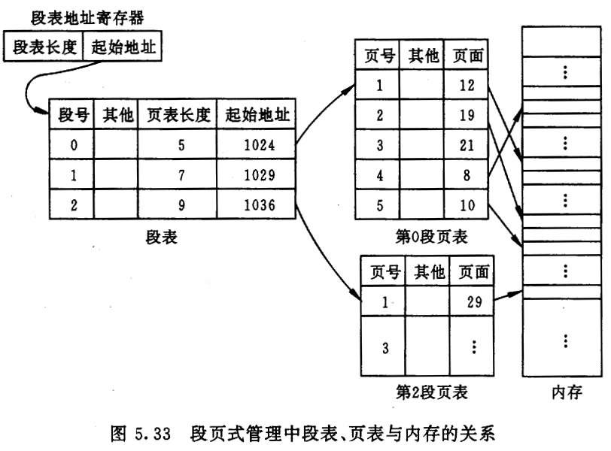
Operating System Concepts - Chapter9 Virtual Memory -

Slide 40
CHAPTER 9
VM concepts,
Implementation of virtual memory：
demand paging, demand segmentation
(9.2) Demand paging
principle, valid–invalid bits in page table;
Process executing and page fault handling (Fig.9.6);
Hardware support ( page table, swap space),

Slide 41
ADD X, Y
(indirect addressing)
ADD
X
pages
in memory
Y
logical
address
space
X
pages
not in
memory
Y

Slide 42

Fig. 9.6 Steps in handling a page fault

Slide 43
CHAPTER 9
操作系统概念（英文）——9 -例题与作业
习题：
  (1) EAT 计算 memory access time plus page fault handling time, ppt例题(Appendix H Exercise Three (cont.) )
  根据页表中的有效无效位，判断访问虚拟地址是否会导致缺页中断
  综合题！?：
给定TLB命中率、缺页中断概率，计算：
“基于TLB的地址变换 + 缺页中断处理”时的EAT
Memory mapped file, COW (概念，了解)

Slide 44
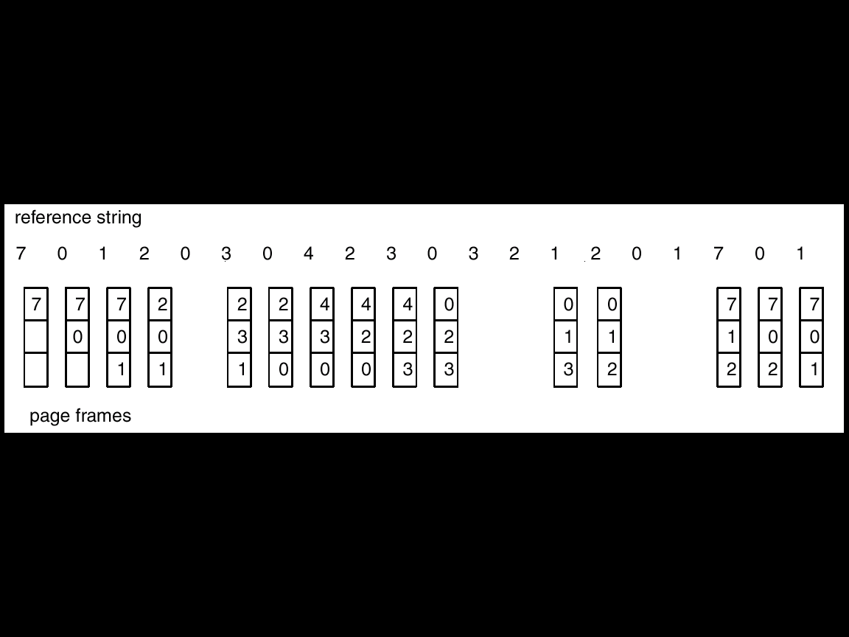
CHAPTER 9
(9.4) Page replacement:
page replacement procedure;
several algorithms:
FIFO, OPR, LRU;
global replacement, local replacement
做题！
将逻辑地址访问串转换为page reference string:
书上例子、作业
Operating System Concepts-

Slide 45

例题1
地址变换：
页表/TLB访问 + 缺页 + 页置换

Slide 46
例题2
In a demand-paging system, there are m frames available for each process in the system, and all frames are initially empty. For a given page-reference string, its length is p, and there are n (n>m) different pages in it.
e.g. m=2;
p=8, n=5, string=1,1,1, 2,2, 3,4, 5；
If OS takes FIFO page replacement algorithm to handle page faults, what is the minimal number of page faults? And why?
What is the maximum number of page faults? And why?

Slide 47
Answers
对于FIFO，缺页中断发生次数的上限是p，下限是n
FIFO淘汰掉最先进来的页，而不管其页面以后是否会用到。由于初始时内存中所有frame为空，因此在引用串中，不同的页至少引起一次缺页中断，故缺页中断发生次数的下限为n。
e.g. m=2，p=8, n=5, string=1,1,1, 2,2, 3,4, 5；
极端情况下，可能引用串中刚被淘汰掉的页又接着要使用, 故缺页中断发生次数的上限为p。
e.g. m=2，p=9, n=5, string=1,2,3,1, 4, 2, 5, 3, 4；

Slide 48
CHAPTER 9
(9.5) Allocation of frames
！minimum number of frames for process executing——做题;
principles of global vs. local allocation
e.g. MVC X, Y
X, Y均为直接寻址
跨页，最少需要6个frames，才能保证指令正常执行

Slide 49
store_d
operation code
00
CC
FF
page i
page i
operand
0xFFCC00
page j
page j
11
(a) direct addressing
(b) store_d reg_A to 0xFFCC00
  Fig. 9.0.1

Slide 50
store_i
00
CC
34
FF
reg_A: 11
operation code
page i
page i
operand
00
DD
12
EE
0xFF34CC00
page j
page j
11
0xEE12DD00
page k
page k
(b) store_i reg_A to 0xFFCC00
(a) indirect addressing
  Fig. 9.0.2

Slide 51
CHAPTER 9
9.6 Thrashing: definition, cause;
（略: locality assumption；
working-set model and strategy)

Slide 52
CHAPTER 10
(10.1) Concepts: file, file system,
why file system needed
File system structure (Fig.11.1), logical file system, basic file system, organization module；→ I/O control
File logical structures
stream-based structure (byte-oriented, logical-block-oriented);
record-based structure;
index-based file，索引顺序文件
（例题：文件逻辑记录与逻辑字节， e.g. 10th byte in the file）
(Logical) Access Methods
sequential, direct/random, indexed
习题： 不同文件组织方式下需要读取的文件块数目

Slide 53

Fig.11.1 Layered File System
(§10)
read record_{m}
file system
mapping
retrieve block n
mapping
I/O instruction operating on device controllers

Slide 54
Why file system needed?
access through
data base system
(DBS)
direct access
through
disk controller
access through
file system
(III)
(II)
access programs
(III)
(I)
access programs
(II)
DBS API
access programs
(I) (e.g. drivers)
DBMS: relational tables’ logical
structures and access methods
system calls related
to file management
file system:
file’s logical structures and access methods
I/O system : drivers
memory controllers (i.e. disk controller),
on the basis of secondary storage’s physical structures,
such as storage structures, access method
secondary storage (e.g. disk, tape)
and data on it (address: cylinder, track, sector)

Slide 55
CHAPTER 10
file system = file + directory
Directory Structure (了解);
FCB/inode：
文件名+ 地址（直接索引，1级/2级/3级间接索引）,
directory, directory entry;
operations on directory
directory structure

Slide 56
CHAPTER 11
(11.1) File system structure
Fig.11.1, 各层的功能!
11.2 Data structure for file-system implementation:
on-disk structure,
in-memory structure(e.g. process-level/system-wide open file table)
CB, partition/volume/logical disk, mounting;
VFS
(11.3) Directory implementation
linear list, hash table

Slide 57
CHAPTER 11
(11.4) Storage allocation for files(文件物理结构)
contiguous (extent-based), linked, indexed
习题
1）参见讲义例题、作业
计算文件最大size、平均访问块数目
2）计算bit map大小
Free space management
bit vector/map , linked list, grouping, counting

Slide 58

已知：block大小
直接、一级、二级、三级索引块的个数
每个物理地址所占字节数（索引项大小）
计算：文件最大size
习题扩展：文件平均访问时间
1）计算各类文件数据块所占比例
2）计算每类文件数据块的访问时间
3）将各类时间按比例计算加权和
根据数据/索引块大小、地址指针占用的byte数目，计算1个索引块指向的数据块或下一级索引块的数目

Slide 59
CHAPTER 12
(12.1, 12.2) Mass-storage structure
structure, principle, addressing of the disk, Fig.12.1;
道时间+旋转延迟
(12.4) Disk scheduling (原理，特点, 算法)
FCFS, SSTF, SCAN, C-SCAN, Look
计算题：
磁盘调度算法，例题/习题

Slide 60

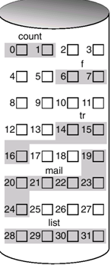
Fig. Moving-head disk mechanism
s_{k}
: sector_{k}
block/record-based file:
0
1
2
3
4
5
6
7
8
parallel access to the record n, n+1, n+2 by the three r/w heads
track 0
block array
s₀
s₁
s₂
platter
s_{n+1}
0
s_{n}
s_{n-1}
seeking
1
rotation
磁柱
2
<cylinder, track, sector>

Slide 61
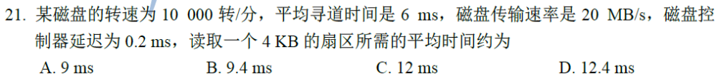
习题
磁盘读操作步骤及各步骤时间
step1. 磁头径向寻道，6ms
step2. 盘片旋转，将目标扇区移动到磁头下——扇区查询/定位：
盘片旋转一圈耗时60*1000/10000=6ms，
平均扇区查询时间3ms
step3. 磁头将4kB扇区数据从盘片读到I/O data-in寄存器时间，
4KB÷磁盘（内部）传输速率20MB/s=0.2ms
step4. 磁盘控制器延时（driver读写I/O端口），0.2ms
读取4KB扇区的平均时间：6+3+0.2+0.2 = 9.4ms

Slide 62
CHAPTER 13
Concepts
device, device controller（通过bus与CPU连接）,
I/O system(software + hardware),
I/O subsystem(software),
kernel I/O subsystem(software in kernel);
drivers;
I/O system structure, Fig.13.6
(13.2) I/O Hardware (略)
I/O ports, registers in device controller;
direct I/O instructions vs memory-mapped I/O;
  I/O modes (了解) ：polling, interrupt, DMA

Slide 63
CHAPTER 13
Application I/O Interface
two types of interfaces: system calls, drivers;
characteristics of devices: Fig.13.7;
block and character-stream devices;
clocks and timers: programmable interval timer;
(略)：blocking and nonblocking I/O, asynchronous I/O system call;

Slide 64
CHAPTER 13
(13.4) Kernel I/O Subsystem:
functions of I/O subsystem: P517;
scheduling, buffering, caching: cache, cache vs. buffer;
I/O protection and error handling
Spooling
principle, spool
(13.5) Transforming I/O requests to hardware
two types of methods for device naming, device file;
I/O procedure for a blocking read request (Fig.13.13).
习题：ppt例题，计算I/O访问引发的I/O操作比例

