Slide 1
PPT Demo

Slide 2
Analysis
Here we find the maximum theophylline concentration for each subject.
Subject | cmax
1 | 10.50
2 | 8.33
3 | 8.20
4 | 8.60
5 | 11.40
6 | 6.44
7 | 7.09
8 | 7.56
9 | 9.03
10 | 10.21
11 | 8.00
12 | 9.75

Slide 3
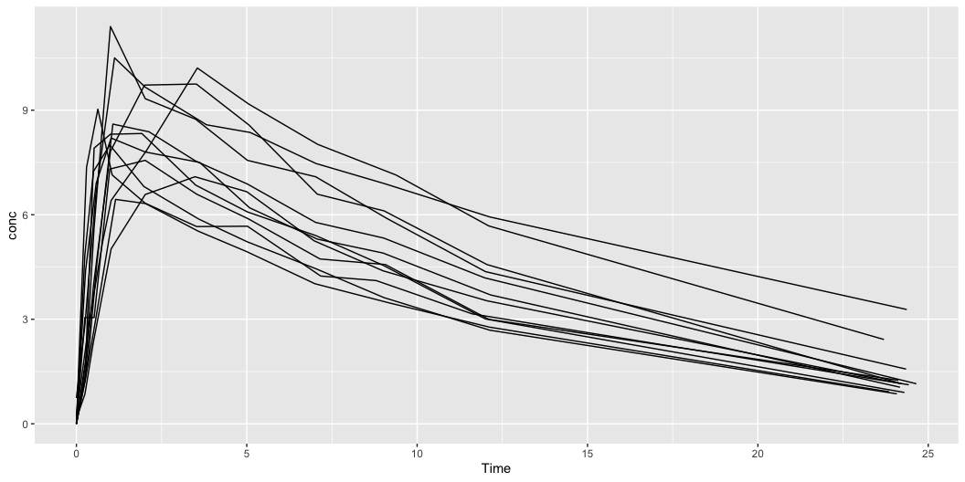
Plots
Plot

