Slide 1
LakeSP filtering
06/18/2025, SLeW
Jida Wang, Mélanie Trudel, Sylvain Biancamaria
Goal: To come up with a globally-applicable filtering strategy that balances
Error removal, and
A good representation of the lake level hydrograph, e.g., in terms of variability, amplitude, and phenological pattern

Slide 2
LakeSP Filters
Lake WSE validation
Based on various combinations of quality flags/indicators
Flag name | Flag definition
quality_f | Summary quality indicator for the lake measurement 0 = normal 1 = bad (PIC0, PGC0); 1 = suspect; 2 = degraded; 3 = bad (PIC2, PID0)
xovr_qual_q | Quality of the cross-over calibration: 0=good; 1=suspect; 2=bad
ice_f | Ice cover flag, from in situ data, or climatological flag given in LakeSP products [Yang et al. 2020] 0=no ice cover 1=partial ice cover 2=full ice cover
partial_f | Flag that indicates only partial lake coverage: 0=covered; 1=partially covered
dark_frac | Fraction of lake area_total covered by dark water
Claire Pottier, Roger Fjørtoft, on behalf of the HR Cal/Val Team, 2024 SWOT ST meeting

Slide 3
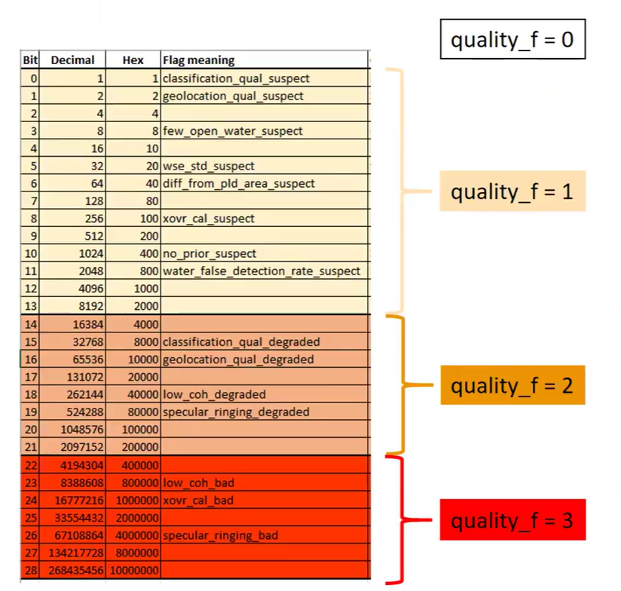
Updated quality_f in PIC2/PID0

Slide 4
lake WSE errors
Lake WSE validation
Impact of filtering of quality flags/indicators on WSE error
Flag | Value | 1σ|error| for lakes < 1km² | 1σ|error| for lakes > 1km²
quality_f | 0 | 17cm | 20cm
+ ice_f | 0&1 0 | 14cm 14cm | 14cm 11cm
+ xovr_qual_q | 0&1 0 | 14cm 14cm | 10cm 10cm
Baseline + partial_f | 0 | 14cm | 9cm
Baseline + dark_frac | < 50% | 13cm | 10cm
Baseline
Not significant: too few
matchups with dark water > 50%
(less than 100)
Claire Pottier, Roger Fjørtoft, on behalf of the HR Cal/Val Team, 2024 SWOT ST meeting

Slide 5
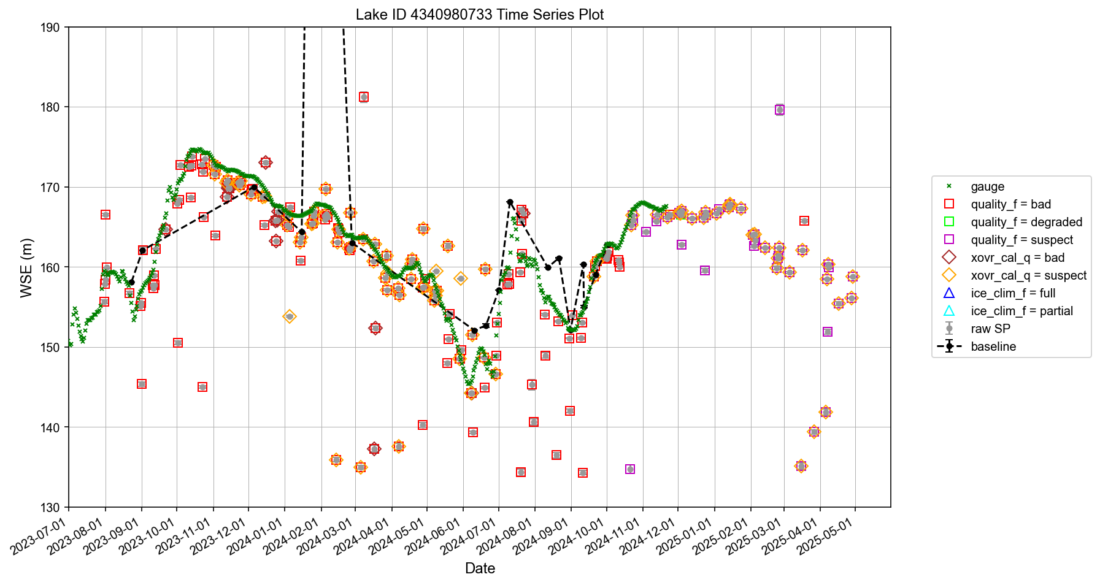
Three Gorges Reservoir
Retention rate 6.7%
Flood control
Peak hydropower
Peak hydropower
Impoundment
Impoundment
Water supply
Flood control
Water supply
Notes:
df_cleaned = df_cleaned.query('xovr_cal_q < 1 & ice_clim_f < 1')
df_cleaned = df_cleaned.query('(quality_f < 1 & (crid != "PIC2" & crid != "PID0")) or (quality_f < 1 & (crid == "PIC2" or crid == "PID0"))')

Slide 6
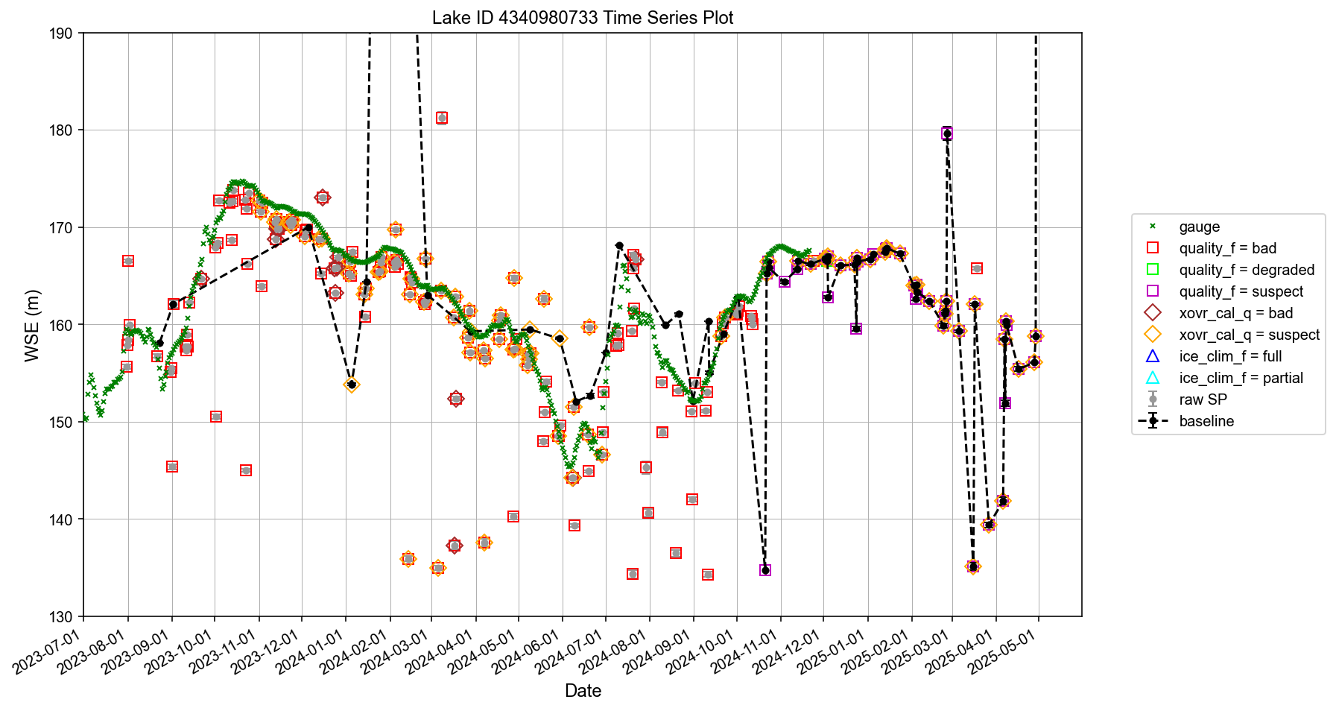
Three Gorges Reservoir
Retention rate 29.0%
Flood control
Peak hydropower
Peak hydropower
Impoundment
Impoundment
Water supply
Flood control
Water supply
Notes:
df_cleaned = df_cleaned.query('xovr_cal_q < 2 & ice_clim_f < 2')
df_cleaned = df_cleaned.query('(quality_f < 1 & (crid != "PIC2" & crid != "PID0")) or (quality_f < 3 & (crid == "PIC2" or crid == "PID0"))

Slide 7
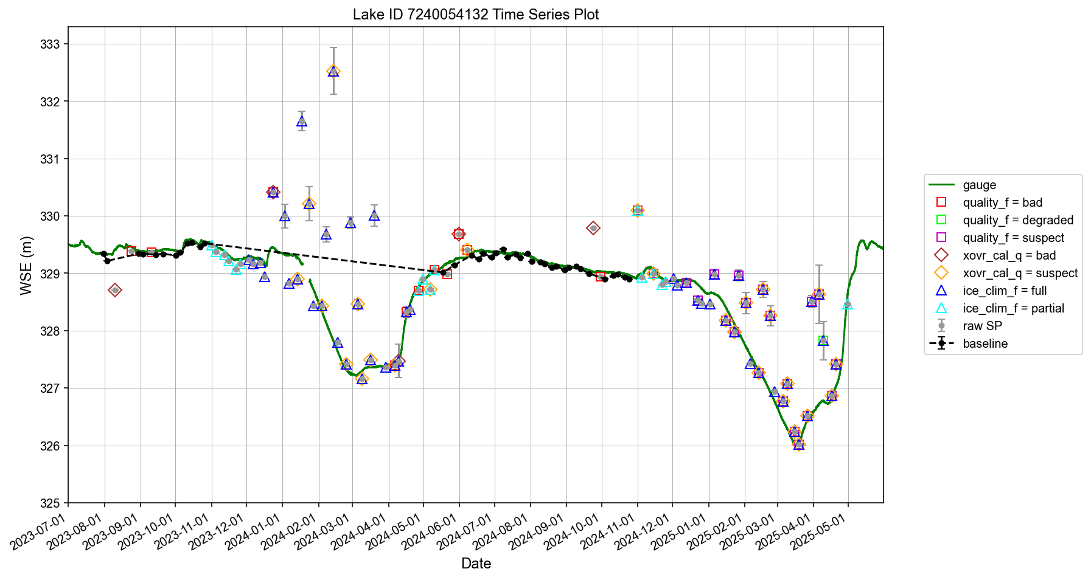
Barrage des Commissaires
Retention rate 33.9%
Notes:
df_cleaned = df_cleaned.query('xovr_cal_q < 1 & ice_clim_f < 1')
df_cleaned = df_cleaned.query('(quality_f < 1 & (crid != "PIC2" & crid != "PID0")) or (quality_f < 1 & (crid == "PIC2" or crid == "PID0"))')

Slide 8
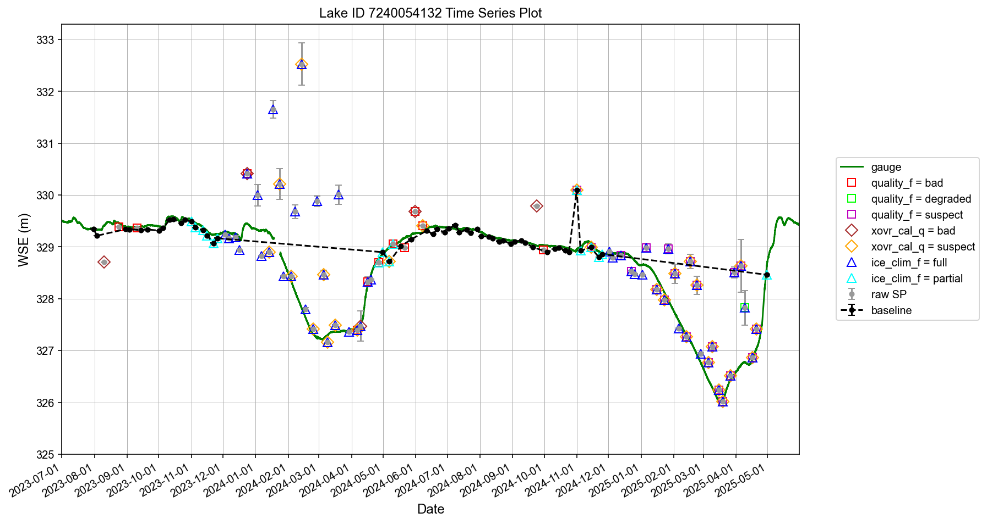
Barrage des Commissaires
Retention rate 46.1%
Notes:
df_cleaned = df_cleaned.query('xovr_cal_q < 2 & ice_clim_f < 2')
df_cleaned = df_cleaned.query('(quality_f < 1 & (crid != "PIC2" & crid != "PID0")) or (quality_f < 3 & (crid == "PIC2" or crid == "PID0"))') #lenient

Slide 9
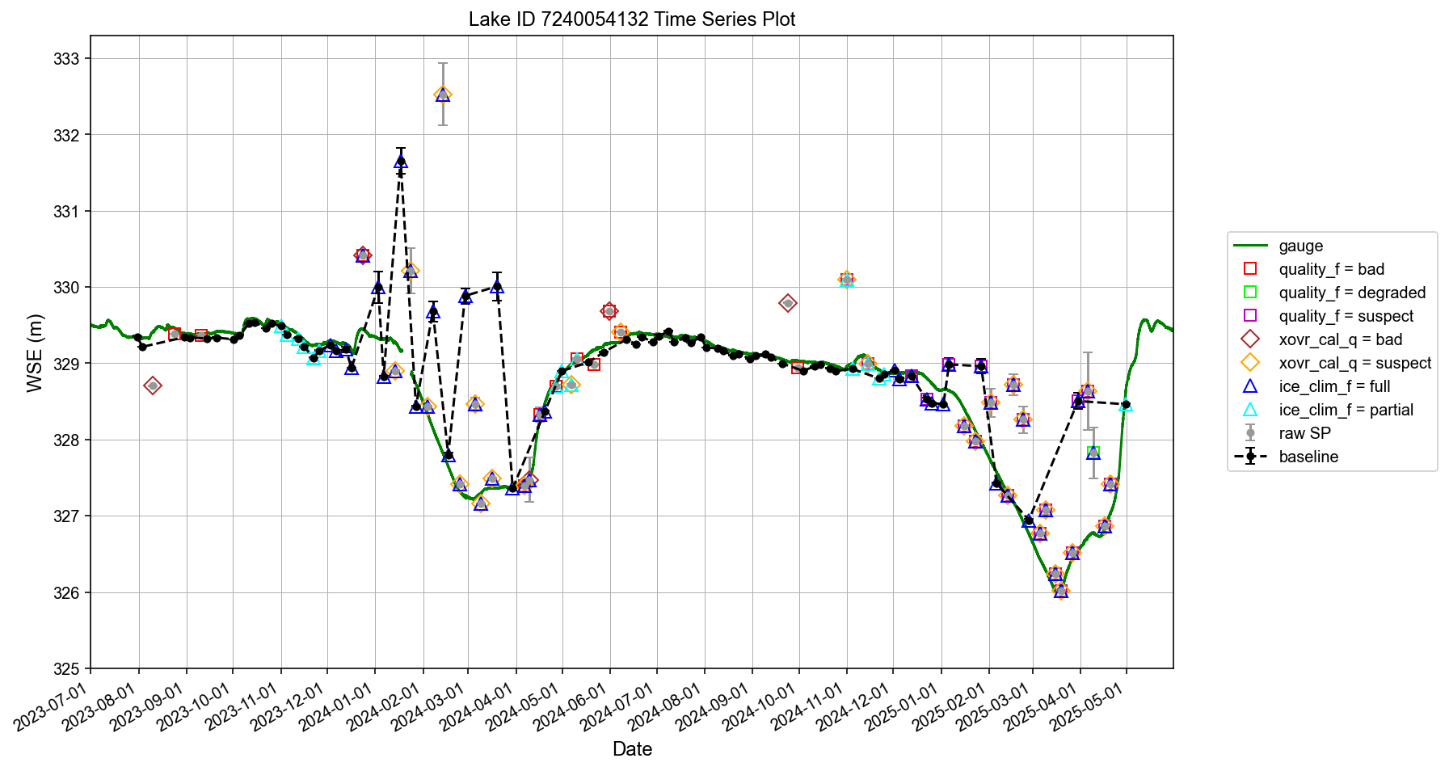
Barrage des Commissaires
Retention rate 65.2%
Notes:
df_cleaned = df_cleaned.query('xovr_cal_q < 1') #no worries about ice.
df_cleaned = df_cleaned.query('(quality_f < 1 & (crid != "PIC2" & crid != "PID0")) or (quality_f < 2 & (crid == "PIC2" or crid == "PID0"))') #lenient. Allow suspect to remain

Slide 10
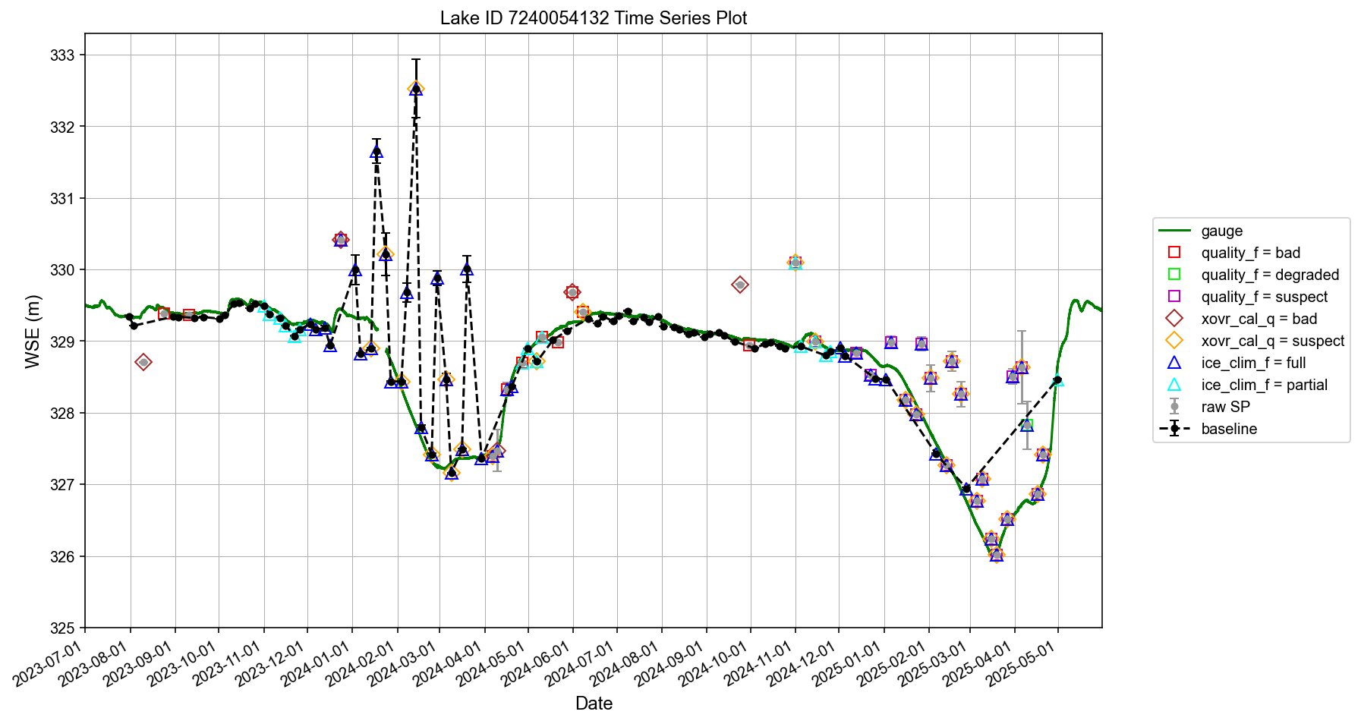
Barrage des Commissaires
Retention rate 68.7%
Notes:
df_cleaned = df_cleaned.query('xovr_cal_q < 2') #no worries about ice.
df_cleaned = df_cleaned.query('(quality_f < 1 & (crid != "PIC2" & crid != "PID0")) or (quality_f < 1 & (crid == "PIC2" or crid == "PID0"))') #lenient. Allow xovr_cal_q suspect to remain.

Slide 11
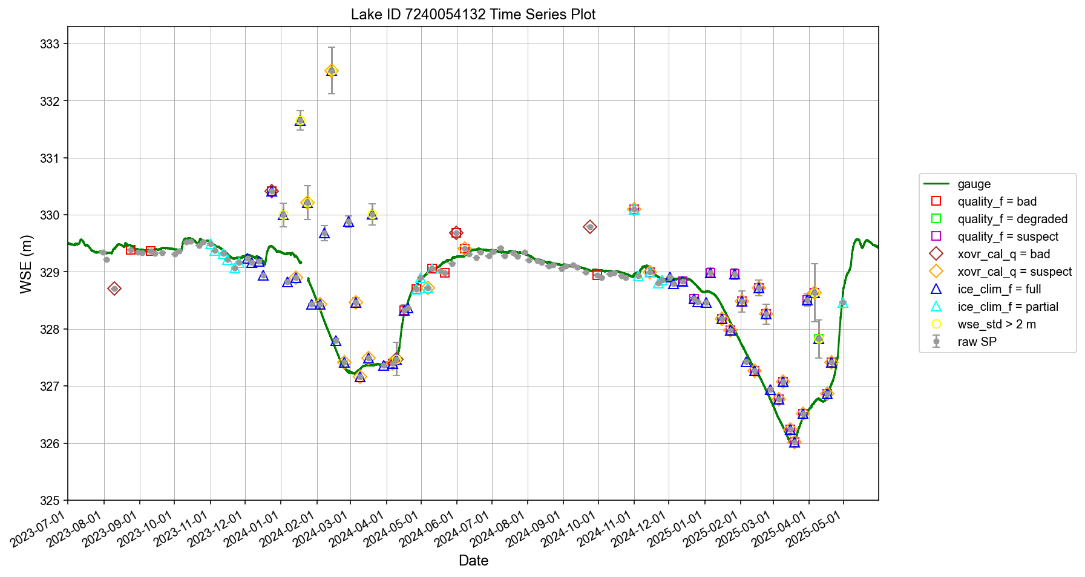
Barrage des Commissaires
Strategy: let data with good quality flags inform maximum wse_std and wse_u thresholds
Notes:
xovr_cal_q = 0 & ice_clim_f <= 1 & quality_f <= 1.

Slide 12
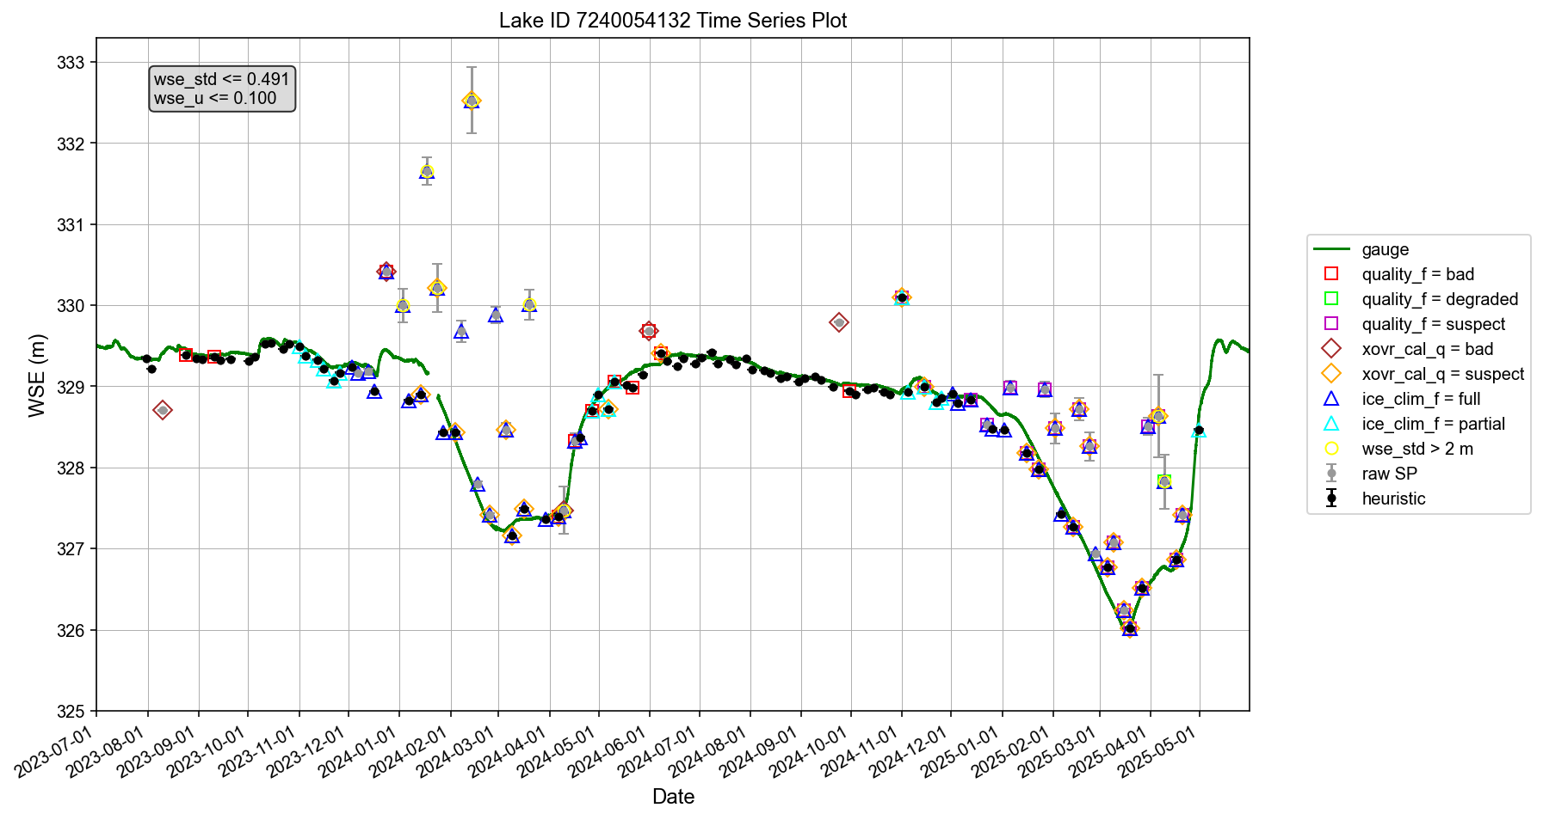
Barrage des Commissaires
Selected data using wse_std and wse_u thresholds
Notes:
df_cleaned = df_cleaned[ (df_cleaned['wse_std'] <= wse_std_threshold)]
df_cleaned = df_cleaned[ df_cleaned['wse_u'] <= wse_u_threshold ]
df_cleaned = df_cleaned[df_cleaned['xovr_cal_q'] < 2]
#Excluding specular_rining_bad, xovr_cal_bad, and low_coh_bad, but only applicable in PIC2 and PID0. For PIC0, do not use quality_f (which only contains 0 and 1)
df_cleaned = df_cleaned[df_cleaned['quality_f'] < 3]

Slide 13
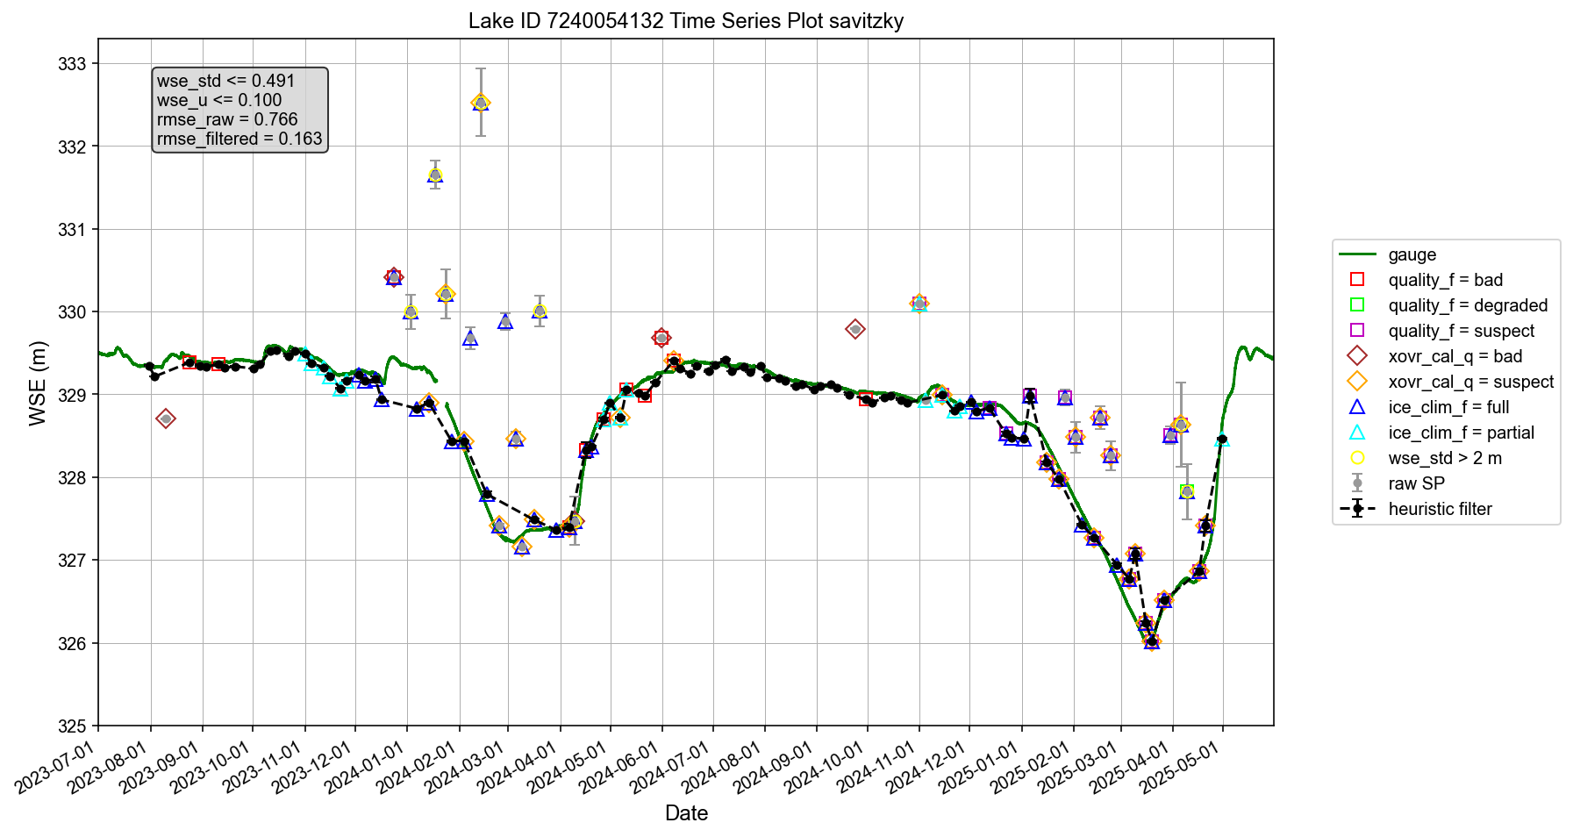
Barrage des Commissaires
Retention rate 79.1%
Further cleaned up using a low-pass filter
Notes:
Savitzky-Golay Filter

Slide 14
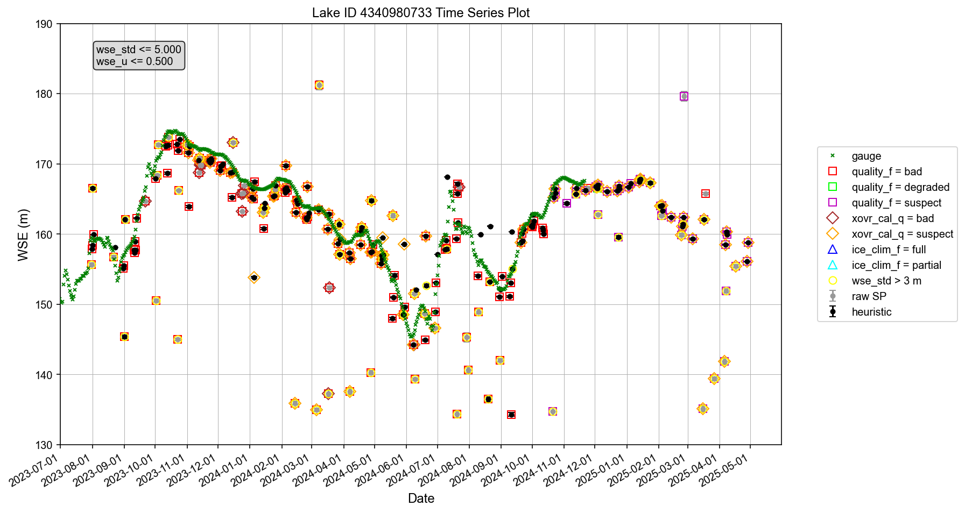
Three Gorges Reservoir
Selected data using wse_std and wse_u thresholds
Flood control
Peak hydropower
Peak hydropower
Impoundment
Impoundment
Water supply
Flood control
Water supply

Slide 15

Three Gorges Reservoir
Retention rate 54.8%
Low-pass filter evaluated on selected data
Flood control
Peak hydropower
Peak hydropower
Impoundment
Impoundment
Water supply
Flood control
Water supply
Notes:
Evaluated on selected data

Slide 16

Three Gorges Reservoir
Retention rate 61.9%
Low-pass filter evaluated on all data
Flood control
Peak hydropower
Peak hydropower
Impoundment
Impoundment
Water supply
Flood control
Water supply
Notes:
Evaluated on all data

Slide 17
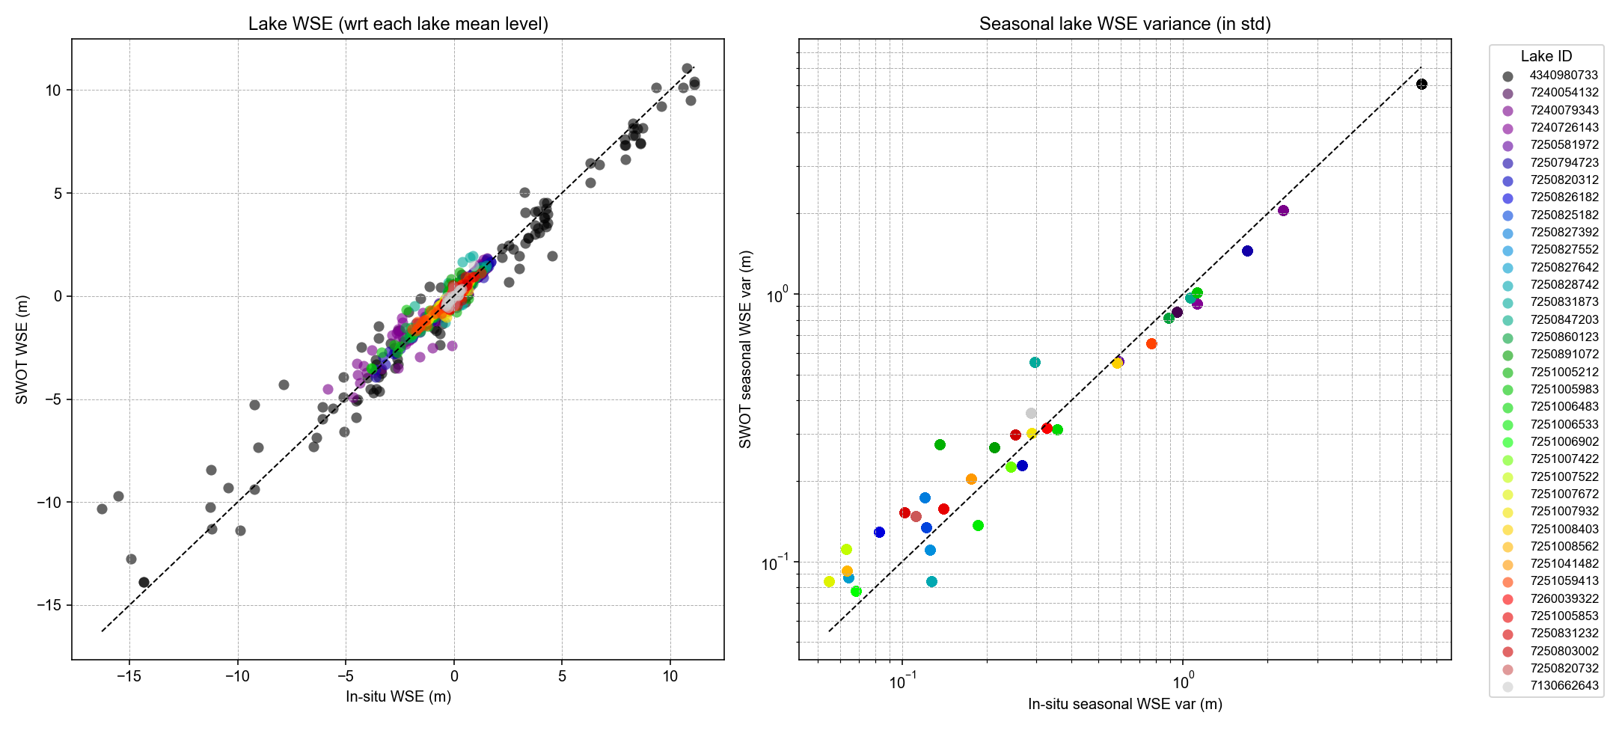
MAE (median, 1σ):
0.12 m, 0.15 m
Relative err (median, 1σ):
14.9%, 26.0%
Average retention rate 80.3% per lake, as opposed to 30–48% if using the baseline filter

Slide 18
Discussion
Is this heuristic filter reasonable?
Any alternative strategy?
Seeking voluntary contributions to:
Possibly improve the filter
Widely validate the filter
In-situ data needed
Merritt Harlan has agreed to provide USGS and ECCC data for about 500 lakes and reservoirs across North America.
Other parts of the world?
Volunteer to lead or assist in validation analysis?

Slide 19
Updates on 07/04/2025
Discussion with Melanie and Sylvain

Slide 20
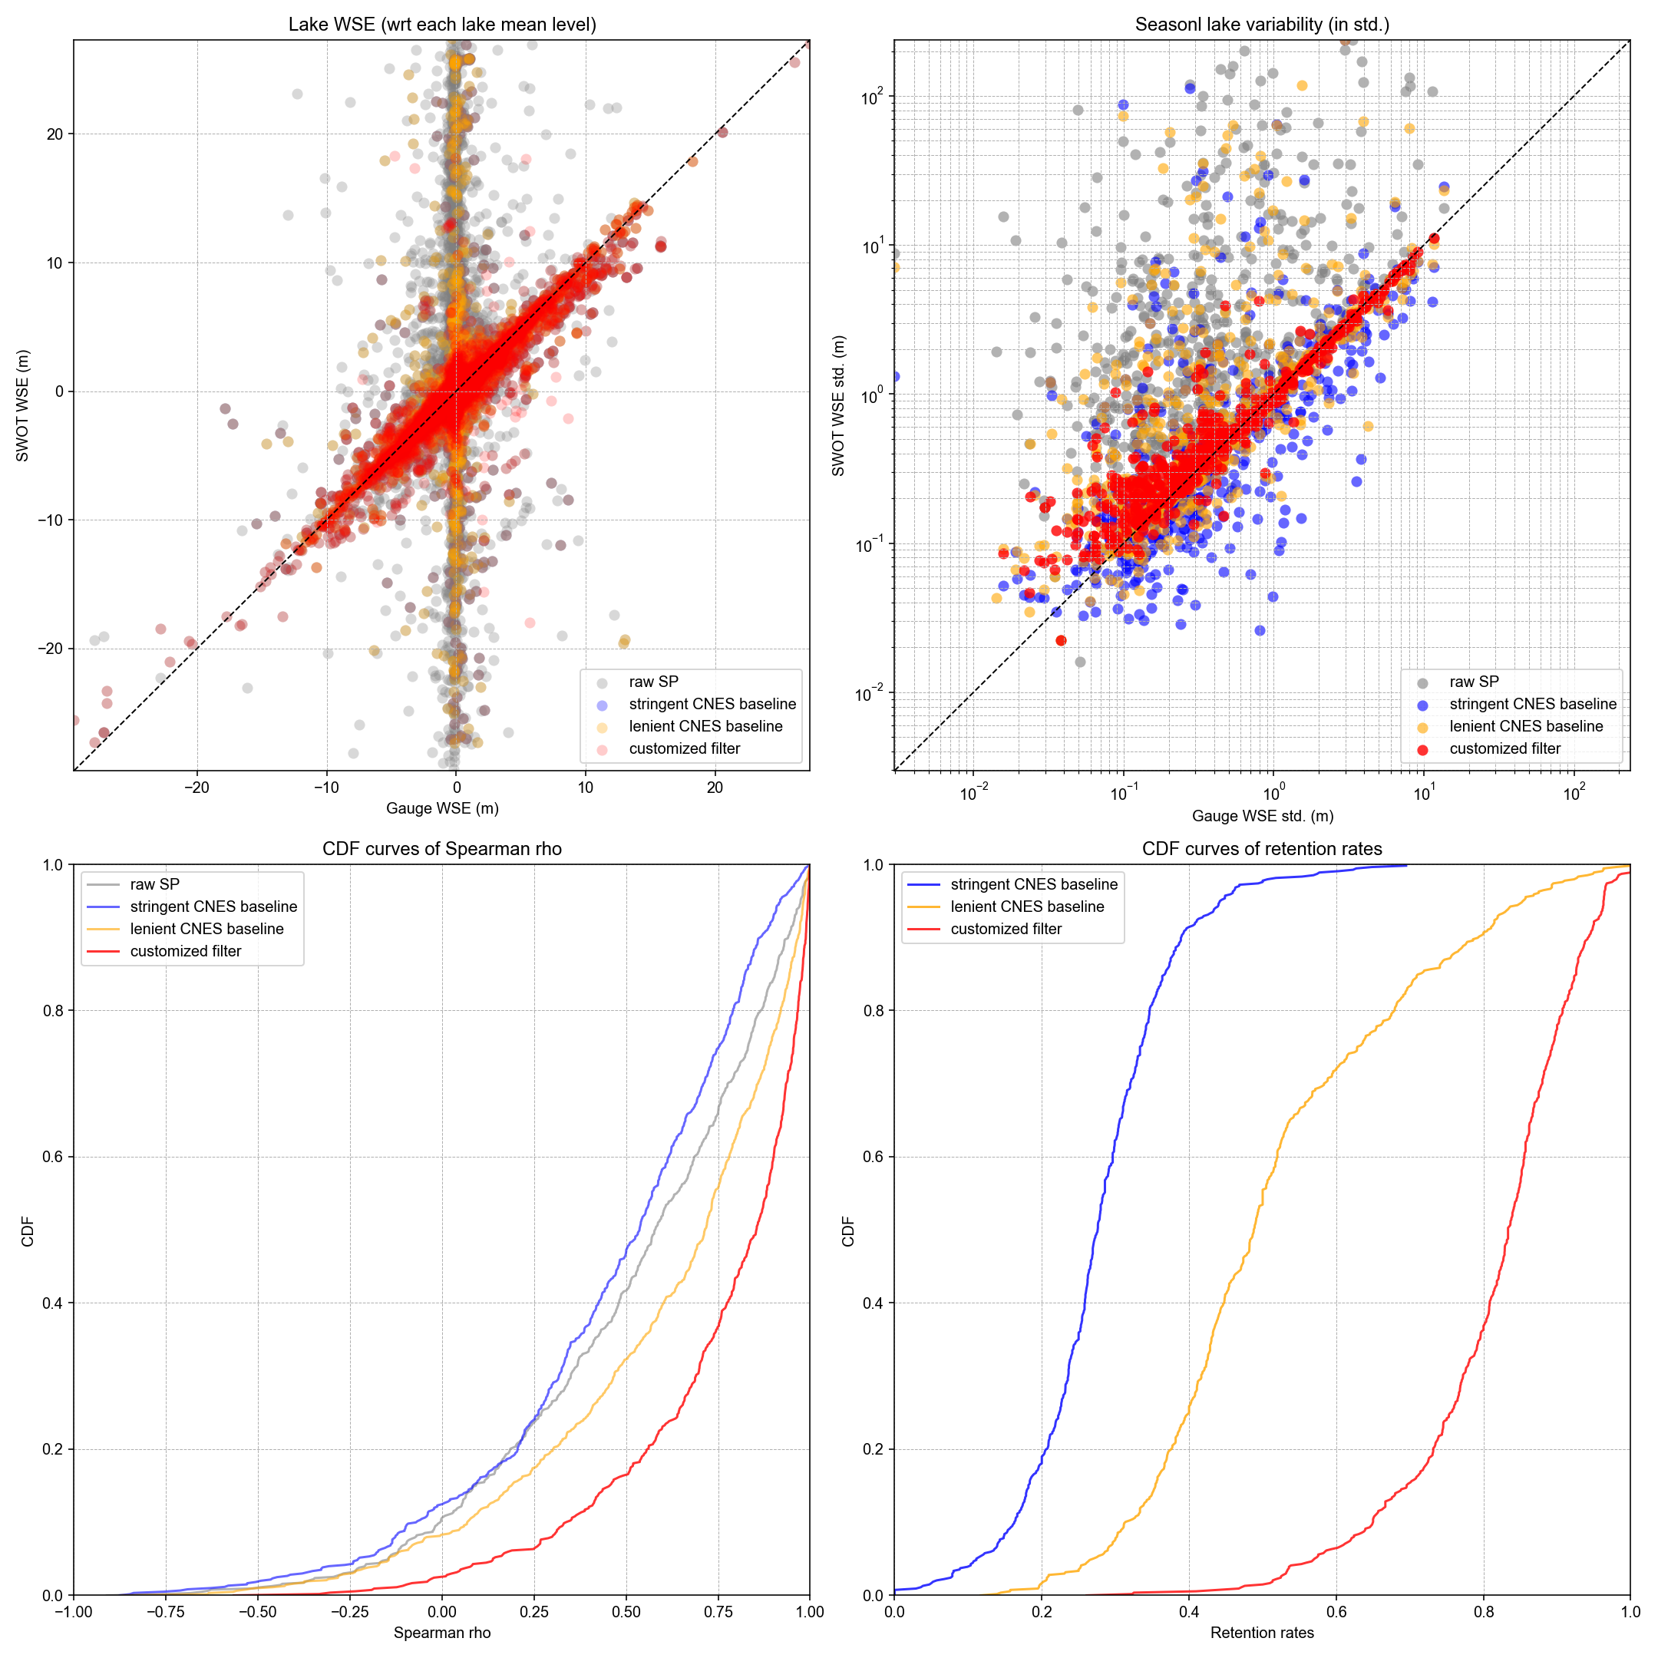
All 630 lakes thus far
(based on script version 5)
Stringent CNES baseline (baseline 1):
CNES_baseline1 = 'xovr_cal_q < 1 & ice_clim_f < 1 & quality_f < 1’
More lenient CNES baseline (baseline 2):
CNES_baseline2 = ('xovr_cal_q < 2 & ice_clim_f < 2 & '
'((quality_f < 1 & (crid != "PIC2") & (crid != "PID0")) '
'| (quality_f < 3 & ((crid == "PIC2") | (crid == "PID0"))))')
1-sigma err = 36%

Slide 21
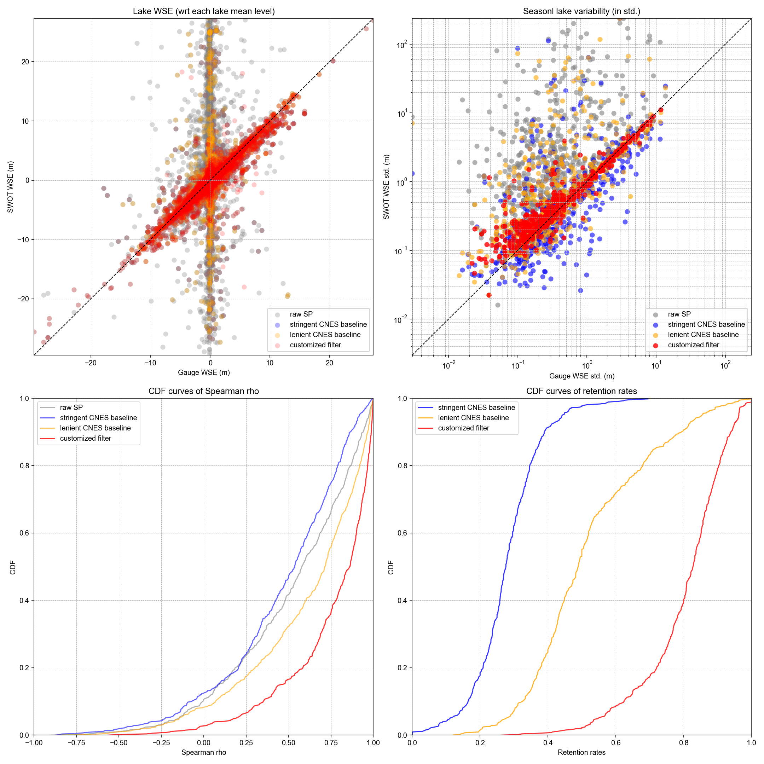
All 630 lakes (version 6)
Improvements:
Flexibility to enable calibration of heuristic thresholds (maximum wse_std and wse_u) to be specific to:
CRID versions: PIC0/PGC0 vs. PIC2/PID0
Pass IDs (for lakes that span multiple SWOT passes)
Flexibility to remove ice-covered anomalies by comparing area_total and WSE against valid ice-free observations, evaluated pass by pass (this has to be pass-specific as area_total is used).
1-sigma err = 33%
This figure implemented:
Lake-specific global thresholds
Pass-specific ice anomaly removal

Slide 22

All 630 lakes (version 6)
Improvements:
Flexibility to enable calibration of heuristic thresholds (maximum wse_std and wse_u) to be specific to:
CRID versions: PIC0/PGC0 vs. PIC2/PID0
Pass IDs (for lakes that span multiple SWOT passes)
Flexibility to remove ice-covered anomalies by comparing area_total and WSE against valid ice-free observations, evaluated pass by pass (this has to be pass-specific as area_total is used).
1-sigma err = 33%
This figure implemented:
CRID-specific thresholds
Pass-specific ice anomaly removal

Slide 23

All 630 lakes (version 6)
Improvements:
Flexibility to enable calibration of heuristic thresholds (maximum wse_std and wse_u) to be specific to:
CRID versions: PIC0/PGC0 vs. PIC2/PID0
Pass IDs (for lakes that span multiple SWOT passes)
Flexibility to remove ice-covered anomalies by comparing area_total and WSE against valid ice-free observations, evaluated pass by pass (this has to be pass-specific as area_total is used).
1-sigma err = 34%
This figure implemented:
CRID-specific and pass-specific thresholds
Pass-specific ice anomaly removal

Slide 24
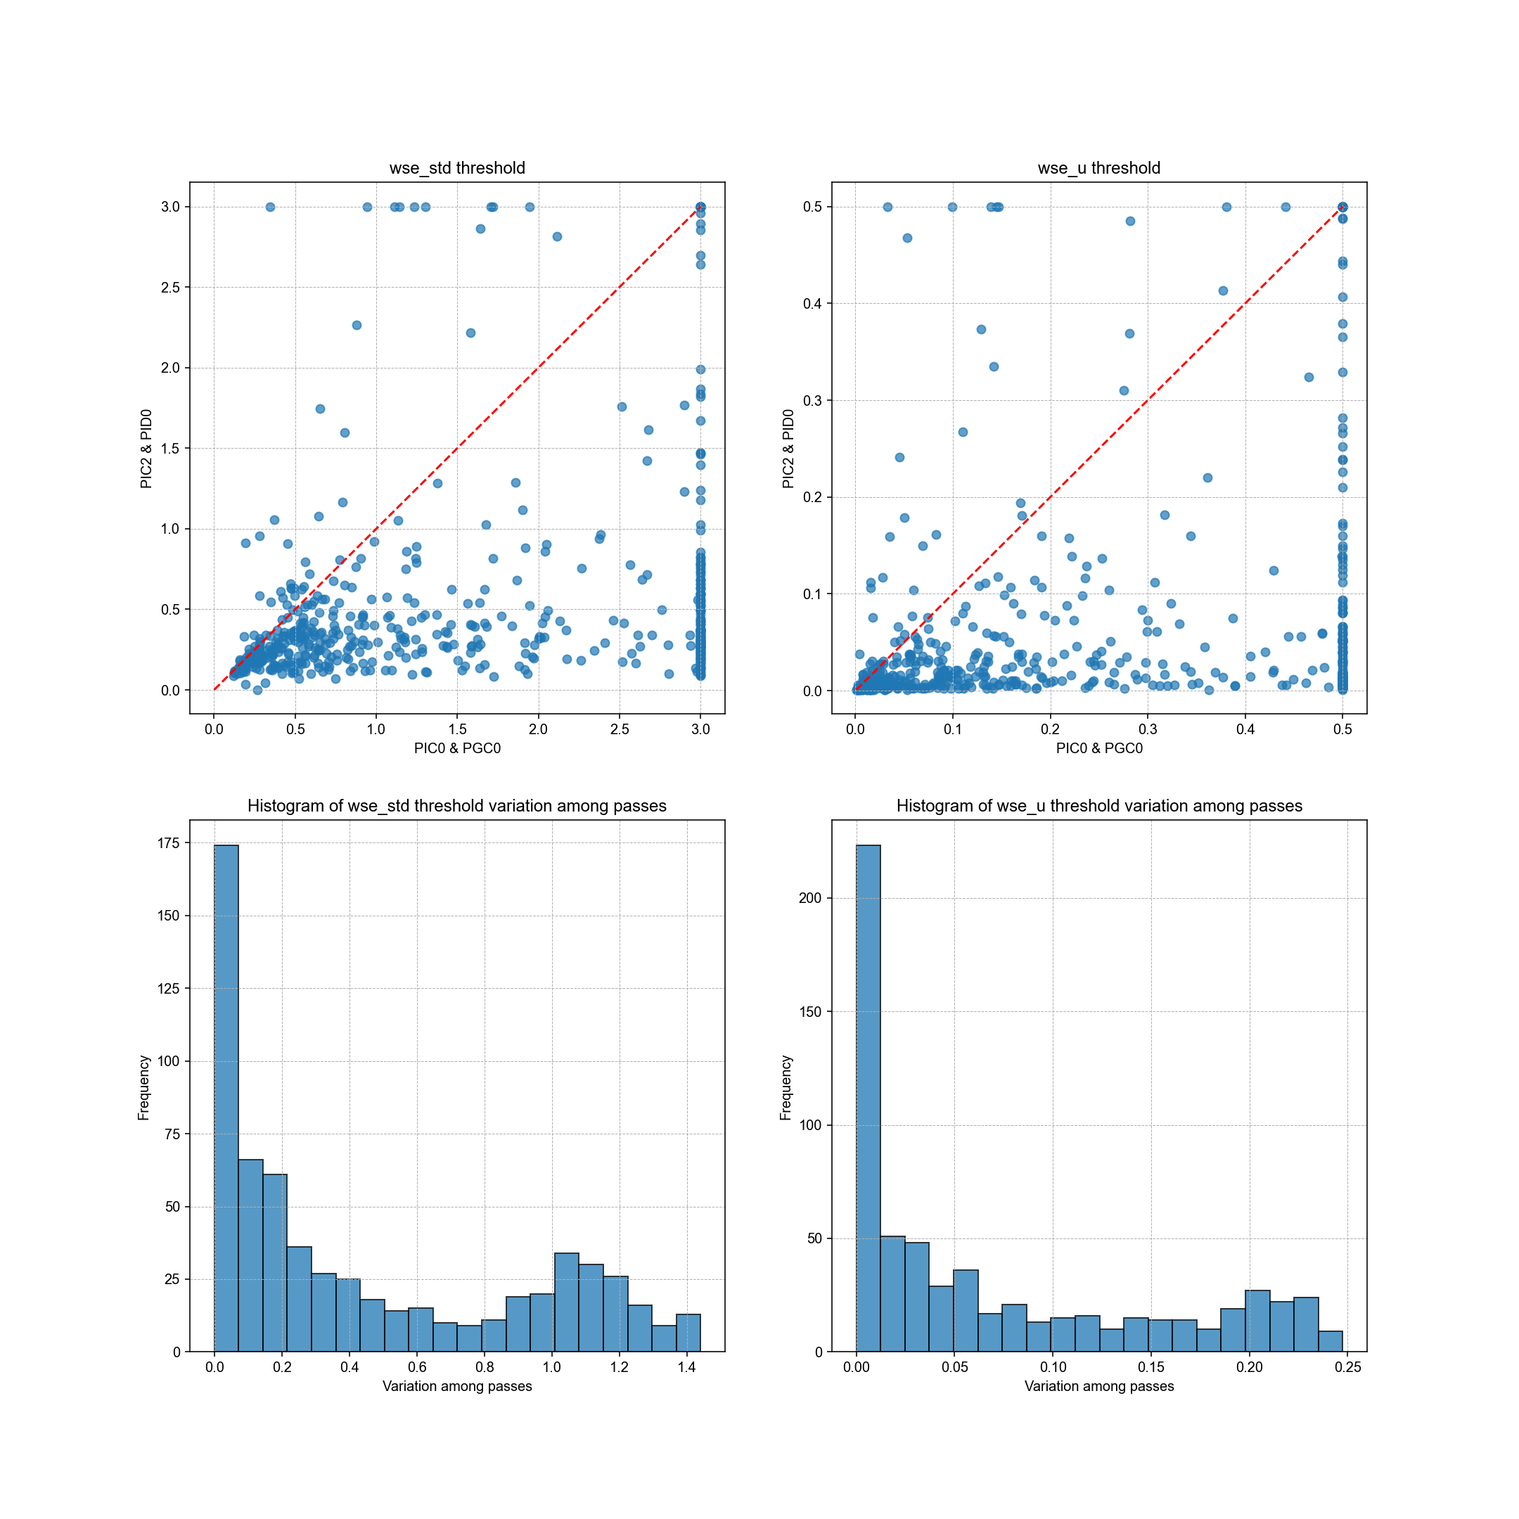
Sensitivity test of heuristic thresholds
As expected, PIC2/PID0 result in lower thresholds for both wse_std and wse_u compared to earlier data versions (PIC0/PGC0).
However, shown in the previous slides, applying CRID-specific thresholds (or pass-specific thresholds) produces filtering results that are largely comparable to those obtained using global thresholds, but sometimes at the cost of over-rejection and reduced retention rate. So, there seems to be a trade-off between accuracy and generalizability.
These options are made available in the code, and we can provide such flexibility to users. But I personally prefer lake-specific global thresholds for our lake dynamic paper.
Sensitivity to CRID versions
Sensitivity to orbit passes

Slide 25
Updates on 07/13/2025
After discussion with Melanie and Sylvain
Included gauge data from 1000+ lakes and reservoirs
Results are based on the latest script (v7): Customized-LakeSP-filter-v7-07132025.py
Improvement:
Allows flexibility of threshold calibration specific to CRID version and SWOT passes.
Improved ice outlier removal, but WSE underestimation during ice periods remains a challenge! Voluntary helps are appreciated.
Incorporated Melanie’s suggestion on bias correction between gauge and SWOT data
Incorporated Melanie’s random forest to compute feature importance

Slide 26
We have thus far collected the following gauge data. Regions/lakes may overlap among the data sources but the unique lake count is 1068.
Region | Count of PLD lakes | Temporal frequency | Sources | Data provider
Quebec | 35 | Daily | CEHQ | Mélanie Trudel
Canada | 277 | SWOT passes | ECCC, CEHQ, Spence, HQ, UDES
North America | 589 | SWOT passes | ECCC, Quebec, USBR, USGS | Merritt Harlan
China | 38 | Daily | Multiple authorities | Chunqiao Song
West Africa | 2 | Hourly or finer | In situ measurement | Manuela Grippa; Félix Girard; Laurent Kergoat
Amazon | 1 | Daily | In situ measurement (Mamirauá Institute for Sustainable Development) | Ayan Fleischmann
Ceará, Brazil | 8 | Every 30 min | In situ measurement (Funceme) | Rafael Oliveira; Marielle Gosset; Eduardo Sávio Rodrigues Martins
India | 358 | Monthly | NWIC, APWRIMS, Gujarat, CWC | Deep Shah; Huilin Gao
Total | 1308
Total unique (excluding duplicates) | 1068

Slide 27
Conceptual procedure of the customized filter
Apply conservative quality flags to subset assumed high-quality SP observations
Raw LakeSP time series
Built-in flexibility to be CRID or pass adaptive
Calibrate heuristic thresholds for this lake (mainly based on wse_std and wse_u; see next slide for RF-based feature importance)
Heuristic baseline time series (i.e., a subset of raw SP time series based on heuristic thresholds)
Check if the heuristic baseline is temporally representative:
no major gaps (> 3 months),
requiring no major extrapolation (> 20% of the time range)
Each iteration includes:
Low-pass filtering
Remove positive ice anomalies
Remove remaining extreme outliers (Tukey’s test)
Option to reintroduce high-quality observations removed by round 1, and apply a round-2 (less aggressive) iterative low-pass filter
Apply a round-1 (more aggressive) iterative low-pass filter.
no
yes
Remove significant WSE inconsistency due to by multiple overpasses
Abandon this lake
Final filtered SP time series

Slide 28
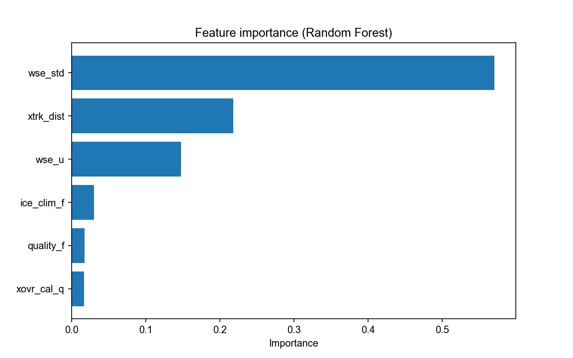
Random forest test for feature importance
In addition to “wse_std” and “wse_u”, “xtrk_dist” turned out to be another important feature, probably related to specular ringing or other errors near the nadir.
We may need to include “xtrk_dist” as another metric to calibrate heuristic thresholds.
Any voluntary help for this will be appreciated!

Slide 29
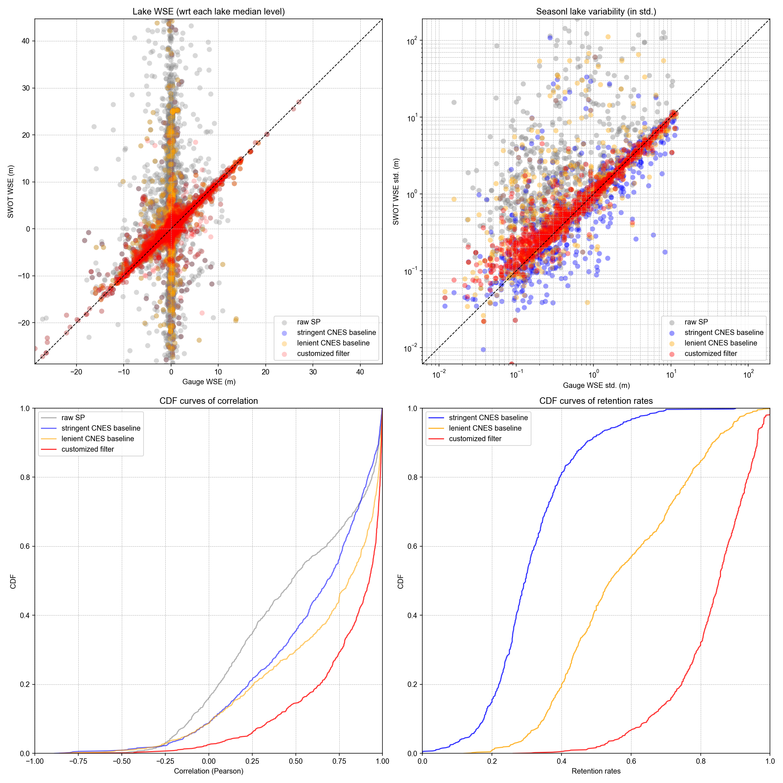
Result based on all 1068 lakes (script v7)
84.1% (898) of these 1068 lakes passed the retention criteria after filtering:
Maximum temporal gap < 3 months
Proportion of time series requiring extrapolation < 80%
For a fair “apples-to-apples” comparison, statistics are computed based on these 84.1% of the lakes. Including the remaining 15.9% of the lakes in the plot will only further deteriorate the statistics for raw LakeSP and the two CNES baselines.
Compared to raw LakeSP and the two CNES baselines (see Slide 20 for definition), the customized filter (red) improved every one of the four metrics: RMSE, relative error in annual WSE variability, Pearson correlation, and retention rate.
Some outliers remain, and most could be attributed to ice-related impacts, and part of them may also come from gauge data errors.
Median err = 12.6%
1-sigma err = 31.0%
Notes:
3.7205749972021973
0.5286440426665399
0.5420948491031606
0.3104395100970873
14.132891092434878
2.1428431506242482
3.3088307316415544
0.4990750408727158

Slide 30
To do list from the team:
1. Quality control on gauge data:
Particularly, please make sure each gauge matches the correct PLD lake ID.
If there are multiple gauges for one PLD lake, avoid the gauge in the upstream “river” section of the lake – where WSE could be impacted by backwater or reflects the river changes instead of the lake variation.
Remove noises in the existing gauge data (I spotted and corrected a few cases but other errors may remain).

Slide 31
To do list from the team:
2. Further minimize ice impacts:
Ice impacts are challenging and can lead to both over- and under-estimation of the lake WSE. Particularly, ice-induced WSE underestimation can falsely increase the annual WSE variability, which is probably the most important remaining error source now. We need voluntary contributions to look into the script and help reduce such impacts. Note we can’t just remove all ice observations as some represent valid/accurate signals such as reservoir drawdowns.
Another challenge is that some gauges are non-operational during winter or freeze-up periods, under the assumption of minimal hydrological activity – despite the possibility of reservoir drawdowns. These seasonal gauge data gaps introduce uncertainty in the evaluation of ice impacts. To validate seasonal WSE variability, we simply interpolated the gauge data to generate continuous daily time series. However, we are not certain if this was the most appropriate way (needs someone to critically review the script.

Slide 32
To do list from the team:
3. Challenges to capture freshets
Preserving freshet-induced WSE jumps, particularly those caused by snowmelt, remains a challenge. These events are often excluded from the heuristic baseline due to high values of WSE_std, WSE_u, or poor xovr_cal_q, among other factors. Alternatively, they may be inadvertently filtered out by the low-pass filter, as such isolated jumps can resemble statistical outliers. For example, in many cases, we wouldn't even recognize them as valid observations without gauge confirmation. We would greatly appreciate any voluntary help in reviewing the script and improving the preservation of these critical freshet-driven WSE signals (see examples in the next couple of slides).

Slide 33
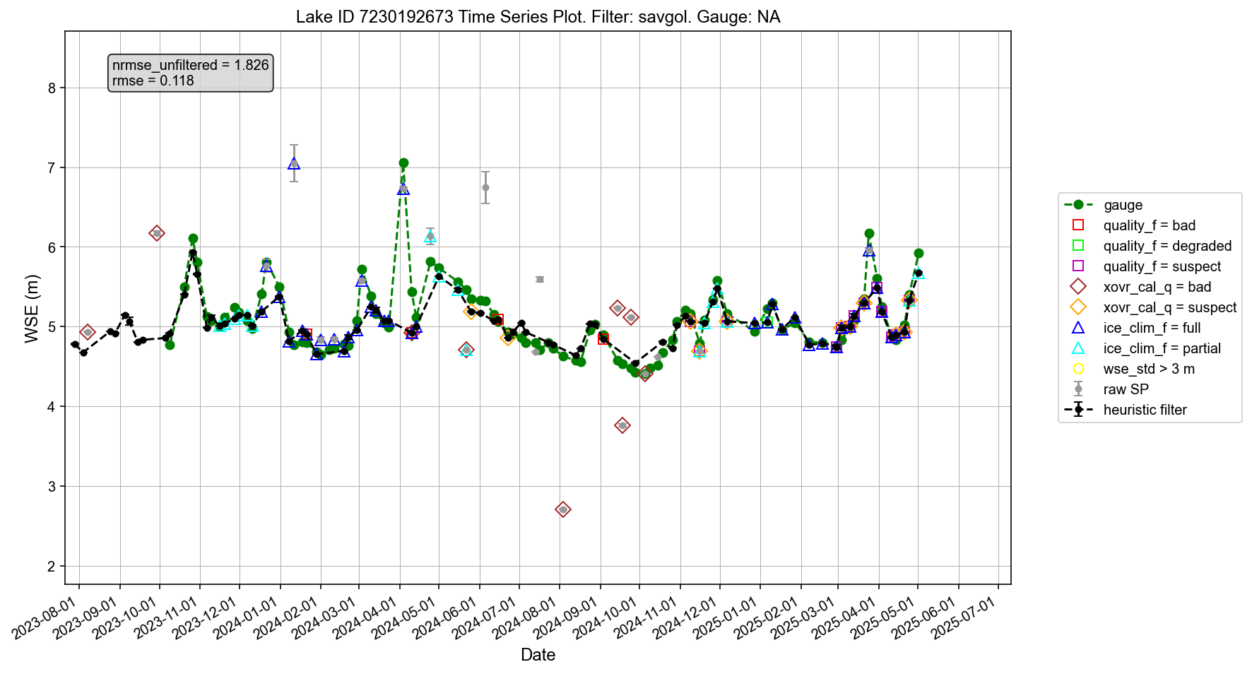

Slide 34
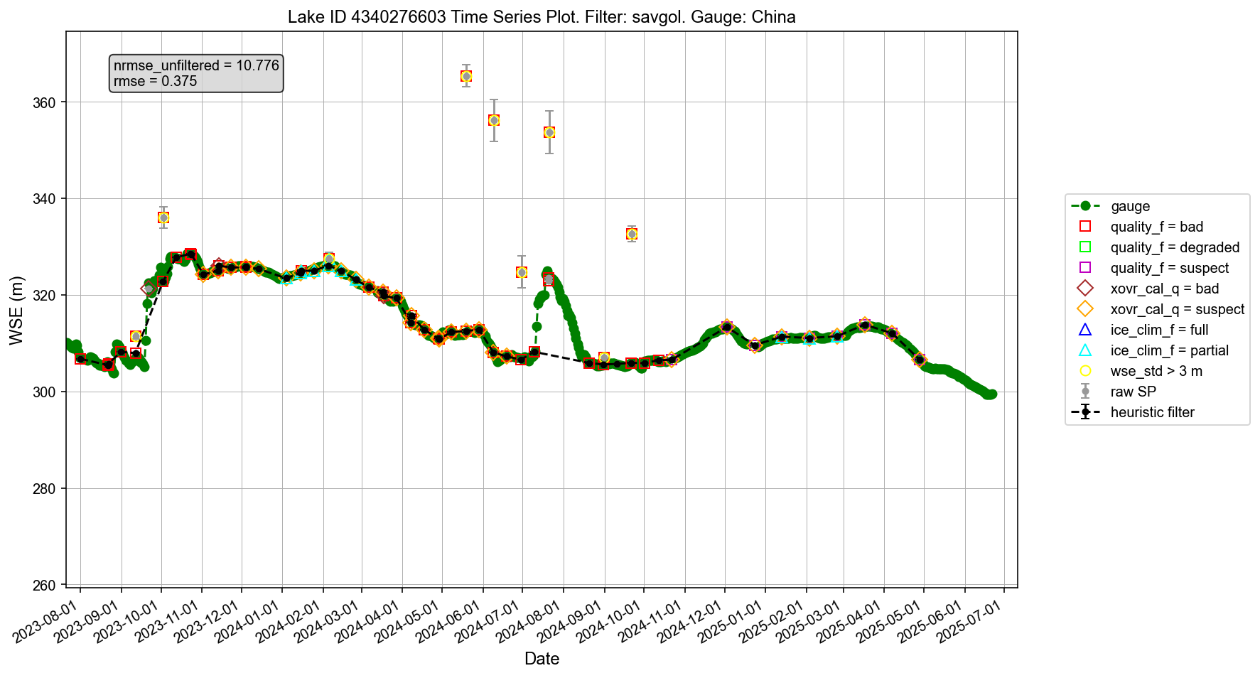

Slide 35
To do list from the team:
4. Include “xtrk_dist” in calibrating heuristic thresholds?
As shown in the Random Forest feature importance results, “xtrk_dist” (along with “wse_std” and “wse_u”) emerged as another important metric influencing WSE errors, likely due to specular ringing or other issues near the nadir. It may be necessary to incorporate “xtrk_dist” as an additional threshold when defining the heuristic baseline prior to applying the low-pass filter. Again, we would greatly appreciate any voluntary help in exploring and implementing this improvement (if necessary at all).

