Slide 1
LakeSP filtering analysis
8/5/2025
Eric Levenson

Slide 2
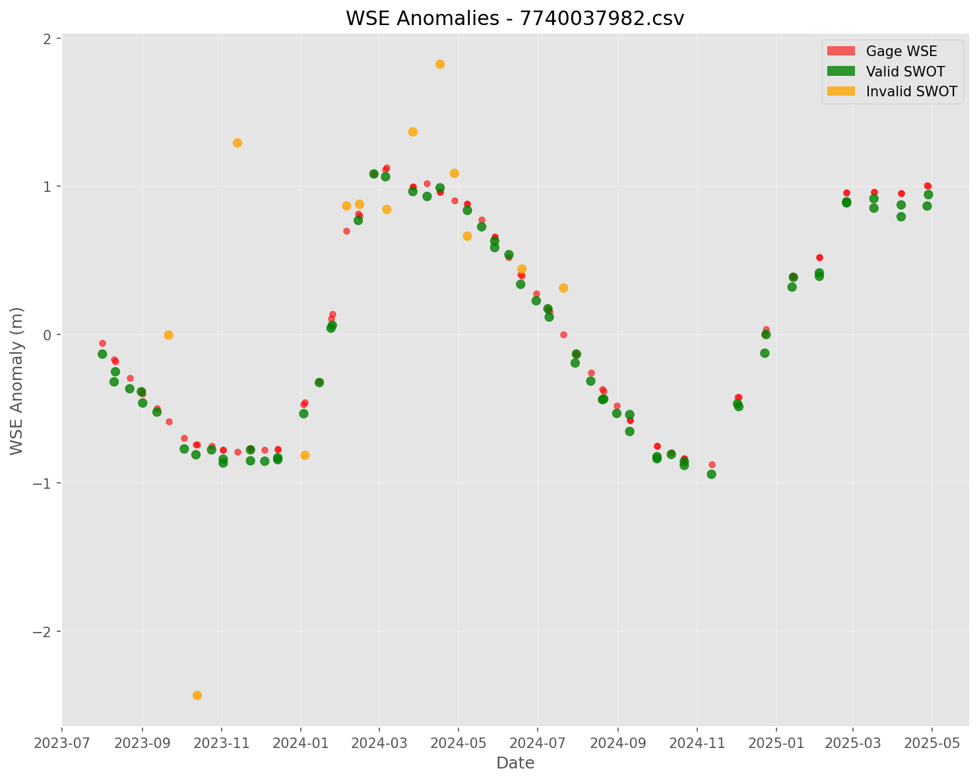
Benchmark Dataset
10,005 coincident SWOT and in situ gage WSE measurements across 200 lakes/reservoirs
Bias corrected SWOT WSE elevations to track gage observations
Each observation classified as ‘valid’ or ‘invalid’ based on WSE error threshold.
10 cm error threshold:
58.3% valid observations
19.1 days/observation
50 cm error threshold:
82.8% valid observations
13.6 days/observation
Example Reservoir: Clear Lake, CA
Notes:
I had collected a dataset of gaged lakes/reservoirs that is essentially a subset of the gaged lakes present on github.
This approach prioritizes relative WSE change over datum (also can be analyzed using dataset)
11.12 days per observation for all data including outliers

Slide 3
SWOT Quality Flag (quality_f) Performance
quality_f value | Meaning | % of dataset | Precision (10cm) | Precision (50cm) | Recall (10 cm) | Recall (50 cm)
0 | Good | 46.6 % | 70.6 % | 90.5 % | 57.1 % | 51.5 %
1 | Suspect | 49.4 % | 47.3 % | 74.8 % | 40.1 % | 45.8 %
2 | Bad | 2.1 % | 50.3 % | 70. 8% | 1.8 % | 1.8 %
1+2 | Good + Suspect | 96.8% | 58.6 % | 82.3 % | 97.2 % | 97.3 %
Total |  | 100 % | 58.3 % | 82.8 % | 100 % | 100 %
*Measuring ability to identify valid observations (e.g., quality_f=0 recall of 52.3% means roughly half of valid observations have the ‘good’ flag).
Key takeaway: quality_f=0 removes 43-50 % of all valid observations, and includes10-30% invalid observations.

Slide 4
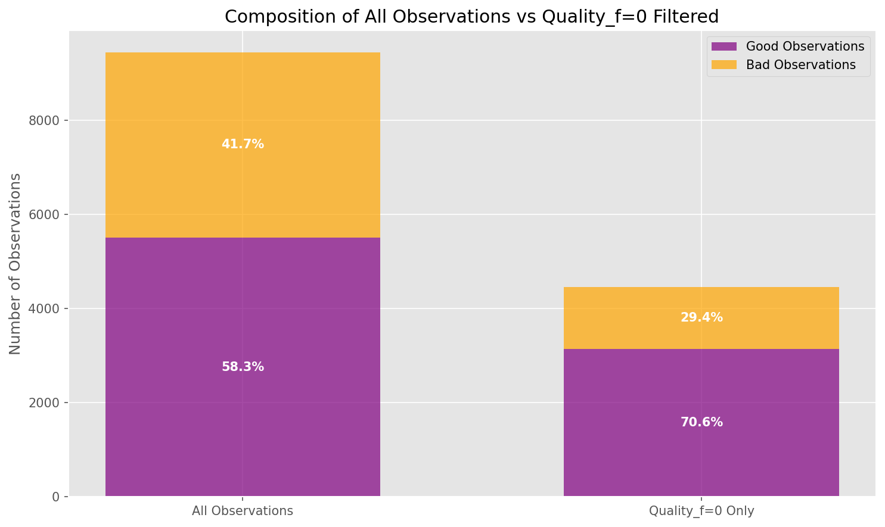
SWOT Quality Flag Performance
*Using 10cm error threshold

Slide 5
SWOT Quality Flag and Temporal Resolution
Dataset Subset | Temporal Resolution (days/observation) | Per-Lake Temporal Resolution (mean/std)
Quality_f=0 | 23.9 | 41.64 (59.17)
Quality_f = 0 | 1 | 11.5 | 13.8 (6.83)
Valid Observations (50 cm) | 13.4 | 17.4 (16.54)
Valid Observations (10 cm) | 19.1 | 25.5 (18.8)
All Observations | 11.12 | 12.96 (5.76)
*Temporal Resolution is specific to science orbit. Note, 10% of lakes have no quality_f=0 observations, thus decreasing per-lake temporal resolution.
Key takeaway: SWOT science orbit has a temporal resolution of 13-19 days, depending on acceptable vertical accuracy.
*This ideal temporal resolution will decrease according to the recall of our observation filtering techniques.

Slide 6
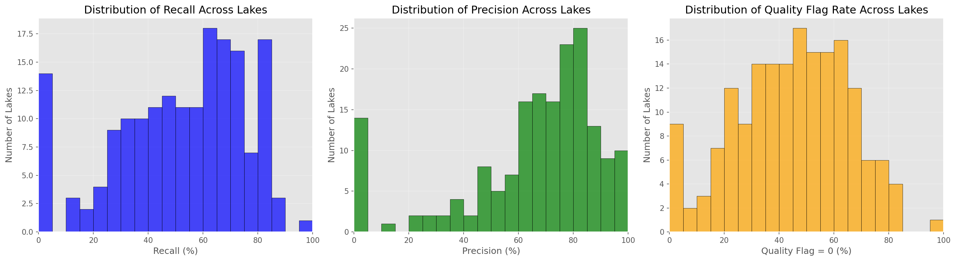
SWOT Quality Flag on per-lake basis
*Distribution of recall, precision, and flag rate for quality_f=0 identifying observations within 10 cm error threshold across 197 lakes.
quality_f value | % of observations (mean/std) | % Precision (mean/std) | % Recall (mean/std)
0 | 48.7 (16.2) | 44% (21.4) | 53.2% (21.8)
1+2 | 95.9 (8.1) | 51% (19.4) | 96.5% (10.1)
Total | 100 (0) | 59.8% (19.5) | 100 (0)
Key takeaway: Quality flag totally fails in ~20% of lakes (no ‘good / quality_f=0 data).
*Measuring ability to identify valid observations in individual lakes

Slide 7
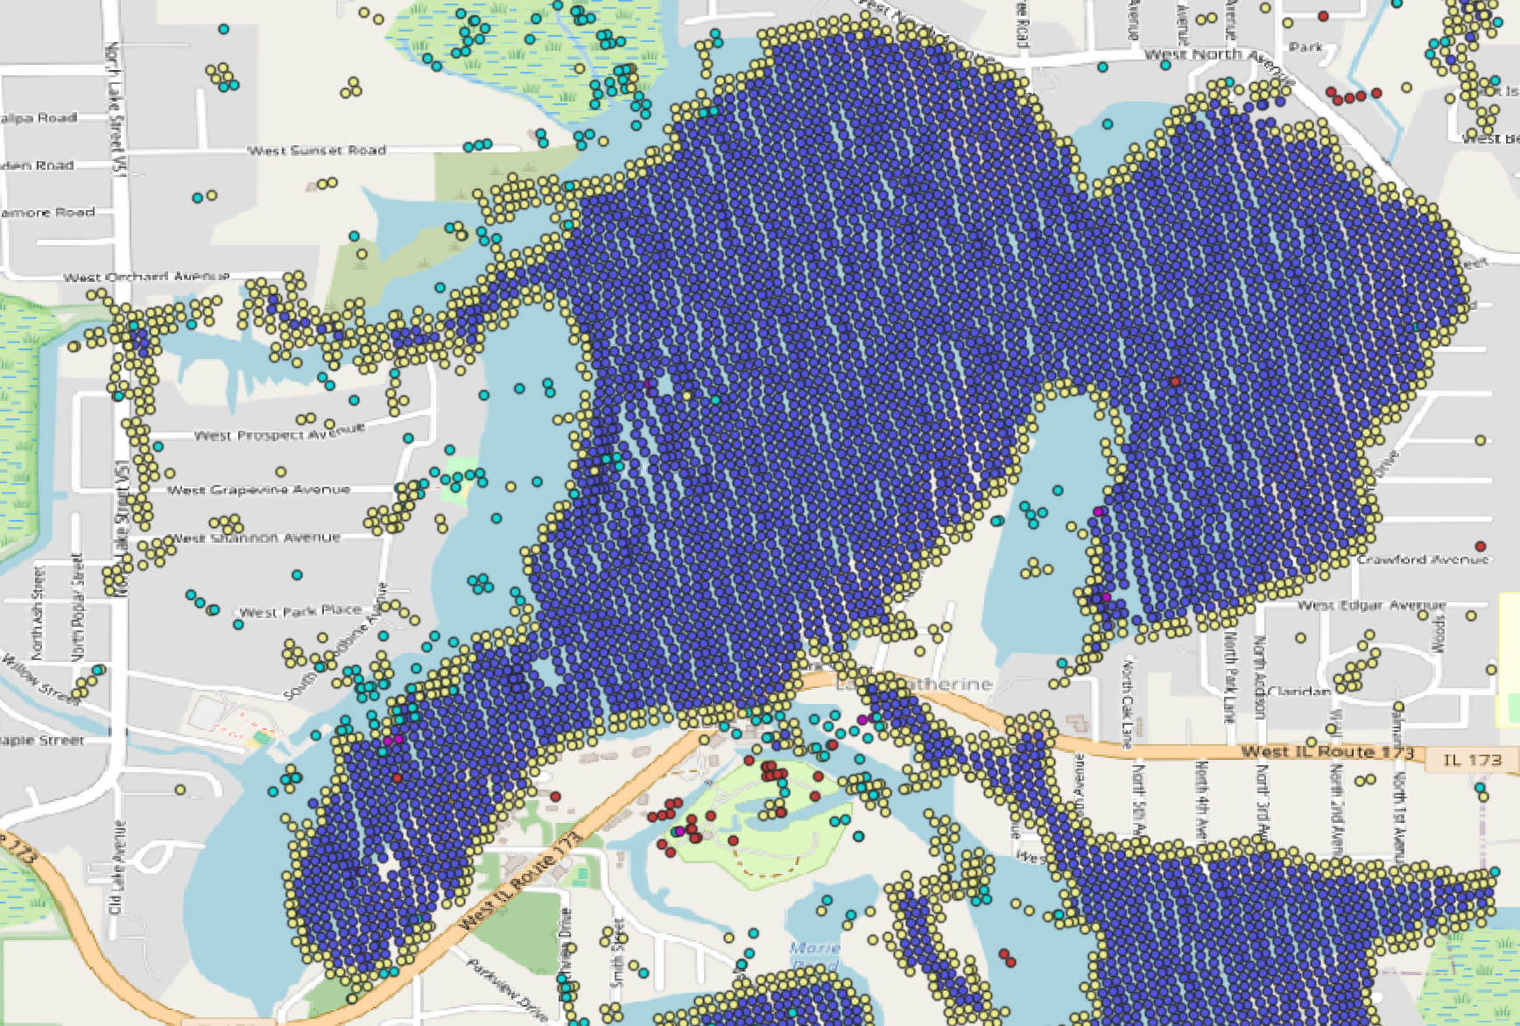
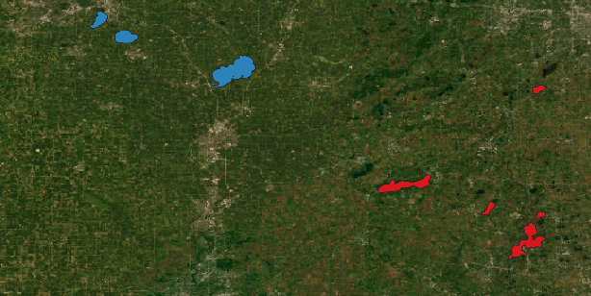
Unresolved sources of error: Roll/Phase
10-30% of quality_f=0 (good) observations have invalid WSE measurements
Promising error metrics (wse_std, wse_u, ice flags), but their WSE values are systematically incorrect.
Systematic errors that suggest roll/phase errors appear when assessing either nearby lakes or the pixel cloud
WSE Error >2m
WSE Error < -2m
Example A: Quality_f=0 and low WSE uncertainty, but systematic WSE and geolocation errors by 6.5m vertically and 150m horizontal.
Example B: Cycle 21 Pass 231 provides quality_f=0 and low WSE uncertainty, but WSE errors vary systematically in the cross-track direction.
Outstanding Question: How can we identify roll/phase errors without manual inspection?
Notes:
Example B can be identified by xovr_cal_q == 2, but roughly 50% with that flag consists of valid observations
Example A is not fixed by phase unwrapping (adusting WSE by multiplying 2pi times phase sensitivity)

Slide 8
Key challenges
Setting thresholds using quality_f=0 observations on a per-lake basis faces the following challenges:
5% of lakes have no quality_f=0 observations, 10% have less than 5.
30% of quality_f=0 observations have errors larger than stated SWOT vertical accuracy goals.
These observations generally have low wse_std and wse_u, but systematic bias.
No simple thresholds easily discriminate valid and invalid observations.
Example: Filtering for wse_u < 0.05 maintains 93% of good observations, but only filters ~50% of invalid observations.
Stricter thresholds remove more good observations, thus reducing temporal resolution. For example, 54% of observations where xovr_cal_q = 1 are actually valid.

Slide 9
Two-stage filtering approach
Step 1: Simple, lenient global thresholds
xovr_qual_q <2, wse_u < 0.05, limit wse range for extreme outliers (+-50m from median)
Maintains 91% of valid observations, removes 47% of invalid observations.
Step 2: Classify remaining observations using random forest*:
This two-step approach achieved Precision of 0.94, Recall of 0.88 and F1 of 0.91 on this dataset.
Likely some overfitting, will validate against more recent and additional gauge data to assess actual performance.
*Could replace random forest with simple decision tree (clear rules but worse performance) another classifier, or thresholds for individual lakes based on quality_f=0.

Slide 10
Next Steps
Is it possible to get quality bit mask for via hydrocron?

