Slide 1
LakeSP filtering
06/18/2025, SLeW
Jida Wang, Mélanie Trudel, Sylvain Biancamaria
Goal: To come up with a globally-applicable filtering strategy that balances
Error removal, and
A good representation of the lake level hydrograph, e.g., in terms of variability, amplitude, and phenological pattern

Slide 2
LakeSP Filters
Lake WSE validation
Based on various combinations of quality flags/indicators
Flag name | Flag definition
quality_f | Summary quality indicator for the lake measurement 0 = normal 1 = bad (PIC0, PGC0); 1 = suspect; 2 = degraded; 3 = bad (PIC2, PID0)
xovr_qual_q | Quality of the cross-over calibration: 0=good; 1=suspect; 2=bad
ice_f | Ice cover flag, from in situ data, or climatological flag given in LakeSP products [Yang et al. 2020] 0=no ice cover 1=partial ice cover 2=full ice cover
partial_f | Flag that indicates only partial lake coverage: 0=covered; 1=partially covered
dark_frac | Fraction of lake area_total covered by dark water
Claire Pottier, Roger Fjørtoft, on behalf of the HR Cal/Val Team, 2024 SWOT ST meeting

Slide 3
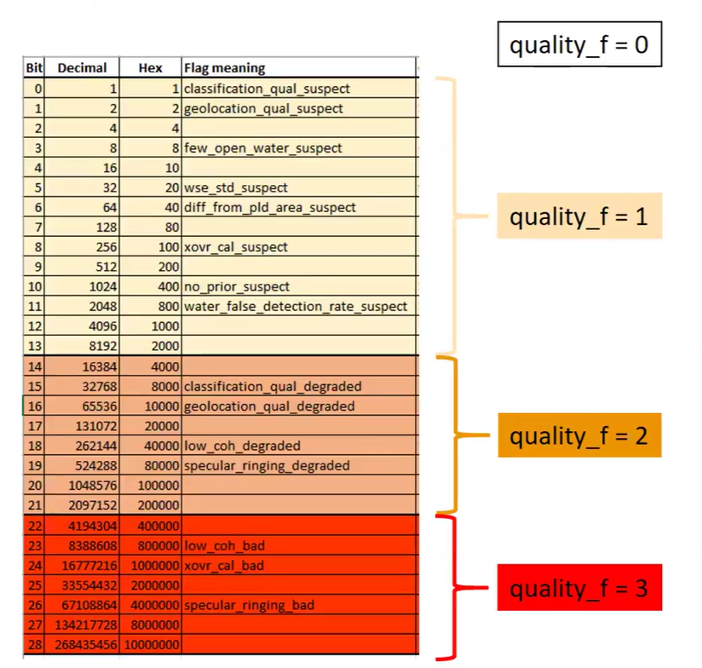
Updated quality_f in PIC2/PID0

Slide 4
lake WSE errors
Lake WSE validation
Impact of filtering of quality flags/indicators on WSE error
Flag | Value | 1σ|error| for lakes < 1km² | 1σ|error| for lakes > 1km²
quality_f | 0 | 17cm | 20cm
+ ice_f | 0&1 0 | 14cm 14cm | 14cm 11cm
+ xovr_qual_q | 0&1 0 | 14cm 14cm | 10cm 10cm
Baseline + partial_f | 0 | 14cm | 9cm
Baseline + dark_frac | < 50% | 13cm | 10cm
Baseline
Not significant: too few
matchups with dark water > 50%
(less than 100)
Claire Pottier, Roger Fjørtoft, on behalf of the HR Cal/Val Team, 2024 SWOT ST meeting

Slide 5
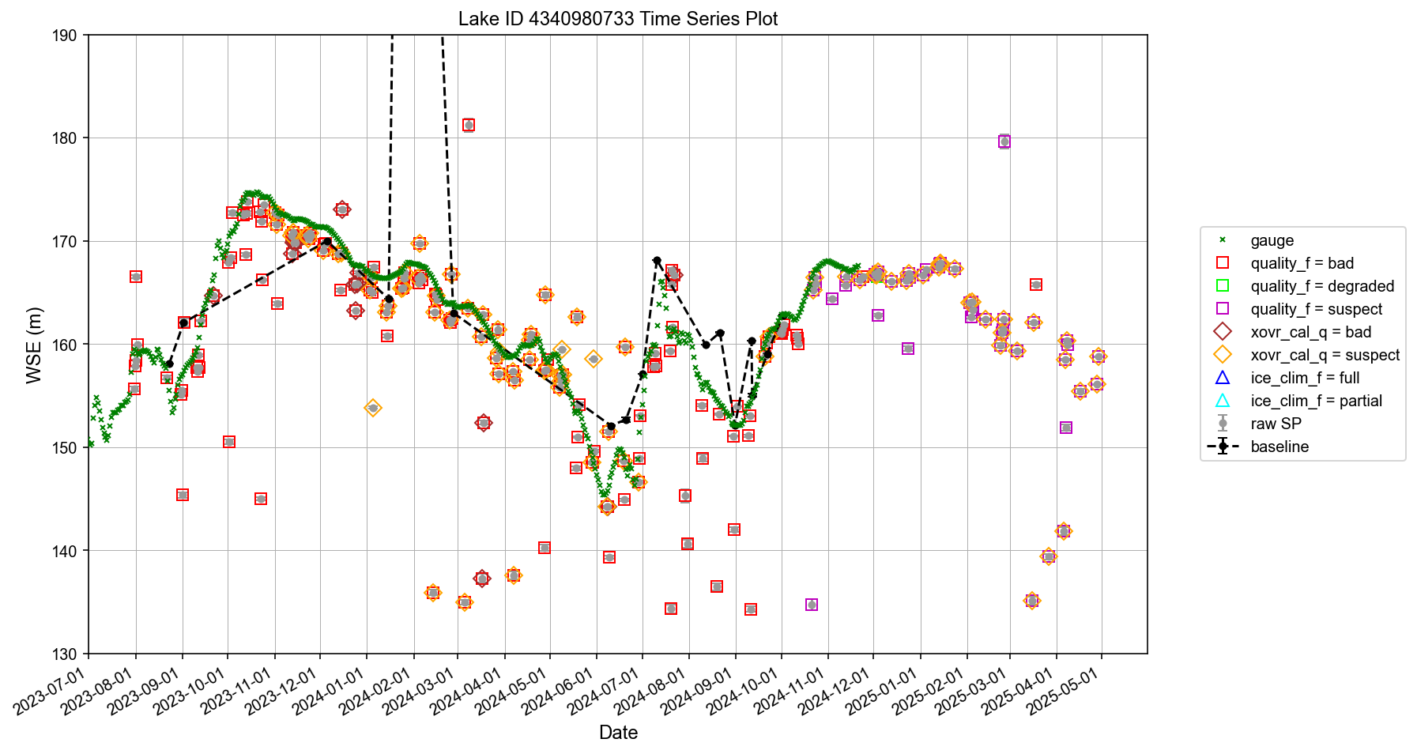
Three Gorges Reservoir
Retention rate 6.7%
Flood control
Peak hydropower
Peak hydropower
Impoundment
Impoundment
Water supply
Flood control
Water supply
Notes:
df_cleaned = df_cleaned.query('xovr_cal_q < 1 & ice_clim_f < 1')
df_cleaned = df_cleaned.query('(quality_f < 1 & (crid != "PIC2" & crid != "PID0")) or (quality_f < 1 & (crid == "PIC2" or crid == "PID0"))')

Slide 6
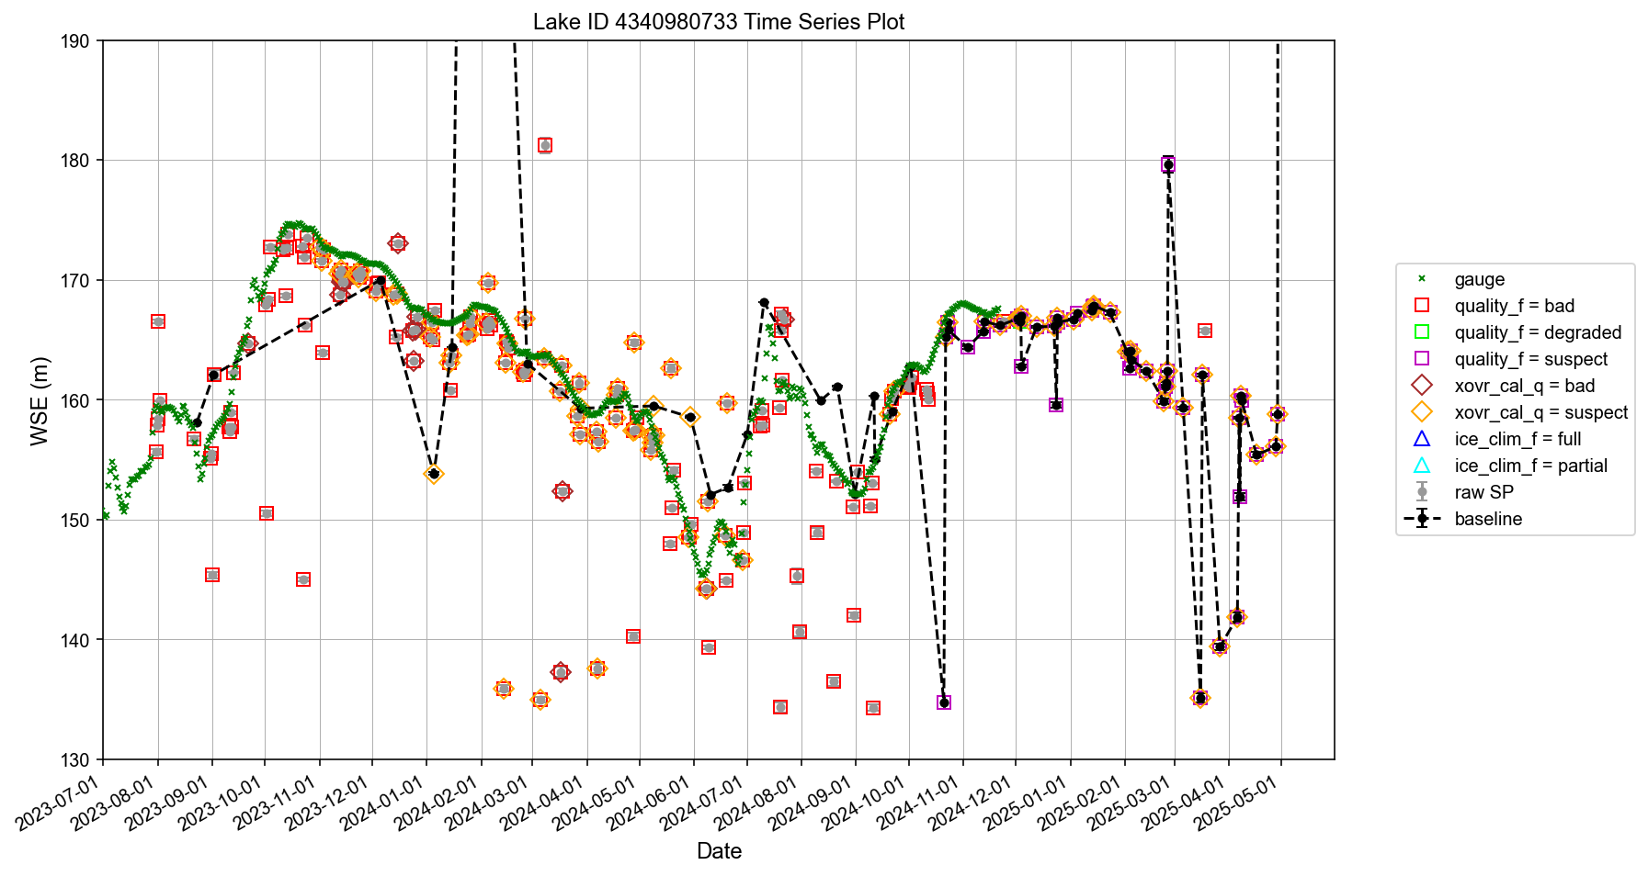
Three Gorges Reservoir
Retention rate 29.0%
Flood control
Peak hydropower
Peak hydropower
Impoundment
Impoundment
Water supply
Flood control
Water supply
Notes:
df_cleaned = df_cleaned.query('xovr_cal_q < 2 & ice_clim_f < 2')
df_cleaned = df_cleaned.query('(quality_f < 1 & (crid != "PIC2" & crid != "PID0")) or (quality_f < 3 & (crid == "PIC2" or crid == "PID0"))

Slide 7
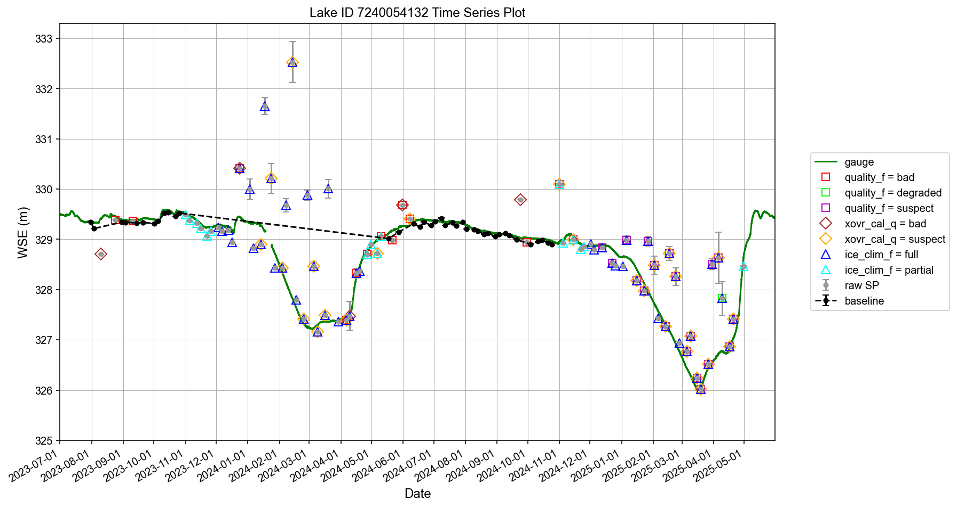
Barrage des Commissaires
Retention rate 33.9%
Notes:
df_cleaned = df_cleaned.query('xovr_cal_q < 1 & ice_clim_f < 1')
df_cleaned = df_cleaned.query('(quality_f < 1 & (crid != "PIC2" & crid != "PID0")) or (quality_f < 1 & (crid == "PIC2" or crid == "PID0"))')

Slide 8
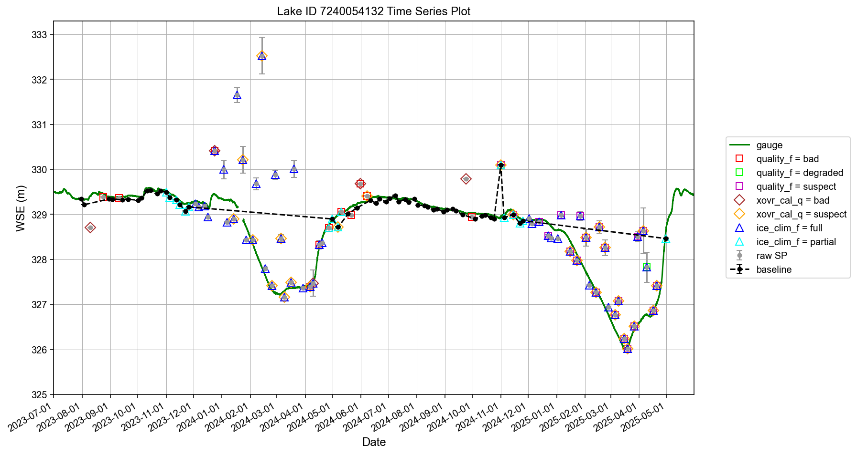
Barrage des Commissaires
Retention rate 46.1%
Notes:
df_cleaned = df_cleaned.query('xovr_cal_q < 2 & ice_clim_f < 2')
df_cleaned = df_cleaned.query('(quality_f < 1 & (crid != "PIC2" & crid != "PID0")) or (quality_f < 3 & (crid == "PIC2" or crid == "PID0"))') #lenient

Slide 9
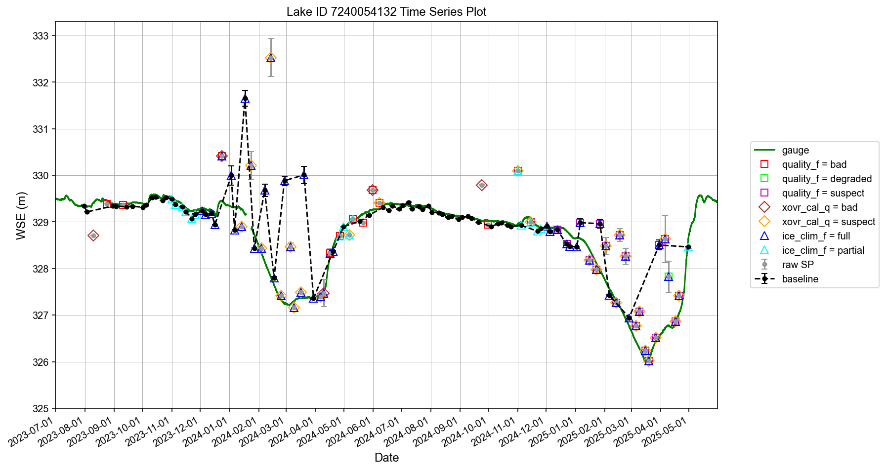
Barrage des Commissaires
Retention rate 65.2%
Notes:
df_cleaned = df_cleaned.query('xovr_cal_q < 1') #no worries about ice.
df_cleaned = df_cleaned.query('(quality_f < 1 & (crid != "PIC2" & crid != "PID0")) or (quality_f < 2 & (crid == "PIC2" or crid == "PID0"))') #lenient. Allow suspect to remain

Slide 10
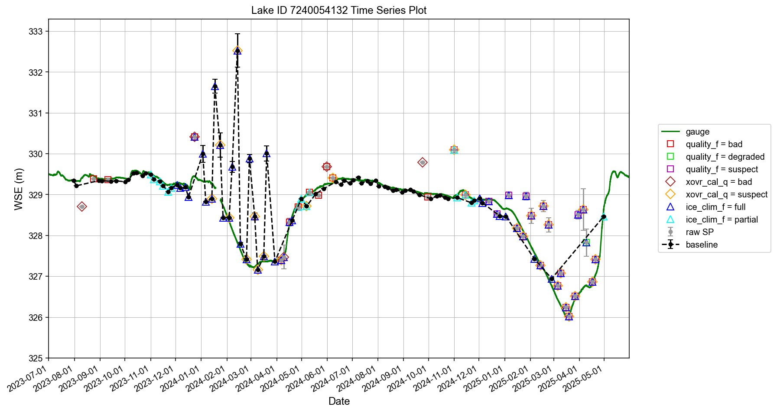
Barrage des Commissaires
Retention rate 68.7%
Notes:
df_cleaned = df_cleaned.query('xovr_cal_q < 2') #no worries about ice.
df_cleaned = df_cleaned.query('(quality_f < 1 & (crid != "PIC2" & crid != "PID0")) or (quality_f < 1 & (crid == "PIC2" or crid == "PID0"))') #lenient. Allow xovr_cal_q suspect to remain.

Slide 11
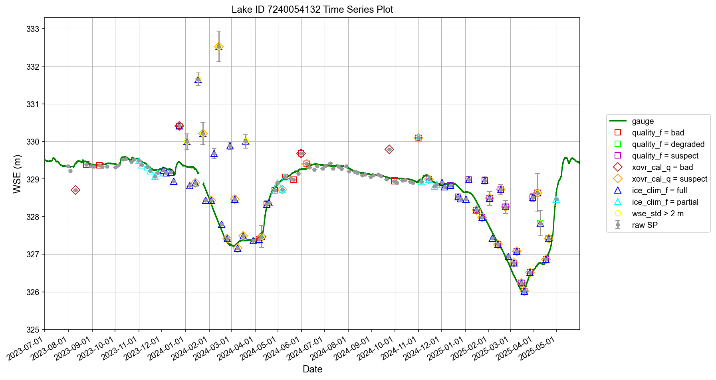
Barrage des Commissaires
Strategy: let data with good quality flags inform maximum wse_std and wse_u thresholds
Notes:
xovr_cal_q = 0 & ice_clim_f <= 1 & quality_f <= 1.

Slide 12
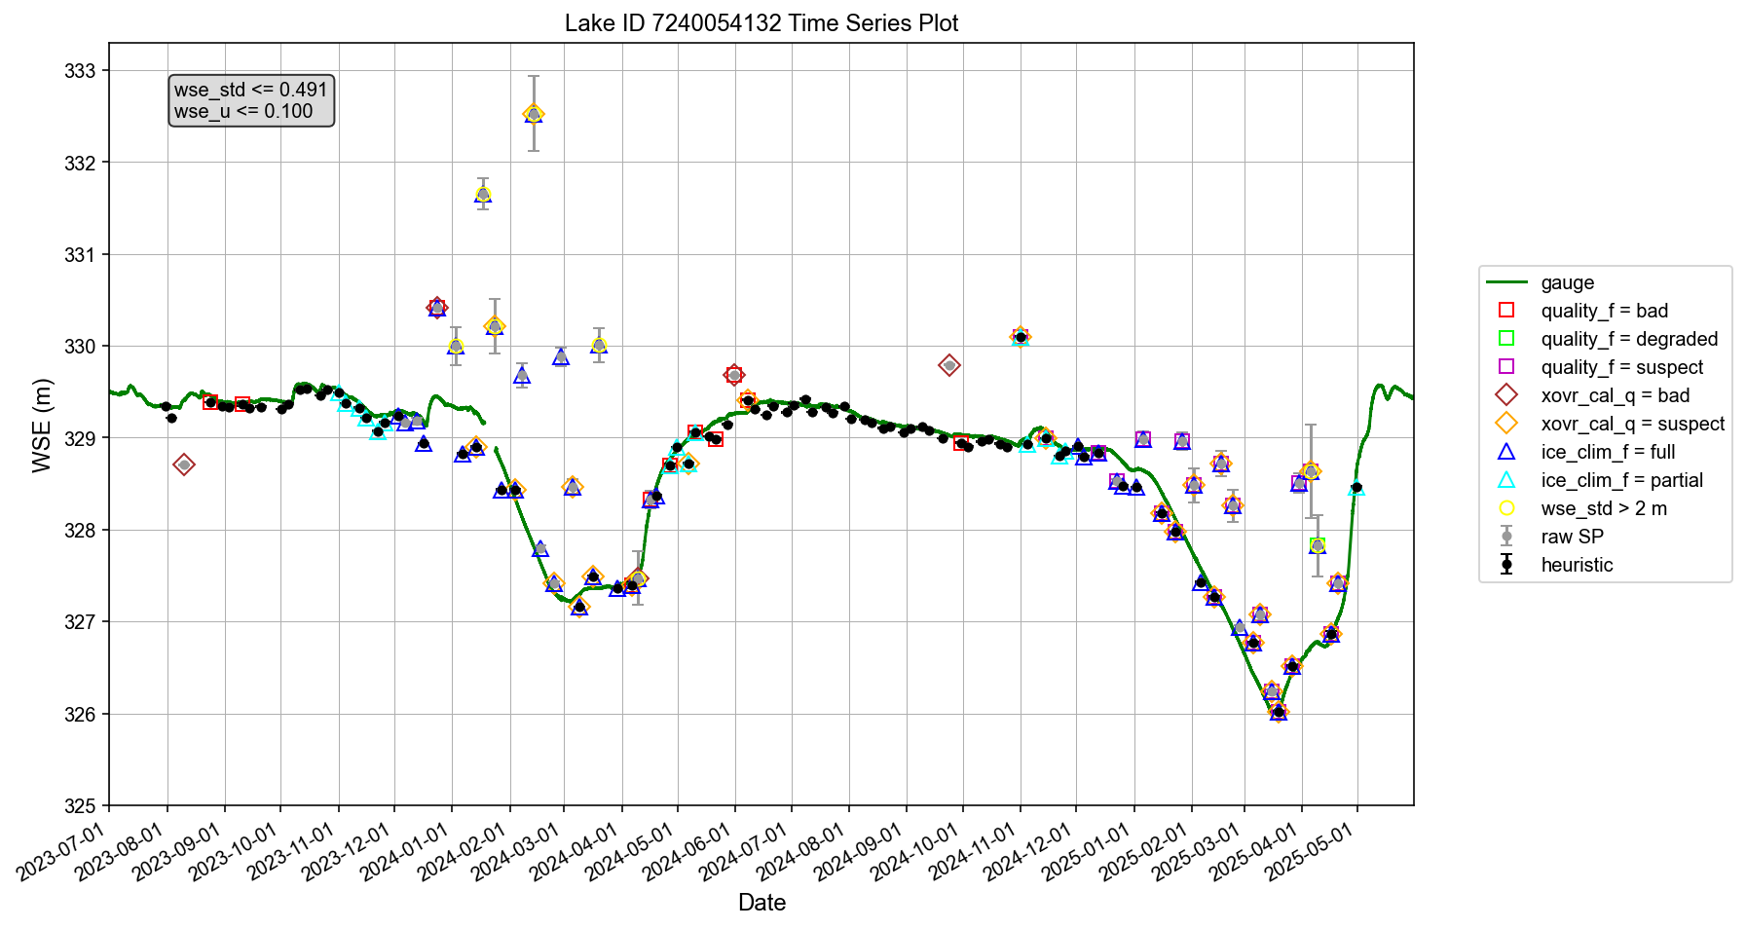
Barrage des Commissaires
Selected data using wse_std and wse_u thresholds
Notes:
df_cleaned = df_cleaned[ (df_cleaned['wse_std'] <= wse_std_threshold)]
df_cleaned = df_cleaned[ df_cleaned['wse_u'] <= wse_u_threshold ]
df_cleaned = df_cleaned[df_cleaned['xovr_cal_q'] < 2]
#Excluding specular_rining_bad, xovr_cal_bad, and low_coh_bad, but only applicable in PIC2 and PID0. For PIC0, do not use quality_f (which only contains 0 and 1)
df_cleaned = df_cleaned[df_cleaned['quality_f'] < 3]

Slide 13
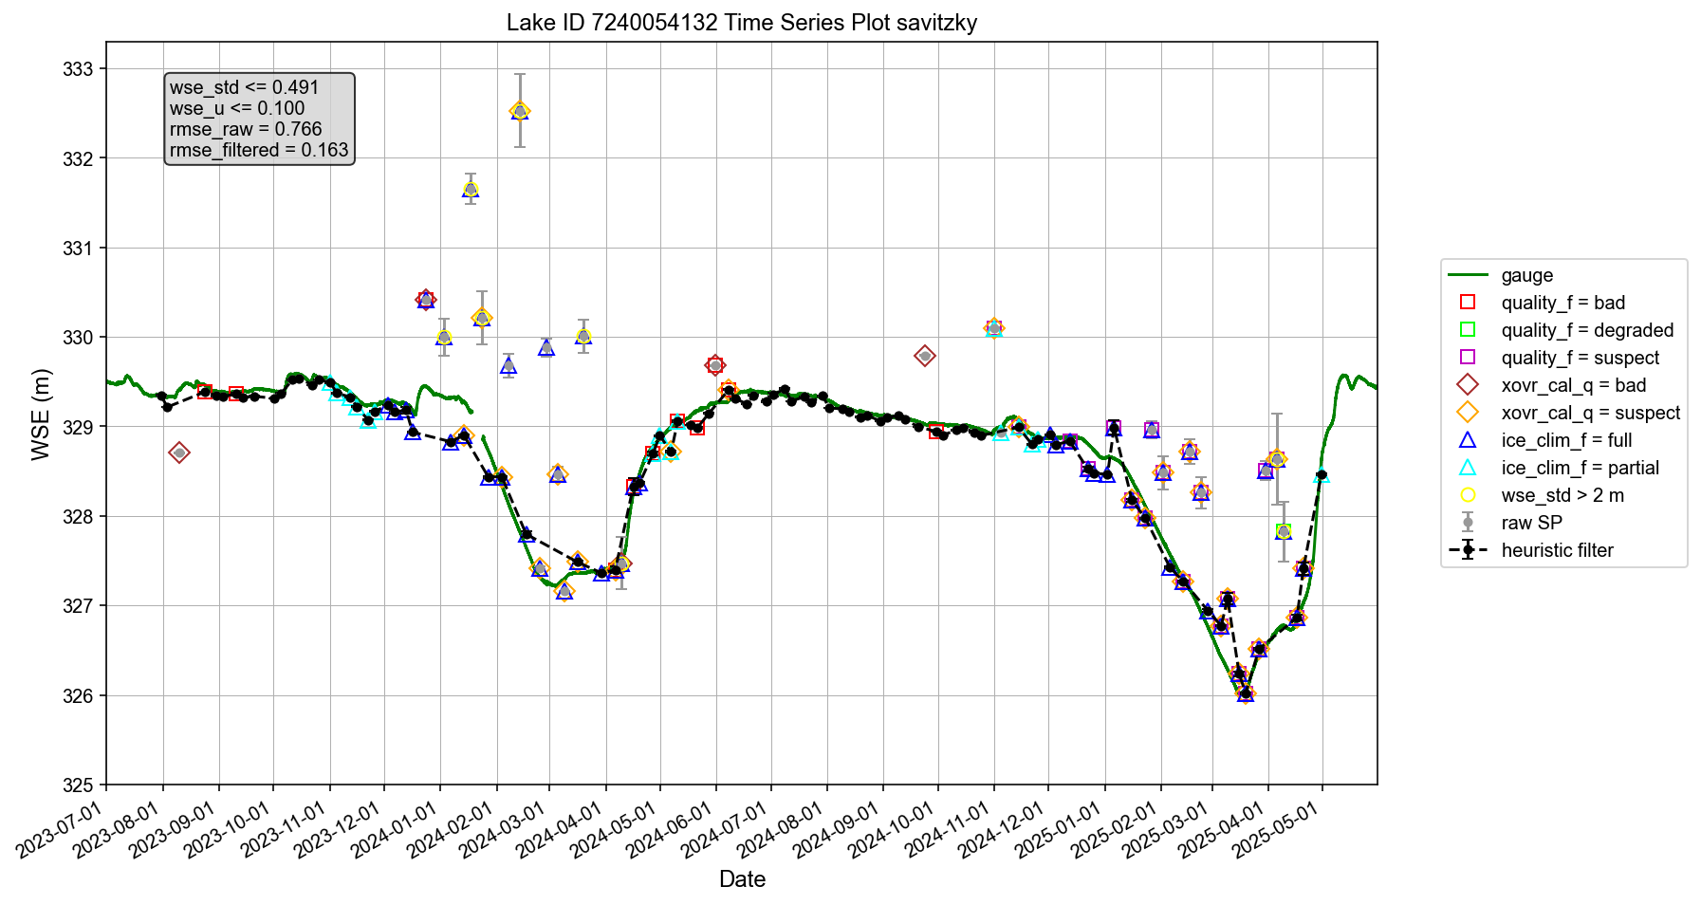
Barrage des Commissaires
Retention rate 79.1%
Further cleaned up using a low-pass filter
Notes:
Savitzky-Golay Filter

Slide 14
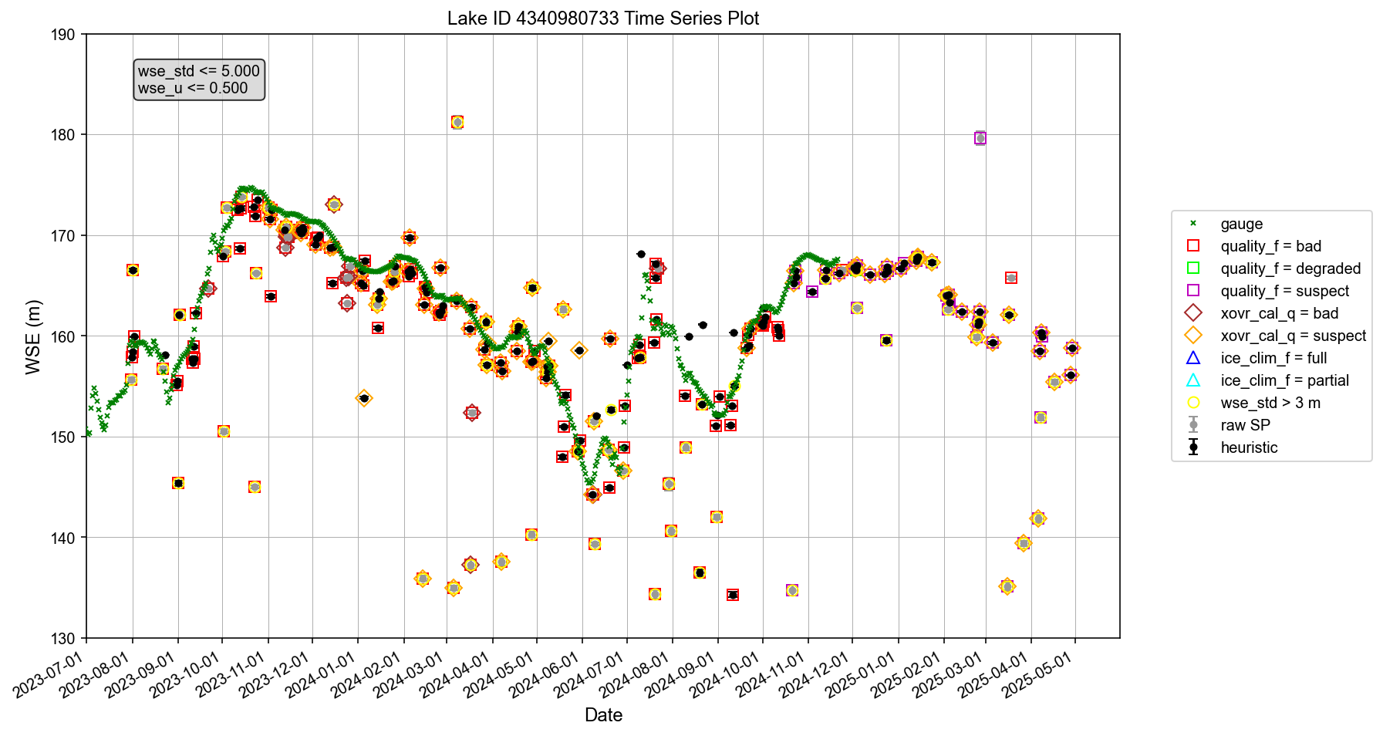
Three Gorges Reservoir
Selected data using wse_std and wse_u thresholds
Flood control
Peak hydropower
Peak hydropower
Impoundment
Impoundment
Water supply
Flood control
Water supply

Slide 15

Three Gorges Reservoir
Retention rate 54.8%
Low-pass filter evaluated on selected data
Flood control
Peak hydropower
Peak hydropower
Impoundment
Impoundment
Water supply
Flood control
Water supply
Notes:
Evaluated on selected data

Slide 16

Three Gorges Reservoir
Retention rate 61.9%
Low-pass filter evaluated on all data
Flood control
Peak hydropower
Peak hydropower
Impoundment
Impoundment
Water supply
Flood control
Water supply
Notes:
Evaluated on all data

Slide 17
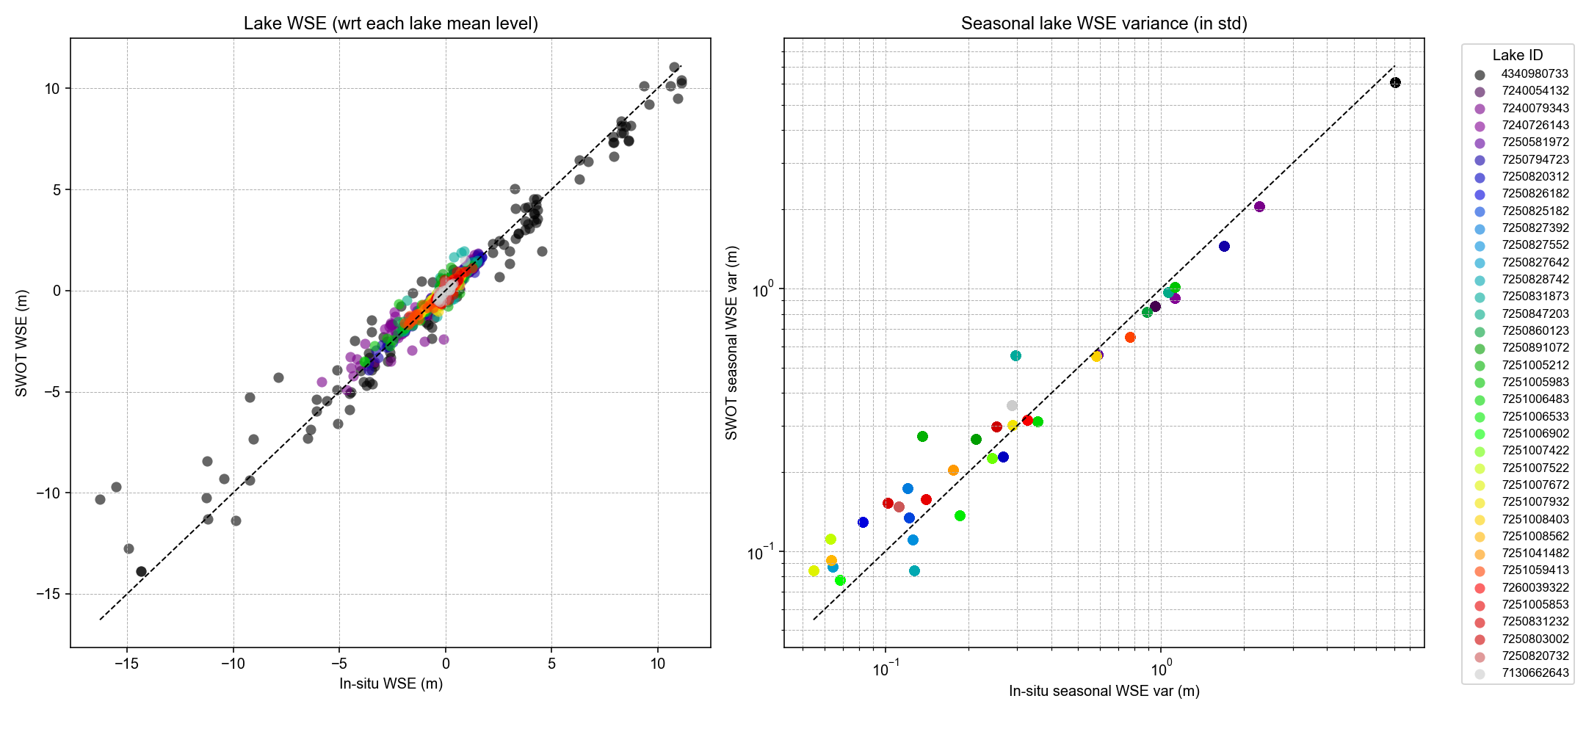
MAE (median, 1σ):
0.12 m, 0.15 m
Relative err (median, 1σ):
14.9%, 26.0%
Average retention rate 80.3% per lake, as opposed to 30–48% if using the baseline filter

Slide 18
Discussion
Is this heuristic filter reasonable?
Any alternative strategy?
Seeking voluntary contributions to:
Possibly improve the filter
Widely validate the filter
In-situ data needed
Merritt Harlan has agreed to provide USGS and ECCC data for about 500 lakes and reservoirs across North America.
Other parts of the world?
Volunteer to lead or assist in validation analysis?

Slide 19
Updates on 07/04/2025
Discussion with Melanie and Sylvain

Slide 20
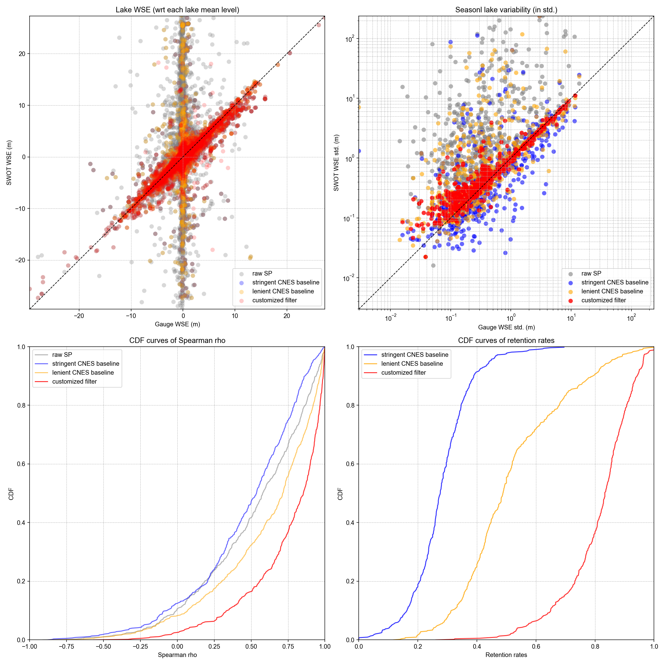
All 630 lakes thus far
(based on script version 5)
Stringent CNES baseline (baseline 1):
CNES_baseline1 = 'xovr_cal_q < 1 & ice_clim_f < 1 & quality_f < 1’
More lenient CNES baseline (baseline 2):
CNES_baseline2 = ('xovr_cal_q < 2 & ice_clim_f < 2 & '
'((quality_f < 1 & (crid != "PIC2") & (crid != "PID0")) '
'| (quality_f < 3 & ((crid == "PIC2") | (crid == "PID0"))))')
1-sigma err = 36%

Slide 21
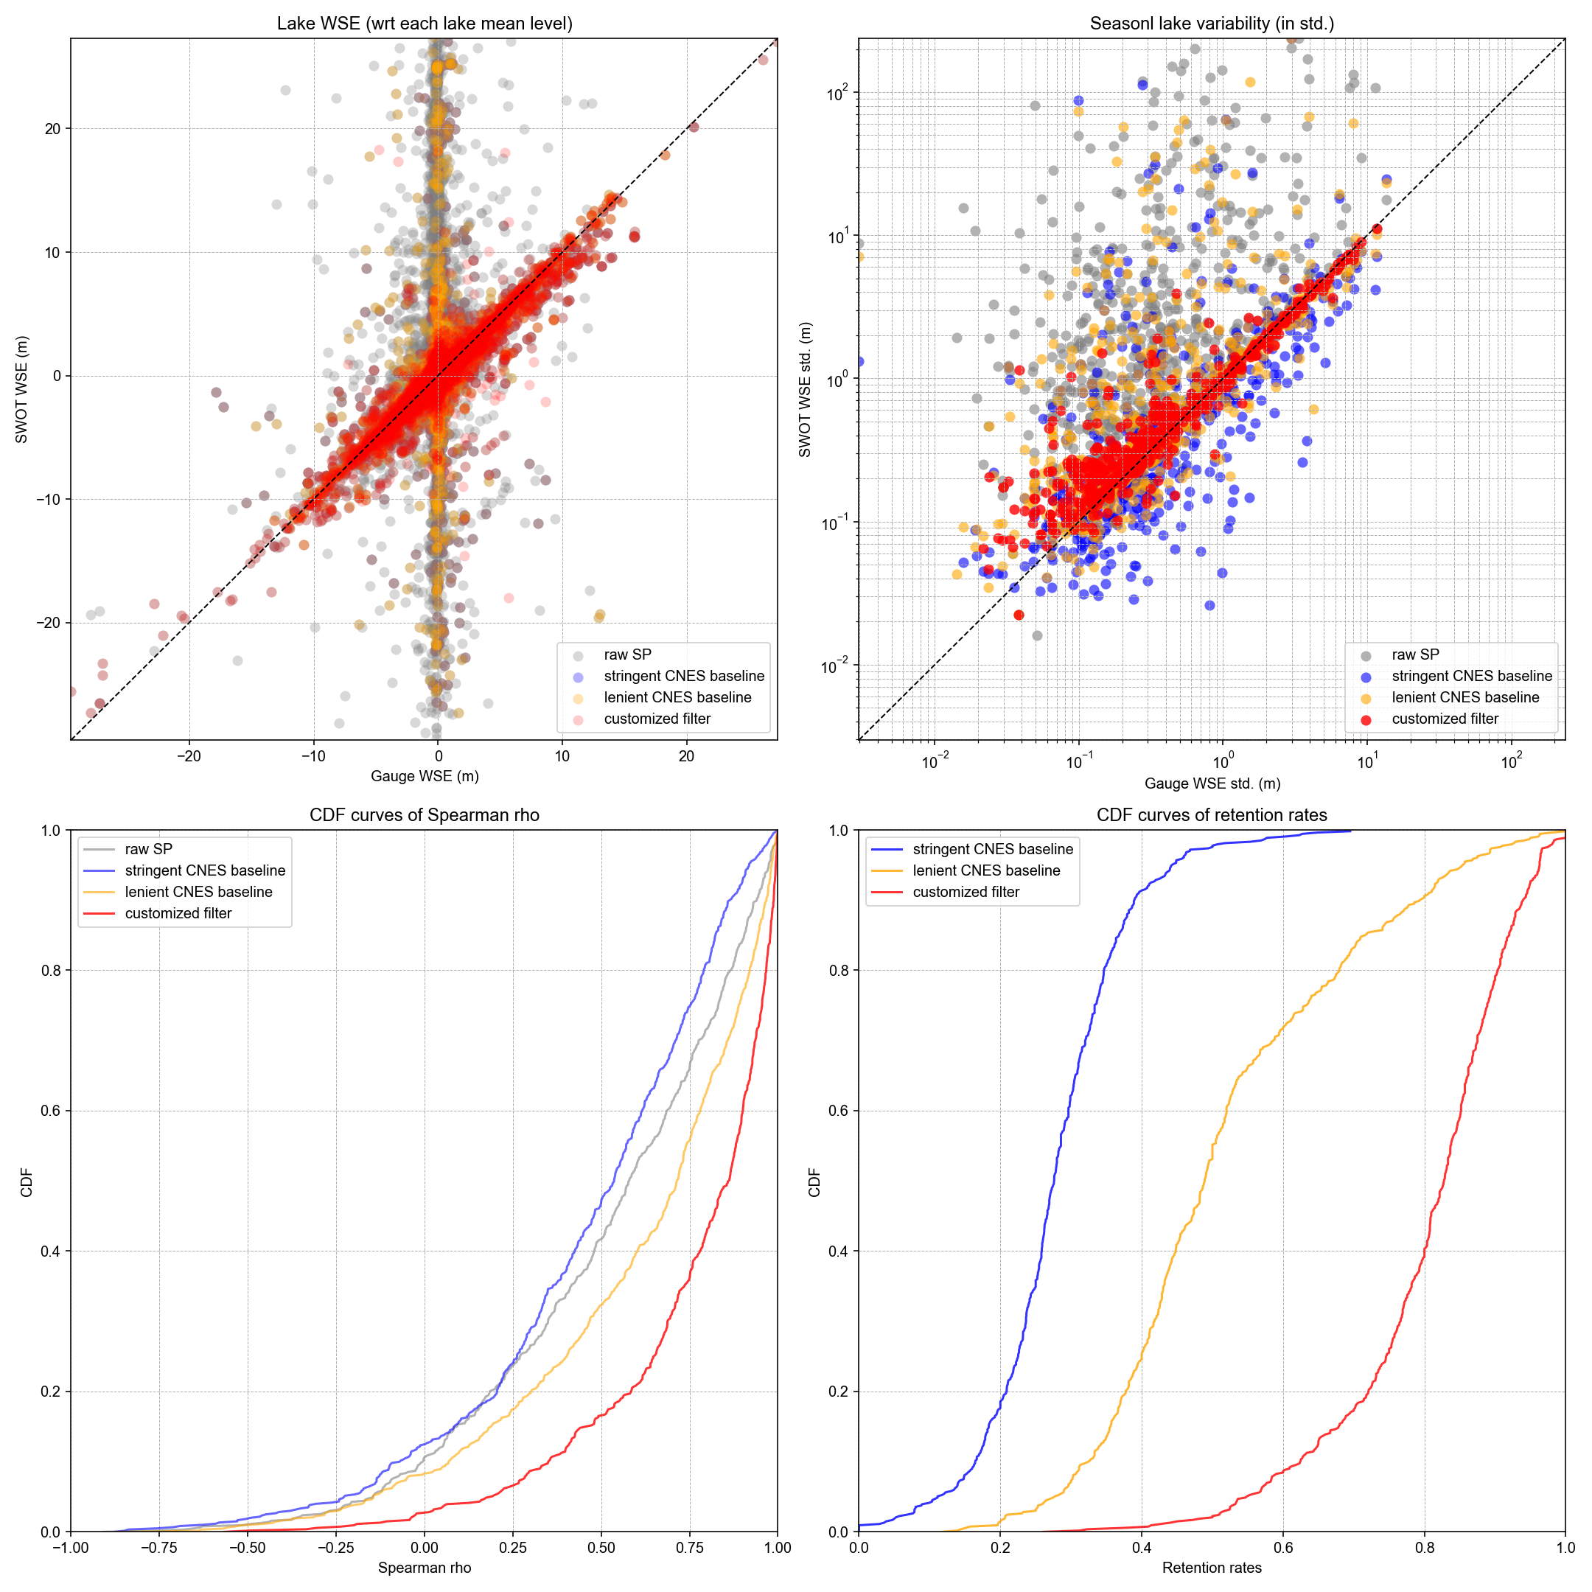
All 630 lakes (version 6)
Improvements:
Flexibility to enable calibration of heuristic thresholds (maximum wse_std and wse_u) to be specific to:
CRID versions: PIC0/PGC0 vs. PIC2/PID0
Pass IDs (for lakes that span multiple SWOT passes)
Flexibility to remove ice-covered anomalies by comparing area_total and WSE against valid ice-free observations, evaluated pass by pass (this has to be pass-specific as area_total is used).
1-sigma err = 33%
This figure implemented:
Lake-specific global thresholds
Pass-specific ice anomaly removal

Slide 22

All 630 lakes (version 6)
Improvements:
Flexibility to enable calibration of heuristic thresholds (maximum wse_std and wse_u) to be specific to:
CRID versions: PIC0/PGC0 vs. PIC2/PID0
Pass IDs (for lakes that span multiple SWOT passes)
Flexibility to remove ice-covered anomalies by comparing area_total and WSE against valid ice-free observations, evaluated pass by pass (this has to be pass-specific as area_total is used).
1-sigma err = 33%
This figure implemented:
CRID-specific thresholds
Pass-specific ice anomaly removal

Slide 23

All 630 lakes (version 6)
Improvements:
Flexibility to enable calibration of heuristic thresholds (maximum wse_std and wse_u) to be specific to:
CRID versions: PIC0/PGC0 vs. PIC2/PID0
Pass IDs (for lakes that span multiple SWOT passes)
Flexibility to remove ice-covered anomalies by comparing area_total and WSE against valid ice-free observations, evaluated pass by pass (this has to be pass-specific as area_total is used).
1-sigma err = 34%
This figure implemented:
CRID-specific and pass-specific thresholds
Pass-specific ice anomaly removal

Slide 24
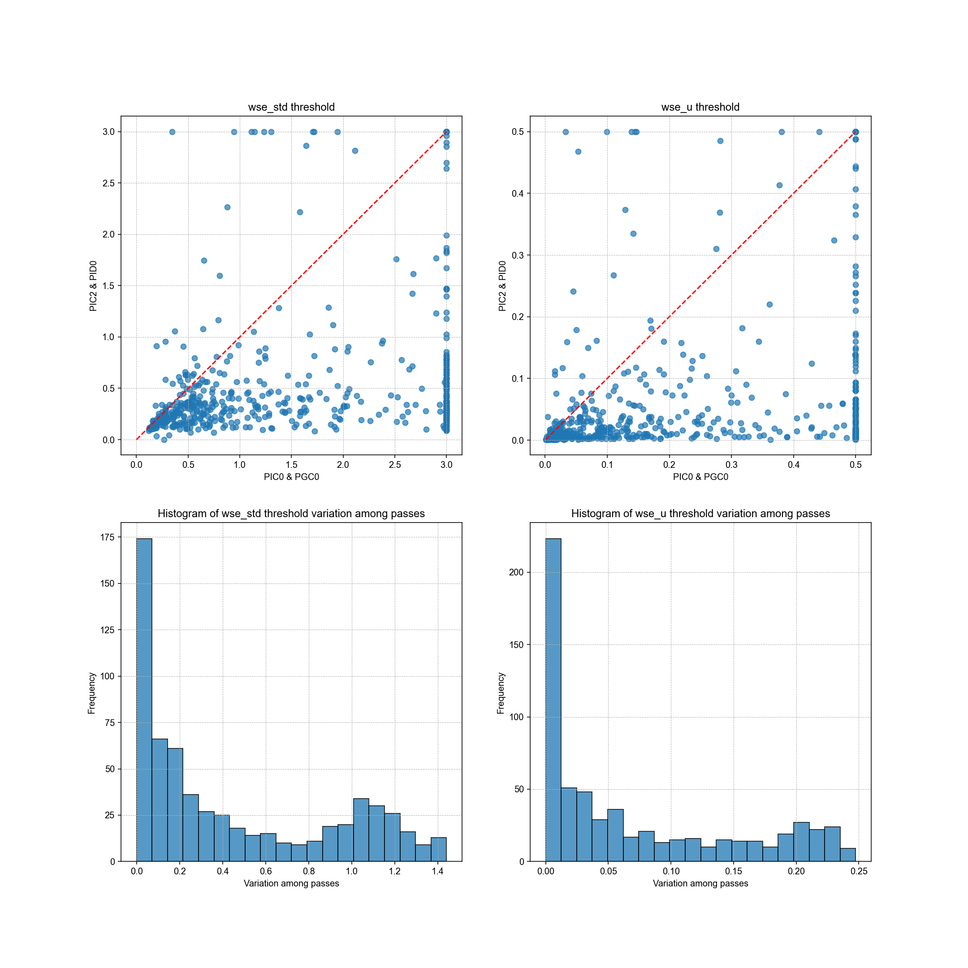
Sensitivity test of heuristic thresholds
As expected, PIC2/PID0 result in lower thresholds for both wse_std and wse_u compared to earlier data versions (PIC0/PGC0).
However, shown in the previous slides, applying CRID-specific thresholds (or pass-specific thresholds) produces filtering results that are largely comparable to those obtained using global thresholds, but sometimes at the cost of over-rejection and reduced retention rate. So, there seems to be a trade-off between accuracy and generalizability.
These options are made available in the code, and we can provide such flexibility to users. But I personally prefer lake-specific global thresholds for our lake dynamic paper.
Sensitivity to CRID versions
Sensitivity to orbit passes

Slide 25
Updates on 07/13/2025
After discussion with Melanie and Sylvain
Included gauge data from 1000+ lakes and reservoirs
Results are based on the latest script (v7): Customized-LakeSP-filter-v7-07132025.py
Improvement:
Allows flexibility of threshold calibration specific to CRID version and SWOT passes.
Improved ice outlier removal, but WSE underestimation during ice periods remains a challenge! Voluntary helps are appreciated.
Incorporated Melanie’s suggestion on bias correction between gauge and SWOT data
Incorporated Melanie’s random forest to compute feature importance

Slide 26
We have thus far collected the following gauge data. Regions/lakes may overlap among the data sources but the unique lake count is 1068.
Region | Count of PLD lakes | Temporal frequency | Sources | Data provider
Quebec | 35 | Daily | CEHQ | Mélanie Trudel
Canada | 277 | SWOT passes | ECCC, CEHQ, Spence, HQ, UDES
North America | 589 | SWOT passes | ECCC, Quebec, USBR, USGS | Merritt Harlan
China | 38 | Daily | Multiple authorities | Chunqiao Song
West Africa | 2 | Hourly or finer | In situ measurement | Manuela Grippa; Félix Girard; Laurent Kergoat
Amazon | 1 | Daily | In situ measurement (Mamirauá Institute for Sustainable Development) | Ayan Fleischmann
Ceará, Brazil | 8 | Every 30 min | In situ measurement (Funceme) | Rafael Oliveira; Marielle Gosset; Eduardo Sávio Rodrigues Martins
India | 358 | Monthly | NWIC, APWRIMS, Gujarat, CWC | Deep Shah; Huilin Gao
Total | 1308
Total unique (excluding duplicates) | 1068

Slide 27
Conceptual procedure of the customized filter
Apply conservative quality flags to subset assumed high-quality SP observations
Raw LakeSP time series
Built-in flexibility to be CRID or pass adaptive
Calibrate heuristic thresholds for this lake (mainly based on wse_std and wse_u; see next slide for RF-based feature importance)
Heuristic baseline time series (i.e., a subset of raw SP time series based on heuristic thresholds)
Check if the heuristic baseline is temporally representative:
no major gaps (> 3 months),
requiring no major extrapolation (> 20% of the time range)
Each iteration includes:
Low-pass filtering
Remove positive ice anomalies
Remove remaining extreme outliers (Tukey’s test)
Option to reintroduce high-quality observations removed by round 1, and apply a round-2 (less aggressive) iterative low-pass filter
Apply a round-1 (more aggressive) iterative low-pass filter.
no
yes
Remove significant WSE inconsistency due to by multiple overpasses
Abandon this lake
Final filtered SP time series

Slide 28
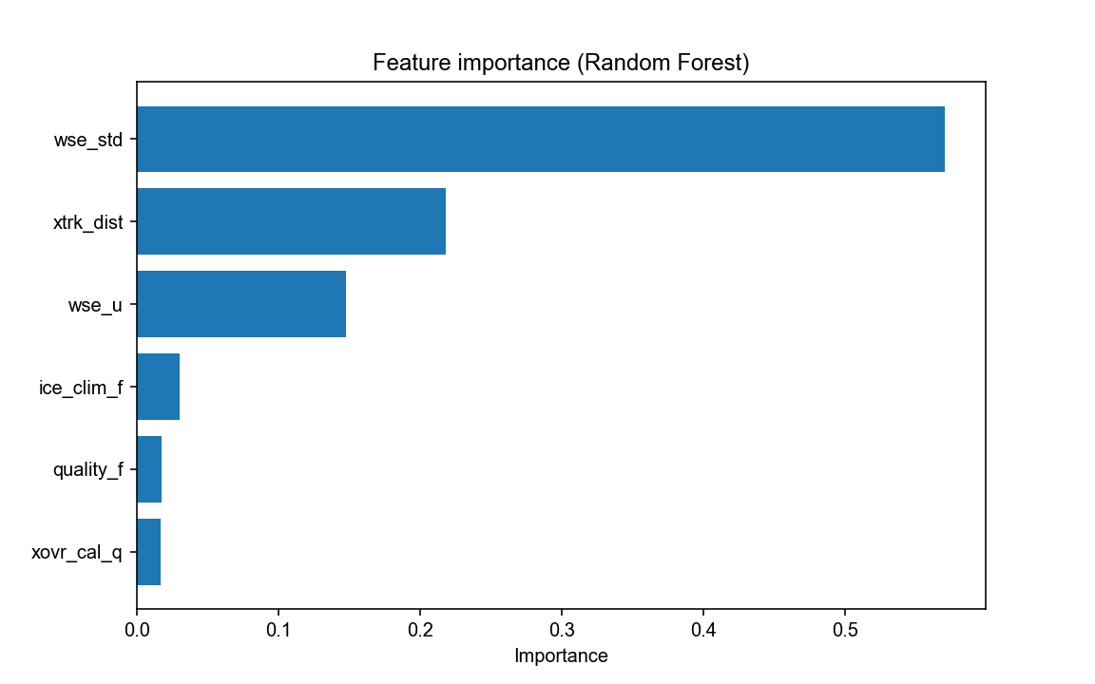
Random forest test for feature importance
In addition to “wse_std” and “wse_u”, “xtrk_dist” turned out to be another important feature, probably related to specular ringing or other errors near the nadir.
We may need to include “xtrk_dist” as another metric to calibrate heuristic thresholds.
Any voluntary help for this will be appreciated!

Slide 29
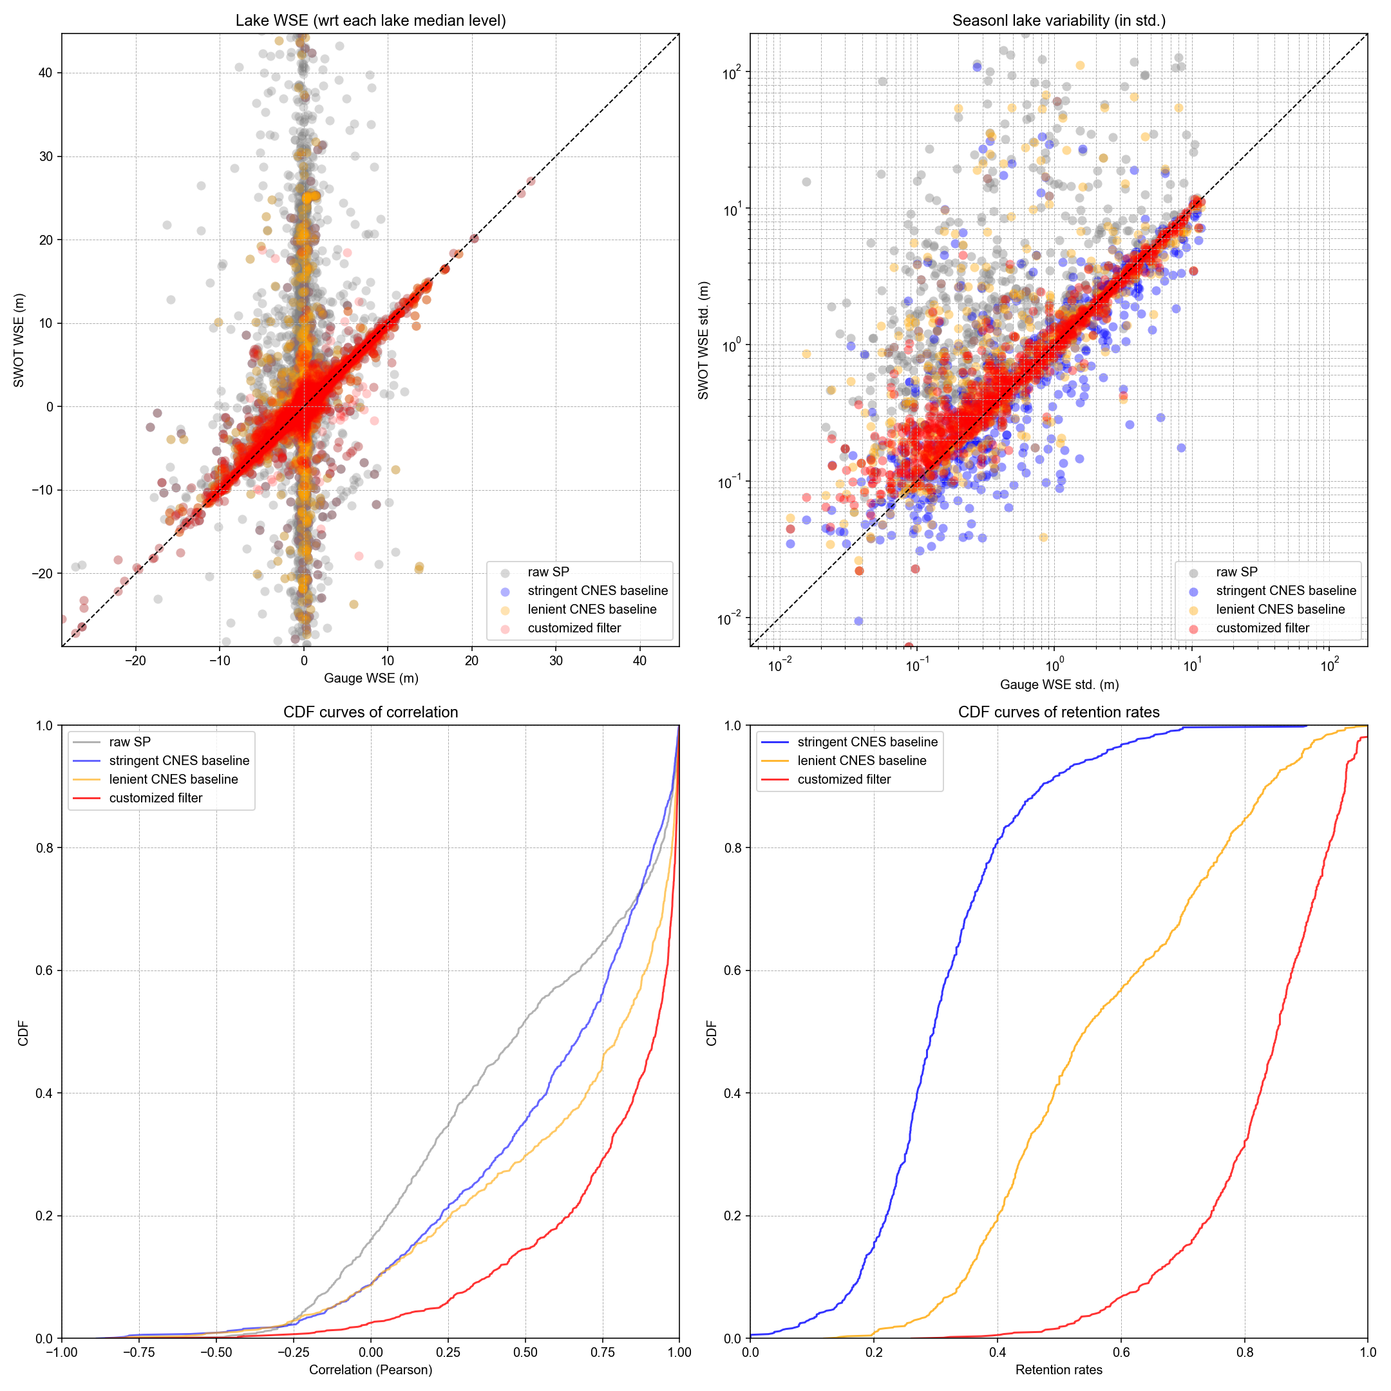
Result based on all 1068 lakes (script v7)
84.1% (898) of these 1068 lakes passed the retention criteria after filtering:
Maximum temporal gap < 3 months
Proportion of time series requiring extrapolation < 80%
For a fair “apples-to-apples” comparison, statistics are computed based on these 84.1% of the lakes. Including the remaining 15.9% of the lakes in the plot will only further deteriorate the statistics for raw LakeSP and the two CNES baselines.
Compared to raw LakeSP and the two CNES baselines (see Slide 20 for definition), the customized filter (red) improved every one of the four metrics: RMSE, relative error in annual WSE variability, Pearson correlation, and retention rate.
Some outliers remain, and most could be attributed to ice-related impacts, and part of them may also come from gauge data errors.
Median err = 12.6%
1-sigma err = 31.0%
Notes:
3.7205749972021973
0.5286440426665399
0.5420948491031606
0.3104395100970873
14.132891092434878
2.1428431506242482
3.3088307316415544
0.4990750408727158

Slide 30
To do list from the team:
1. Quality control on gauge data:
Particularly, please make sure each gauge matches the correct PLD lake ID.
If there are multiple gauges for one PLD lake, avoid the gauge in the upstream “river” section of the lake – where WSE could be impacted by backwater or reflects the river changes instead of the lake variation.
Remove noises in the existing gauge data (I spotted and corrected a few cases but other errors may remain).

Slide 31
To do list from the team:
2. Further minimize ice impacts:
Ice impacts are challenging and can lead to both over- and under-estimation of the lake WSE. Particularly, ice-induced WSE underestimation can falsely increase the annual WSE variability, which is probably the most important remaining error source now. We need voluntary contributions to look into the script and help reduce such impacts. Note we can’t just remove all ice observations as some represent valid/accurate signals such as reservoir drawdowns.
Another challenge is that some gauges are non-operational during winter or freeze-up periods, under the assumption of minimal hydrological activity – despite the possibility of reservoir drawdowns. These seasonal gauge data gaps introduce uncertainty in the evaluation of ice impacts. To validate seasonal WSE variability, we simply interpolated the gauge data to generate continuous daily time series. However, we are not certain if this was the most appropriate way (needs someone to critically review the script.

Slide 32
To do list from the team:
3. Challenges to capture freshets
Preserving freshet-induced WSE jumps, particularly those caused by snowmelt, remains a challenge. These events are often excluded from the heuristic baseline due to high values of WSE_std, WSE_u, or poor xovr_cal_q, among other factors. Alternatively, they may be inadvertently filtered out by the low-pass filter, as such isolated jumps can resemble statistical outliers. For example, in many cases, we wouldn't even recognize them as valid observations without gauge confirmation. We would greatly appreciate any voluntary help in reviewing the script and improving the preservation of these critical freshet-driven WSE signals (see examples in the next couple of slides).

Slide 33
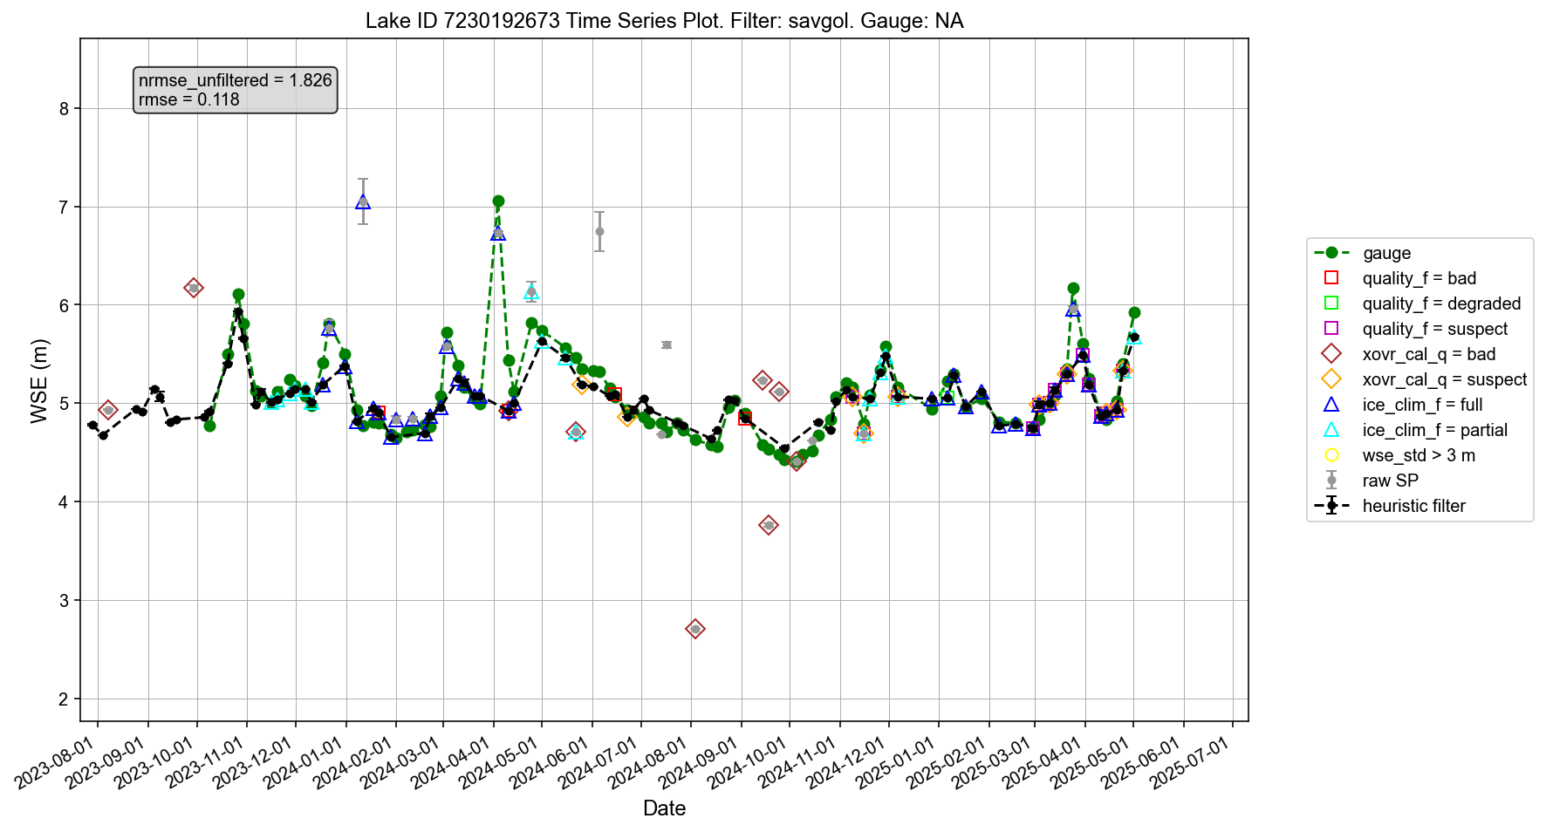

Slide 34
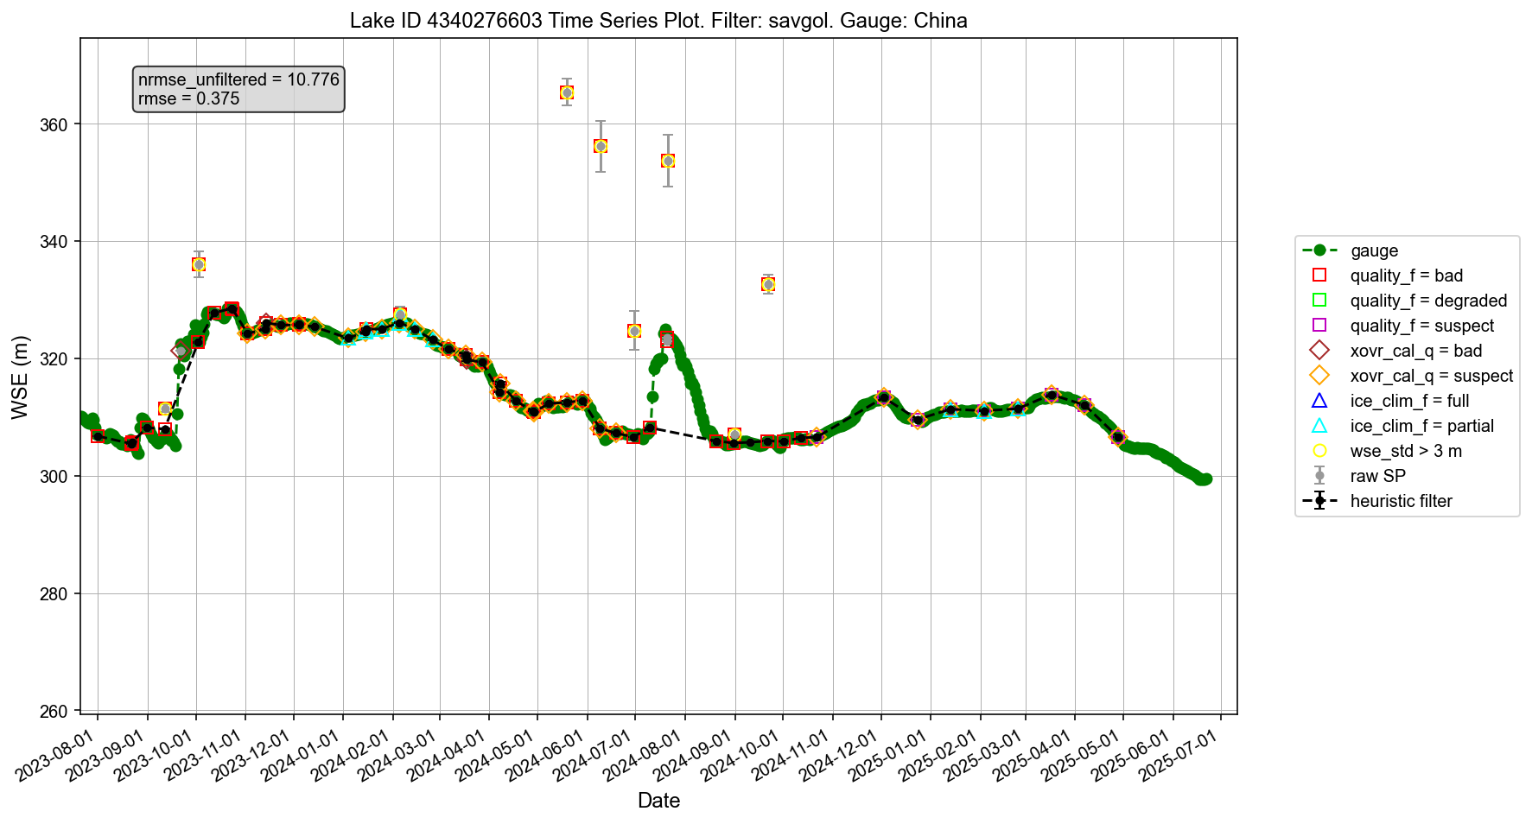

Slide 35
To do list from the team:
4. Include “xtrk_dist” in calibrating heuristic thresholds?
As shown in the Random Forest feature importance results, “xtrk_dist” (along with “wse_std” and “wse_u”) emerged as another important metric influencing WSE errors, likely due to specular ringing or other issues near the nadir. It may be necessary to incorporate “xtrk_dist” as an additional threshold when defining the heuristic baseline prior to applying the low-pass filter. Again, we would greatly appreciate any voluntary help in exploring and implementing this improvement (if necessary at all).

Slide 36
Summary of updates on August 7, 2025
Incorporated “xtrk_dist” as another threshold to the filter (in addition to “wse_std” and “wse_u”): It doesn’t make too much difference likely because the discriminatory capability of “xtrk_dist” largely overlaps with those of “wse_std” and “wse_u”.
Also importantly, low “xtrk_dist” values for the LakeSP product can be caused by one validly detected lake split into both swaths (such as the Three Gorges Reservoir), leading to the centroid of the lake falling within the track gap. This does not mean the lake detection is of poor quality. We suggest that for future LakeSP improvement, computing another xtrk_dist metric based on the absolute distances to the track, instead of the negative and positive distances.

Slide 37
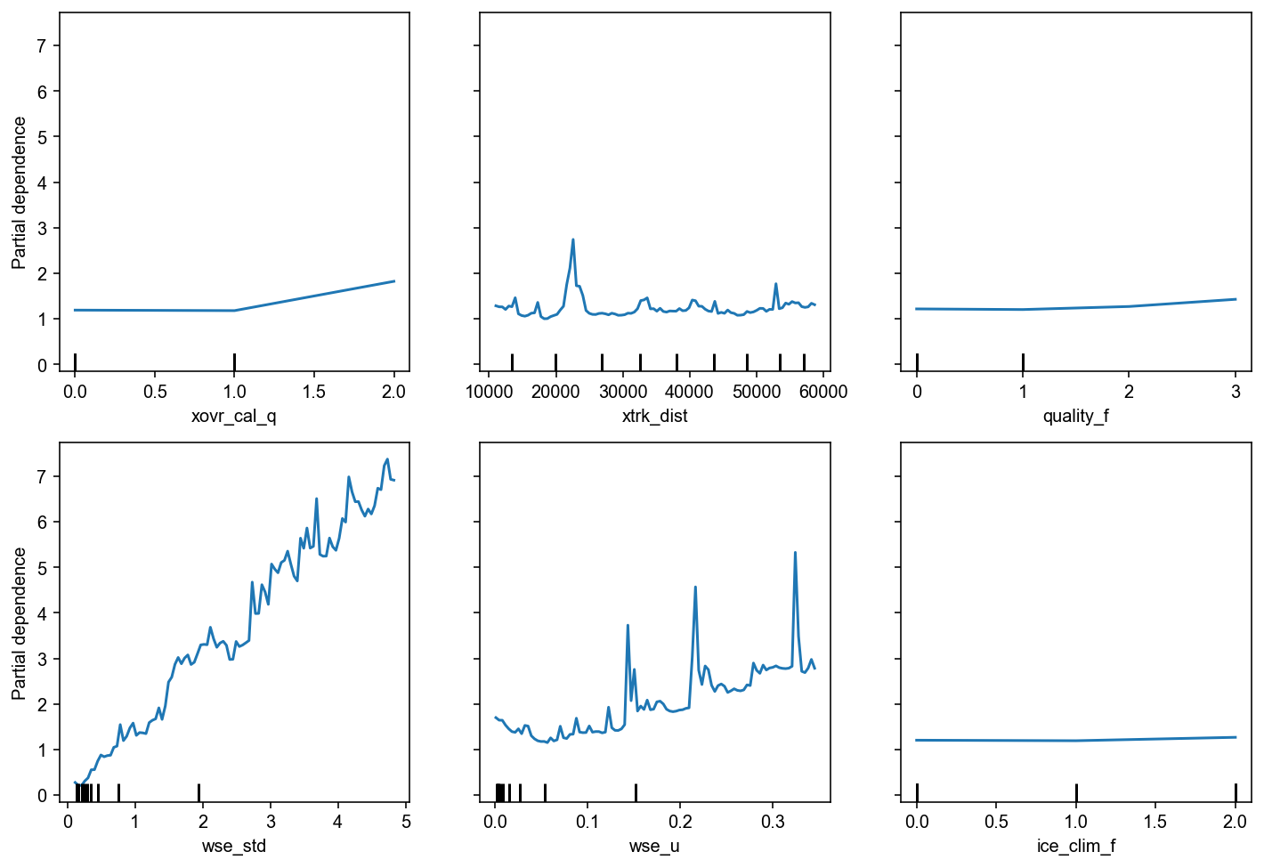
Notes:
#mask = (SWOT_error < 30 ) & (X_RF['ice_clim_f'] >= 0)
In scikit-learn’s Partial Dependence Plot (PDP), those longer tick marks on the x-axis aren’t random — they mark the actual feature values present in your training data that were used when computing the PDP curve.
Not necessarily all unique values — they represent the grid points that scikit-learn actually used to compute the partial dependence, and that grid is based on the unique values in your training data, but often it’s a subset.
Meaning of the long ticks
If your feature is categorical or has few unique numeric values: Long ticks will likely represent all unique values.
If your feature is continuous with many unique values: Long ticks will be the sampled grid points (not all unique values).

Slide 38
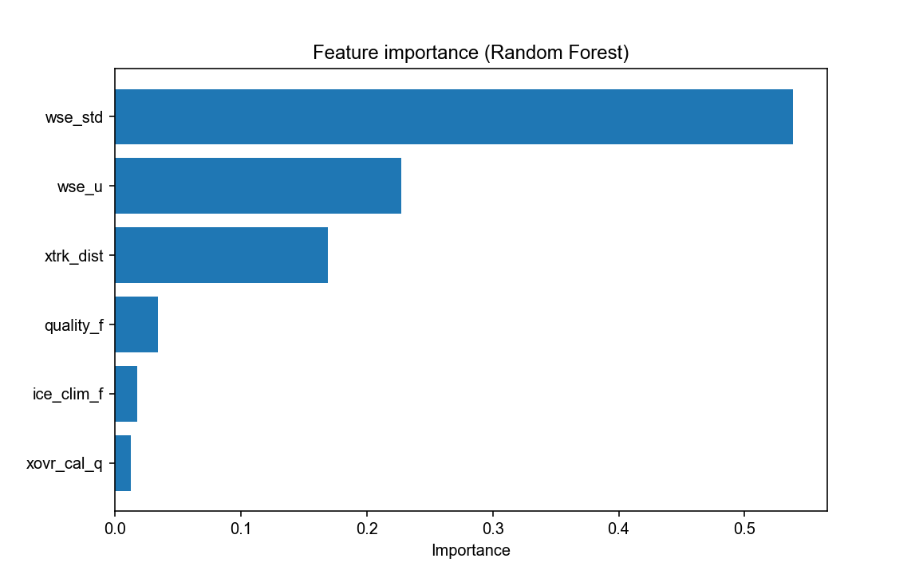
Notes:
Updated RF feature importance using all errors: (SWOT_error >= 0) & (X_RF['ice_clim_f'] >= 0)

Slide 39
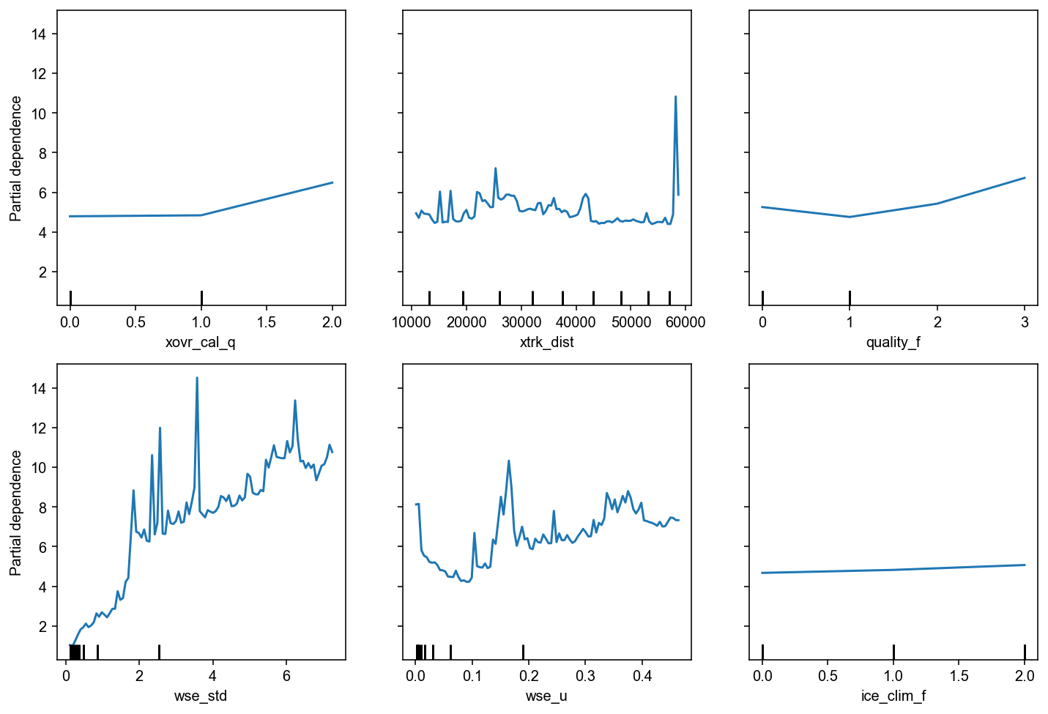
Notes:
Updated RF feature depende using all errors: (SWOT_error >= 0) & (X_RF['ice_clim_f'] >= 0)

Slide 40
Result based on all 1068 lakes (script v7)
84.1% (898) of these 1068 lakes passed the retention criteria after filtering:
Maximum temporal gap < 3 months
Proportion of time series requiring extrapolation < 80%
For a fair “apples-to-apples” comparison, statistics are computed based on these 84.1% of the lakes. Including the remaining 15.9% of the lakes in the plot will only further deteriorate the statistics for raw LakeSP and the two CNES baselines.
Compared to raw LakeSP and the two CNES baselines (strict and lenient), the customized filter (red) improved every one of the four metrics: RMSE, relative error in annual WSE variability, Pearson correlation, and retention rate.
Some outliers remain, and most could be attributed to ice-related impacts, and part of them may also come from gauge data errors.
Median err = 12.6%
1-sigma err = 31.0%
Notes:
3.7205749972021973
0.5286440426665399
0.5420948491031606
0.3104395100970873
14.132891092434878
2.1428431506242482
3.3088307316415544
0.4990750408727158

Slide 41
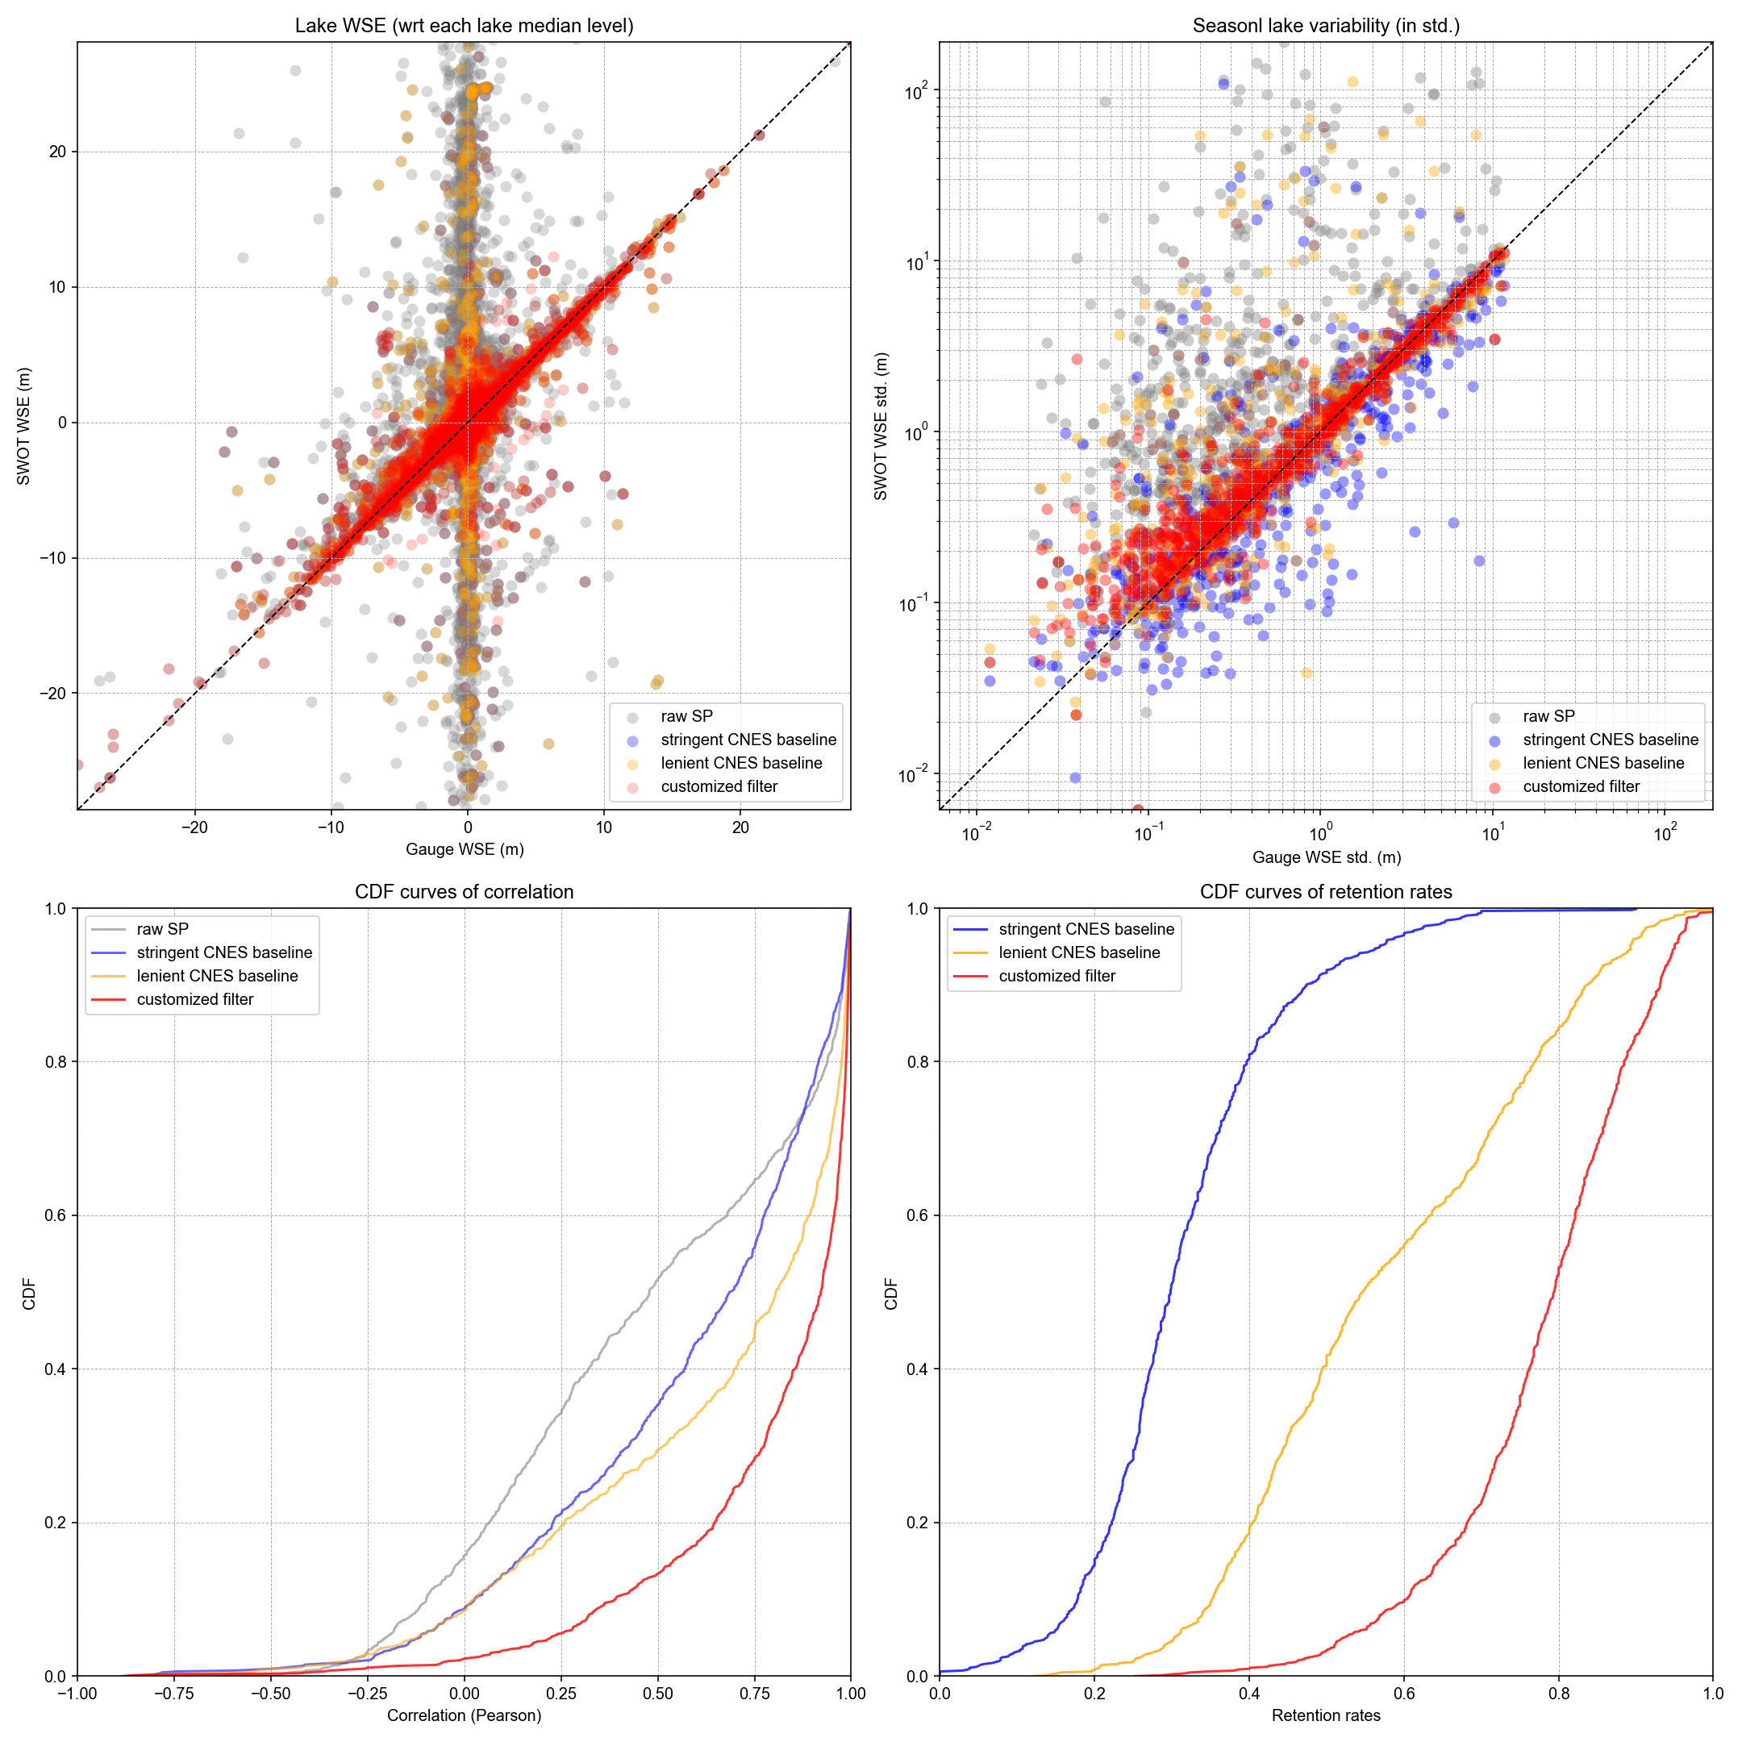
Result based on all 1068 lakes (script v7)
Incorporated “xtrk_dist” as another heuristic threshold, together with wse_std and wse_u
Retention rate decreased from 84% to 81%
Variability errors are not improved too much, likely because the discriminatory capability of xtrk_dist overlaps with those of wse_std and wse_u.
Median err = 12.9%
1-sigma err = 31.2%
Notes:
With xtrk_dist
3.610950278993773
0.531408376085037
0.5340549107520951
0.3116192984023878
1.190980727874294
0.29002954108654233
0.20384483337537843
0.12942378331049856
13.21192469595705
2.145775715742798
3.1752643403752003
0.584689252079969

Slide 42
Summary of updates on August 12, 2025
Gauge data update:
Chunqiao and Deep returned gauge data in China and India after assuring correct PLD assignment
Merritt shared continuous gauge time series in NA
Elyssa shared another 60 reservoirs in Brazil
Re-ran validation results using gauge data update: overall consistent with previous results (with slight improvements)
Minor tweaks of the script (now version 8)

Slide 43
Updated gauge data
Region | Count of PLD lakes | Temporal frequency | Sources | Data provider | Comments
Quebec | 35 | Daily | CEHQ | Mélanie Trudel
Canada | 277 | SWOT passes | ECCC, CEHQ, Spence, HQ, UDES
North America | 589590 | 15 min to daily SWOT passes | ECCC, Quebec, USBR, USGS | Merritt Harlan | Merritt updated all data with the best available temporal frequencies. I dropped one lake (PLD 7421035423) due to gauge data issues, but I will double check other lakes as well.
China | 38 | Daily | Multiple authorities | Chunqiao Song
West Africa | 2 | Hourly or finer | In situ measurement | Manuela Grippa; Félix Girard; Laurent Kergoat
Amazon | 1 | Daily | In situ measurement (Mamirauá Institute for Sustainable Development) | Ayan Fleischmann
Ceará, Brazil | 8 | Every 30 min | In situ measurement (Funceme) | Rafael Oliveira; Marielle Gosset; Eduardo Sávio Rodrigues Martins
Other Brazil | 4360 | Daily | To confirm source | Elyssa Collins; Augusto Getirana | Originally 60. I deleted 17 reservoirs with gauge data issues
India | 304 | Monthly | NWIC, APWRIMS, Gujarat, CWC | Deep Shah; Huilin Gao
Total | 1297
Total unique (excluding duplicates) | 1057

Slide 44
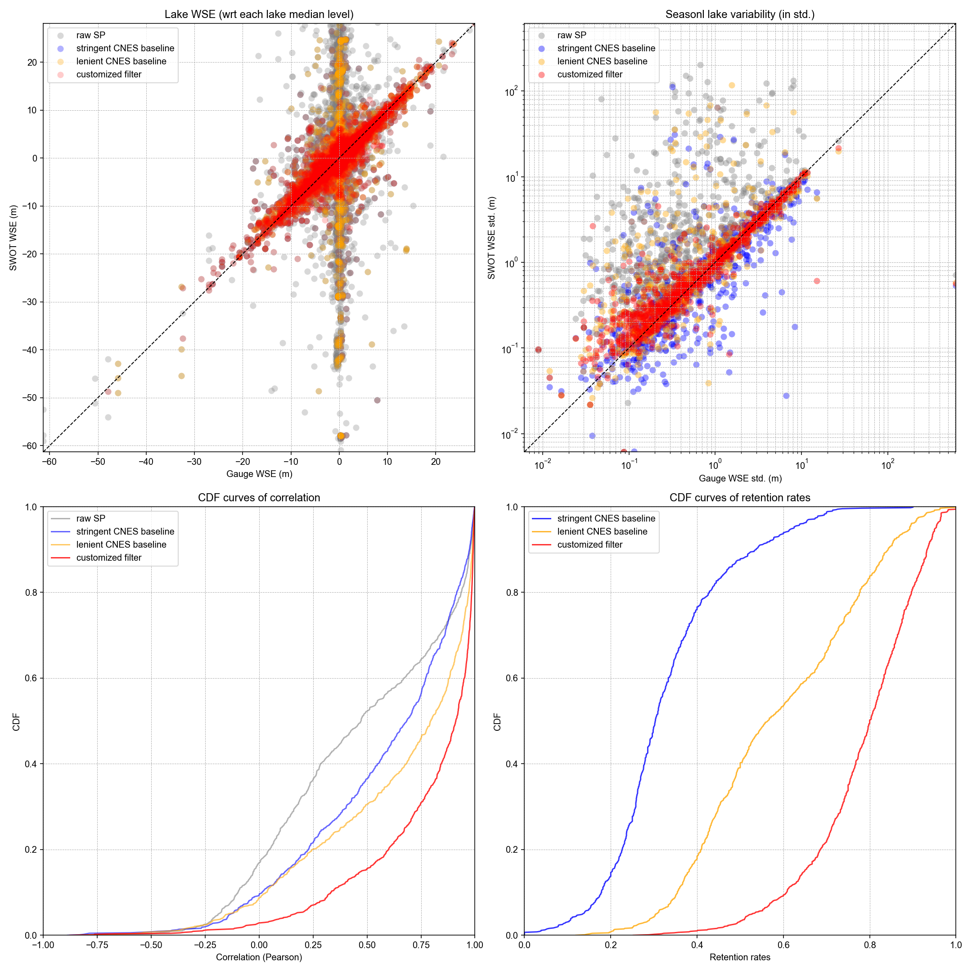
Incorporated “xtrk_dist” as another heuristic threshold, together with wse_std and wse_u
Also increased the temporal gap from 92 days now to 95 days (to keep some reservoirs with huge WSE variability).
Median err = 11.8%
1-sigma err = 27.8%
Notes:
Proportion of lakes passing the criteria of the customized filter: 0.8371428571428572
3.4512940456103793
0.4991326142911042
0.4976839858050733
0.2778909976491113
1.017177239661973
0.28283370920856127
0.2058400716803469
0.11792237470355885
12.921772848352987
1.821060831415198
2.870975236409621
0.5597415164524991

Slide 45
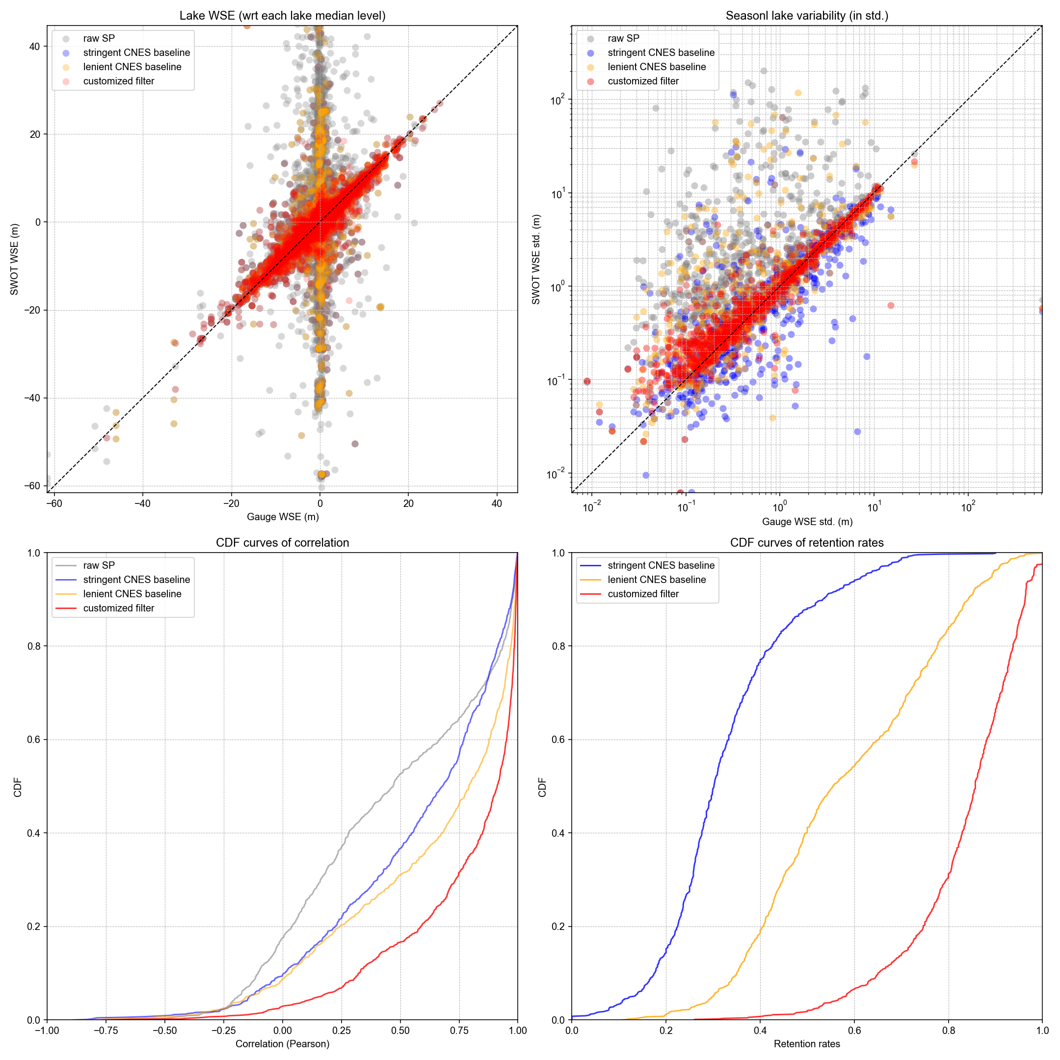
Did not incorporate “xtrk_dist” as another heuristic threshold, together with wse_std and wse_u
Also increased the temporal gap from 92 days now to 95 days (to keep some reservoirs with huge WSE variability).
Median err = 11.9%
1-sigma err = 27.6%
Notes:
Proportion of lakes passing the criteria of the customized filter: 0.8552380952380952
3.5061473336456905
0.49914892431438235
0.5046458968251535
0.27648569196453615
1.023819829798744
0.284038410618436
0.212531605036356
0.11851097031086753
13.169325210866075
1.8370854777355325
3.0083795997963962
0.4775111859639161

Slide 46
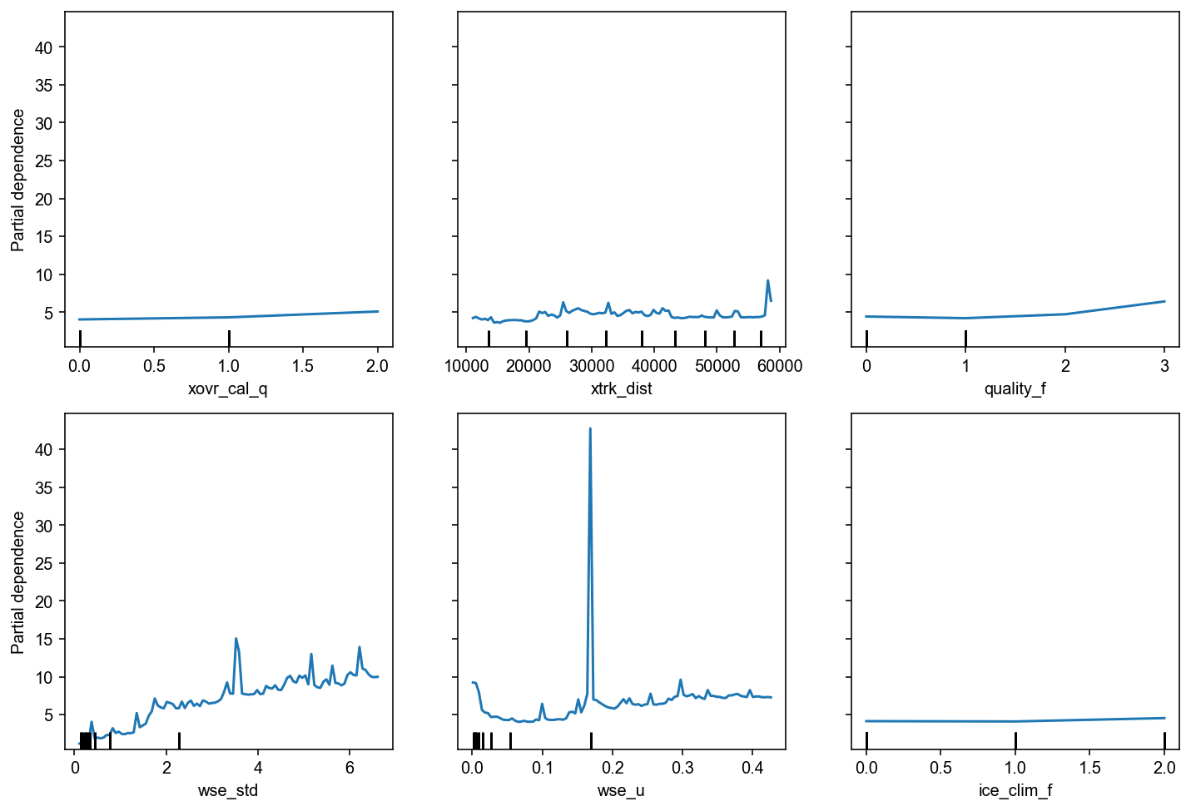


Slide 47
LakeSP filtering
08/29/2025
Jida Wang, Mélanie Trudel, Sylvain Biancamaria
Goal: To come up with a globally-applicable filtering strategy that balances
Error removal, and
A good representation of the lake level hydrograph, e.g., in terms of variability, amplitude, and phenological pattern

Slide 48
Conceptual procedure of the customized filter
Apply conservative quality flags to subset assumed high-quality SP observations
Raw LakeSP time series
Built-in flexibility to be CRID, pass, and ice-condition adaptive
Calibrate heuristic thresholds for this lake (mainly based on wse_std and wse_u; see next slide for RF-based feature importance)
Heuristic baseline time series (i.e., a subset of raw SP time series based on heuristic thresholds)
Check if the heuristic baseline is temporally representative:
no major gaps (> 3 months),
at least one-year duration
Each iteration includes:
Low-pass filtering
Remove positive ice anomalies
Remove remaining extreme outliers (Tukey’s test)
Option to reintroduce high-quality observations removed by round 1, and apply a round-2 (less aggressive) iterative low-pass filter
Apply a round-1 (more aggressive) iterative low-pass filter.
no
yes
Remove significant WSE inconsistency due to by multiple overpasses
Abandon this lake
Final filtered SP time series

Slide 49
Updated gauge data
Region | Count of PLD lakes | Temporal frequency | Sources | Data provider | Comments
Quebec | 35 | Daily | CEHQ | Mélanie Trudel
Canada | 277 | SWOT passes | ECCC, CEHQ, Spence, HQ, UDES
North America | 589590 | 15 min to daily SWOT passes | ECCC, Quebec, USBR, USGS | Merritt Harlan | Merritt updated all data with the best available temporal frequencies. I dropped one lake (PLD 7421035423) due to gauge data issues, but I will double check other lakes as well.
China | 38 | Daily | Multiple authorities | Chunqiao Song
West Africa | 2 | Hourly or finer | In situ measurement | Manuela Grippa; Félix Girard; Laurent Kergoat
Amazon | 6 | Daily | In situ measurement (Mamirauá Institute for Sustainable Development) | Ayan Fleischmann
Ceará, Brazil | 8 | Every 30 min | In situ measurement (Funceme) | Rafael Oliveira; Marielle Gosset; Eduardo Sávio Rodrigues Martins
Other Brazil | 4360 | Daily | To confirm source | Elyssa Collins; Augusto Getirana | Originally 60. I deleted 17 reservoirs with gauge data issues
India | 304 | Monthly | NWIC, APWRIMS, Gujarat, CWC | Deep Shah; Huilin Gao
Total | 1302
Total unique (excluding duplicates) | 1062

Slide 50
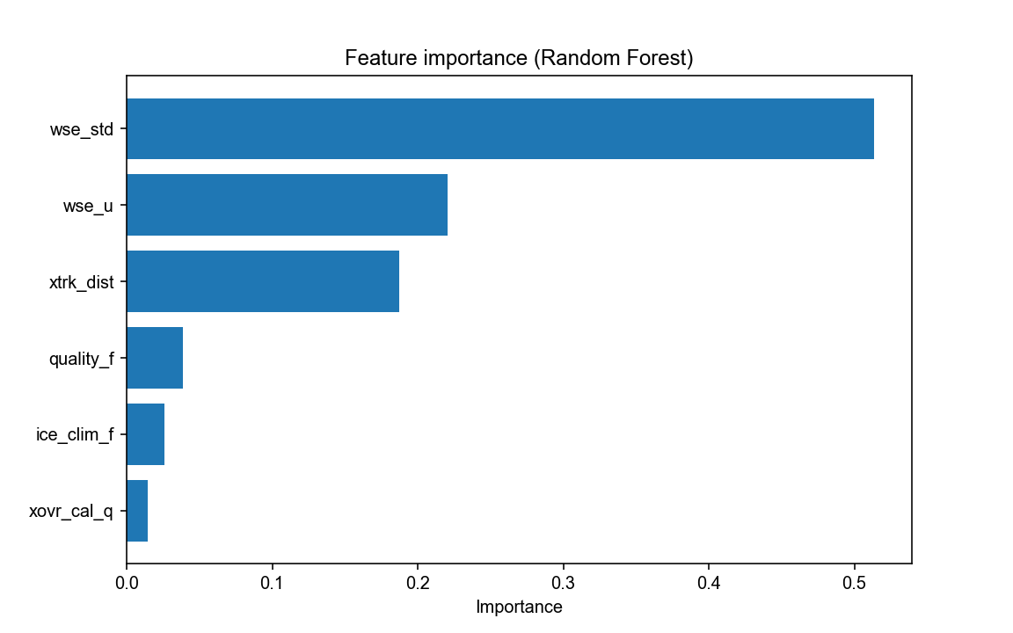

Slide 51
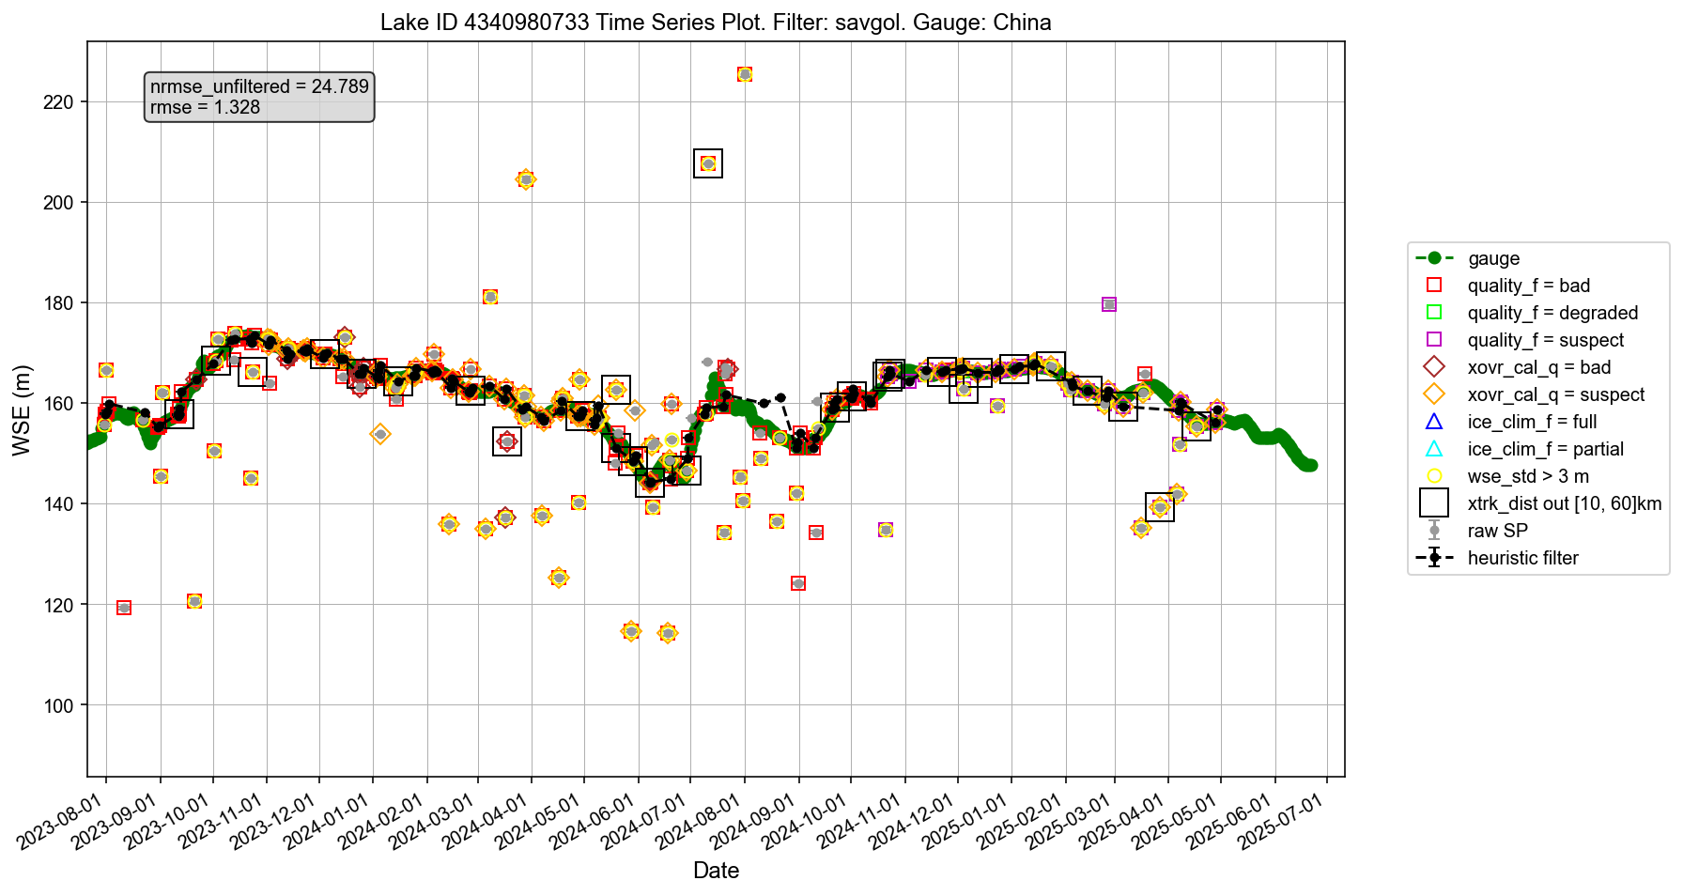

Slide 52
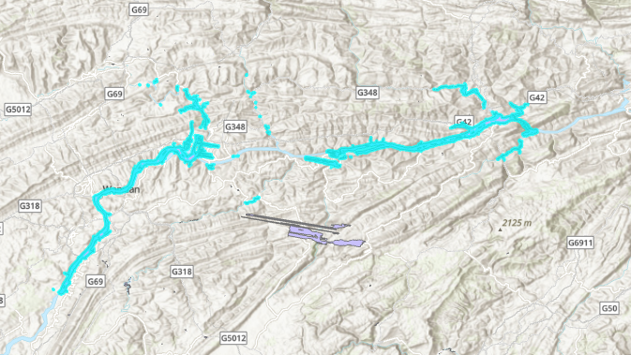
Low “xtrk_dist” values for the LakeSP product can be caused by one validly detected lake split into both swaths (such as the Three Gorges Reservoir), leading to the centroid of the lake falling within the track gap. This does not mean the lake detection is of poor quality. We suggest that for future LakeSP improvement, computing another xtrk_dist metric based on the absolute distances to the track, instead of the negative and positive distances.

Slide 53
Update summary on 09/15/2025
For clarity, I organized all major functions needed for executing the filter in a separate script: customized_functions.py
The main script to execute the filter is: Customized-LakeSP-filter-v9-08122025.py
Now after removing duplicated and problematic gauges, we have 1070 unique PLD lakes with gauge for validation (summarized in the table of the next slide). The full gauge data are given in the Google Drive, and I haven’t included the European gauge data yet. The Google Drive also contains a “Plots” folder that shows the validation plot for each of the lakes.
I also ran the filter through my school server on the entire 6 million PLD lakes with all available LakeSP records so far. It took about 10 hours to complete (overall quite efficient), and I added the WSE variability map at the end of the slides (sorry, I haven’t added the legend yet).

Slide 54
Updated gauge data
Region | Count of PLD lakes | Temporal frequency | Sources | Data provider | Comments
Quebec | 35 | Daily | CEHQ | Mélanie Trudel
Canada | 277 | SWOT passes | ECCC, CEHQ, Spence, HQ, UDES
North America | 586 | 15 min to daily | ECCC, Quebec, USBR, USGS | Merritt Harlan | Merritt updated all data with the best available temporal frequencies. I dropped one lake (PLD 7421035423) due to gauge data issues, but I will double check other lakes as well.
China | 38 | Daily | Multiple authorities | Chunqiao Song
West Africa | 2 | Hourly or finer | In situ measurement | Manuela Grippa; Félix Girard; Laurent Kergoat
Amazon | 6 | Daily | In situ measurement (Mamirauá Institute for Sustainable Development) | Ayan Fleischmann
Ceará, Brazil | 8 | Every 30 min | In situ measurement (Funceme) | Rafael Oliveira; Marielle Gosset; Eduardo Sávio Rodrigues Martins
Other Brazil | 62 | Daily | To confirm source | Elyssa Collins; Augusto Getirana | Originally 62. I deleted 17 reservoirs with gauge data issues
India | 296 | Monthly | NWIC, APWRIMS, Gujarat, CWC | Deep Shah; Huilin Gao
Total | 1310
Total unique (excluding duplicated and deleted) | 1070

Slide 55
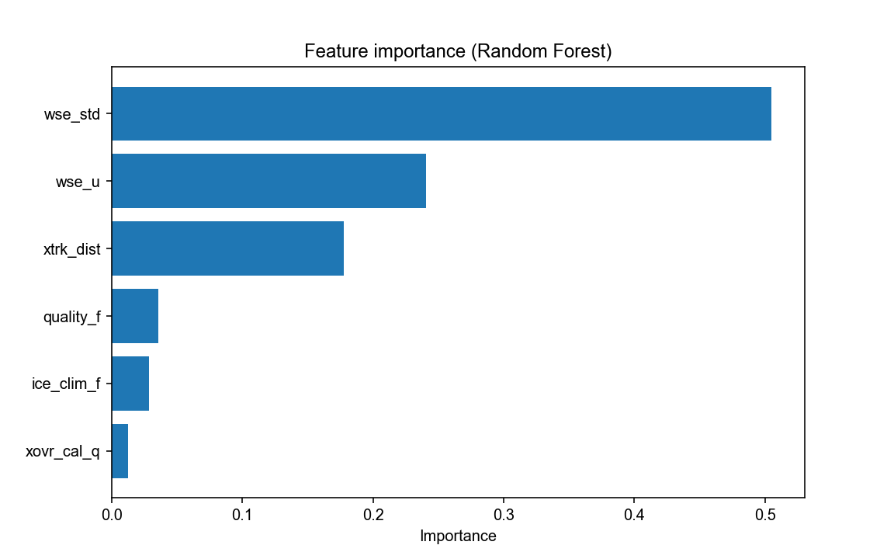
Feature Importance
wse_std 0.505106
wse_u 0.240500
xtrk_dist 0.177777
quality_f 0.035842
ice_clim_f 0.028451
xovr_cal_q 0.012324

Slide 56
Conceptual procedure of the customized filter
Apply high-quality CNES flags to subset a conservative baseline time series
Raw LakeSP time series
Built-in flexibility to be CRID, pass, and ice-condition adaptive
Calibrate heuristic thresholds for wse_std and wse_u (xtrk_dist deprecated) based the conservative baseline
Other bound parameters
Apply heuristic thresholds to retrieve a heuristic baseline time series
Iterative Low-pass filtering
Option to re-introduce high-quality observations removed after first convergence, and apply a round-2 (less aggressive) iterative filtering
Each iteration includes:
Low-pass outlier filter
Remove positive ice anomalies
Remove remaining extreme outliers
Iteration until convergence
Cycle adjustment to reduce WSE inconsistency due to multiple overpasses
Criteria to ensure time series remains representative:
Temporal gaps, temporal span, and/or frequency
Final filtered SP time series

Slide 57
Additional filter hierarchy
For each lake, we first attempted to filter the SP time series in a strict standard, but this did not always lead to a successful execution (criteria too strict). If so, we made a second attempt with a lowered standard. Both attempts were based on our customized filtering scheme (heuristic thresholding + low-pass filtering). If both failed, however, the customized filter may not work for this lake, so we made a third attempt just using a simple Tukey IQR method. If this also failed, we left this lake time series unfiltered. This hierarchy is not reflected by the flowchart because this level of details may not be needed for conceptualization.
Definition of each attempt is given below:
1_strict: Strict criteria applied to the customized filter, so that retained time series must be sufficiently long (e.g., 1 year) and must not contain major gaps (not longer than 3 months or 1 season)
2_lenient: Less strict criteria applied to the customized filter, so there is no constraint on temporal span or gap, but retained time series must contain at least 5 observations
3_tukey: If attempt 1 or 2 still failed, apply only a Tukey (IQR) method on the baseline time series, and the retained time series must contain at least one observation.
4_none: If none of the first three attempts was successful, this lake is left without any filtering.

Slide 58
Additional filter hierarchy
Proportions (%) of the 1070 lakes that were eventually filtered by each of the attempts:
“1_strict” (attempt 1): 82.1% (hooray!)
“2_lenient” (attempt 2): 15.8%
“3_tukey IQR” (attempt 3): 0.5%
“4_none” (attempt 4): 0.7%
Lakes with no SWOT data at all (attempt 0): 0.8%
The next slide shows the result only based on the 890 (82.1%) lakes meeting 1_strict.

Slide 59
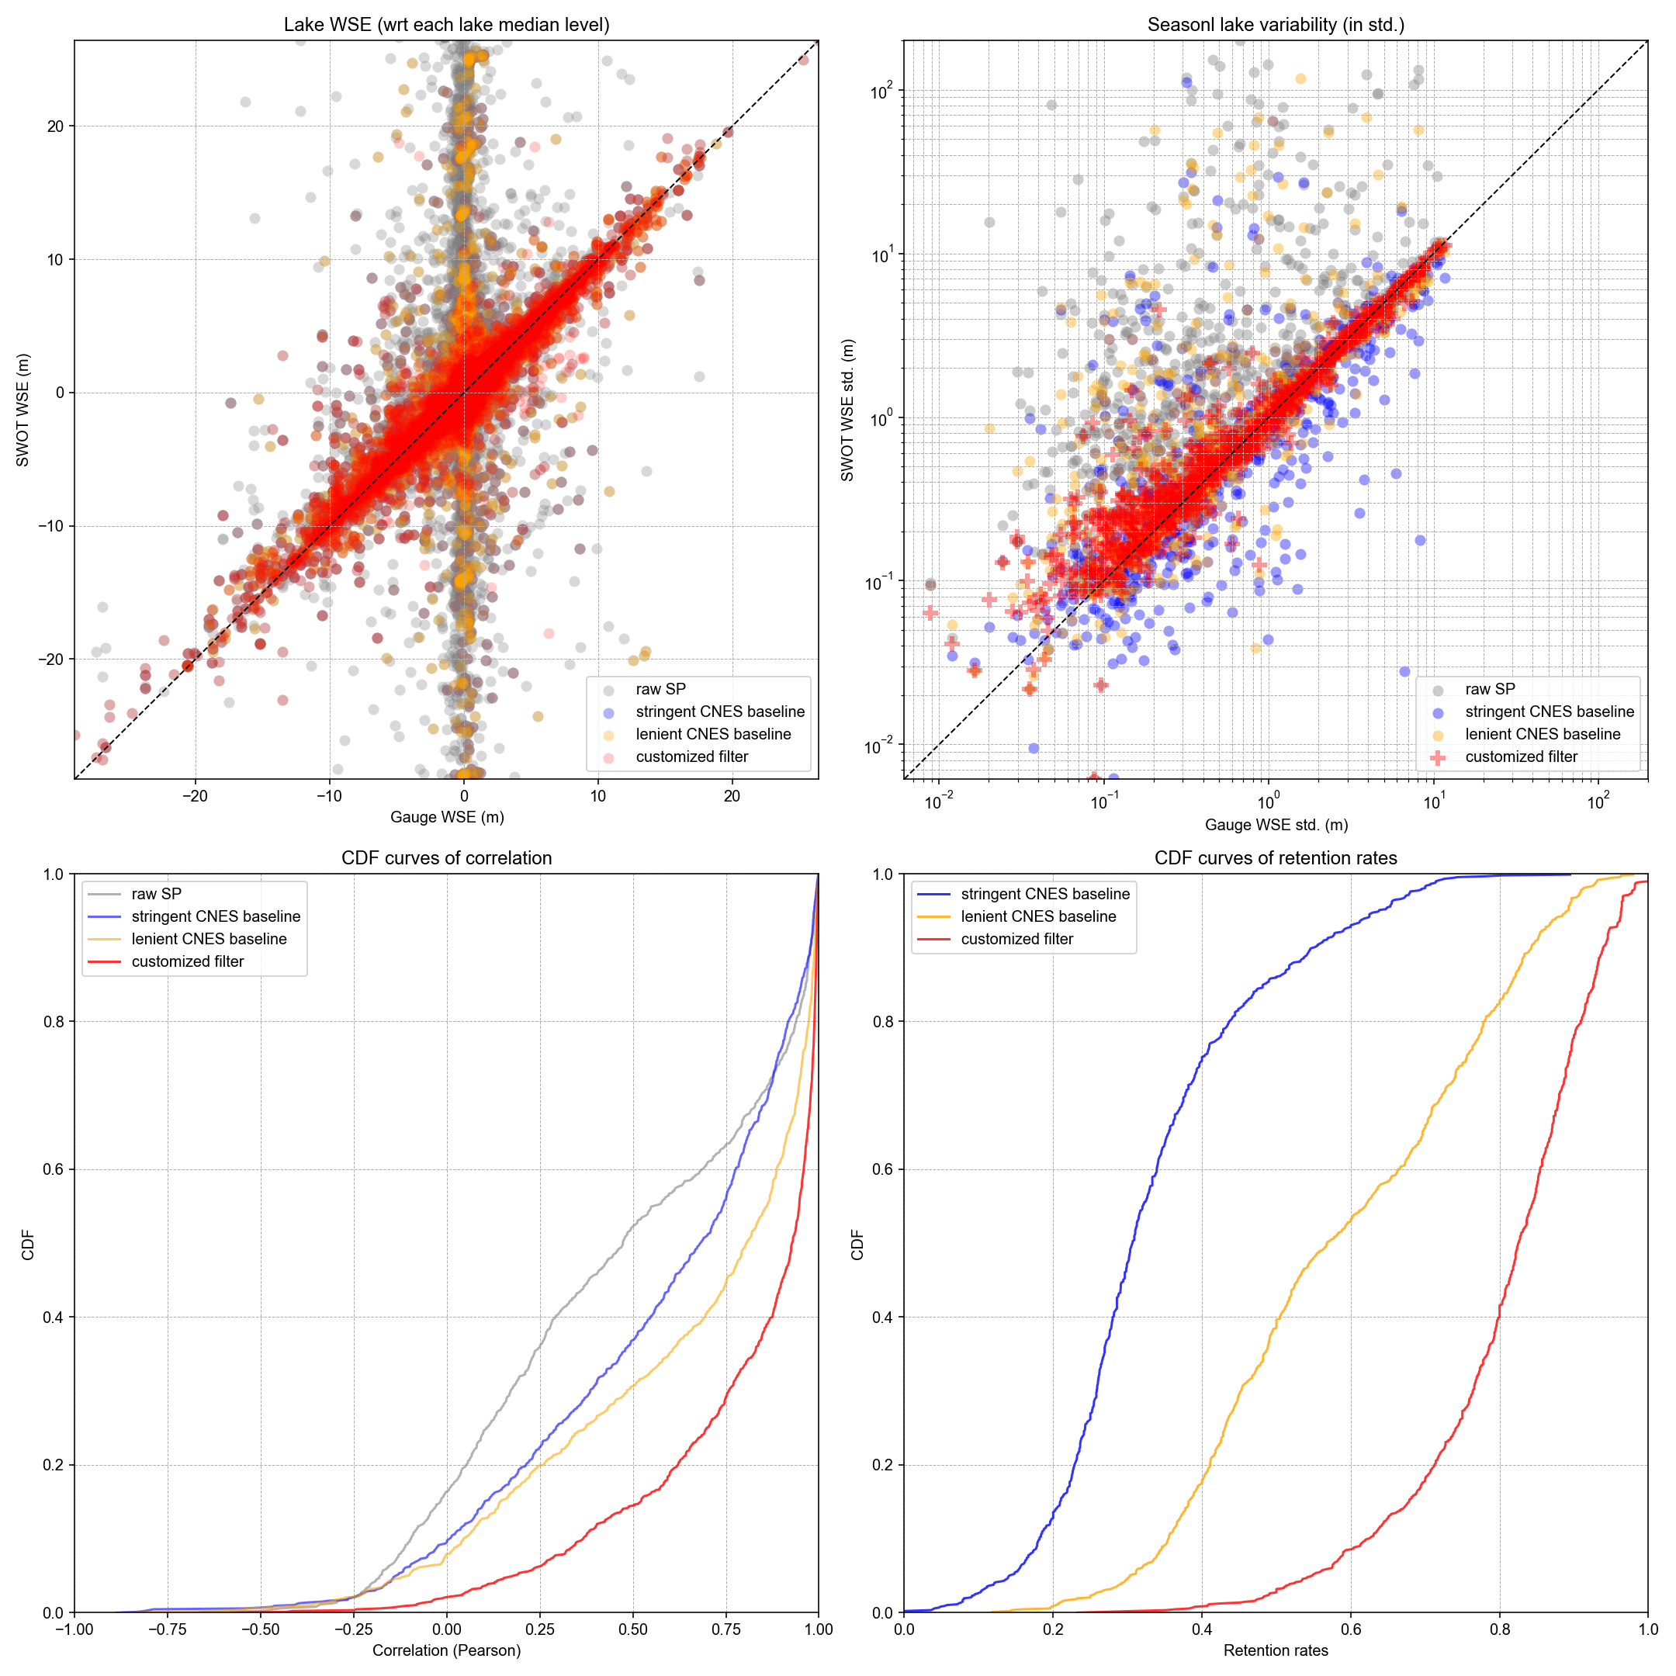
Relative error (%) of seasonal WSE variability (std):
68% (50%) of the validated lakes have errors less than 23.4% (11.3%). Yet in comparison, the statistics are only:
337.1% (100.7%) if not applying any filter (gray)
48.7% (27.7) if filtered by CNES baseline1 (blue; see script for definition)
48.5% (19.2%) if filtered by CNES baseline2 (yellow; see script for definition)
Our customized filter also yields higher Spearman correlation and retention rate.
This result is based on the 890 (82.1%) lakes meeting 1_strict. Including another 170 (15.8%) lakes meeting 2_lenient will increase the retention rate to 98% but also raise the error from 23.4% (1-sigma) and 11.3% (median) to 26.4% and 12.4%.

Slide 60
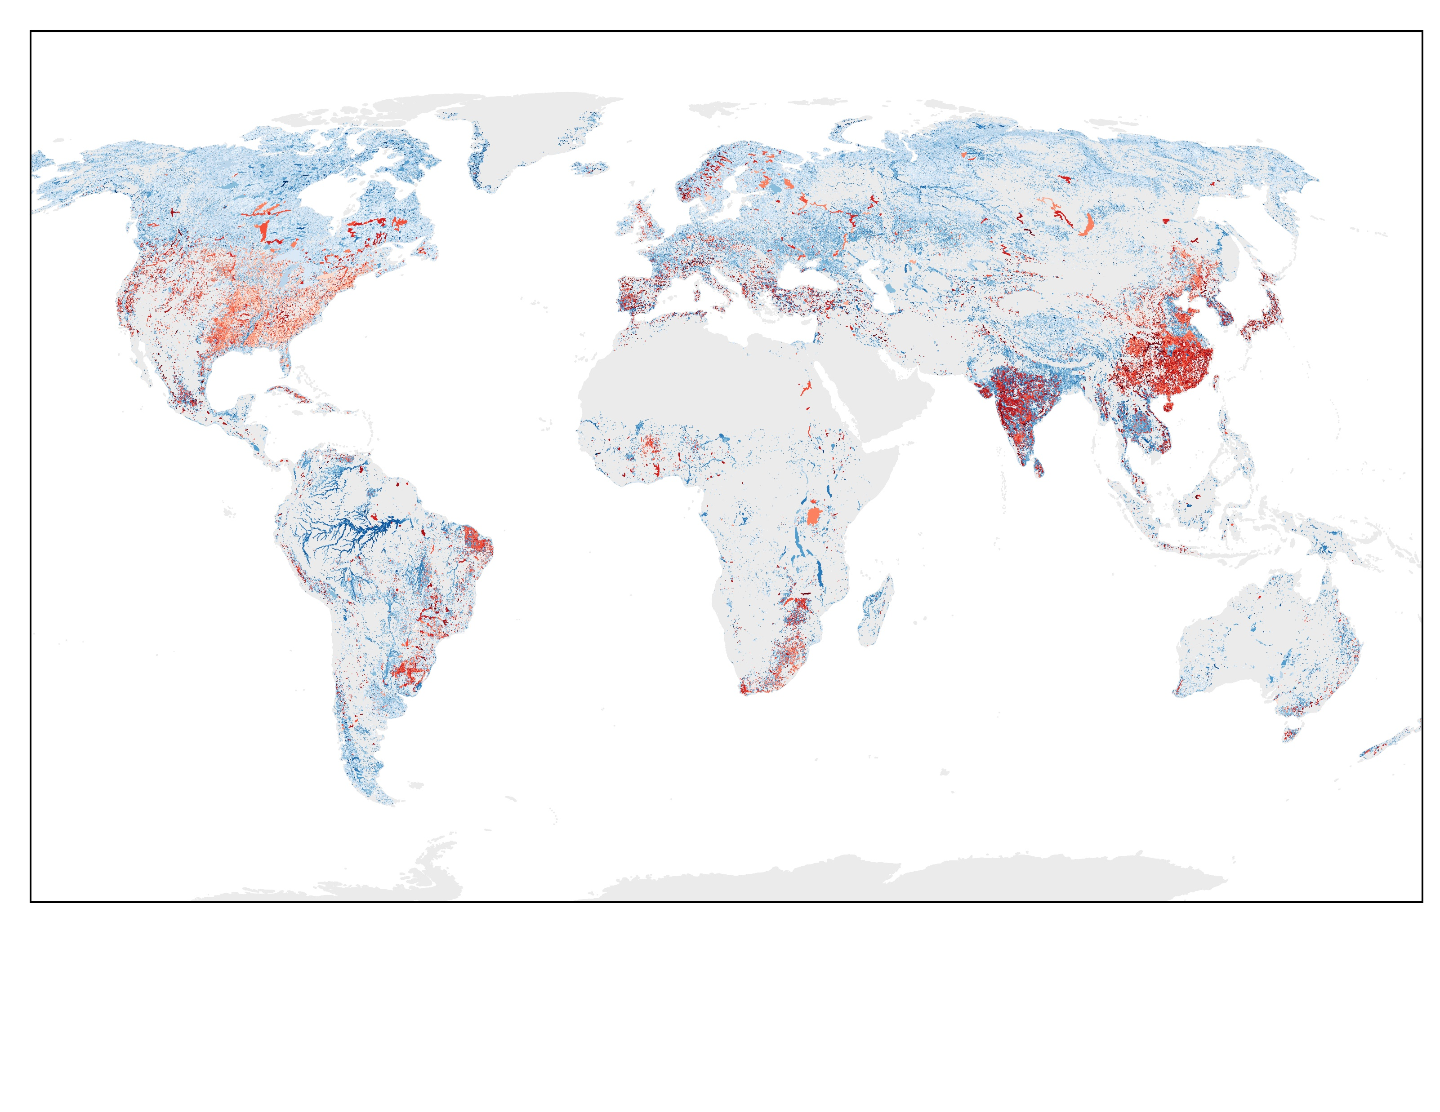
Run the filter to the global prior lakes. Reservoir WSE variability (red) seems to prevail, as expected. Sorry I will add the legend later.

