Slide 1
Design Point Cycle Model
TEAM 1: NIGHT RAVENS
LAUREN MARTINS & JOHN CLARDY

Slide 2
Final Selected Parameters
Design Point:
Cruise: 38,000 ft
Mach: 0.65
Standard Temperature
Parameters | Values
OPR | 17.15
TET [K] | 1700
FPR | 2.5
BPR | 1.2

Slide 3
Performance metrics
Parameters | Excel Values | Gas Turb Values
Thrust [kN] | 7.596 | 7.34
Specific Thrust [N*s/kg] | 528.41 | N/A
TSFC [g/(kN*s)] | 25.57 | 26.1564

Slide 4
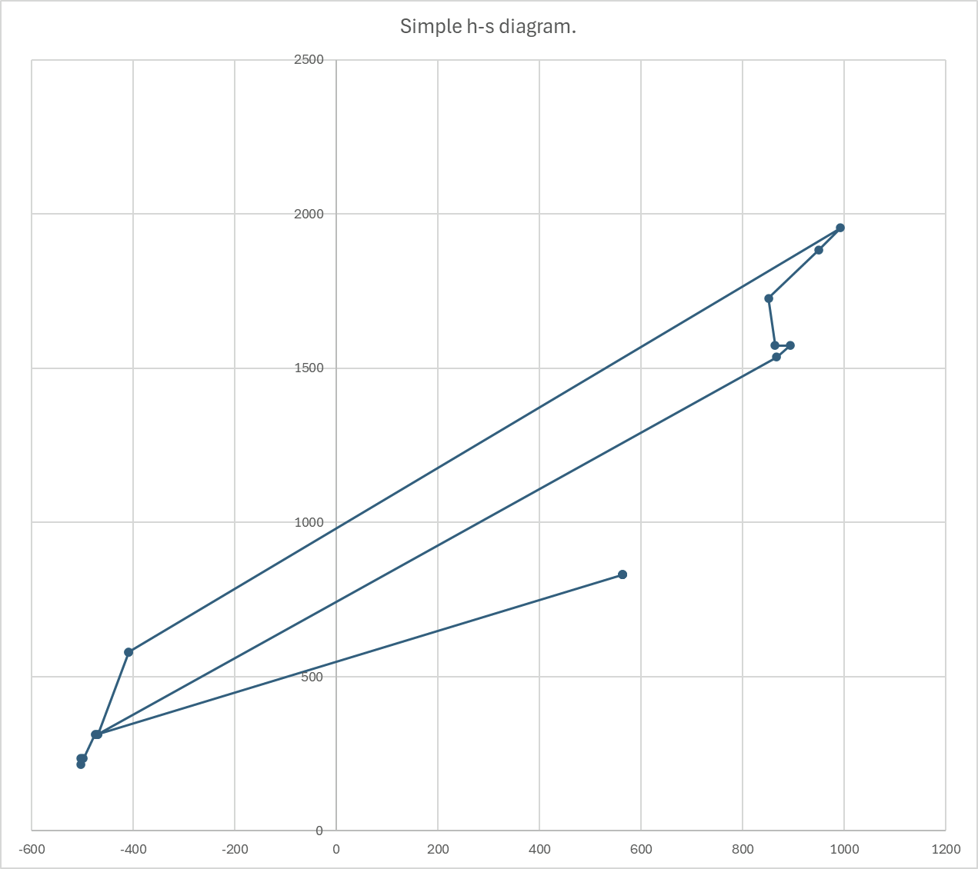
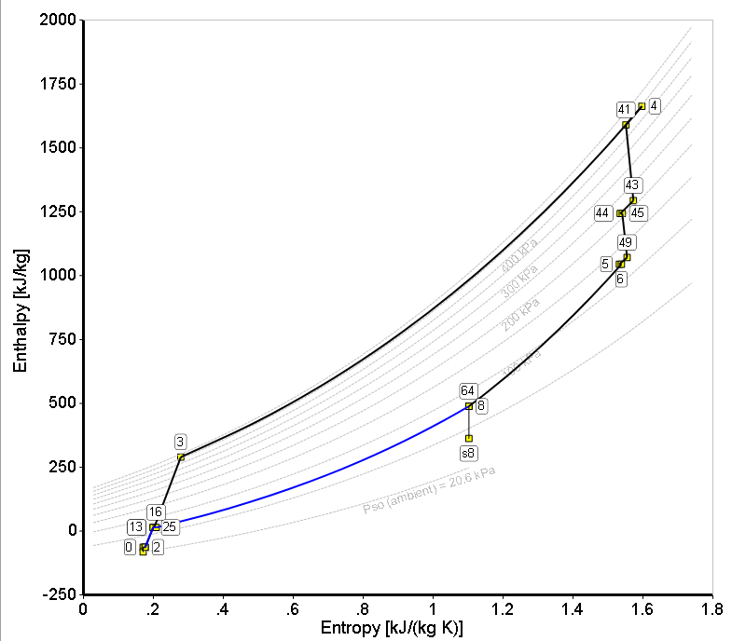
H-S (mollier) diagram
tbd
tbd

Slide 5
Efficiency assumptions
Parameters | Values
Fan/LPC Polytropic Efficiency | 0.92
IPC Polytropic Efficiency | 0.9
Combustion Efficiency | 0.99
HPT Polytropic Efficiency | 0.9
HPC Polytropic Efficiency | 0.88

Slide 6
Bleed flow assumptions
Gas Turb Cooling Presets
Parameters | Values [% core flow]
LPT Cooling | 3
NGV Cooling | 5
HPT Cooling | 5

Slide 7
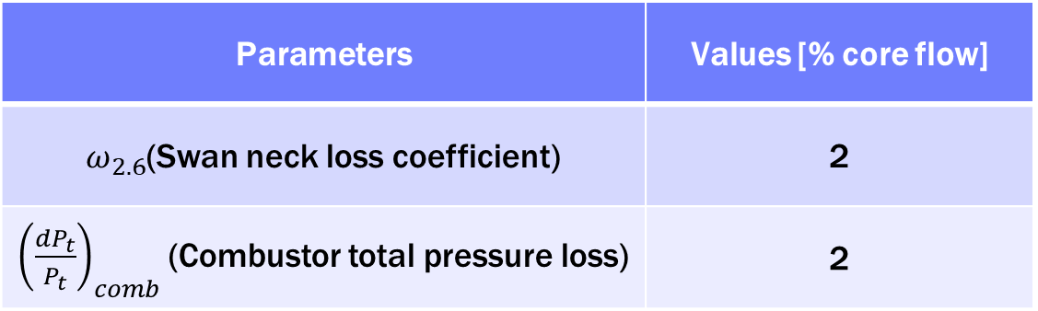
Additional loss assumptions
Parameters | Values [% core flow]
$ω_{2.6}$(Swan neck loss coefficient) | 2
${\left(\frac{dP_{t}}{P_{t}}\right)}_{comb}$(Combustor total pressure loss) | 2

Slide 8
Thermodynamic properties

Slide 9
Total pressure

Slide 10
Total temperature

Slide 11
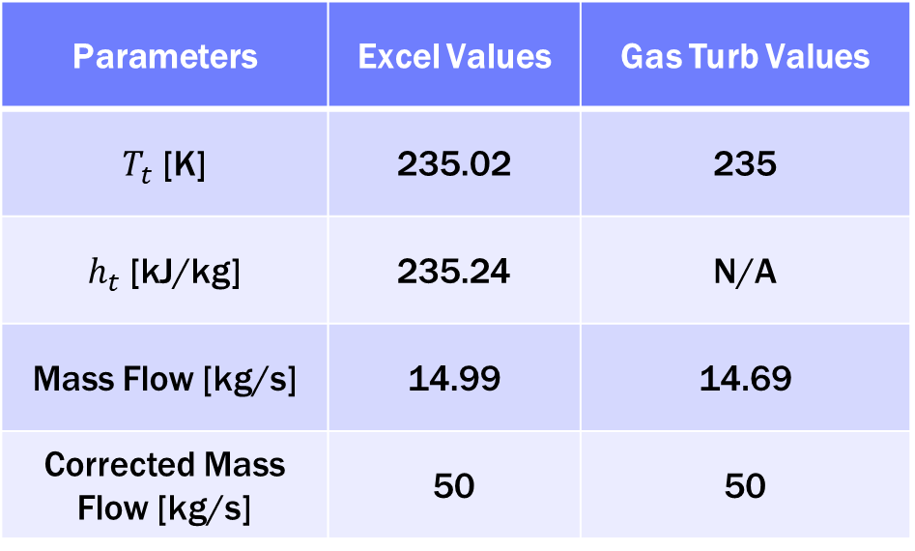
Inlet Face (1)
Parameters | Excel Values | Gas Turb Values
$T_{t}$ [K] | 235.02 | 235
$h_{t}$ [kJ/kg] | 235.24 | N/A
Mass Flow [kg/s] | 14.99 | 14.69
Corrected Mass Flow [kg/s] | 50 | 50

Slide 12
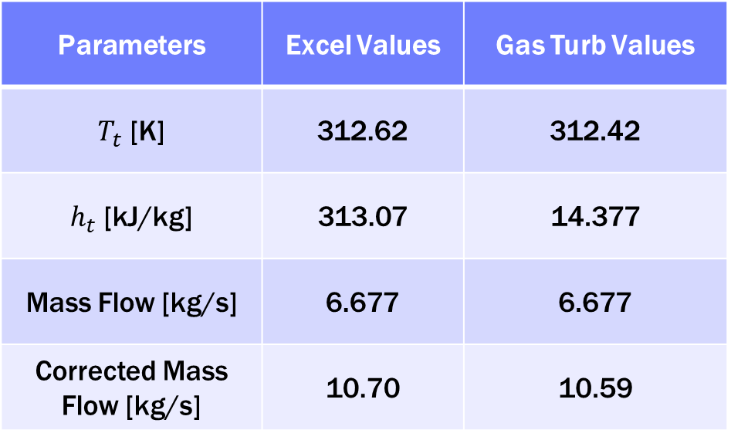
HPC Inlet (2.6)
Parameters | Excel Values | Gas Turb Values
$T_{t}$ [K] | 312.62 | 312.42
$h_{t}$ [kJ/kg] | 313.07 | 14.377
Mass Flow [kg/s] | 6.677 | 6.677
Corrected Mass Flow [kg/s] | 10.70 | 10.59

Slide 13
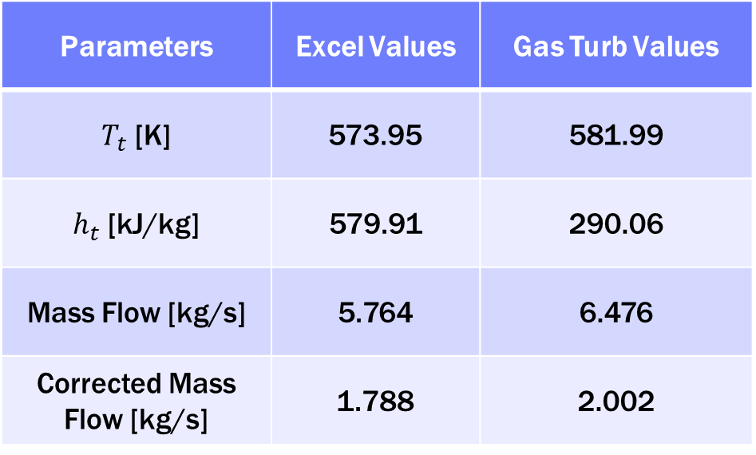
HPC Discharge diffuser (3.1)
Parameters | Excel Values | Gas Turb Values
$T_{t}$ [K] | 573.95 | 581.99
$h_{t}$ [kJ/kg] | 579.91 | 290.06
Mass Flow [kg/s] | 5.764 | 6.476
Corrected Mass Flow [kg/s] | 1.788 | 2.002

Slide 14
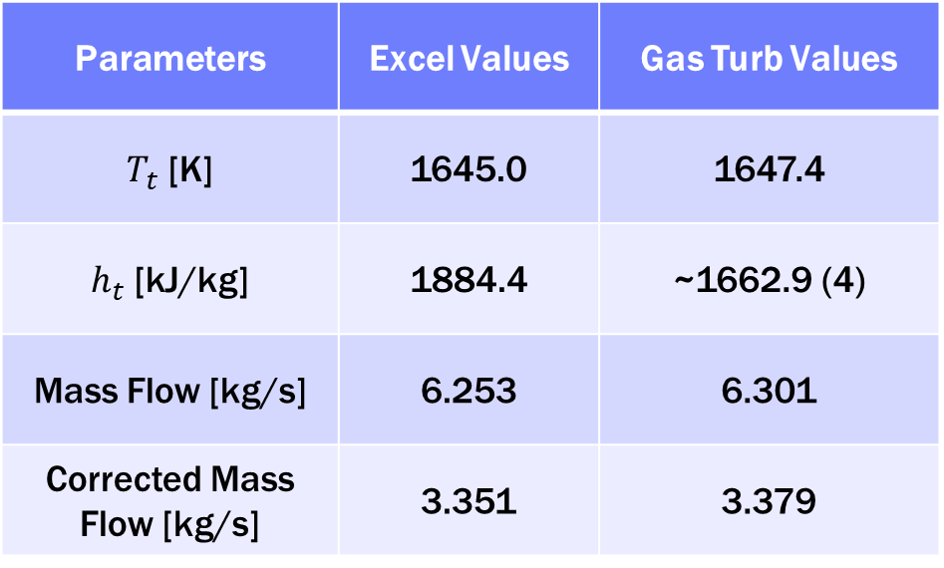
NGV Cool Pre-Throat (4.05)
Parameters | Excel Values | Gas Turb Values
$T_{t}$ [K] | 1645.0 | 1647.4
$h_{t}$ [kJ/kg] | 1884.4 | ~1662.9 (4)
Mass Flow [kg/s] | 6.253 | 6.301
Corrected Mass Flow [kg/s] | 3.351 | 3.379

Slide 15
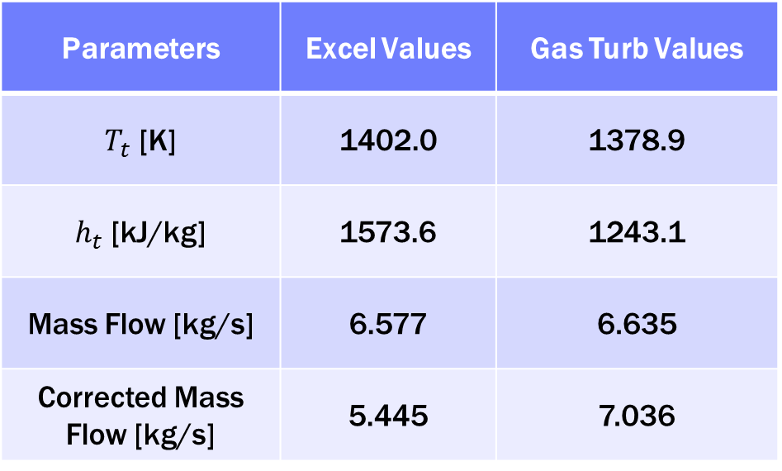
LPT Inlet (4.8)
Parameters | Excel Values | Gas Turb Values
$T_{t}$ [K] | 1402.0 | 1378.9
$h_{t}$ [kJ/kg] | 1573.6 | 1243.1
Mass Flow [kg/s] | 6.577 | 6.635
Corrected Mass Flow [kg/s] | 5.445 | 7.036

Slide 16
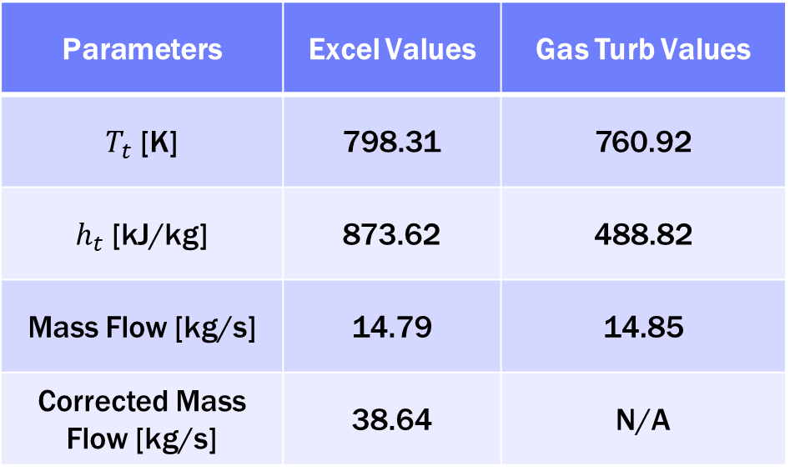
Mixer (6)
Gas Turb has no Station 7 data
Mixer (Station 6) was chosen as stand-in for core nozzle inlet
Lacked Corrected Mass Flow value
Parameters | Excel Values | Gas Turb Values
$T_{t}$ [K] | 798.31 | 760.92
$h_{t}$ [kJ/kg] | 873.62 | 488.82
Mass Flow [kg/s] | 14.79 | 14.85
Corrected Mass Flow [kg/s] | 38.64 | N/A

Slide 17
References
“Aero L-39 Skyfox.” Wikipedia, Wikimedia Foundation, 17 Jan. 2026, en.wikipedia.org/wiki/Aero_L-39_Skyfox.
“AIDC T-5 Brave Eagle.” Wikipedia, Wikimedia Foundation, 26 Jan. 2026, en.wikipedia.org/wiki/AIDC_T-5_Brave_Eagle.
“On-design Cycle Analysis of a Turbofan Engine.” Course notes, Embry-Riddle Aeronautical University, n.d.

Slide 18
THANK YOU
Are there any questions?

