Slide 1
Final design review
TEAM 1: NIGHT RAVENS
LAUREN MARTINS & JOHN CLARDY

Slide 2
Requirements specification
Design Point:
Cruise: 38,000 ft
Mach: 0.65
Standard Temperature
Parameters | Values
Maximum Engine Front Face Diameter | 25 in (0.635 m)
Maximum Engine Length | 137.795 in (3.5 m)
Required Installed Thrust @ Cruise | 1326.9 lbf (5902.3 N)
Notes:
During presentation, talk about how all of these influenced design decisions

Slide 3
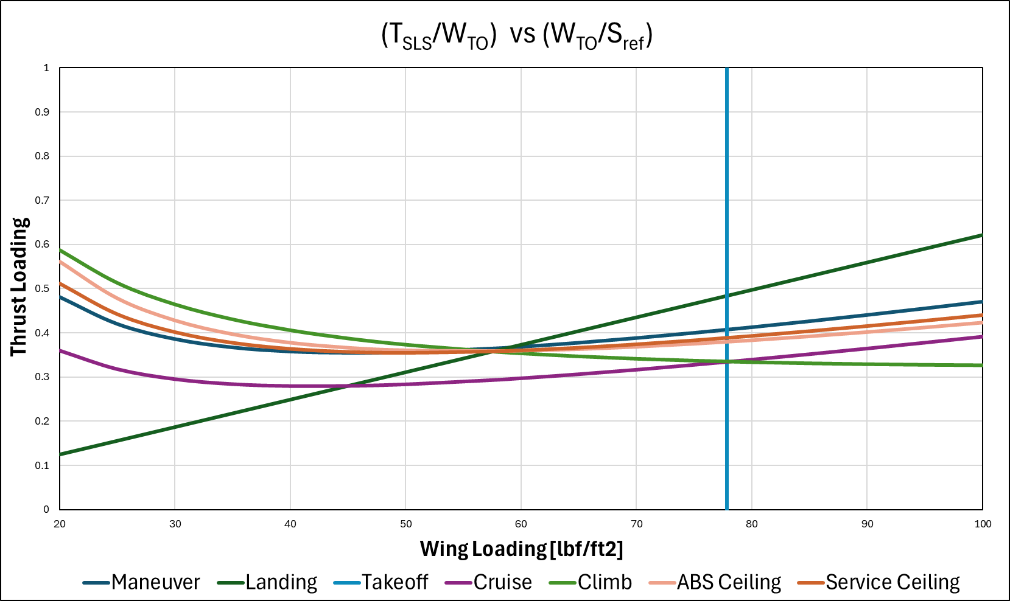
Constraint analysis
Design Point:
(57.7, 0.37)
Notes:
During presentation, talk about how all of these influenced design decisions

Slide 4
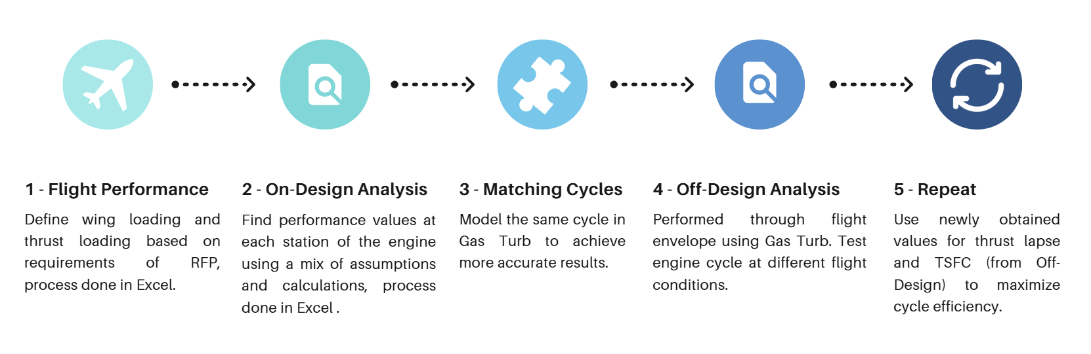
Methodology

Slide 5
Methodology
Gas Model:
Pseudo-perfect. Specific heat is treated as a function of T & FAR, but independent from P.
Simplifying Assumptions:
Ideal gas, adiabatic components, polytropic efficiency
Installation Effects:
Add 5% of thrust to get required thrust

Slide 6
Performance Specifications
Parameters | Values
Thrust | 1371.3 lbf (6.10 kN)
Specific Thrust | 1362.5 ft/s (415.28 m/s)
TSFC | 0.758 (lbm/hr)/lbf (21.46 g/(kN*s))
Max Climb Rate:
23,367 ft/min at M = 0.800, h = 0 ft
Acceleration:
4.355 m/s² (0.444 g) at M = 0.487, h = 0 ft
Airframe
K1 | K2 | C_{D0} | C_{DR}
0.18 | 0 | 0.014 | 0

Slide 7
Performance Specifications
TOGW: 13585 lb

Slide 8
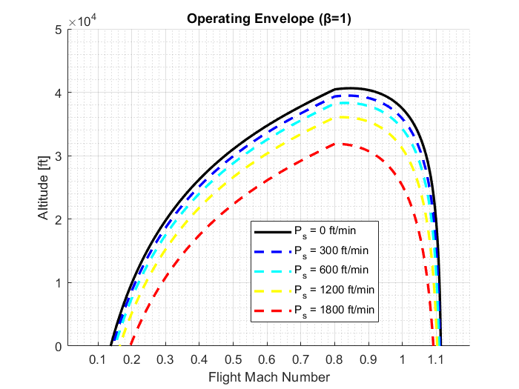

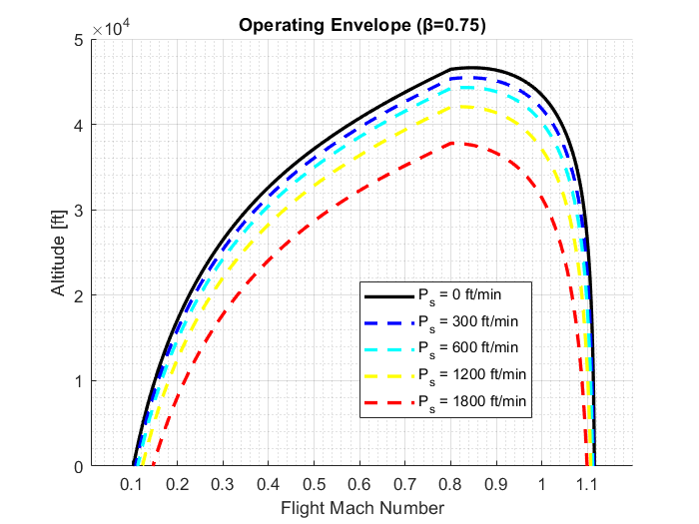
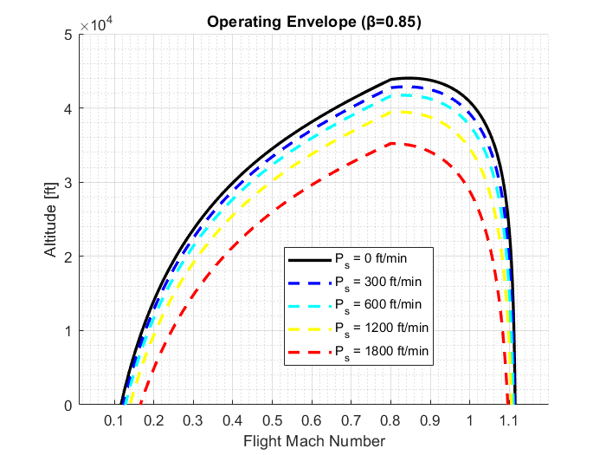
Performance Specifications

Slide 9
Engine Sizing

Slide 10
Space Claim
Parameter | Value | Value
Overall space claim | 30.23 in | 0.768 m
Length | 137.05 in | 3.481 m
Expected Weight | 1914.6 lb | 868.5 kg

Slide 11
intake
Parameter | Value
A1 Area | 418.5 in² (0.27 m²)
A2 Area | 573.5 in² (0.37 m²)
Athroat Area | 263.5 in² (0.17 m²)
A1 Diameter | 0.5832 m (22.96 in)
A2 Diameter | 0.6881 m (27.09 in)
Athroat | 0.4684 m 18.44 in
Intake Pressure Recovery | 0.9104%

Slide 12
Combustor
Parameters | Values
Volume | 0.029 m³
Cross-Sectional Area | 0.02171 m²
Length of Combustor | 1.35 m (53.14in)
Estimated Loss | ~5%
Expected Loading @ Design Point | 2.0249
Relight Capability @ Design Point | Yes
NOTE: Based on the preliminary analysis done so far on the combustor, it appears that relight should be possible at any point along the entire mission.
Notes:
In research, the loading seems to be really low for the usual jet trainer, and the length of the combustor seems to be particularly large compared to the usual engine. This would be something to work on in future designs to see if the engine can be made smaller

Slide 13
Thermodynamic cycle
Chosen design point
Engine architecture
Cruise: 38,000 ft
Mach: 0.65
Standard Temperature
Optimize Cruise TSFC
2-Spool Mixed Turbofan
Non-Afterburning

Slide 14
Parametric studies

Slide 15
Sensitivity – bleeds
Study | Base | Delta | SFC% | Sp. Thrust%
Rel. Overboard Bleed W_Bld/W25 | 0.01 | 0.01 | 0.53 | -1.79
HPT NGV 1 Cooling Air / W25 | 0.05 | 0.01 | -0.42 | -0.85
HPT Rotor 1 Cooling Air / W25 | 0.05 | 0.01 | -0.27 | -0.99
LPT Rotor 1 Cooling Air / W25 | 0.05 | 0.01 | -0.28 | -0.99
Rel.HP Leakage to LPT exit | 0.05 | 0.01 | -0.16 | -1.11

Slide 16
Sensitivity – component eff.
Study | Base | Delta | SFC% | SpThrust%
Polytr.Inner LPC Efficiency | 0.92 | -0.01 | 0.06 | -0.28
Polytr.Outer LPC Efficiency | 0.92 | -0.01 | 0.1 | -0.1
Polytr. HPC Efficiency | 0.88 | -0.01 | 0.15 | -0.72
Polytr. HPT Efficiency | 0.9 | -0.01 | 0.26 | -0.25
Polytr. LPT Efficiency | 0.91 | -0.01 | 0.17 | -0.17
Polytr.Inner LPC Efficiency | 0.92 | 0.01 | -0.05 | 0.27
Polytr.Outer LPC Efficiency | 0.92 | 0.01 | -0.1 | 0.1
Polytr. HPC Efficiency | 0.88 | 0.01 | -0.13 | 0.68
Polytr. HPT Efficiency | 0.9 | 0.01 | -0.24 | 0.24
Polytr. LPT Efficiency | 0.91 | 0.01 | -0.16 | 0.16
Burner Design Efficiency | 0.9995 | -0.01 | 0.95 | 0.06

Slide 17
Sensitivity – Pr
Study | Base | Delta | SFC% | SpThrust%
Inner Fan Pressure Ratio | 2.8 | 0.1 | -0.45 | -0.25
Outer Fan Pressure Ratio | 2.8 | 0.1 | -0.42 | 0.42
Design Bypass Ratio | 1.41961 | 0.2 | -2.67 | -5.1
HP Compressor Pressure Ratio | 10.5138 | 0.1 | -0.12 | -0.08

Slide 18
Final parameters
Parameters | Values
OPR | 29
TET | 1606 K
FPR | 2.8
BPR | 1.4

Slide 19
H-s (mollier) diagram

Slide 20
Component efficiencies
Parameters | Values
Fan/LPC Polytropic Efficiency | 0.92
HPC Polytropic Efficiency | 0.88
Combustion Efficiency | 0.99
HPT Polytropic Efficiency | 0.9
LPT Polytropic Efficiency | 0.91

Slide 21
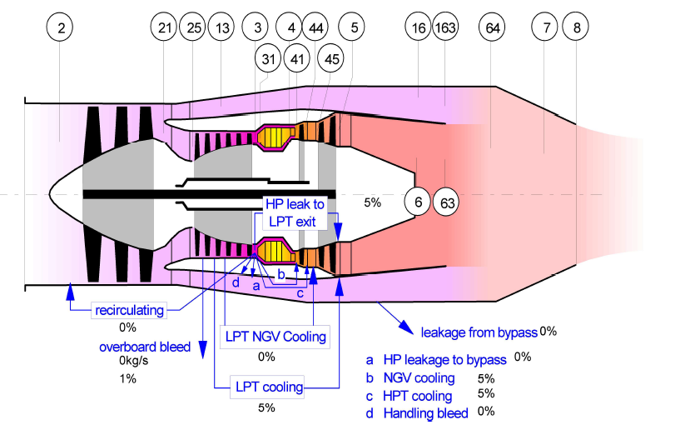
Bleed flow assumptions

Slide 22
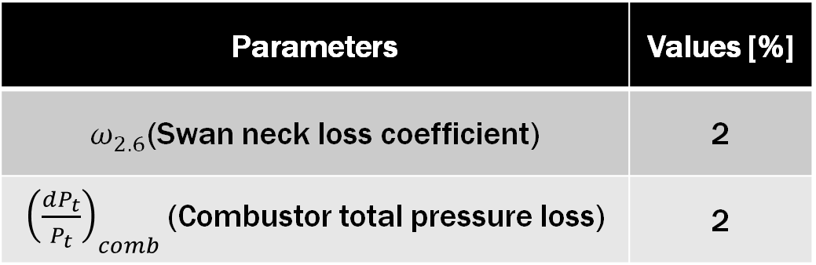
Additional losses
Parameters | Values [%]
$ω_{2.6}$(Swan neck loss coefficient) | 2
${\left(\frac{dP_{t}}{P_{t}}\right)}_{comb}$(Combustor total pressure loss) | 2

Slide 23
Thermodynamic properties

Slide 24
Mach assumptions
Location | Mach
Fan Inlet | 0.5
Fan Exit | 0.52
HPC Inlet & Exit | 0.55
Burner Exit & HPT Exit | 0.4
LPT Exit | 0.5
Bypass | 0.5

Slide 25
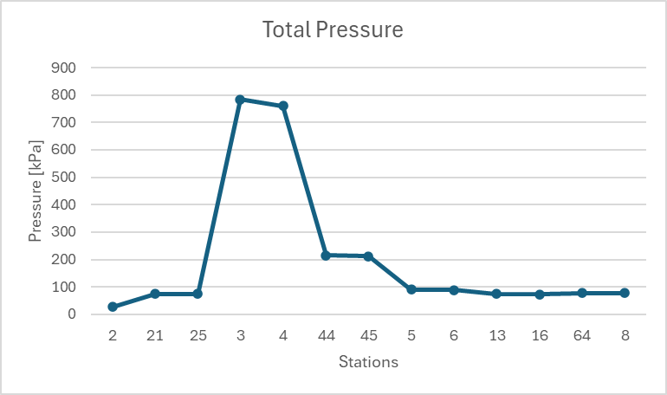
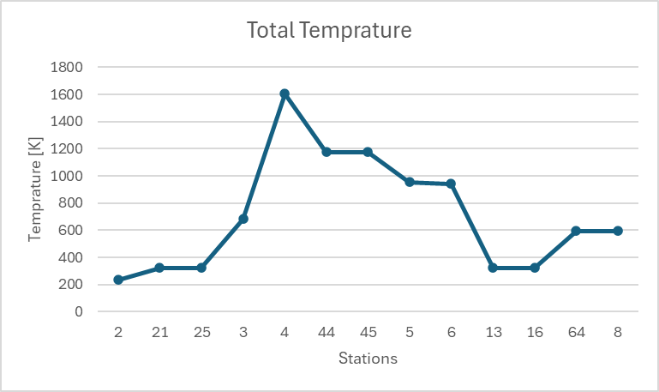
Pressure & Temperature

Slide 26
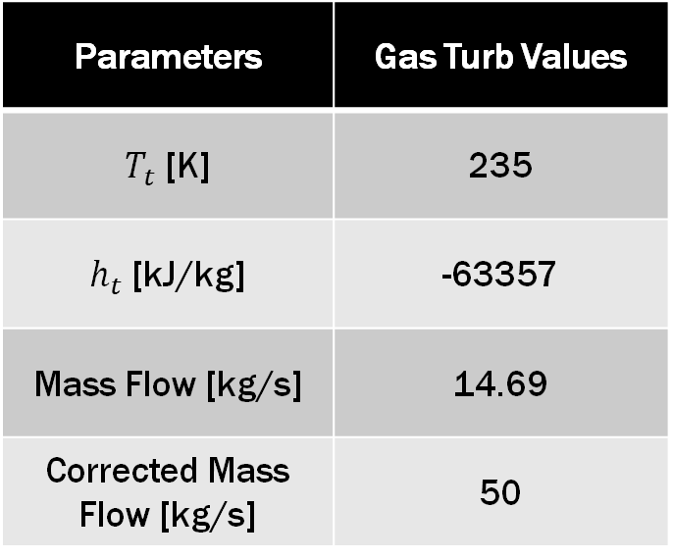
fAN Face (2)
Parameters | Gas Turb Values
$T_{t}$ [K] | 235
$h_{t}$ [kJ/kg] | -63357
Mass Flow [kg/s] | 14.69
Corrected Mass Flow [kg/s] | 50

Slide 27
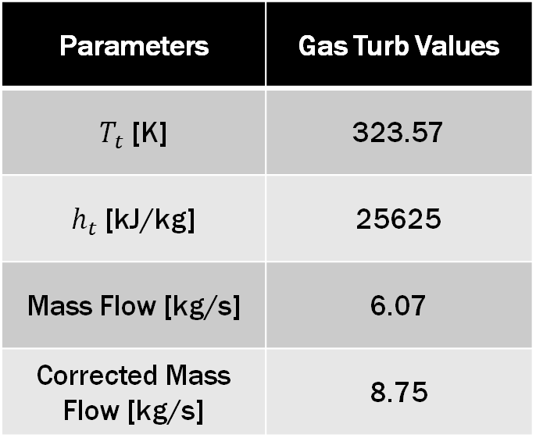
HPC Inlet (25)
Parameters | Gas Turb Values
$T_{t}$ [K] | 323.57
$h_{t}$ [kJ/kg] | 25625
Mass Flow [kg/s] | 6.07
Corrected Mass Flow [kg/s] | 8.75

Slide 28
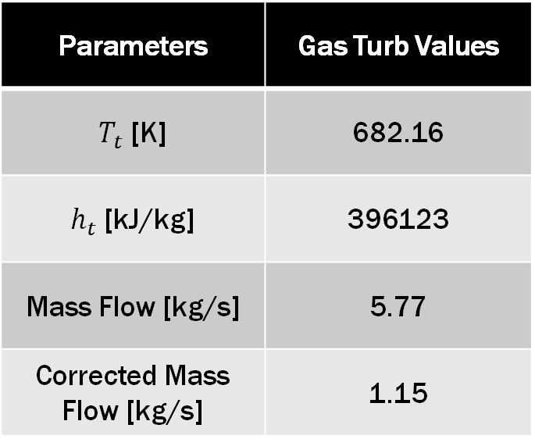
Combustor Inlet(3)
Parameters | Gas Turb Values
$T_{t}$ [K] | 682.16
$h_{t}$ [kJ/kg] | 396123
Mass Flow [kg/s] | 5.77
Corrected Mass Flow [kg/s] | 1.15

Slide 29

COMBUSTOR exit(4)
Parameters | Gas Turb Values
$T_{t}$ [K] | 1606.68
$h_{t}$ [kJ/kg] | 1528220
Mass Flow [kg/s] | 4.93
Corrected Mass Flow [kg/s] | 1.551

Slide 30

LPT Inlet (45)
Parameters | Gas Turb Values
$T_{t}$ [K] | 1174.73
$h_{t}$ [kJ/kg] | 981613
Mass Flow [kg/s] | 5.53
Corrected Mass Flow [kg/s] | 5.36

Slide 31

eXIT (8)
Parameters | Gas Turb Values
$T_{t}$ [K] | 595.23
$h_{t}$ [kJ/kg] | 306810
Mass Flow [kg/s] | 14.76
Corrected Mass Flow [kg/s] | 27.601

Slide 32
Engine design tables

Slide 33
Engine cycle performance
Case | Pamb [kPa] | Tamb [K] | M0 | TET [K] | OPR | FPR | BPR | Fnet [kN] | Fnet [lbf] | TSFC [g/kNs] | TSFC [(lbm/hr)/lbf] | FAR
SLS | 101.33 | 288.15 | 0.00 | 1850.00 | 30.22 | 2.84 | 1.35 | 30.95 | 6958.83 | 18.07 | 0.6381 | 0.01127
RTO | 90.81 | 282.25 | 0.20 | 1638.90 | 24.46 | 2.48 | 1.49 | 20.25 | 4551.93 | 18.32 | 0.6468 | 0.00883
TOC | 18.75 | 216.70 | 0.55 | 1850.00 | 38.65 | 3.31 | 1.21 | 7.27 | 1634.71 | 23.62 | 0.8339 | 0.01259
CRZ | 20.65 | 216.70 | 0.65 | 1543.89 | 28.65 | 2.77 | 1.43 | 5.98 | 1345.25 | 21.34 | 0.7533 | 0.00874

Slide 34
fan
Case | Ptin [kPa] | Ttin [K] | W [kg/s] | Wcorr [kg/s] | PR | Power [kW] | Eff [Poly] | Nmech [%]
SLS | 99.30 | 288.15 | 49.64 | 50.65 | 2.84 | 5612.25 | 0.9044 | 113.48
RTO | 91.51 | 284.47 | 41.99 | 46.19 | 2.48 | 3770.57 | 0.9519 | 99.21
TOC | 22.58 | 229.79 | 13.64 | 54.67 | 3.31 | 1669.45 | 0.8035 | 121.20
CRZ | 26.88 | 235.00 | 14.60 | 49.70 | 2.77 | 1275.13 | 0.9262 | 98.92

Slide 35
compressor
Case | Ptin [kPa] | Ttin [K] | W [kg/s] | Wcorr [kg/s] | PR | Power [kW] | Eff [Poly] | Nmech [%]
SLS | 278.95 | 400.32 | 21.16 | 9.06 | 10.76 | 9356.23 | 0.8743 | 114.46
RTO | 225.18 | 373.59 | 16.85 | 8.63 | 9.94 | 6516.37 | 0.8872 | 105.91
TOC | 73.80 | 351.50 | 6.16 | 9.34 | 11.82 | 2628.79 | 0.8539 | 111.90
CRZ | 73.82 | 321.94 | 6.00 | 8.70 | 10.43 | 2197.31 | 0.8809 | 99.31

Slide 36
HPT
Case | Ptin [kPa] | Ttin [K] | W [kg/s] | Wcorr [kg/s] | ER | Power [kW] | Eff [Poly] | Nmech [%]
SLS | 2908.85 | 1850.00 | 18.33 | 1.62 | 3.55 | 9860.29 | 0.9047 | 114.46
RTO | 2167.53 | 1638.90 | 14.53 | 1.62 | 3.56 | 6901.18 | 0.9033 | 105.91
TOC | 847.67 | 1850.00 | 5.35 | 1.62 | 3.51 | 2850.31 | 0.9029 | 111.90
CRZ | 746.97 | 1543.89 | 5.17 | 1.62 | 3.53 | 2286.22 | 0.8996 | 99.31

Slide 37
LPT
Case | Ptin [kPa] | Ttin [K] | W [kg/s] | Wcorr [kg/s] | ER | Power [kW] | Eff [Poly] | Nmech [%]
SLS | 803.16 | 1405.53 | 19.39 | 5.40 | 2.34 | 5668.93 | 0.9333 | 113.48
RTO | 596.88 | 1237.16 | 15.37 | 5.41 | 2.27 | 3808.65 | 0.9324 | 99.21
TOC | 236.52 | 1407.47 | 5.65 | 5.35 | 2.44 | 1686.30 | 0.9055 | 121.20
CRZ | 207.65 | 1163.60 | 5.46 | 5.36 | 2.34 | 1288.01 | 0.9107 | 98.92

Slide 38
References
“On-design Cycle Analysis of a Turbofan Engine.” Course notes, Embry-Riddle Aeronautical University, n.d.
“Gas Turb 14 Manual.” Gas Turb, 4 April. 2026, https://www.gasturb.com/Downloads/Manuals/GasTurb14.pdf.
“Gas Turbine Combustors.” Course notes, Embry-Riddle Aeronautical University, n.d.
“AE440_Inlets.” Course notes, Embry-Riddle Aeronautical University, n.d.

Slide 39
THANK YOU
Are there any questions?

