Slide 1
MDP, Optimal Policies and Values Functions
LARK Lab RL Reading Seminar Week 3
May 12, 2025
Slides will be available on github repo

Slide 2
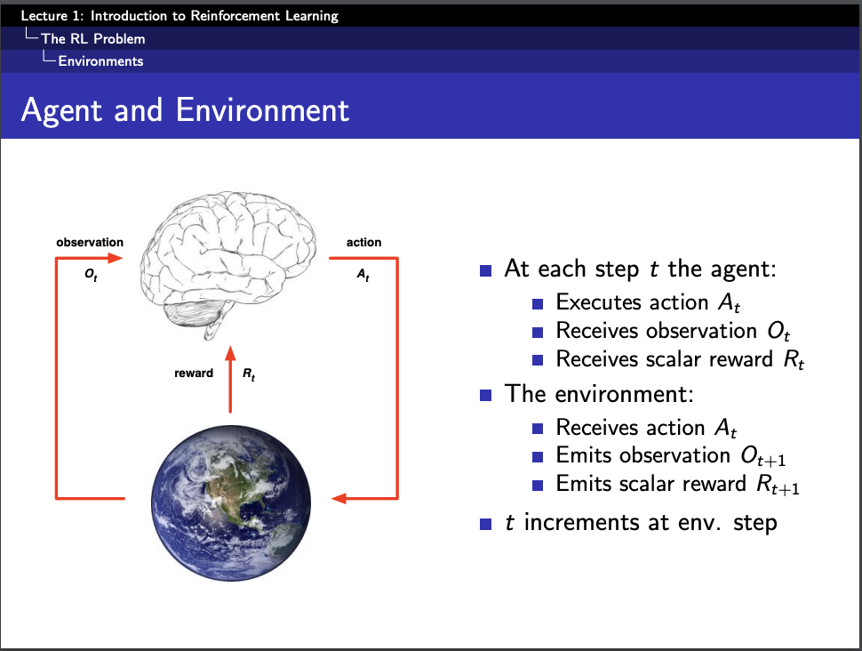

Slide 3
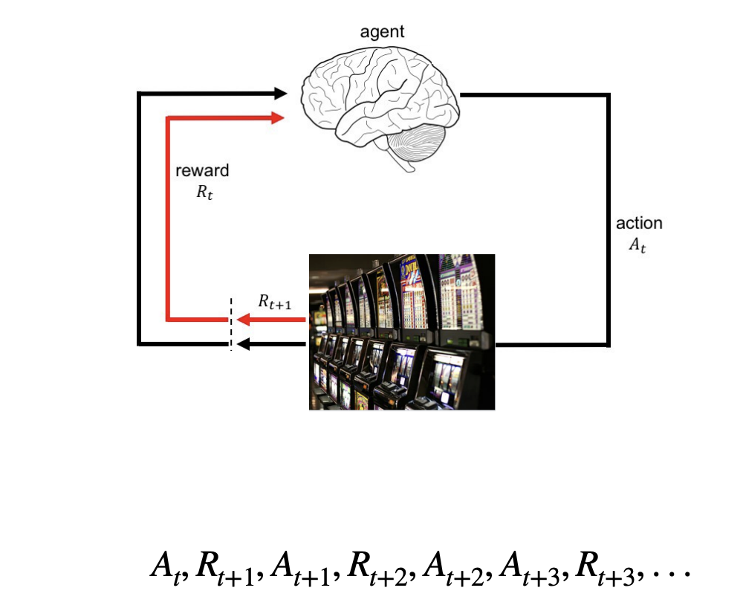
Recap
Multi-armed bandit problem
Exploration vs. Exploitation
Greedy vs. epsilon-greedy vs. UCB and others
In bandits, we act and observe. In MDPs, our actions change the world. What changes when where you are matters?

Slide 4
This week
Markov Decision Process!
Very foundational and rich topic
Most of the RL problems can be formulated MDP
Optimal policies and value functions
Bellman equation!
Foundational framework for many RL algorithms – recursive “reasoning”
If you do not remember any RL after this seminar ends, it is okay, as long as you remember and understand Bellman Equation!
Policy Evaluation and Iterations (if time permits)

Slide 5
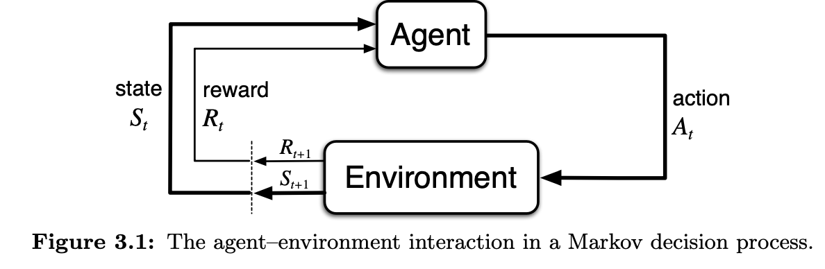

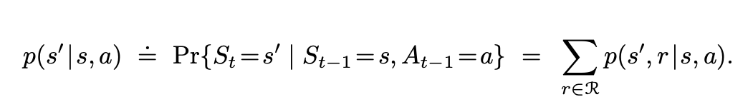
Markov Decision Process
MDP Trajectory:
How the states and rewards change given the actions of the agent
Conditional probability for state transition

Slide 6
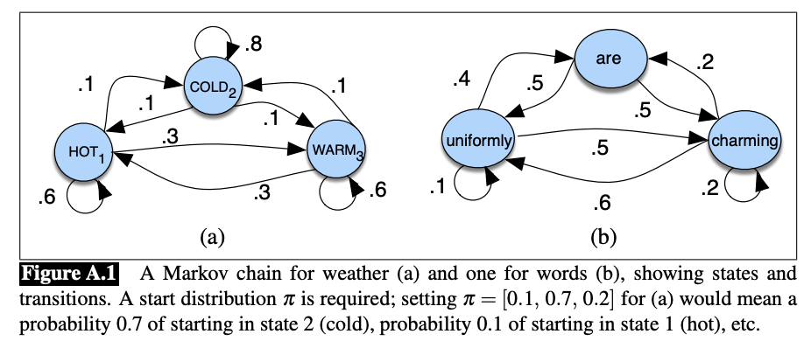
Markov Chain (Hidden Markov) vs. MDP
Passive Observer (no action available) vs. Active Planner
Example taken from Jurafsky NLP textbook

Slide 7

True or False
Even if the problem is not a Markovian process, one could still apply MDP?
Markovian process: next state (t+1) only depends the current state (t), not the previous history (t-1).
We say a process has Markov property:

Slide 8
True or False
Even if the problem is not a Markovian process, one could still apply MDP?
Yes -- one could approximate the problem as MDP.
Carefully choose the state representation
Bonus read: HMM, Strong Markov Property, Partially Observable MDP (POMDP)

Slide 9
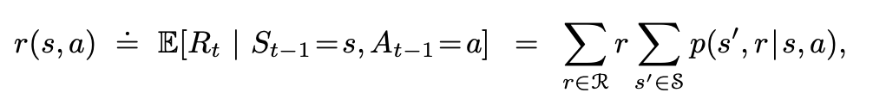
Rewards and Expected Rewards
Expected rewards for state–action pairs as a two-argument function

Slide 10
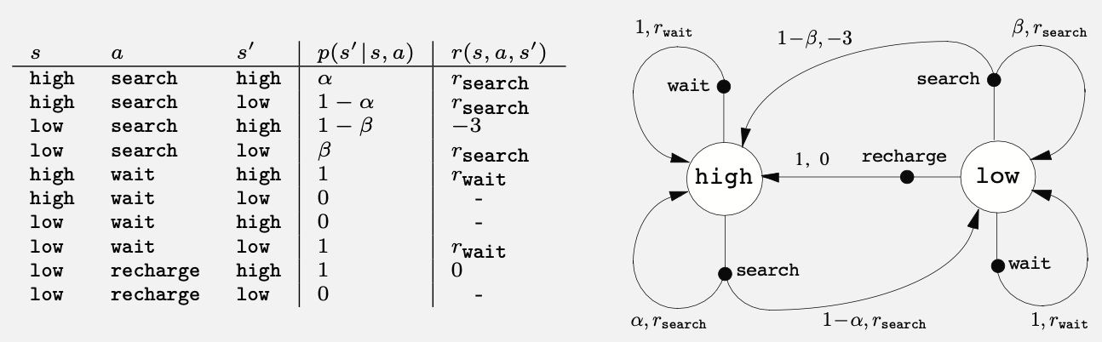
Transition graph

Slide 11
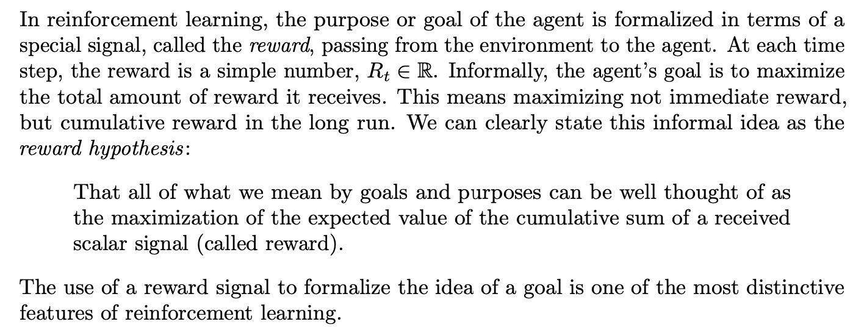
Goals and Rewards
pp 75

Slide 12
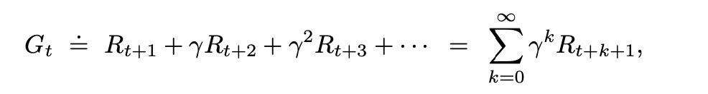
Returns and Episodes
Expected Return G_{t} – Some specific function of the rewards
Return vs. Reward:
Reward: a specific value obtained through the agent acting an action
Return: cumulative reward when the agent picks a sequence of actions, leading to terminal state.
The agent is trained to choose the action that maximize the expected return
Why discounted factor (discounted factor)?

Slide 13

Discounted Factor
Balancing immediate reward vs. future reward
If gamma < 1, G_{t} from being $∞$ --> finite sum
If gamma = 0, only consider immediate reward
Why is it bad if gamma > 1?

Slide 14
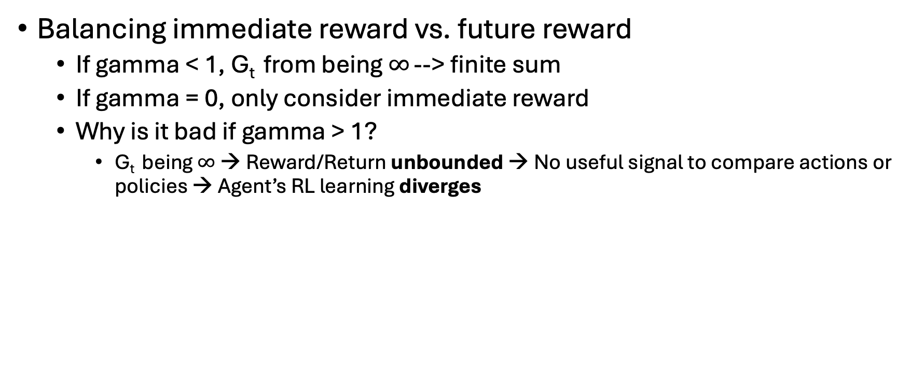
Discounted Factor
Balancing immediate reward vs. future reward
If gamma < 1, G_{t} from being $∞$ --> finite sum
If gamma = 0, only consider immediate reward
Why is it bad if gamma > 1?
G_{t} being $∞$ → Reward/Return unbounded → No useful signal to compare actions or policies → Agent’s RL learning diverges

Slide 15
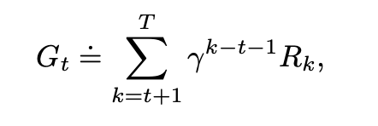
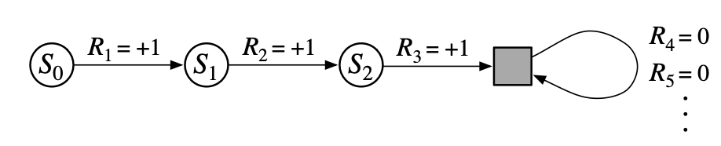
Unified Notation
Finite-horizon discounted return
Starting from t+1 because at time t, the expected return is the cumulative & discounted reward starting from time t+1
Termination state (where agent gets stuck at getting 0 reward), aka. “absorbing state” in the book

Slide 16
Policies and Value Functions
Value function: how good it is for the agent to be in a given state (or how good is it to perform a given action in a given state)
Policy: mapping from states to probabilities of selecting each possible action.
Probability distribution of actions given a state s

Slide 17


Policies and Value Functions
State-value function
Action-value function
Both could be estimated (learned) from experiences (training data), e.g. Monte Carlo methods

Slide 18
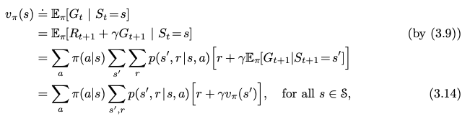

Bellman Equation
For any policy $π$ and any state, the following consistency condition holds between the value of s and the value of its possible successor states:

Slide 19

Optimal Policies and Optimal Value Function
How do we know if a policy is better than the other? (leading to a better expected return)
There might be more than one optimal policy

Slide 20


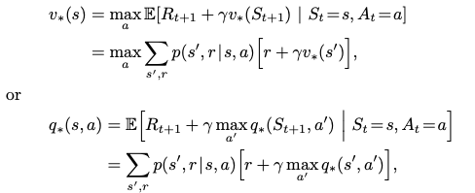
Optimal action-value function
Apply Bellman Equation

Slide 21
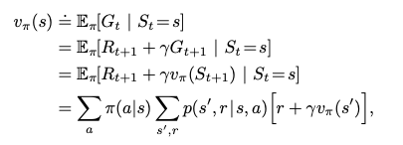

Policy Evaluation
Compute the state-value function for a given policy $π$
Update rule (for a fixed policy)
Iterative policy evaluation (computable)
Bellman Equation base form

Slide 22
Iterative Policy Evaluation
What happen from v_{k}(s) to v_{k+1}(s)
It replaces the old value of state s with a new value based on:
• The expected immediate rewards,
• The old values of the successor states of s,
• And all the one-step transitions possible under the current policy.
• This operation is called an expected update.

Slide 23
Contd.
• Each iteration updates the value of every state once to produce the new approximate value function v_{k+1}.
• There are different kinds of expected updates, depending on:
- Whether the update is based on a state or a state–action pair,
- And how the successor state values are aggregated.
• All dynamic programming (DP) updates are called expected updates because they involve expectations over all possible next states, rather than sampling a single next state

Slide 24
Next Session: Policy Evaluation and Iteration and DP (contd)
So far, we are still talking about estimating how good the current policy is
How to improve the policy is what we will cover next session.

