Slide 1
Multi-Armed Bandits
LARK Lab RL Reading Seminar Week 2
April 1, 2025
Slides will be available on github repo
Some slides are adapted from Katerina Fragkiadaki, Spring 2019, CMU 10403

Slide 2
Recap
Seminar introduction
Elements of RL
Exploration vs. Exploitation
exploit what it already knows in order to obtain reward
explore in order to make better action selections in the future

Slide 3
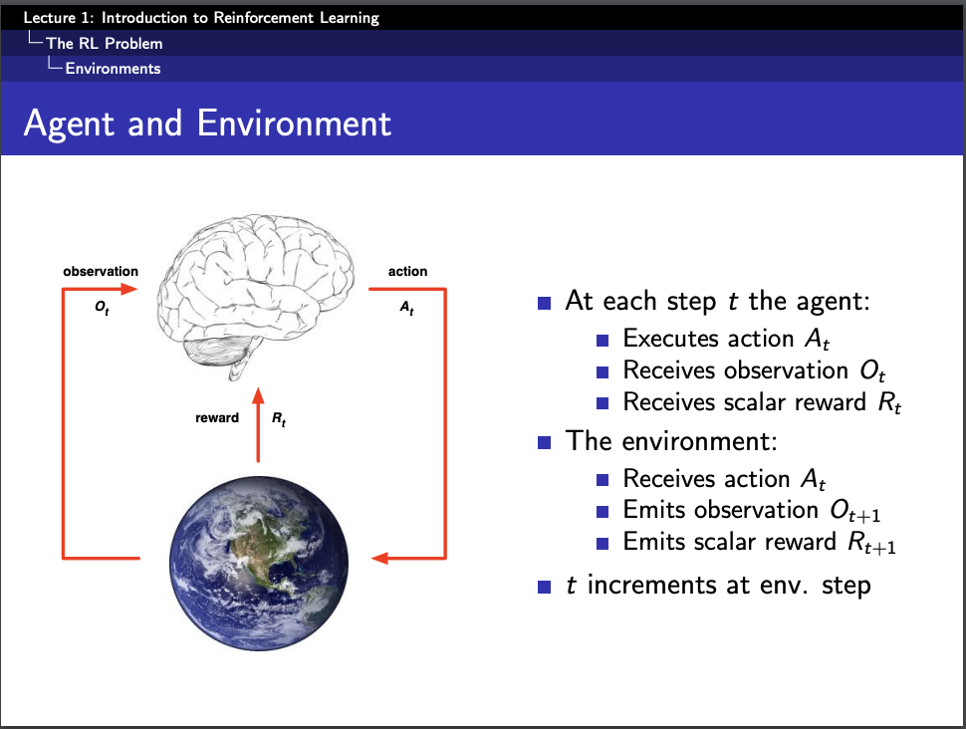
Source: David Silver’s slides

Slide 4
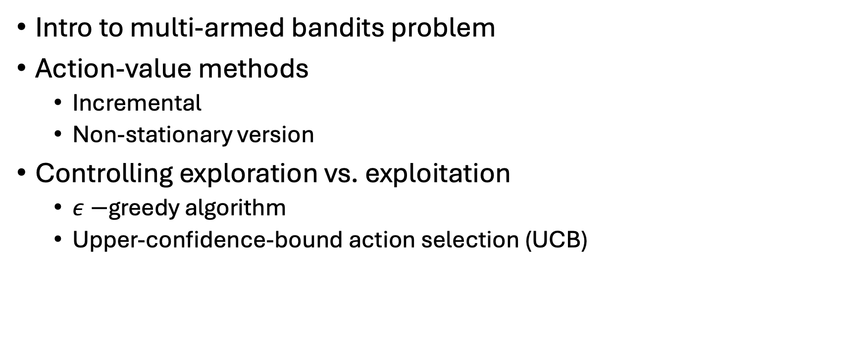
This week
Intro to multi-armed bandits problem
Action-value methods
Incremental
Non-stationary version
Controlling exploration vs. exploitation
$ε−$greedy algorithm
Upper-confidence-bound action selection (UCB)

Slide 5
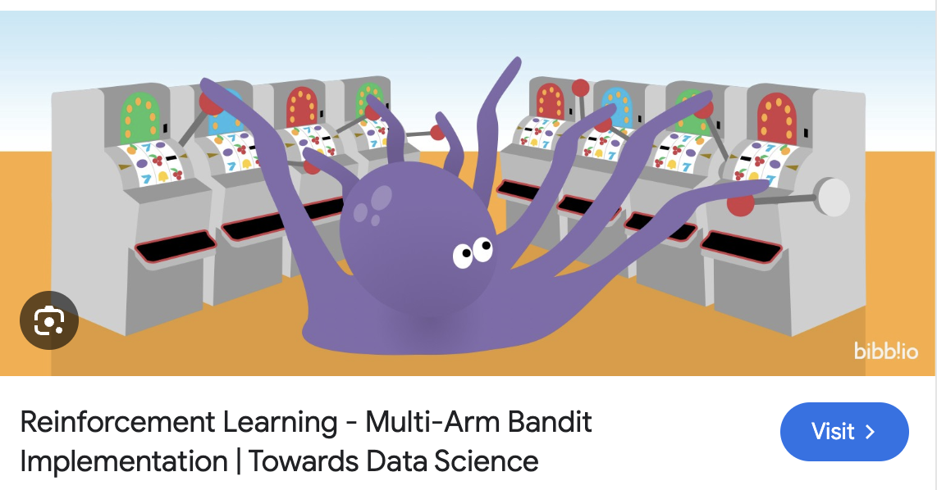
K-armed bandit

Slide 6
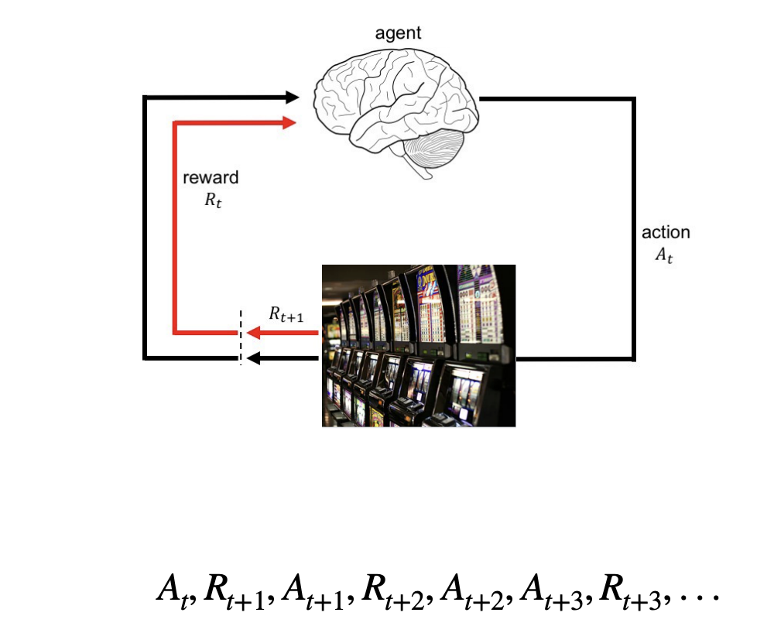
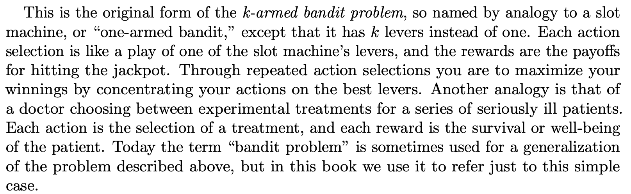
K-armed bandit
A simple RL setup --- the states are not changed!

Slide 7
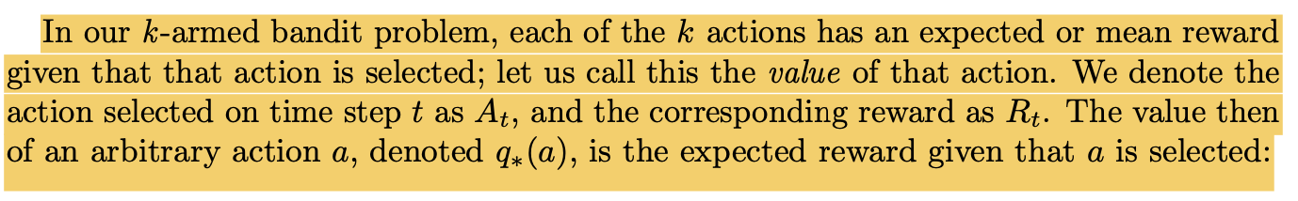

At each time step, the agent chose one of the k arms
The i_{th} arm produce the reward at each time step; each of the k actions have an expected or mean reward given an action
The rewards are drawn from a probability distribution
However, the agent does not know the true probability distribution of the reward, but has an estimate Q_{t}(a)
Goal: get the maximum rewards based on the estimated Q_{t}(a)!

Slide 8
Exploration vs. Exploitation Dilemma
Greedy version: always select the max Q_{t}(a) – exploitation using the known knowledge
Cons?
Non-greedy: give up the max Q_{t}(a), look for other options -- exploration for new enables you to improve your estimate of the nongreedy action’s value.
Exploitation is the right thing to do to maximize the expected reward on the one step, but exploration may produce the greater total reward in the long run. For example, suppose a greedy action’s value is known with certainty, while several other actions are estimated to be nearly as good but with substantial uncertainty. The uncertainty is such that at least one of these other actions probably is actually better than the greedy action, but you don’t know which one. If you have many time steps ahead on which to make action selections, then it may be better to explore the nongreedy actions and discover which of them are better than the greedy action. Reward is lower in the short run, during exploration, but higher in the long run because after you have discovered the better actions, you can exploit them many times. (pp.48)

Slide 9
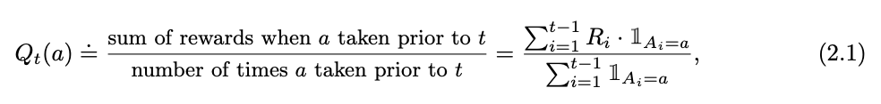

Action-value method
How do we get Q_{t}(a)?
Sample-average: estimating action values based on the average of the sample of relevant rewards (the actual rewards)
Greedy selection:

Slide 10

What if we have some control over being greedy?
$∈−$a small probability sampling randomly from all possible actions
1 - $∈$ $−$ probability of always choosing the certain actions (with max Qt(a))

Slide 11
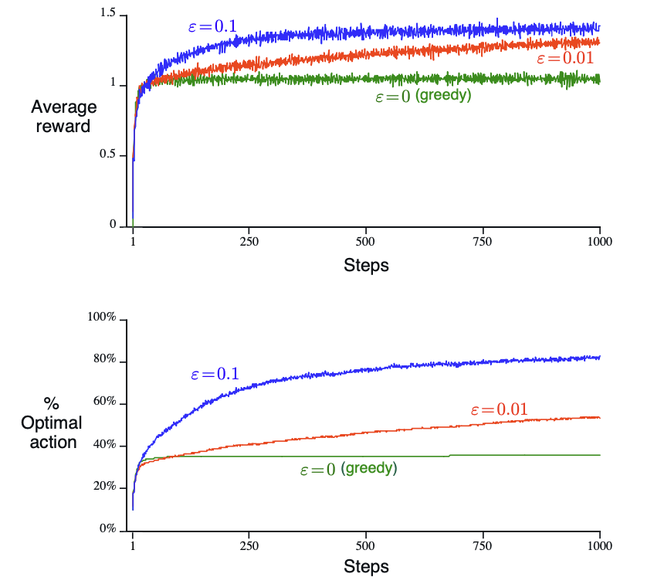
Simulating model behavior on 10-arm bandit
Assuming Gaussian (normal) distribution
Depending on the task and reward variances
If reward variance is small, no significant difference between near-greedy vs. greedy

Slide 12
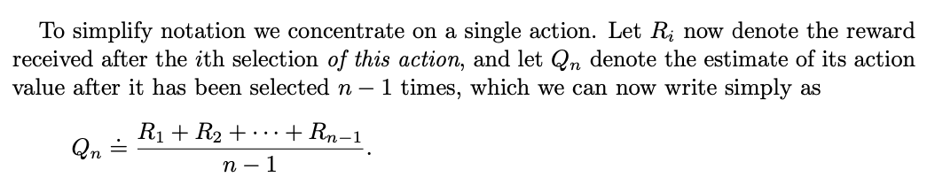
Incremental Implementation
Keeping track of all rewards the agent went through is memory consuming!
Better way?
(Relationship between n+1, n, n-1)

Slide 13
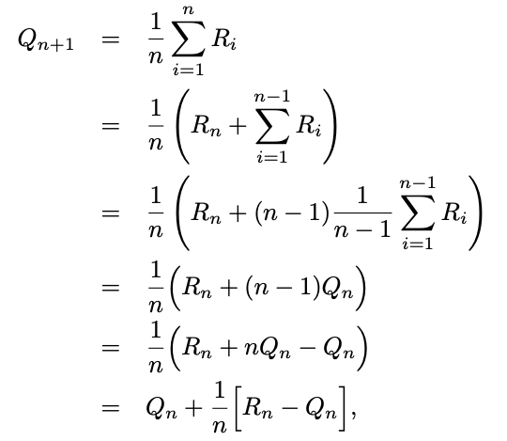
Rewrite into constant computation

Slide 14
*General rule
Step-wise Error
Qt(A)
Rt : actual reward
Qt(A)
Only need the reward and old estimate from last step!

Slide 15
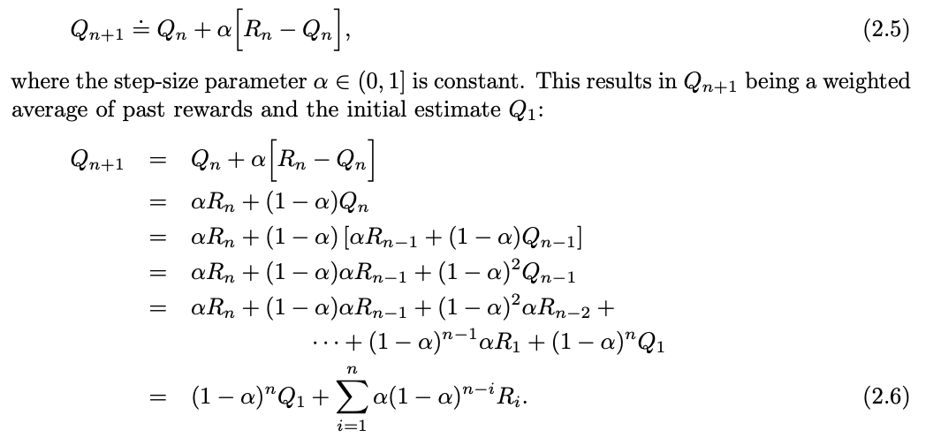

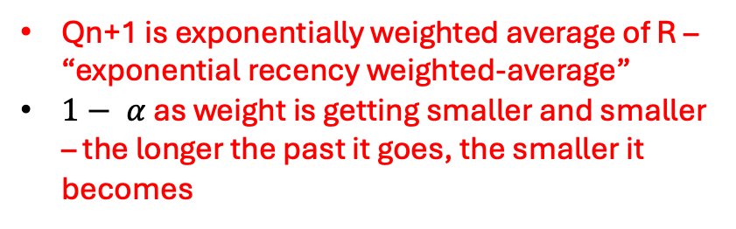
Non-stationary problem
Assigning weights to past rewards -- $α$
Qn+1 is exponentially weighted average of R – “exponential recency weighted-average”
$1− α$ as weight is getting smaller and smaller – the longer the past it goes, the smaller it becomes

Slide 16
Optimistic initial values
Qn+1 is dependent on Q1, the initial value estimates – Qn+1 is “biased”
How do we know we are choosing the right Q1? (what is a good “start”?)
In practice, this kind of bias is usually not a problem and can sometimes be very helpful. The downside is that the initial estimates become, in effect, a set of parameters that must be picked by the user, if only to set them all to zero. The upside is that they provide an easy way to supply some prior knowledge about what level of rewards can be expected. (pp. 56)

Slide 17
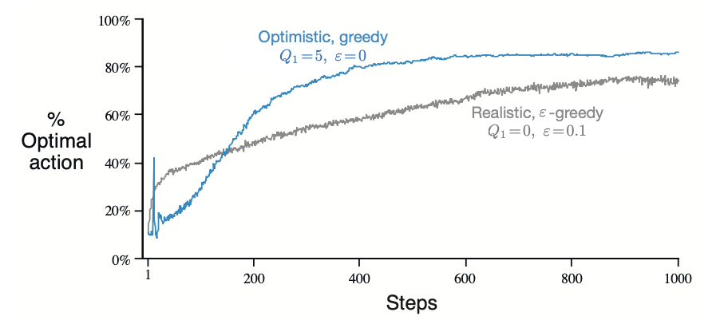
Tradeoff again
In the 10-armed problem:
If starting with super optimistic value and being greedy all the time
Start off bad but has more long-term values
Because super optimistic beginning leads to more ”disappointment”, therefore encouraging more “exploration”!
Only works when the problem is static.

Slide 18
Where epsilon-greedy might not be enough
Exploration is needed because there is always uncertainty about the accuracy of the action-value estimates. The greedy actions are those that look best at present, but some of the other actions may actually be better. epsilon-greedy action selection forces the non-greedy actions to be tried, but indiscriminately, with no preference for those that are nearly greedy or particularly uncertain. It would be better to select among the non-greedy actions according to their potential for actually being optimal, taking into account both how close their estimates are to being maximal and the uncertainties in those estimates. (pp.57)
Epsilon-greedy looks at all actions equally.
Heuristics might be helpful to decide what actions might be better than the others.

Slide 19
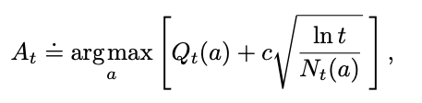
Upper-confidence-bound action selection
Current time step t
Exploration term
The action chosen at time step t
Current estimated value (mean reward)
Nt(a): Numbers of times an action a being selected up to time t – can’t be zero! All actions have to be sampled at least once.
Exploitation term

Slide 20
Behavior Dynamics Over Time
Current time step t
The action chosen at time step t
Current estimated value (mean reward)
Nt(a): Numbers of times an action a being selected up to time t – can’t be zero! All actions have to be sampled at least once.
When the exploration begins -- small t
All actions have low Nt(a), so the exploration term is large
This leads to more exploration: actions that haven't been selected yet will have large bonuses and are likely to be chosen.

Slide 21
Behavior Dynamics Over Time
Current time step t
The action chosen at time step t
Current estimated value (mean reward)
Nt(a): Numbers of times an action a being selected up to time t – can’t be zero! All actions have to be sampled at least once.
After some time steps t:
As Nt(a) increases for some actions, their exploration bonus shrinks.
If Qt(a) for some actions become consistently larger, Exploitation dominates
If actions are sampled less frequently, they would still be chosen occasionally

Slide 22
Behavior Dynamics Over Time
Current time step t
The action chosen at time step t
Current estimated value (mean reward)
Nt(a): Numbers of times an action a being selected up to time t – can’t be zero! All actions have to be sampled at least once.
Later time steps – larger t
Ln t grows slowly (natural logarithm), exploration term grows slower and smaller for actions tried many times
Action with highest Qt(a) always being chosen (unless some rare actions making Nt(a) small)
stabilizes on near-optimal actions, but continues low-frequency exploration

Slide 23
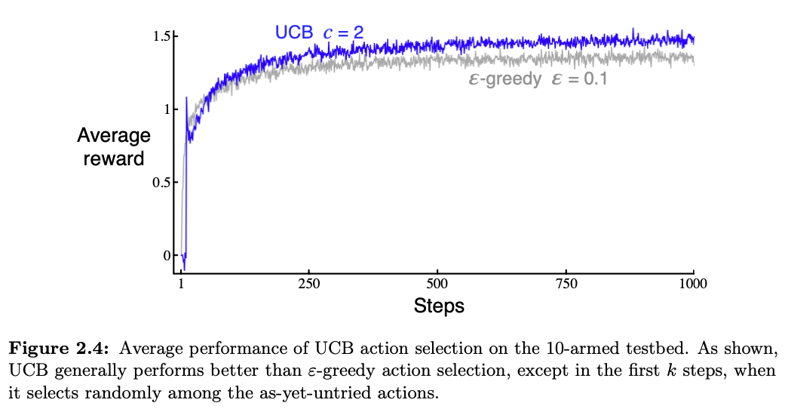

Slide 24
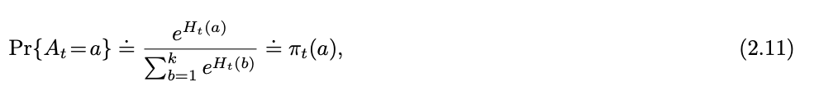
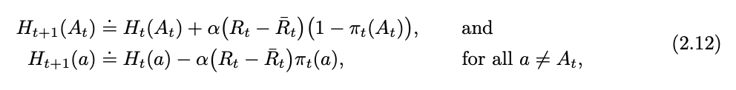
Another option: Gradient bandit
Sampling actions based on distribution (Gibbs or Boltzmann)

Slide 25
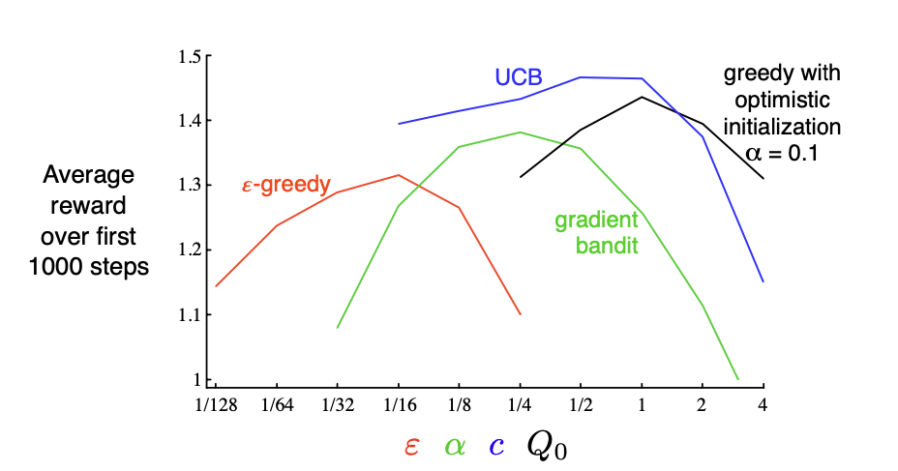
Comparing 10-armed bandit problems

Slide 26
Next week
Markov Decision Process!

Slide 27
Next Reading and Preparation
Read the chapter by yourself – before meeting
During the seminar, we will walk through important concepts, math equations and proofs together
Read the chapter again – feel the flow!

