Slide 1

Locally Nameless at Scale
An experience report on Coq+Ott+LNgen for PL metatheory
Stephanie Weirich, Antoine Voizard and Anastasiya Kravchuk-Kirilyuk
University of Pennsylvania

Slide 2
Core Dependent Haskell
A Specification for Dependent Types in Haskell Stephanie Weirich, Antoine Voizard, Pedro Henrique Avezedo de Amorim, Richard A. Eisenberg In ICFP 2017
All Coq proofs available online
http://github.com/sweirich/corespec.git
Notes:
This talk is based on the Coq development that appeared in ICFP 2017. Some of the authors of this paper are here in this room.
The main results of this work is the development of a core dependently-typed language, suitable for extending GHC with dependent types.
We're not going to explain the results of that paper. Just enough to understand how they interact with the formalization.

Slide 3
Why Coq formalization?
Part of DeepSpec project
Be convincing about system soundness in presence of nontermination
Errors in prior versions of the system pointed out in Eisenberg's dissertation
Missed a case in [Weirich et al. ICFP14], see [Eisenberg 16] for fix.
Others have made mistakes too
Fun!
Notes:
Do we want to include this slide??? Only if SCW gives this part of the talk.

Slide 4
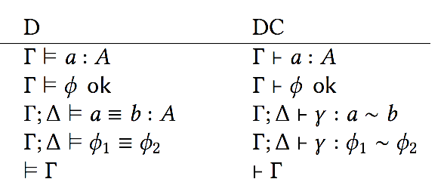
Two related languages
For
simplicity
For
GHC
Curry style vs. Church style type systems (36/35 rules)
DC has decidable type checking, D does not
Both languages have preservation/progress
Language are equivalent via erasure/annotation
Consistency of equality shown via confluence of parallel reduction
Notes:
This is as much of an overview of the ICFP paper as we should give. Also should mention that we will only talk about D in the rest of the talk.

Slide 5
Tool based formalization
Ott
source
file
 | LOC
Ott spec | 1423
LaTeX macros | 1851
Paper sources | 2317
Coq | 32828
Language def | 1432
Syntactic lemmas | 11730
System D | 5399
Consistency | 2417
System DC | 8142
Decidability | 3529
Erasure/Annotation | 2215
Utils | 629
Other | 2732
ott
ott
Language
Defs
latex
macros
lngen
syntactic
lemmas
paper sources
Coq
proofs
ott: Sewell, Zappa Nardelli, et al
lngen: Aydemir

Slide 6
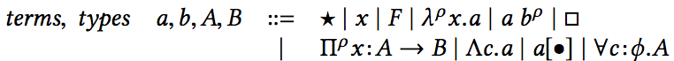
Ott: Locally Nameless Syntax
tm, a, b, A, B :: 'a_' ::=
| TYPE :: :: Star
{{ tex \star }}
| x :: :: Var
| \ rho x . b :: :: UAbs (+ bind x in b +)
{{ tex ... }}
| ...
Inductive tm : Set :=
| a_Star : tm
| a_Var_b (_:nat)
| a_Var_f (x:tmvar)
| a_UAbs (rho:relflag)(b:tm)
| …
Notes:
Point out
- OTT bindspec
Coq: bound and free variables separated
Coq: no variables in abstraction
LaTeX is most compact form by far
Language contains four different binders for three different abstraction forms. Normal functions, Irrelevant functions, and coercion abstraction (and their types).

Slide 7
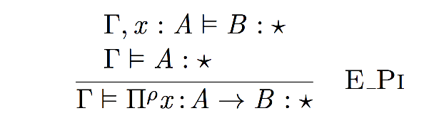
Ott: Cofinite Quantification
G, x:A |= B : TYPE
G |= A : TYPE
------------------------------- :: Pi
G |= all rho x:A -> B : TYPE
Ott
Coq
E_Pi : forall L G rho A B,
(forall x , x \notin L ->
Typing ((x ~ Tm A) ++ G)
(open_tm_wrt_tm B (a_Var_f x)) a_Star)
-> Typing G A a_Star
-> Typing G (a_Pi rho A B) a_Star
PDF
Notes:
Acknowledge that LN backend for Ott is by Francesco Zappa Nardelli. No one on Penn team contributed to Ott (other than as evangelism).
CoFinite quantification is an artifact of locally nameless variable encoding, Ott & Latex versions don't mention it explicitly.
We DON'T want to write out papers using only Coq definitions. Too wordy and too many artifacts from variable encoding. Ott/PDF versions provide MUCH better specifications for the community.

Slide 8
Ott: Generated definitions
(* Free variable substitution *)
tm_subst_tm_tm : tm -> tmvar -> tm -> tm
(* Free variable calculation *)
fv_tm_tm_tm : tm -> vars
(* Bound variable "substitution" *)
open_tm_wrt_tm : tm -> tm -> tm
(* Ensure no "dangling" bound variables *)
lc_tm : tm -> Prop
Notes:
Point out that we actually have versions of these for coercion variables as well as term variables.
Names are a bit heavy, but we have layered a few type classes & tactics to help with reasoning.

Slide 9
CoFinite quantification
E_Pi :
forall L G rho A B,
(forall x , x \notin L ->
Typing ((x ~ Tm A) ++ G)
(open_tm_wrt_tm B (a_Var_f x)) a_Star)
-> Typing G A a_Star
-> Typing G (a_Pi rho A B) a_Star
Generated
Provable
E_Pi_exists :
forall G rho A B x,
x \notin dom G \u fv_tm_tm_tm B ->
-> Typing ((x ~ Tm A) ++ G)
(open_tm_wrt_tm B (a_Var_f x)) a_Star
-> Typing G A a_Star
-> Typing G (a_Pi rho A B) a_Star
Notes:
Sometimes you want to be able to construct a derivation using a particular variable that you already know something about. The "standard" LN typing rule is derivable from weakening and substitution.
Give credit to Arthur Chargueraud for CoFinite quant
We may or may not need to use this slide.

Slide 10
LNgen
(* Replace free variable with bound variable *)
close_tm_wrt_tm : tmvar -> tm -> tm
(* Theory of syntactic operations *)
Lemma open_tm_wrt_tm_close_tm_wrt_tm :
forall a1 x1,
open_tm_wrt_tm (close_tm_wrt_tm x1 a1)
(a_Var_f x1) = a1.
(* Many classic results of lambda calculus *)
Lemma fv_tm_tm_tm_tm_subst_tm_tm_fresh :
forall a1 a2 x1,
x1 `notin` fv_tm_tm_tm a1 ->
fv_tm_tm_tm (tm_subst_tm_tm a2 x1 a1) [=]
fv_tm_tm_tm a1.
Notes:
Give credit to Brian Aydemir
LNgen is a tool that works in conjunction with Ott
Experience with LN has shown us that we need additional definitions.
Example: close is the inverse of open. Allows us to create abstractions by "binding" a free variable (i.e. replacing it with a bound variable).
Many results about the generated "syntactic" functions are easy to state and prove automatically.

Slide 11
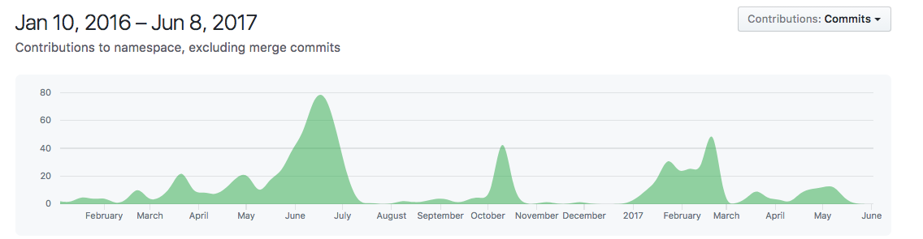
Proof Timeline
July 2016, POPL deadline ☹
October 2016, ESOP deadline ☹
February 2017, ICFP deadline ☺
April 2017, ICFP notification ☺ ☺
May 2017, public release
Paper writing / proofs
eta-equivalence
first cut
Decidability
proof / paper writing
Clean-up & refactoring
Notes:
It takes a long time to create mechanical proofs & write papers

Slide 12
Eta-equivalence: Two phases
Challenge: How to express eta-reduction in this context?
Initial version completed Mar-April 2017
[SCW main developer, system expert]
Two nonstandard extensions currently in progress
[AKK main developer, novice]

Slide 13
Eta-reduction
First try
beyond scope of
Ott's LN backend.
|- b => b'
x `notin` fv b
------------------- :: Eta
|- \+x.(b x+) => b'
|- b => b'
a = b x+
----------------- :: Eta
|- \+x.a => b'
Solution: name (b x)
subterm
Wait, what about
x not in fv b?
Notes:
Mention the syntax for relevant application

Slide 14
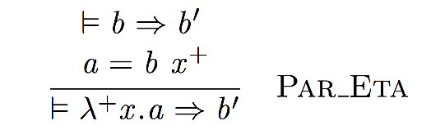
Where can x appear?
This doesn't
look like the
usual rule…
Par_Eta : forall (L:vars) (a b' b:tm),
Par b b'
-> (forall x, x \notin L
-> open_tm_wrt_tm a (a_Var_f x) =
a_App b Rel (a_Var_f x))
-> Par (a_UAbs Rel a) b'
a, b, and b' are quantified at the top level and equation must hold for any x
Notes:
This is a little unsatisfactory. Details of the binding representation is "leaking" into the PDF.
Would be good to have a better theory about LN representation in this case.

Slide 15
Where can x appear?
But, the "exists" form is derivable
Par_EtaRel_exists : forall x (a b' b:tm),
x `notin` fv_tm_tm_tm a \u
fv_tm_tm_tm b'
-> Par b b'
-> open_tm_wrt_tm a (a_Var_f x) =
a_App b Rel (a_Var_f x)
-> Par (a_UAbs Rel a) b'
Notes:
The derivable "exists" version of the rule makes the freshness more explicit.

Slide 16
Update confluence proofs
Confluence for 𝛽𝜂-reduction proved by Tait-Martin Löf (for untyped lambda calculus, see Barendregt 1984)
Good news: Coq points out three new required cases
Not so good news: Need induction on height of term, not structure
Not so bad news:
Height function automatically defined by LNgen
Existing tactics in proof for applying IH could be modified
Omega tactic easily handles all arithmetic

Slide 17
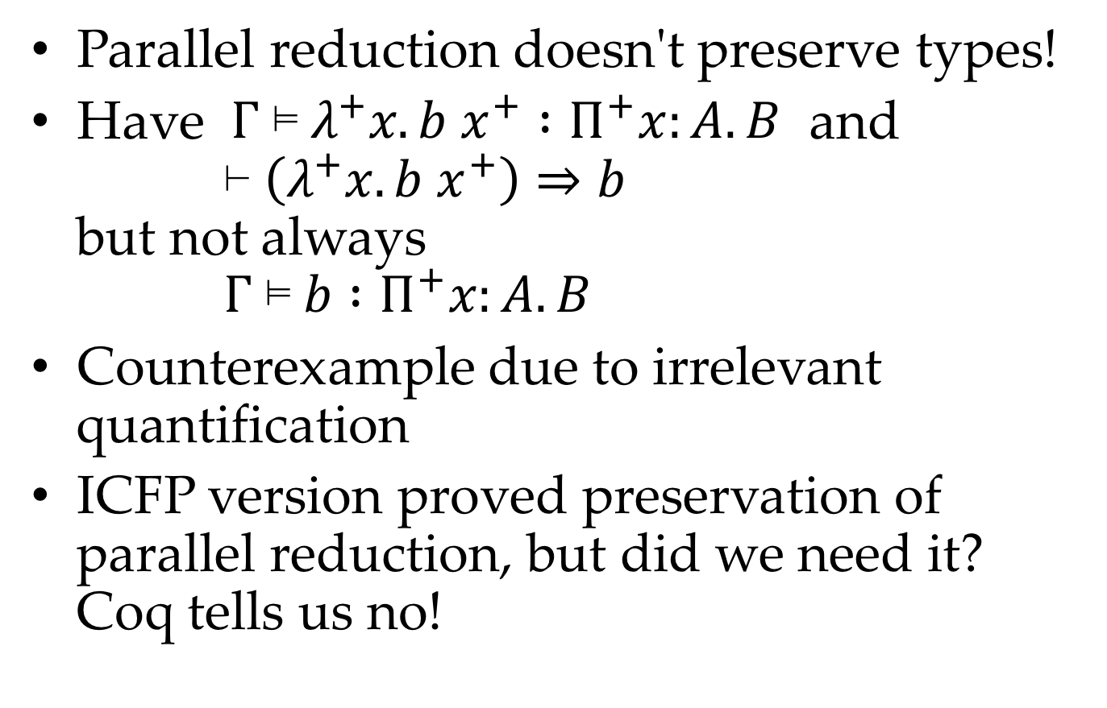
More "bad" news
Parallel reduction doesn't preserve types!
Have $Γ \text{⊨} λ^{+}x. b x^{+} :Π^{+}x:A. B$ and ⊢ $\left(λ^{+}x. b x^{+}\right)⇒b$ but not always $Γ \text{⊨} b :Π^{+}x:A. B$
Counterexample due to irrelevant quantification
ICFP version proved preservation of parallel reduction, but did we need it? Coq tells us no!
Notes:
Parallel reduction is a proof technique only, not part of the language definition
Equals => joinable => consistent
More terms can be joinable than the language defines equal
Can join terms via ill-typed reductions, as long as the result is consistent
Still somewhat worrisome, I'm glad I have a machine-checked proof

Slide 18
Extension in progress (AKK)
|- b => b'
a = b []
----------------------------- :: EtaIrrel
|- \- x. a => b'
|- b => b'
a = b [o]
----------------------------- :: EtaC
|- /\c. a => b'
Irrelevant
arguments
Coercion abstraction

Slide 19
Anastasiya, what can you say about your experience joining this project, working with this large development, and editing these proofs?

Slide 20
Related work
Shafer, Tebbi, Smolka: Autosubst
Keuchel: Needle and Knot

Slide 21
Conclusions?
We need some sort of summary slide here
Notes:
Don't forget about typesetting

Slide 22
No more paper proofs!
Good for typesetting
Good for extension
eta / roles / levity polymorphism / higher-inductive types
Good for refactoring
Removed unnecessary hypotheses from rules
Adopted alternative push rules in DC operational semantics
Good for details
Decidability of type checking
Erasure / annotation lemma
Regularity lemmas
Low-level syntactic properties
Weakening, substitution
If 𝛤 ⊢ a : A then fv a ∈ dom 𝛤
Notes:
CoqPL know all of this stuff, so not sure we want to say all of this

