Slide 1
CrisisFACTS: Social Media in Disasters
Disaster Help Family Reddit Friends Twitter Hurricane Instagram Florence Challenge Flooding Levy Information Dorian Reddit Save Rescue Disaster Help Family Reddit Friends Twitter Hurricane Instagram Florence Challenge Flooding Levy Information Dorian Reddit Save Rescue Disaster Help Family Disaster Help Family Reddit Friends Twitter Hurricane Instagram Florence Challenge Flooding Levy Information Dorian Reddit Save Rescue Disaster Help Family Reddit Friends Twitter Hurricane Instagram Florence Challenge Flooding Levy Information Dorian Reddit Save Rescue Reddit Friends Twitter Hurricane Instagram Florence Challenge Flooding Levy Information Disaster Help Family Reddit Friends Twitter Hurricane Instagram Florence Challenge Flooding Levy Information Dorian Reddit Save Rescue Dorian Reddit Save Rescue Disaster Help Family Reddit Friends Twitter Hurricane Instagram Florence Challenge Flooding Disaster Help Family Reddit Friends Twitter Hurricane Instagram Florence Challenge Flooding Levy Information Dorian Reddit Save Rescue Levy Information Dorian Disaster Help Family Reddit Friends Twitter Hurricane Hurricane Instagram Florence Challenge Flooding Levy Information Dorian Reddit Save Instagram Florence Challenge Flooding Levy Information Dorian Reddit Hurricane Instagram Florence Challenge Flooding Levy Information Dorian Reddit Save Save Rescue Reddit Save Disaster Help Family Reddit Friends Twitter Hurricane Instagram Florence Challenge Hurricane Instagram Florence Challenge Flooding Levy Information Dorian Reddit Save Flooding Levy Information Dorian Reddit Disaster Help Family Reddit Friends Twitter Hurricane Hurricane Instagram Florence Challenge Flooding Levy Information Dorian Reddit Save Instagram Florence Challenge Flooding Levy Information Dorian Reddit Save Rescue Save Rescue Rescue Hurricane Instagram Florence Challenge Flooding Hurricane Instagram Florence Challenge Flooding Levy Information Dorian Reddit Save Levy Information Dorian Reddit Save Hurricane Instagram Florence Challenge Flooding
Group 23042
Moufarrij, Taylor, Thomas

Slide 2
Overview
Disaster Help Family Reddit Friends Twitter Hurricane Instagram Florence Challenge Flooding Levy Information Dorian Reddit Save Rescue Disaster Help Family Reddit Friends Twitter Hurricane Instagram Florence Challenge Flooding Levy Information Dorian Reddit Save Rescue Disaster Help Family Disaster Help Family Reddit Friends Twitter Hurricane Instagram Florence Challenge Flooding Levy Information Dorian Reddit Save Rescue Disaster Help Family Reddit Friends Twitter Hurricane Instagram Florence Challenge Flooding Levy Information Dorian Reddit Save Rescue Reddit Friends Twitter Hurricane Instagram Florence Challenge Flooding Levy Information Disaster Help Family Reddit Friends Twitter Hurricane Instagram Florence Challenge Flooding Levy Information Dorian Reddit Save Rescue Dorian Reddit Save Rescue Disaster Help Family Reddit Friends Twitter Hurricane Instagram Florence Challenge Flooding Disaster Help Family Reddit Friends Twitter Hurricane Instagram Florence Challenge Flooding Levy Information Dorian Reddit Save Rescue Levy Information Dorian Disaster Help Family Reddit Friends Twitter Hurricane Hurricane Instagram Florence Challenge Flooding Levy Information Dorian Reddit Save Instagram Florence Challenge Flooding Levy Information Dorian Reddit Hurricane Instagram Florence Challenge Flooding Levy Information Dorian Reddit Save Save Rescue Reddit Save Disaster Help Family Reddit Friends Twitter Hurricane Instagram Florence Challenge Hurricane Instagram Florence Challenge Flooding Levy Information Dorian Reddit Save Flooding Levy Information Dorian Reddit Disaster Help Family Reddit Friends Twitter Hurricane Hurricane Instagram Florence Challenge Flooding Levy Information Dorian Reddit Save Instagram Florence Challenge Flooding Levy Information Dorian Reddit Save Rescue Save Rescue Rescue Hurricane Instagram Florence Challenge Flooding Hurricane Instagram Florence Challenge Flooding Levy Information Dorian Reddit Save Levy Information Dorian Reddit Save Hurricane Instagram Florence Challenge Flooding
Disasters
Useful Data
The Challenge
Florence and Dorian
Our Method
NLTK
The Results
What was Useful

Slide 3
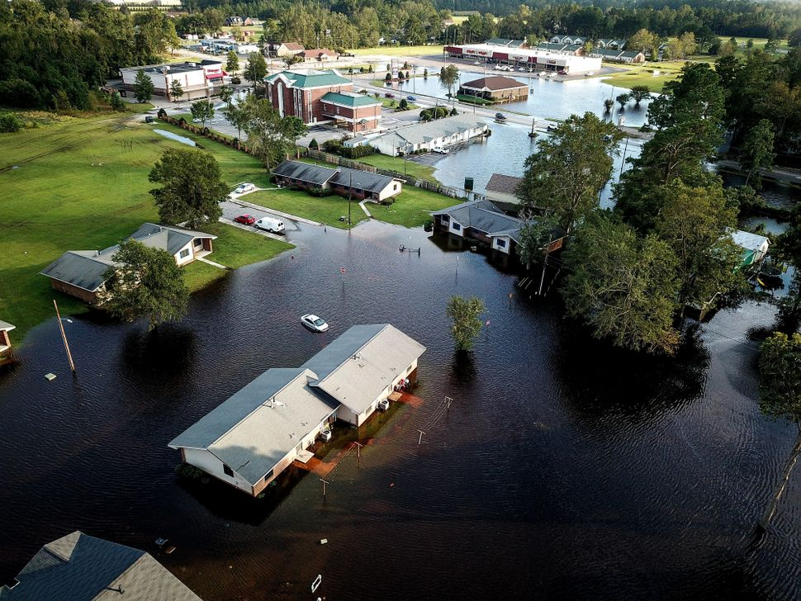
Nine River Gauges Flooded
At least 42 Fatalities & 5214 people rescued
$16.7 Billion in Damages
Record-breaking rainfall in the Carolinas
130mph wind gusts in South Carolina
Hurricane
Florence

Slide 4
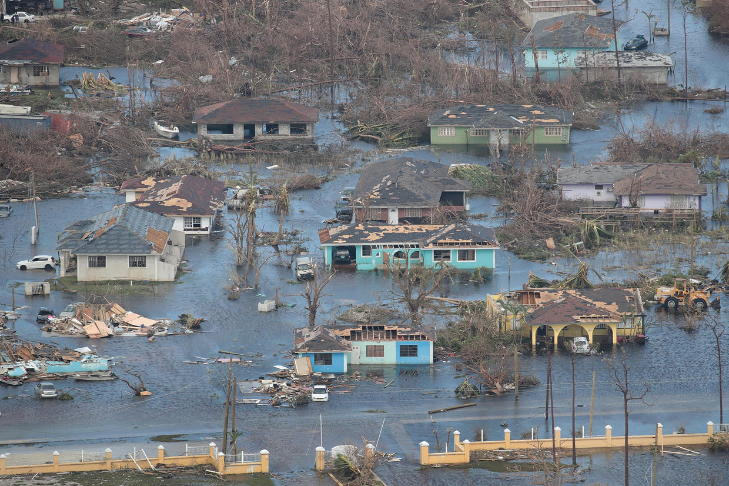
Hurricane
Dorian
Up to 7ft storm surge
190,000 people left homeless
$1.6 Billion in US Damages
Strongest Tropical Storm to hit the Bahamas
185 sustained winds

Slide 5
Challenges
Disaster Help Family Reddit Friends Twitter Hurricane Instagram Florence Challenge Flooding Levy Information Dorian Reddit Save Rescue Disaster Help Family Reddit Friends Twitter Hurricane Instagram Florence Challenge Flooding Levy Information Dorian Reddit Save Rescue Disaster Help Family Disaster Help Family Reddit Friends Twitter Hurricane Instagram Florence Challenge Flooding Levy Information Dorian Reddit Save Rescue Disaster Help Family Reddit Friends Twitter Hurricane Instagram Florence Challenge Flooding Levy Information Dorian Reddit Save Rescue Reddit Friends Twitter Hurricane Instagram Florence Challenge Flooding Levy Information Disaster Help Family Reddit Friends Twitter Hurricane Instagram Florence Challenge Flooding Levy Information Dorian Reddit Save Rescue Dorian Reddit Save Rescue Disaster Help Family Reddit Friends Twitter Hurricane Instagram Florence Challenge Flooding Disaster Help Family Reddit Friends Twitter Hurricane Instagram Florence Challenge Flooding Levy Information Dorian Reddit Save Rescue Levy Information Dorian Disaster Help Family Reddit Friends Twitter Hurricane Hurricane Instagram Florence Challenge Flooding Levy Information Dorian Reddit Save Instagram Florence Challenge Flooding Levy Information Dorian Reddit Hurricane Instagram Florence Challenge Flooding Levy Information Dorian Reddit Save Save Rescue Reddit Save Disaster Help Family Reddit Friends Twitter Hurricane Instagram Florence Challenge Hurricane Instagram Florence Challenge Flooding Levy Information Dorian Reddit Save Flooding Levy Information Dorian Reddit Disaster Help Family Reddit Friends Twitter Hurricane Hurricane Instagram Florence Challenge Flooding Levy Information Dorian Reddit Save Instagram Florence Challenge Flooding Levy Information Dorian Reddit Save Rescue Save Rescue Rescue Hurricane Instagram Florence Challenge Flooding Hurricane Instagram Florence Challenge Flooding Levy Information Dorian Reddit Save Levy Information Dorian Reddit Save Hurricane Instagram Florence Challenge Flooding
Large Datasets
Judging Emotions

Slide 6
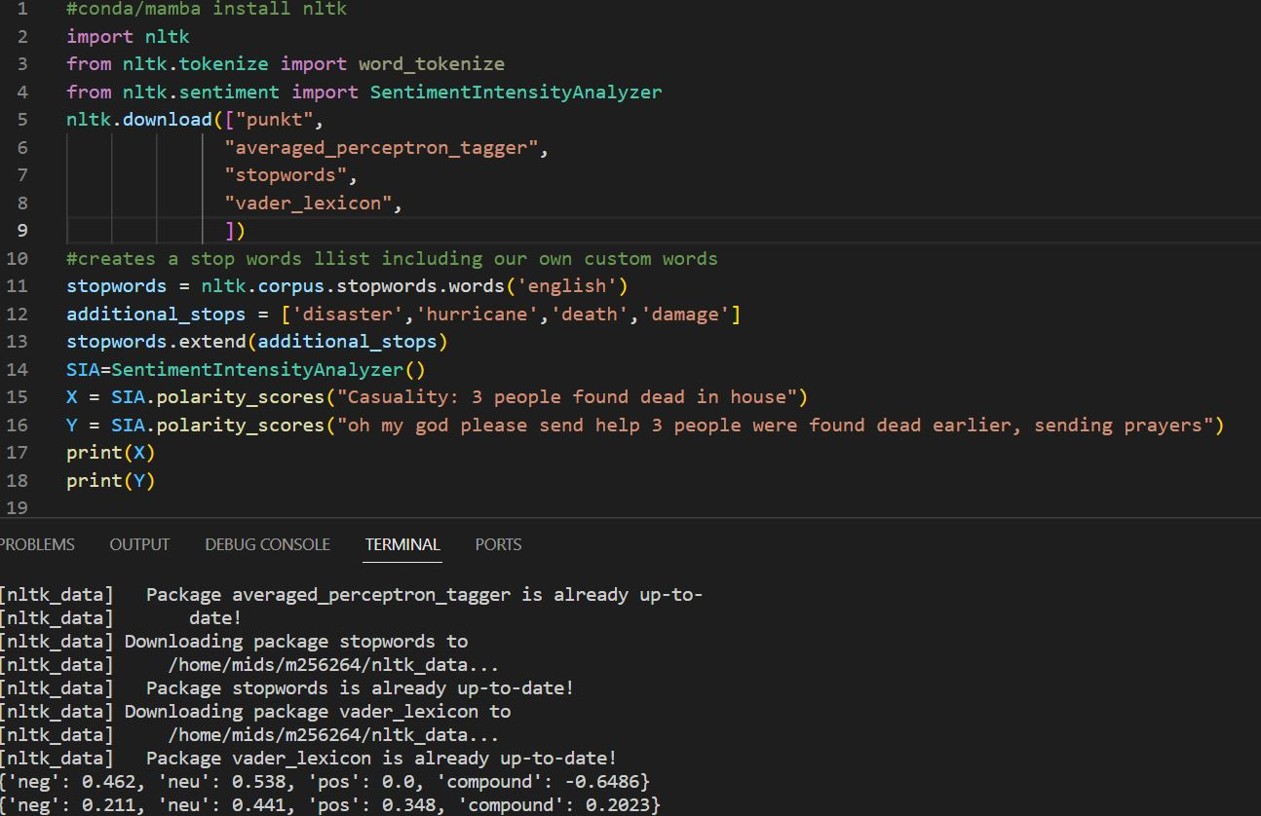
Judging Emotions
NLTK libraries imported
Sentences being Analyzed
Sentiment Output

Slide 7
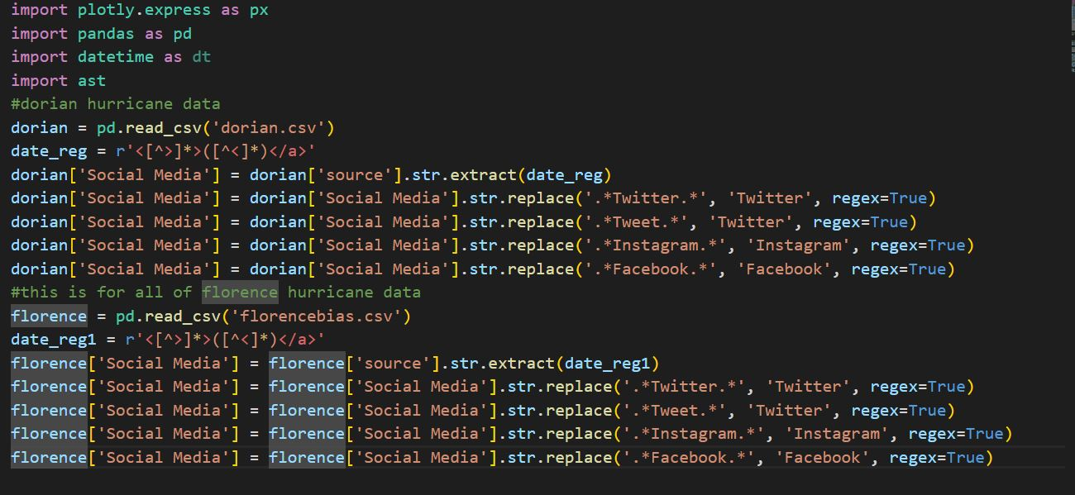
Data condensed to CSV
Reg-Ex to gather unformatted data
Replace some the data with simple labels

Slide 8
Broken Media Counts (Florence)
1.4M
1.2M
1.0M
0.8M
0.6M
0.4M
0.2M
0
IFTTT
Twitter
Facebook
SocialNewsDesk
Instagram

Slide 9
Broken Media Counts (Dorian)
1.4M
1.2M
1.0M
0.8M
0.6M
0.4M
0.2M
0
IFTTT
Twitter
Facebook
RoundTeam
Paper.li

Slide 10
Media Counts
8K
14k
7K
12K
6K
10K
5K
8K
4K
6K
3K
4k
2K
1K
2K
0
0
Facebook
IFTTT
SocialWestDesk
Instagram
Facebook
IFTTT
RoundTeam
Paper.li
Dorian
Florence

Slide 11
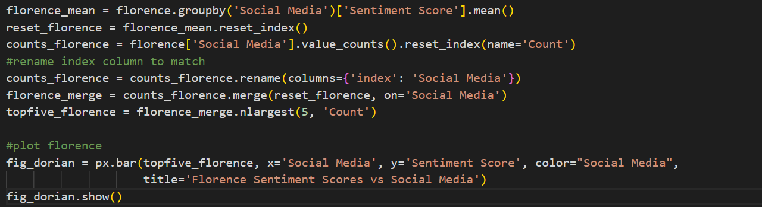
Example of Plotly Usage

Slide 12
Sentiment Scores
0.9
0.9
0.8
0.8
0.7
0.7
0.6
0.6
0.5
0.5
0.4
0.4
0.3
0.3
0.2
0.2
0.1
0.1
Twitter
Facebook
IFTTT
SocialNewsDesk
Instagram
Twitter
Facebook
IFTTT
RoundTeam
Paper.li
Dorian
Florence
Florence

Slide 13
Time scores
Disaster Help Family Reddit Friends Twitter Hurricane Instagram Florence Challenge Flooding Levy Information Dorian Reddit Save Rescue Disaster Help Family Reddit Friends Twitter Hurricane Instagram Florence Challenge Flooding Levy Information Dorian Reddit Save Rescue Disaster Help Family Disaster Help Family Reddit Friends Twitter Hurricane Instagram Florence Challenge Flooding Levy Information Dorian Reddit Save Rescue Disaster Help Family Reddit Friends Twitter Hurricane Instagram Florence Challenge Flooding Levy Information Dorian Reddit Save Rescue Reddit Friends Twitter Hurricane Instagram Florence Challenge Flooding Levy Information Disaster Help Family Reddit Friends Twitter Hurricane Instagram Florence Challenge Flooding Levy Information Dorian Reddit Save Rescue Dorian Reddit Save Rescue Disaster Help Family Reddit Friends Twitter Hurricane Instagram Florence Challenge Flooding Disaster Help Family Reddit Friends Twitter Hurricane Instagram Florence Challenge Flooding Levy Information Dorian Reddit Save Rescue Levy Information Dorian Disaster Help Family Reddit Friends Twitter Hurricane Hurricane Instagram Florence Challenge Flooding Levy Information Dorian Reddit Save Instagram Florence Challenge Flooding Levy Information Dorian Reddit Hurricane Instagram Florence Challenge Flooding Levy Information Dorian Reddit Save Save Rescue Reddit Save Disaster Help Family Reddit Friends Twitter Hurricane Instagram Florence Challenge Hurricane Instagram Florence Challenge Flooding Levy Information Dorian Reddit Save Flooding Levy Information Dorian Reddit Disaster Help Family Reddit Friends Twitter Hurricane Hurricane Instagram Florence Challenge Flooding Levy Information Dorian Reddit Save Instagram Florence Challenge Flooding Levy Information Dorian Reddit Save Rescue Save Rescue Rescue Hurricane Instagram Florence Challenge Flooding Hurricane Instagram Florence Challenge Flooding Levy Information Dorian Reddit Save Levy Information Dorian Reddit Save Hurricane Instagram Florence Challenge Flooding
September 7: 0.879
September 14: 0.878
August 26: 0.866
September 2: 0.852

Slide 14
Disaster Help Family Reddit Friends Twitter Hurricane Instagram Florence Challenge Flooding Levy Information Dorian Reddit Save Rescue Disaster Help Family Reddit Friends Twitter Hurricane Instagram Florence Challenge Flooding Levy Information Dorian Reddit Save Rescue Disaster Help Family Disaster Help Family Reddit Friends Twitter Hurricane Instagram Florence Challenge Flooding Levy Information Dorian Reddit Save Rescue Disaster Help Family Reddit Friends Twitter Hurricane Instagram Florence Challenge Flooding Levy Information Dorian Reddit Save Rescue Reddit Friends Twitter Hurricane Instagram Florence Challenge Flooding Levy Information Disaster Help Family Reddit Friends Twitter Hurricane Instagram Florence Challenge Flooding Levy Information Dorian Reddit Save Rescue Dorian Reddit Save Rescue Disaster Help Family Reddit Friends Twitter Hurricane Instagram Florence Challenge Flooding Disaster Help Family Reddit Friends Twitter Hurricane Instagram Florence Challenge Flooding Levy Information Dorian Reddit Save Rescue Levy Information Dorian Disaster Help Family Reddit Friends Twitter Hurricane Hurricane Instagram Florence Challenge Flooding Levy Information Dorian Reddit Save Instagram Florence Challenge Flooding Levy Information Dorian Reddit Hurricane Instagram Florence Challenge Flooding Levy Information Dorian Reddit Save Save Rescue Reddit Save Disaster Help Family Reddit Friends Twitter Hurricane Instagram Florence Challenge Hurricane Instagram Florence Challenge Flooding Levy Information Dorian Reddit Save Flooding Levy Information Dorian Reddit Disaster Help Family Reddit Friends Twitter Hurricane Hurricane Instagram Florence Challenge Flooding Levy Information Dorian Reddit Save Instagram Florence Challenge Flooding Levy Information Dorian Reddit Save Rescue Save Rescue Rescue Hurricane Instagram Florence Challenge Flooding Hurricane Instagram Florence Challenge Flooding Levy Information Dorian Reddit Save Levy Information Dorian Reddit Save Hurricane Instagram Florence Challenge Flooding
Conclusions
Little Change Over Time
Little Variance on Platform
Social Media Can be Useful for Information

