Slide 1


IMPLEMENTATION OF CATBOT USING NLP

Slide 2

Learning Objectives
Understand the fundamentals of Natural Language Processing (NLP).
Learn how to implement a chatbot using NLP techniques.
Explore text processing, tokenization, and intent recognition.
Gain hands-on experience with Python libraries for NLP.
Develop a chatbot capable of understanding and responding to user queries.
GOAL
Source :
www.freepik.com/

Slide 3
Tools and Technology used
Programming Language: Python
Libraries & Frameworks:
NLTK (Natural Language Toolkit)
Scikit-learn
Flask
Pandas & NumPy
IDE: Jupyter Notebook
Dataset: Custom dataset for training chatbot responses

Slide 4
Methodology
Data Preprocessing – Tokenization, stemming, and lemmatization for text cleaning.
Intent Classification – Using ML models to categorize user queries.
Response Generation – Rule-based or AI-driven response selection.
Chatbot Development – Implementing a Flask-based web interface.
Testing & Deployment – Evaluating responses and deploying the chatbot.

Slide 5
Problem Statement:
Traditional customer support and information retrieval are time-consuming.
Users face difficulties in getting instant responses to their queries.
Manual handling of repetitive queries leads to inefficiency.
Need for an automated chatbot that can handle basic queries efficiently.

Slide 6
Solution:
Develop a chatbot using NLP to understand and respond to user queries.
Use intent classification and response generation techniques.
Implement preprocessing steps (tokenization, stemming, lemmatization) for accurate text understanding.
Provide a Flask-based web interface for easy user interaction.
Ensure chatbot learns from training data to improve accuracy over time.

Slide 7
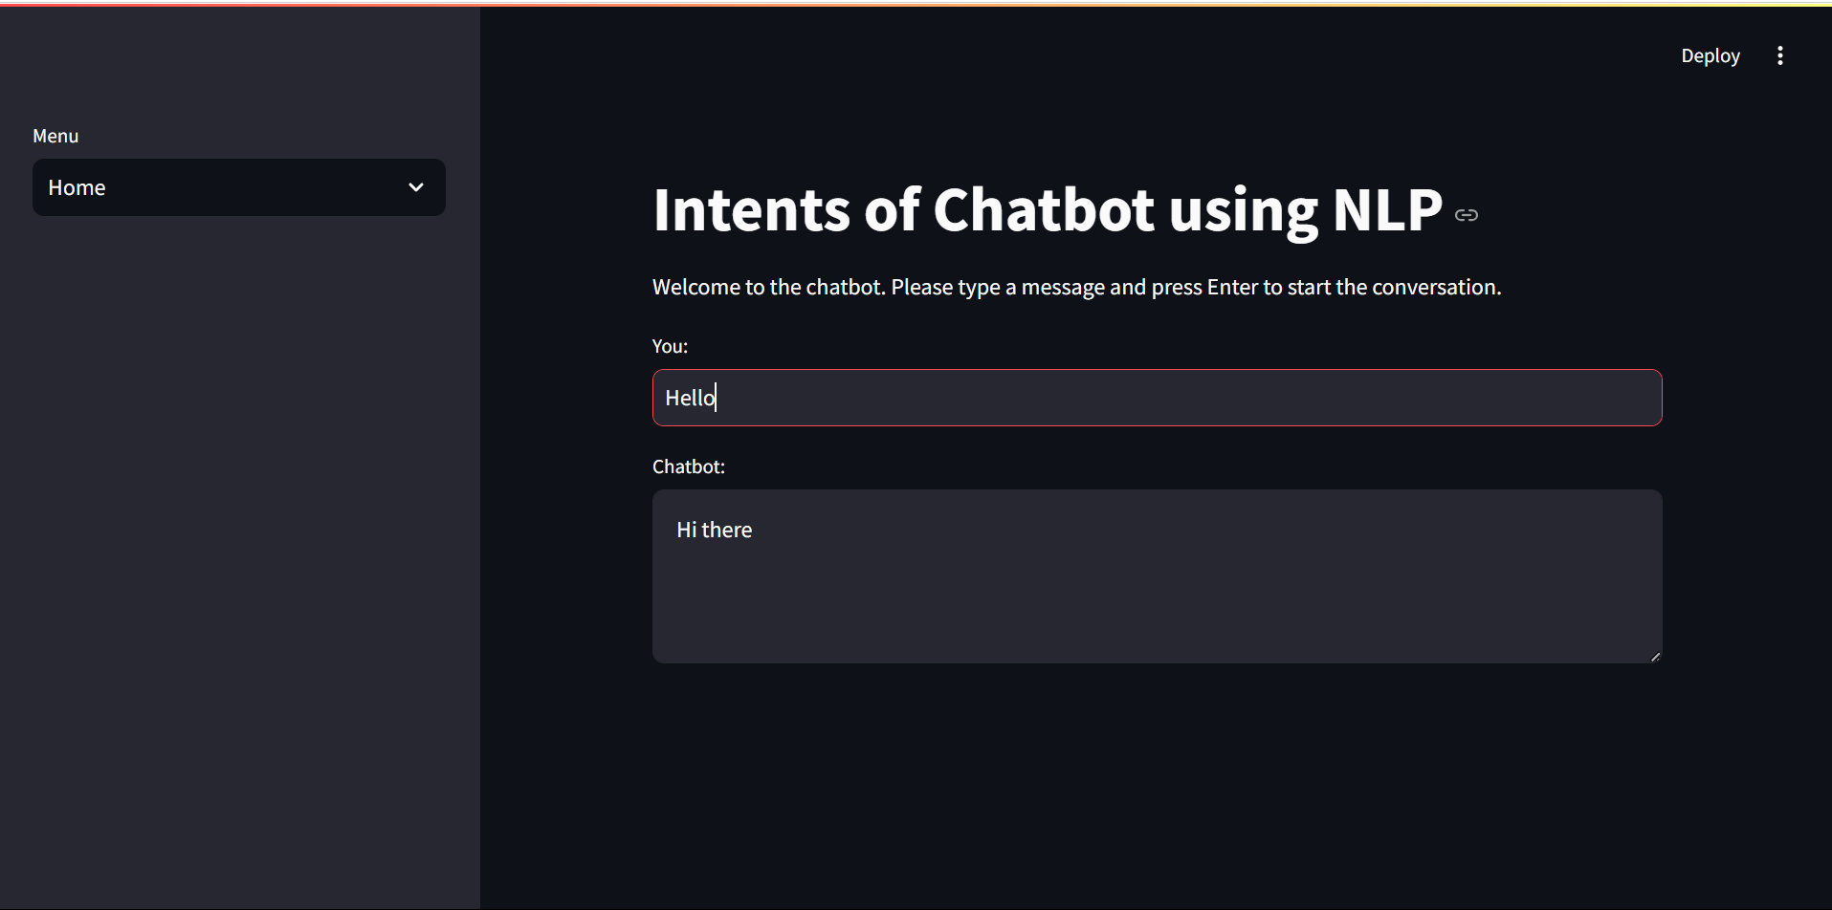
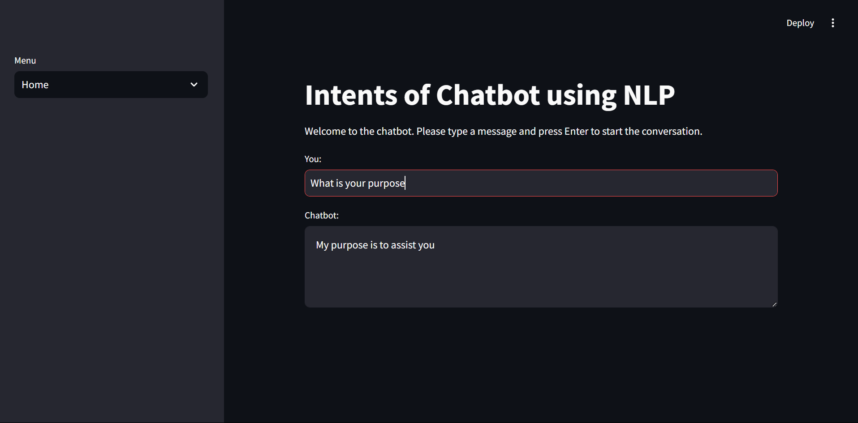
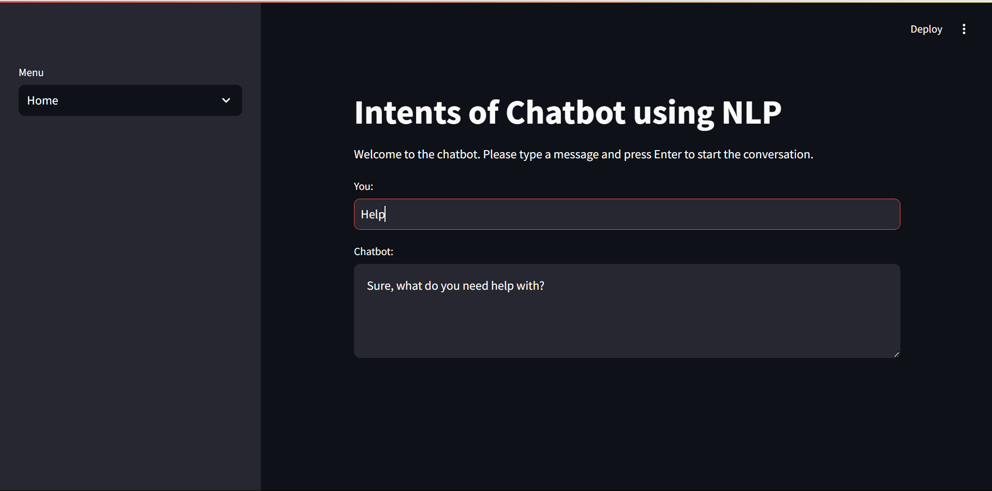
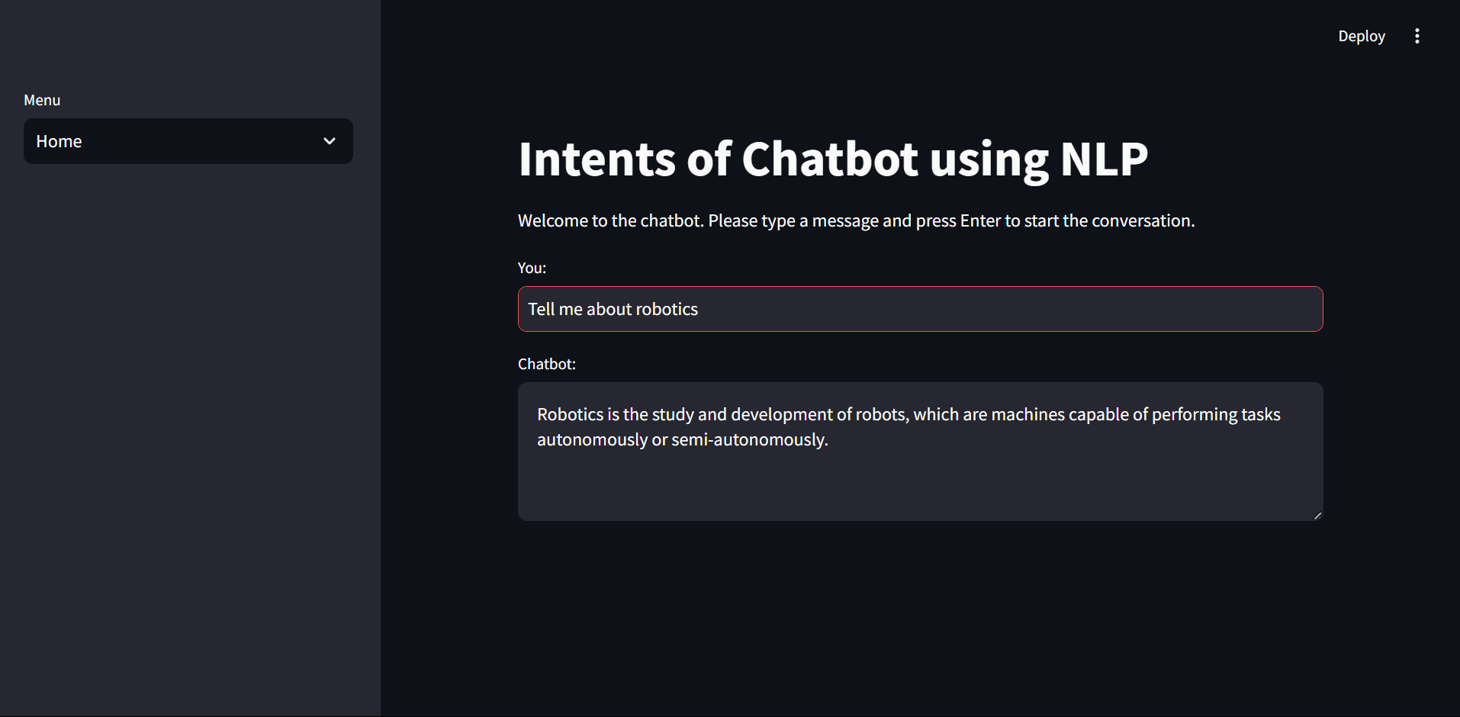
Screenshot of Output:

Slide 8
Conclusion:
We have successfully developed a chatbot using NLP and machine learning.
This chatbot can interpret user queries and generate relevant responses.
Can be integrated into various domains (customer service, education, healthcare).
Future scope includes enhancing chatbot intelligence using Deep Learning & AI.

