Slide 1
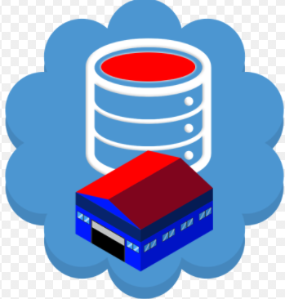
Data Warehousing and Modeling
Module -1
By,
Kavya D N
Assistant Professor
Dept. of CS&E
BNMIT

Slide 2
Contents
Basic concepts
Multitier architecture
Data warehouse models
Extraction , Transformation & loading
Data cube
Schemas
Dimensions, measures
OLAP operations

Slide 3
What Is a Data Warehouse?
Data warehousing provides architectures and tools for business executives to systematically organize, understand, and use their data to make strategic decisions.
Data warehouse systems are valuable tools in today’s competitive, fast-evolving world.
In the last several years, many firms have spent millions of dollars in building enterprise-wide data warehouses.
Many people feel that with competition mounting in every industry, data warehousing is the latest must-have marketing weapon—a way to retain customers by learning more about their needs.
A data warehouse refers to a data repository that is maintained separately from an organization’s operational databases. Data warehouse systems allow for integration of a variety of application systems. They support information processing by providing a solid platform of consolidated historic data for analysis.
“A data warehouse is a subject-oriented, integrated, time-variant, and non-volatile collection of data in support of management’s decision making process”.

Slide 4
Key features:
Subject-Oriented: A data warehouse can be used to analyze a particular subject area. For example, "sales" can be a particular subject.
Integrated: A data warehouse integrates data from multiple data sources. For example, source A and source B may have different ways of identifying a product, but in a data warehouse, there will be only a single way of identifying a product.
Time-Variant: Historical data is kept in a data warehouse. For example, one can retrieve data from 3 months, 6 months, 12 months, or even older data from a data warehouse. This contrasts with a transactions system, where often only the most recent data is kept. For example, a transaction system may hold the most recent address of a customer, where a data warehouse can hold all addresses associated with a customer.
Non-volatile: Once data is in the data warehouse, it will not change. So, historical data in a data warehouse should never be altered.

Slide 5
Data Warehousing: A Multitiered Architecture
Tier-1: The bottom tier is a warehouse database server that is almost always a relational database system. Back-end tools and utilities are used to feed data into the bottom tier from operational databases or other external sources (such as customer profile information provided by external consultants). These tools and utilities perform data extraction, cleaning, and transformation (e.g., to merge similar data from different sources into a unified format), as well as load and refresh functions to update the data warehouse . The data are extracted using application program interfaces known as gateways. A gateway is supported by the underlying DBMS and allows client programs to generate SQL code to be executed at a server.

Slide 6
Examplesof gateways include ODBC (Open Database Connection) and OLEDB (Open Linkingand Embedding for Databases) by Microsoft and JDBC (Java Database Connection). This tier also contains a metadata repository, which stores information aboutthe data warehouse and its contents.
Tier-2: The middle tier is an OLAP server that is typically implemented using either a relational OLAP (ROLAP) model or a multidimensional OLAP. OLAP model is an extended relational DBMS thatmaps operations on multidimensional data to standard relational operations. A multidimensional OLAP (MOLAP) model, that is, a special-purpose server that directly implements multidimensional data and operations.
Tier-3: The top tier is a front-end client layer, which contains query and reporting tools, analysis tools, and/or data mining tools (e.g., trend analysis, prediction, and so on).

Slide 7
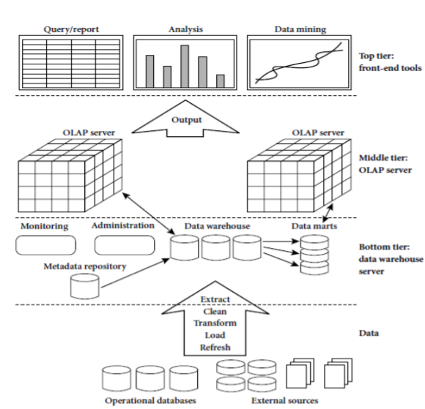

Slide 8
Data Warehouse Models:
1. Enterprise warehouse:
An enterprise warehouse collects all of the information about subjects spanning the entire organization.
It provides corporate-wide data integration, usually from one or more operational systems or external information providers, and is cross-functional in scope.
It typically contains detailed data as well as summarized data, and can range in size from a few gigabytes to hundreds of gigabytes, terabytes, or beyond.
An enterprise data warehouse may be implemented on traditional mainframes, computer super servers, or parallel architecture platforms.
It requires extensive business modeling and may take years to design and build.

Slide 9
Data mart:
A data mart contains a subset of corporate-wide data that is of value to a specific group of users. The scope is confined to specific selected subjects. For example ,a marketing data mart may confine its subjects to customer, item, and sales. The data contained in data marts tend to be summarized.
Data marts are usually implemented on low-cost departmental servers that are UNIX/LINUX- or Windows-based. The implementation cycle of a data mart is more likely to be measured in weeks rather than months or years. However, it may involve complex integration in the long run if its design and planning were not enterprise-wide.
Depending on the source of data, data marts can be categorized as independent or dependent. Independent data marts are sourced from data captured from one or more operational systems or external information providers, or from data generated locally within a particular department or geographic area. Dependent data marts are sourced directly from enterprise data warehouses.

Slide 10
Virtual warehouse:
A virtual warehouse is a set of views over operational databases. For efficient query processing, only some of the possible summary views may be materialized.
A virtual warehouse is easy to build but requires excess capacity on operational database servers.

Slide 11
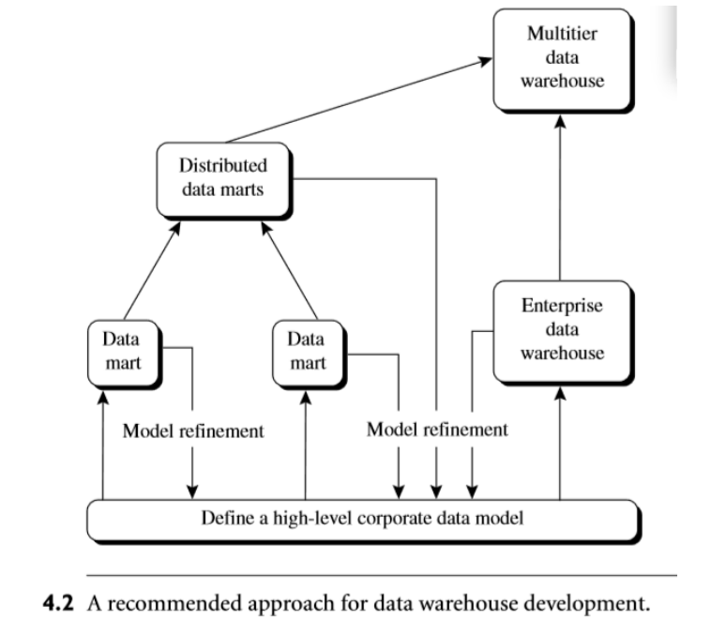

Slide 12
Extraction, Transformation, and Loading
Data warehouse systems use back-end tools and utilities to populate and refresh their data .These tools and utilities include the following functions: Data extraction, which typically gathers data from multiple, heterogeneous, and external sources.
Data cleaning, which detects errors in the data and rectifies them when possible.
Data transformation, which converts data from legacy or host format to warehouse format.
Load, which sorts, summarizes, consolidates, computes views, checks integrity, and builds indices and partitions.
Refresh, which propagates the updates from the data sources to the warehouse.

Slide 13
Data Warehouse Modeling: Data Cube and OLAP
Data warehouses and OLAP tools are based on a multidimensional data model. This model views data in the form of a data cube.
Data Cube : A multidimensional Data model
A data cube, such as sales, allows data to be modeled and viewed in multiple dimensions
Dimension tables, such as item (item_name, brand, type), or time(day, week, month, quarter, year)
Fact table contains measures (such as dollars_sold) and keys to each of the related dimension tables
In data warehousing literature, an n-D base cube is called a base cuboid. The top most 0-D cuboid, which holds the highest-level of summarization, is called the apex cuboid. The lattice of cuboids forms a data cube.

Slide 14
Stars, Snowflakes, and Fact Constellations: Schemas for Multidimensional Data Models
The most popular data model for a data warehouse is a multidimensional model, which can exist in the form of a star schema , a snow flake schema, or a fact constellation schema.
Star schema: A fact table in the middle connected to a set of dimension tables 
Snowflake schema: A refinement of star schema where some dimensional hierarchy is normalized into a set of smaller dimension tables, forming a shape similar to snowflake
Fact constellations: Multiple fact tables share dimension tables, viewed as a collection of stars, therefore called galaxy schema or fact constellation

Slide 15
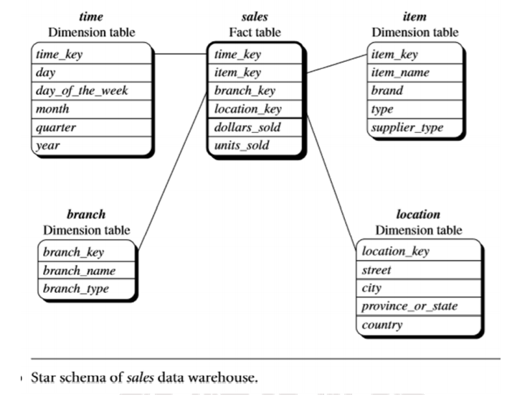

Slide 16
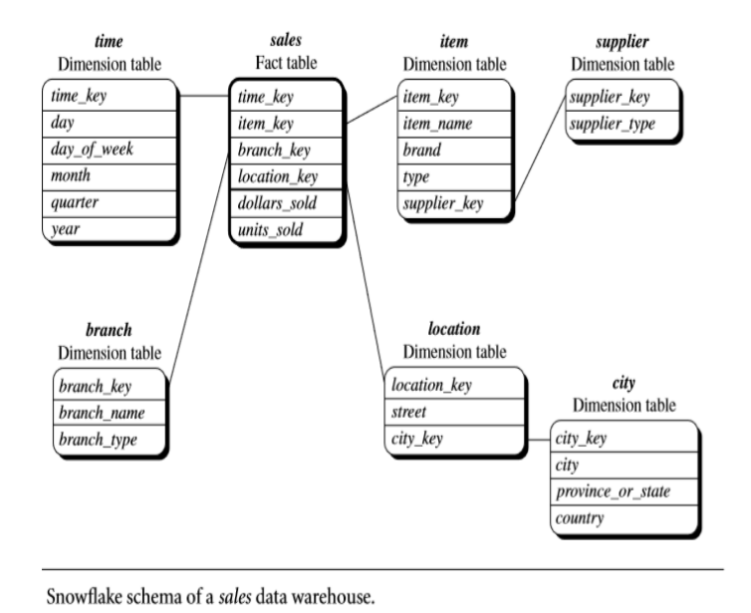
Snowflake schema: The snowflake schema is a variant of the star schema model, where some dimension tables are normalized, thereby further splitting the data into additional tables. The resulting schema graph forms a shape similar to a snowflake

Slide 17
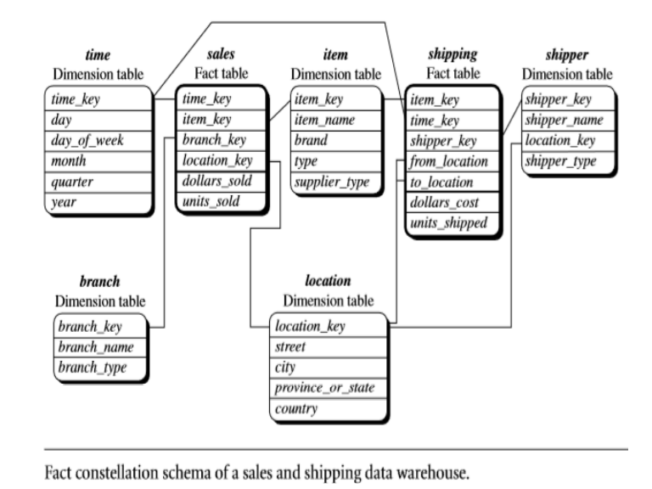
Fact constellation: Sophisticated applications may require multiple fact tables to share dimension tables. This kind of schema can be viewed as a collection of stars, and hence is called a galaxy schema or a fact constellation

Slide 18
Dimensions: The Role of Concept Hierarchies
A concept hierarchy defines a sequence of mappings from a set of low-level concepts to higher level, more general concepts. Consider a concept hierarchy for the dimension location. City values for location include Vancouver, Toronto, New York, and Chicago. Each city, however, can be mapped to the province or state to which it belongs.
For example, suppose that the dimension location is described by the attributes number, street, city, province or state, zip code, and country. These attributes are related by a total order, forming a concept hierarchy such as “street < city < province or state < country.” This hierarchy is shown in Figure

Slide 19
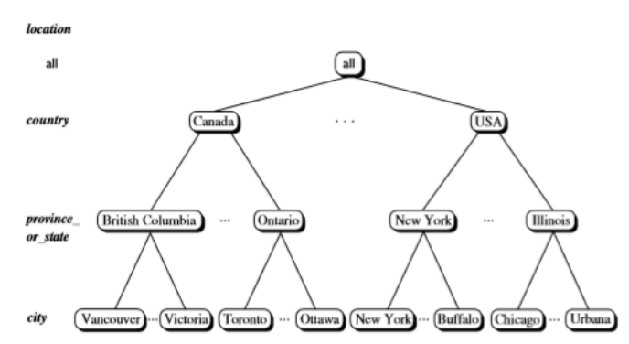

Slide 20
Measures: Their Categorization and Computation
Distributive: if the result derived by applying the function to n aggregate values is the same as that derived by applying the function on all the data without partitioning
E.g., count(), sum(), min(), max()
Algebraic: if it can be computed by an algebraic function with M arguments (where M is a bounded integer), each of which is obtained by applying a distributive aggregate function
E.g., avg(), min_N(), standard_deviation()
Holistic: if there is no constant bound on the storage size needed to describe a subaggregate.
E.g., median(), mode(), rank()

Slide 21
Typical OLAP Operations
ROLL-UP This is like zooming-out on the data-cube This is required when the user needs further abstraction or less detail.
Initially, the location-hierarchy was "street < city < province < country".
On rolling up, the data is aggregated by ascending the location-hierarchy from the level-of city to level-of-country.
DRILL DOWN This is like zooming-in on the data. This is the reverse of roll-up.
This is an appropriate operation → when the user needs further details or → when the user wants to partition more finely or → when the user wants to focus on some particular values of certain dimensions.
This adds more details to the data.
Initially, the time-hierarchy was "day < month < quarter < year”. • On drill-up, the time dimension is descended from the level-of-quarter to the level-of month

Slide 22
PIVOT (OR ROTATE)
• This is used when the user wishes to re-orient the view of the data-cube. This may involve → swapping the rows and columns or → moving one of the row-dimensions into the column dimension.
SLICE & DICE These are operations for browsing the data in the cube.
• These operations allow ability to look at information from different viewpoints.
• A slice is a subset of cube corresponding to a single value for 1 or more members of dimensions..

Slide 23
