Slide 1
Employee gender analysis using excel
Student Name: Lavanya J
Register Number:312215029
Department: commerce
College Name : soka ikeda college of arts and science for women
Notes:
Employee gender analysis using excel

Slide 2
Project title
EMPLOYEE GENDER ANALYSIS USING EXCEL

Slide 3
AGENDA
Problem statement
Project overview
End users
Our solution and proposition
Dataset description
Modelling approach
Results and discussion
Conclusion

Slide 4
Problem statement
The “Employee gender analysis”
Project aims to examine gender distribution, representation potential disparities within an organization.By analysing data on employee demographics, positions, promotion,salaries,the project seeks to identify trends and patterns that may indicate gender biases or imbalances.The findings will inform recommendations for fostering a more equitable work place, ensuring diversity,and promoting inclusive policies.

Slide 5
Project overview
The employee gender analysis projects aims to assess gender distribution and disparities within an organization.It involves collecting and analysing employee data, including
Gender,job roles , promotion, salaries,and performance rating.
The goal is identify trends,ensure equitable treatment,and inform policies to promote diversity and inclusion.
The project will provide actionable insights to address gender imbalance and enhance organisation fairness

Slide 6
Who aretheenduser ?
The end users for the employee gender analysis datasets
The diversity and inlusion officers.
Company executives.
Hr Manager.

Slide 7
Our solution and it’s value proposition
Our solution the employee gender analysis project is a comprehensive data analytics tool tha visualizes gender distribution across varies roles and departments.
The value proposition lies in its ability to provide actionable insights for promoting gender equality,identifying disparities,and ensuring complainces with diversity policies.

Slide 8
Dataset description
The data which I used for this analysis,which I downloaded from kaggle there are 8 features in the data
(e.i) 1.emp ID
. 2.NAME
. 3.Gender
. 4.department
. 5.salary
. 6.start date
. 7.employee type
. 8.work location

Slide 9
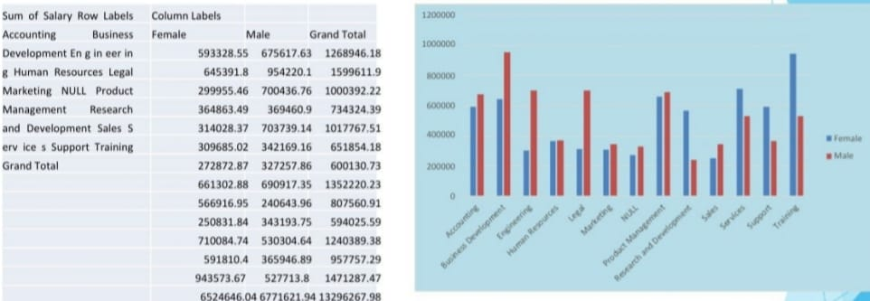
Results

Slide 10
Conclusion
In conclusion,the employee gender analysis project offers vital insights into gender representation, enabling stakeholders to identify disparities and drive positive change.
This project not only support with legal requirements but also strengtheness the organisation commitment to gender equality and overall work place diversity

