Slide 1
EMPLOYEE DATA ANALYSIS USING EXCEL
STUDENT NAME: LAVANYA.C
REGISTER NO :312204585,815C94B8E7F4885AA0845E32FBF4D821
DEPARTMENT :COMMERCE
COLLEGE :K.C.S KASI NADAR COLLEGE OF ARTS & SCIENCE

Slide 2
PROJECT TITLE
Employee analysis according to department

Slide 3


AGENDA
Project Overview
Problem Statement
End Users
Our Solution and Proposition
Dataset Description
Modelling Approach
Results and Discussion
Conclusion
3/21/2024 Annual Review

Slide 4
PROBLEM STATEMENT
This analysis is critical for identifying trends in employee behaviour , productivity levels, and engagement within each department .

Slide 5
PROJECT OVERVIEW
The purpose of this project is to conduct an in –depth analysis of employee performance, turnover rate, skill levels, and engagement across various department .
Tables .
conditional formatting .
pivot chart- line chart , pie chart
sum formulas. slicers.

Slide 6

WHO ARE THE END USERS?
Human resources development.
Research & development.
Sales development.

Slide 7
OUR SOLUTION AND ITS VALUE PROPOSITION
USER – FRIENDLY INTERFACE. COMPERHENSIVE DATA MANAGEMENT ADVANCED ANALYTICAL TOOLS
VISUAL REPRESENTATION
SCENARIO ANALYSIS

Slide 8
DATASET DESCRIPTION
DATA OVERVIEW
To provide an employee analysis based on department data in excel, the overview typically includes several key metrics and summaries.
DATA FIELD
Employee id
Age
Department
Education field
Gender
Hourly rate
Marita status
Per day rate

Slide 9
MODELLING
Creating interactive dashboard by putting all together elements
Inserting formulas in dash board to make interaction
Inserting pivot chart in dashboard
Creating dashboard
Creating pivot chart
Creating table
Data cleaning
9

Slide 10
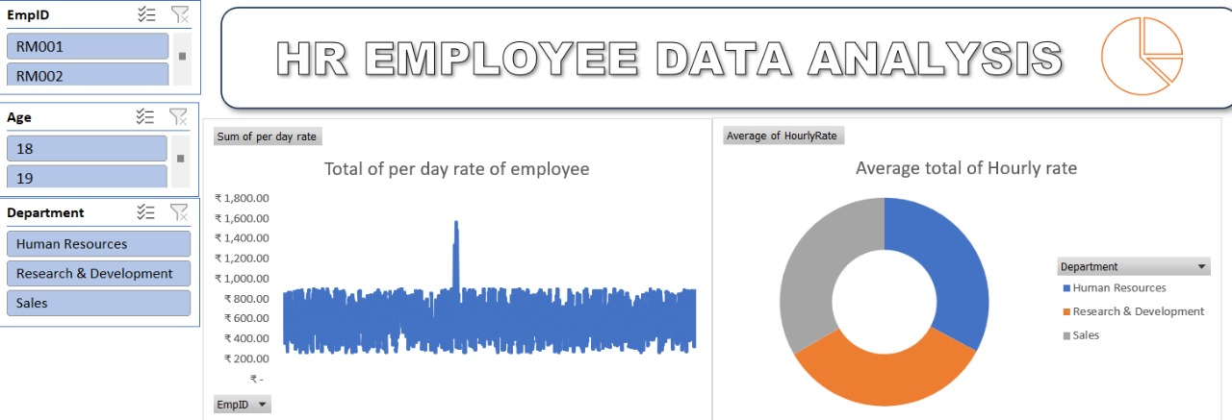
RESULTS
(click to open file)
10

Slide 11
CONCLUSION
To conclude an employee analysis based on department , it’s essential to summarize key findings such as Productivity , strengths , weaknesses ,and opportunities for improvement within each department. By focusing on these key insights , management can implement more effective strategies for improving employee performance , satisfaction , and overall organizational success.

