Slide 1
ONLINE MOVIE REVIEW
Lavanya.B

Slide 2
PROBLEM STATEMENT:
Cinetalk is a online movie review platform , where the users can view the current trending movies , popular movies and also movies that are on- going in theatres.
It is a single page application website where the users can preview the movie reviews and also has the capacity to add their ratings and share their opinion.
Components used:
Login component.
Home component.
Movie component.

Slide 3
LOGIN PAGE:
In login page the user can access the home page using their email and password given to them.
If the email and password are incorrect it shows invalid credentials.
The validation are given by creating services ,in which we create another component called as auth services.
In auth services, the valid credentials are given.
Once the login is valid, it routed to home page component.

Slide 4
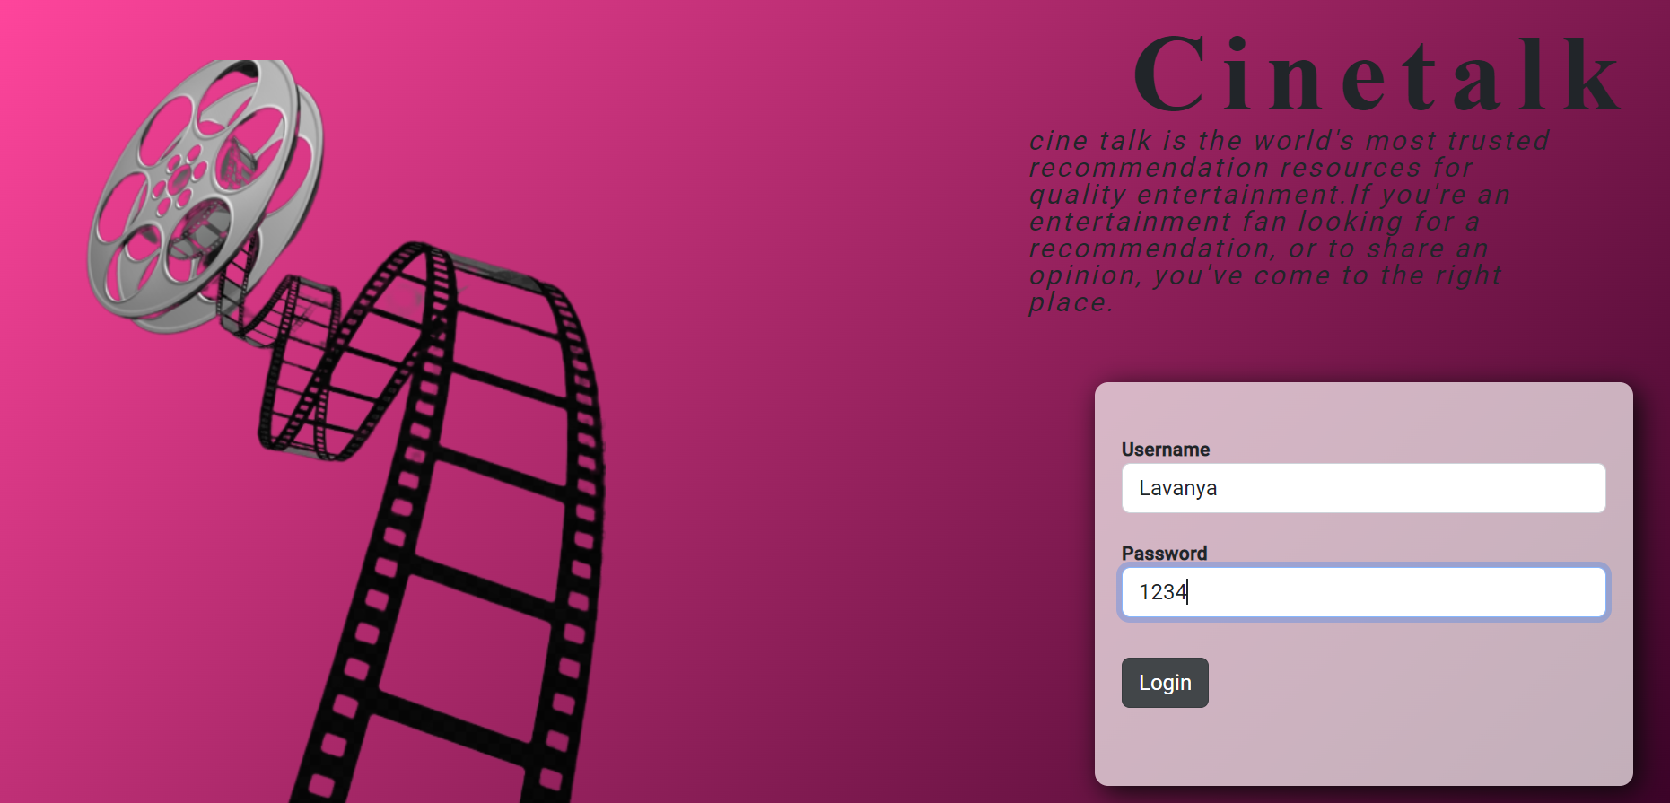
Login page

Slide 5
HOME PAGE
In home page component, the user can review the ratings added so far by the another user.
They can also view the movies which are going in theatre , popular movies and trending movies.
When the user click any of the movie it will be routed to another component called movie component.

Slide 6
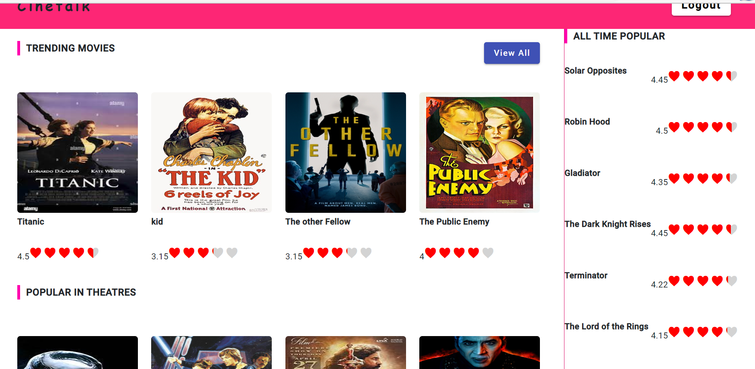
Home page

Slide 7
REVIEW PAGE
The movie component consists of review page, where the user can see the reviews already added by another user at bottom.
The user can also share their opinion in the review page and also can give rating of their choice.
These shared opinion of the users can be helpful for another user whenever they access this website.
Atlast , there will be a log out button at the top most corner of the web page where the user can log out and goes to the login page.

Slide 8
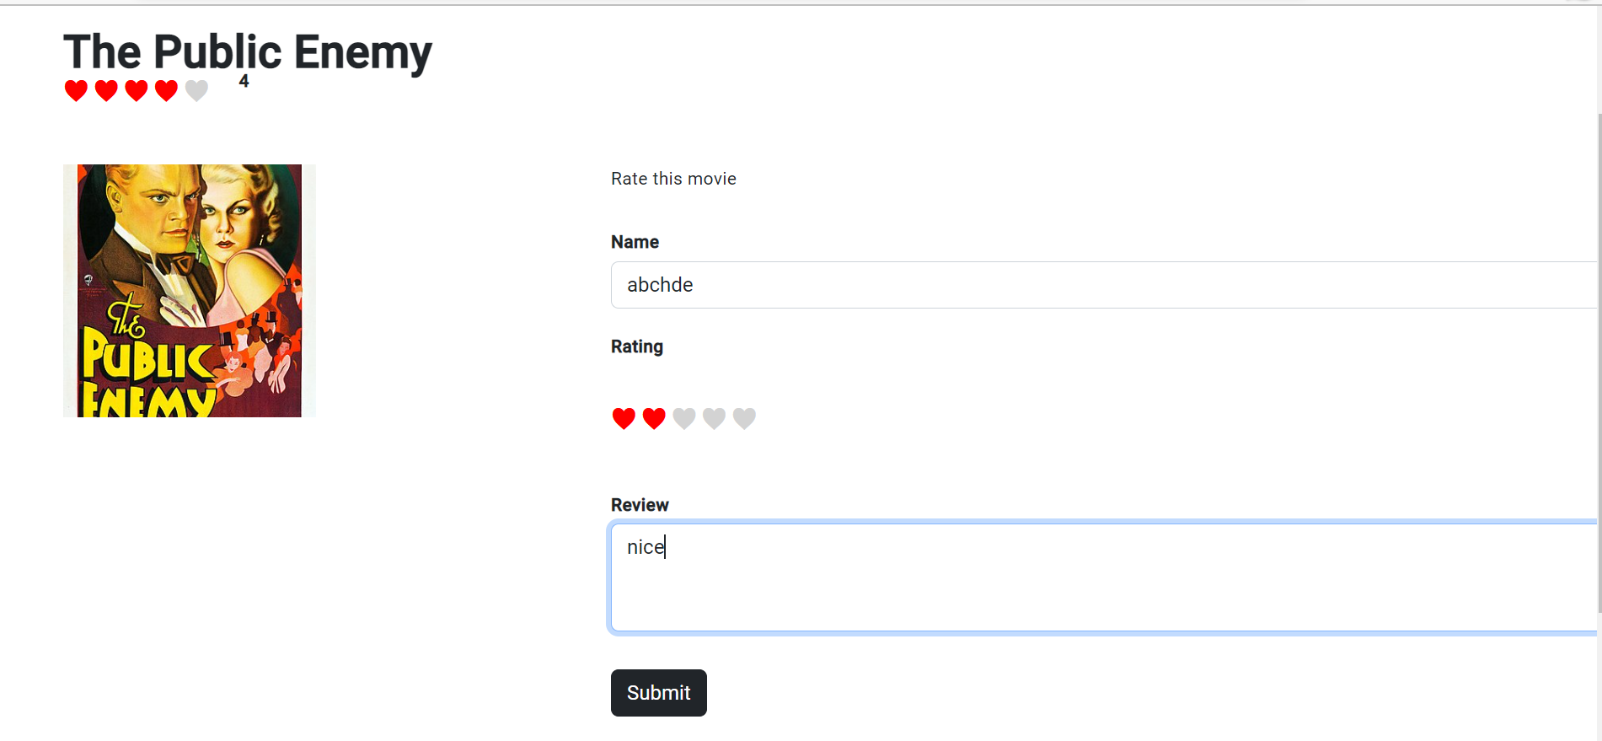
Review page

Slide 9
THANK YOU!!!

