Slide 1


MongoDB
Introduction to

Slide 2
What is MongoDB ?
• Scalable High-Performance Open-source, Document-orientated database.
• Built for Speed
• Rich Document based queries for Easy readability.
• Full Index Support for High Performance.
• Replication and Failover for High Availability.
• Auto Sharding for Easy Scalability.
• Map / Reduce for Aggregation.

Slide 3
Why use MongoDB?
• SQL was invented in the 70’s to store data.
• MongoDB stores documents (or) objects.
• Now-a-days, everyone works with objects (Python/Ruby/Java/etc.)
• And we need Databases to persist our objects. Then why not store objects directly ?
• Embedded documents and arrays reduce need for joins. No Joins and No-multi document transactions.

Slide 4
Why MongoDB
Intrinsic support for agile development
Super low latency access to your data
  Very little CPU overhead
No Additional caching layer required
Built in Replication and Horizontal Scaling support

Slide 5
What is MongoDB great for?
• RDBMS replacement for Web Applications.
• Semi-structured Content Management.
• Real-time Analytics & High-Speed Logging.
• Caching and High Scalability
Web 2.0, Media, SAAS, Gaming
HealthCare, Finance, Telecom, Government

Slide 6
Let’s Dive in !

Slide 7
Database
When I say
Think
Database
• Made up of Multiple Collections.
• Created on-the-fly when referenced for the first time.

Slide 8
Collection
When I say
Think
Table
• Schema-less, and contains Documents.
• Indexable by one/more keys.
• Created on-the-fly when referenced for the first time.
• Capped Collections: Fixed size, older records get dropped after reaching the limit.

Slide 9
Document
When I say
Think
Record/Row
• Stored in a Collection.
• Can have _id key – works like Primary keys in MySQL.
• Supported Relationships – Embedded (or) References.
• Document storage in BSON (Binary form of JSON).
MongoDB there is no concept of relationship as like RDMS

Slide 10
Terminology
RDBMS | Mongo
Table, View | Collection
Row(s) | JSON Document
Index | Index
Join | Embedded Document
Partition | Shard
Partition Key | Shard Key

Slide 11
Mongodb installation
Install mongodb
Create a local db folder (C:\>md data , C:\md data\db)
C:\>move mongodb-win64-* mongodb
1 dir(s) moved.
D:\set up\mongodb\bin>mongod.exe(This will show waiting for connections message on the console output indicates that the mongod.exe process is running successfully)

Slide 12
Now to run the mongodb you need to open another command prompt and issue the following command
D:\set up\mongodb\bin>mongo.exe
MongoDB shell version: 2.4.6 , connecting to: test
db.test.save( { a: 1 } )
db.test.find()
{ "_id" : ObjectId(5879b0f65a56a454), "a" : 1 }
Design your schema according to user requirements.

Slide 13
use mydb (creation of a db named mydb)
switched to db mydb
db.movie.insert({"name":"tutorials point"})
show dbs
local 0.78125GB
mydb 0.23012GB
test 0.23012GB
use mydb
switched to db mydb
db.dropDatabase()

Slide 14
db.createCollection("mycollection")
{ "ok" : 1 }
db.tutorialspoint.insert({"name" : "tutorialspoint"})
Db.COLLECTION_NAME.drop()
db.mycol.insert({ _id: ObjectId(7df78ad8902c),
title: 'MongoDB Overview', description: 'MongoDB is no sql database',
by: 'tutorials point', url: 'http://www.tutorialspoint.com',
tags: ['mongodb', 'database', 'NoSQL'], likes: 100 })
db.mycol.find().pretty()

Slide 15
AND/OR in mongo db
db.mycol.find({"by":"tutorials point","title": "MongoDB Overview"}).pretty()
{ "_id": ObjectId(7df78ad8902c),
"title": "MongoDB Overview",
"description": "MongoDB is no sql database",
"by": "tutorials point", "url": "http://www.tutorialspoint.com", "tags": ["mongodb", "database", "NoSQL"], "likes": "100" }
db.mycol.find( { $or: [ {key1: value1}, {key2:value2} ] } ).pretty()

Slide 16
update
{ "_id" : ObjectId(5983548781331adf45ec5), "title":"MongoDB Overview"}
{ "_id" : ObjectId(5983548781331adf45ec6), "title":"NoSQL Overview"}
{ "_id" : ObjectId(5983548781331adf45ec7), "title":"Tutorials Point Overview"}
>db.mycol.update({'title':'MongoDB Overview'},{$set:{'title':'New MongoDB Tutorial'}}) >db.mycol.find()
{ "_id" : ObjectId(5983548781331adf45ec5), "title":"New MongoDB Tutorial"}

Slide 17
Save/Remove/Projection
db.mycol.save( { "_id" : ObjectId(5983548781331adf45ec7), "title":"Tutorials Point New Topic", "by":"Tutorials Point" }
db.mycol.remove({'title':'MongoDB Overview'})
Projection
db.mycol.find({},{"title":1,_id:0})
{"title":"MongoDB Overview"}
{"title":"NoSQL Overview"}
{"title":"Tutorials Point Overview"}

Slide 18
LIMIT/SKIP/INDEXING
LIMIT
db.mycol.find({},{"title":1,_id:0}).limit(2)
{"title":"MongoDB Overview"}
{"title":"NoSQL Overview"}
db.mycol.find({},{"title":1,_id:0}).limit(1).skip(1) {"title":"NoSQL Overview"}
db.mycol.ensureIndex({"title":1})

Slide 19
AGGREGATION
{ _id: ObjectId(7df78ad8902c)
title: 'MongoDB Overview',
description: 'MongoDB is no sql database',
by_user: 'tutorials point',
url: 'http://www.tutorialspoint.com',
tags: ['mongodb', 'database', 'NoSQL'],
likes: 100 },
{ _id: ObjectId(7df78ad8902d)
title: 'NoSQL Overview',
description: 'No sql database is very fast',
by_user: 'tutorials point',
url: 'http://www.tutorialspoint.com',
tags: ['mongodb', 'database', 'NoSQL'], likes: 10 },
{ _id: ObjectId(7df78ad8902e)
title: 'Neo4j Overview',
description: 'Neo4j is no sql database',
by_user: 'Neo4j', url: 'http://www.neo4j.com',
tags: ['neo4j', 'database', 'NoSQL'], likes: 750 },

Slide 20
AGGREGATION
db.mycol.aggregate([{$group : {_id : "$by_user", num_tutorial : {$sum : 1}}}])
{ "result" : [
{ "_id" : "tutorials point",
"num_tutorial" : 2 },
{ "_id" : "Neo4j",
"num_tutorial" : 1 } ],
"ok" : 1 }

Slide 21
Replication
Replication is the process of synchronizing data across multiple servers
To keep your data safe
High (24*7) availability of data
Disaster Recovery
No downtime for maintenance (like backups, index rebuilds, compaction)
Read scaling (extra copies to read from)
Replica set is transparent to the application
MongoDB achieves replication by the use of replica set. A replica set is a group of mongod instances that host the same data set. In a replica one node is primary node that receives all write operations. All other instances, secondaries, apply operations from the primary so that they have the same data set. Replica set can have only one primary node.

Slide 22
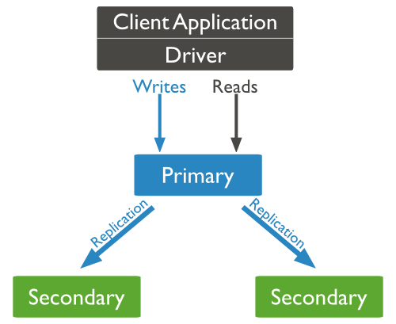
Replication
mongod --port "PORT" --dbpath "YOUR_DB_DATA_PATH" --replSet "REPLICA_SET_INSTANCE_NAME"

Slide 23
Understanding the Document Model.
var p = {
‘_id’: ‘3432’,
‘author’: DBRef(‘User’, 2),
‘title’: ‘Introduction to MongoDB’,
‘body’: ‘MongoDB is an open sources.. ‘,
‘timestamp’: Date(’01-04-12’),
‘tags’: [‘MongoDB’, ‘NoSQL’],
‘comments’: [{‘author’: DBRef(‘User’, 4),
‘date’: Date(’02-04-12’),
‘text’: ‘Did you see.. ‘,
‘upvotes’: 7, … ]
}
> db.posts.save(p);

Slide 24
Deployment
& Scaling

Slide 25
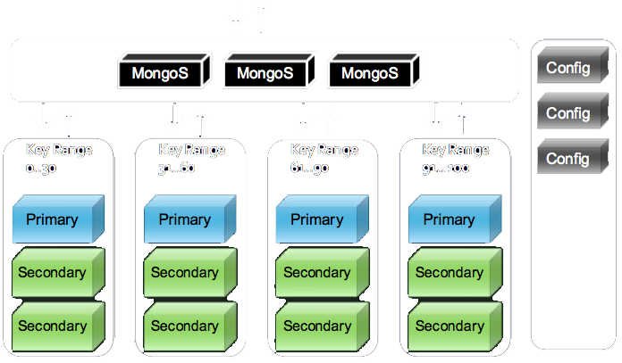
Sharding

Slide 26

Python
How do we use MongoDB
MongoDB
MongoEngine

Slide 27
Sample document
location1= {
name: "10gen East Coast”,
address: ”134 5th Avenue 3rd Floor”,
city: "New York”,
zip: "10011”
}

Slide 28
db.locations.find({zip:”10011”}).limit(10)
location1= {
name: "10gen East Coast”,
address: ”134 5th Avenue 3rd Floor”,
city: "New York”,
zip: "10011”
}

Slide 29
db.locations.find({zip:”10011”, tags:”business”})
location1 = {
name: "10gen East Coast”,
address: "17 West 18th Street 8th Floor”,
city: "New York”,
zip: "10011”,
tags: [“business”, “mongodb”]
}

Slide 30
db.locations.ensureIndex({latlong:”2d”})
db.locations.find({latlong:{$near:[40,70]}})
location1 = {
name: "10gen HQ”,
address: "17 West 18th Street 8th Floor”,
city: "New York”,
zip: "10011”,
tags: [“business”, “cool place”],
latlong: [40.0,72.0]
}
Notes:
Latlong are actually real lat / long points
$near gives you the closest 100

Slide 31
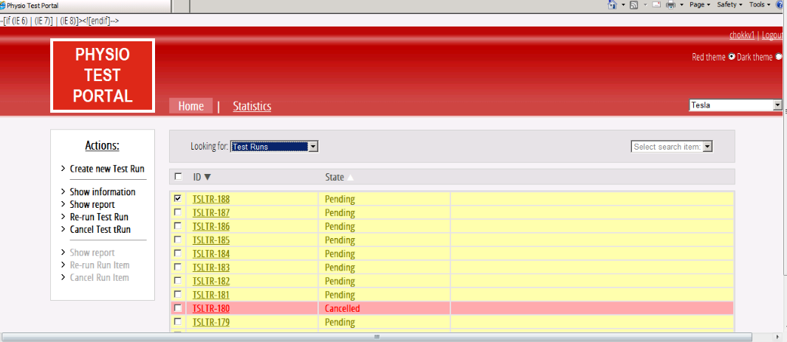
TMS WEB UI

Slide 32
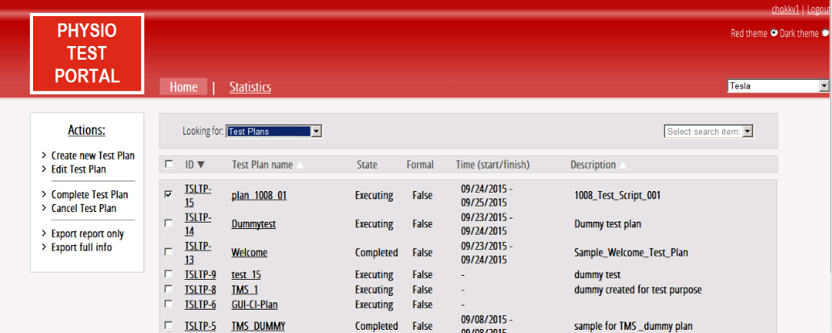

Slide 33
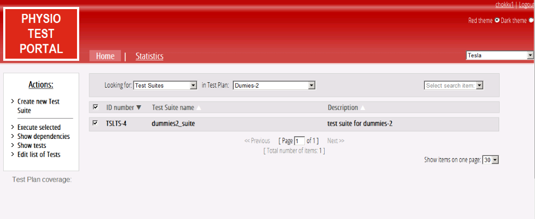

Slide 34
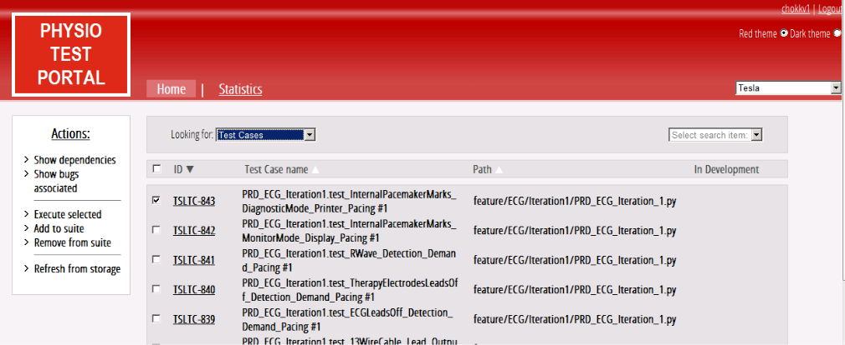

Slide 35
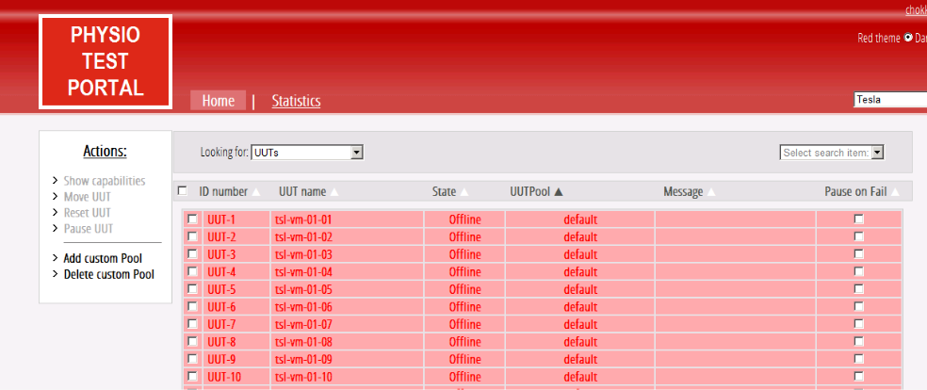

Slide 36
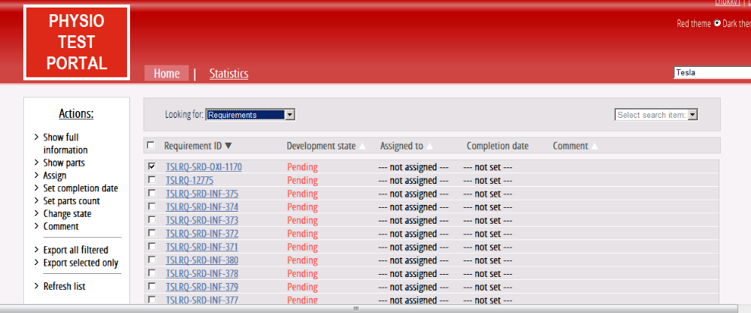

Slide 37
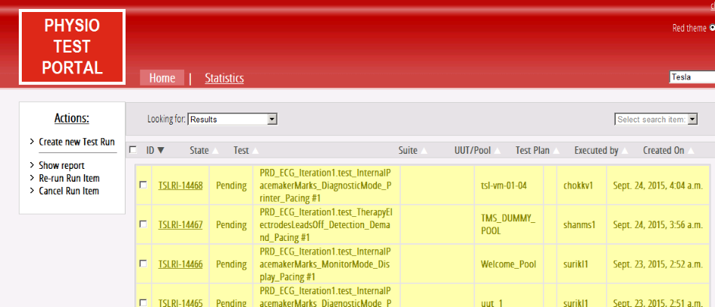

Slide 38
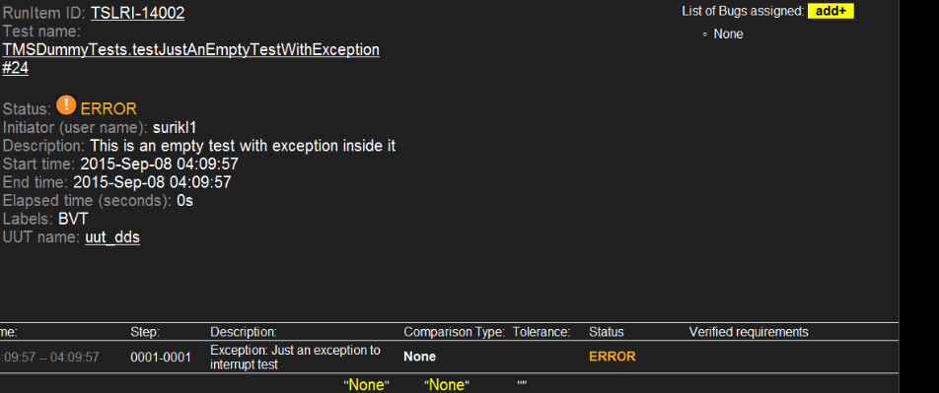

Slide 39
Thank You ☺
Stay Hungry, Stay Foolish !!!
- Lavanya

