Slide 1
React Tutorial

Slide 2

React
React is an open-source JavaScript library developed by Facebook
for building user interfaces, especially for single-page applications.
It emphasizes the creation of reusable UI components,
simplifying the management of complex web applications.

Slide 3
Key Features of React:
Component-Based Architecture: Enables the building of encapsulated components that manage their state.
Virtual DOM: Improves performance by minimizing direct interactions with the actual DOM.
Unidirectional Data Flow: Ensures a predictable data structure, making debugging and understanding the app easier.
JSX Syntax: Allows HTML to be written directly within JavaScript, enhancing code readability and development efficiency.

Slide 4

Uses of React
Efficiency with Virtual DOM: React reduces the number of direct manipulations to the actual DOM, which can be slow. The Virtual DOM optimizes updates for better performance.
01
Reusable Components: Components can be reused across different parts of the application, speeding up development and ensuring consistency.
02
Developer Productivity: Tools like React DevTools and a supportive ecosystem streamline debugging and development processes.
03
Strong Community and Ecosystem: React has a large community, offering a wealth of libraries, resources, and third-party tools to enhance development.
04

Slide 5
Advantages of React
Advantages—
01
1.Component based architecture.(reusable components)
02
2.Virtual DOM use
03
3.Declarative UI(manually we don’t need to update DOM react Handles it itself.)- you will tell react how to make the HTML and other things and React will make it itself
04
4.Seamlessly integrate react into any of your applications.
05
5. Unidirectional Data Flow.

Slide 6
Limitations of React
Limitations
1.Learning curve is steep--Although the basics of React are relatively easy to learn, mastering advanced topics (such as state management with hooks, Context API, Redux, performance optimization, and server-side rendering) can be complex.
2.SEO limitations
3. Performance issues: While React is generally fast and efficient, poorly optimized code or inefficient use of React components can lead to performance issues.
4. Large file sizes: React applications can have large file sizes due to the use of JSX syntax and the need to import additional libraries and dependencies.

Slide 7
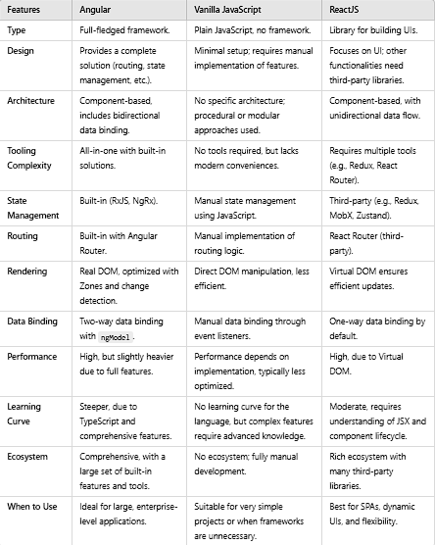
Difference angular, react and Vanilla JS?

Slide 8
React First
Example
<!DOCTYPE html>
<html lang="en">
<head>
<meta charset="UTF-8" />
<meta name="viewport" content="width=device-width, initial-scale=1.0" />
<!-- here content delivery network and here react is hosted -->
<title>React tutorial</title>
</head>
<body>
<div id="root">
</div>
<!-- react -->
<script
crossorigin
src="https://unpkg.com/react@18/umd/react.development.js"
></script>
<!-- react DOM -->
<script
crossorigin
src="https://unpkg.com/react-dom@18/umd/react-dom.development.js"
></script>
<script src="./index.js"></script>
</body>
</html>
Index.html

Slide 9
React First
Example
// create element is special way of creating element
const headingEle = React.createElement(
"h1",
{
id: "heading",
},
"hello world from react"
);
// headingele is a normal JS object react element
// creating a root
const rootEle = ReactDOM.createRoot(document.getElementById("root"));
// render this heading inside root
// this render is responsible to convert this heading JS object above to the heading element and put in DOM
rootEle.render(headingEle);
index.js

Slide 10
// wee will craete a tough react ele now {
/* <div id="mainContainer">
<div id="childContainer">
<h1>hello 1</h1>
<h1>hello 2</h1>
</div>
</div>; */
}
// creating a root
const rootEle = ReactDOM.createRoot(document.getElementById("root"));
const parent = React.createElement(
"div",
{ id: "mainContainer" },
// child
React.createElement(
"div",
{ id: "childContainer" },
// if 2 siblings create a array
[
React.createElement("h1", {}, "hello 1"),
React.createElement("h1", {}, "hello 2"),
]
)
);
rootEle.render(parent);
React First
Example
index.js

Slide 11
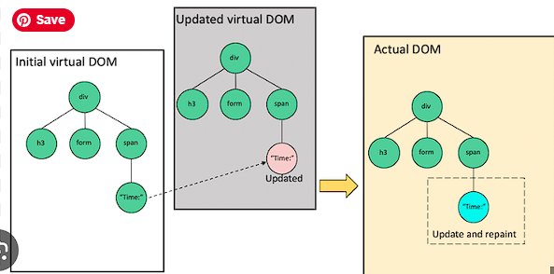
How virtual DOM works??
Virtual DOM is a lightweight , in-memory representation of the actual DOM. React uses it to track changes in components, allowing updates to only the parts of the DOM that need it rather than re-rendering the entire page. which enhances performance.
Virtual DOM steps—
1.On loading of react application, Virtual DOM which is a tree stuture is created from real DOM. It is nothing but a javascript object.
2.Whenver a state /props update – a new virtual DOM tree is created which contains updated UI.
3.React compare the new Virtual DOM tree with previous and checks what has changed(process –diffing).For checking react uses reconciliation algo.
4.Based on result new virtual DOM become original virtual DOM tree and only necessary changes are applied to real DOM rather than re-rendering whole data

