Slide 1

Kharcha
खर्चा = "expense"
An expense tracker, shipped the DevOps way
Session 21 · Final DevOps Capstone
Lavya · github.com/LAVYA255/devops-heros
Notes:
Hi, I'm Lavya. This is my final DevOps capstone, and the app is called Kharcha. Kharcha is the Hindi word for expense.
The course rules say the app has to be our own idea, not a copy of the TaskBoard reference. So I built a small expense tracker, and then I took it through every layer we learned: tests, Docker, a CI/CD pipeline with security scanning, Kubernetes and Helm, Terraform for AWS, Prometheus and Grafana, and GitOps with ArgoCD.
Everything I show in this video really ran, on my laptop with Minikube and on GitHub Actions. The numbers and screenshots are from those runs, not made up.

Slide 2
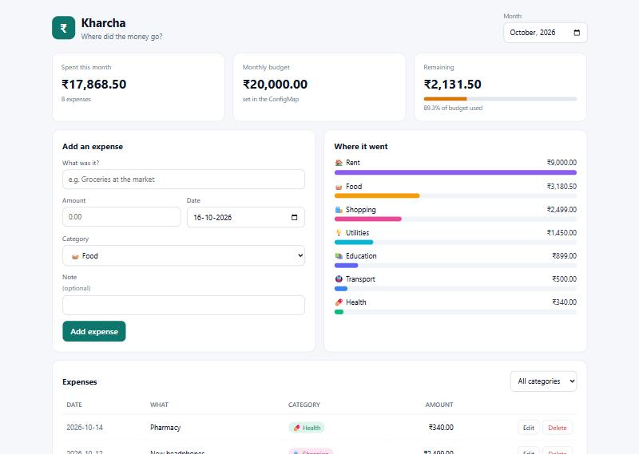



What Kharcha does
Log every expense
Add, edit, delete, nine categories, filter by month
Know your budget
Budget used, money left, the card turns red when you overspend
See where it went
Per-category bars and your spending pace per day
Notes:
First, what the app actually does, because everything else exists to ship this.
You log what you spend: a title, an amount in rupees, a category like food or rent, and a date. You can edit or delete entries and filter by month.
The top cards answer the real question: how much have I spent, how much of my monthly budget is gone, and how much is left. When you cross 80 percent the meter turns amber, and when you go over budget it turns red. The first card also shows your pace, the average you are spending per day so far.
On the right side, "where it went" breaks the month down by category.
It's a React frontend, a FastAPI backend and a Postgres database. Small on purpose, so the focus can be the DevOps around it.

Slide 3










From one commit to running pods
1
2
3
4
5
Git push
Tests
Security scans
Docker build
Security gate
10
9
8
7
6
Monitoring
ArgoCD sync
GitOps commit
Kind deploy test
GHCR :sha
About 7 minutes from git push to new pods, and nobody types kubectl.
Notes:
This is the whole story in one picture, and it's the order I'll follow.
I push code. GitHub Actions runs the tests, then the security scanners, then builds both Docker images and scans them with Trivy. A security gate checks that every stage passed. Only then are the images pushed to the GitHub Container Registry, tagged with the commit hash, never "latest".
The pipeline then deploys those exact images to a throwaway Kubernetes cluster to prove they work. Its very last job doesn't touch my real cluster at all. It just commits the new image tag into git.
ArgoCD, running inside my cluster, sees that commit and rolls the app forward. Prometheus and Grafana watch the result.
In my timed demo this took about seven minutes, from git push to new pods serving traffic, without anyone typing kubectl.

Slide 4







Architecture
GitHub
Minikube cluster (WSL2)
Actions
Ingress
Frontend
Backend
14 jobs, security gate
/ , /api , /health
nginx, 2 pods
FastAPI, 2-6 (HPA)
GHCR
Postgres
images :commit-sha
StatefulSet + PVC
gitops/ values
ArgoCD
Prometheus
Grafana
bot commits new tag
syncs from git
scrapes /metrics
dashboards
Terraform: AWS VPC + EKS (applied on LocalStack) · kind cluster in every CI run
Notes:
Here's how the pieces fit.
On the left is GitHub. Actions builds and tests, the images go to the GitHub Container Registry, and a values file in the repo holds the image tag that should be running.
On the right is my Minikube cluster. A request comes in through the ingress-nginx Ingress. The root path goes to the frontend, which is nginx serving the React build. Anything under /api goes to the FastAPI backend. The browser only ever talks to nginx, so there's no CORS and the API is never exposed directly. The backend scales between 2 and 6 pods with an autoscaler, and all the state lives in one Postgres StatefulSet with a persistent volume.
Along the bottom, ArgoCD pulls the desired state from git, Prometheus scrapes the backend's /metrics endpoint, and Grafana shows the dashboard.
Separately, Terraform describes the AWS version, a VPC and an EKS cluster. I'll be honest about that part later.

Slide 5


The stack
Backend
Frontend
Database
FastAPI, SQLAlchemy, Alembic
React 19, Vite, nginx-unprivileged
PostgreSQL 16
Containers
CI/CD
Security
Multi-stage Docker, Compose
GitHub Actions, GHCR
Trivy, bandit, pip-audit, gitleaks
Orchestration
Infrastructure
Observability
Kubernetes, Helm, ingress-nginx
Terraform, LocalStack
Prometheus, Grafana
GitOps
ArgoCD
Notes:
Quickly, the tools, layer by layer.
The backend is Python with FastAPI, SQLAlchemy for the database and Alembic for migrations. The frontend is React built with Vite and served by an nginx image that runs without root. The database is Postgres 16.
Everything is containerised with multi-stage Docker builds and runs locally with Docker Compose.
The pipeline is GitHub Actions, pushing to GitHub's container registry. Security uses four scanners: Trivy for images and config, bandit for Python code, pip-audit and npm audit for dependencies, and gitleaks for secrets.
It runs on Kubernetes, packaged as a Helm chart, behind ingress-nginx. Terraform describes the AWS infrastructure. Prometheus and Grafana handle monitoring, and ArgoCD does GitOps.

Slide 6
The app and its tests
Method | Path
GET | /api/expenses?month=&category=
POST | /api/expenses
GET / PUT / DELETE | /api/expenses/{id}
GET | /api/expenses/summary?month=
GET | /health (liveness)
GET | /ready (readiness, checks DB)
GET | /metrics (Prometheus)
33
tests passing
100%
line coverage
90%
pipeline coverage floor
Money is Decimal, never float. The database also refuses an amount of 0 or less.
Notes:
The backend is a normal REST API: list expenses filtered by month and category, create one, get, update or delete one by ID, and a monthly summary.
Two endpoints are just for Kubernetes. /health is liveness: it only says the process is alive, and it deliberately does not check the database. /ready is readiness, and it does check the database. Why split them? If Postgres has a hiccup, readiness takes the pods out of traffic, but liveness stays green, so Kubernetes doesn't pointlessly restart every API pod.
Money is stored as an exact decimal, never a float, and the database itself has a rule that the amount must be more than zero, so bad data can't sneak in around the API.
There are 33 tests at 100 percent coverage. They run on an in-memory SQLite database, never a real one, and the pipeline fails if coverage drops under 90 percent. That floor actually caught me once: I added a database retry loop with no tests, the first pipeline run went red at 89 percent, and I had to write the missing tests.

Slide 7
Docker: small, patched, never root
Backend
Frontend
2 stages: build wheels, then a slim runtime
Runs as uid 10001
347 MB, pip removed from the image
0 fixable HIGH/CRITICAL CVEs
2 stages: Node builds, nginx serves
Runs as uid 101 on port 8080
112 MB, no Node inside at all
0 vulnerabilities of any severity
docker compose up --build -> the whole stack at localhost:3000
Notes:
Both images are multi-stage builds. The backend compiles its Python packages in a builder stage and only copies the finished ones into a slim runtime image. The frontend uses Node only to build the React app; the final image is just nginx and static files, so there's no Node, no node_modules, nothing extra.
Neither container runs as root. The backend runs as user 10001 and the frontend as nginx's user 101 on port 8080, which is why it doesn't need root to bind a port.
For local development, one command, docker compose up, starts Postgres, the API and the UI, and each service waits for the one before it to be actually healthy, not just started.
I also measured and fixed something here: nginx's default "one worker per CPU" counts the whole machine, so on my 24-core laptop a tiny container was running 24 workers. I pinned it to 2.

Slide 8
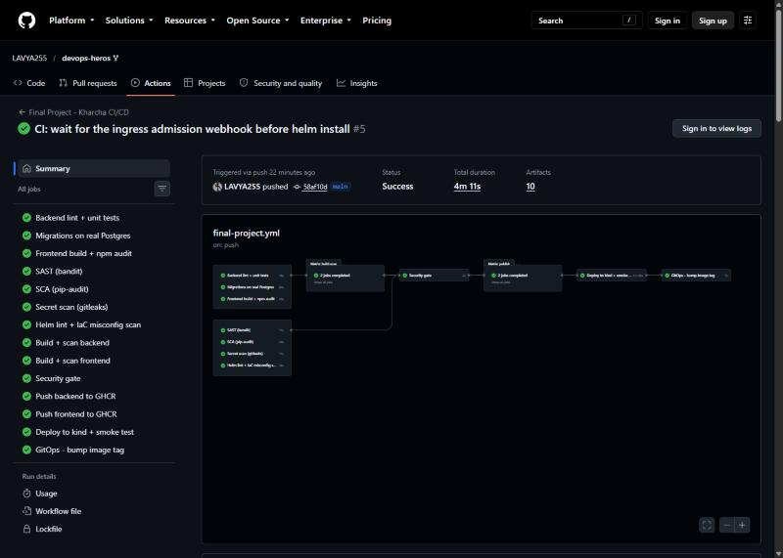
The CI/CD pipeline
Test
pytest, migrations on real Postgres, frontend build
Scan
bandit, pip-audit, gitleaks, helm lint, trivy config
Build + Trivy
both images, scanned before anything ships
Security gate
one job that says yes or no
Push to GHCR
the exact scanned bytes, tag = commit SHA
Deploy to kind
real Ingress, smoke test, helm test
14 jobs · about 4 minutes · main branch only for push and deploy
GitOps bump
commit the new tag for ArgoCD
Notes:
This is the pipeline, 14 jobs, about four minutes when everything is green.
First, tests: lint and unit tests, then a job that runs the real database migrations against a real Postgres, up, down and up again. That job exists because my unit tests never ran a migration, and a broken migration config once crash-looped the real container while every unit test passed.
Then the scanners run in parallel. Then both images are built and scanned with Trivy.
The security gate is one job that checks every scanner passed. Everything that ships depends on it, so a red scanner stops the release.
Then, only on the main branch, the images are pushed to GHCR. An important detail: it pushes the exact image that was scanned, not a rebuild, because a rebuild could pull in a newer, unscanned base layer.
Then it deploys to a temporary kind cluster with a real Ingress and runs smoke tests and helm test. The last job commits the new image tag. That's the hand-off to GitOps.

Slide 9

DevSecOps: the gate blocked me
43 → 0
fixable HIGH CVEs, all inherited from the nginx base image
Upgraded the Alpine packages
apk upgrade in the Dockerfile
Removed curl entirely
nothing used it; 20 of the 43 CVEs
Nothing hidden
unfixed findings are reported, not gated
Notes:
Here's the security story, and it's my favourite part because the gate actually stopped me.
Trivy looks inside the built image at every operating system package and library and checks them against known vulnerability databases. The first time I scanned my frontend image it found 43 fixable HIGH severity vulnerabilities. None were in my code. They all came from the Alpine packages in the official nginx base image: curl, openssl, expat and a few others. The gate failed the build and nothing was shipped.
I fixed it two ways. I upgraded the Alpine packages inside the Dockerfile, and I removed curl completely, because nothing in my image used it, and 20 of the 43 findings were in curl alone. Removing something beats patching it.
The next scan found zero vulnerabilities at any severity.
The backend still has some HIGH findings listed in its report, but they're Debian packages with no fix released yet. The gate fails on what I can actually fix today and reports everything else.
Secret scanning works too: I planted a fake AWS key in a scratch folder and gitleaks caught both lines.

Slide 10






Kubernetes
Restricted namespace
Deployments
StatefulSet + PVC
Services + Ingress
Pod Security refuses root pods
2 backend + 2 frontend minimum
Postgres keeps its data
/ to frontend, /api to backend
ConfigMap + Secret
Probes
HPA + PDB
Quota + LimitRange
password generated in the cluster
startup, readiness, liveness
2 to 6 pods, never all down
a cap on the whole namespace
Every pod: non-root, read-only root filesystem, all capabilities dropped, no service-account token
Notes:
In Kubernetes, the app lives in its own namespace that enforces the "restricted" Pod Security Standard. That means the API server refuses any pod that wants to run as root or keep extra Linux permissions. I proved it: a test pod asking for root was rejected straight away.
The backend and frontend are Deployments with at least two pods each. Postgres is a StatefulSet with a persistent volume, so the data survives restarts. ClusterIP Services connect them, and the Ingress routes slash to the frontend and /api to the backend.
Settings like the budget live in a ConfigMap. The database password is a Secret, and it's generated inside the cluster by a script, so it's never in git and never printed.
Each container has startup, readiness and liveness probes. The autoscaler grows the backend from 2 to 6 pods on CPU, and disruption budgets make sure maintenance can never take every pod down at once. A quota caps what the whole namespace can use.
And every single pod runs as a normal user with a read-only filesystem. I tested that too: trying to write a file inside the backend gives "read-only file system".

Slide 11
Helm chart: decisions that matter
1
Zero-downtime rollouts
2
The HPA owns replicas
maxUnavailable 0, plus a 5 s preStop pause
the chart leaves replicas out, so nobody fights it
3
Config change rolls pods
4
No password in the chart
a checksum of the ConfigMap is in the pod template
it only names an existing Secret
5
Commit SHAs only
6
Migrations before start
images.tag=latest makes the chart refuse to render
init container + Postgres advisory lock
helm test: 4 checks from inside the cluster, all passed
Notes:
The whole app is one Helm chart. A few decisions in it are worth explaining.
One: rollouts never drop below the desired number of pods, and each pod waits five seconds before shutting down. I'll show later why that pause matters, because I measured requests failing without it.
Two: the autoscaler owns the backend's replica count, so the chart simply doesn't set one. Otherwise every deploy would fight the autoscaler.
Three: environment variables are only read when a pod starts, so changing a ConfigMap normally does nothing. The chart puts a hash of the ConfigMap into the pod template, so a config change automatically rolls the pods.
Four: there's no password anywhere in the chart. It just names a Secret that already exists.
Five: the image tag must be a commit hash. If you try "latest", the chart refuses to render.
Six: database migrations run in an init container before each pod starts, and a Postgres lock makes sure two pods starting together don't both migrate.
Finally, helm test runs a pod inside the cluster that checks the whole path end to end.

Slide 12
Autoscaling under real load
2 → 6
pods in about 35 seconds
409 → 0
failed requests, after fixing a bug it exposed
88 → 138
requests per second
Notes:
To show autoscaling for real, I wrote a load test script that sends traffic through the Ingress with 40 parallel workers for four minutes.
Within about 35 seconds, CPU went far above the 70 percent target and the autoscaler went from 2 pods to 4, then to 6, its maximum. ArgoCD stayed in sync the whole time, because the chart leaves the replica count to the autoscaler.
But the first run also showed a problem: 409 of about 21 thousand requests failed. I didn't hide that. I dug in, and it turned out the database itself was being restarted in the middle of the test. I'll explain why on the bugs slide.
After the fix I ran the exact same test again: more throughput, 138 requests a second instead of 88, and zero failed requests out of 33 thousand.

Slide 13
Terraform: AWS VPC + EKS
VPC 10.20.0.0/16 · ap-south-1
39
resources planned
ap-south-1a
ap-south-1b
Public subnet
NAT gateway, load balancers
Public subnet
load balancers
23
applied for real (network)
Private subnet
EKS nodes, no public IP
Private subnet
EKS nodes, no public IP
34
destroyed cleanly
Ran on LocalStack, not a paid AWS account. Its free edition has no EKS, so the cluster step returns a 501.
EKS: private API endpoint, KMS-encrypted Secrets, managed node group
Notes:
The AWS side is Terraform. It builds a VPC across two availability zones in Mumbai, with a public and a private subnet in each. The worker nodes live in the private subnets with no public IP addresses. They reach the internet through a NAT gateway, and the only way in is a load balancer in a public subnet.
The EKS cluster is secure by default: its API endpoint is private unless you list your own IP, and Kubernetes Secrets are encrypted with my own KMS key. Validations even refuse to open the API to the whole internet.
Now the honest part. I don't have a paid AWS account, so I ran all of this against LocalStack, which emulates AWS in a container. No real credentials were used anywhere. The full plan is 39 resources. The network part, 23 resources, really applied, and I checked it by asking the emulated AWS API directly. EKS fails with a 501, because LocalStack's free edition doesn't emulate EKS at all. I show that error instead of hiding it, and the README has the exact commands to run it on a real account. Destroy removed everything cleanly.

Slide 14
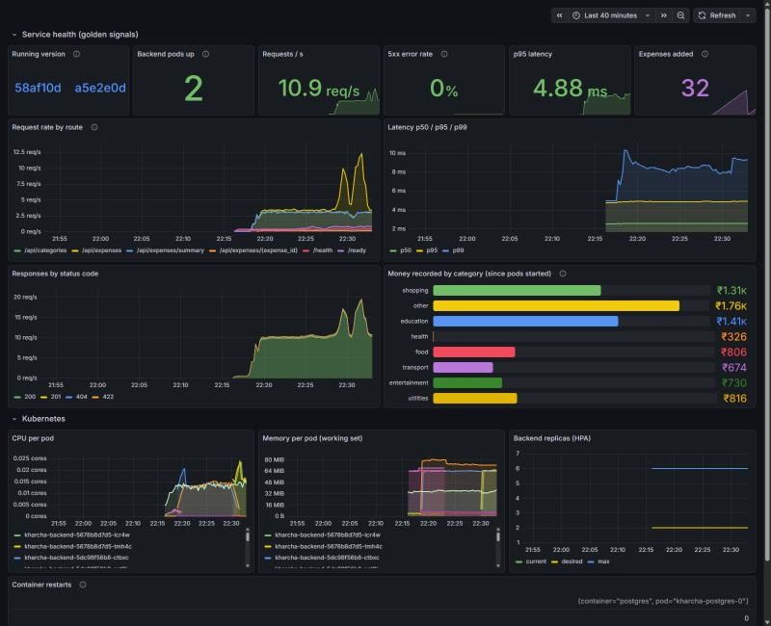

Monitoring: Prometheus + Grafana
Found by annotations
new pods are scraped automatically, no config to update
Golden signals
traffic, errors, latency, plus money by category
5 alert rules
backend down, 5xx rate, slow p95, restarts, HPA at max
Notes:
For monitoring, the backend exposes a /metrics endpoint in Prometheus format: requests by route and status code, latency as a histogram, and two business metrics, expenses created and money recorded per category.
Prometheus finds the backend pods through annotations on the pods themselves. So when the autoscaler adds a pod, Prometheus starts scraping it immediately, with no config to update.
One detail I'm proud of: metrics are labelled by the route template, like /api/expenses/{id}, never the real ID. Otherwise every expense would create its own time series, which is the classic way to take down a Prometheus server.
The Grafana dashboard is provisioned from a JSON file in git, nothing clicked together. It shows the running version, pods up, requests per second, error rate and p95 latency, then per-pod CPU and memory and the autoscaler. In this screenshot you can even see two versions running at once, because a rollout was happening.
There are five alert rules too, for things like the backend going down or the error rate climbing.

Slide 15
GitOps with ArgoCD
16:53
16:55
16:57
16:59
17:00
git push
Security gate
Bot commits tag
ArgoCD syncs
Live
commit 58af10d
all tests and scans green
deploy 58af10d
new pods start
/health says 58af10d
~7 min
2 seconds
push to new pods, zero kubectl typed
for ArgoCD to undo a hand edit in the cluster
Notes:
GitOps means git is the only way anything changes in the cluster. My pipeline never runs kubectl or helm against my cluster. It doesn't even have credentials for it. Its last job just commits the new image tag, and ArgoCD, running inside the cluster, pulls that commit and makes the cluster match.
This is a real timed run, in UTC. I pushed at 16:53. By 16:55 every test and scan had passed. At 16:57 the bot committed the new tag. ArgoCD noticed on its next check at 16:59 and started new pods, and by 17:00 every pod was on the new version, and the app's /health endpoint said so. About seven minutes, with nobody typing kubectl.
Self-heal is the other half. I made three manual changes in the live cluster: I broke the Service port, I scaled the frontend by hand, and I deleted the ConfigMap. ArgoCD put each one back by itself in two, two and six seconds.
Rolling back is just git revert.

Slide 16
Troubleshooting lab
What I broke | What you see | Root cause found with
Typo in DB host | new pods stuck in Init, app still up | init container logs, DNS lookup
Image tag never pushed | ImagePullBackOff | kubectl describe pod, Events
DB Secret re-created | pods stuck retrying | Postgres log: password failed
Service targetPort edited | 502 on every API call, pods Ready | endpoints show the wrong port
Service selector wrong | connection refused, pods Ready | endpoints empty, labels differ
Scrape annotation wrong | app fine, targets DOWN | Prometheus scrape URL
Each one: identify → investigate → root cause → fix → verify
Notes:
The final challenge asks us to break the project on purpose and debug it. I did that in a separate copy of the app, a lab namespace, because in the real namespace ArgoCD fixes my "mistakes" in two seconds and I couldn't debug anything.
Each scenario follows the same steps: identify what the user sees, investigate, find the root cause, fix it, and verify.
A typo in the database host: new pods hang in their init container, but users notice nothing, because the old pods keep serving until new ones are ready. The init container's log and a DNS lookup show the name doesn't exist.
An image tag that was never pushed gives ImagePullBackOff, and describe pod says "not found".
Re-creating the database Secret looks vague from the app, just "OperationalError", but the Postgres log says exactly which password failed. I wrote a small script that fixes it without ever printing the password.
Two scenarios break Services: a wrong target port gives 502 errors, and a wrong label selector gives "connection refused", both while every pod looks perfectly healthy. Checking the Service's endpoints is what gives it away.
And a wrong scrape annotation leaves the app fine but monitoring blind.

Slide 17

Real bugs I found by breaking things
Ingress hung on 29% of requests
A typo silently created an empty database
7 of 24 nginx workers had died during a reload and their sockets swallowed connections
the chart named Postgres after database.host, so a typo built a second, empty one
29 / 100 → 0 / 100
now refused at render
Rolling updates dropped requests
Under load, the database was restarted
pods stopped listening before Kubernetes stopped routing to them
a 1 s liveness probe timed out while Postgres was busy
5 / 450 → 0 / 900
409 → 0 failed
Notes:
These four were real bugs, not planned scenarios, and finding them taught me the most.
One: through the Ingress, about one request in four just hung. Measuring instead of guessing helped: 29 out of 100. nginx had started 24 workers, one per CPU on my laptop, and 7 of them died during a reload, but their sockets kept accepting connections. 7 out of 24 is 29 percent. Exactly the hang rate. Capping the workers at 4 fixed it.
Two, the scariest: a typo in the database host setting made my chart quietly create a second, empty database, and the app switched to it with every health check green. A user would have seen all their data disappear. The chart now refuses that setting.
Three: during every rolling update, about 1 percent of requests failed, because a pod stopped listening a moment before Kubernetes stopped sending it traffic. A five second pause before shutdown took it from 5 failures in 450 to 0 in 900.
Four: under load, the database's liveness probe, with only a one second timeout, decided a busy Postgres was dead and restarted it. I made the probe patient and gave the database more CPU, and the failures went to zero.

Slide 18
Live demo: what I'll show
1
Add an expense in the app
2
CRUD in Swagger at /docs
budget card and pace update
the API on its own
3
Commit a visible change
4
Watch the pipeline
and push to main
tests, scans, gate, push
5
Trivy + GHCR
6
kubectl get pods,svc,hpa
scan output, SHA-tagged images
everything Running
7
ArgoCD rolls the change
8
Load test
footer shows the new version
HPA scales 2 to 6
9
Grafana + Prometheus
10
Break a Service
traffic and the rollout live
debug it from its endpoints
Notes:
Now I'll switch to the screen and show it working, in the same order as the story.
I'll add an expense in the app and watch the budget card and daily pace change. Then the same API in Swagger at /docs, creating, editing and deleting an expense.
Then the core of the demo: I'll make a small visible change, commit it and push. We'll watch the pipeline run: tests, scanners, the Trivy scan, the security gate, and the images landing on GHCR tagged with the commit hash.
While that runs I'll show the cluster with kubectl: pods, services and the autoscaler. When the pipeline finishes, the bot commits the new tag, ArgoCD picks it up, and the footer of the app changes to the new version.
Then I'll run the load test and watch the autoscaler go from 2 to 6 pods, live in Grafana and Prometheus.
And to finish, I'll break a Service on purpose and find the problem from its endpoints.
(Recording tip: the pipeline plus ArgoCD takes about 7 minutes. Start the push first, show the other parts while it runs, then come back.)

Slide 19

What I learned
Green is not the same as correct
Measure, don't guess
my worst bug passed every health check
"sometimes slow" became 29 of 100, and the cause fell out
Check the defaults
A liveness probe can turn slow into down
nginx counted 24 CPUs inside a 0.2 CPU container
it should only fire when a process is truly stuck
Let the gates fail you
Say what you couldn't do
coverage and Trivy both stopped me, and both were right
LocalStack has no EKS, so I showed the error
Notes:
To wrap up, the lessons I'll actually keep.
Green is not the same as correct. My most dangerous bug passed every probe. A health check proves a database answers, not that it's the right one.
Measure, don't guess. "The Ingress is sometimes slow" told me nothing. "29 out of 100 requests" pointed straight at 7 dead workers out of 24.
Defaults are sized for someone else's machine. nginx's automatic worker count looked at my 24-core laptop, not at the tiny container it was running in.
A liveness probe can turn a slow service into a down one. It should only fire when something is truly stuck, never just busy.
Let the gates fail you. The coverage check and Trivy both failed my builds, and both times they were right. Lowering the bar would have been easier and wrong.
And say what you couldn't do. LocalStack can't run EKS, so I showed the real error and documented how to run it on AWS, instead of pretending.

Slide 20
Thank you
Kharcha · Final DevOps Project
Code and write-ups: github.com/LAVYA255/devops-heros/tree/main/final-devops-project
Pipeline: github.com/LAVYA255/devops-heros/actions
Notes:
That's Kharcha: a small expense tracker, with a complete DevOps pipeline around it, from git push to monitored, self-healing pods.
Everything I showed, the code, the pipeline, the screenshots and a written explanation of every part, is in the repository linked here, in the final-devops-project folder. The README there maps each part of the grading rubric to the exact files and evidence.
Thanks for watching.

