Slide 1
Computer vision
Fun with opencv

Slide 2
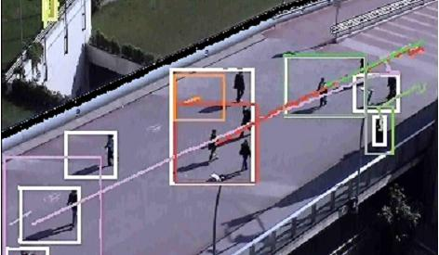
Opencv
C / C++
Open Source
Intel
CUDA
OpenCL

Slide 3
Todays DEMO

Slide 4
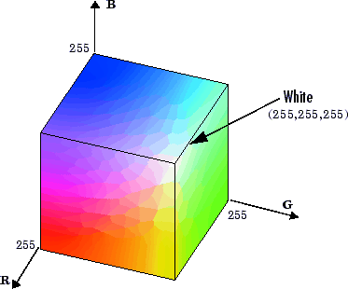
RGB

Slide 5
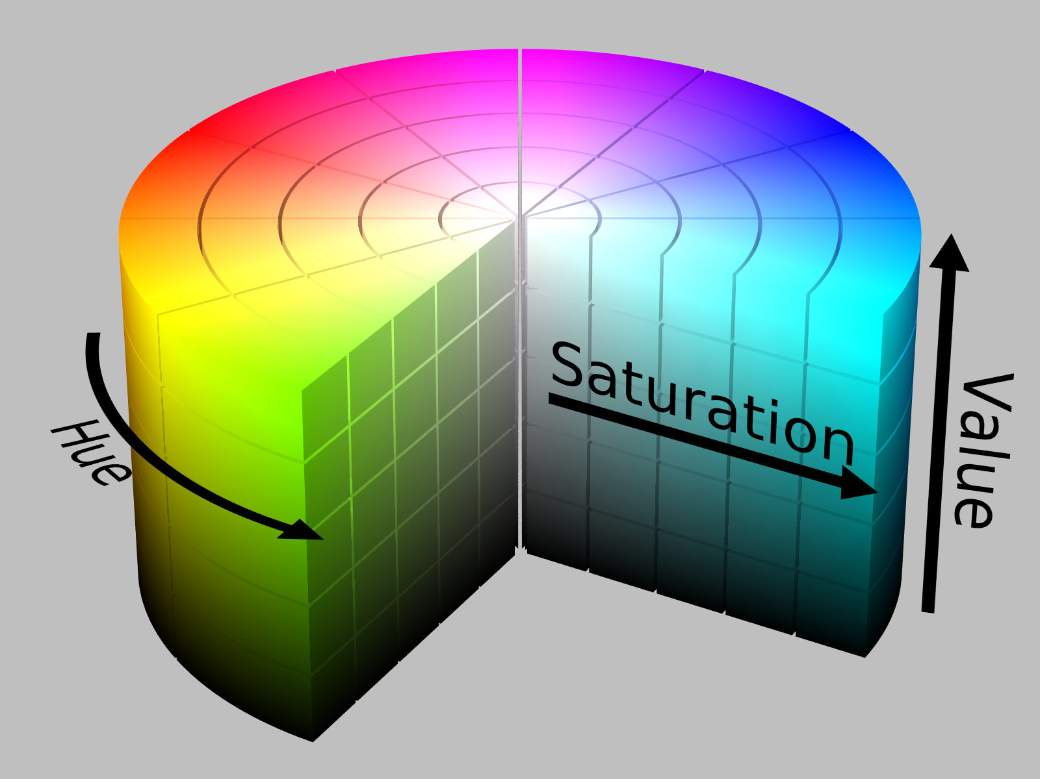
HSV

Slide 6
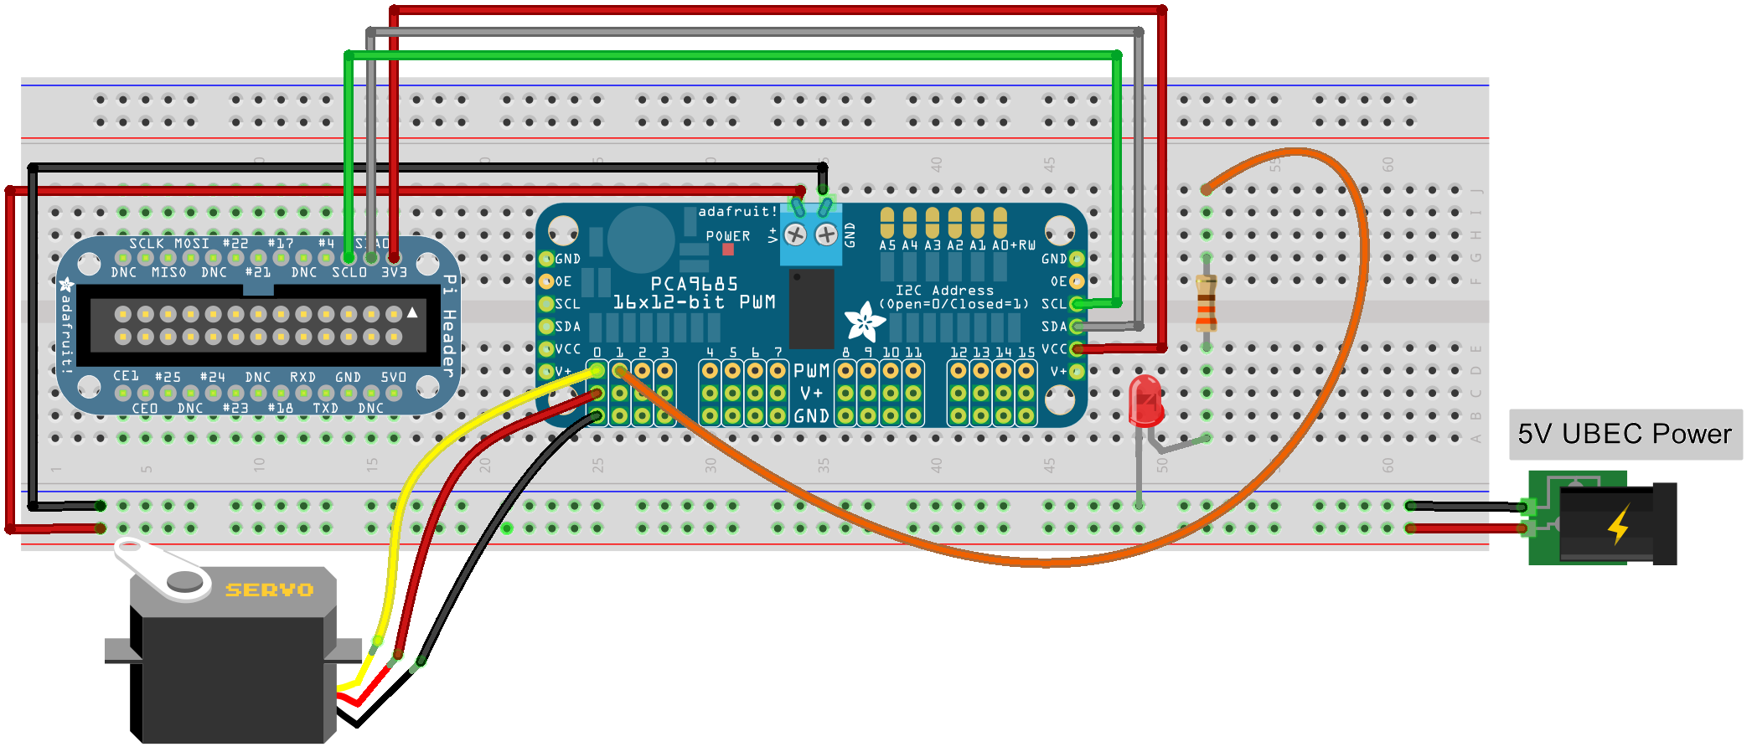
Servo PWM Circuit

Slide 7
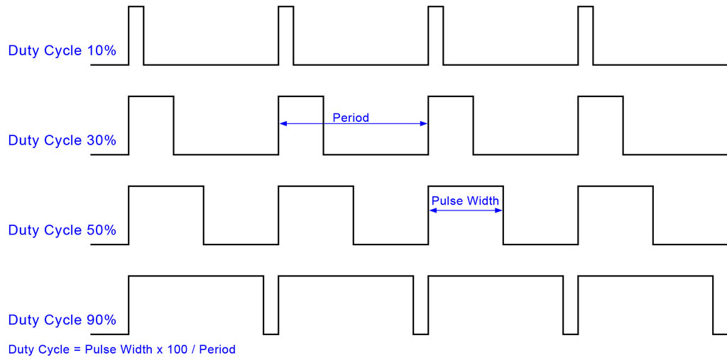
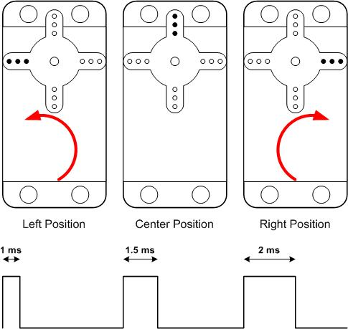
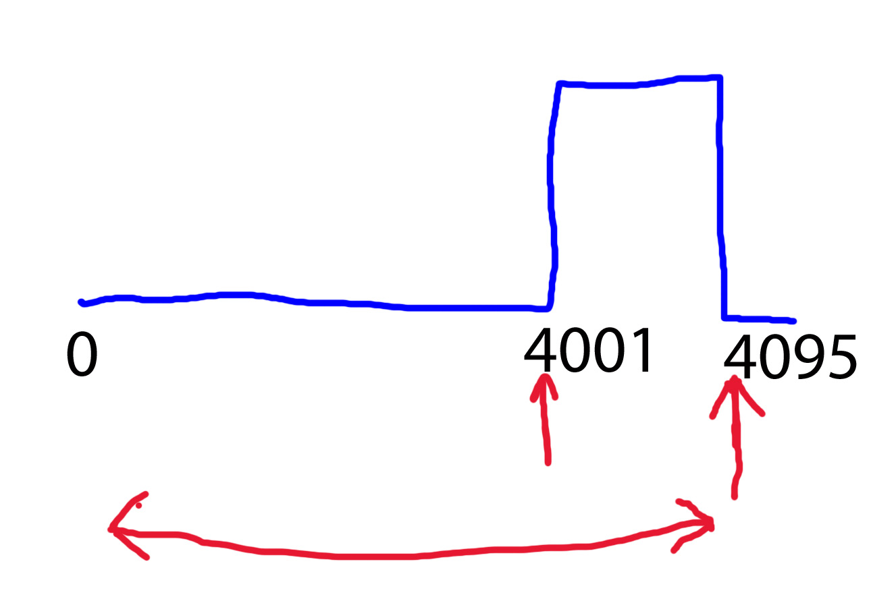
Pulse width modulation

