Slide 1


ShelfScan: Revolutionizing Expiry Tracking and Medication Management
s
shelfscan
Innovative Solutions for Heathcare Efficiency

Slide 2

Contents
Indroduction to ShelfScan
Core Features of ShelfScan
Dual-Purpose Tracking Capabilities
Safety and Waste Reduction Features

Slide 3

Introduction to ShelfScan
Innovative Solutions for Heathcare Efficiency

Slide 4

Overview of ShelfScan
Definition and Purpose
ShelfScan empowers users by simplifying expiry tracking and medication management, ensuring safety and efficiency in health practices through innovative technology solutions. Embrace the future of smart care!
Key Features and Innovations
ShelfScan empowers users with real-time expiry tracking and seamless medication management, transforming healthcare experiences through innovative technology and enhancing patient safety.
Target Audience
Discover how ShelfScan empowers tech-savvy individuals to transform medication management, enhancing safety and efficiency through innovative software solutions that inspire proactive health choices.

Slide 5
Importance of Expiry Tracking
Risks of Consuming Expired Products
Consuming expired products can pose serious health risks, including medication ineffectiveness and potential toxicity, underscoring the urgent need for effective expiry tracking solutions like ShelfScan.
Impacts on Health and Safety
Effective expiry tracking through ShelfScan ensures safer medication use, reducing health risks and enhancing patient safety, fostering a healthier future for individuals and communities.
Financial Implications of Waste
Effective expiry tracking minimizes waste, enhances financial efficiency, and promotes responsible medication management, empowering users to save costs while ensuring health and safety.

Slide 6

02
Core Features of ShelfScan
Innovative Solutions for Heathcare Efficiency

Slide 7


QR/Barcode Scanning
Automatic Data Entry
Experience the ease of automatic data entry with ShelfScan, streamlining medication management through quick QR/barcode scanning, ensuring accuracy and efficiency while reducing manual effort.
Enhancing User Experience
ShelfScan's QR/Barcode scanning simplifies expiry tracking, empowering users with instant access to vital medication information, ensuring safety and peace of mind in every interaction.
Reducing Errors and Time Consumption
By integrating QR/barcode scanning, ShelfScan significantly reduces human errors and streamlines processes, saving valuable time and empowering users to focus on what truly matters—health and well-being.

Slide 8



Advanced Medicine Reminder System
Dose -Time Notifications
Experience timely and personalized Dose-Time Notifications that empower you to manage your medications with confidence, ensuring your health journey is seamless and worry-free.
Refill Alerts
Elevate your medication management with ShelfScan’s Refill Alerts, ensuring timely reminders that empower you to stay on track and enhance your well-being effortlessly.
Expiry Warnings for Medication
ShelfScan empowers users with proactive expiry alerts, transforming medication management into a seamless experience that enhances health and wellness for all. Embrace the future of smart reminders!

Slide 9

shelfscan
03
Dual-Purpose Tracking Capabilities
Innovative Solutions for Heathcare Efficiency

Slide 10
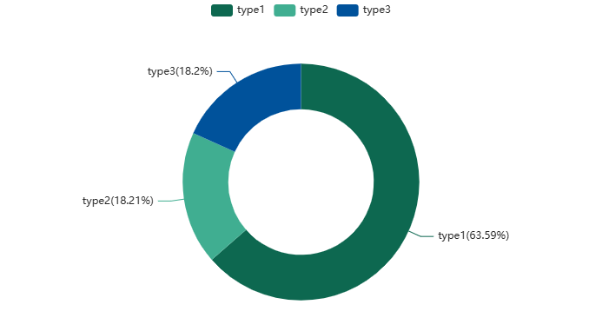
Unified Dashboard for Medicines and Food
Simplifying Household Management
Experience effortless management with ShelfScan's dual-purpose tracking, streamlining the monitoring of medicines and food for a healthier, happier household. Embrace simplicity and stay empowered!
Comparative Benefits for Users
Experience seamless management with ShelfScan’s dual-purpose tracking, empowering users to ensure medication safety and food freshness, ultimately promoting better health and well-being.
Case Studies or User Testimonials
Users report increased confidence in managing expiration dates, leading to enhanced safety and efficiency in both medication and food usage, empowering healthier choices every day.

Slide 11
Collaborating with Caregivers and Family
Multi-Device Synchronization
Experience seamless multi-device synchronization with ShelfScan, empowering caregivers and families to effortlessly track medication expiry and manage health together, enhancing collaboration and peace of mind.
Shared Access Features
Shared access features empower caregivers and family members to collaboratively monitor medication expiry, fostering a supportive environment that enhances health management and strengthens relationships.
Enhancing Communication and Coordination
Enhancing communication and coordination through ShelfScan empowers caregivers and families to collaboratively manage medications, ensuring timely interventions and fostering a supportive network for optimal health outcomes.

Slide 12

shelfscan
04
Safety and Waste
Reduction Features
Innovative Solutions for Heathcare Efficiency

Slide 13







Safety-First Alerts
Disposal Reminders for Expired Products
Stay proactive with ShelfScan's disposal reminders, ensuring expired products are safely discarded, promoting health, sustainability, and peace of mind in your medication management journey.
Color-Coded Expiry Notifications
Color-coded expiry notifications empower users to effortlessly identify critical dates, enhance medication safety, and promote responsible management, ensuring health and well-being for everyone.
Preventing Accidental Ingestion
Empowering users with proactive alerts, ShelfScan ensures safe medication practices, preventing accidental ingestion and fostering confidence in managing health and well-being.

Slide 14
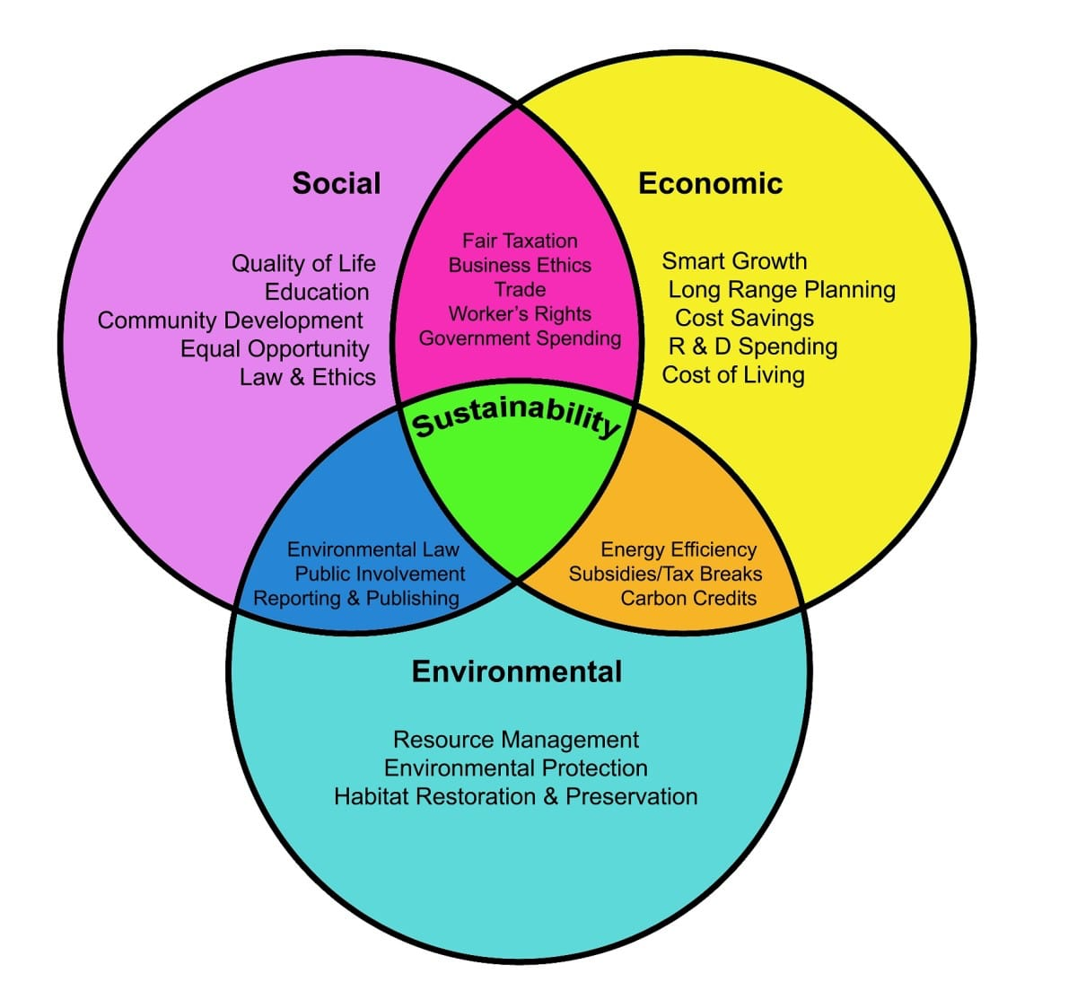
Economic and Environmental Benefits
Saving Money through Timely Alerts
Timely alerts from ShelfScan empower users to minimize waste, ensuring both economic savings and a reduced environmental impact, fostering responsible consumption for a sustainable future.
Reducing Food and Medication Waste
By minimizing food and medication waste, ShelfScan fosters sustainability, inspires responsible consumption, and empowers individuals to make a positive impact on both their health and the environment.
Supporting Sustainable Practices in Households
ShelfScan empowers households to reduce waste, promoting sustainable practices by tracking expiry dates efficiently, leading to conscious consumption and a greener lifestyle

Slide 15
Thank you
shelfscan
PRESENTED BY TEAM SHELFSCAN

