Slide 1
Exercise (0)
Objective:
know how to decode binary GA presentation to variables
How:
Open folder “ Example 0” and study the code your self
“ main.m”
Your Task:
Given [1,0,1,0,1,1,1,0,0,1];
If it represents a integer value, what it is
If it represents a continuous value between 4 and 8, what it is

Slide 2
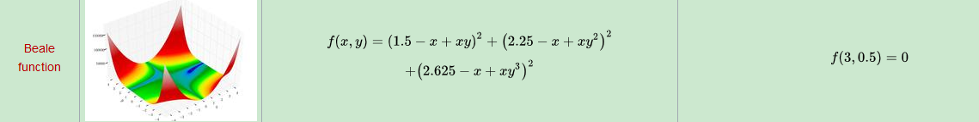
Exercise (1)
Objective:
familiar with basic matlab GA syntax
How:
Open folder “Example 1 Basic ga” and lets look at the code together
Tasks: Solve the following function with constraints that x is integer
Reference: https://en.wikipedia.org/wiki/Test_functions_for_optimization

Slide 3
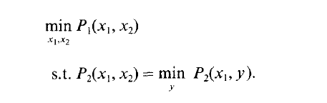
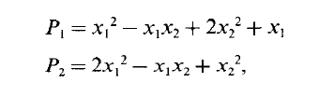
Exercise (2)
Objective:
Understand the basic bilevel structure and how it can be solved by GA
How:
Open folder “Example 2 SimpleBilevel”

Slide 4
Exercise (3)
Objective:
Solve simple network design problem
Network design problem:
Given a network
AssumeCreate 4 links to connect the network
passengers select the shortest path
The objective is to minimize the total travel time

Slide 5
Exercise (4)
Your Tasks:
1. Given the following demand
Node A –> B : 50 pas
Node A –> C: 60 pas
Node A –> D : 25 pas
2. Instead of having 4 links. You can build as many links as possible. However, each link’s construction cost is $100.
3. Design the network (still assume shortest path)

Slide 6
Exercise (3)
Your Tasks:
1. Given the following demand
Node A –> B : 50 pas
Node A –> C: 60 pas
Node A –> D : 25 pas
2. Instead of having 4 links. You can build as many links as possible. However, each link’s construction cost is $100.
3. Design the network

Slide 7
In class exercise (4)
Objective:
Solve frequency design with transit assignment
How:
Open folder “Example 4 Frequency Design”

Slide 8
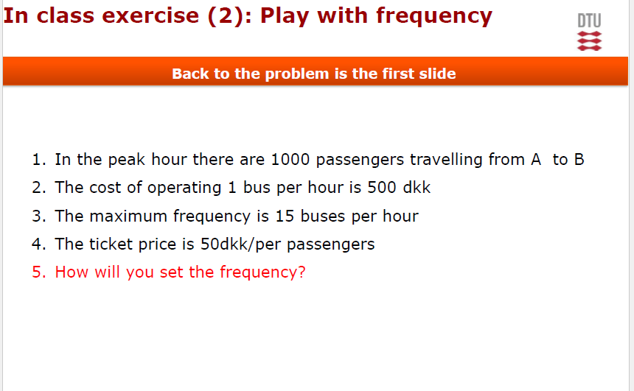
In class exercise (4)
Your Tasks: Revisit the first exercise

Slide 9
Idea on more complicated network design
GA Solution
Network structure
Frequency
Create network
Assignment on the network
Function to evaluate the fitness value

