Slide 1
Truck Parts Application Insights
Leopoldo Daniel Araiza
DATA 824 - Final Project
Summer 2025
Notes:
Good morning, everyone. Thank you for joining me. Today I’ll be presenting my final project for DATA 824 — a real-world data product built around truck part listings.
This project uses R, Shiny, and Tableau to deliver interactive analysis tools and business insights that would be valuable to a truck parts retailer, reseller, or marketplace manager.

Slide 2
Background and Objective
The goal of this project was to create an interactive Shiny app and supporting visualizations to explore real-world truck part listings data.
Use Case: Analyzing online truck part sales for insights in pricing, listing trends, and condition breakdowns. Intended audience: Automotive business owners or inventory managers.
Notes:
The objective of this project was to create an interactive dashboard and application to analyze truck part listings. Why this data? Because in the parts industry, pricing and availability shift constantly, and inventory managers need tools to track trends quickly. I imagined this being used in a business meeting setting — helping a regional manager review listings and make decisions on which price ranges are working and what types of parts to focus on.
The data we're using is pulled from over 95,000 real truck part listings. It's rich, current, and reflects real-world pricing and condition trends.
We set out to build something both practical and insightful: a Shiny app and Tableau dashboard that deliver real business intelligence.

Slide 3
Data Source and Structure
The dataset was sourced from an online applications database containing over 95,000 listings. It includes:
• Price (in GEL and USD)
• Item condition (New, Used)
• Registration date
• App ID, Seller ID, Vehicle Type ID
• Insert date and listing title
The data is large, diverse, and offers multiple variables for analysis.
Notes:
The dataset includes over 95,000 truck part listings. Each entry includes a part headline, price in GEL and USD, condition (new or used), and several ID fields including seller ID, application ID, and vehicle type ID.I chose this dataset because it’s real, current, and diverse — it offers enough complexity to explore pricing behavior, seller trends, and inventory breakdowns.
The dataset powering this project is robust. It includes variables such as item condition, headline, seller and application IDs, registration dates, and part prices in both USD and GEL.
This variety and volume give us room to analyze price ranges, item conditions, and trends over time. It’s an ideal foundation for building interactive visuals that provide immediate, data-driven insights for decision-makers.

Slide 4
What Does the Shiny App Do?
The interactive Shiny app allows users to:
• Filter listings by item condition
• View a dynamic price histogram
• Examine a searchable data table
Purpose: Provide actionable insights for stakeholders analyzing online truck part markets.
Notes:
The Shiny app allows a user to select “All,” “New,” or “Used” listings and instantly see a filtered histogram of price distribution and a live, searchable data table. The idea is that you could hand this to someone working in inventory, and they could quickly answer questions like: “Are most of our listings under $100?” or “Are used parts priced competitively?”
Users can select a part condition — New, Used, or All — and the app updates automatically to show a filtered histogram of prices and a detailed, interactive table.
This allows any team — sales, purchasing, or inventory — to instantly evaluate what's trending, where prices cluster, and how the condition affects value.
The app was built using the tidyverse, janitor, DT, and ggplot2 libraries — all fully reactive.

Slide 5
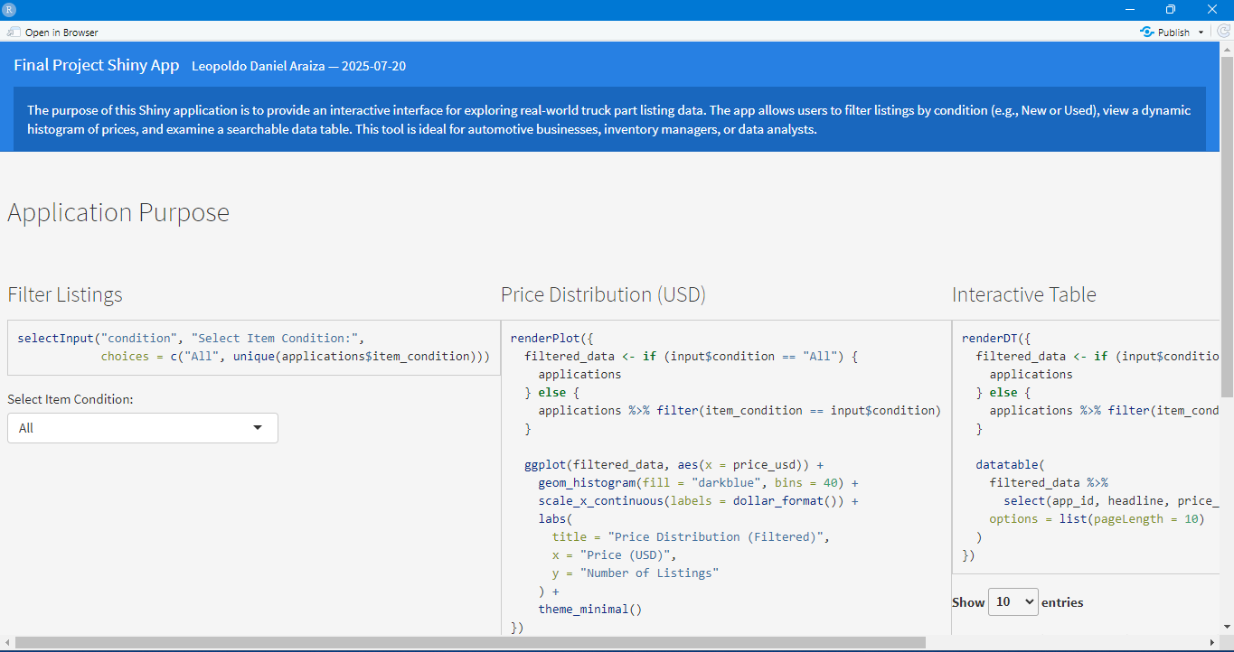
Shiny Application Use
Notes:
This app demonstrates key R skills: importing and cleaning data, building reactivity with shiny, filtering with dplyr, creating a ggplot2 histogram, and deploying DT tables.It’s fast, informative, and scalable — and it’s built with principles of usability and interactivity in mind.The app works entirely with real-world business data and answers practical questions in real time.

Slide 6
What Does the Tableau Dashboard Show?
In addition to R, Tableau was used to create high-level visuals including:
• Monthly trends in listings
• Item condition breakdown
• Heatmap of price ranges by item condition
This supports business decision-making and pricing strategy evaluation.
Notes:
To complement the R-based app, I built a Tableau dashboard. This one is more visual and strategic in nature.
Users can explore listings over time, compare new vs used item volumes, and examine a heatmap of condition vs price range — which reveals gaps and pricing clusters in the inventory.

Slide 7
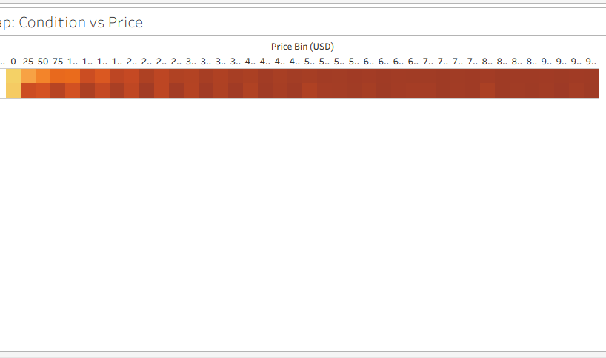
Heatmap Condition vs Price
Notes:
This heatmap was one of the most interesting visuals. It shows how listing volume varies by price range and item condition.
You can see most New parts are priced under $150, while Used parts dominate the $25–$75 range.
There’s very little activity over $300, which could suggest missed opportunities or buyer resistance at those price levels.

Slide 8
Key Insights Discovered
• Most parts listed were in 'New' condition.
• Price clustering occurs below $100 USD.
• Listing volume peaked in Fall 2024.
• Tableau heatmap revealed price sweet spots and gaps in listings.
These patterns suggest buyer preferences and pricing opportunities.
Notes:
Here are some of the biggest takeaways:
New parts dominate the dataset
Most parts are listed under $100 USD
Listing volume spiked in September and October 2024Used parts taper off fast at higher prices
Together, these insights help a business set smarter pricing, understand seasonal trends, and review inventory strategy.

Slide 9
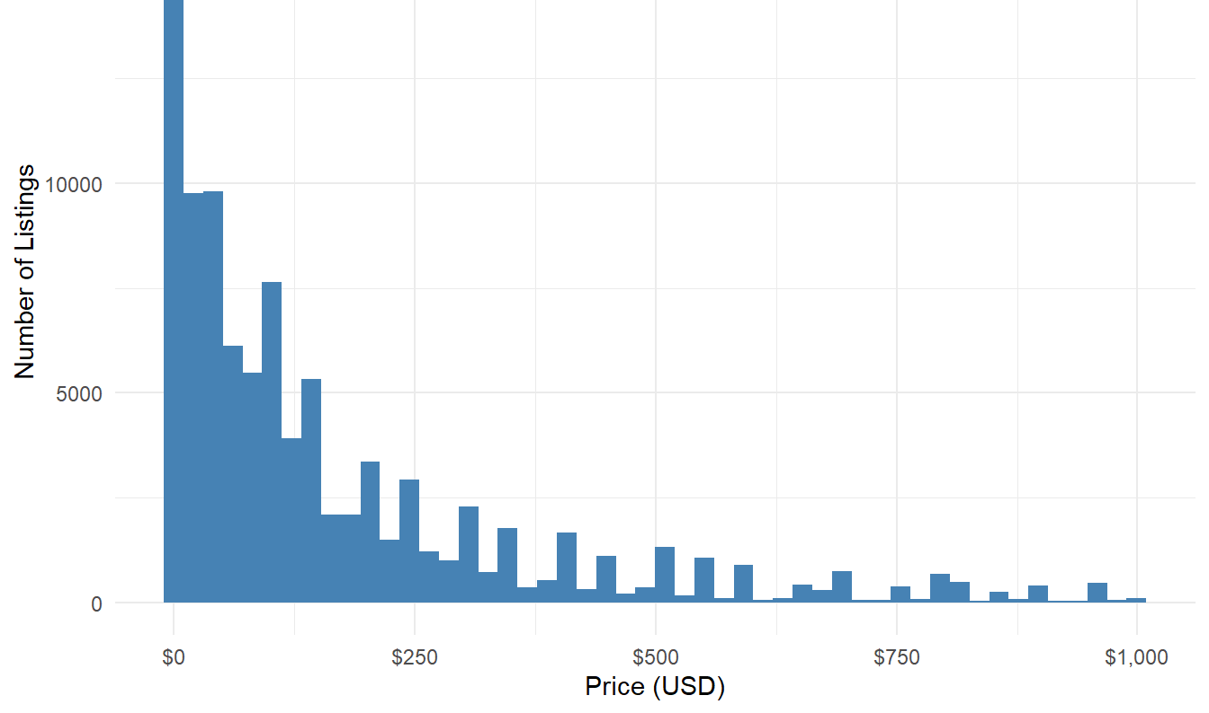
Price Distribution (USD)
Notes:
This histogram shows the distribution of all listed truck part prices in USD.
We can clearly see that many listings are priced below $200. In fact, there’s a strong clustering effect between $25 and $150, with a steep drop-off after that. The long tail on the right shows there are a few outliers with very high prices, but these are rare.
This tells us something important — if you're pricing a new part above $200, you're already out of the mainstream. That doesn’t mean it won’t sell, but it does suggest fewer competitors or a more niche market.

Slide 10
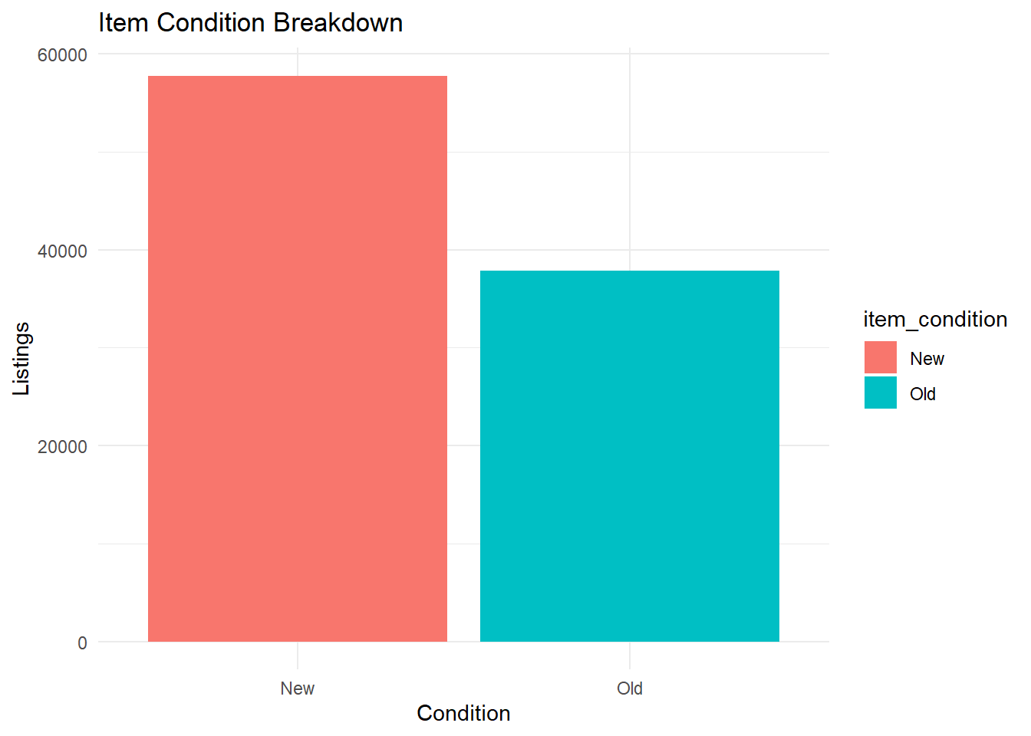
New vs Used Items
Notes:
Here we break down the listings by item condition — New vs. Used. Unsurprisingly, New items dominate.
This tells us that the platform or the sellers using it prioritize new inventory — possibly because of return policies, buyer trust, or reseller sourcing practices. Used listings are present, but they represent a much smaller slice of the market.
This insight matters: if you're a used parts dealer, you may be facing less competition, but also less overall buyer activity. If you're selling new, you’re in a crowded space and may need to optimize pricing or offer something unique.

Slide 11
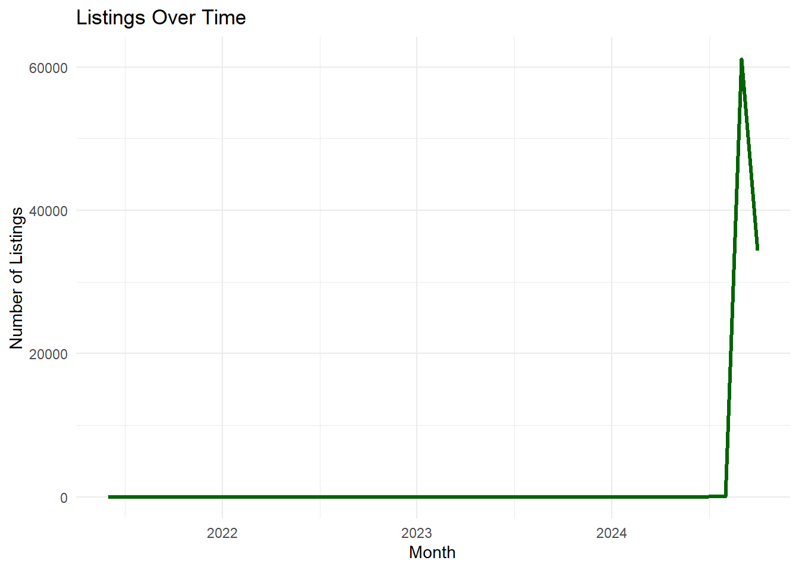
Listings Over Time
Notes:
This line chart shows how listings changed over time, aggregated monthly.
We can see a noticeable peak in listings around September and October 2024. There’s strong listing activity mid-year, followed by a taper — this could reflect seasonal trends in repair activity, marketing campaigns, or shifts in availability.
For a business, this kind of insight is crucial. If demand is seasonal, they might want to prepare inventory or adjust marketing strategies during key months.

Slide 12
Principles and Storytelling
• Visuals followed clear labeling, appropriate scales, and relevant color schemes.
• Data was grouped logically (bins, monthly trends, categories).
• The story arc moved from overview → behavior → insight.
• Violations of visual principles were avoided.
Final Result: A compelling, clean, and exploratory tool.
Notes:
This project followed the design principles we learned — appropriate scales, clean formatting, minimal distractions, and use of color only where meaningful.
The story arc of the project was deliberate: we start with a real-world business problem, explore the data through tools, and arrive at a set of insights that could be acted on immediately.

Slide 13
Data Source
https://www.usabledatabases.com/database/us-auto-parts-database-by-year-make-model-engine-brand/
Notes:
This application is an interactive dashboard built using R and Shiny that allows users to explore and analyze real-world truck part listings. Users can filter by item condition (New, Used, or All), view an automatically updating histogram of price distribution, and examine a searchable table of listings that includes part details, prices, and registration dates.
The app is designed for business decision-makers — such as inventory managers or automotive sellers — to quickly assess market behavior, identify price clusters, and uncover patterns in listing trends.
The dataset comes from UsableDatabases.com, specifically the U.S. Auto Parts Database, which includes structured data on vehicle parts by year, make, model, engine, and brand. It contains over 95,000-part listings and offers a rich foundation for analysis and real-world application.

Slide 14
Conclusion and Next Steps
This project demonstrates practical use of R and Tableau for real-world data.
Next steps could include:
• Predictive modeling
• Market segmentation by seller
• Expanding filters
This type of dashboard could scale for dealerships or online truck part platforms.
Notes:
In conclusion, this was more than a class assignment — it’s a prototype of something that could be deployed by an actual truck parts company.
The tools work, the visuals guide decision-making, and the data is real.
For next steps, I could integrate predictive modeling, CSV exports, more filter options, and GitHub deployment for broader access.
Thank you for your time — I’d be happy to answer any questions.

